Slide 1
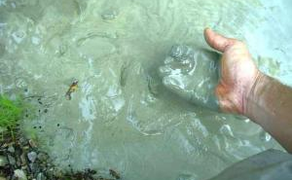
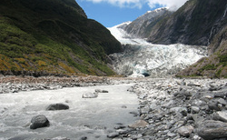
Lead Kiln Docent – Clay and Kiln information
Notes:
What is clay?
Minerals from the earth – specifically silica and alumina. Often clay is found near rivers where small particles of rock are carried down to a lower part and collect together to form clay.
Clay characteristics –
Clay is plastic when it’s wet –clay can be pushed, stretched, stamped, or impressed
Clay shrinks as it dries
Clay hardens as it dries – when wet it has no structural strength (can slump or distort if handled roughly) Bone dry clay, before heated, is quite brittle
Clay vitrifies when subjected to sufficient heat – clay becomes hard, durable, waterproof

Slide 2
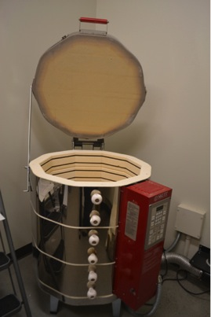
Electric Kiln
Notes:
Today we use a special electric oven called a kiln to cook the clay. How hot does your kitchen oven at home reach when you are cooking food? 375 or 400 degrees F? Our kiln will cook your projects at about 1800 -2000 degrees F. (show photo of kiln)
Cooking in a kiln is called firing. This is important because it makes the clay stronger and more waterproof. Clay that has been kiln fired would not return to a soft state even if it were in water for a long time. That is because the extreme heat causes permanent physical and chemical changes to occur. These reactions, among other changes, cause the clay to be converted into a ceramic material.

Slide 3
What Clay to Use?
ISD uses Low Fire 06 (LF06) (gray or white in color)
Glazes need to be Cone 06 (low fire glaze)
to work with LF06 clay temps
Purchased from Seattle Pottery Inc.
They deliver for $85 or you can go pick up
To use a Purchase Order (your initials and order date as the PO #, ex: JB10252022)
Must order by phone (or in person)
Mention you are from Issaquah School District
Give your school address (to find your account)
Order sooner than you need it, as all schools will be ordering around the same time, and potential for No Stock issues.
For example, order in early October, or late September
First grade project is in November.

Slide 4
To Do in September:
Evaluate Kiln Shelves to determine if you need to redo the kiln wash.
Excess glaze melted on needs to be removed.
Gouges of kiln wash missing
Scrap shelves and apply kiln wash (if needed)
Take inventory of last year’s supplies. (restock as needed)
Clay bags, number of full bottles of glaze
Portion cups 3oz with lids
Paper plates or foam trays for each grade level
Kiln Staples to hold heating element coils in the walls of the kiln.

Slide 5
Preparing Clay for each Grade Level Projects
The Clay Project Schedule is designed to take advantage of the previous grade’s scraps.
Scraps can be reused for Pinch Pot type projects (turtles, tidepools, pots, etc)
Ball up scraps and put them into a air tight bucket with a wet “bar” size towel.
Spritz the clay and sides of bucket with water and clay is good to use for up to a month before needing to be rehydrated again.

Slide 6
How Much to Buy & Cut
Clay comes in 25 lb bags,
Depending on the project, will determine how many bags to order.
1 slab = 1 student project
Leaf Bowls – slice short end at 7/8” = 13 slabs
Salmon
14” Full size platters – slice lengthwise at 7/8” = 8 slabs
10” Small size platters or wall hanger – slice short end 1”-7/8” = 12- 13 slabs
Hanging Owls – slice short end 7/8” = 13 slabs
Taco Dragons – slice short end at 1” = 12 slabs
Turtle and Tide Pool Pinch Pots – use the scraps from Leaf Bowls and Owls.

Slide 7
Clay Project Schedule
November – Slab – Kindergarten Leaf Bowls
January – Pot – 1st Grade Turtles (or other animals)
February – Slab – 2nd Grade Hanging Owls
March – Pot – 5th Grade Tide Pool bowls
April – Slab – 4th Grade Taco Dragons
May – Slab – 3rd Grade Hanging Salmon

Slide 8
Clay types: clays are defined by the temperature at which the clay body matures/vitrifies
Low Fire Clay (LF) fired between cones 09 and 02 (1700-2000 degrees F)
Mid Fire (MF) fired between cones 4 and cone 7 (2160-2290 degrees F)
High Fire (HF) fired between cones 8 and 11, some porcelains go to 14
At school we use Low Fire Clay
Bisque fire at cone 06
Glaze fire at cone 06

Slide 9
Clay Characteristics
Clay is plastic when wet – can be pushed, stretched, stamped, or impressed, with out losing it’s cohesion
Clay shrinks as it dries and when it vitrifies as water evaporates from the piece
Clay hardens as it dries – when wet it has no structural strength. It is very likely to slump or distort if handled roughly. Leather hard clay can support its own weight while still bending. Bone dry clay is quite brittle and must be handled with care.
Clay vitrifies when subjected to sufficient heat – clay becomes hard and durable, stoneware and porcelain become impervious to water and acids
Clay has memory – when you move, pull or push clay it remembers. For example, a slab project may curl as it dries.

Slide 10
Clay Stages
Slip – clay slurry, heavy cream consistency, used to glue together pieces
Wet/Plastic – soft workable clay, coils can bend without cracking but won’t stick to your hands
Leather-Hard – has been allowed to dry completely, it no longer contains environmental water. Clay will shrink as it dries about 10%- 15%. Clay should be dried slowly.
Green ware – all unfired ceramic ware.
Bisque – after first firing, still water permeable and hard enough to hand easily
Vitrified – clay has lost all moisture and has a crystalline structure that gives it strength and durability.

Slide 11
Methods of Working with Clay
Slab Method
Pinch Method
Coil Method
Molds
Joining

Slide 12
Firing
Clay items are fired twice in our setting
BISQUE fire (Cone 06) - takes clay from a dry, fragile state to a hard, strong state
If you don’t let it dry completely for 1 to 2 weeks after wet clay lesson, the remaining moisture (water) in the clay turns to steam at 212 degrees F. If water is still in the clay project it could explode when kiln reaches that temperature.
GLAZE fire (cone 06) – glaze is melted to a glossy, water tight state
Firing takes at Medium speed about 7.5 hours, plus another 12+ hours to cool down. Plan to load kiln in the morning, and come back the next morning (24 hours) from load to unload of kiln for complete cool down

Slide 13
Glazing
Glaze – mixture of ground glass, clays, coloring materials and water. It’s applied to a bisque piece by brushing, sponging, dipping, etc.
Glaze helps strengthen, decorate and waterproof an item.
Make sure students add enough glazed to all parts of their project so there is no visible bisque white visible.
Do not glaze the bottom of the projects, unless you are prepared to Stilt every piece in the kiln to prevent glaze from permanently adhering to the shelf.
You can re-glaze (already fired glazed items) to fix any areas after they come out of the kiln.
If students want white areas on their projects, use white glaze. This allows the project to be shiny, waterproof, and look finished.

Slide 14
Tips for Glazing Bisque-ware
Make sure glaze is well mixed (use a long-handled spoon or back end of a paintbrush to mix all the sediment at the bottom of the jar or your color will be much lighter)
CG Glazes have bits of glass frit to bring out pops of color. This needs to be stirred well to get the sediment frit off the bottom of the bottle.
EL has unique properties and needs to be shaken well
F (Foundation) needs to be shaken. If it starts looking too thick or chunky, you can add small amount of water and shake well to give it new life.
Setting up for class:
Use portion cups with lids. Label the lid and the cup with the glaze name.
Cover the tables with butcher paper. Place 1 cup of each color onto each table.
OPTIONAL - label the glaze name on the butcher paper next to EACH cup.
ALWAYS - Place a glazed color sample tile next to each corresponding cup color. This helps students know what the color will look like after it is fired. Fired glaze does NOT look the same as when in the liquid state
If another class is using the same colors, you can store the glaze in the portion cups with the lids on. REMEMBER TO REFILL THE CUPS AFTER YOUR CLASS TO BE KIND TO THE NEXT DOCENT.
any unused glaze should go back in the container – we salvage every drop since it is expensive
Set out multiple brushes per color. Each paint cup should have its own brush(es). No double dipping in multiple cups with the same brush!
ONLY USE BRUSHES THAT ARE DESIGNATED FOR GLAZE.

Slide 15
Glazing Continued
Most glazes look best with a minimum of 3 coats of glaze. The glaze is applied with a paintbrush but does not go on like paint. The liquid in the glaze will be pulled into the bisque clay causing it to dry very quickly.
Apply the glaze in thin layers between each coat, so that it has time to dry before the next coat.
Some glazes (like Red and some Crystal Glazes, need 4-5 coats)
The brush is used to blot the glaze on since it can’t be dragged very far before the liquid dries
Glaze does not run when it is fired. It stays right where it is painted. Make sure you do not leave any white bisque showing. Use the round brushes to dab glaze into deep holes and crevasse in order to get proper coverage.
Remember to glaze the sides of all 3D objects and any place that can be seen from all angles.
Do not glaze the bottom of the projects. But, if you do, you MUST place the project on stilts so it does not adhere itself permanently to the kiln shelf.
Foundations Glaze (by Mayca) can be mixed in small cups prior to painting them on. But, if you are layering different glaze colors on, only the last layer’s color will show. (only mix colors if we do not have the premade color you desire, and do not give the students the option to mix their own)
Glazed pieces can be stored indefinitely until glaze fired in the kiln however they should not be stacked on each other until after firing as the glaze can scratch off
If glaze accidently gets on the bottom of the project, use a wet sponge and wipe off the glaze before firing in the kiln (or use stilts to lift it off the kiln shelf)
Glazed pieces should have at least 1/2 inch space between each other in the kiln so that they don’t permanently adhere to each other. Pieces with CG bits of frit should be placed further apart, as frit has been known to jump off its project and stick to other’s during the firing process.
Fire the glaze load at cone 06 (make sure it’s not 6 because this is much hotter and it will turn your low fire clay into a puddle)

Slide 16
Cleaning up after Wet Clay
Prevention is the best method.
Use butcher paper on the tables, then put the canvas tarps on top of the paper. This prevents the clay dust from getting onto the tables.
Use the 3 bucket method. Clay should NEVER go down the drain. One bucket for tools. One for students to rinse their hands, and the 3rd to use to wash the tables if needed.
Always wash the clay off of the tools and wire brushes before putting them away. NEVER leave clay to dry onto the tools.
Empty the buckets of dirty clay water outside in a garden.
Leftover clay - If you are making projects using clay slabs, then scrunch up the scraps into tight balls of clay. Store these balls in tightly closed plastic bags within bins with wet 1 wet bar size towel. Spritz clay with water as needed. These will be used for next month’s clay projects.
Scraps leftover from pinch pot and coil projects need to be placed in an open container to allow to dry. Consolidate all scraps into as few bags possible.
NEVER put clay scraps in the main trash cans inside the schools. Custodians are not prepared to lift this weight. Leave bags of scraps in the kiln room until its time to toss them into the dumpsters outside the back kitchen door.

Slide 17
Cleaning up after Glaze Class
Cover tables with butcher paper prior to lesson.
Wash all glaze brushes in the sink in warm soapy water.
NEVER leave glaze on a brush.
Store brushes by size with bristles facing UP.
If you are the last to use the portion cups, scrape the glaze back into its original container.
If colors got mixed, toss out the portion cup with tainted glaze.
Store containers by color in the kiln room.
Put all glaze sample tiles back on their ring by color, and place the ring attached to the shelf in front of the glaze bottle of that color.
Tiles have their glaze name on the backs of the tiles.

Slide 18
Steps for students to make a clay mask:
1. Place the template on the clay slab and trace using the knife in an upright manner all the way around the mask.
2. Remove template and lift clay mask up to scratch name on back with dull pencil.
3. Place clay mask aside.
4. Use scrap pieces of clay to practice with texturizing tools to see what effects will help you achieve the look you want for your mask.
5. Take the clay mask and cut holes for eyes and mouth.
6. Use a drinking straw to “punch” places for hanging mask and spots for where raffia will string through along the bottom.
Use the texturizing tools to add details all over surface of the mask.
Use scoring method to attach nose made from scrap clay.
Use a finger with one drop of water (not too much) to smooth all the edges so they won’t be jagged or sharp once fired.
Lay mask over mold to take shape of rounded mask and allow to air dry.
9. Clean up – dunk hands in bucket of water first to get big chunks of clay off so they don’t go down the drain and clog it. Then wash with soap and water in sink.

Slide 19
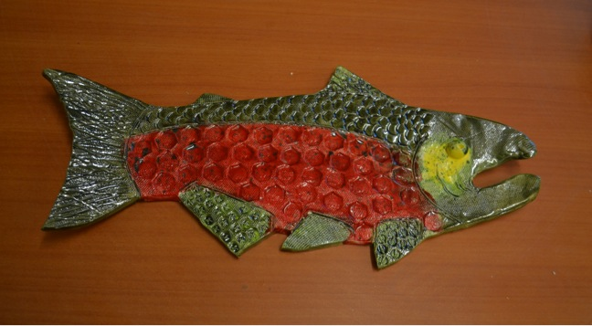

Slide 20
Steps for students to make a clay salmon platter:
1. Place the template on the clay slab and trace using the knife in an upright manner all the way around the fish.
2. Remove template and lift clay fish up to scratch name on back with dull pencil
3. Place clay fish on tray to dry and set aside..
4. Use scrap pieces of clay to practice with texturizing tools to see what effects will help you achieve the look of scales, fins, etc.
5. Take the clay salmon and draw the dividing lines on the salmon to separate the different parts of the body
6. Use the texturizing tools to add details like scales, ridges in the fins, eye, etc.
7. Use a finger with one drop of water (not too much) to smooth all the edges so they won’t be jagged or sharp once fired.
8. Clean up – dunk hands in bucket of water first to get big chunks of clay off so they don’t go down the drain and clog it. Then wash with soap and water in sink.

Slide 21
Today’s Project

Slide 22
Steps for students to make a water lily bowl:
Place clay slabs on canvas placemats
Place the templates on the clay slabs and trace them using the knife (or skewer or opened paper clip) in an upright manner all the way around the leaf template and the flower template.
Remove templates and lift clay up to scratch name on back (of leaf and flower) with dull pencil (so it doesn’t cut through the slab) Small initials in middle of flower will help it not show once formed upright.
4. Use scrap pieces of clay to practice texturizing with wooden skewer to draw lines on leaves and flower
5. Now take the clay leaves and draw lines for veins. Place leaves on plate to dry flat.
6. Take flower slab and form it in the small bowl. Use skewer to add small dots in middle of flower.
7. Use a finger with one drop of water (not too much) to smooth all the edges on both pieces so they won’t be jagged or sharp once fired.
8. Clean up – dunk hands in bucket of water first to get big chunks of clay off so they don’t go down the drain and clog it. Then wash with soap and water in sink.

Slide 23
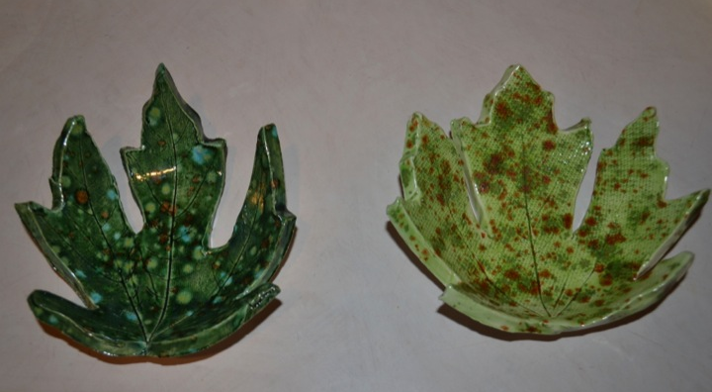
Notes:
Here is a photo of the leaf bowls. We will be making part one today.

Slide 24
Steps for students to make a clay leaf bowl:
Place the leaf (vein side down) on the clay slab and use a rolling pin to push leaf firmly into the clay to make an impression.
Trace around the perimeter of the leaf using the knife or opened paper clip in an upright manner (adults may need to help young kids).
Remove leaf by lifting stem.
Lift clay up to scratch student’s name on back with dull pencil.
Place clay leaf in styrofoam or coated paper bowl and slump by pressing gently to achieve bowl shape with clay leaf
Use a finger with one drop of water (not too much) to smooth all the edges so they won’t be jagged or sharp once fired.
Set bowl with clay leaf inside to air dry for 1-2 weeks until ready to fire
Clean up – dunk hands in bucket of water first to get big chunks of clay off so they don’t go down the drain and clog it. Then wash with soap and water in sink.
Notes:
http://www.princetonol.com/groups/iad/lessons/elem/jeryl-leaf.htm
http://funart4kids.blogspot.com/2010/09/fall-favorites.html

