Slide 1
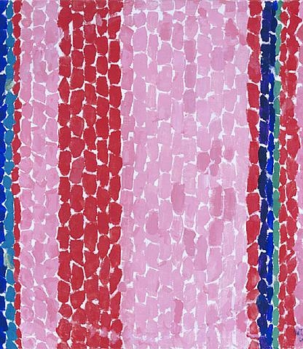
ALMA W. THOMAS (1891-1978)
Inspired by the work of
Abstract Impressionism

Slide 2
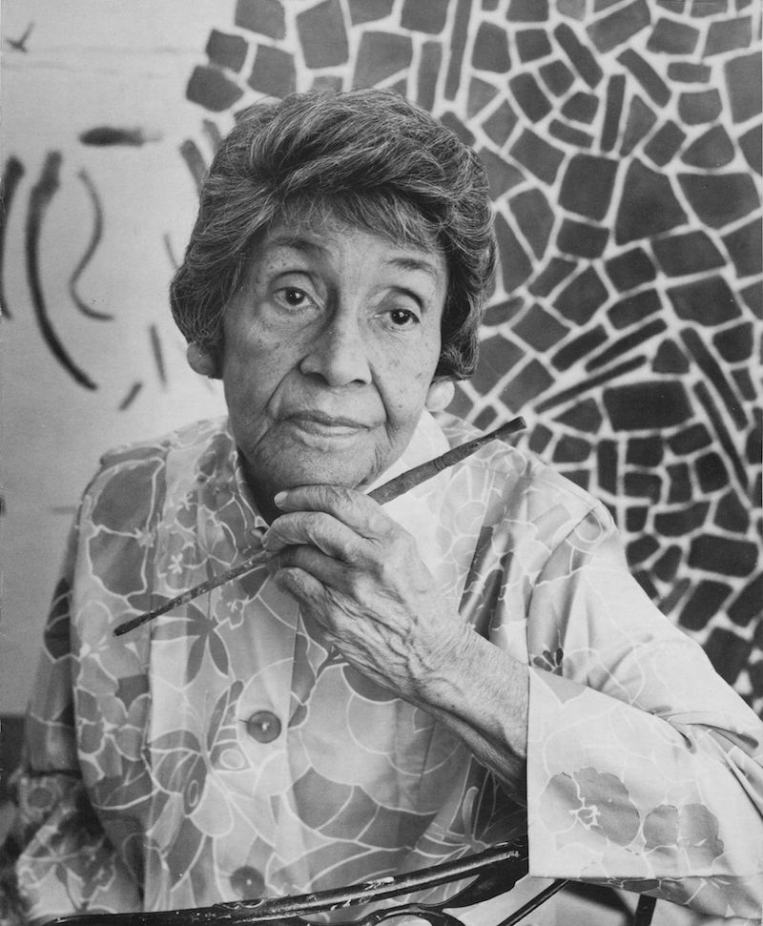
Alma Thomas was born in Columbus, Georgia. She moved with her family to Washington, D.C. at age 15 where she lived for the rest of her life.
As a girl, she dreamed of being an architect and building bridges, but there were few women architects then. Instead, she attended Howard University, becoming its first fine arts graduate in 1924.
In 1924, she began a 35 year career teaching art at a D.C. junior high school. She was devoted to her students and organized art clubs, lectures, and student exhibitions for them. Teaching allowed her to support herself while pursuing her own painting part-time.

Slide 3
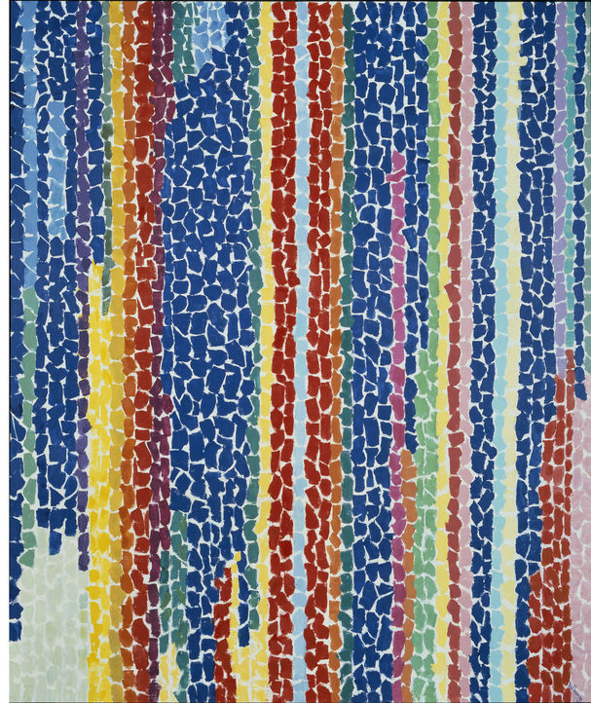
After retiring as a school teacher in 1960, she committed herself full-time to her art.
In 1972, at age 80, Alma Thomas was the first African-American woman to have a solo exhibition at the Whitney Museum in New York.
Alma developed a style of brilliantly colored short brushstrokes. She created works with vertical stripes and circular patterns. She was inspired by the patterns of light in her garden and images from the Apollo moon missions.
Iris, Tulips, Jonquils, and Crocuses, 1969

Slide 4
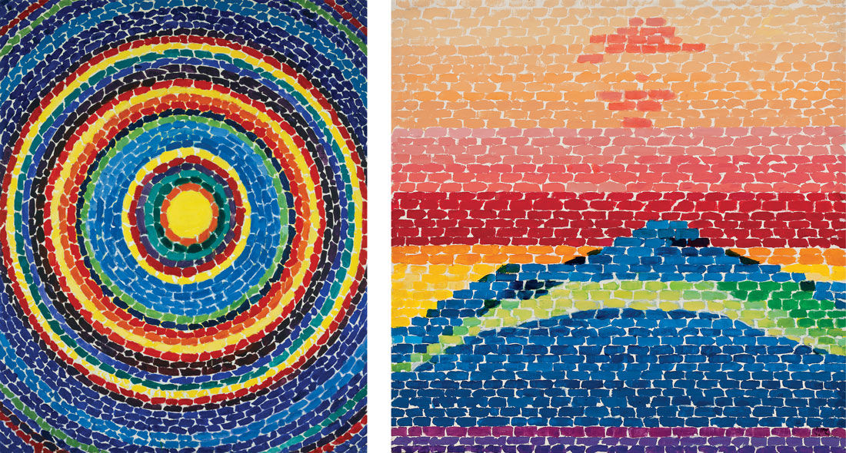
Splash Down Apollo 13, 1970
Apollo 12 “Splash Down,” 1970

Slide 5
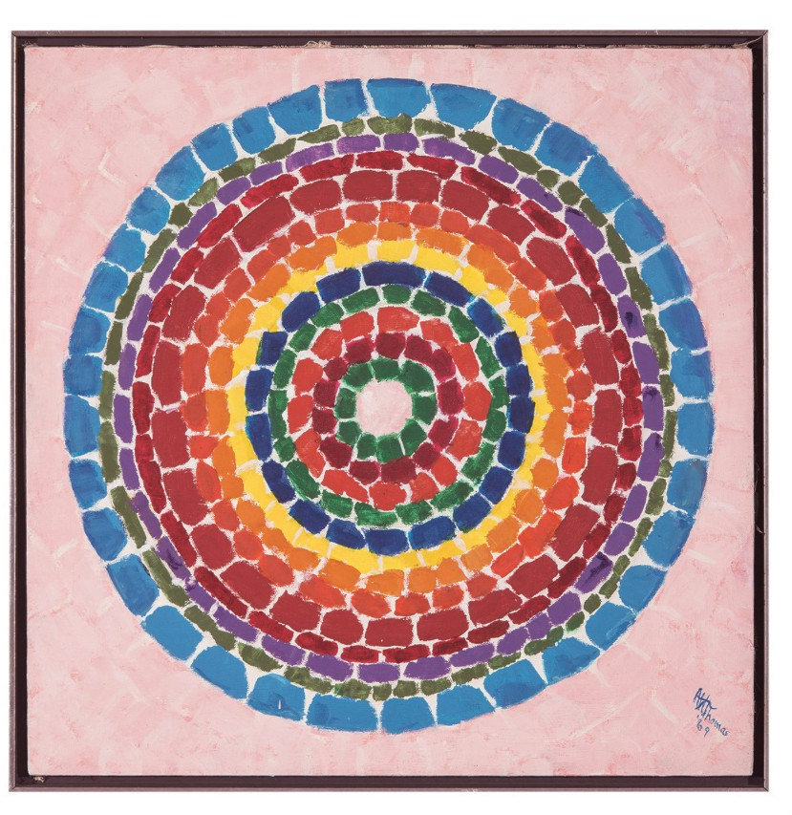
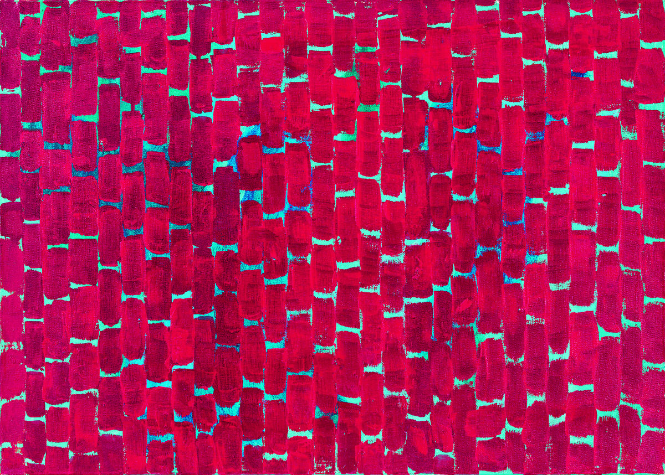
Deep Red Roses Chant, 1972
Spring Flowers in Washington, D.C., 1969

Slide 6
Let’s create some art!!

Slide 7
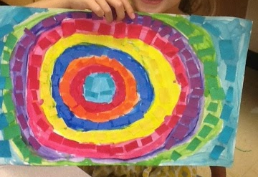
MATERIALS:
Tempera paint in different colors
Paint brushes
Large white paper
Elmer’s Glue
Cut up pieces of construction paper in different colors

Slide 8
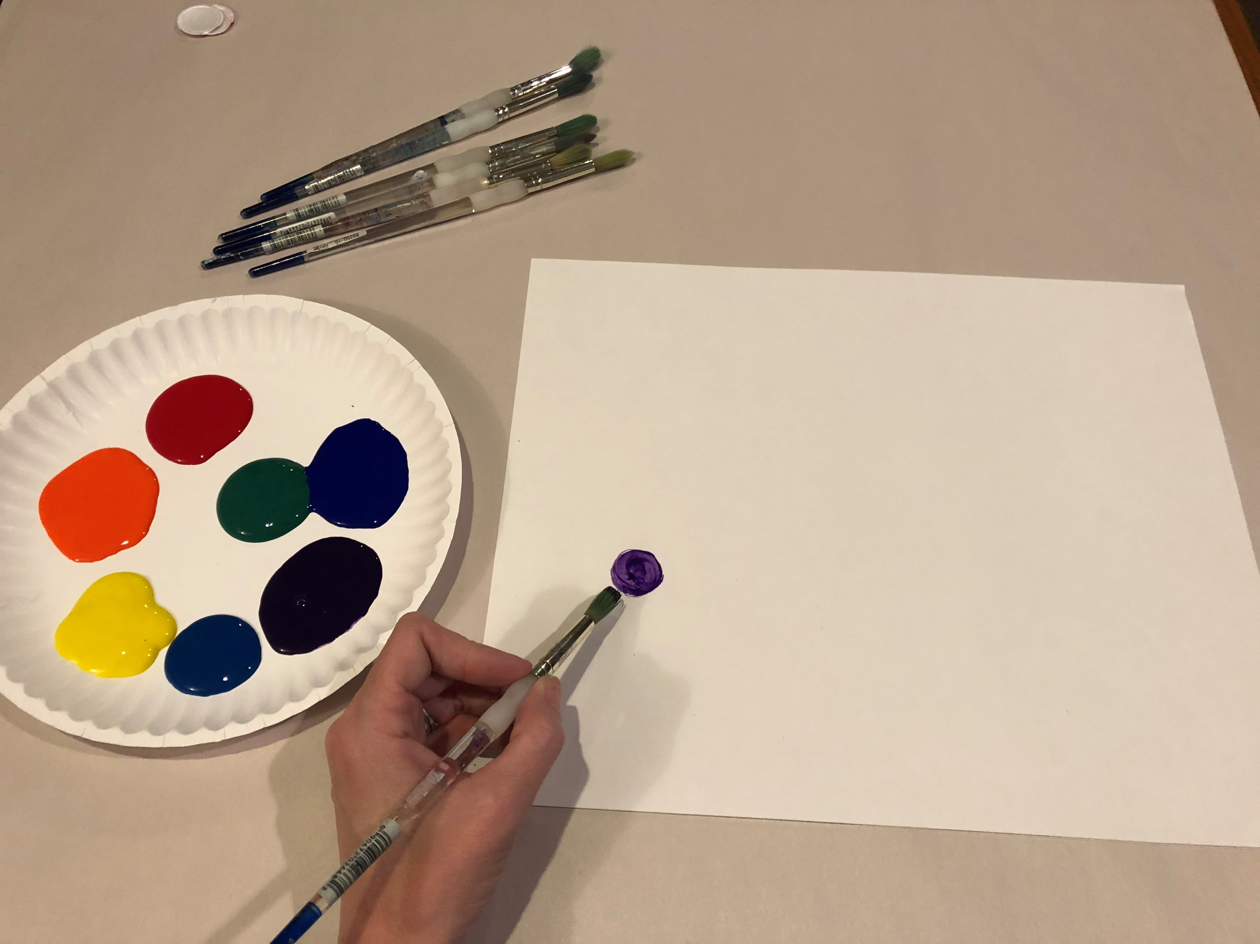
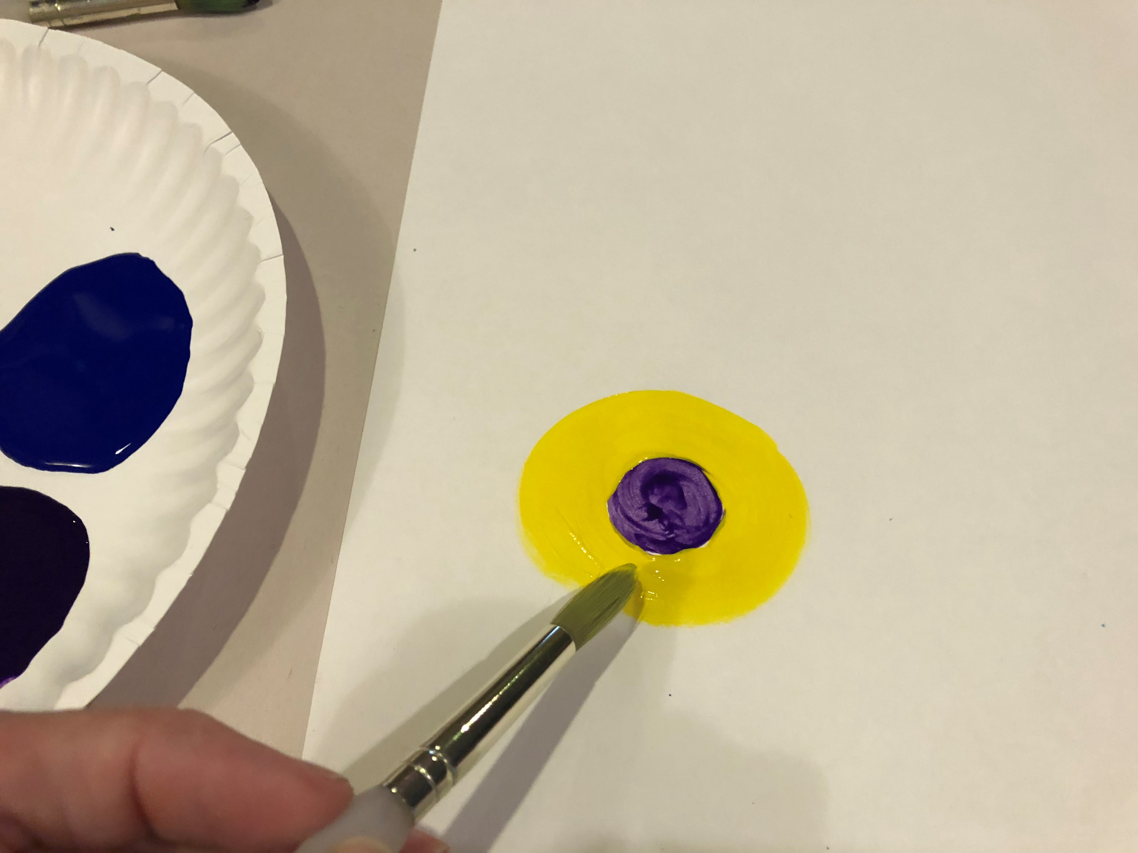
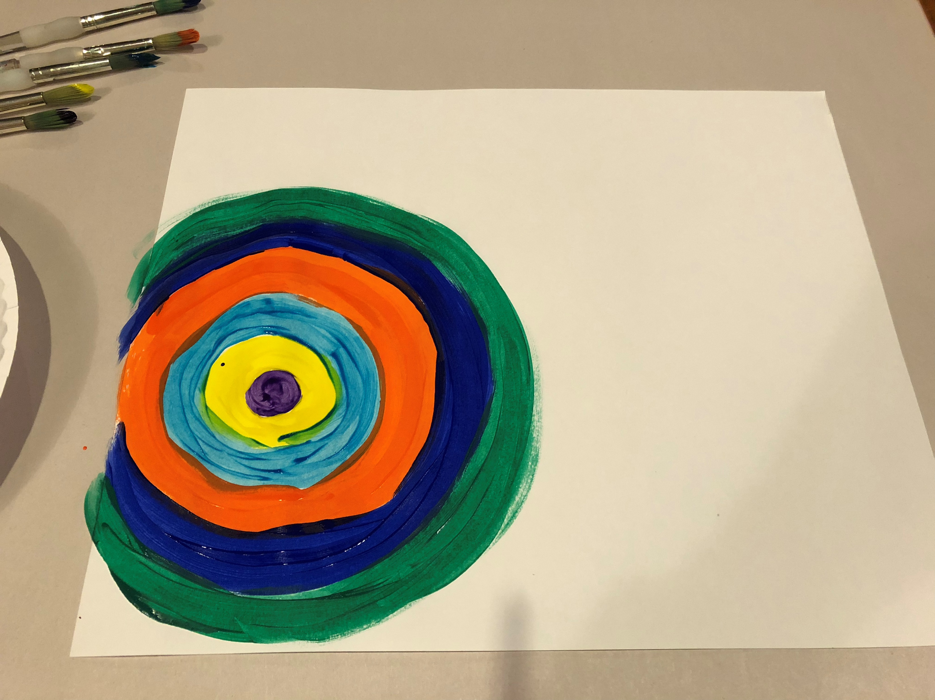
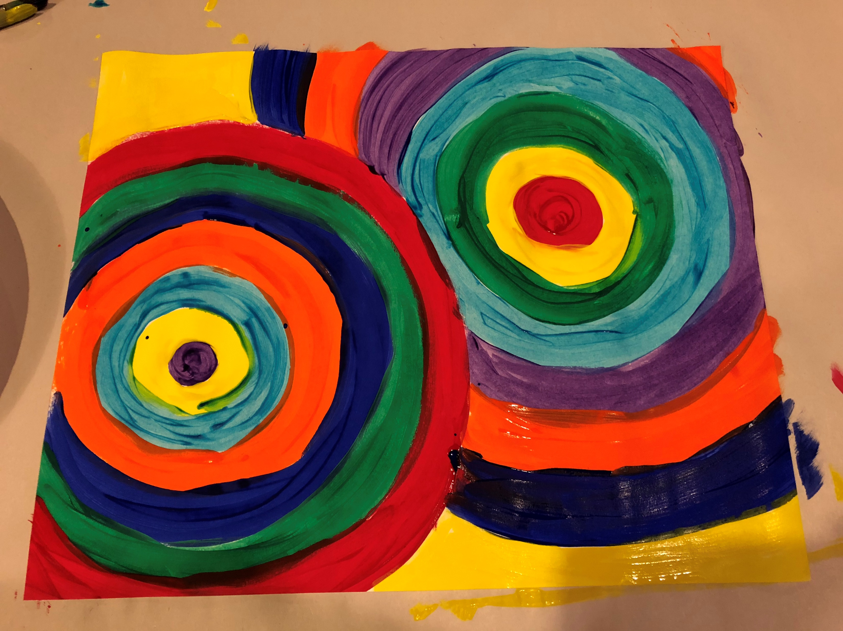
Write your name on the white paper and flip over.
Choose whether you want to do circles or straight lines.
If CIRCLES:
1. Choose any color and paint a circle. 2. Switch colors and paint a circle around the first circle.
3. Keep switching colors and painting circles. 4. You may choose to do more than one circle.

Slide 9
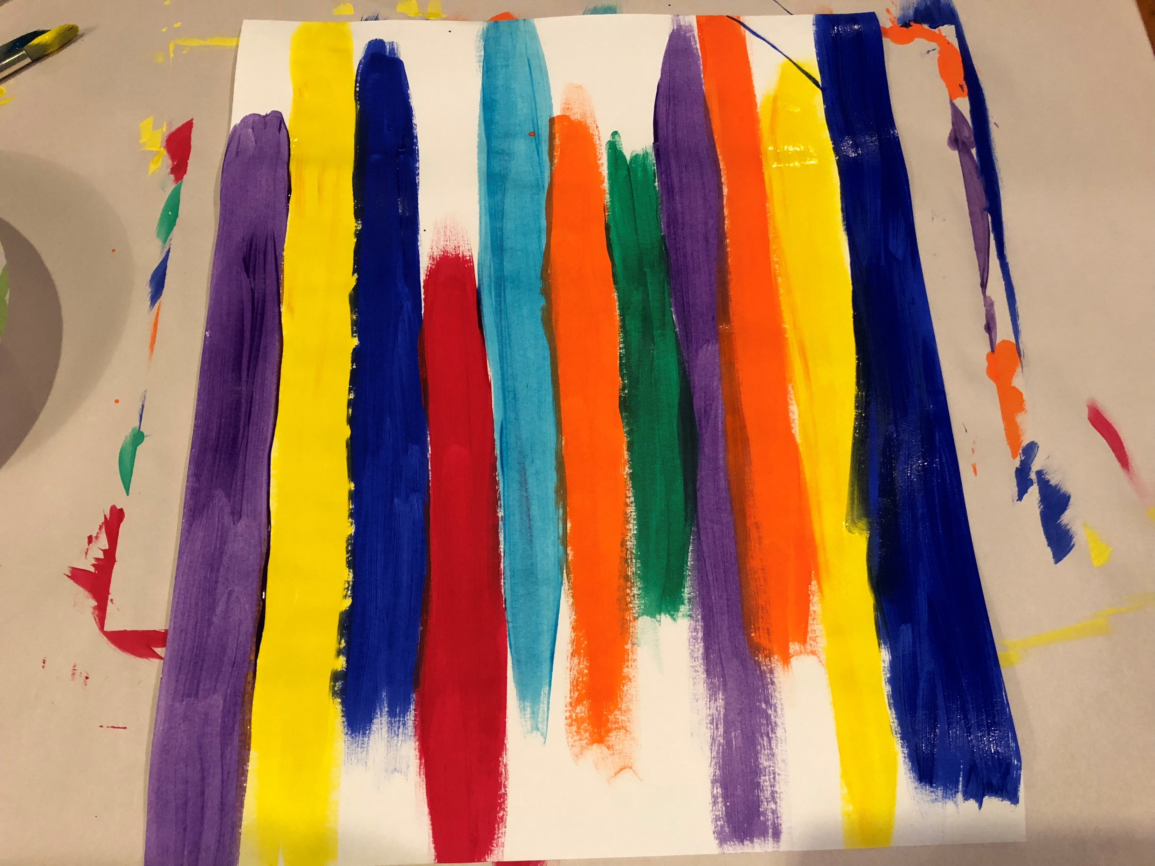
If you choose STRAIGHT LINES:
Choose any color and paint a line. 2. Keep switching colors and painting lines.
They do not need to all be the same length.

Slide 10
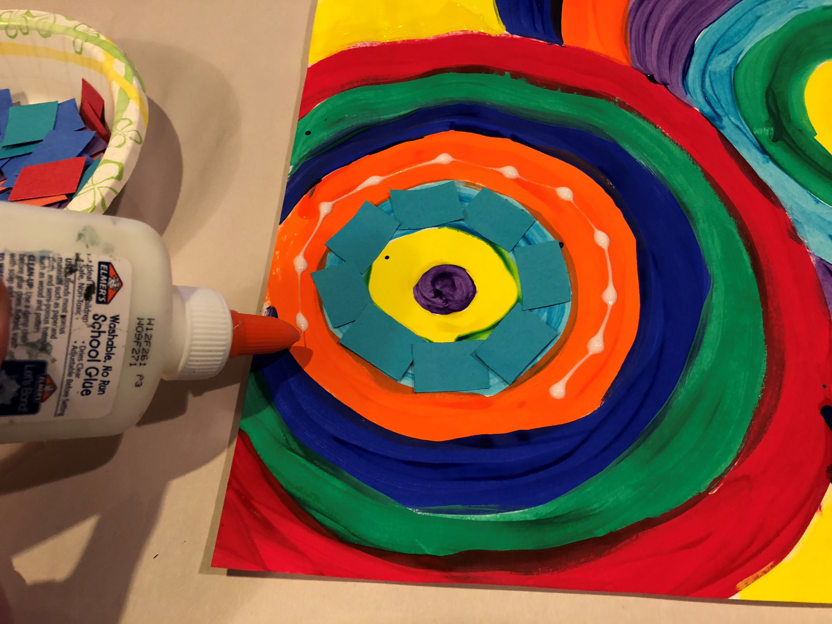
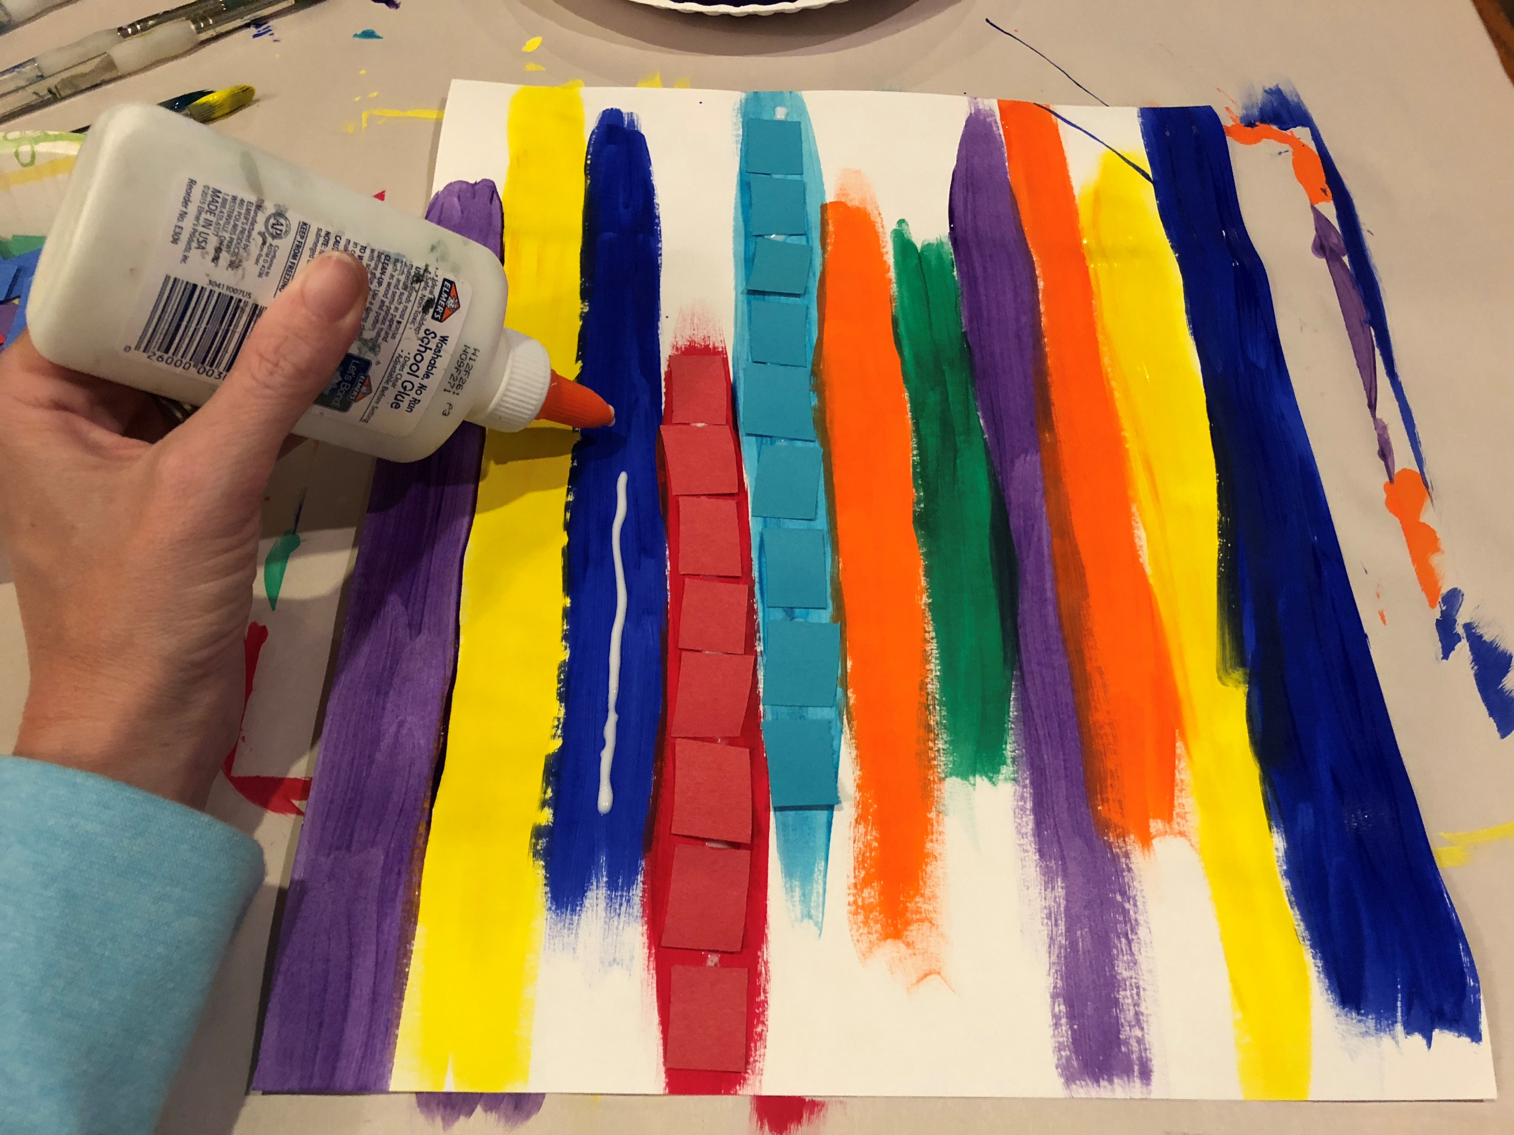
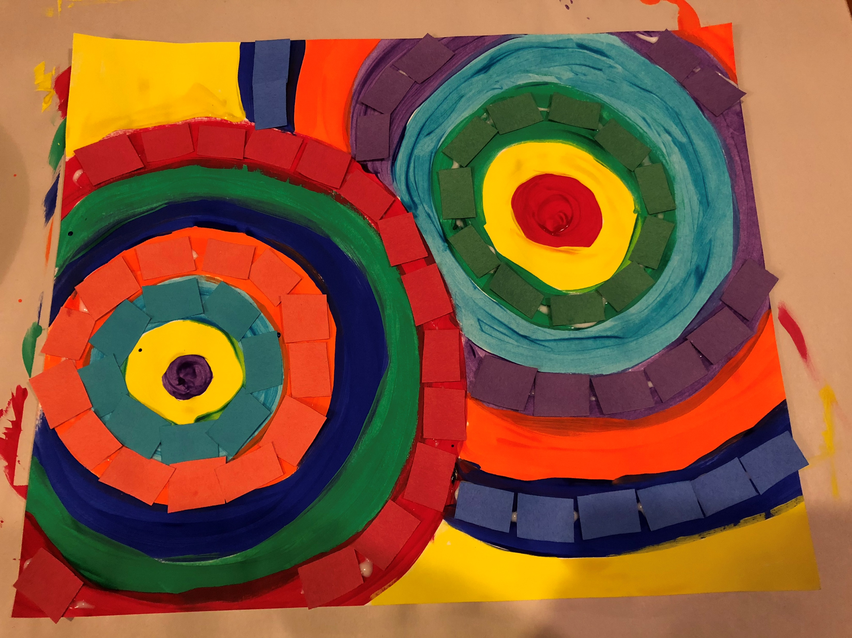
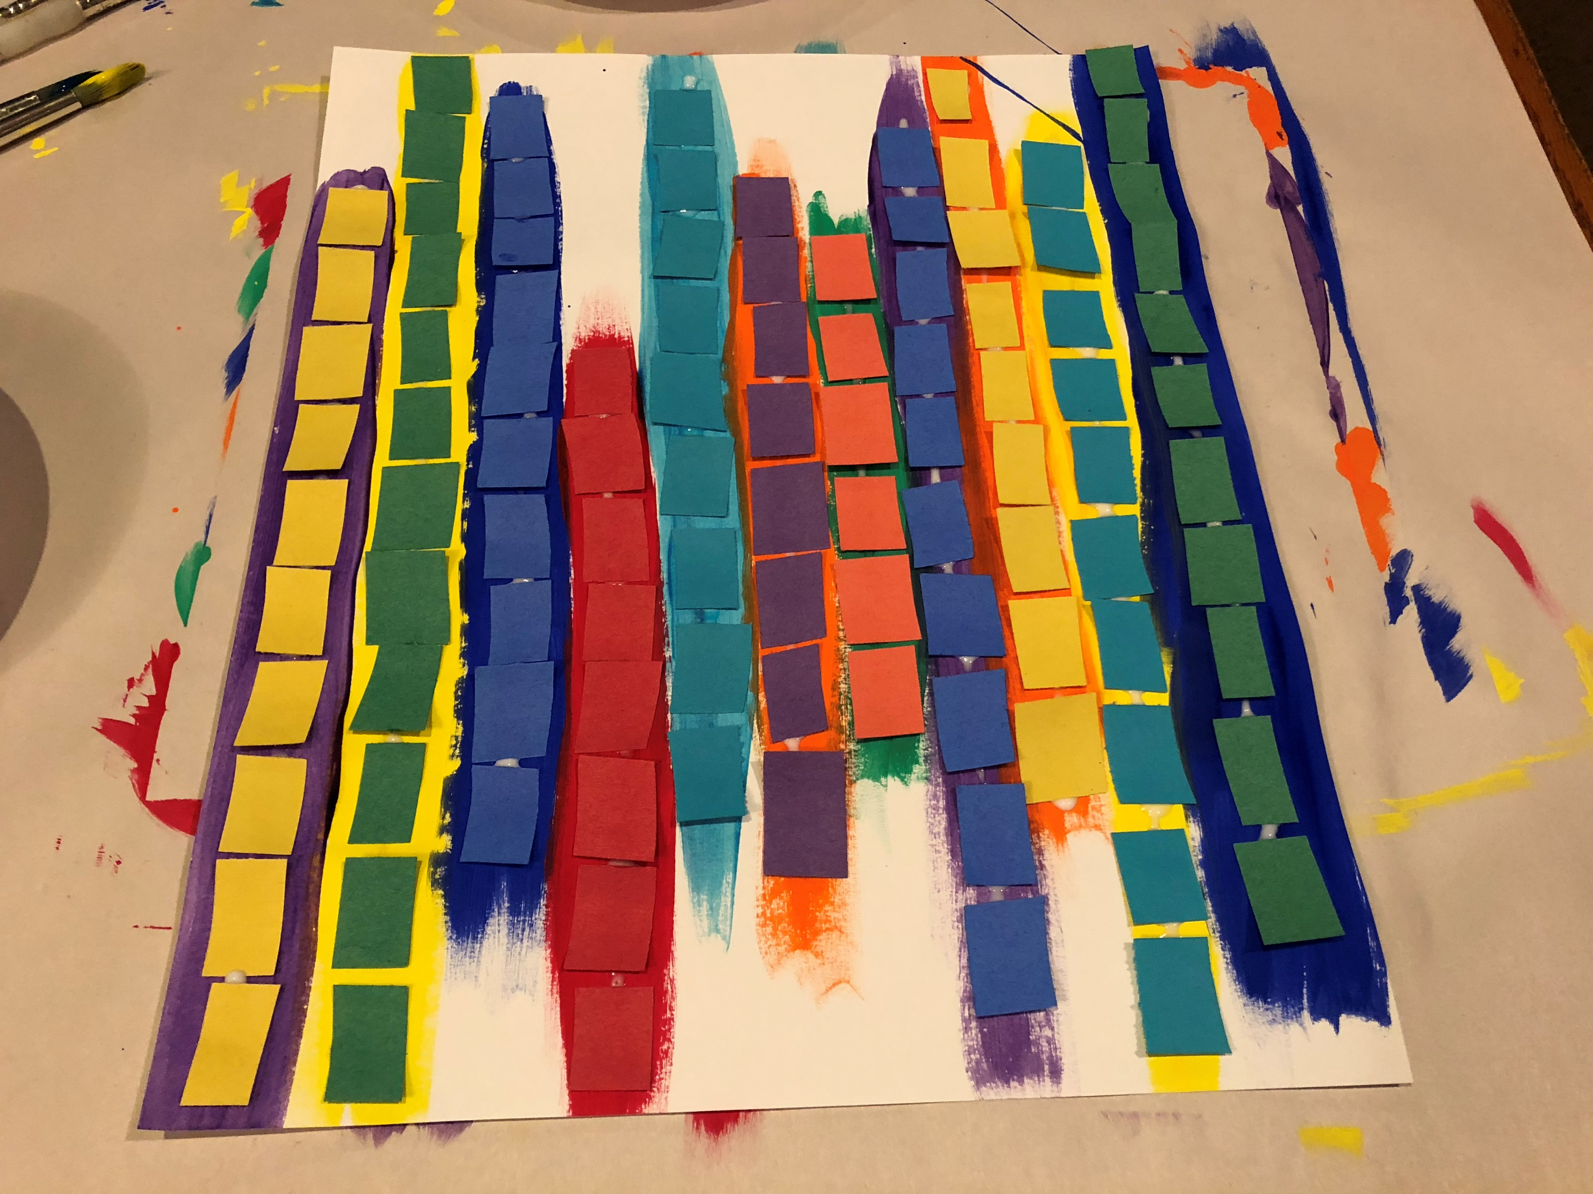
After you are done painting, glue construction paper rectangles on your masterpiece.
You do not need to glue paper to every line or circle. Also, you can use the same colors as the paint, or different colors.

Slide 11
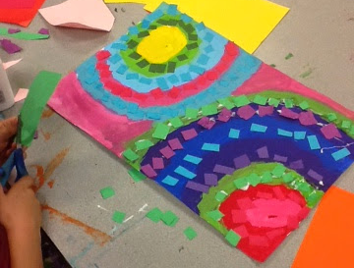
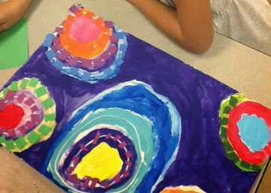
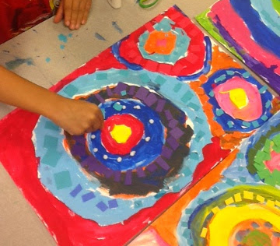
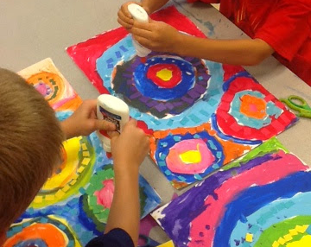
More Examples…

