Slide 1
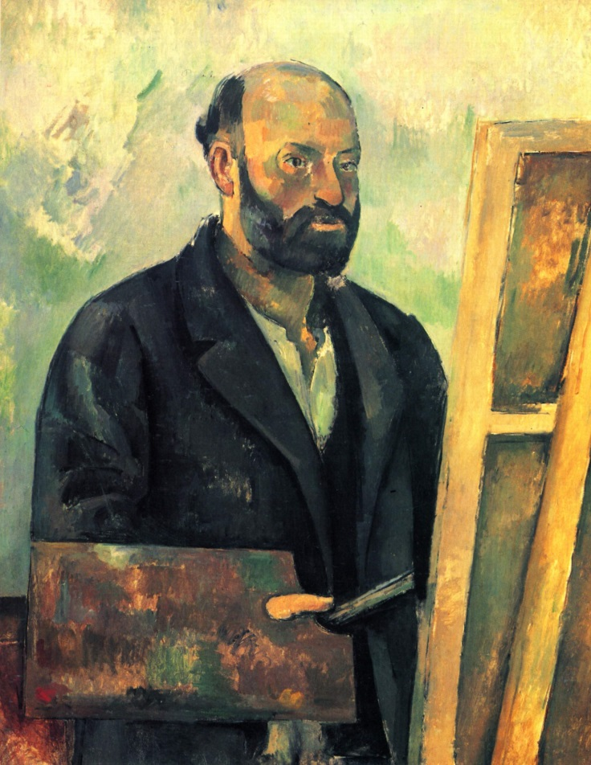
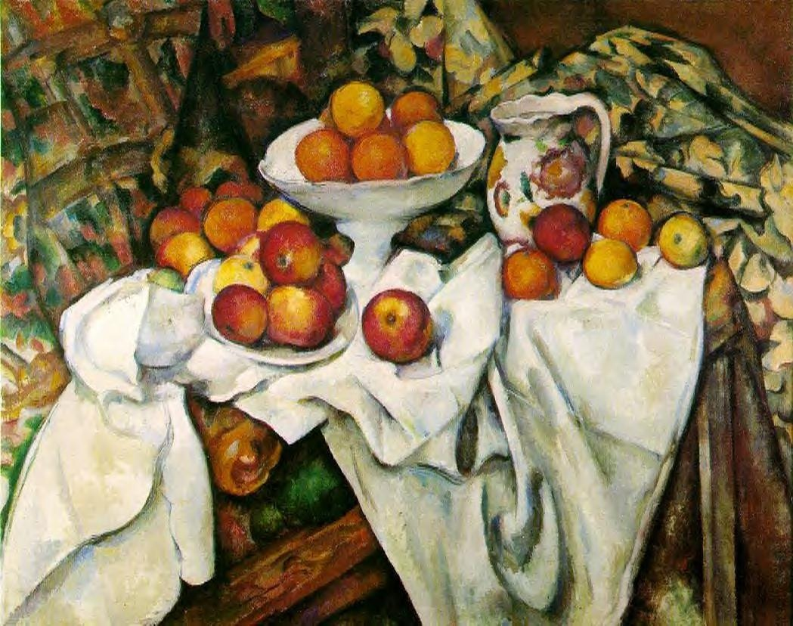
Paul Cézanne
K to 2nd grade
and still life

Slide 2
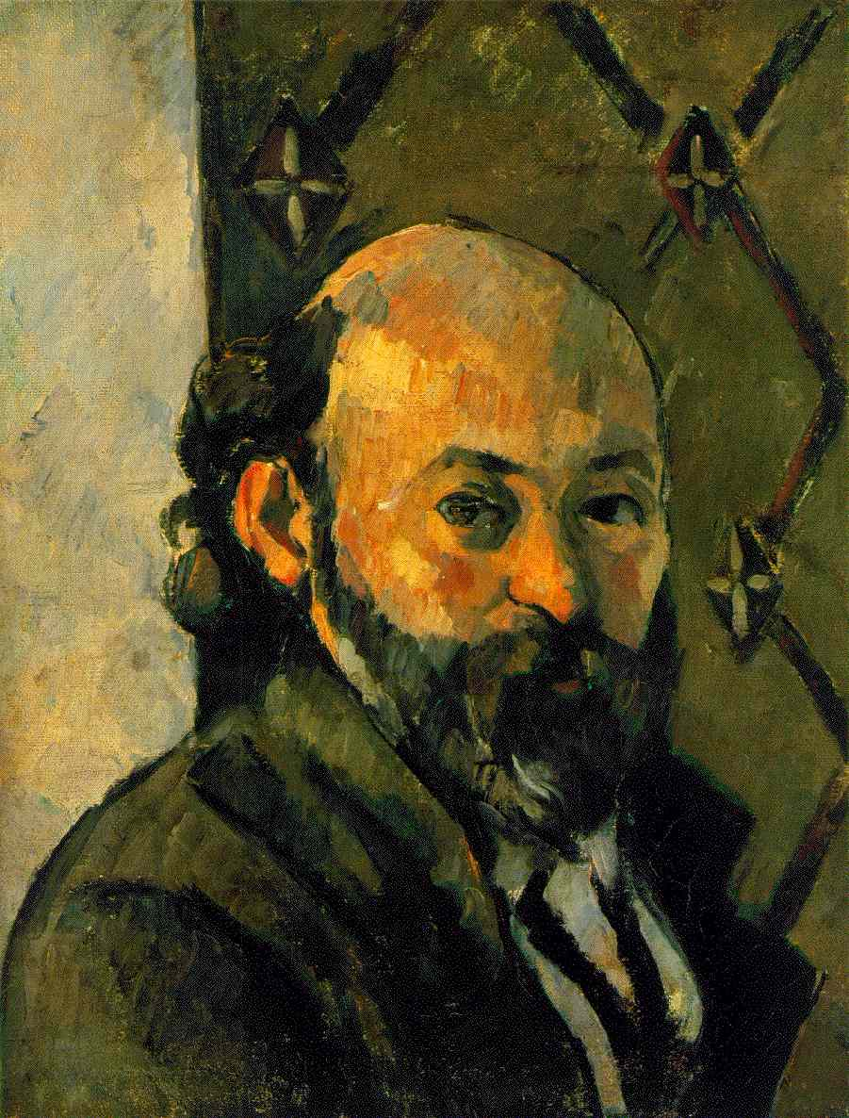
Paul Cézanne
Paul believed that
color, light and space
were the most important elements of any art.
He believed it was enough to make any art unique!

Slide 3
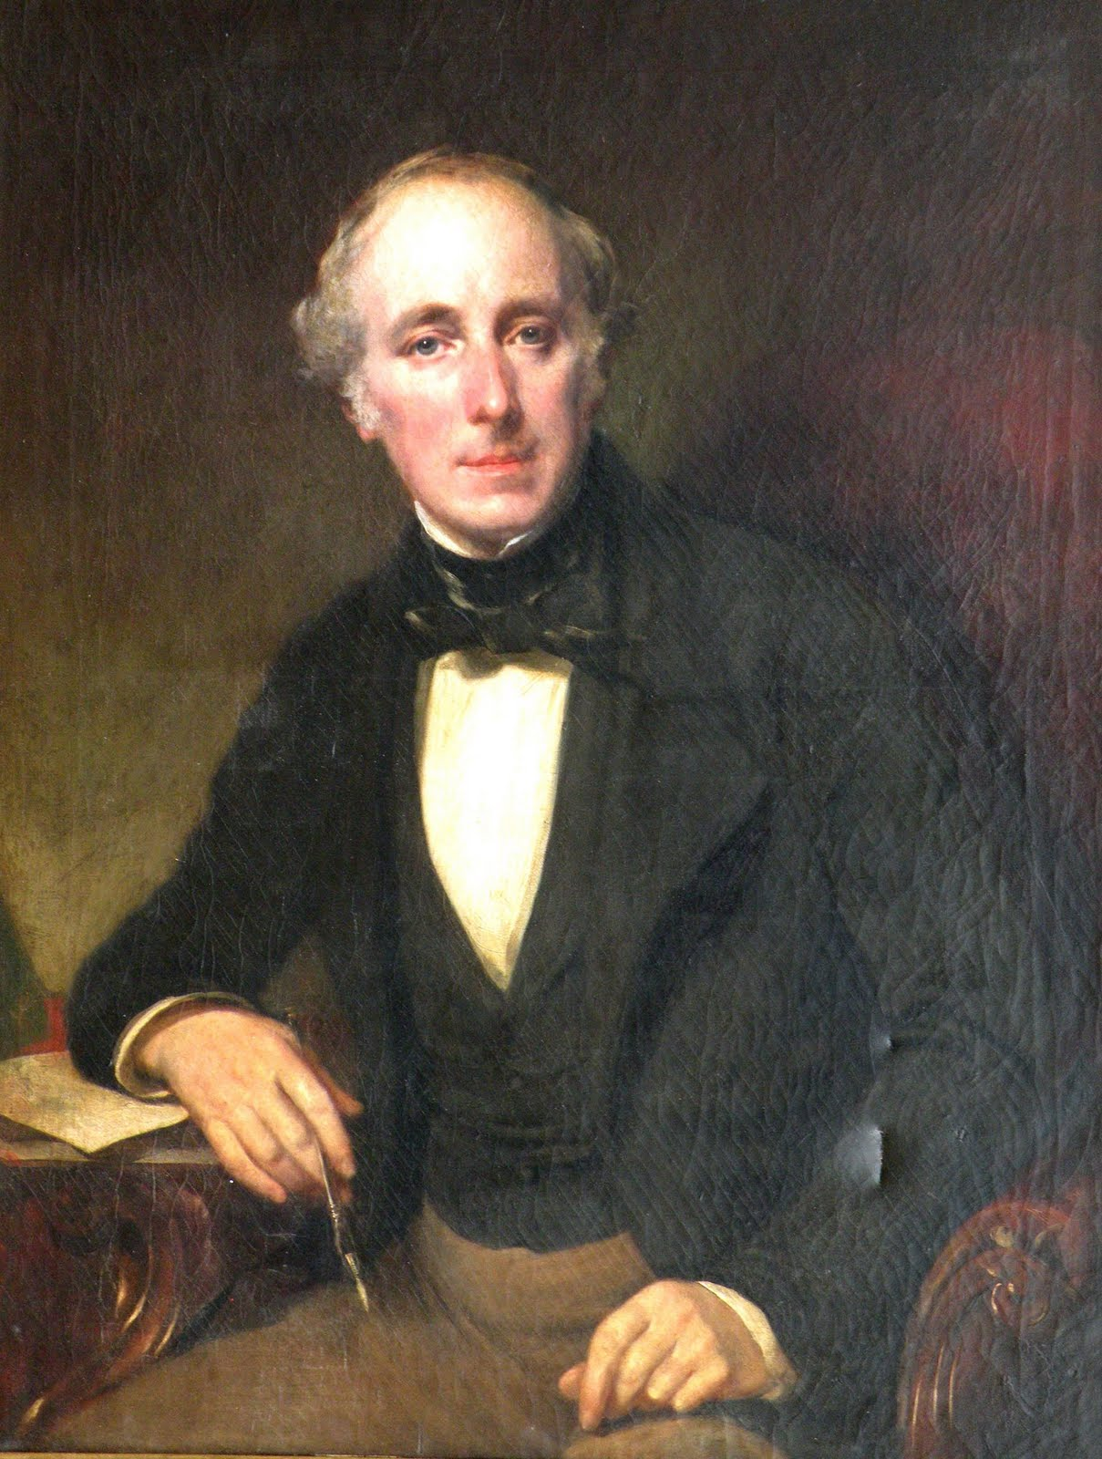
So, while other artists painted
portraits of rich people

Slide 4
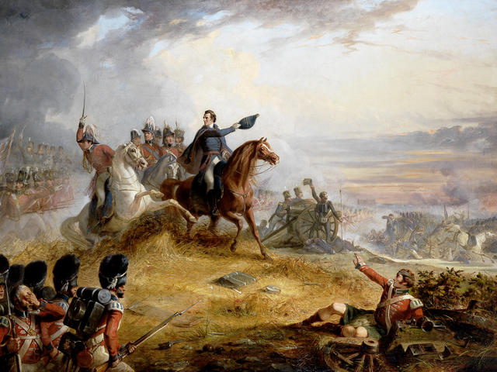
Epic battle scenes

Slide 5
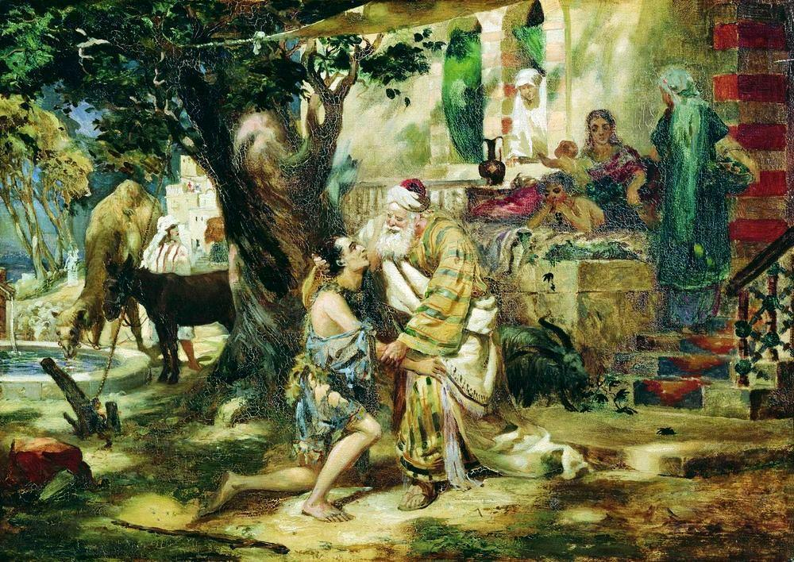
or religious and mythical scenes

Slide 6
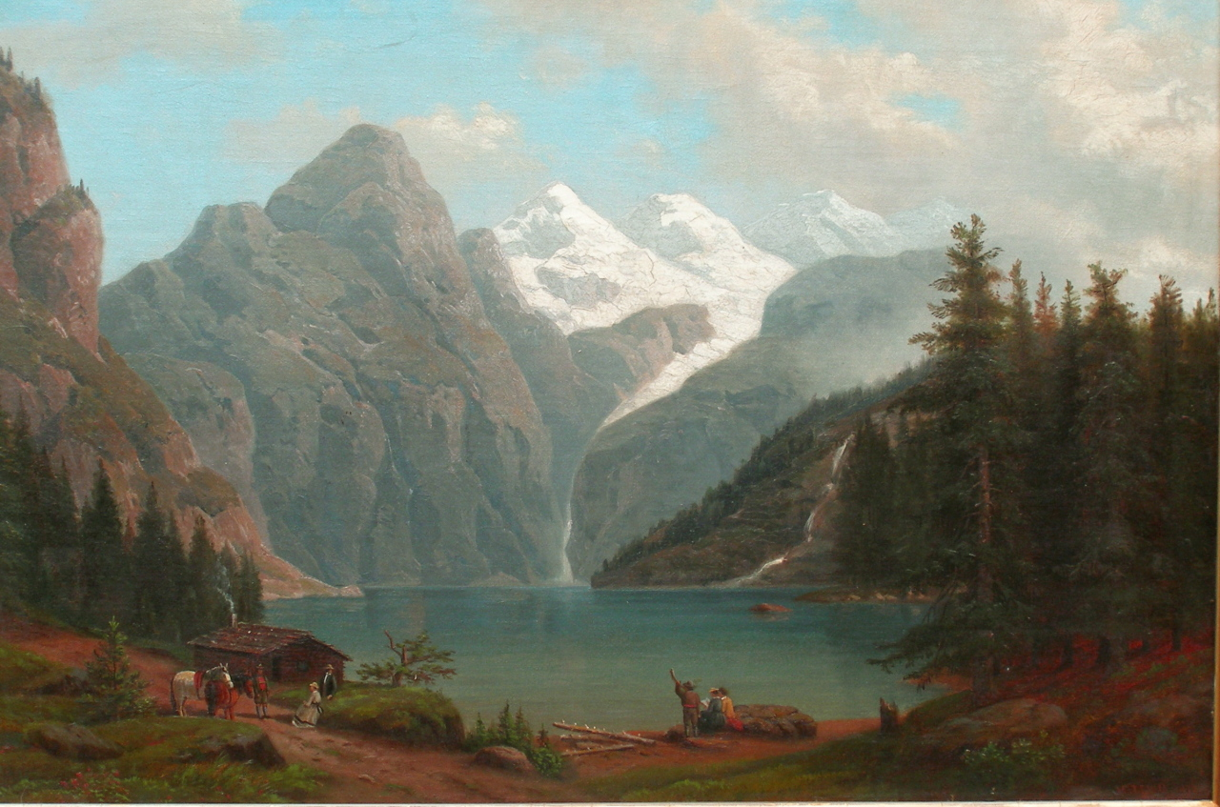
and landscape artists were considered slackers by most critics...

Slide 7
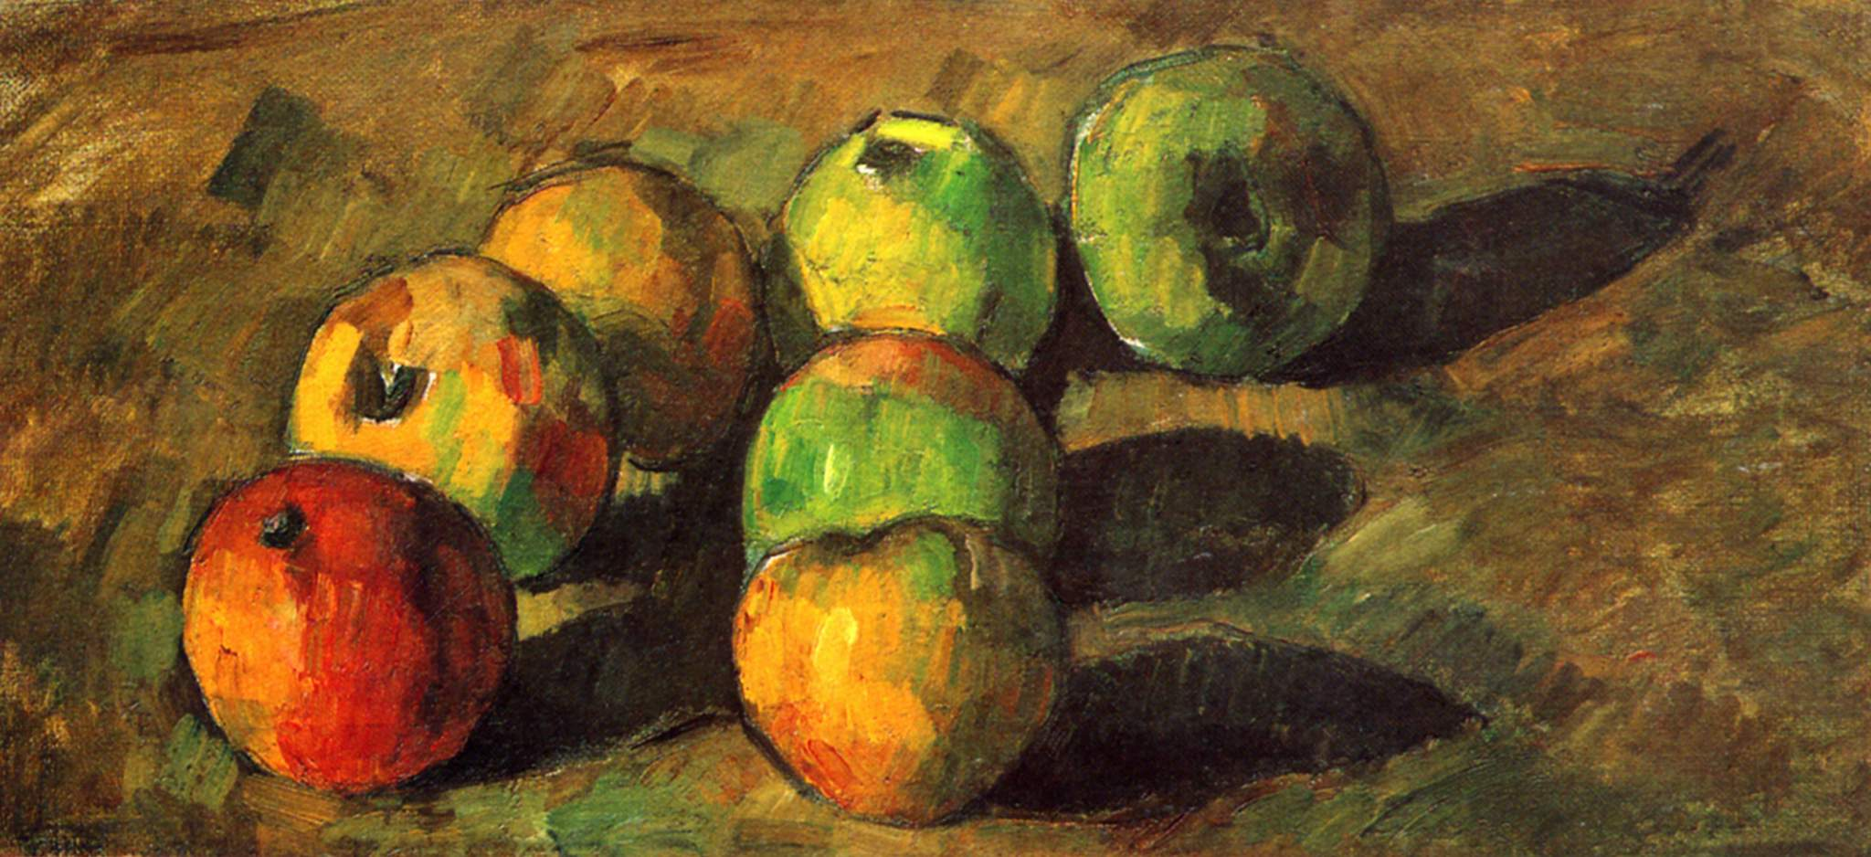
Paul decided to paint only the lowliest art form of them all:
still life!

Slide 8
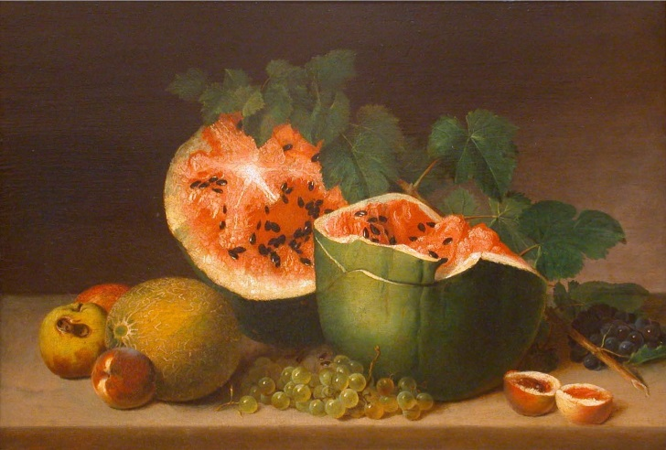
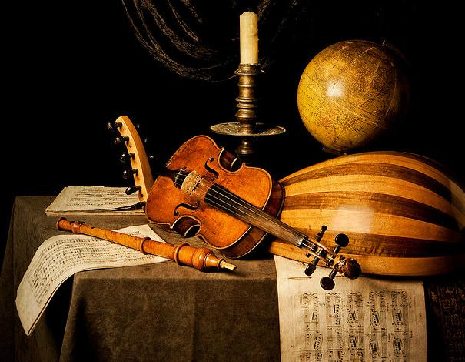
What is a still life painting?
A still life is a work of art capturing mostly inanimate objects.
They are painting of:
Food
Flowers
Plants
Rocks or shells
Drinking glasses
Books
Vases
Jewelry
What else could you paint?

Slide 9
Paul painted still lifes but to prove his point: that art can be anything if you do it right,
he decided to paint the most common thing he could fine:
an APPLE

Slide 10
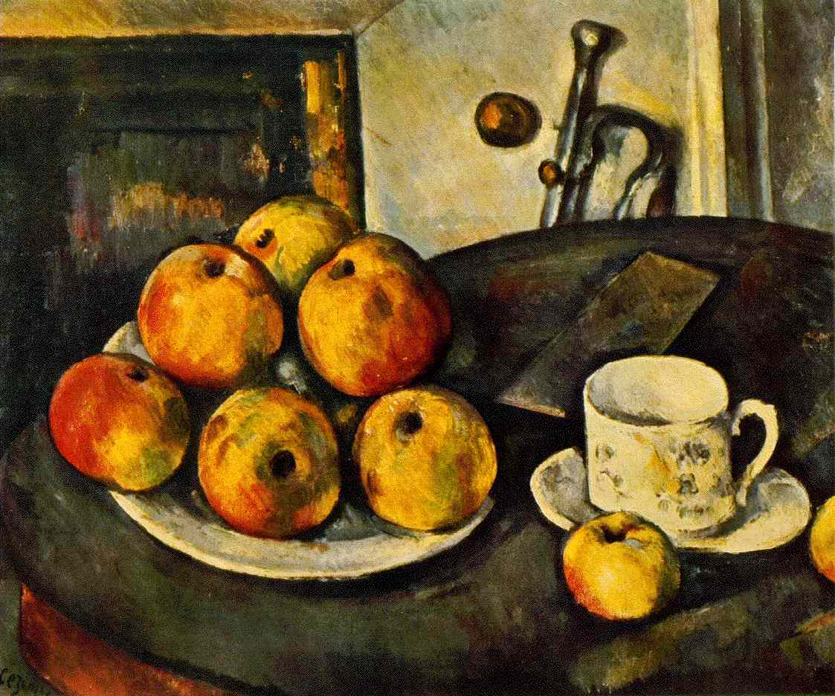
He said: I want to astonish Paris with an apple!
And after more than 30 years of hard work, he did!

Slide 11
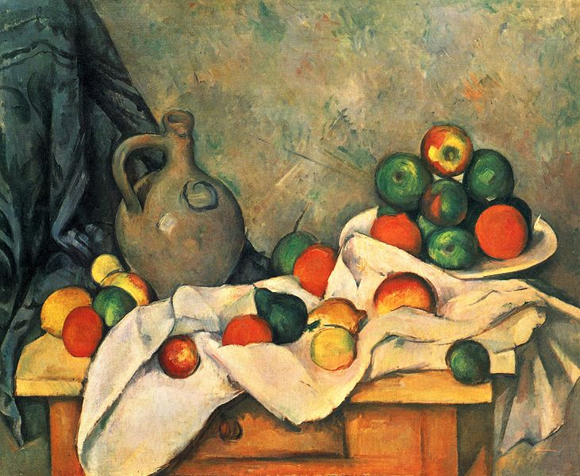
How did he do that?
He played around with colors, light and space
(like nobody before him)
Still Life, Drapery, Pitcher, and Fruit Bowl, 1893-4

Slide 12
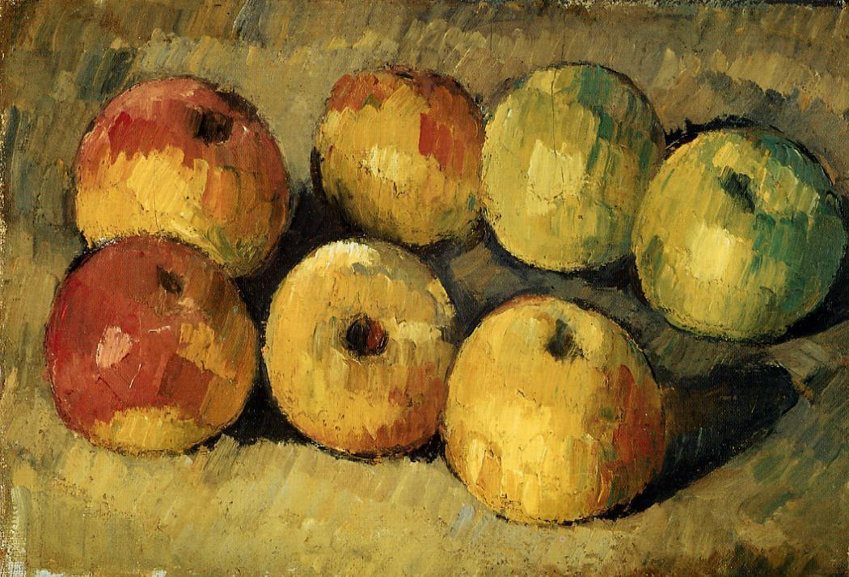
Paul painted over 200 still life paintings with apples.
Apples, 1878

Slide 13
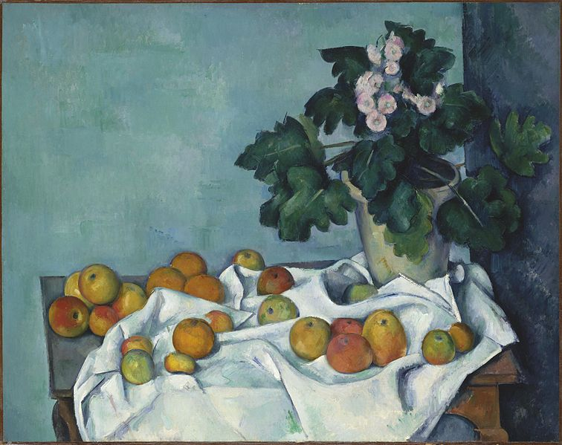
Still Life with Apples and a Pot of Primroses
1890

Slide 14
Still Life, Drapery,
Pitcher, and Fruit Bowl
1893-4

Slide 15
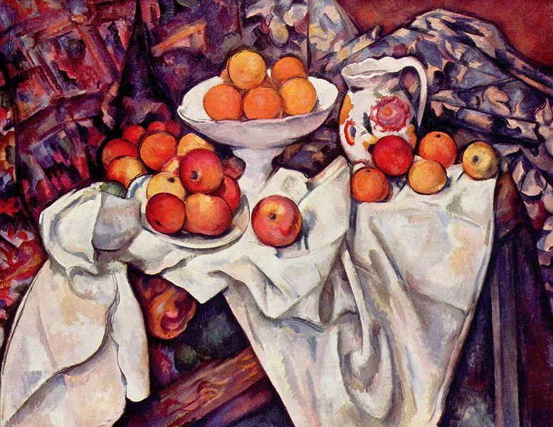
Then he painted the scene. Slowly. For many days.
And yes, often he needed to get new apples.
They got bad – or eaten (if he was hungry).
Apples and Oranges, 1899

Slide 16
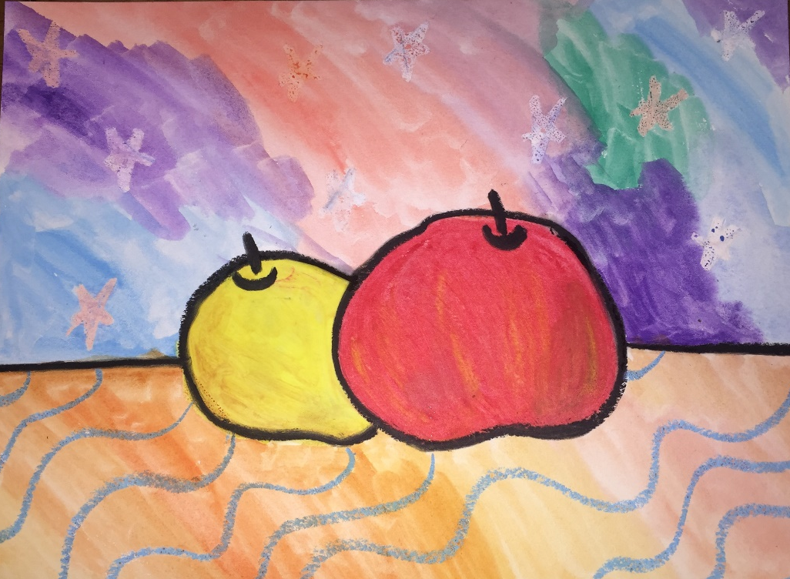
Let’s make some ART!

Slide 17
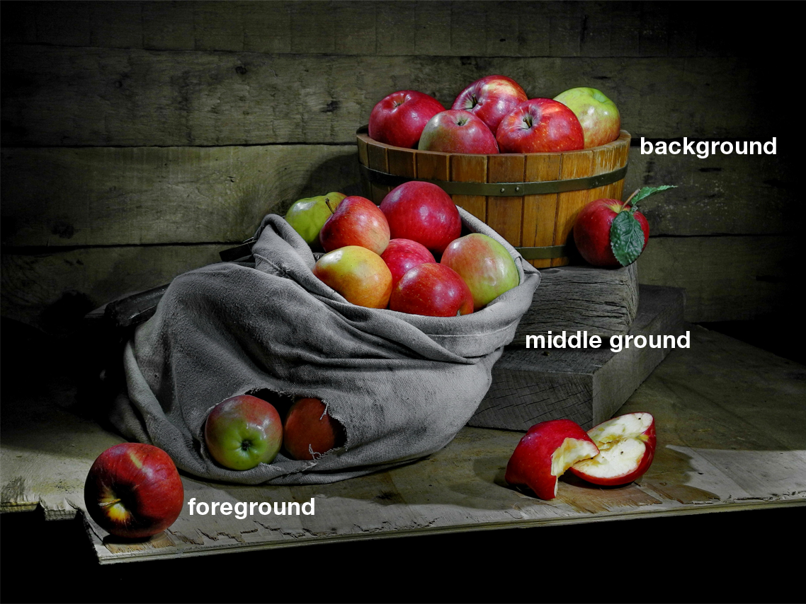
First create your still life
What is a composition?
It is the placement of objects in a painting.
It literally means: putting together.

Slide 18
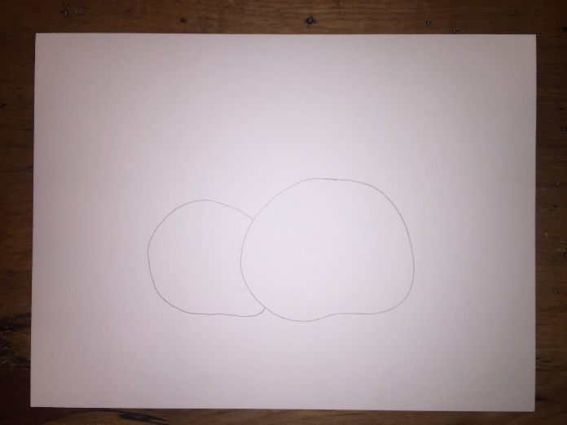
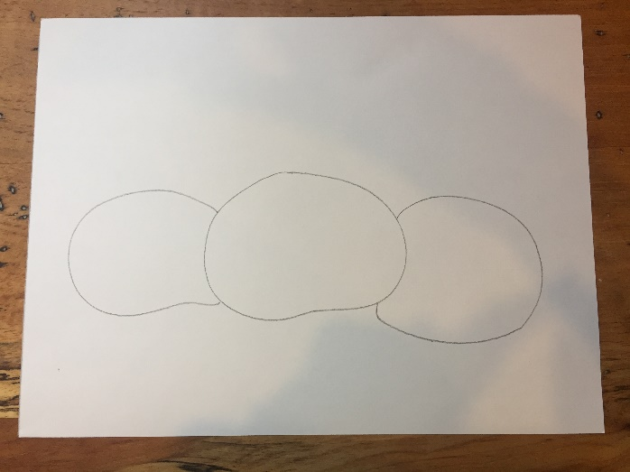
Sketch what you see!
But do not be afraid to exaggerate a little, like Paul.
Sketch it with oil pencil.
You can sketch 1, 2, or 3 apples. If 2 or 3 – overlap them!

Slide 19
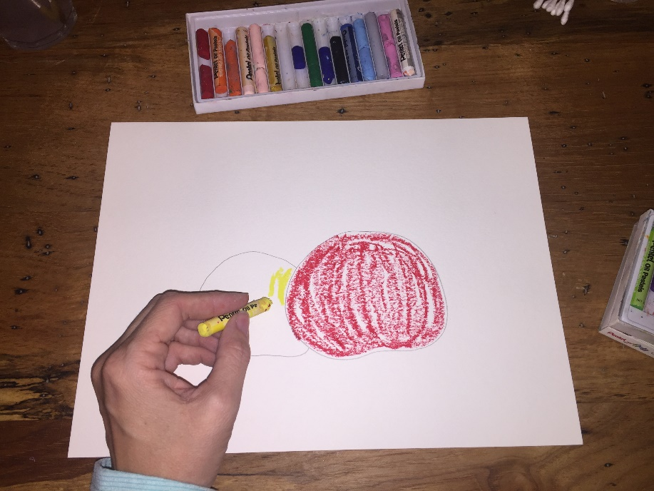
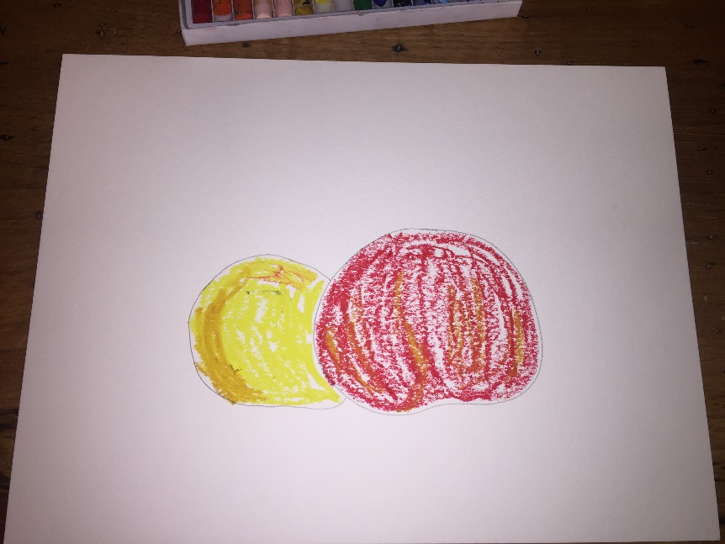
Color it in using oil pastels
What colors do you see?
Color it in.
It does not have to be perfect.
In should not be perfect.
You are done when it looks like this.

Slide 20
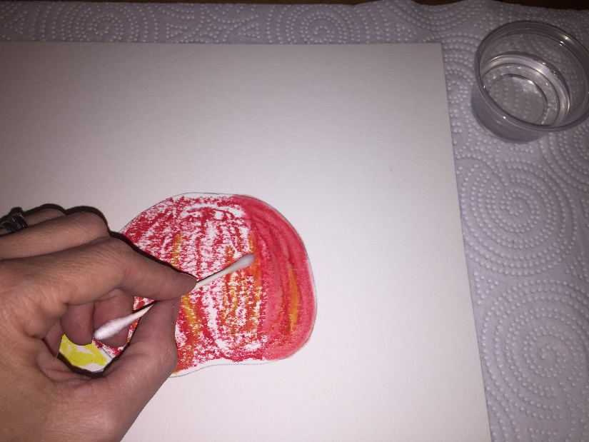
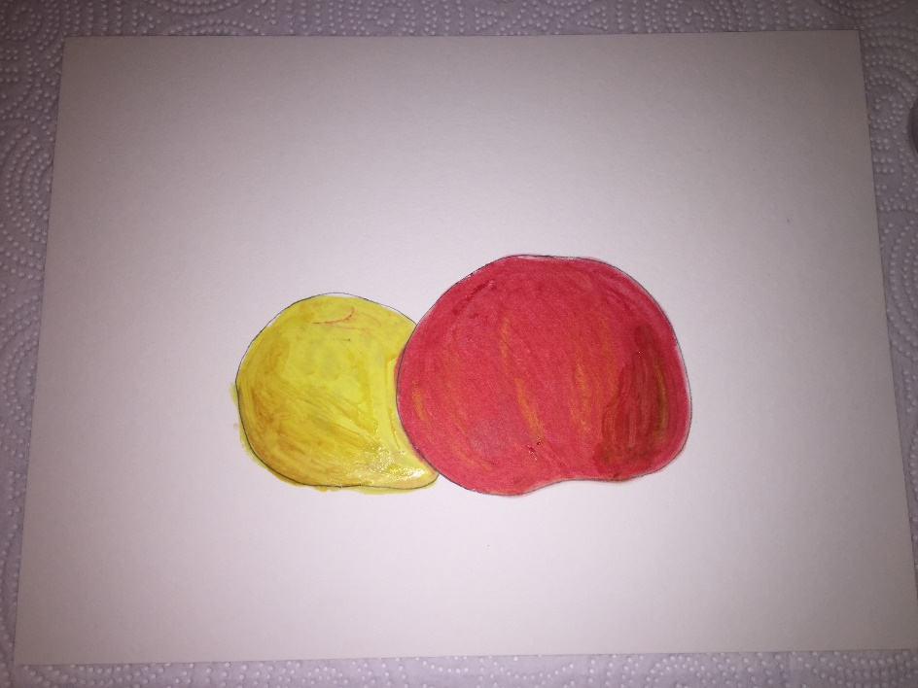
Blend it (with oil)
Dip your q-tips in oil.
DO NOT SPILL
Blend (mix) the colors together with oil.
Do you see what happens?

Slide 21
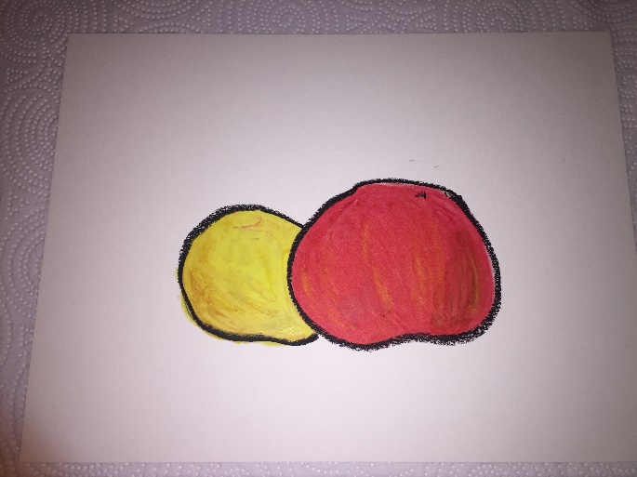
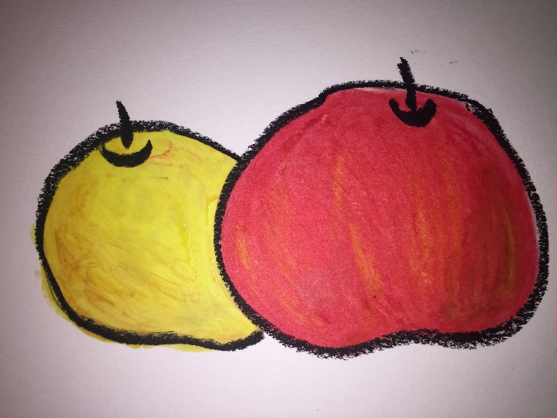
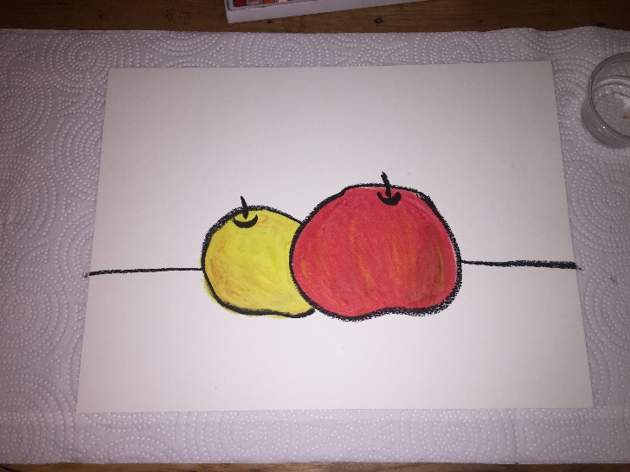
Black lines
Outline apples with black oil pastel.
Add a stem (a U shape with a vertical line).
Draw a horizontal line on each side to create a foreground and a background.
You may use qtip and oil to blend a little.

Slide 22
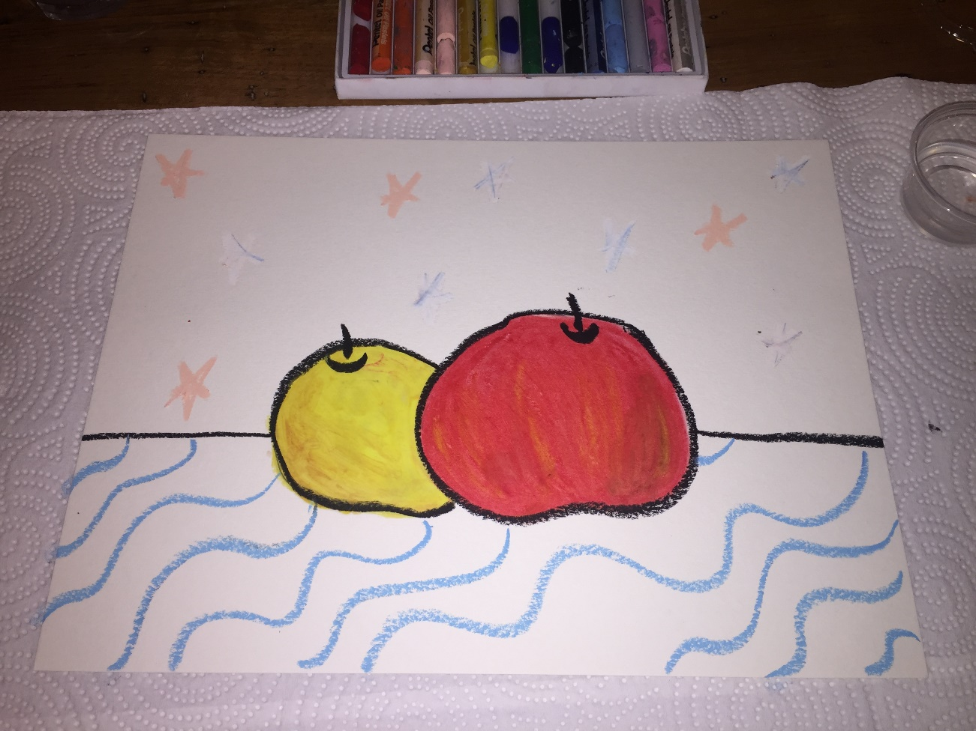
Add patterns
Using oil pastel, add a pattern to the background.
Add a different pattern to the foreground.

Slide 23
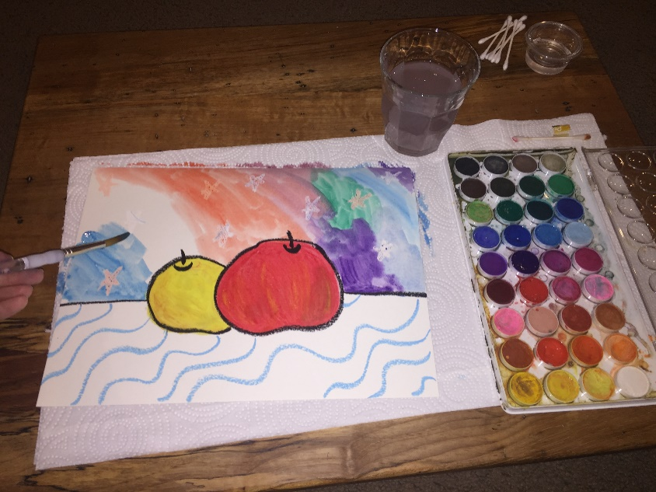
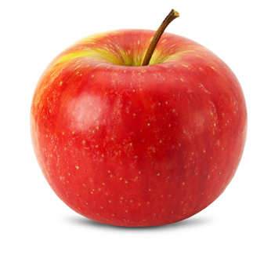
Watercolor background and foreground
Use watercolors to paint over
the background and the foreground.
You can go over the still life,
it will not stick on the oil pastels.

