Slide 1
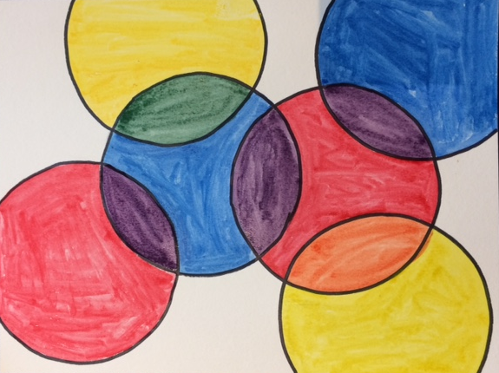
Circles
Using primary colors to mix secondary colors

Slide 2
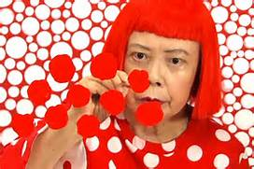
Yayoi kusama
The Princess of Polka dots
Yayoi Kusama is a modern artist famous for her circle and polka dot creations. She feels the circle represents the sun and creating a polka dot pattern represents infinity. Her paintings are known as “Pop Art.”

Slide 3
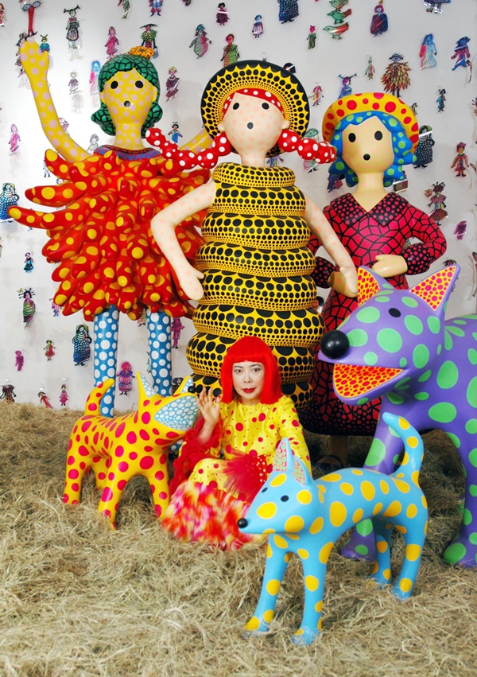
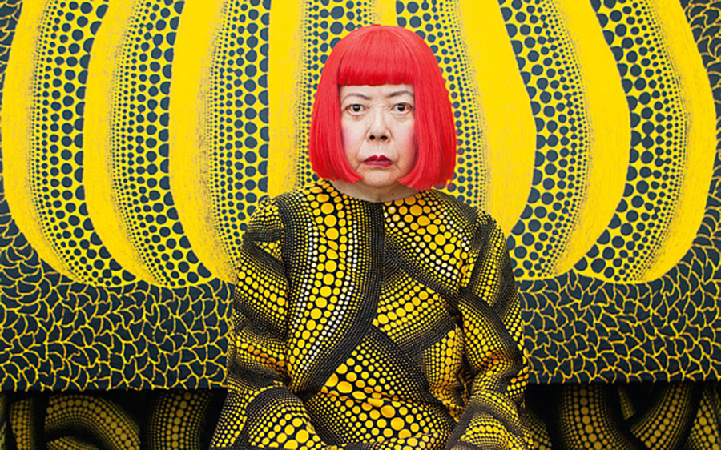
Kakoi is known for her bold and crazy designs. She began using polka dots in her art when she was 8 years old while growing up in Japan.

Slide 4
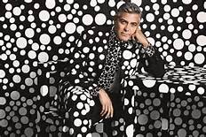
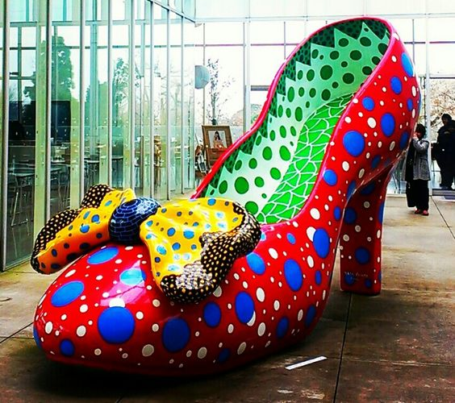
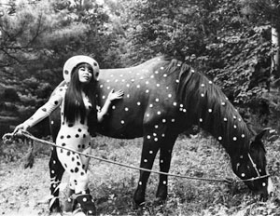
Not only does she put polka dots on paintings, she puts them on clothing, statues, and even people and animals.

Slide 5
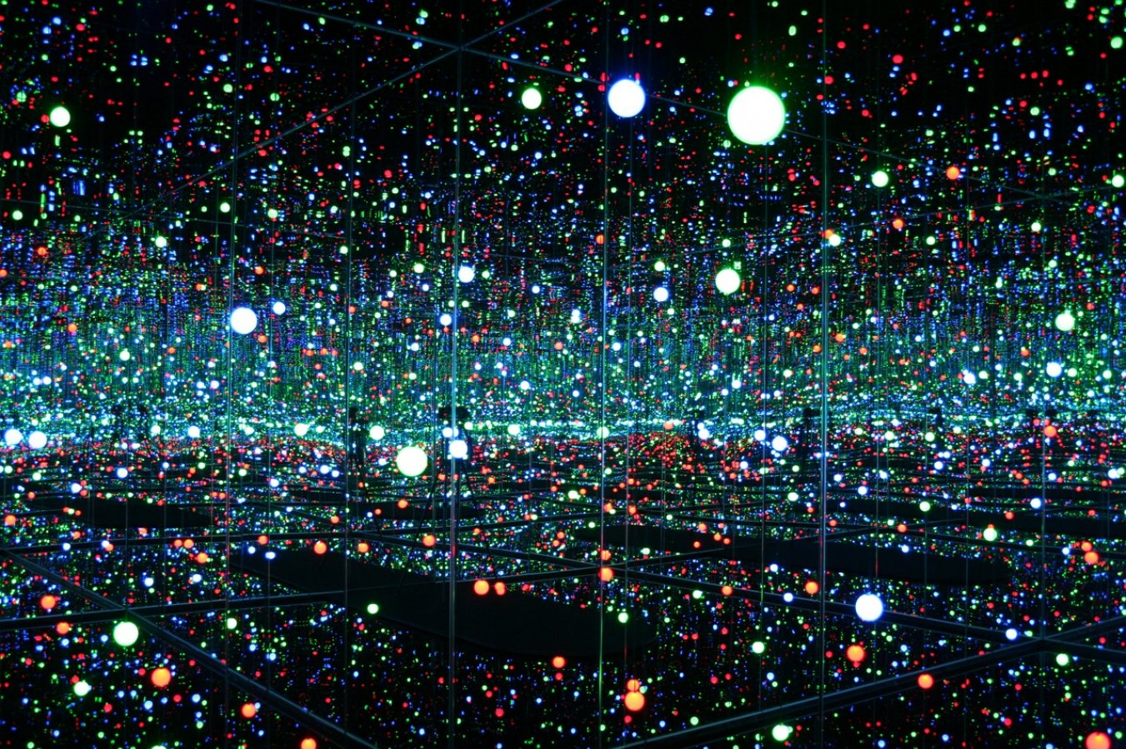
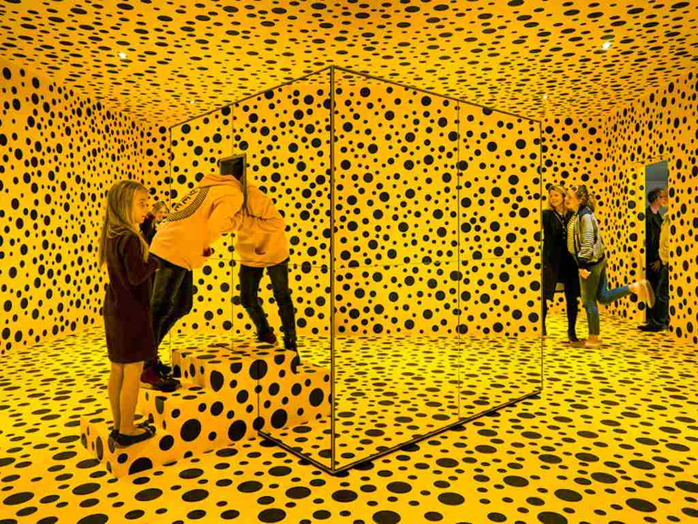
Her current projects are Infinity Rooms which use mirrors to make the dots look like they go on forever.

Slide 6
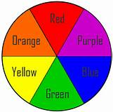
Mixing Secondary Colors
The Three Primary Colors are Red, Yellow, and Blue. They are called Primary because they can not be mixed from other colors.
The Three Secondary Colors are Orange, Green, and Purple. They are called Secondary because they are mixed from the primary colors.

Slide 7
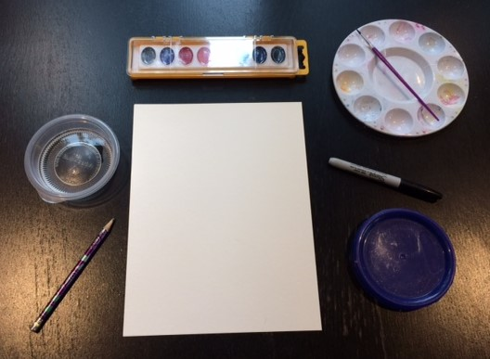
Creating our Circles
You will need:
watercolor paper
water color paints
water
a palette
a pencil
a sharpie
A plastic top

Slide 8
First, Write your name on the back

Slide 9
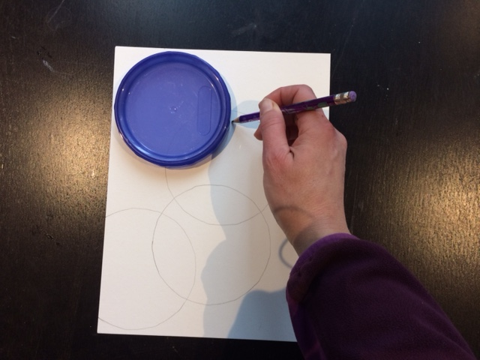
Using a pencil, trace several overlapping circles
Make sure that only two circles overlap

Slide 10
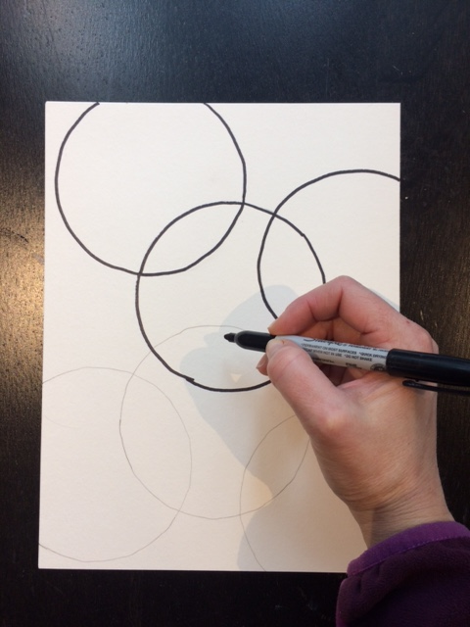
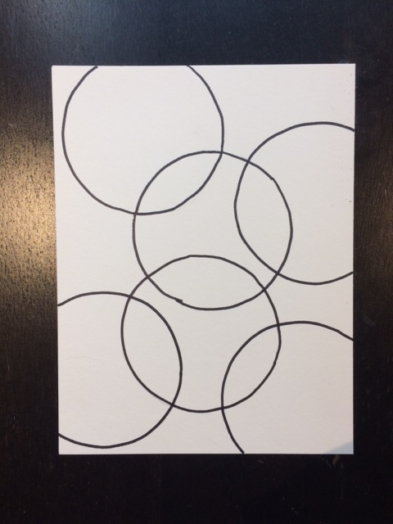
Using a sharpie, trace the circles

Slide 11
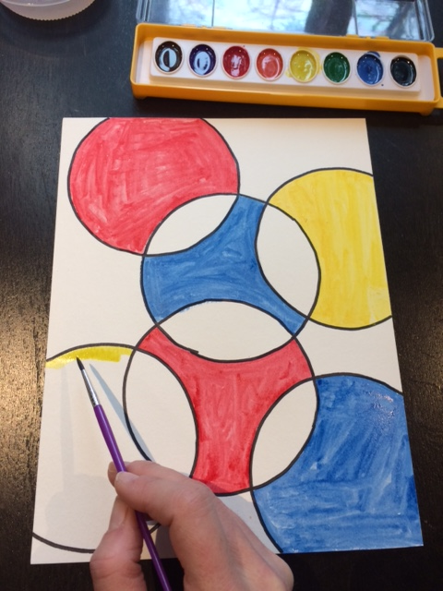
Paint the insides of the circles using primary colors
Remember to use red, blue, and yellow.
Also remember to rinse your brush between each color to keep each color clean.

Slide 12
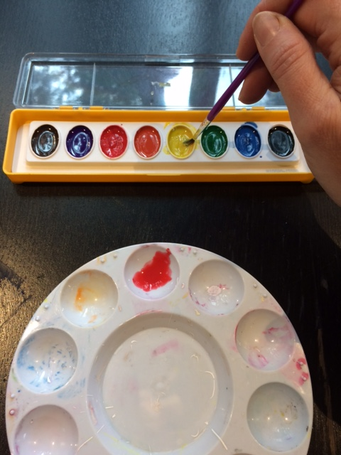
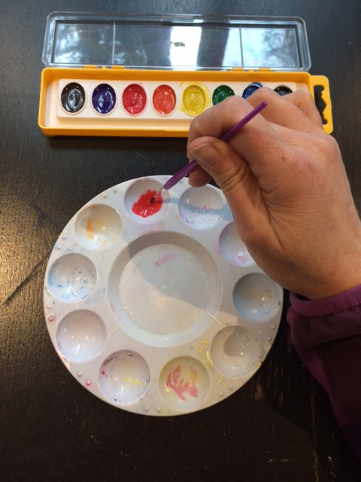
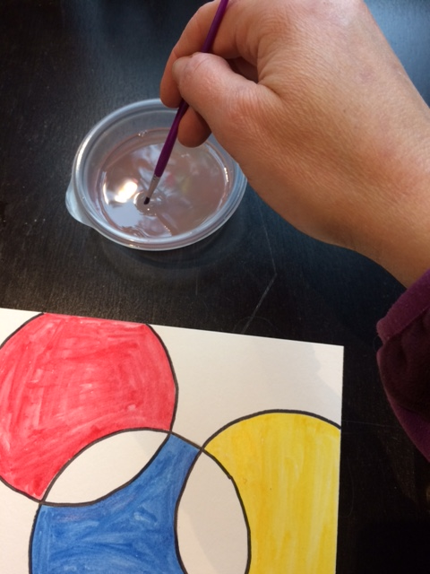
Now we’ll mix a secondary color: Orange
Using your brush and some water, put some red paint onto your palette.
Rinse Your Brush.
Then using your brush and water put some yellow paint into the same area.

Slide 13
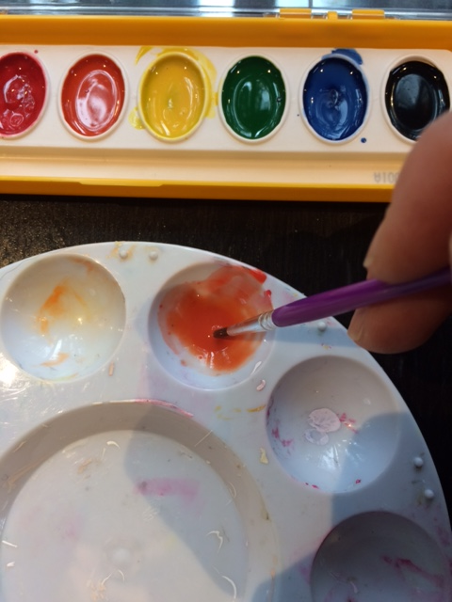
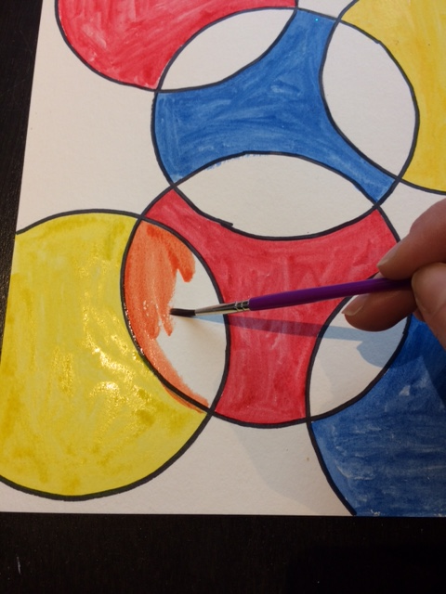
Mix together.
Paint the areas where the yellow and red circles overlap.

Slide 14
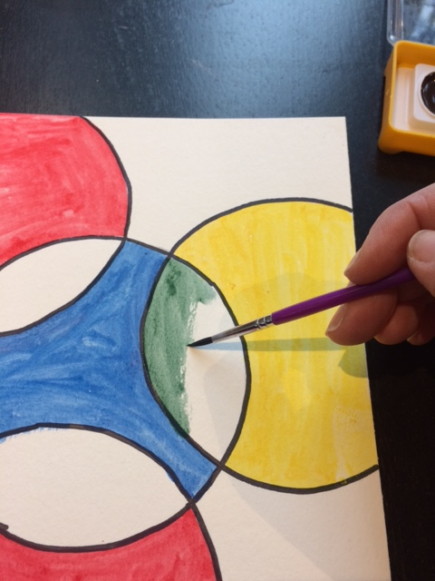
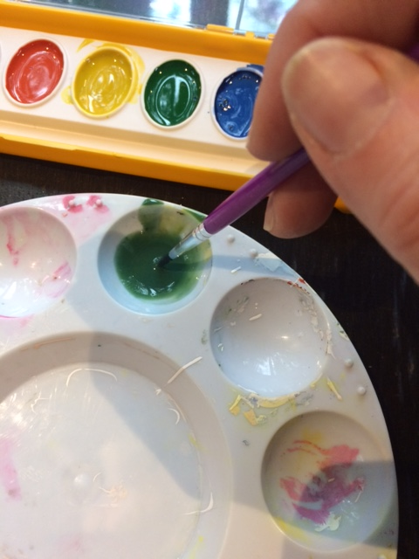
Now mix green
Use Blue and Yellow to mix Green.
Paint the area where the Blue and Yellow circles overlap.

Slide 15
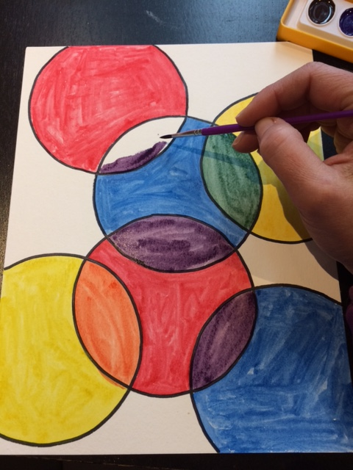
Now Mix Purple
Paint the overlap between the Blue and Red circles.

Slide 16
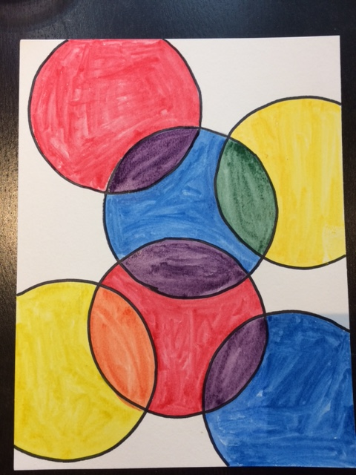
You’re Finished

