Slide 1
Kites across the sky

Slide 2
Kites were invented in China, where materials ideal for kite building were readily available including silk fabric for sail material; fine, high-tensile-strength silk for flying line; and resilient bamboo for a strong, lightweight framework. ... The earliest known Chinese kites were flat (not bowed) and often rectangular. (206 B.C.-220 A.D.)

Slide 4
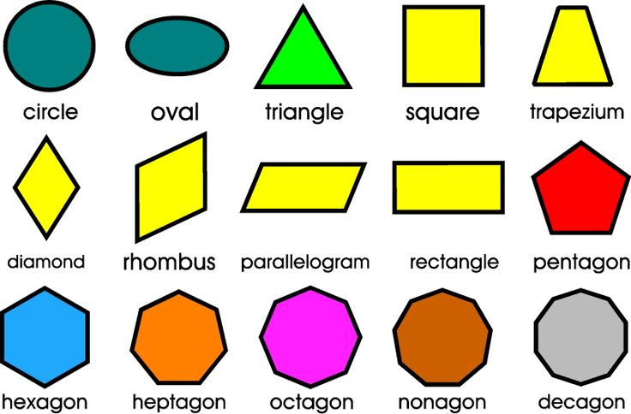
Geometric and Organic Shapes
Here are some examples of geometric shapes.
When a line connects, it creates a shape. Shapes are two dimensional objects containing length and width. They have precise edges.

Slide 5
Organic Shape
Organic Shapes are commonly found in nature. They do not contain straight edges. Examples of organic shapes are…

Slide 6
Today we will be creating colorful kites using both organic and geometric shapes.
In our example artwork, what object is an organic shape? How about a geometric shape?

Slide 7
FIRST:
Crumple up a paper towel and dip into the white tempura paint. Add the paint onto your blue paper creating clouds. Use a circular movement around the paper.

Slide 8
While the background is drying, begin drawing your geometric kite shapes. Remember, kites come in all different shapes. The most common shape is a diamond. Think of it as 2 triangles.
Use your pencil and draw your shapes onto your black cardstock. Let’s start with 2 diamond shape kites. Try to make them different sizes.

Slide 10
Use your chalk pastels to add color and details to your shapes. Glue them onto your blue background paper up high in the sky. Imagine what direction the wind is blowing. Should the kites all be flying in the same direction? Why?
Add kite strings in all different colors trailing down.

Slide 12
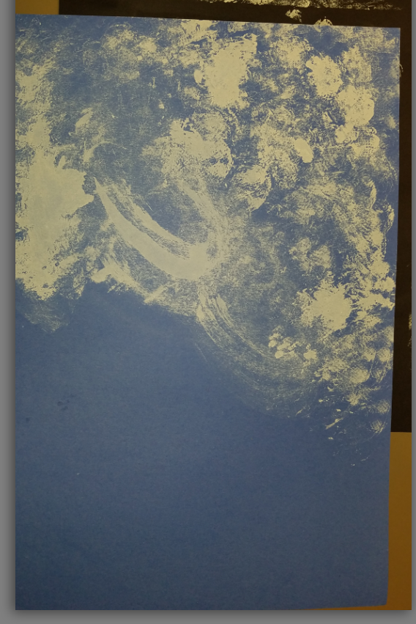
Unconventional Painting tools

Slide 13
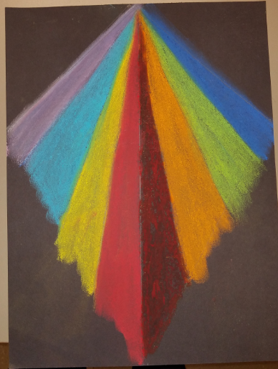
Make Kites
We are going to make 3 kites
1 Big
1 small
1 different shape
Draw your kites with Pencil.
Cut out each kite
Color each kite with Pastel Chalks

Slide 14
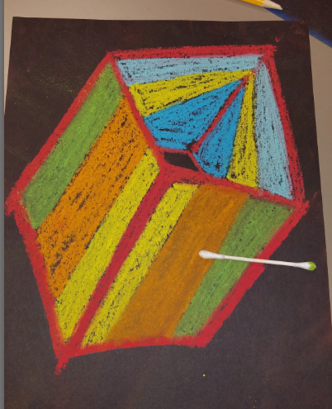
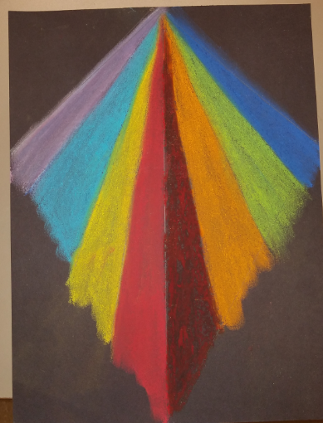
Using Pastel Chalks
Smudges easy!
BLOW the dust off – DO NOT WIPE
Use Q-tip to blend colors (or fingers)

Slide 15
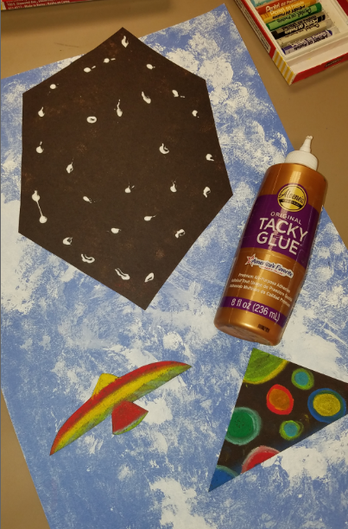
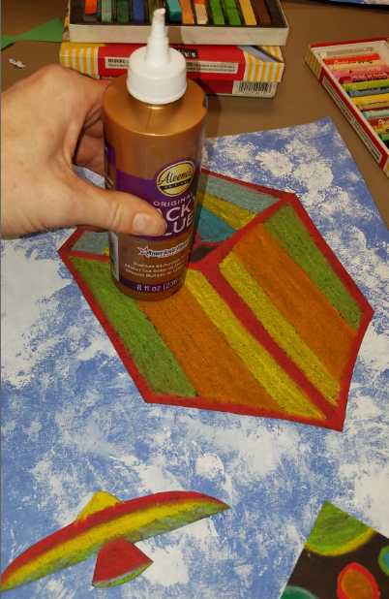
Glue the Kites to Background
Using Tacky Glue.
Small dots of glue
Use an object to push down the kite onto the paper. (DO NOT RUB)

Slide 16
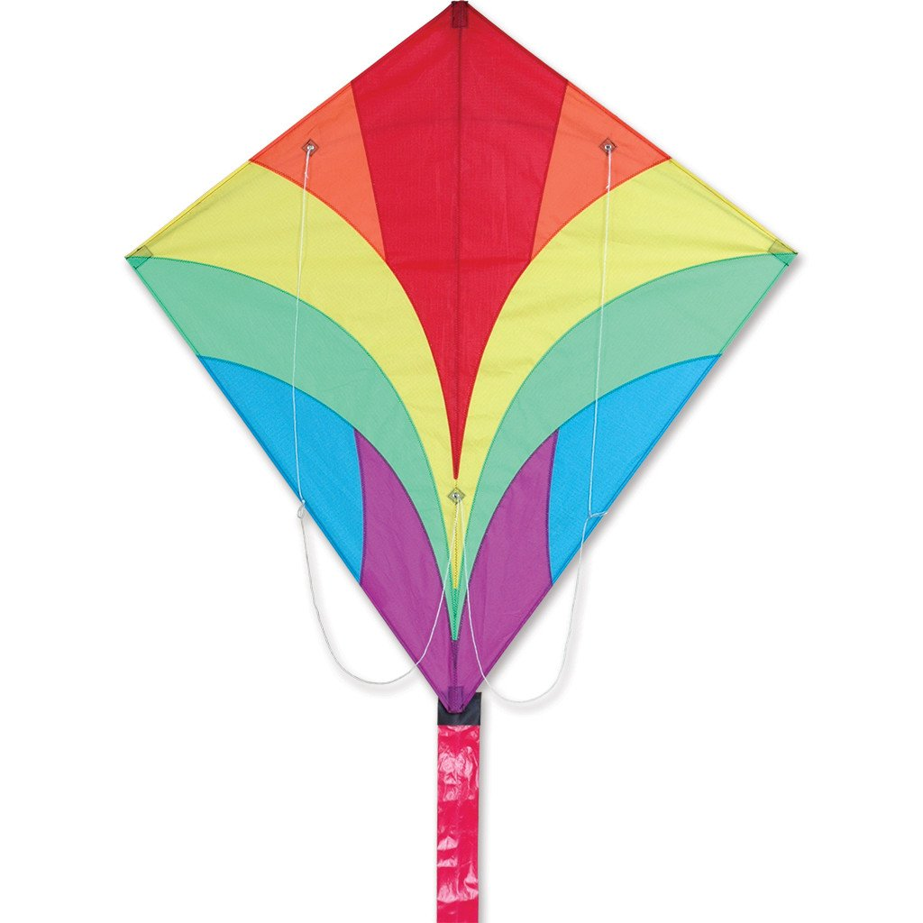
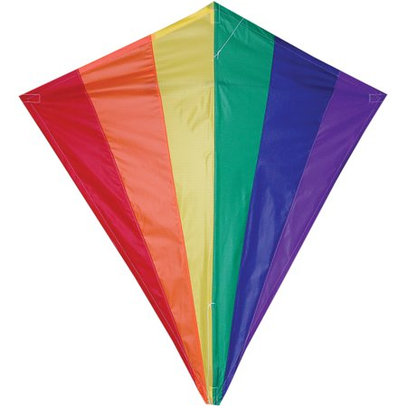
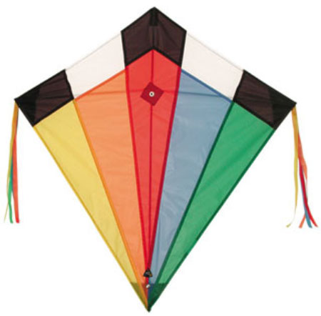
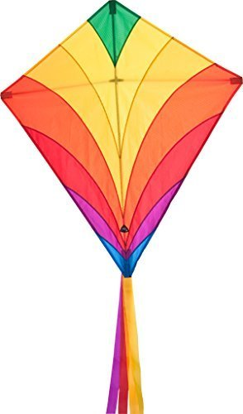
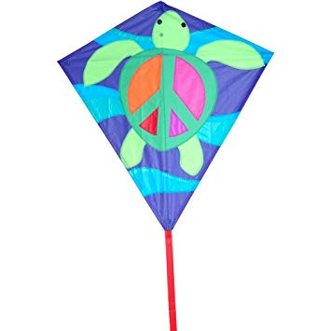
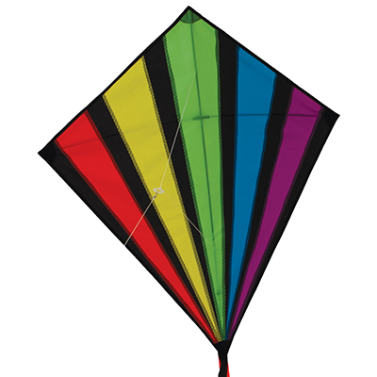
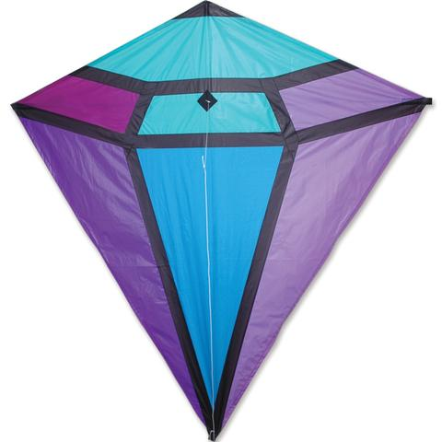
Ideas

Slide 17
