Slide 1
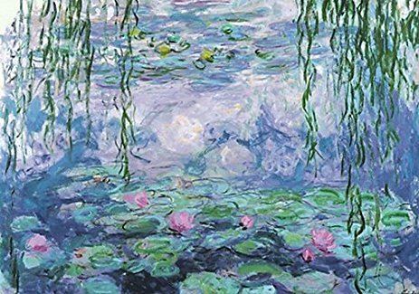
Water Lilies
Inspired by the paintings of Claude Monet

Slide 2
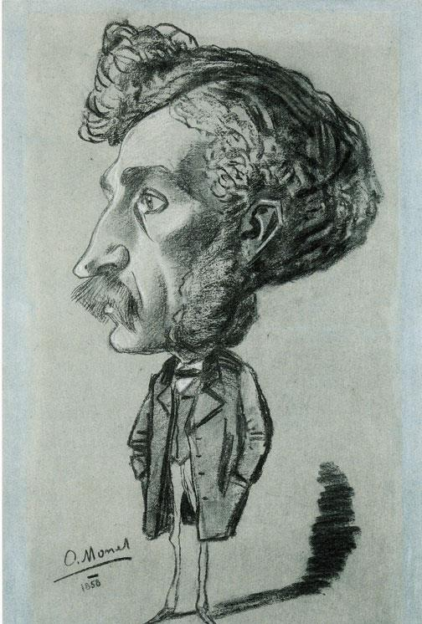
CLAUDE MONET (1840-1926)
Claude Monet was born on November 15, 1840 in France
He loved to draw as a child. He began drawing funny pictures of people that were quite good. →
At age 11, Claude went to a school for the arts. Claude met some other artists and began to use oil paints to paint the outdoors.

Slide 3
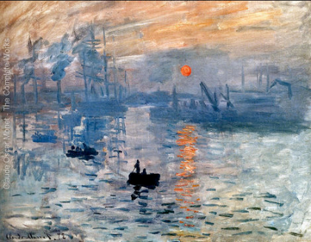
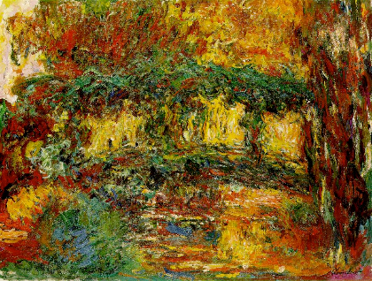
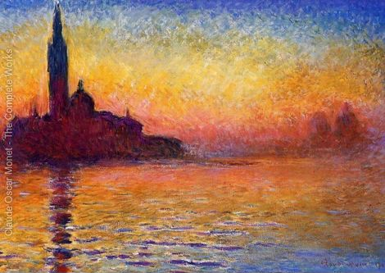
Impressionism
Later in life, Monet became known as an "Impressionist.” Impressionist paintings have an unfinished look, which was very different from the paintings of artists who lived before him.
Impressionsism: Using many short brush strokes, applying paint thickly, to create the idea, or impression, of a subject

Slide 4
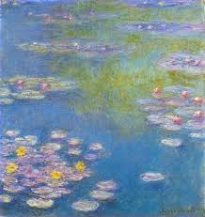
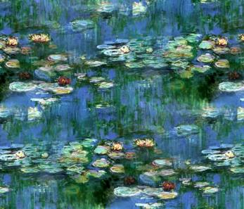
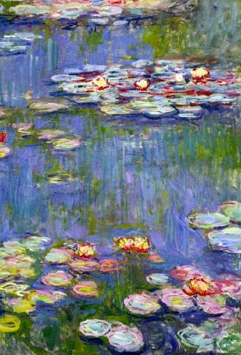
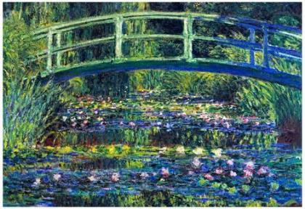
Water Lilies
Monet painted the lily pond at his home in Giverny, France over and over again. He liked painting the same scene in different seasons or times of day. In fact, he painted over 250 paintings in his Water Lilies series.

Slide 5
Let’s Make a 3-Dimensional Water Lily
Session 1
Create 3 different parts of Water Lily
Session 2
Cut and assemble pieces of Water Lily

Slide 6
SESSION 1: 3 Stations to make each part of the Water Lily

Slide 7
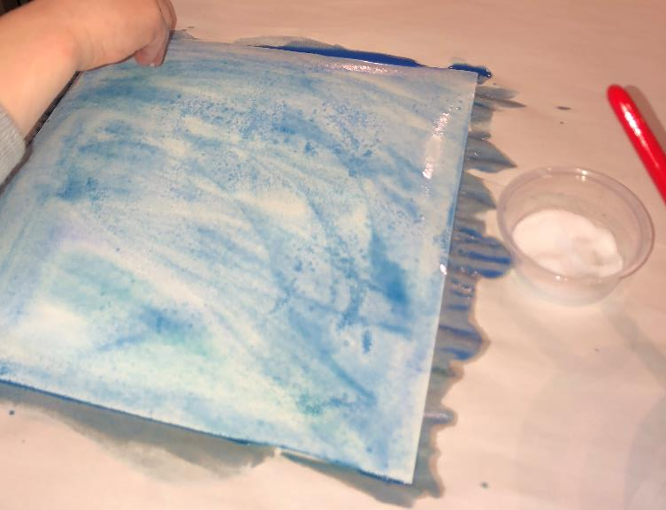
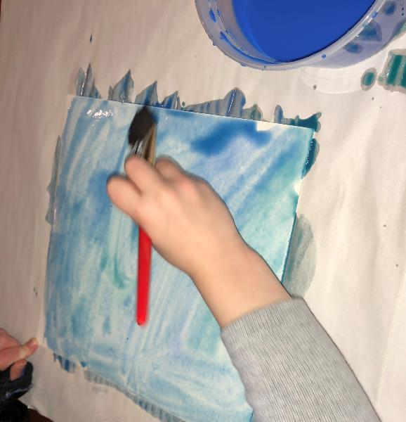
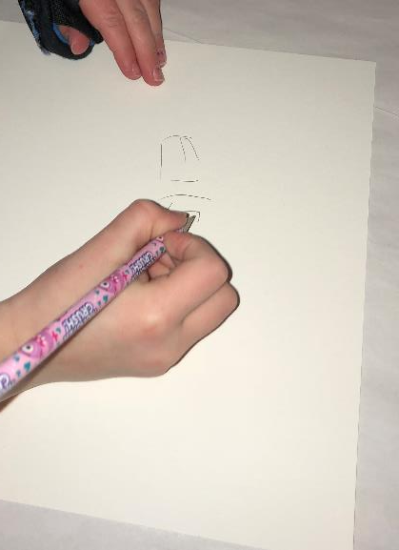
Blue Background
Materials:
9” x 9” piece of water color paper
Blue water color
Large water color paint brushes
Salt
Pencil
Directions:
Write name on paper with pencil.
Flip paper over.
Paint all over with blue water color. No white spaces.
Sprinkle (just one or two pinches) with salt.
Place on drying rack.

Slide 8
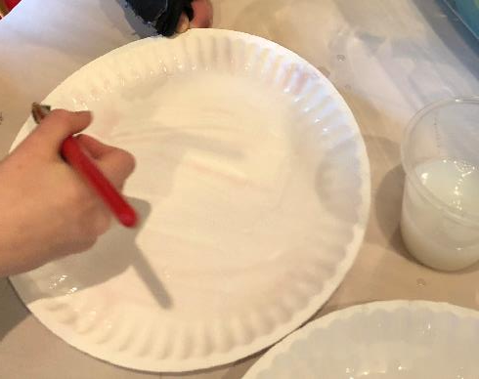
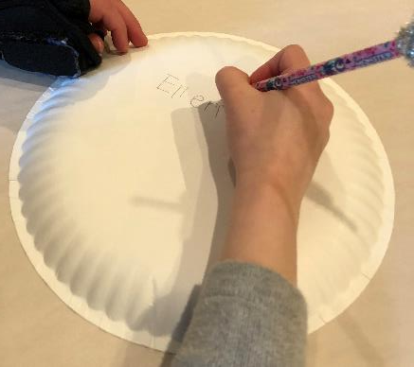
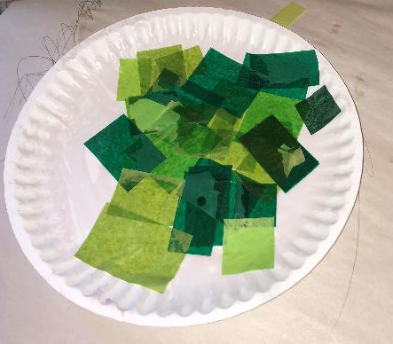
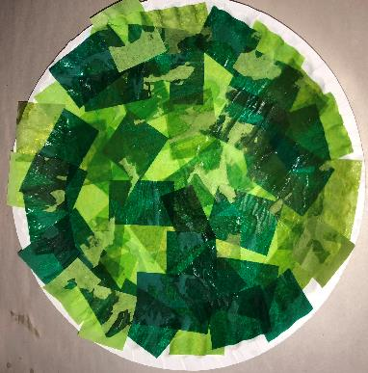
Green Lily Pad
Materials:
Paper plate
Green tissue paper rectangles
Large paint brushes
Sta-Flo
Pencil
Directions:
Write name on back of paper plate with pencil.
Flip paper plate over.
Paint all over with Sta-Flo.
Stick green rectangles to plate in a random arrangement.
Use more Sta-Flo if needed. Do not use too much or it will take a long time to dry.
Cover all white space with green tissue paper.
Place on drying rack.

Slide 9
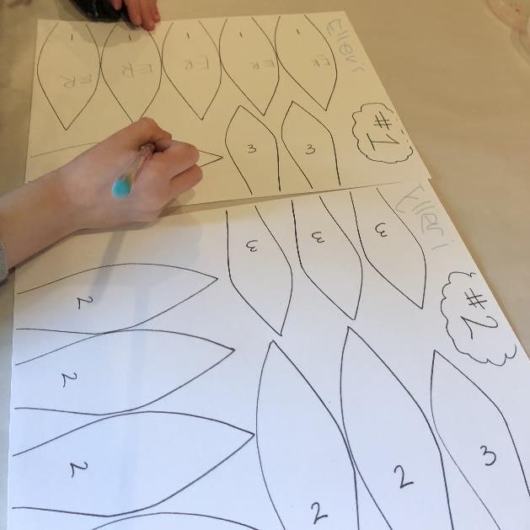
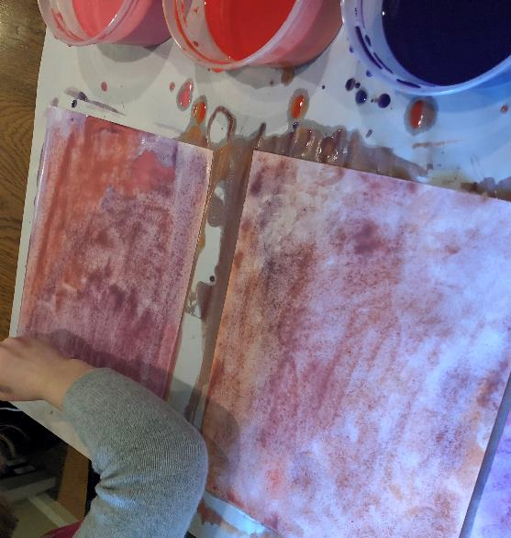
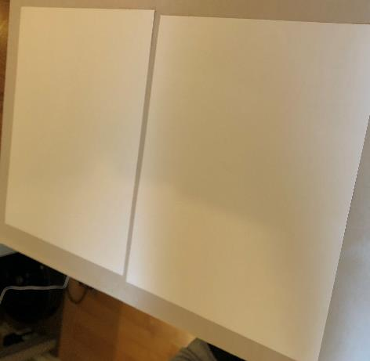
Pink, Orange, and Purple Petals
Materials:
2 papers with petal shapes - #1 and #2
Pink, orange, and purple water color
Large water color paint brushes
Pencil
Directions:
Write name on back of each paper with pencil.
Write initials on each petal.
Flip papers over to blank sides.
Paint all over with any combination of pink, orange, and purple water color. Cover all white space.
Place on drying rack.

Slide 10
SESSION 2: Assembly
Pass back each students’ green paper plate, blue background, and 2 sheets of petals

Slide 11
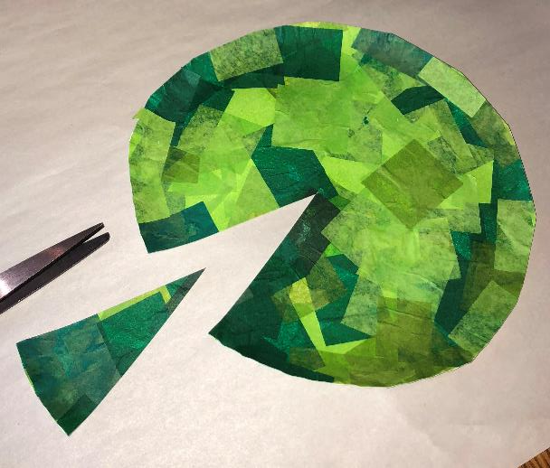
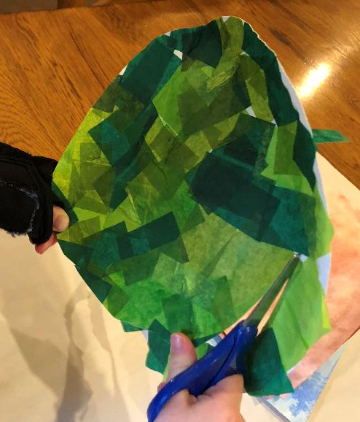
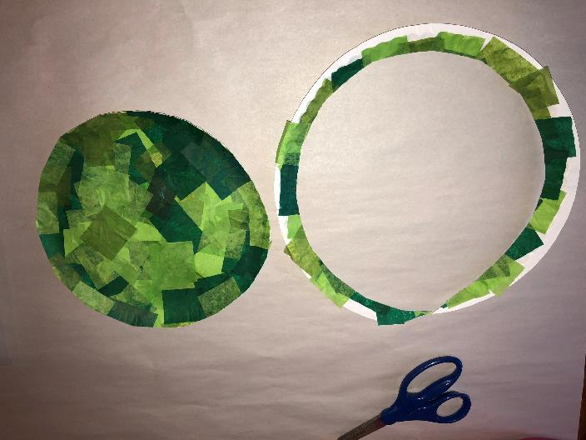
Step 1: Cut Lily Pad
Materials:
Scissors
Green paper plate
Directions:
Cut off edge around green paper plate.
Cut a triangle (pizza slice) from plate.

Slide 12
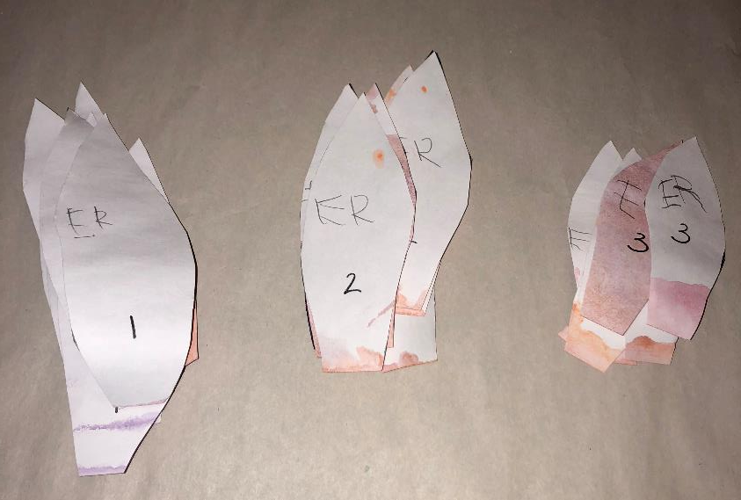
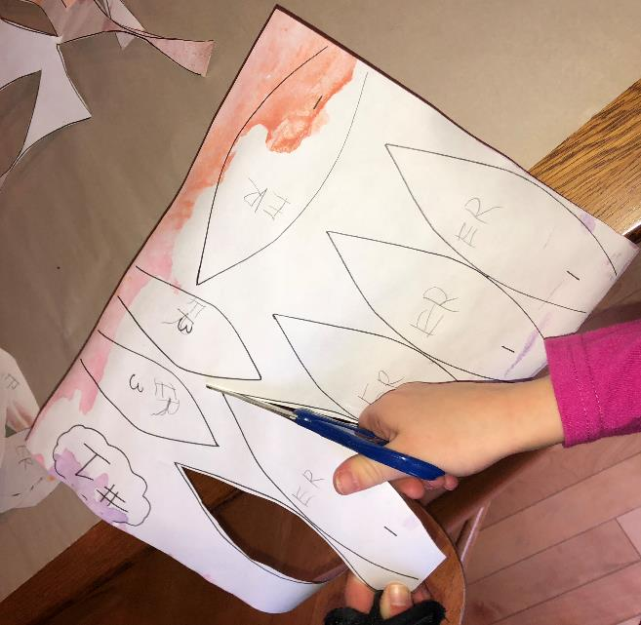
Step 2: Cut Petals
Materials:
Scissors
2 painted sheets of petals
Directions:
Cut all 18 petals out.
Sort in to piles by number – 1, 2, and 3.
You should have 6 petals in each pile.

Slide 13
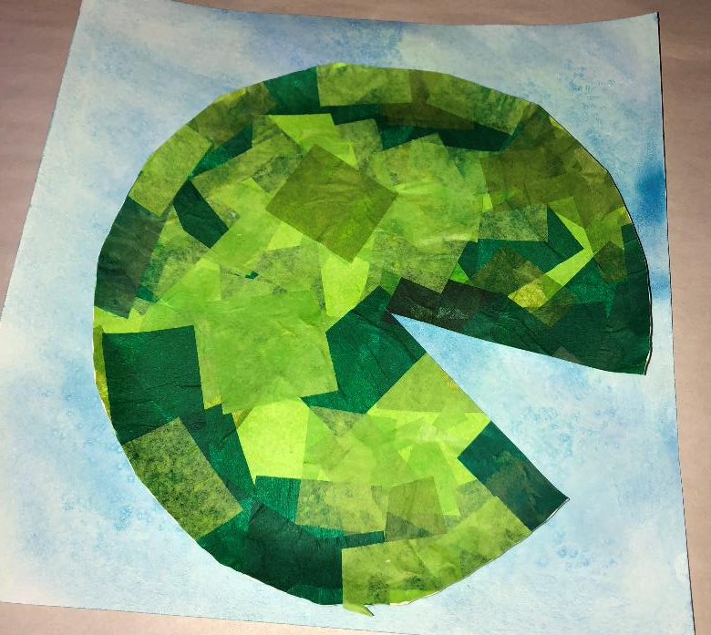
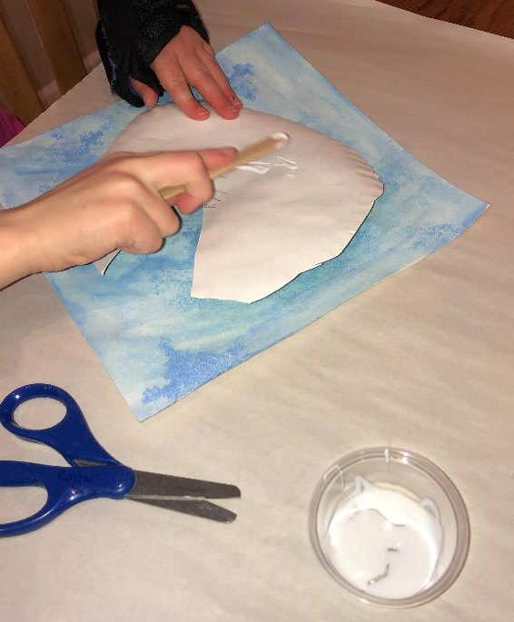
Step 3: Glue Lily Pad to Background
Materials:
Blue Background
Green Lily Pad
Glue
Directions:
Glue Lily Pad to Blue Background

Slide 14
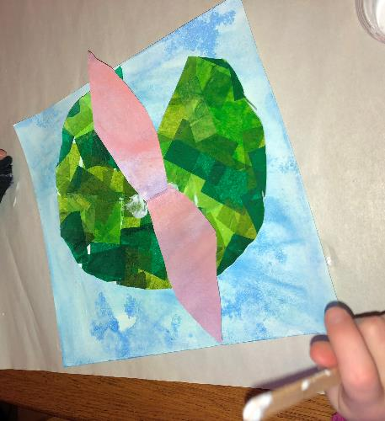
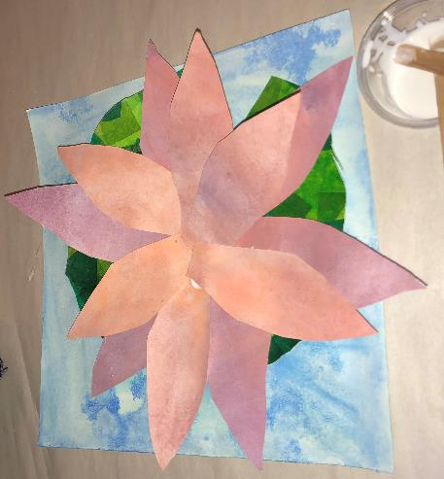
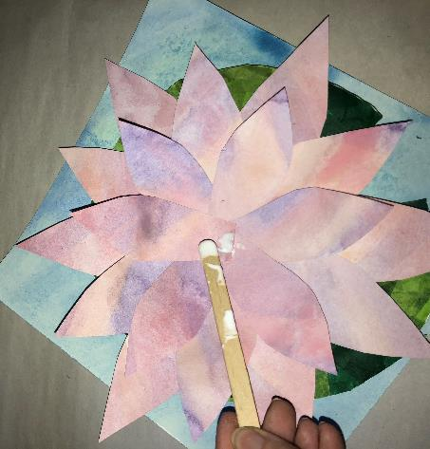
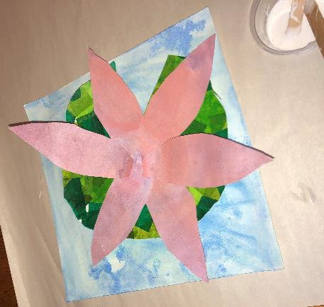
Step 4: Glue Petals
Materials:
Glued Background and Lily Pad
18 Petals
Glue
Directions:
Start with number 1 Petals. Glue 1’s in a circle making a flower. Overlap ends.
Glue 2’s in a circle, overlapping ends in the middle.
Glue 3’s in a circle, overlapping ends in the middle.
1’s
2’s
3’s

Slide 15
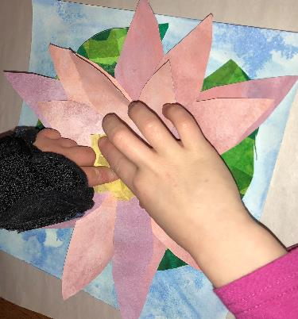
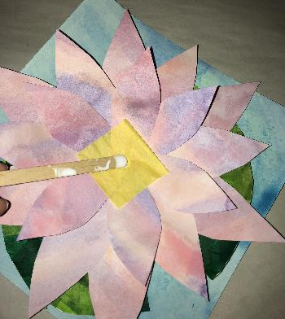
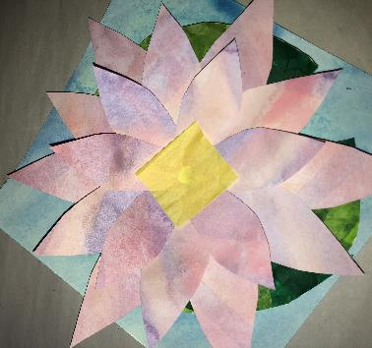
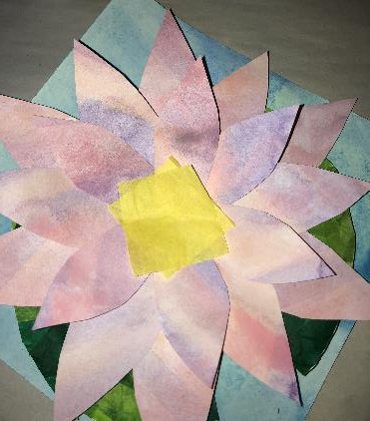
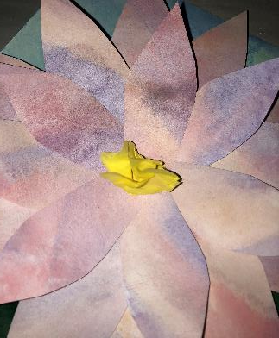
Step 5: Glue Yellow Middle
Materials:
Glued Background, Lily Pad, and Petals
2 pieces of yellow tissue paper
Glue
Directions:
Put a dab of glue in the middle of the flower.
Place one piece of tissue paper on it.
Put another dab of glue in the middle.
Place other piece of tissue paper on it.
Holding in the middle with one finger, scrunch it up.
1’s
2’s

Slide 16
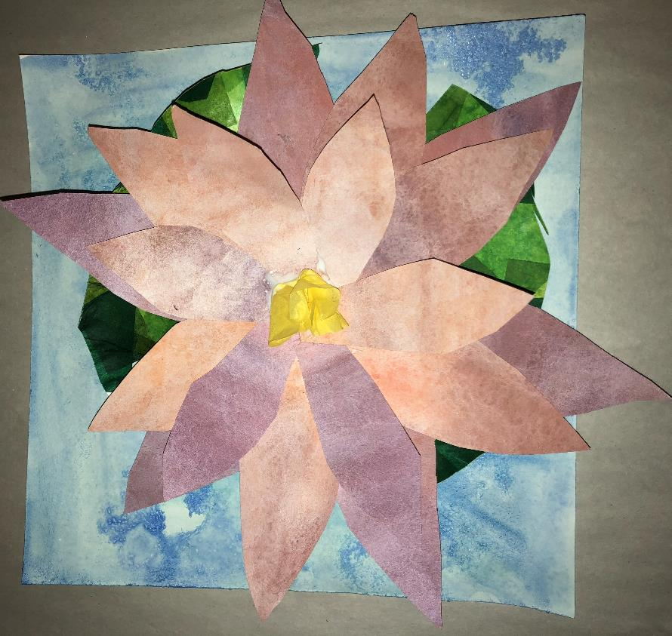
Step 6: Allow to Dry

