Slide 1
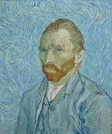
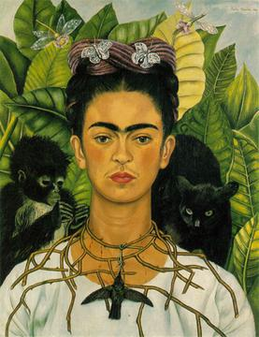
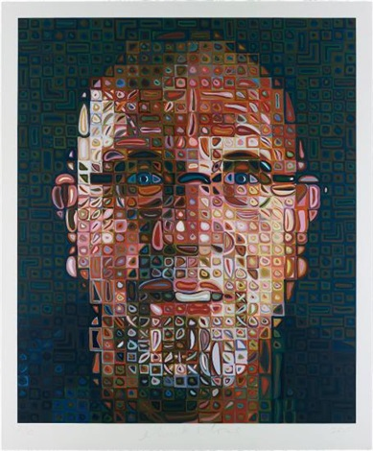
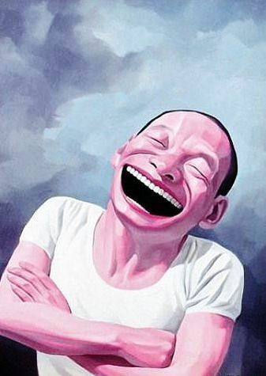
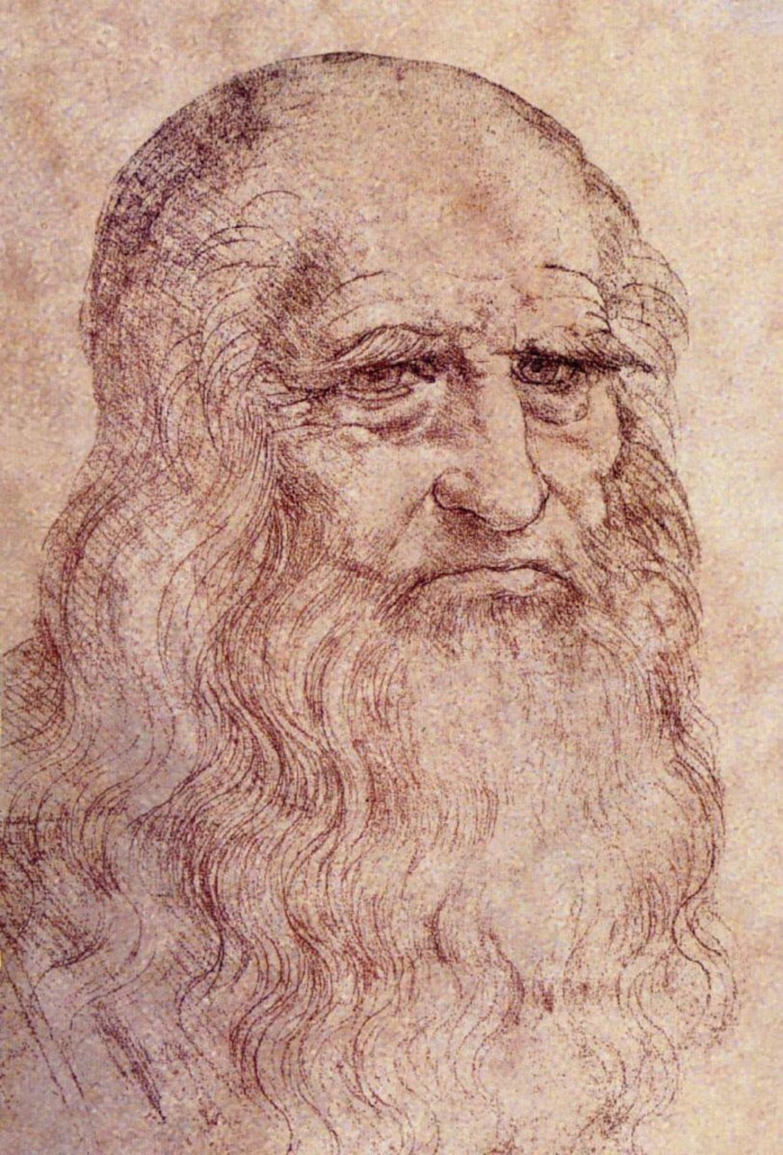
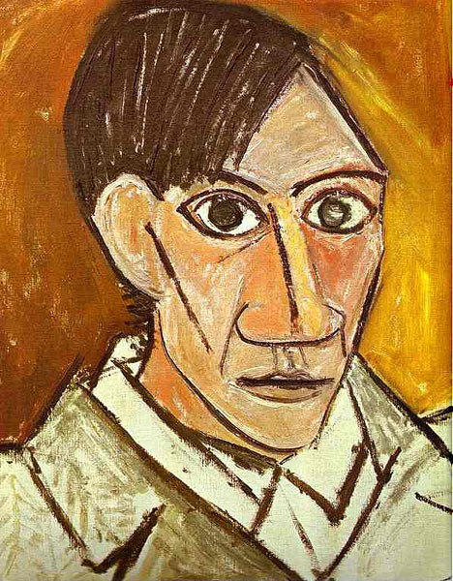
SELF Portrait
A Portrait of the Artist

Slide 2
Inspiration…
Pablo Picasso’s Self Portrait
Look at how Picasso used the Elements of Art in his portrait.
Line
Straight and curved lines, thin and thick lines
Shape
Shape of facial features
Color
Monochromatic (all one color family)
Form
Dimension
Value
Light and dark shades of color
Texture
Look of texture created by brush strokes
Space
Face takes up most of the space on the paper

Slide 3
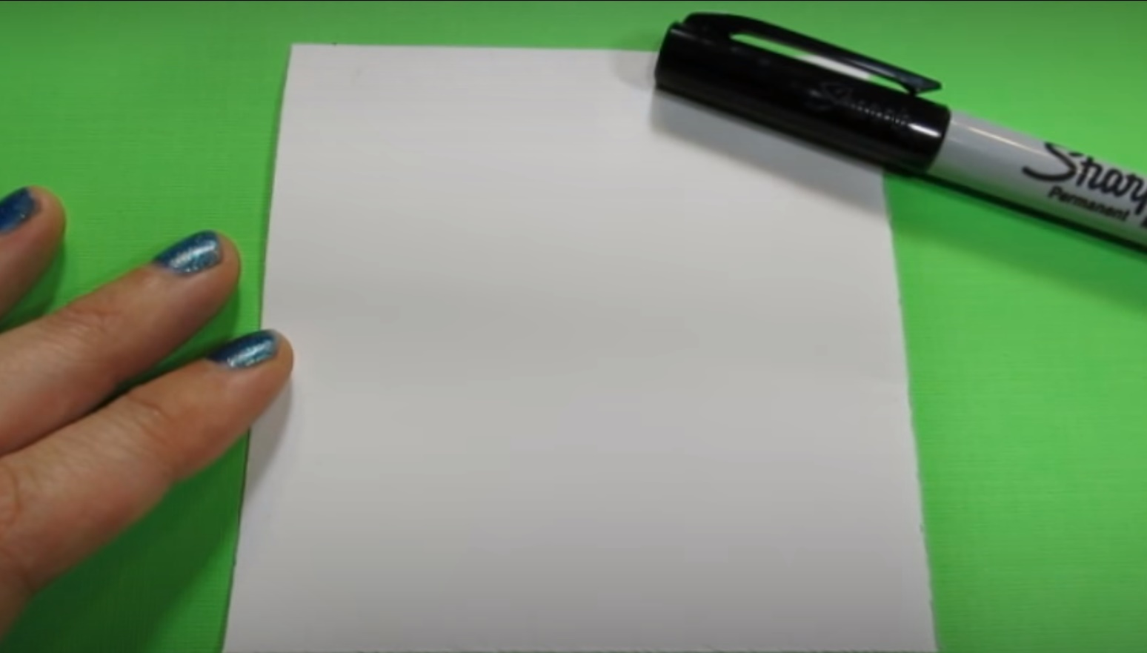
Drawing a Self Portrait
You will each have a square piece of white paper to draw your portrait on.
Everyone in 1st Grade will be creating a self portrait and then they will all be put together to create one large mural.
You will be using a Sharpie to draw your portrait.

Slide 4
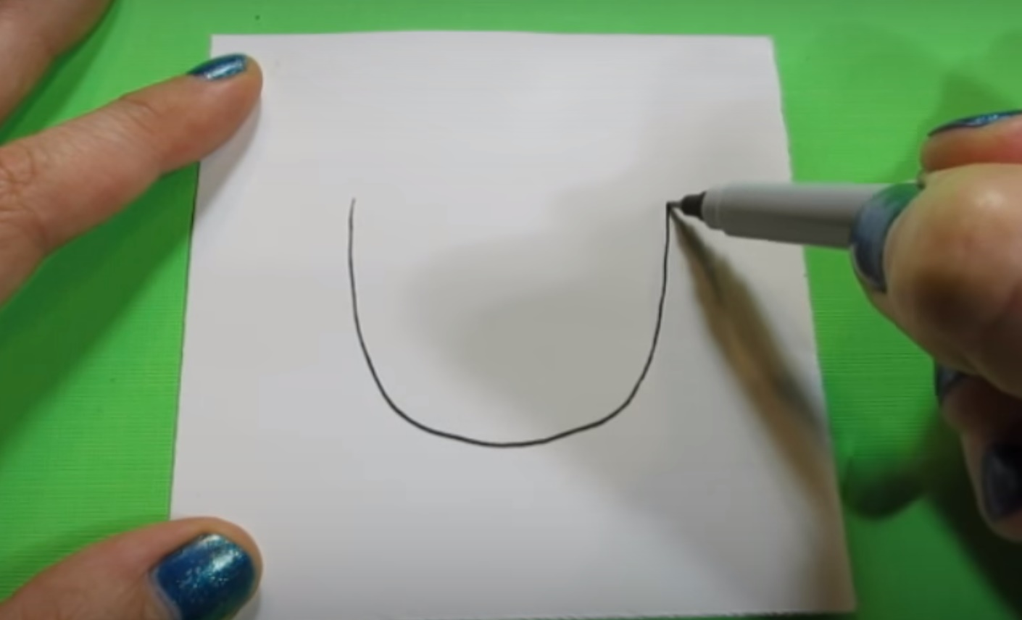
LINE and SPACE
Start by drawing the shape of your face with the Sharpie.
- U-shaped
- Fill a lot of the page
* If you feel like you really need to use a pencil first, draw very lightly and erase after you draw over it with Sharpie.

Slide 5
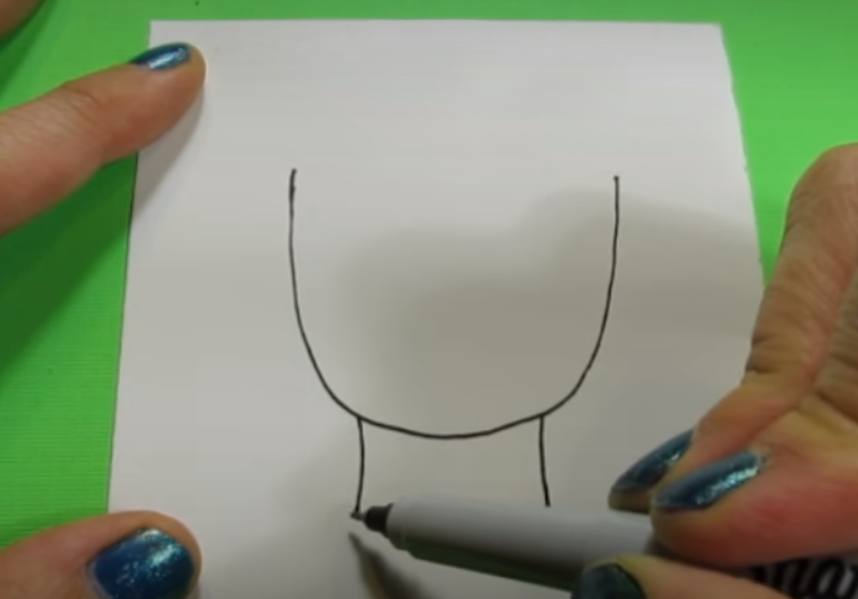
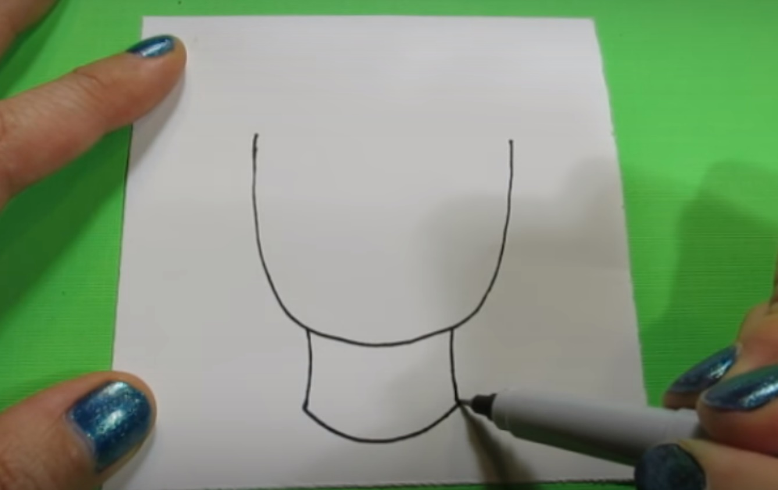
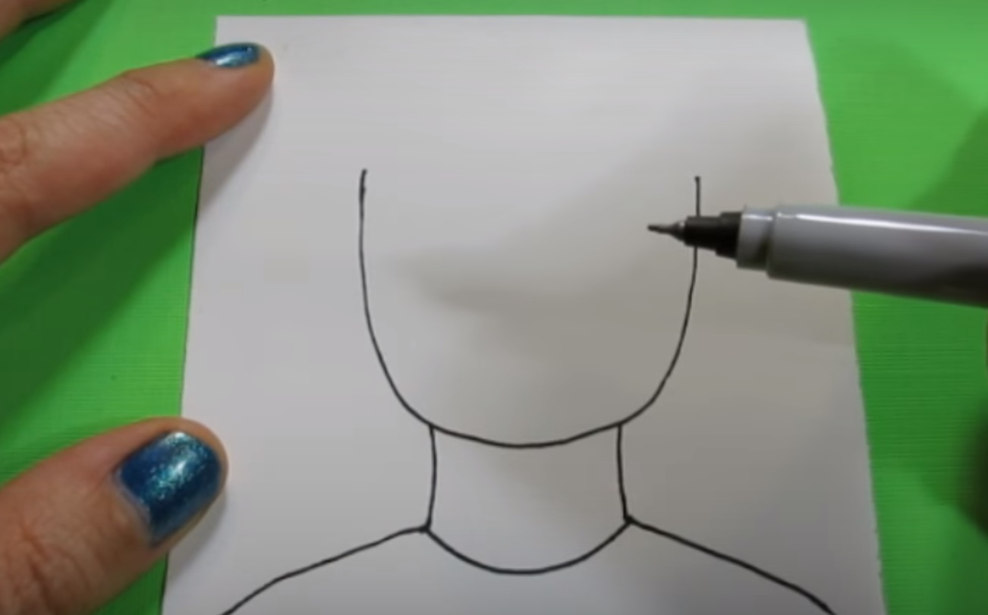
LINE
Draw two vertical lines for your neck.
Draw the neckline of your shirt.
Draw your shoulders.

Slide 6
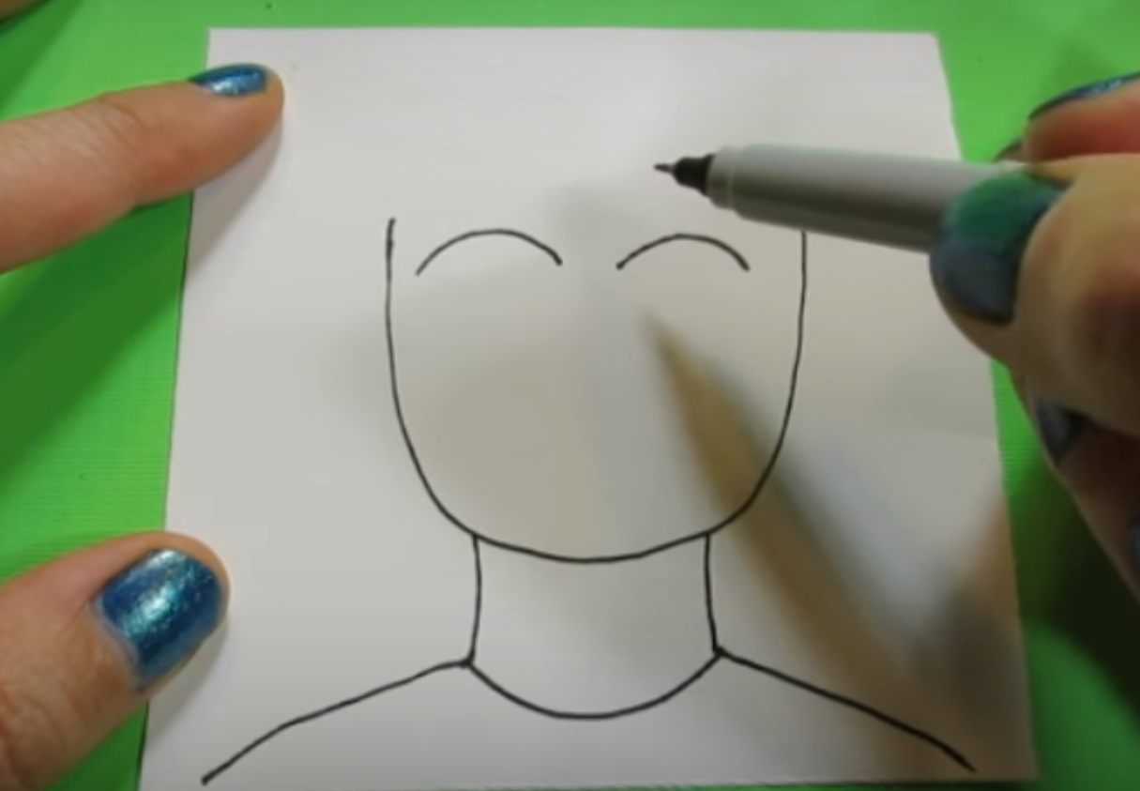
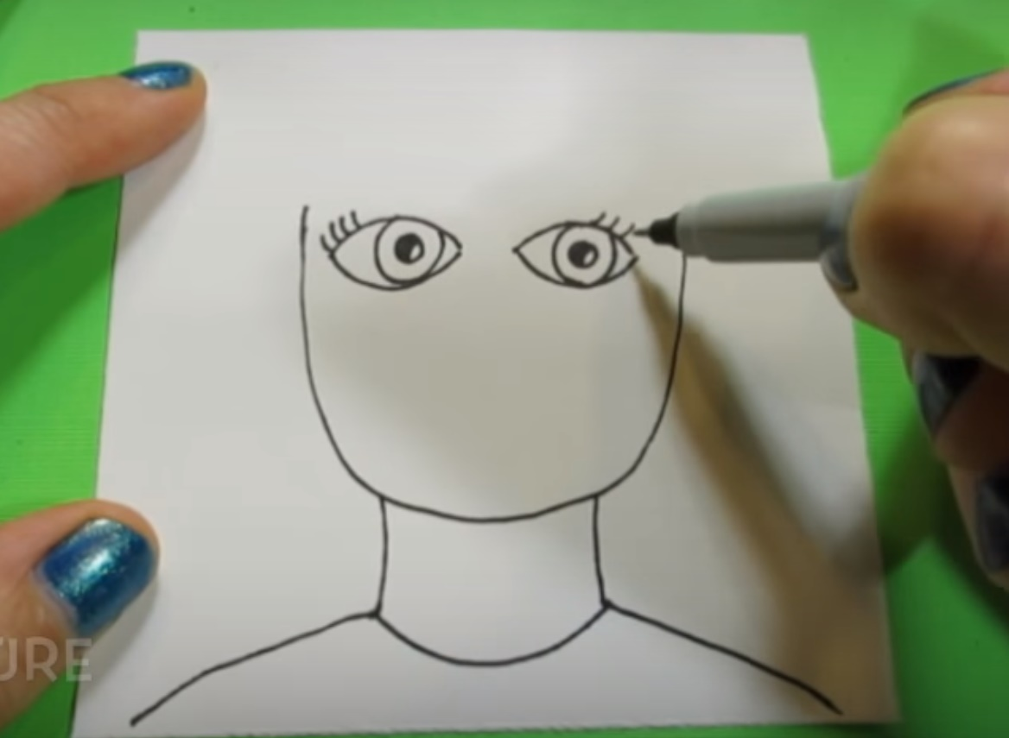
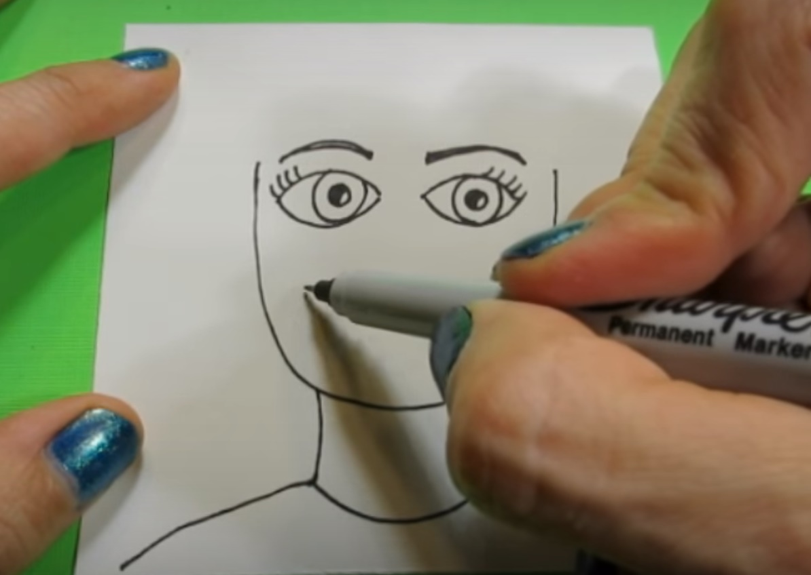
SHAPE and Form
Draw your eyes.
Think about the shape. There are idea sheets on your table for examples.
Add eye brows. They create expression.

Slide 7
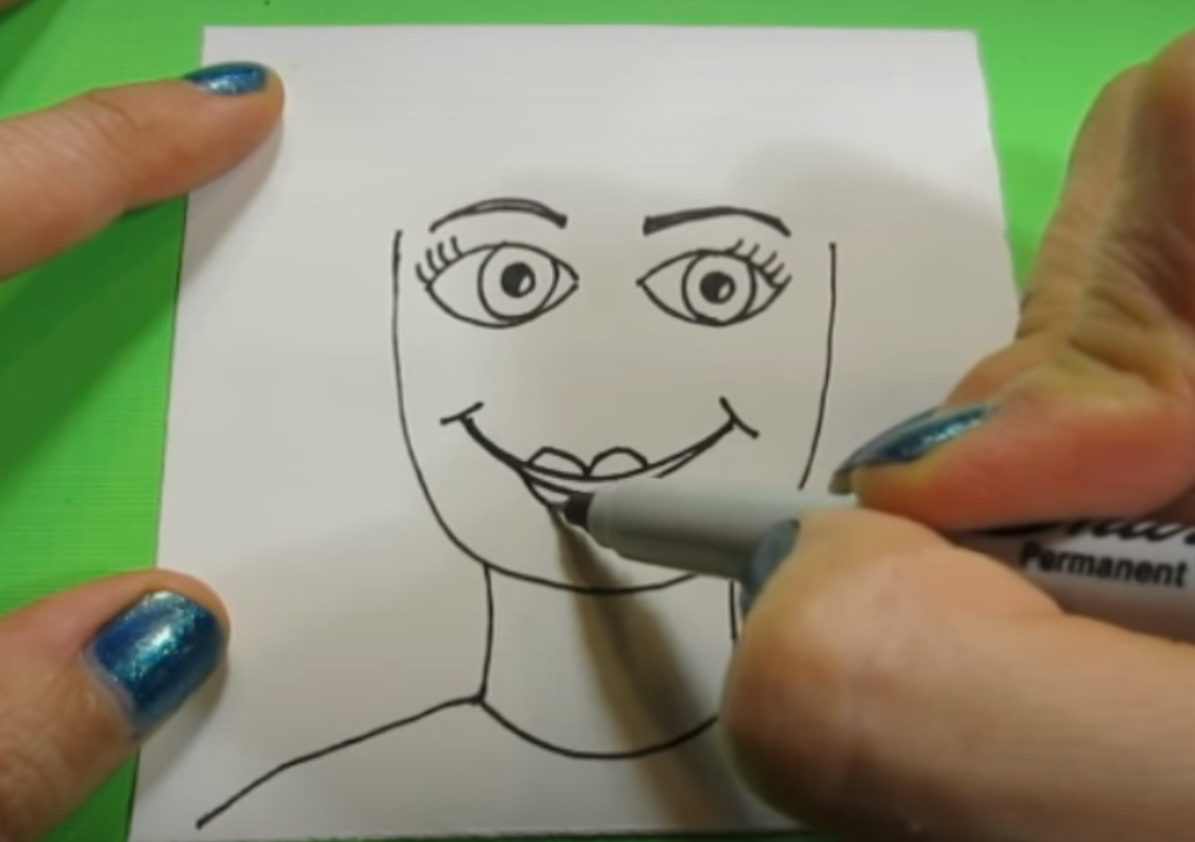
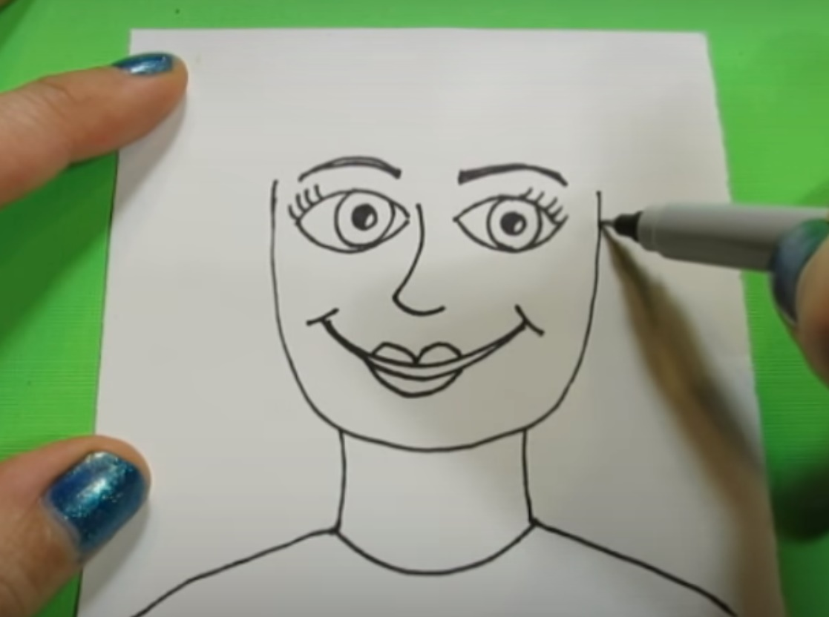
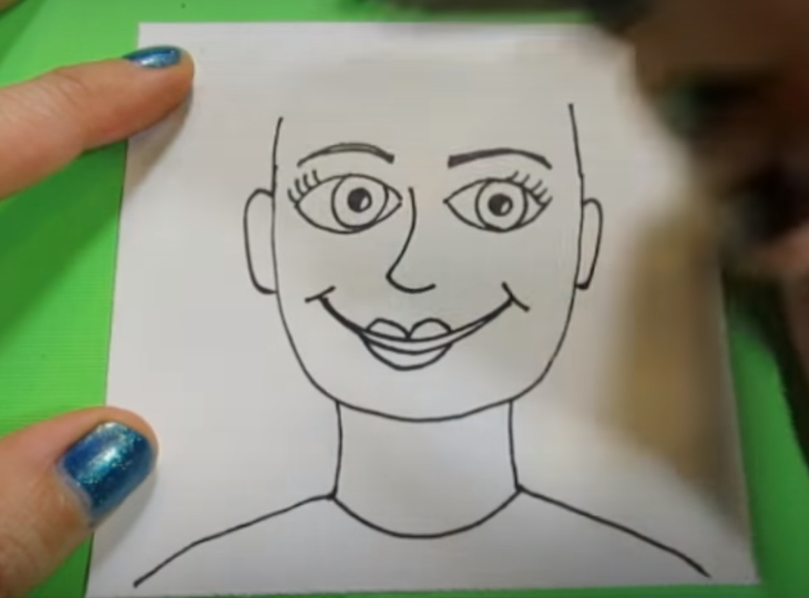
SHAPE
Draw a mouth...
…a nose
…and ears.

Slide 8
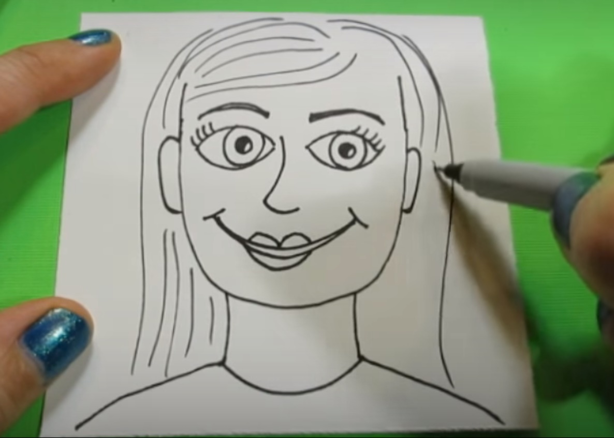
Texture
Draw hair. Don’t color in with the Sharpie. Just draw lines.

Slide 9
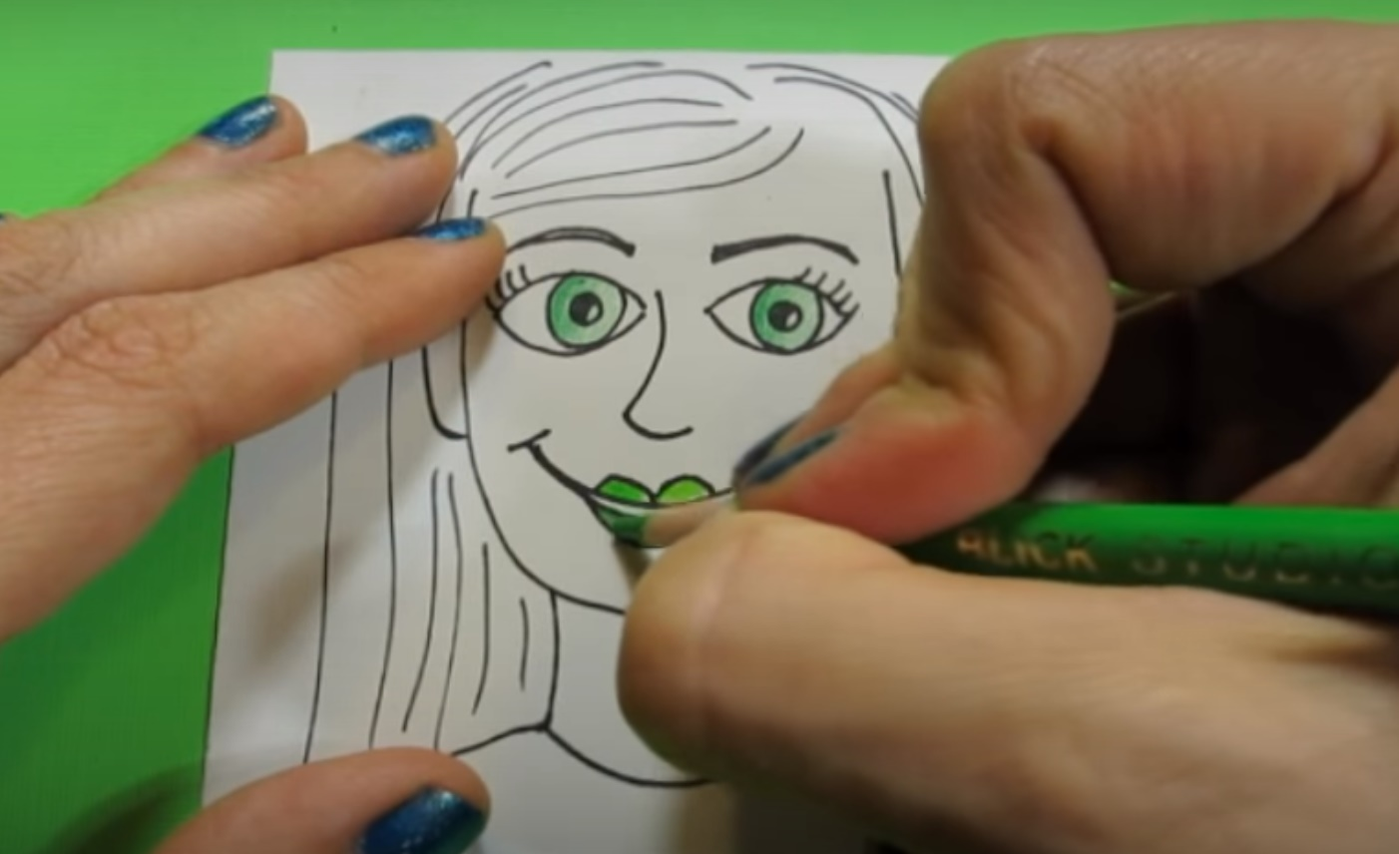
color
Your portraits will be MONOCHROMATIC meaning one color.
You will be using the color of the table you are sitting at.
ONLY USE COLORED PENCIL ON YOUR FACE. Markers can sometimes be too dark and cover details.

Slide 10
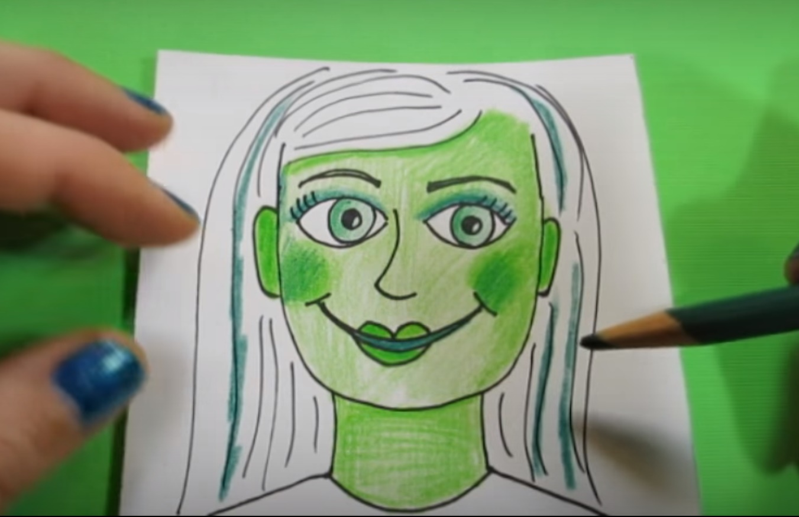
VALUE
You can press a little harder or softer to change the value of your colored pencil.

Slide 11
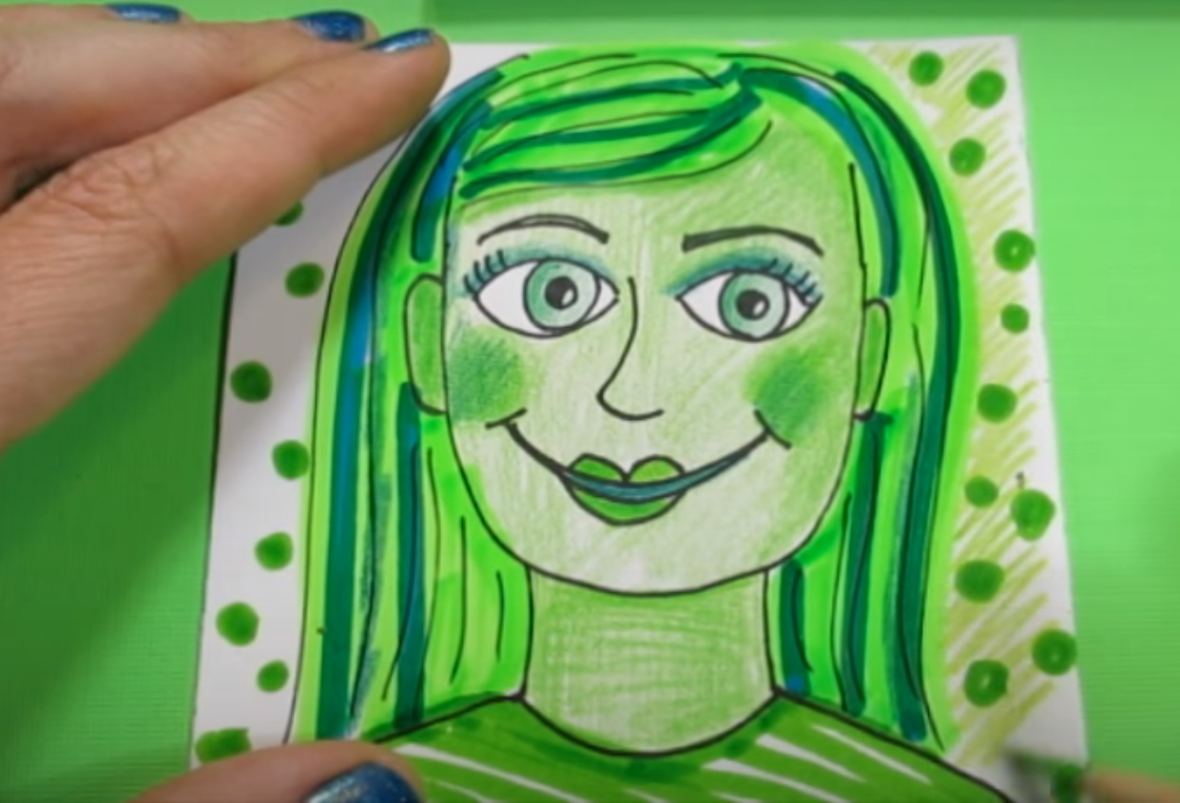
Fill in the Rest of the White Space
Now you may use markers for your hair, shirt, and the background. You can also use colored pencils. You may add a design in your background. NO WHITE LEFT EXCEPT IN EYES.

Slide 12
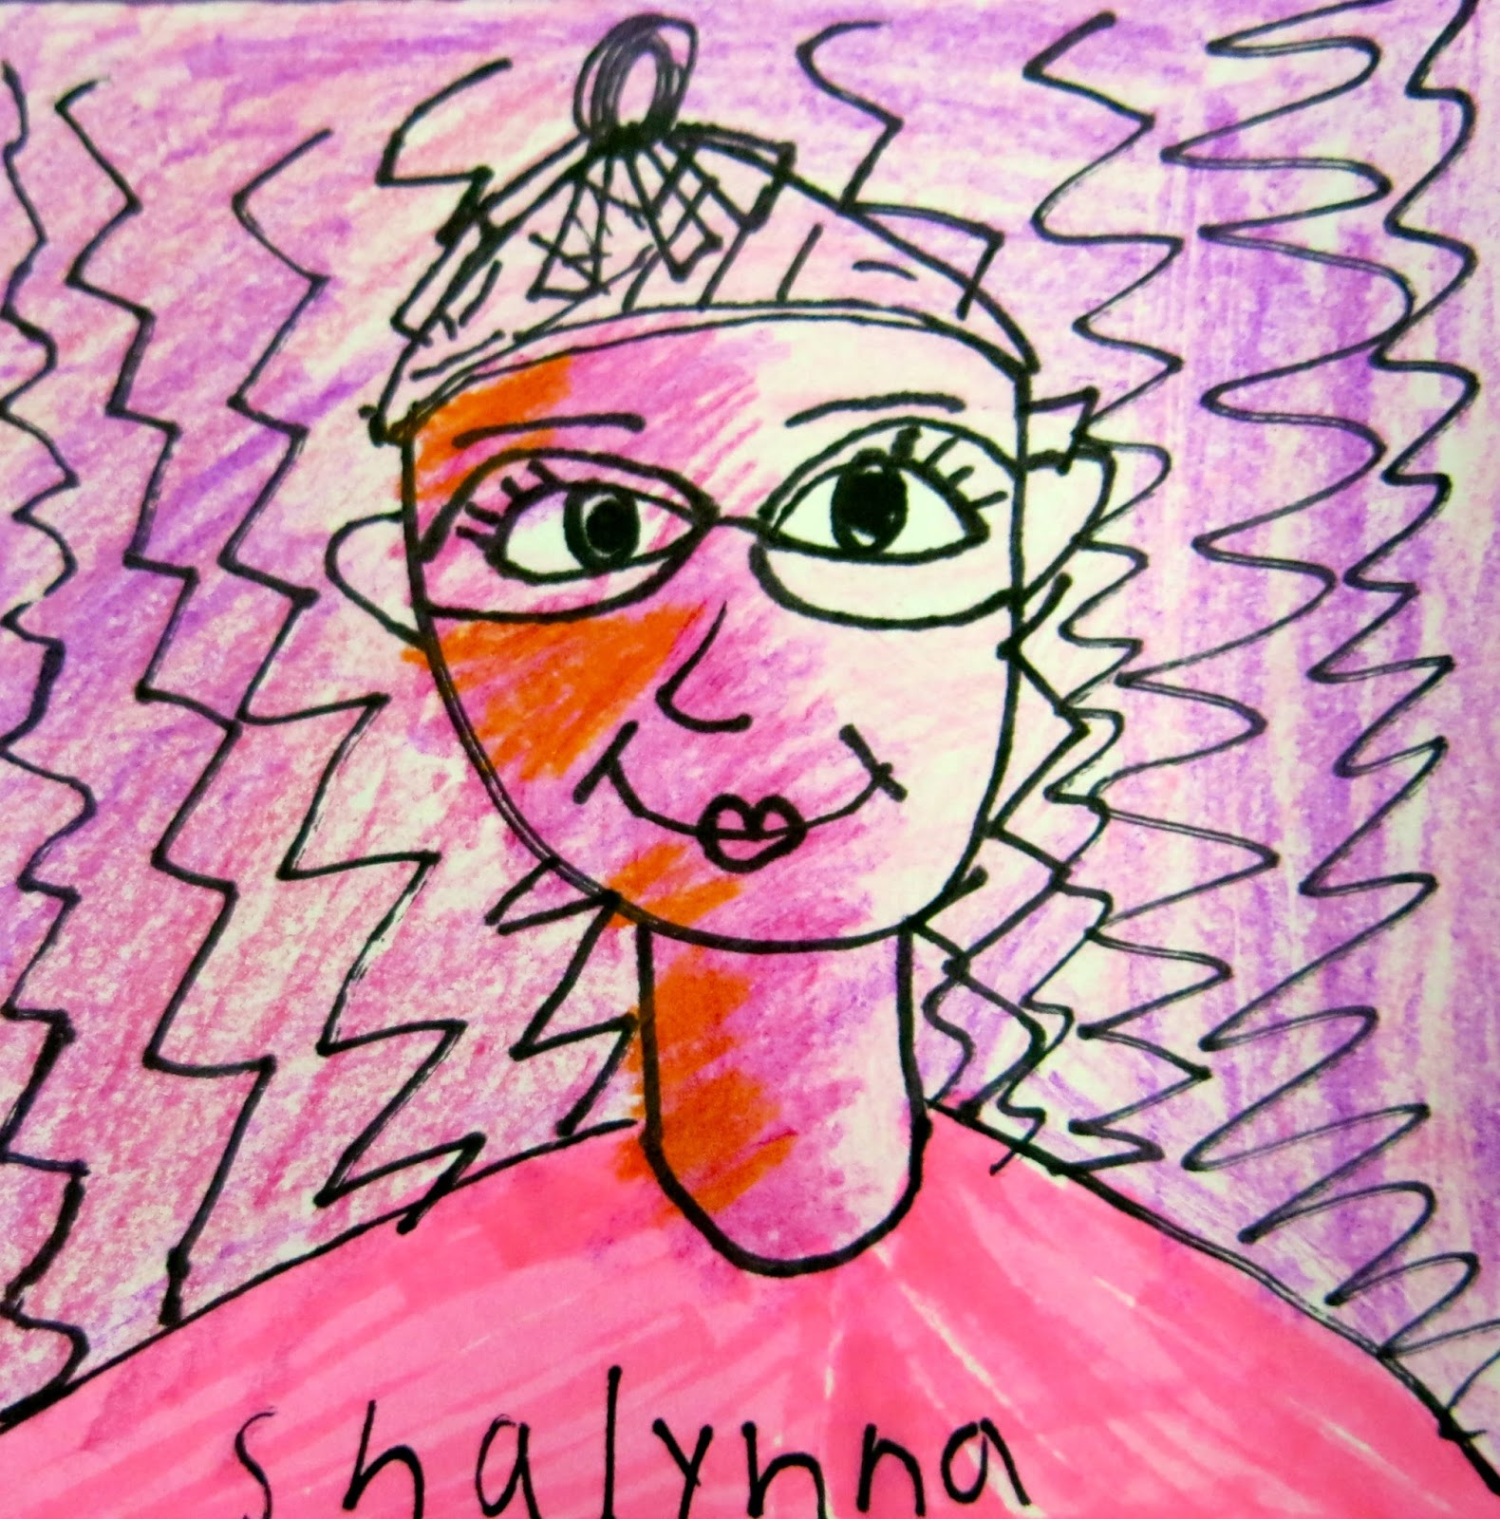
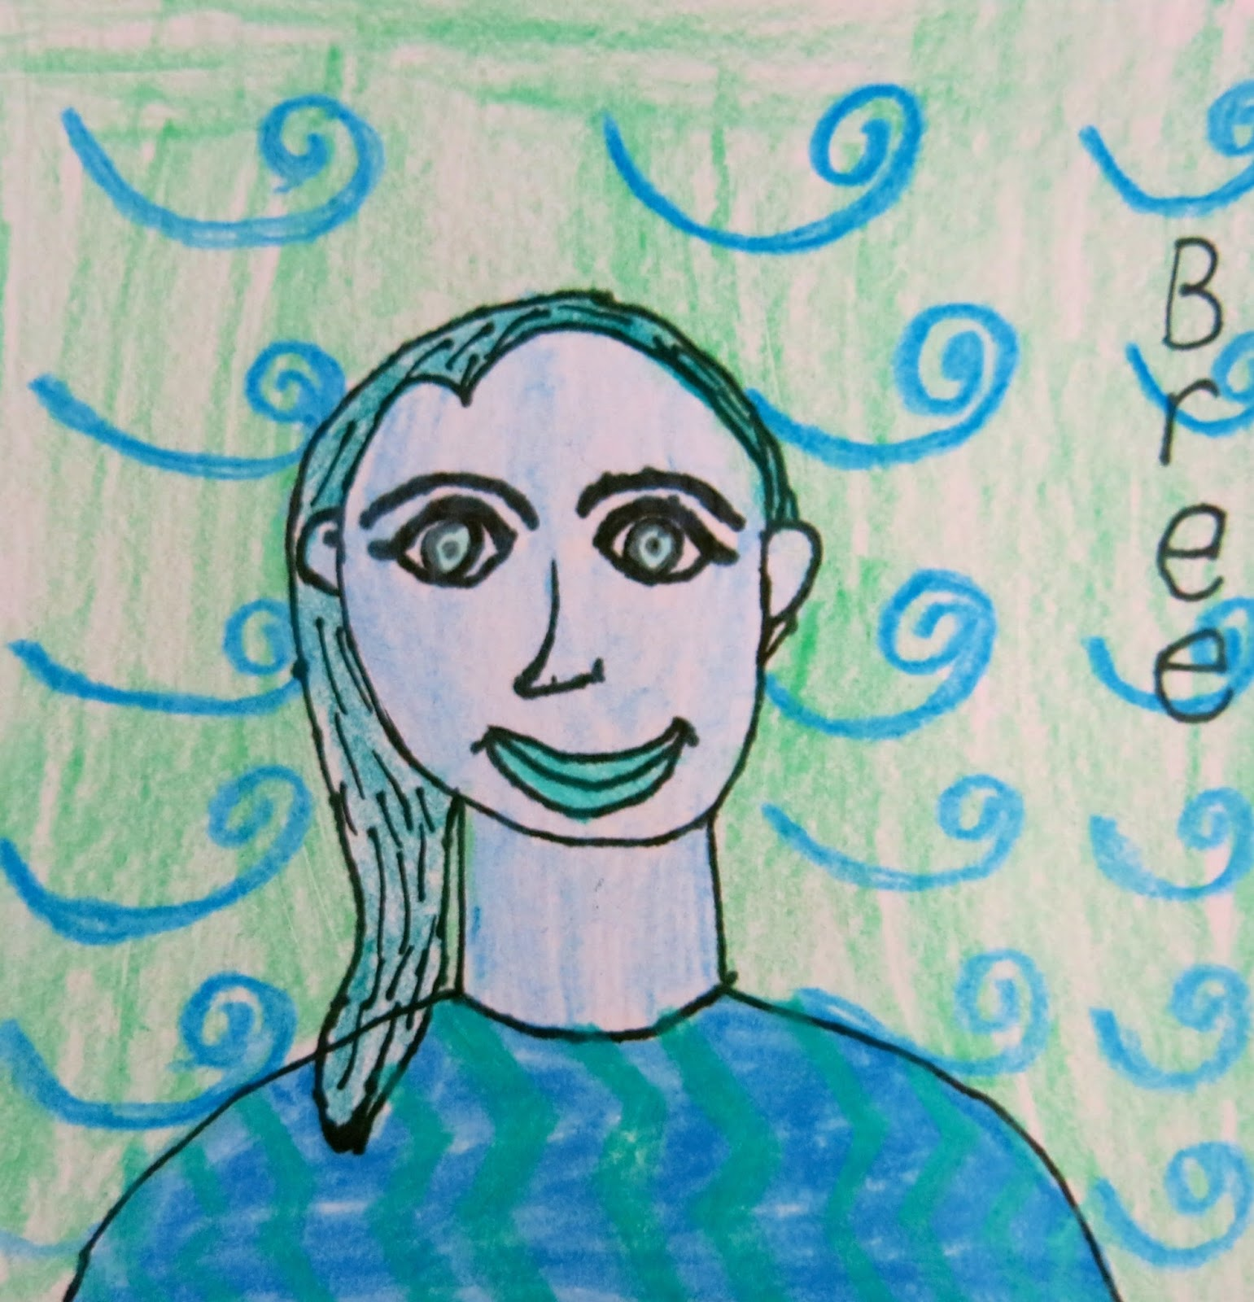
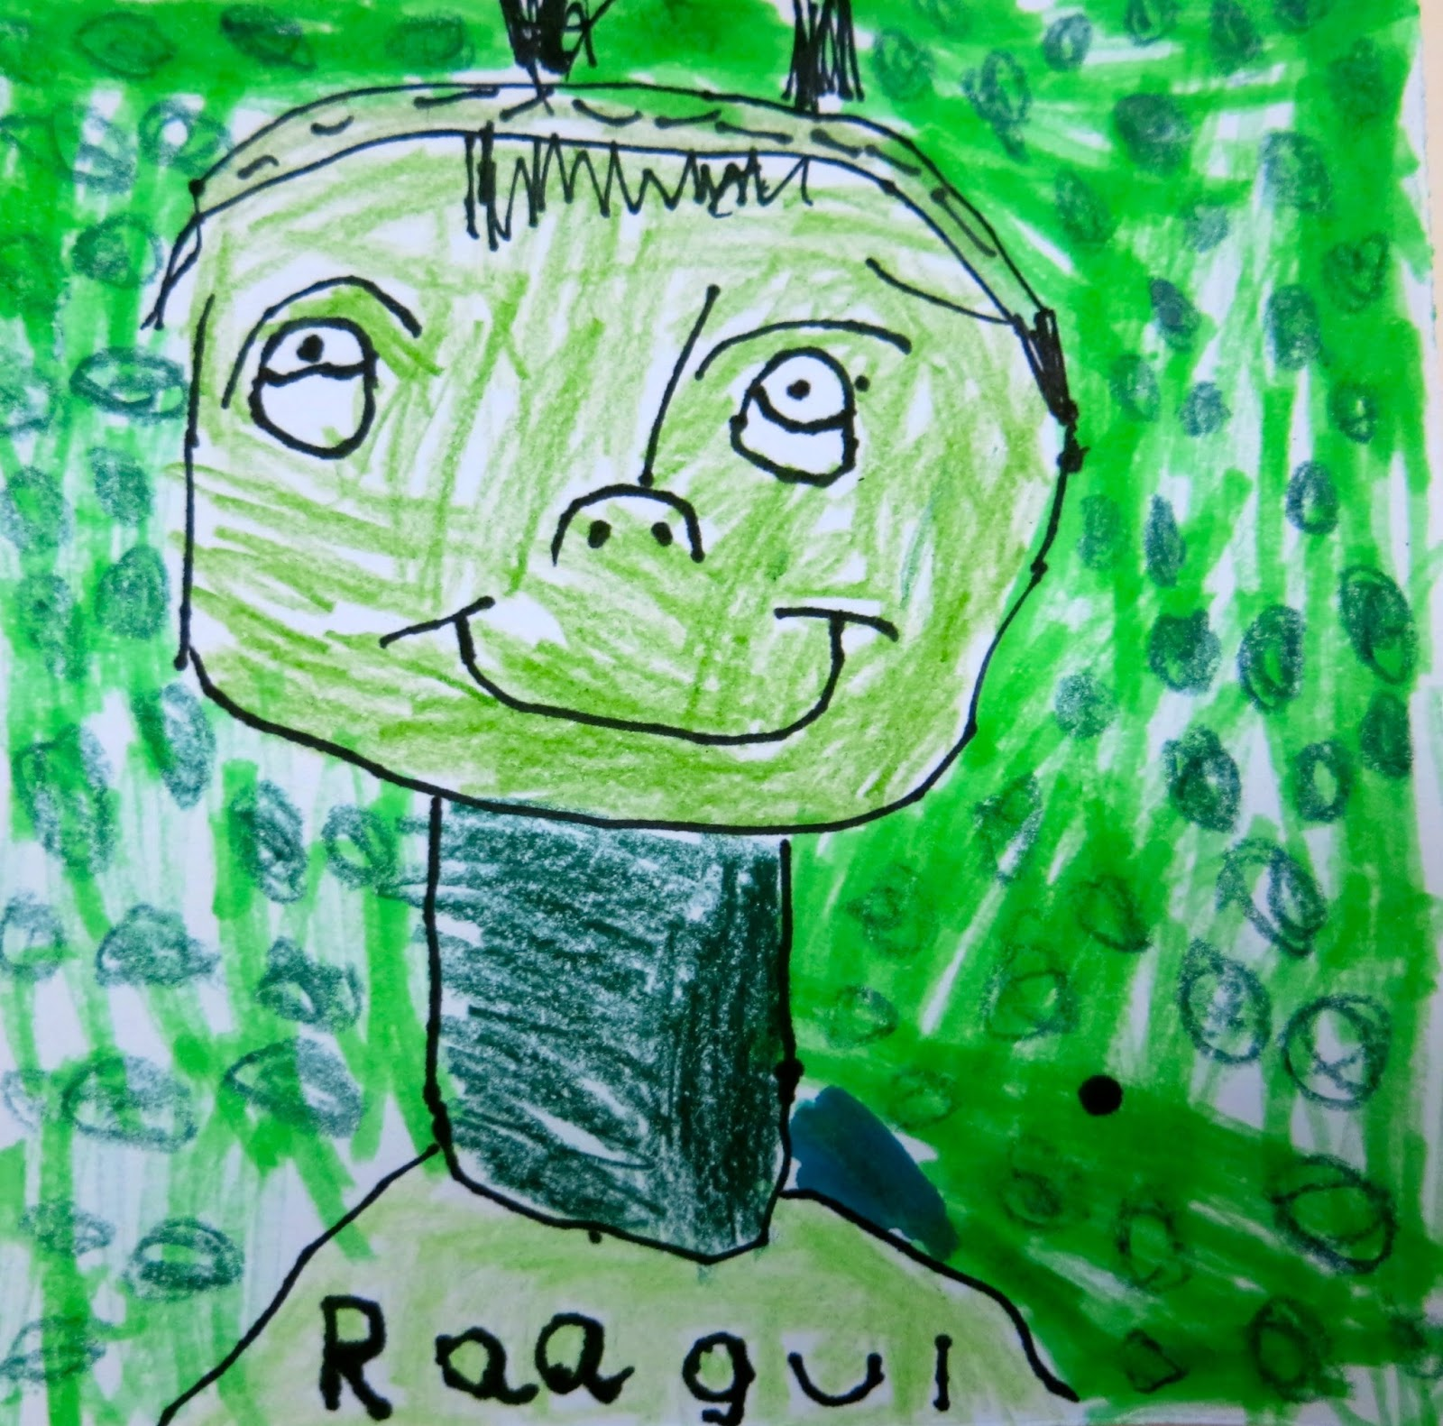
Sign your work
Make sure you sign your masterpiece on the front with Sharpie.

Slide 13
FINISHED PRODUCT

