Slide 1
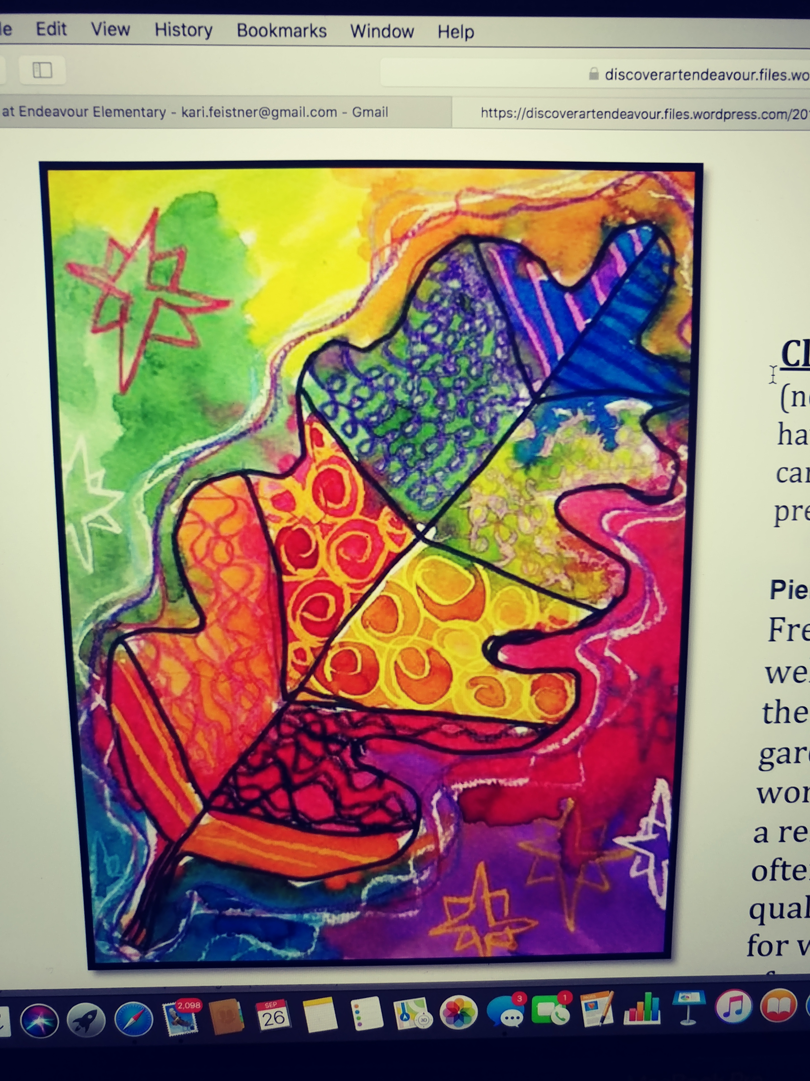
Pattern and Line
A fun leaf project for 1st grade

Slide 2
Pattern- a repeated design

Slide 3
Patterns exist in nature.
Can you guess who these patterns belong too?

Slide 5
Gustav Klimt-a famous Austrian Pattern ARtist
Klimt’s paintings are know for his use of patterns. He also used gold leafing,
and bright patterns in some of his designs. His work was inspired by Greek and Egyptian art.
Klimt’s TREE of LIFE
Klimt’s APPLE TREE

Slide 6
Lines-
Lets try a few of these! Draw a zigzag line. Then repeat the line under it 2 more times.
Now you have a pattern of lines! .

Slide 7
Lets start our art project!
Materials needed:
Watercolor paper
Large leaf shape template
Black sharpie
Oil pastels
Watercolors
paint brushes
Spray bottles for the watercolors
Printout of patterns

Slide 8
1st: trace the leaf with pencil.
Add some veins in the leaf creating sections.
Outline your lines with black sharpie
2nd: Using the pattern print out for ideas,
begin adding patterns in each of your sections using oil pastels.
Do not completely color in any of the sections.
Just create patterns of lines.
3rd: Choose a different watercolor for each section!
Have an adult helper spray your paint palette with water.
Wash your brush between each color to keep your palette clean.
the paint will not cover the oils pastel lines.
This is because the oil is resisting the water.

