Slide 1
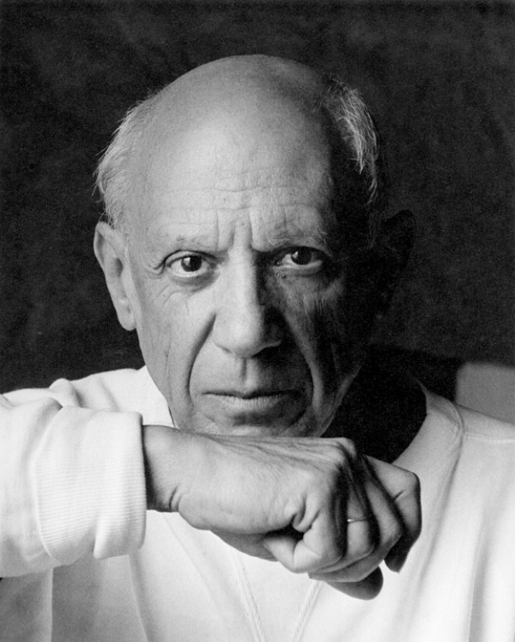
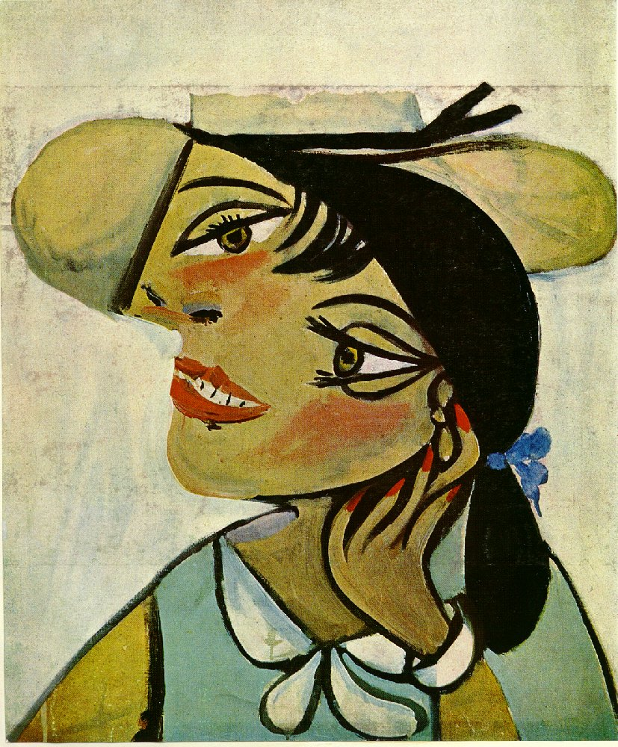
Pablo Picasso
and witches, ghouls and monsters

Slide 2
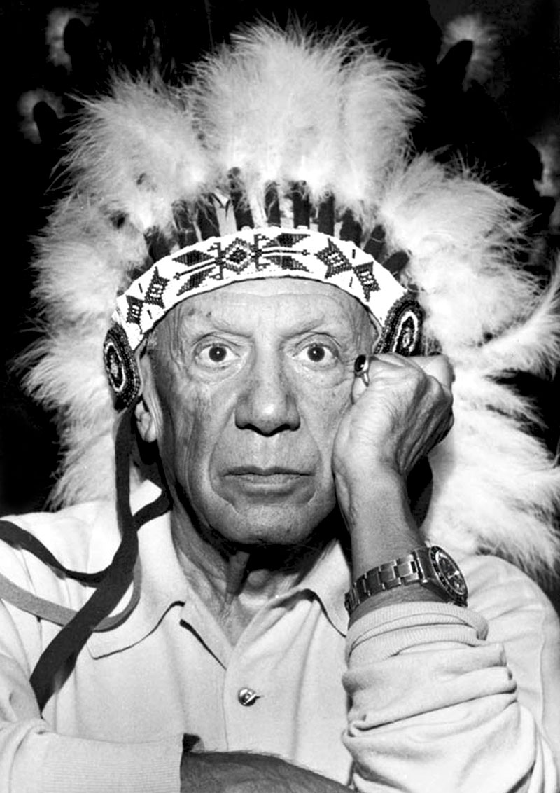
Pablo Picasso
Painted since he was little
He spent a long time looking
for his unique artistic style.
Which ones did he try?

Slide 3
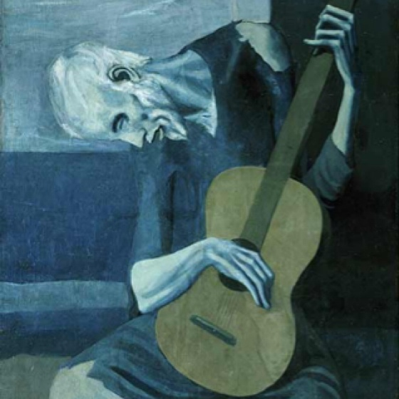
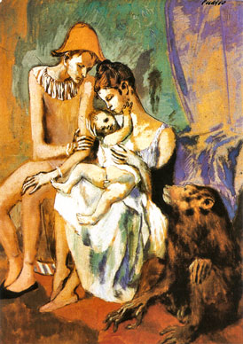
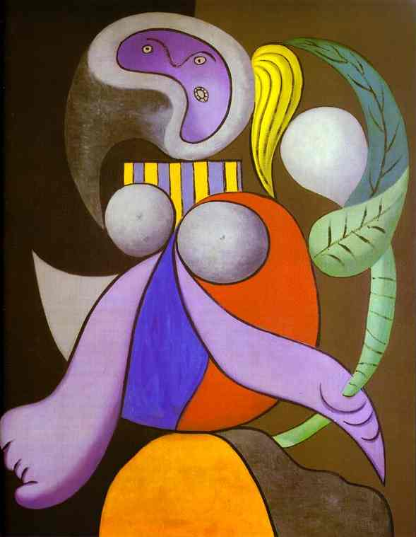
Many artistic periods
Blue Period
(lost his dear friend)
Rose Period
(fell in love)
Surrealism
(later in life)
And along the way he found CUBISM
Notes:
Surrealists were inspired by subconscious thoughts and visions giving their artworks a fantasy approach.

Slide 4
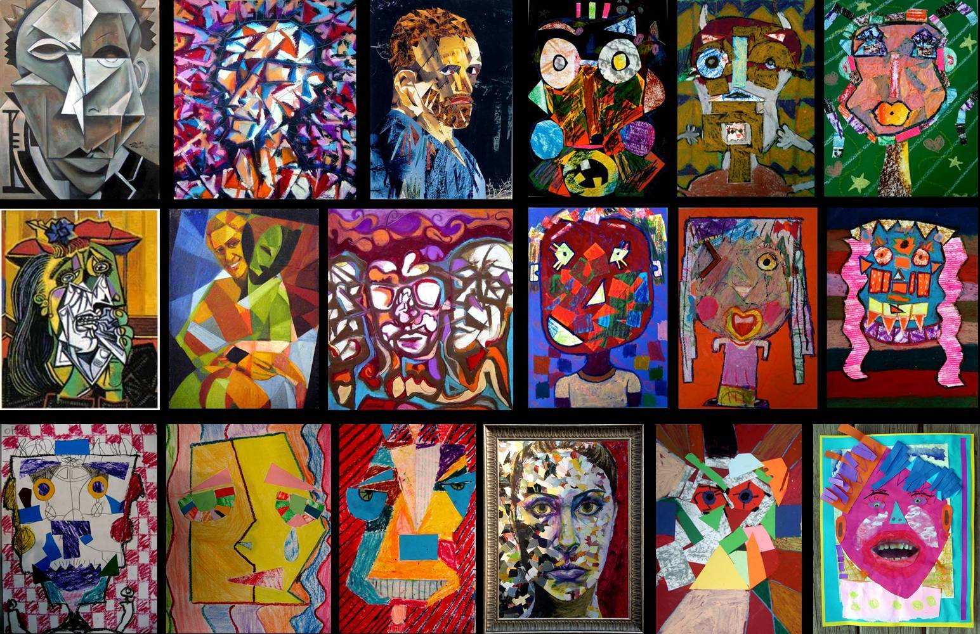
What is cubism?

Slide 5
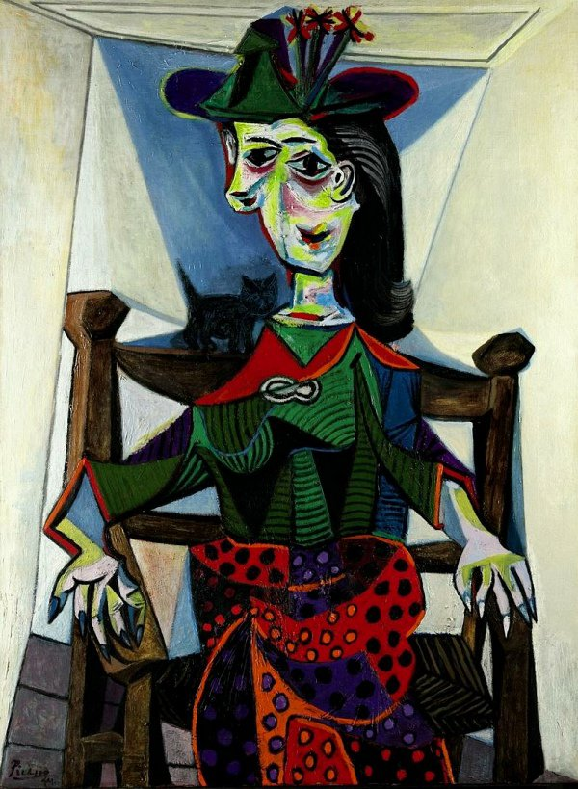
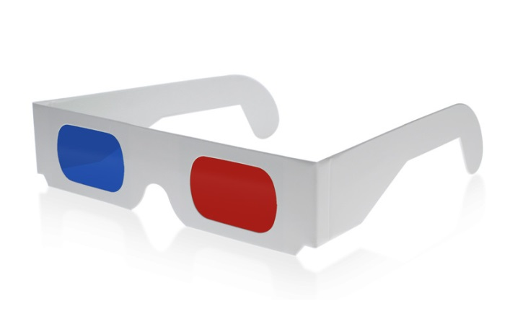
Cubism was an art movement that tried to capture three dimensions on a flat canvas.
Without the 3D glasses.

Slide 6
HOW?
The artists analyze their subjects
Break them into different sections
(Looked at it from different angles)
Put them together again.

Slide 7
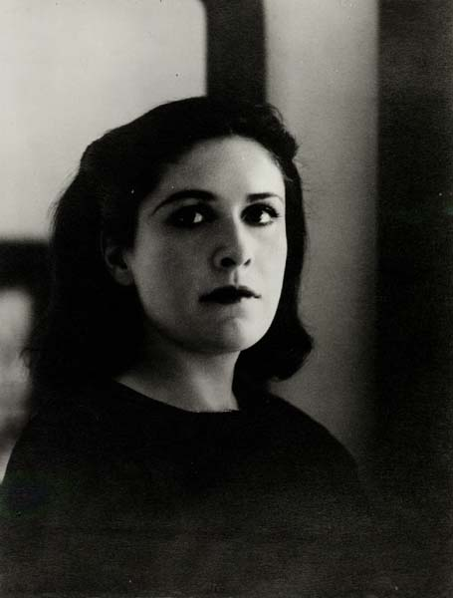
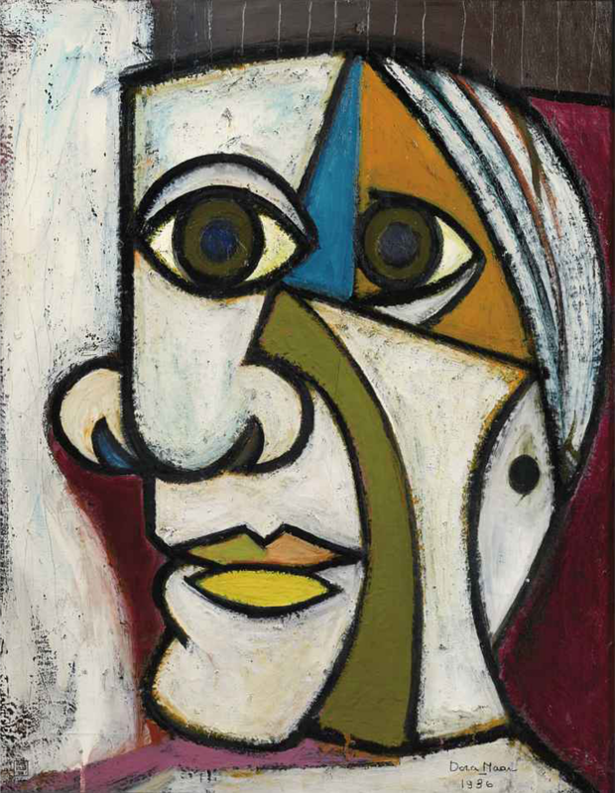
What is the trick?
They never put the things together the ‘right’ way.
Picasso would look at Dora Maar from all sides and then painted them all (that he liked) into one painting.

Slide 8
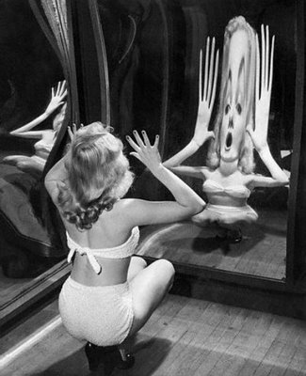
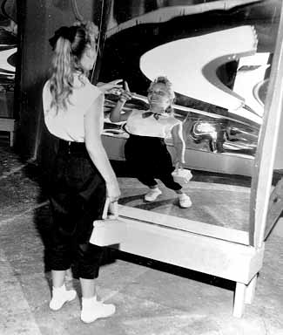
They looked like fun house mirrors
Cubist painting distorted the image and made you think twice about what you were seeing.

Slide 9
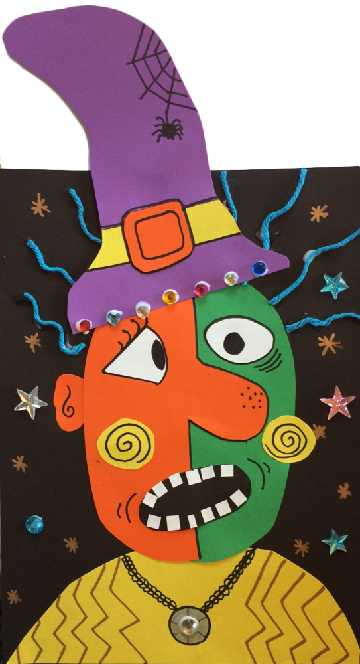
Let’s make some ART!

Slide 10
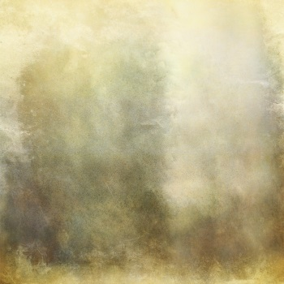
What are shapes?
Shape is an area which stands out because of
a defined boundary, change in color or texture.
You can clearly see where it begins and where it ends.
What shapes do you know?

Slide 11
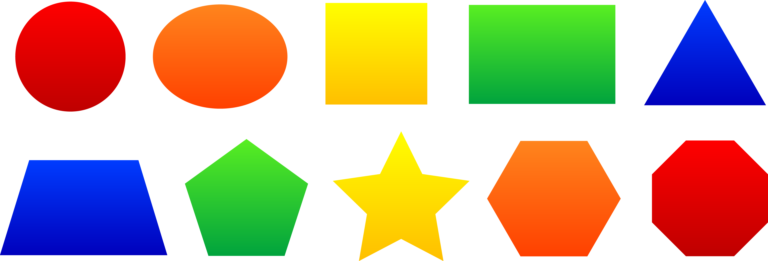
GEOMETRIC shapes

Slide 12
GEOMETRIC shapes
rectangle
pentagon
square
triangle
circle
hexagon
parallelogram
pie

Slide 13
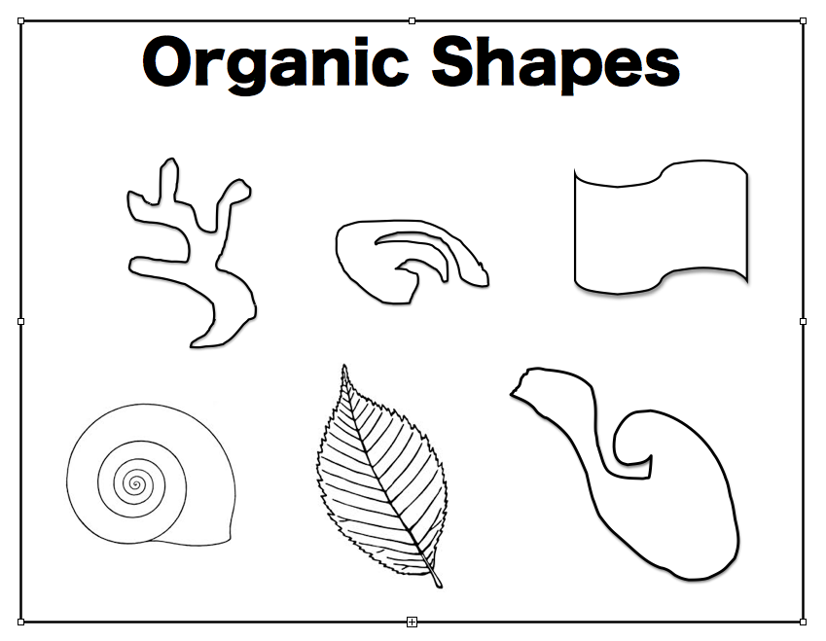
ORGANIC shapes

Slide 14
What shapes do you see?
Geometric
Organic

Slide 15
What shapes do you see?
Geometric
Organic
face
Hat
Orange face with a nose
buckle
teeth
cheek

Slide 16
First…. Write your name on the back of the large black paper with a pencil.

Slide 17
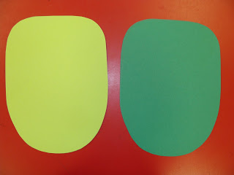
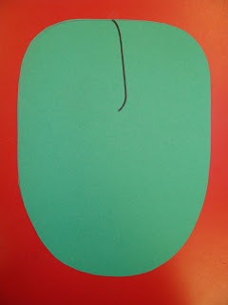
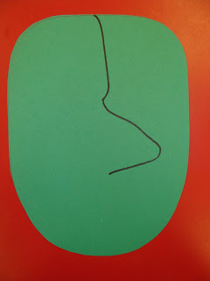
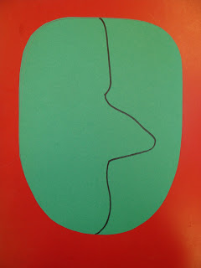
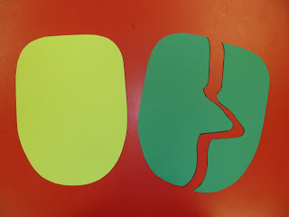
Pick 2 different colors for your head.
Using just one, start drawing a line at the forehead – middle, top.
Continue drawing and add a nose.
Add the chin.
Add the chin.
Cut along the line.

Slide 18
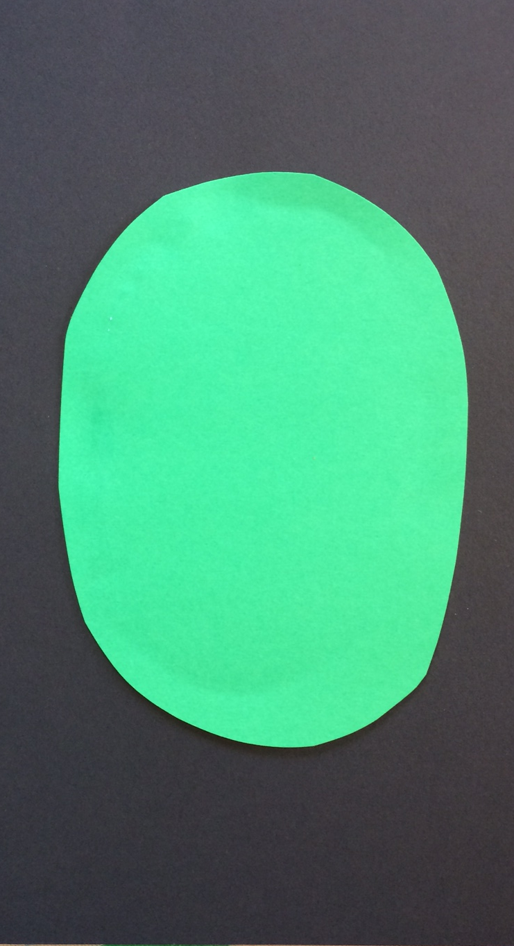
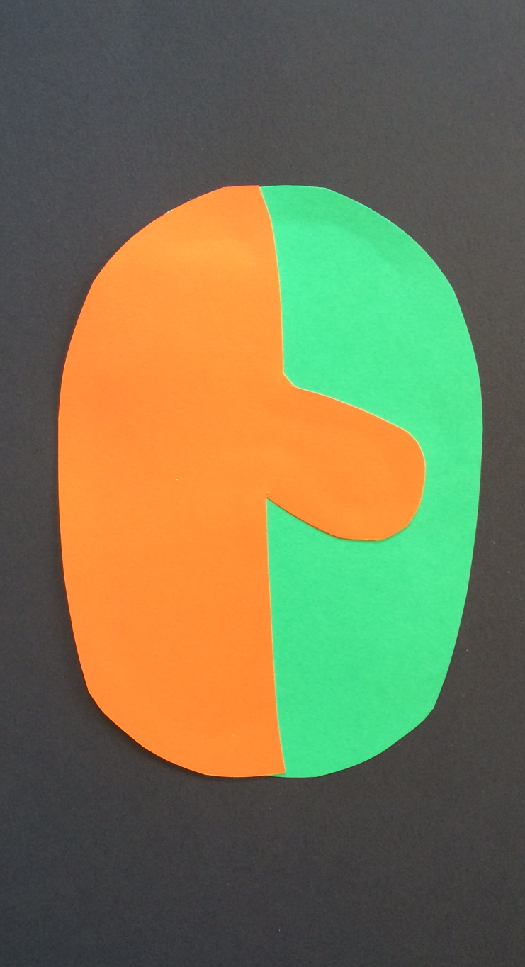

Slide 19
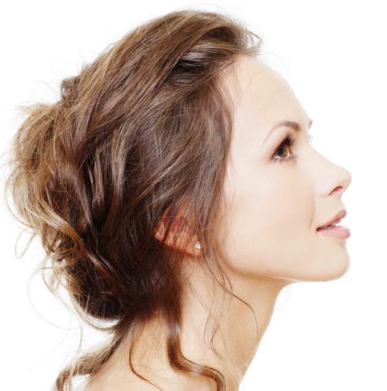
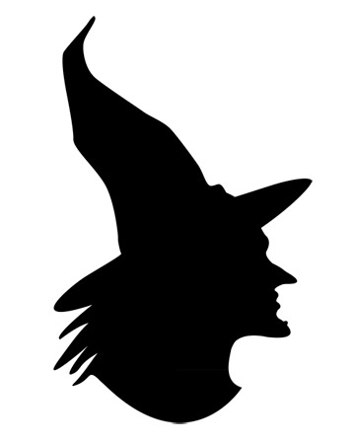
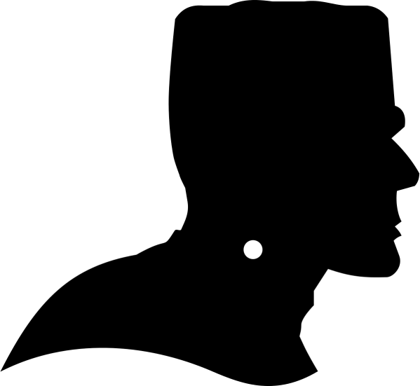
PROFILE

Slide 20
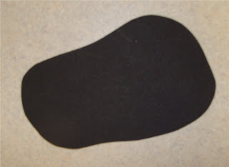
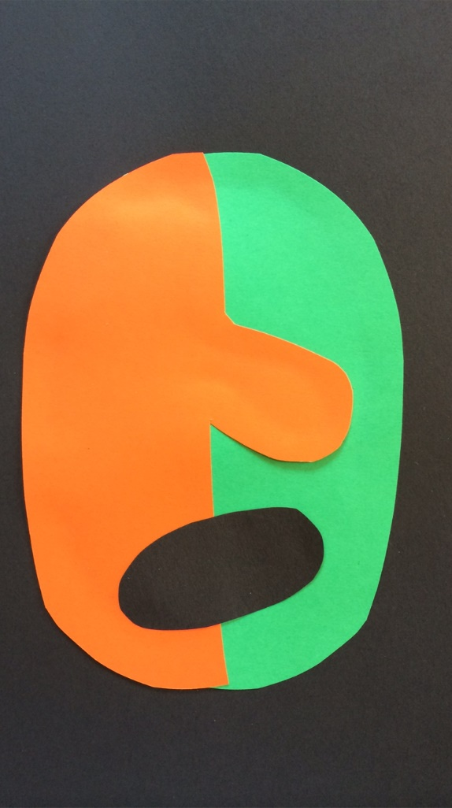
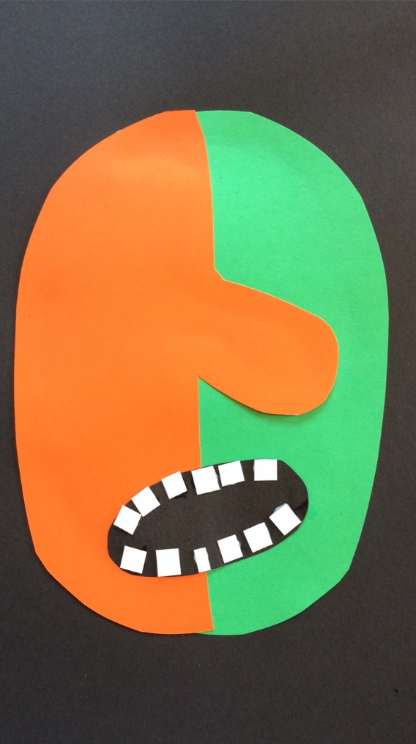
Cut organic shape for mouth from small black paper.
Glue mouth to head.
Cut teeth from small white paper. Glue on.

Slide 21
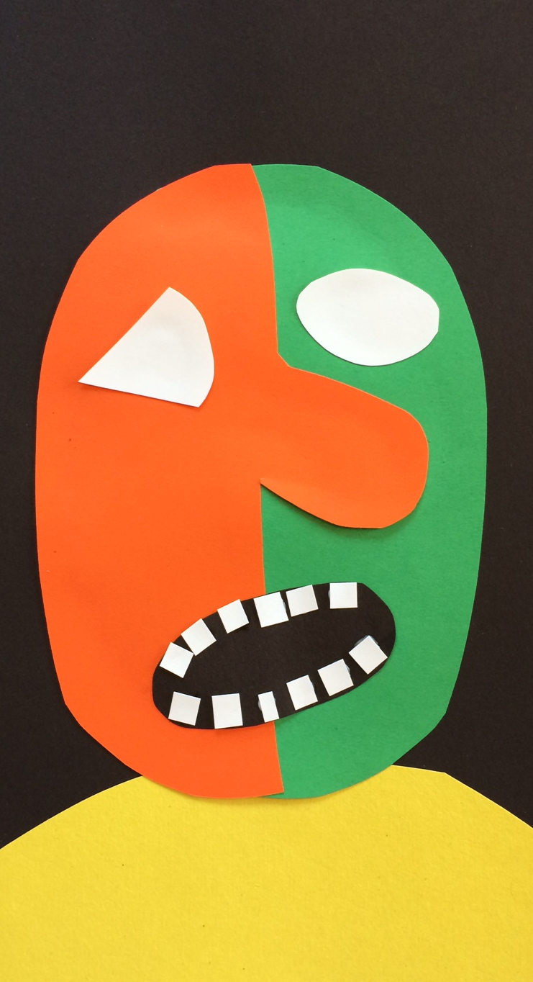
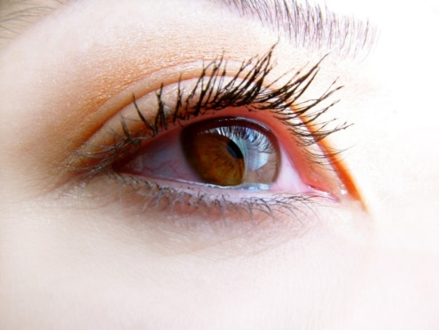
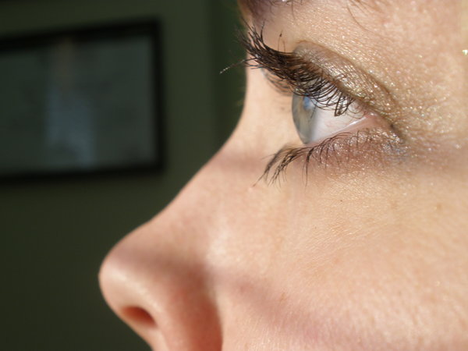
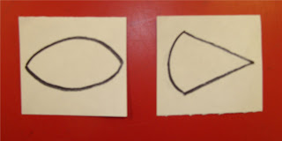
FRONT view
SIDE view
Draw 2 eyes on small white paper. One eye shape that is facing forward (like a football) and one eye that is facing sideways (like an ice cream cone.) Cut them out.

Slide 22
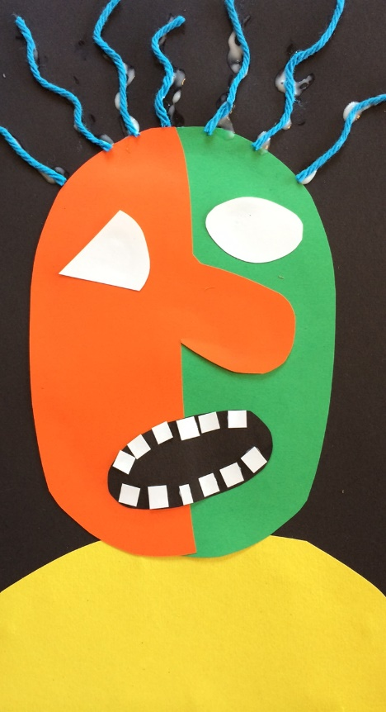
Use construction paper to add other features such as:
A hat
Cheeks
Shoulders
An ear
Hair
Use the black sharpie to add fine details such as:
Pupils and eye lashes
Outlines
Patterns on clothing
Other face details
Add other details with available materials.

Slide 23
