Slide 1
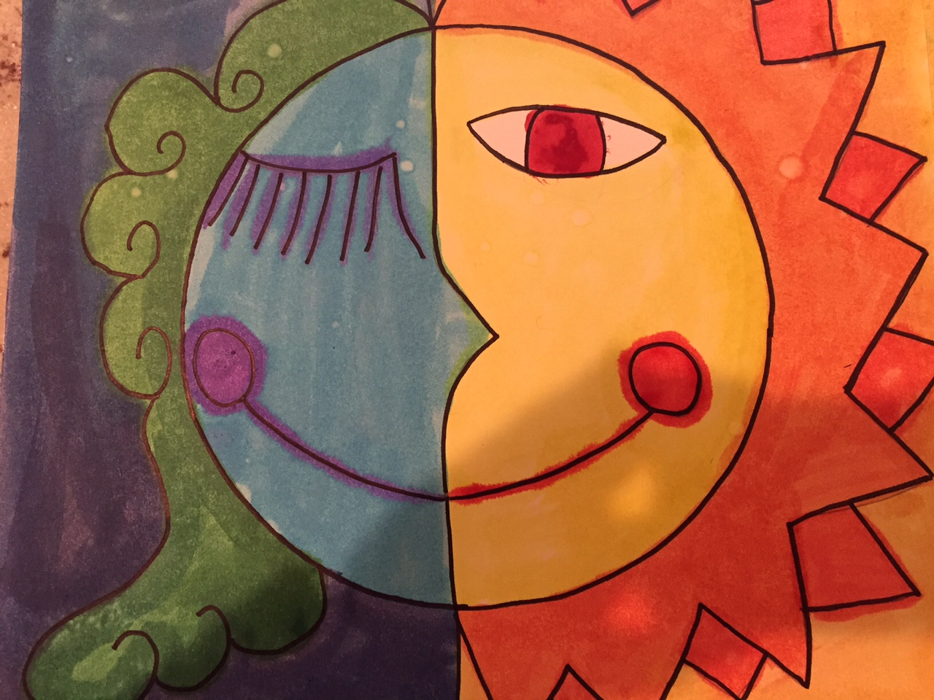
SUN AND MOON inspired by Pablo Picasso

Slide 2
ART RULES
All classroom rules apply
HAVE FUN!
Raise your hand and ask for help BEFORE you get frustrated
Don’t jump ahead of the steps you are given
I don’t want your art to be “perfect” there is no such thing as perfect in art. Just let it be yours
KEEP IT POSITIVE when talking about your work and other classmate’s work
Sometimes less is more – especially when we work with paint!
HAVE FUN!

Slide 3
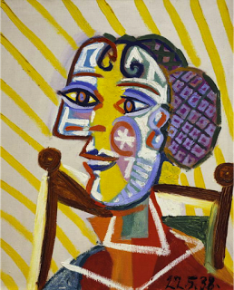
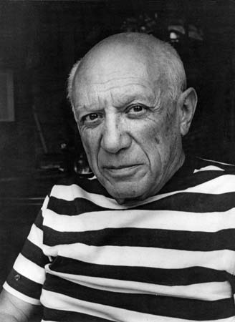
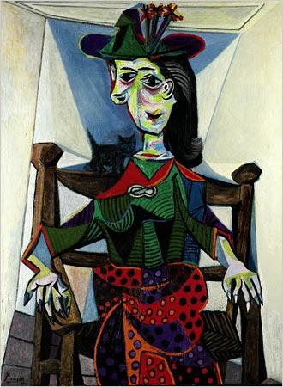
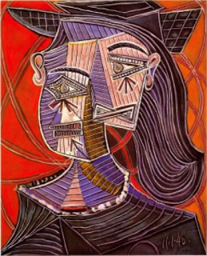
PABLO PICASSO
He was born more than 120 years ago in Spain
At age 7 he started training to be a artist
His real name was: Pablo Diego José Francisco de Paula Juan Nepomuceno María de los Remedios Cipriano de la Santísima Trinidad Clito Ruiz Picasso.
He is one of the most famous painters, and his paintings are some of the most expensive in the world.
One style of his paintings was called CUBISM – where the style of painting is broken up and painted in an abstract form.

Slide 4
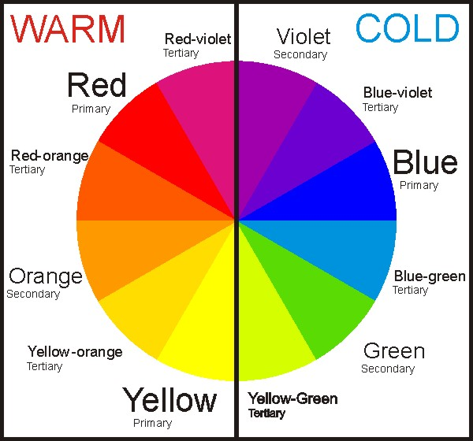
WARM AND COLD COLORS

