Slide 1
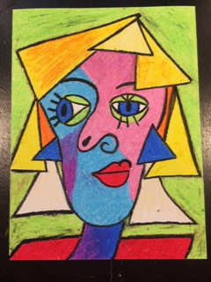
Cubist Portrait of Your Teacher
Pablo Picasso

Slide 2
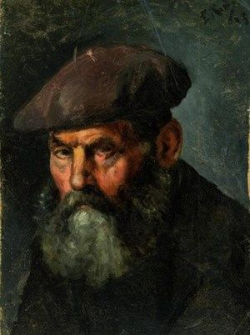
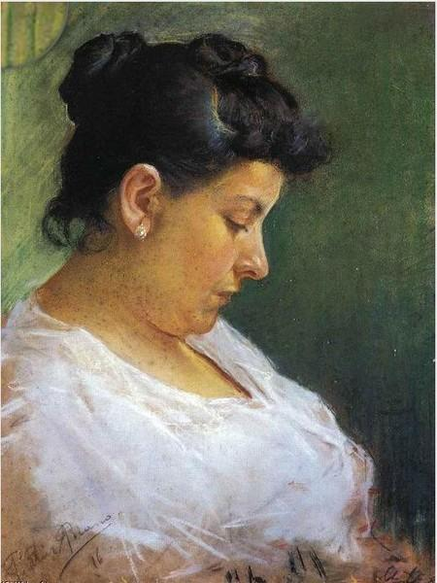
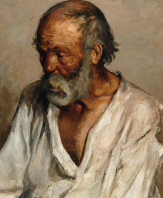
Pablo Picasso
Pablo Picasso is considered one of the most important artists in history. This is because he created a new style of art called Cubism.
Pablo Picasso began painting as a young person and painted people in a realistic way. Here’s some of his early work.
Man in a Beret
Portrait of Picasso’s Mother
Old Man

Slide 3
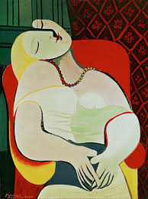
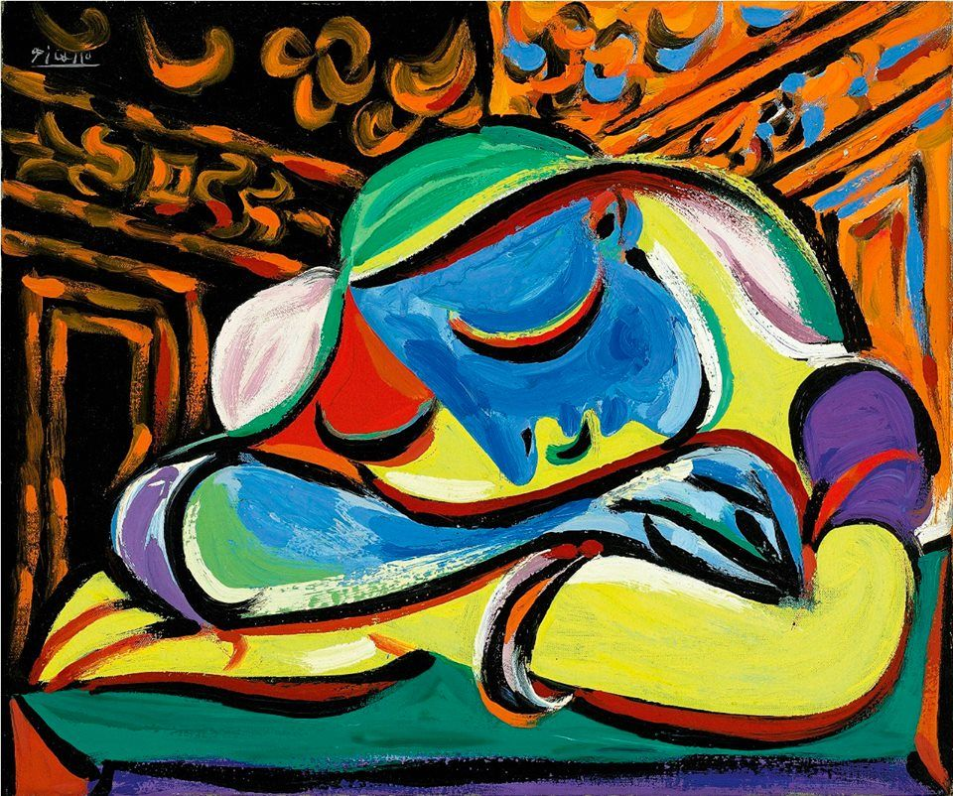
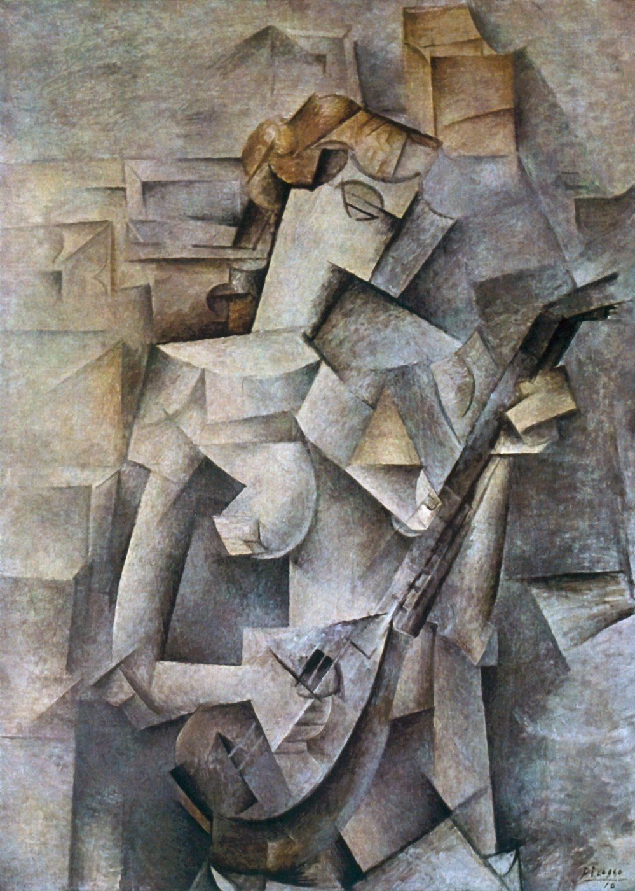
Pablo Picasso & Cubism
Then Picasso began experimenting with painting. He wanted to get to the basics of painting. His constant exploring with objects, shapes, lines, & color became to be known as “Cubism.”
Cubist artists determine what they want to paint, figure out what simple shapes are in the object, and then reassemble them in an “abstract” way. They also try to see different views of the object at the same time. It’s called “perspective.” That means the painting will not look exactly like what is being painted. Here’s what it looks like.
The Dream
Young Girl Sleeping
Girl Playing a Mandolin

Slide 4
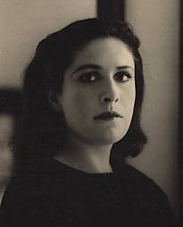
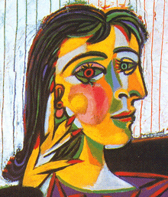
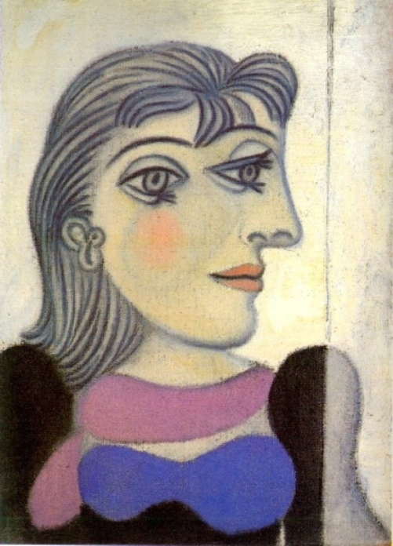
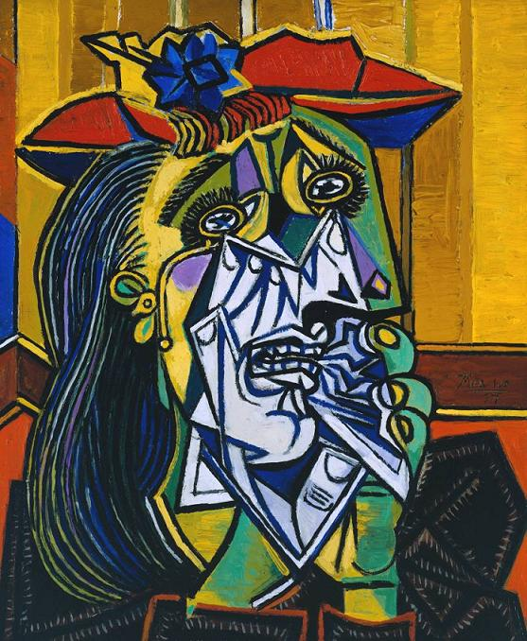
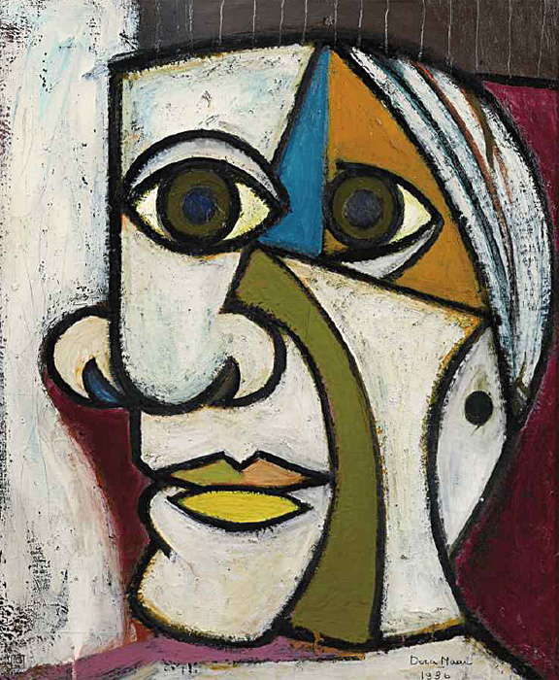
Dora Maar
Picasso liked to paint pictures of a woman named Dora Maar. Here’s what she looked like in real life and some of the pictures Picasso painted of her. What do you think of them?

Slide 5
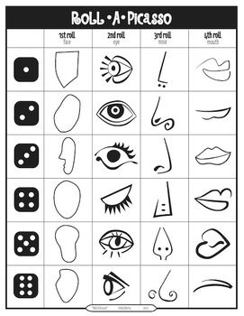
Your Cubist Portrait
We’re going to create a portrait of your teacher using a fun way. Each student’s portrait will look very different from everyone else’s.
By rolling a dice, you will know what shape to draw.

Slide 6
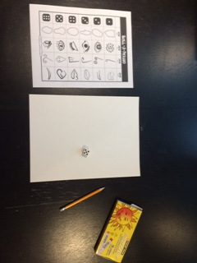
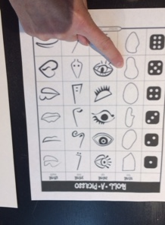
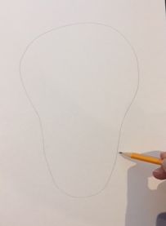
First, you’ll need your Roll-A-Picasso page, a die, a piece of paper, a pencil, and oil pastels.
Roll the die to see what face shape you’ll draw.
Draw the face BIG, so that it is 1.5” to 2” from all sides of the paper. (leaving room for the HAIR)

Slide 7
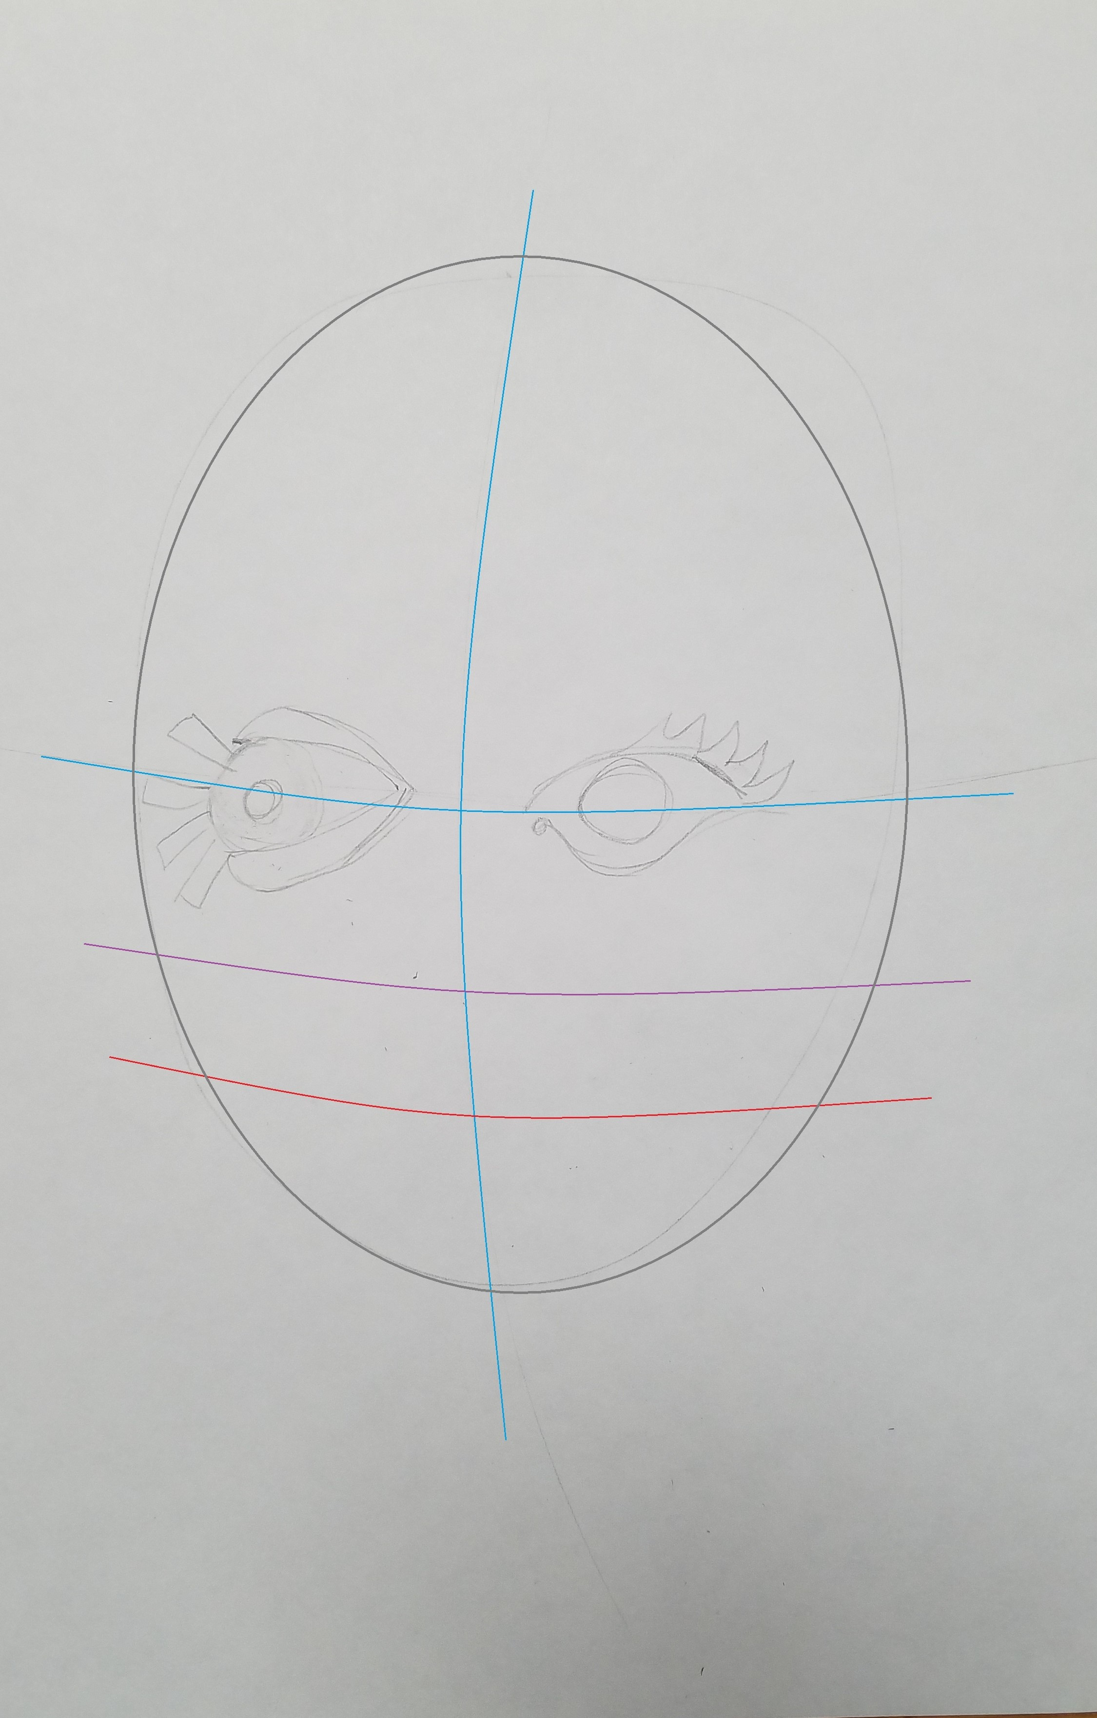
Once you have drawn your head shape, now we are going to LIGHTLY sketch the guidelines to where the EYES, NOSE, MOUTH, and EARS go on a face.
Start off, divide your head in half the long way.
Next, divide your head in half the short way.
Next, divide the face horizontally into 3 sections between the horizontal (EYES) line and the CHIN.
Then, 2/3rds of the way down from the EYES, draw another horizontal line for the MOUTH.

Slide 8
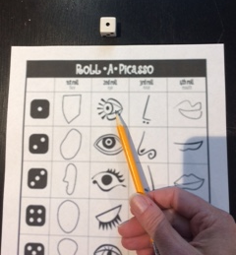
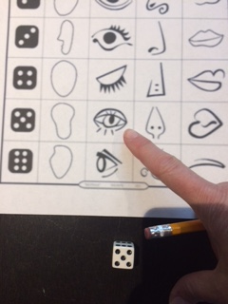
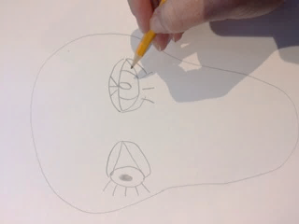
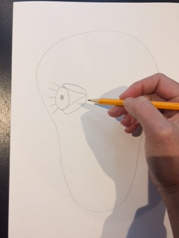
Next we need to do the eyes. Roll the die once to see the first eye you’ll draw, then roll the die again to see what the other eye will look like.

Slide 9
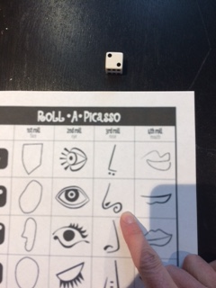
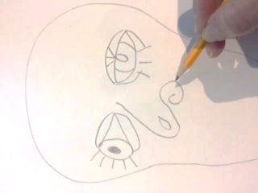
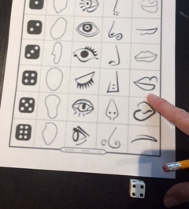
Next is the nose. Then the mouth. Don’t forget a neck.

Slide 10
The center of the eyes go on the center line.
The tip of the nose should go on the nose line and the vertical line.
The part in the lips should go on the mouth line.
Leaving a big forehead for the hair.
(ears, go between the eye and nose line on the side of the head.)

Slide 11
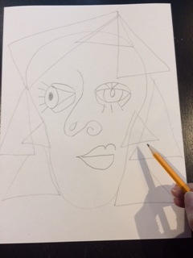
Now look at your teacher. What does her hair look like? What about her clothes? Does she have earrings? Add those into your picture. Remember, you’re going for the main shapes when you draw.

Slide 12
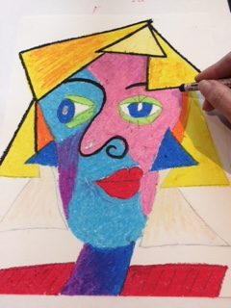
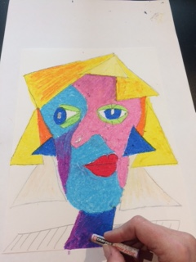
Time to add color. When using oil pastels it’s best to work from the top down and from the center outward. That way you don’t smear the pastels with your hands as you’re coloring.
Add a black outline. Picasso added a lot of black outlines to his work. It really makes the drawing “pop.”
Color the back ground in if you have time.

Slide 13
Beautiful!

Slide 14
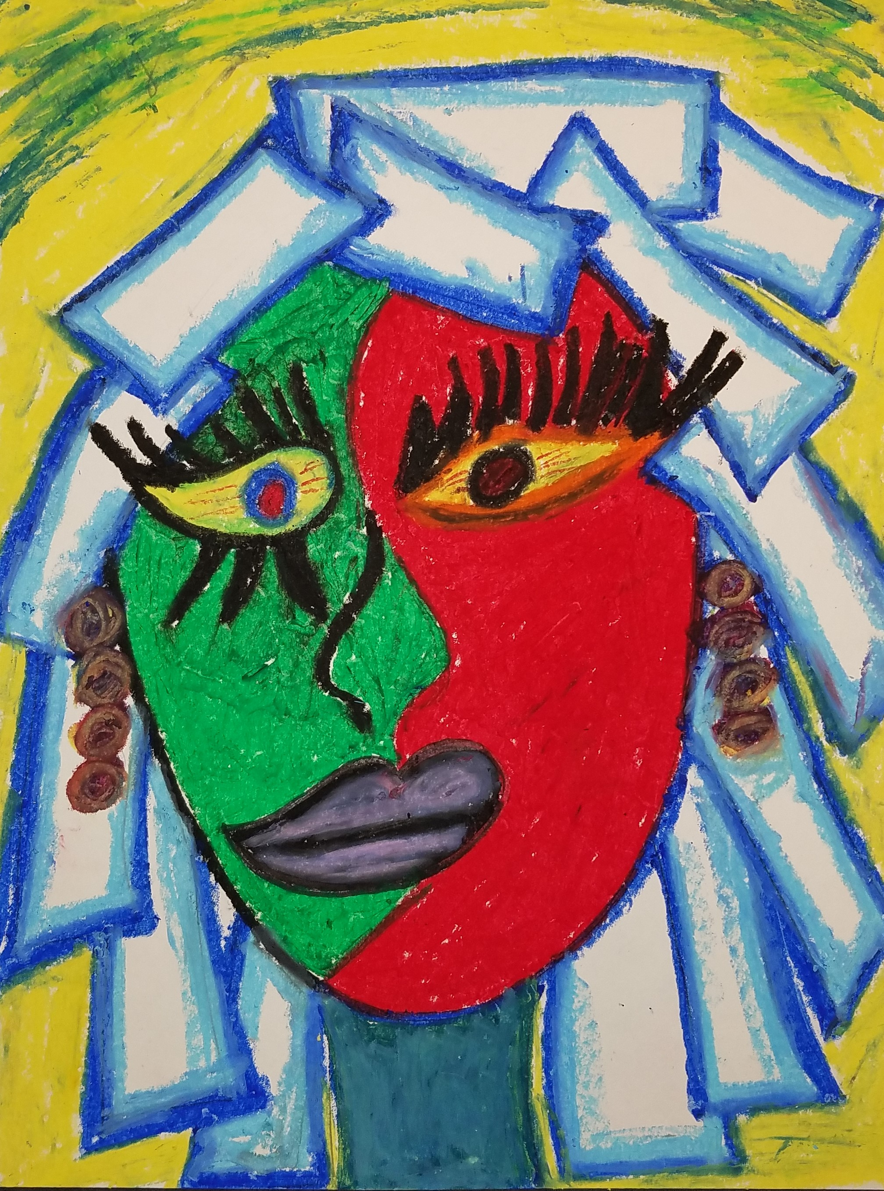
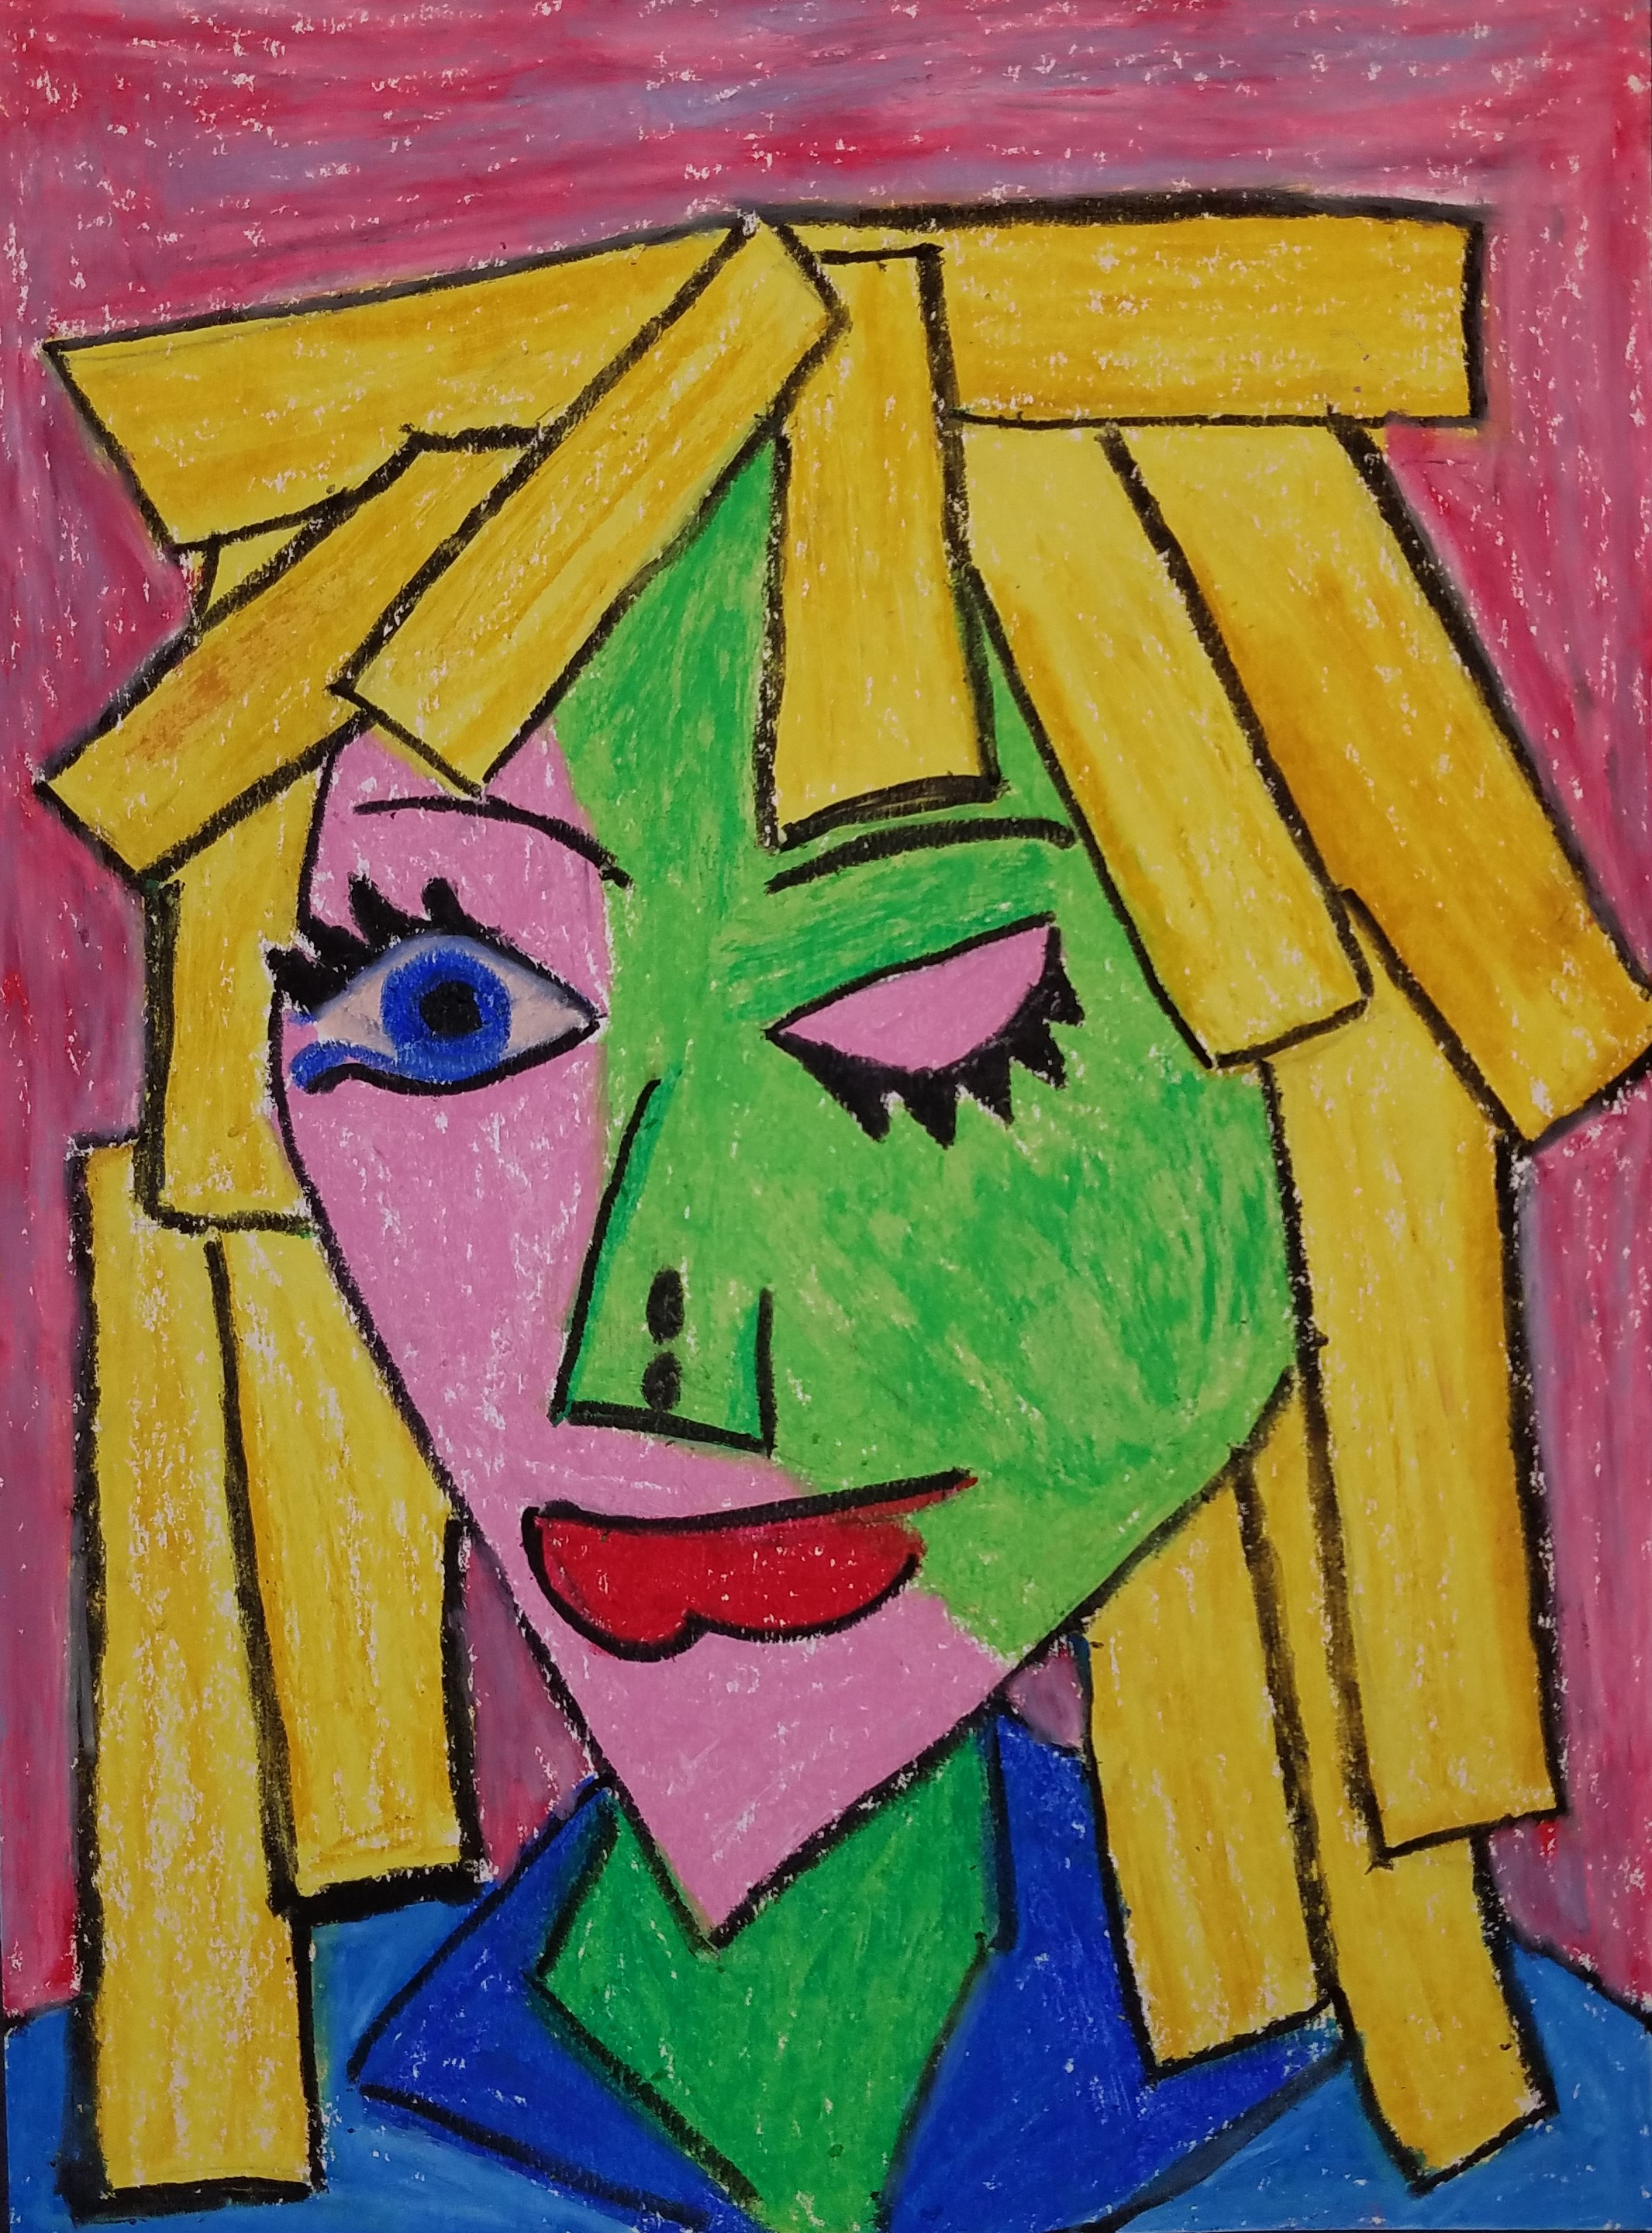
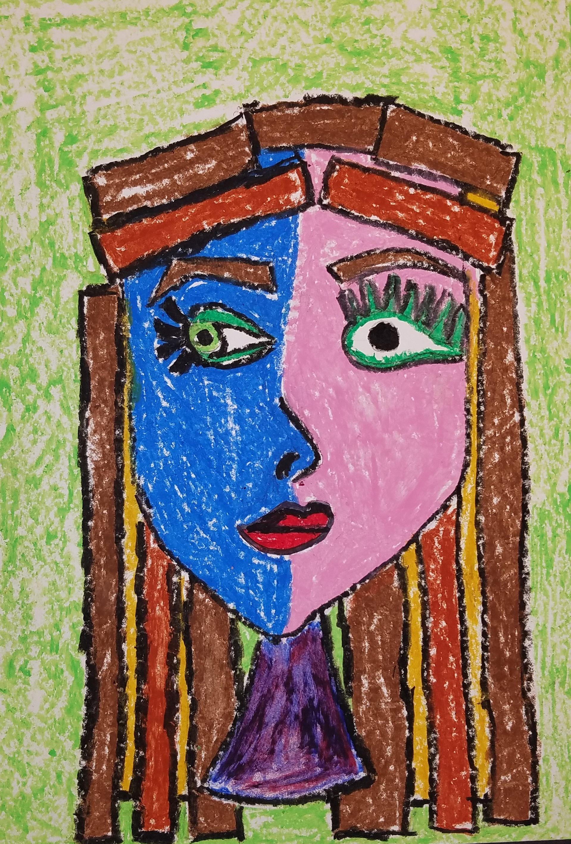
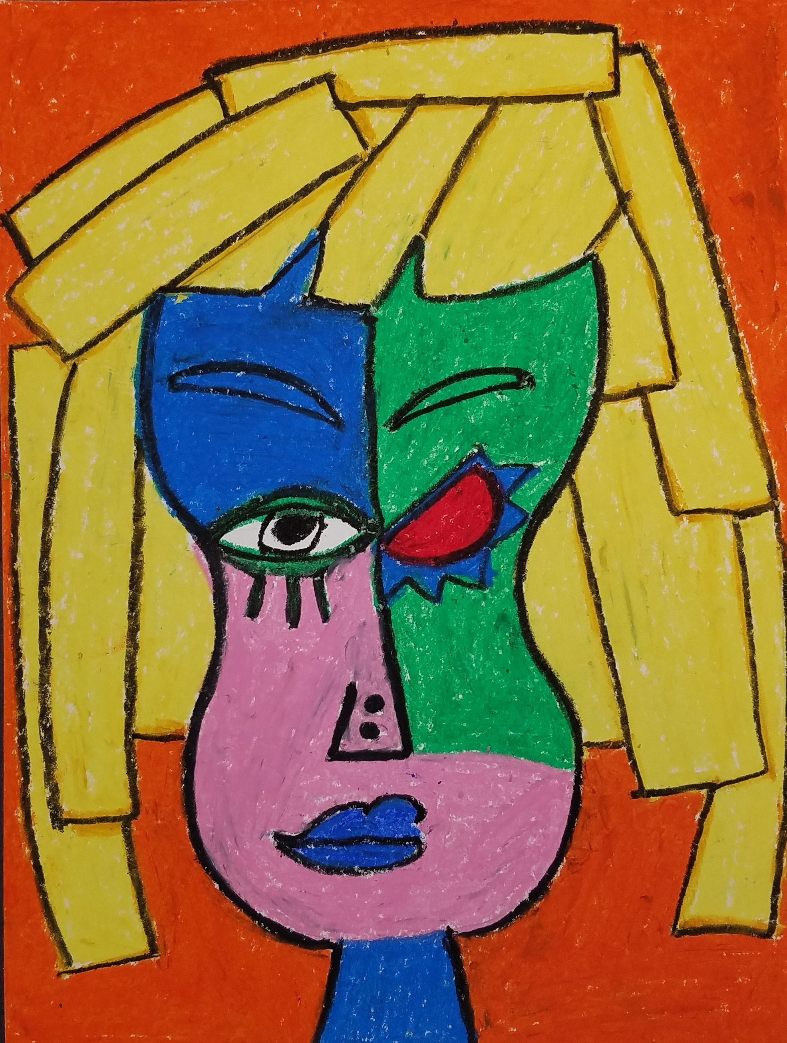
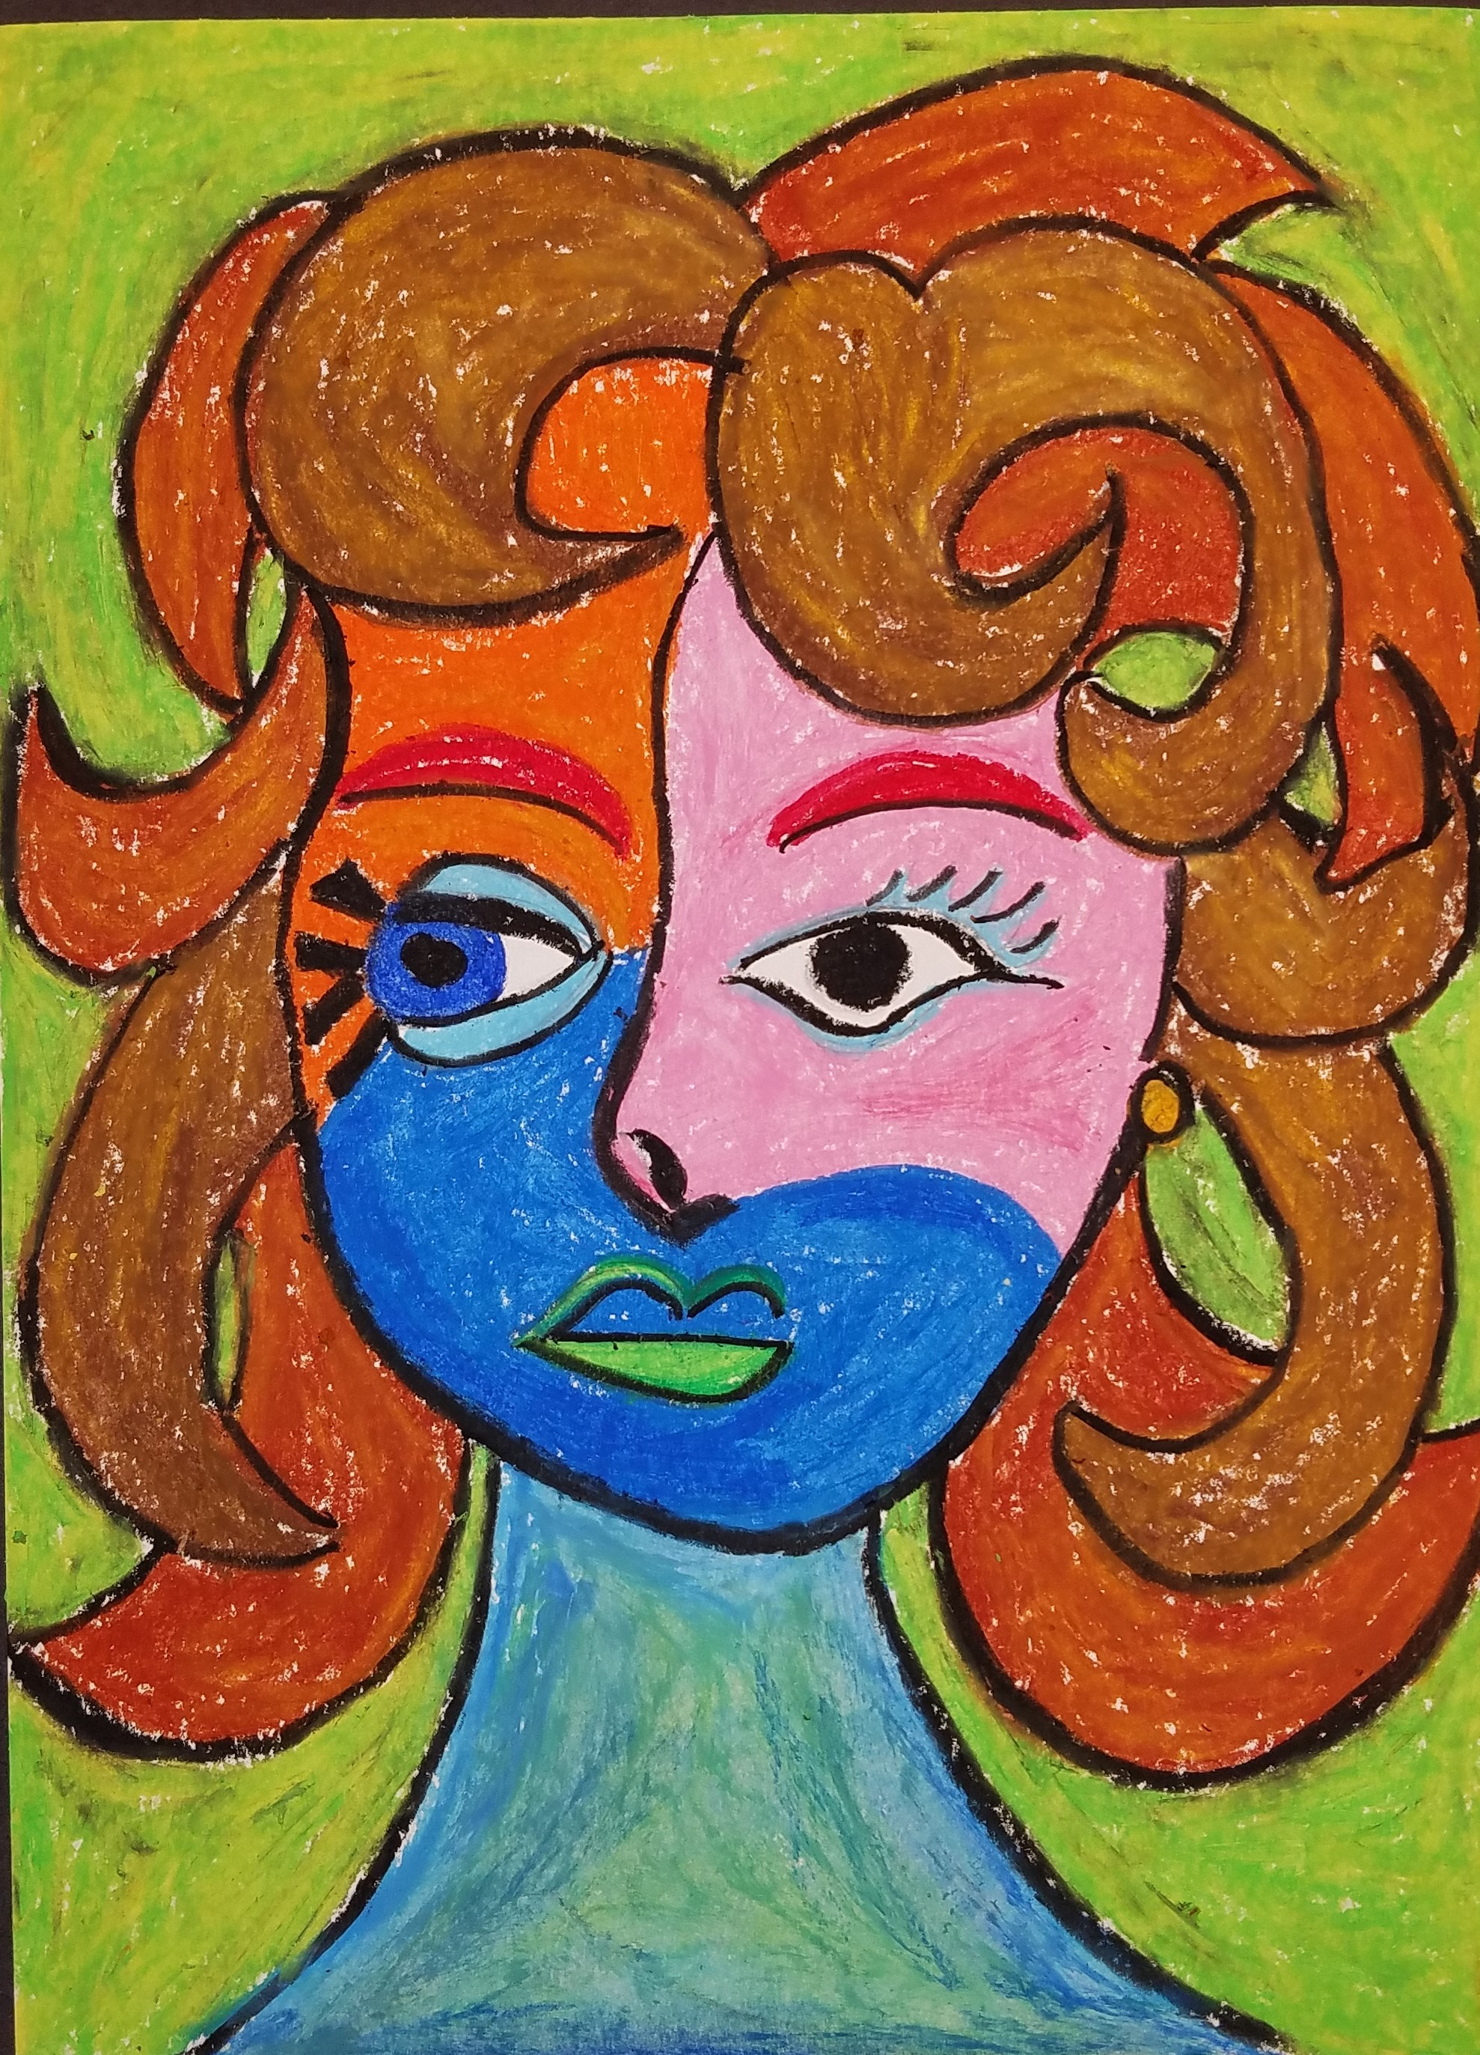
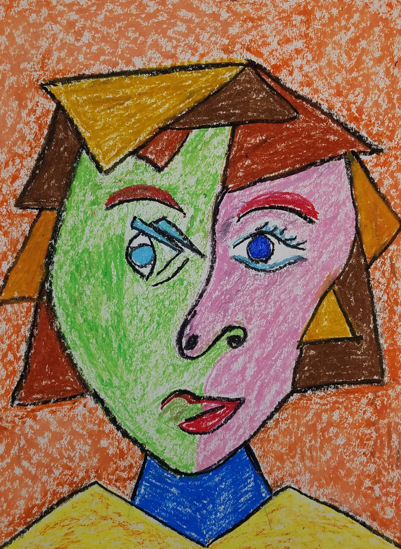
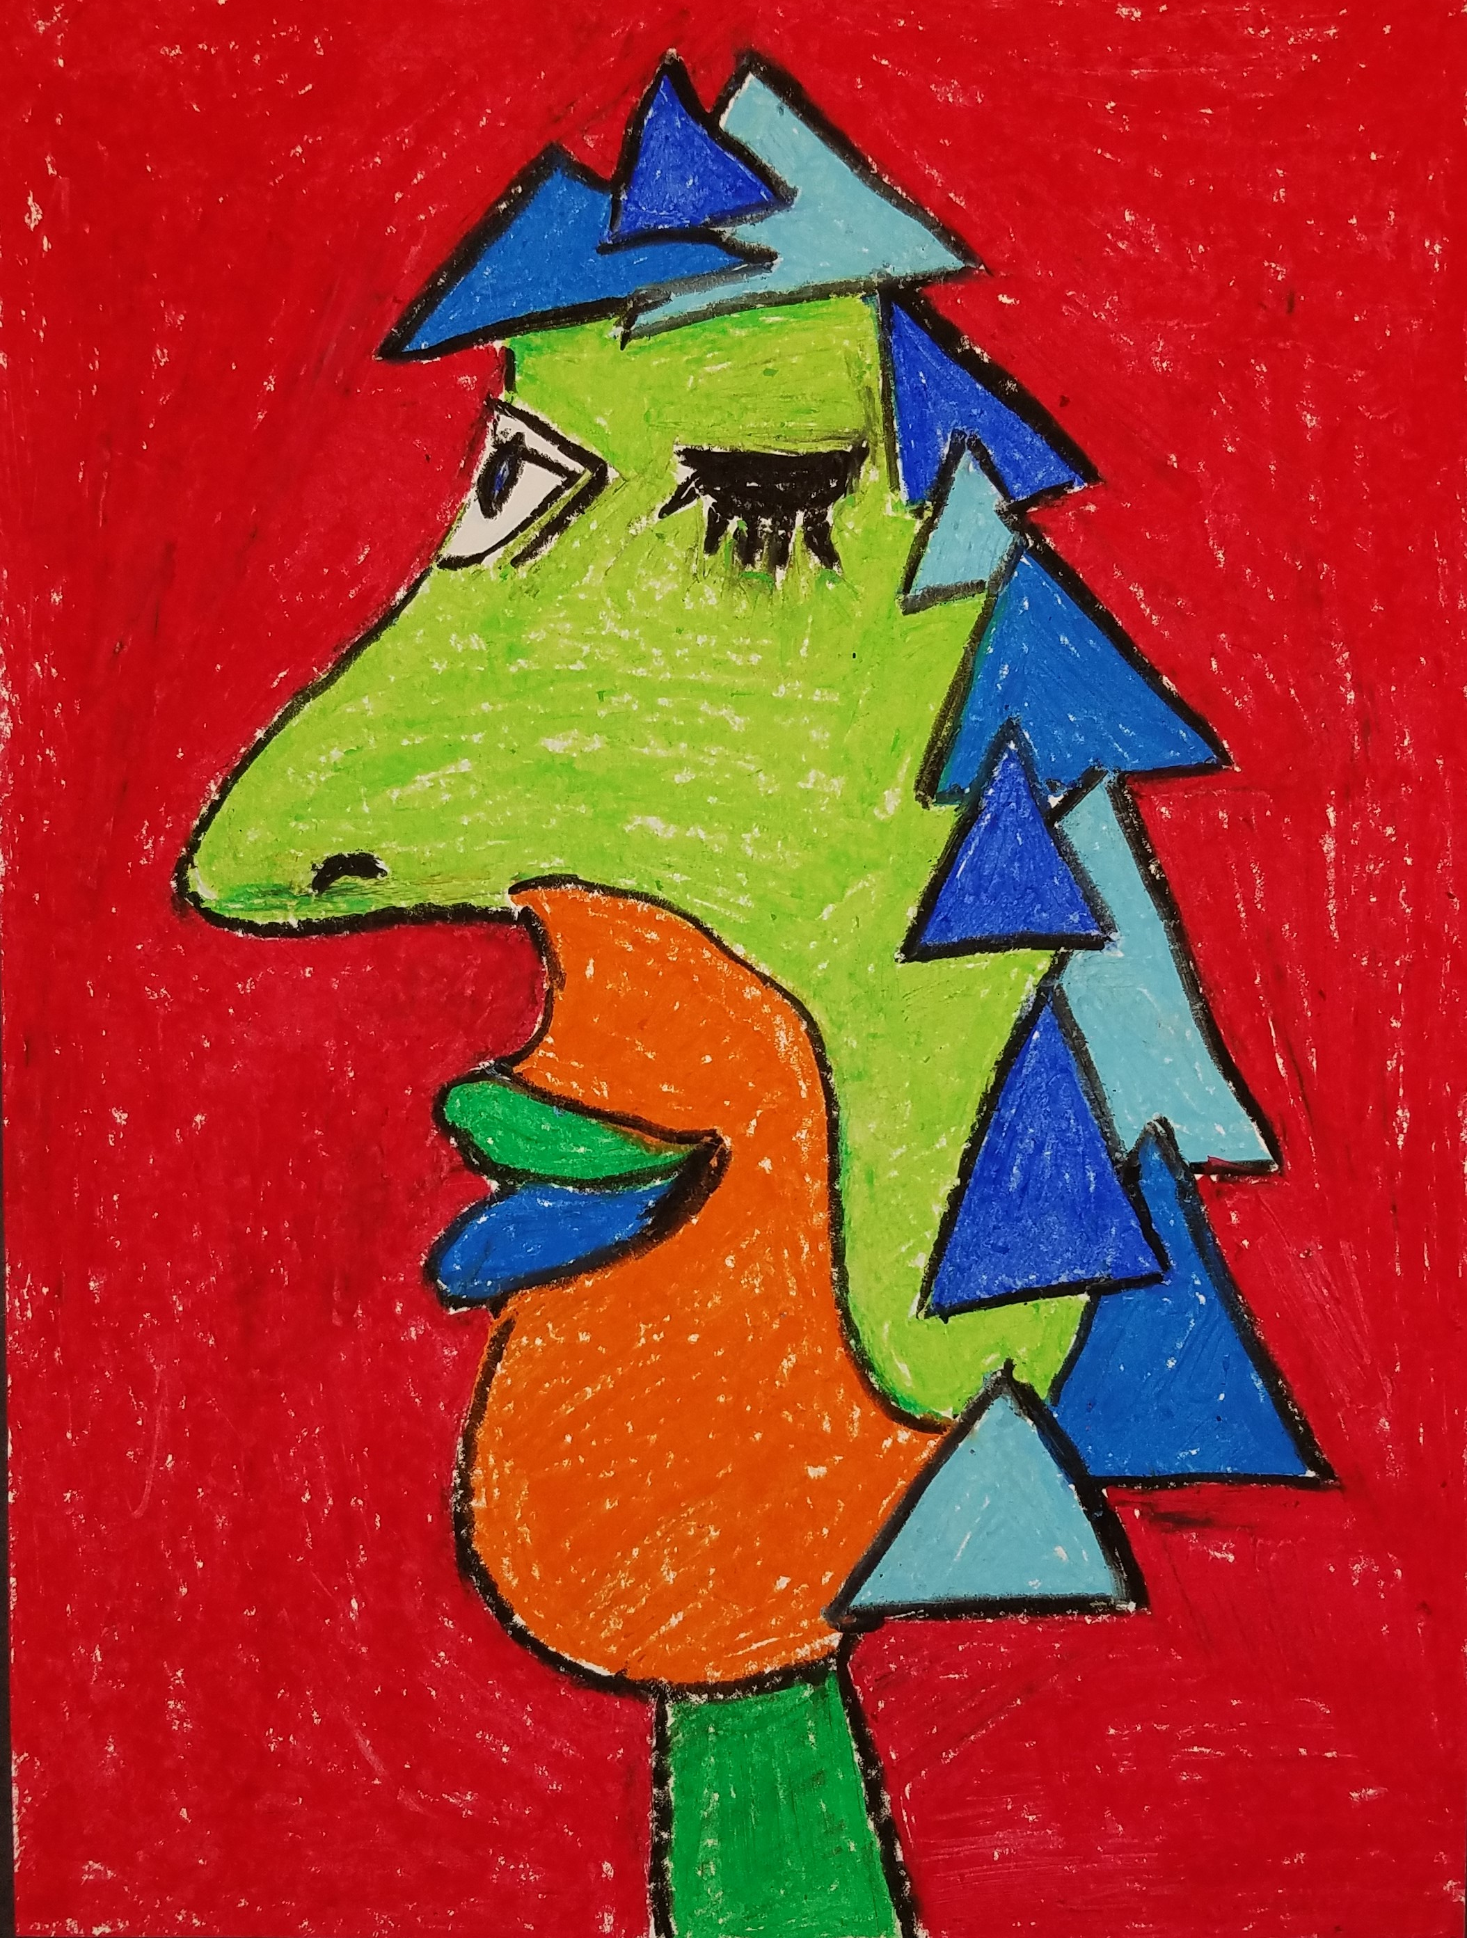
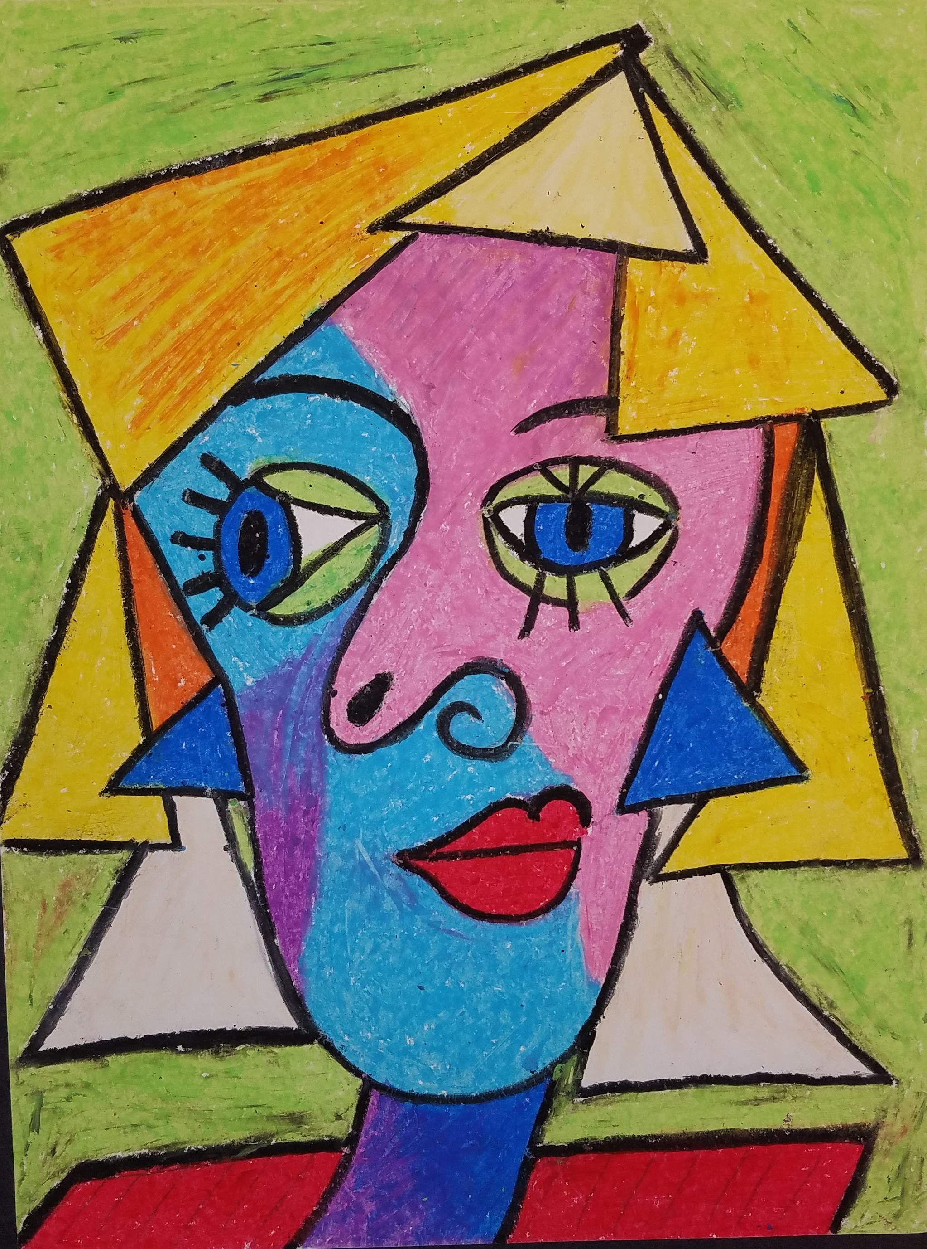
Examples

