Slide 1
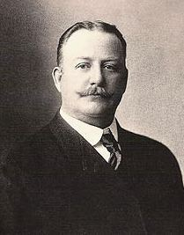
Frederic Remington

Slide 2
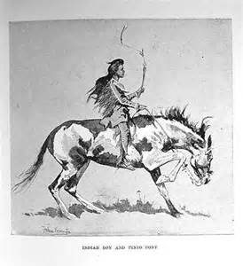
Frederic Remington was born in New York in 1861. His family were horsemen.
When he was in grade school in New York he would draw pictures of his classmates.
He began making drawings and sketches of soldiers, Native Americans, and cowboys at an early age.
When he was in college at Yale he played football and took art classes.

Slide 3
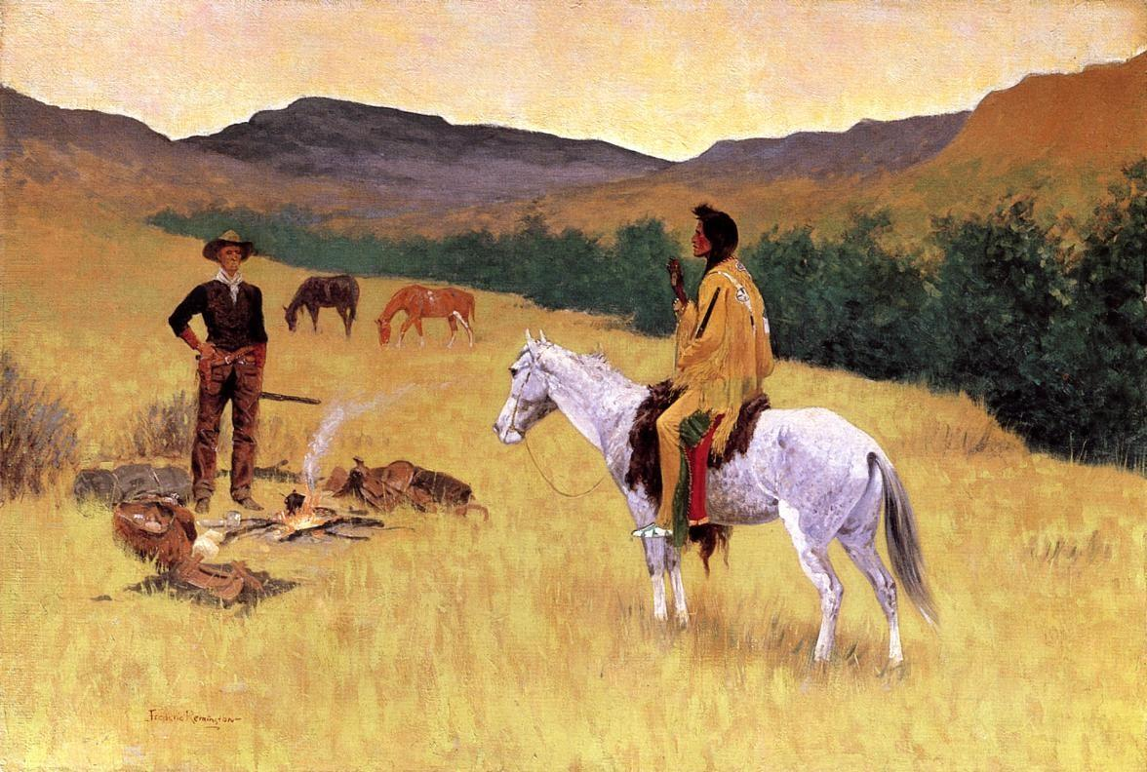
When he left Yale college he became a newspaper reporter for his uncle’s newspaper.
At 19 he took his first trip west to go camping in Montana then south to Arizona where he fell in love with the vast prairies and deserts.
Out west he spent time with cowboys, soldiers, and native tribes which inspired his drawings.

Slide 4
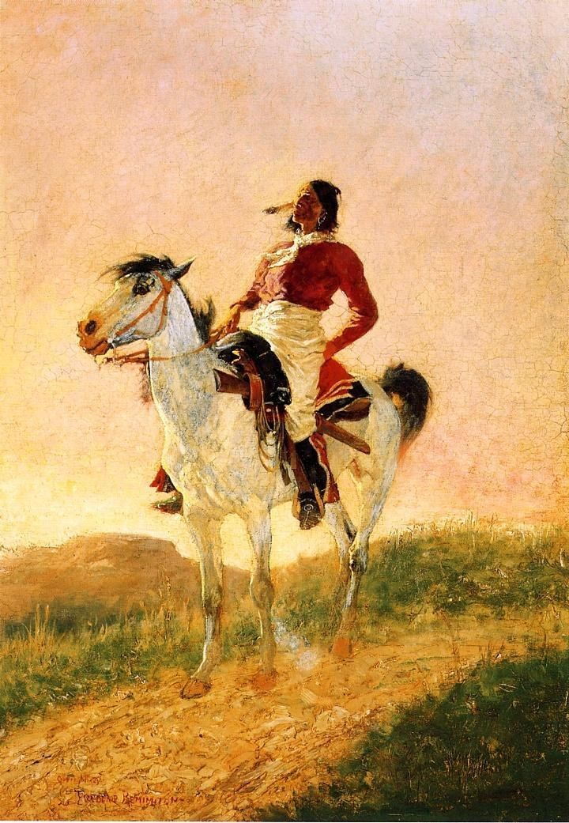
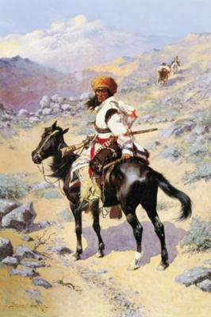
He noticed the true colors of the west and liked to paint his drawings showing different lights of day.

Slide 5
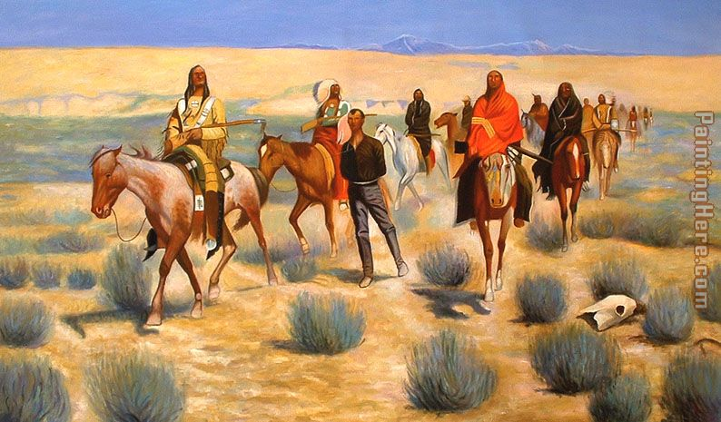
His drawings were published in many magazines which helped him become a famous western artist.
His first one man art show had 21 of his paintings and was well received.

Slide 10
