Slide 1
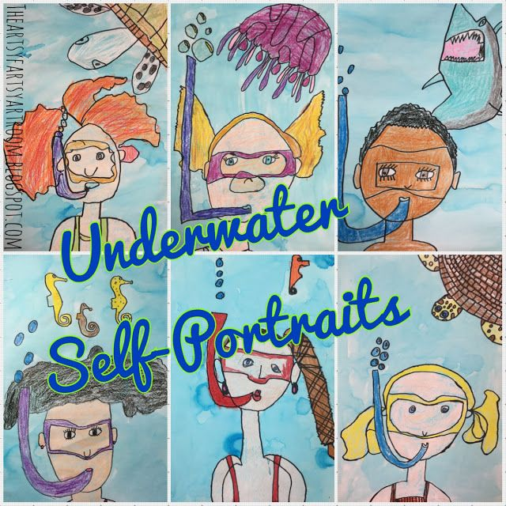
I Have Something To Say
Using Art To Get Across A Message

Slide 2
Using Art
Usually in an art lesson, we teach you a piece of theory behind art. (Theory are ideas about the way things work.) So far this year, we’ve covered creating different pattern and textures and also using contrasting colors to make things “pop” on the page.
But today’s lesson is going to be different. We’re going to learn about using art as a way to get a message across.

Slide 3
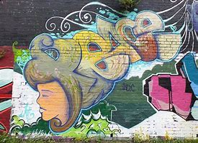
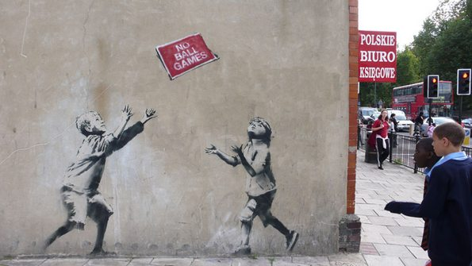
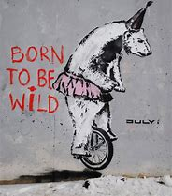
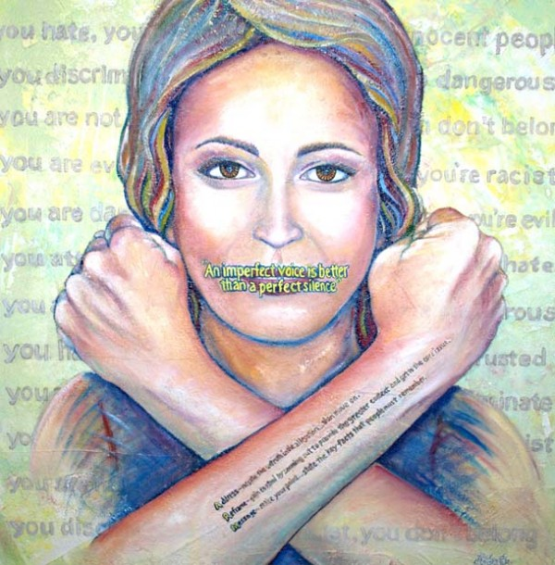
Sometimes people can feel very strongly about something and want to tell others about it. They may want something to change in the world. But they don’t know what words to use, or they might be to shy to actually say anything. Creating a picture can help them get that message to other people in an amazing way.

Slide 4
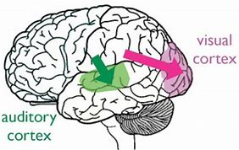
Let Me See…
Art is a “Visual Medium.” That means the we see art with our eyes. Our brains literally think differently about art because we are using a different part of our brains to make sense of what we see than if we heard the same message. This can have a profound effect on our emotions and senses.

Slide 5
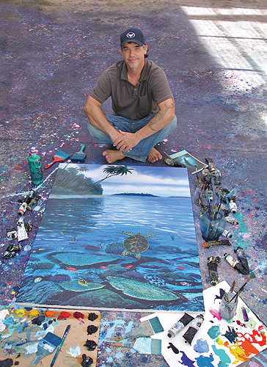
Robert Wyland
Robert Wylan grew up in Michigan. But when he was 14 years old, his family took a trip to California where he saw the ocean for the first time.
On that trip, he saw several grey whales migrating down the coast to Mexico. The whales impacted him so much that when he grew up, he moved to California and began painting whales.

Slide 6
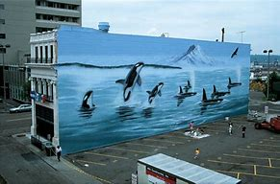
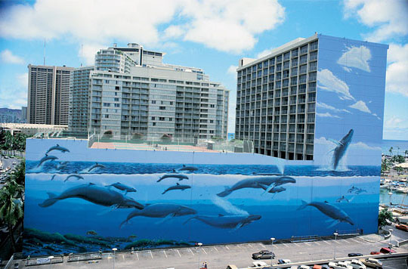
Go Big or Go Home…
But he didn’t just paint whales on pieces of paper. He wanted other people so see how huge and amazing whales were. So he painted whales and other underwater sea life on whole buildings… over 100 buildings in all!

Slide 7
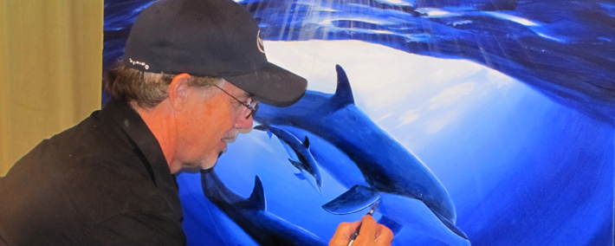
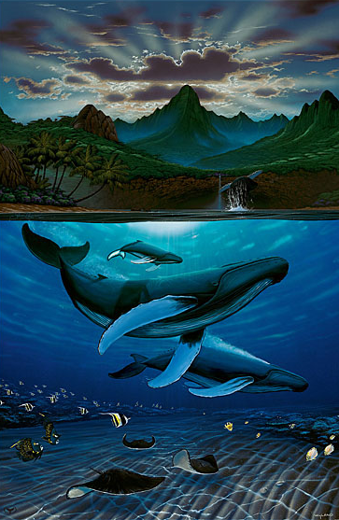
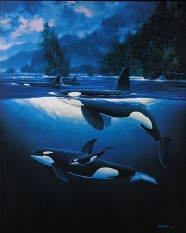
Wyland realized that we as humans are hurting our oceans and destroying underwater habitats. So using his art, he tells other people about how beautiful underwater sea creatures are and how we need to protect them.
He also started the Wyland Foundation to teach kids about the environment and to help in other environmental projects.

Slide 8
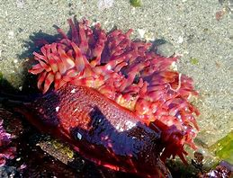
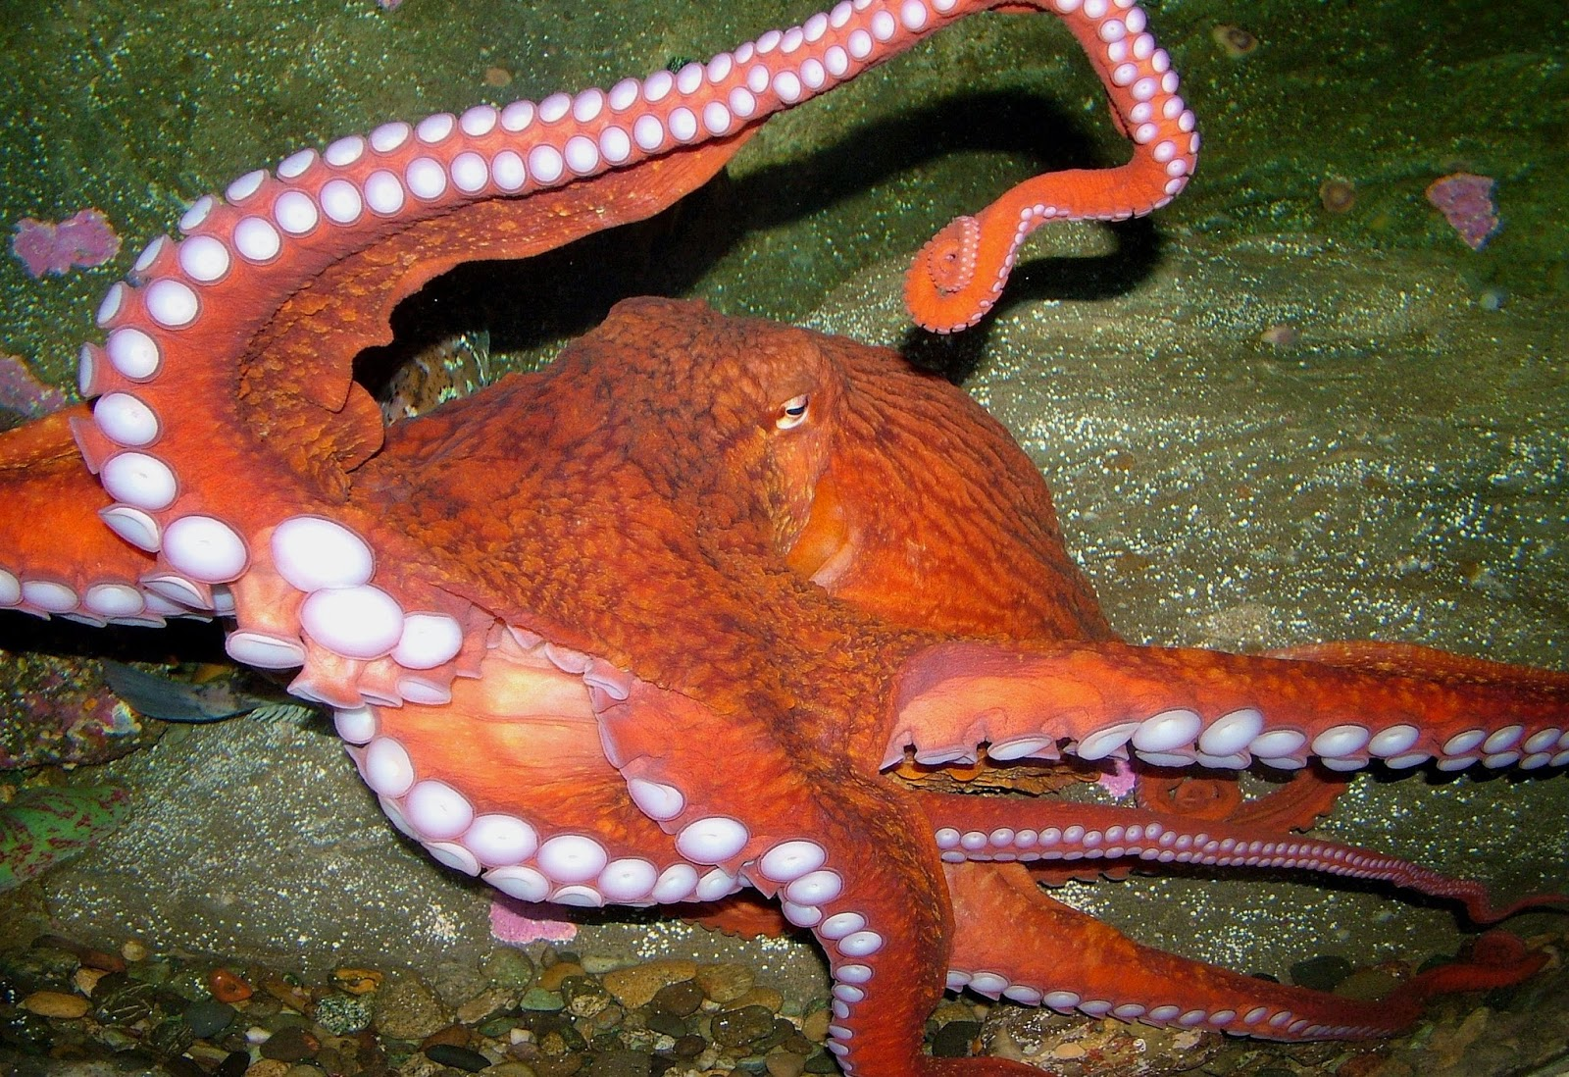
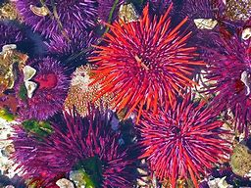
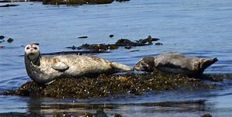
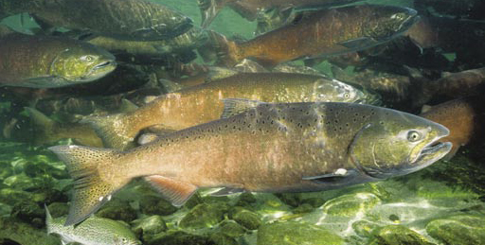
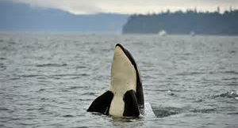
We are Sooo Lucky!
Here in Seattle we have underwater sea life all around us! You can see crabs on the beach, starfish and anemones in the water, or even orcas up in the San Juans. You can see salmon spawning in our rivers and hear sea lions barking at the Ballard Lochs.
But all that is threatened if we don’t take care of our water environments. We need everyone who lives here to know that we have to do our part not to pollute!
So you have a message to get out: protect our water creatures!
But how are you going to get your message out?

Slide 9
Create a picture of yourself and your favorite Sea Creature
It’s your turn to use art to
get out your message.
First, write your name on the
back of your paper.

Slide 10
Draw a picture of yourself from the shoulders up. Make the picture look like you’re underwater with a mask and snorkel. Use pencil and draw lightly so you can easily erase.
First, draw your head, neck, and shoulders. (Don’t draw your hair yet.)
Don’t make your head too big or too small. You’ll need room to draw a sea creature.

Slide 11
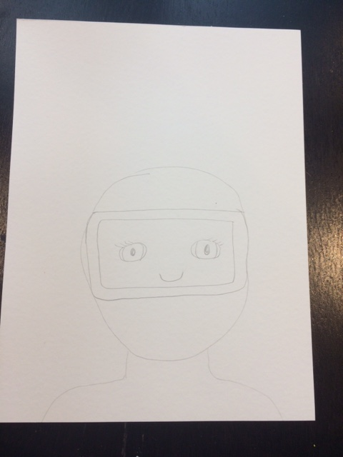
Now draw the mask AROUND your eyes and nose. The mask goes from one side of your face to the other- don’t make it too small.
Next, draw your eyes and nose.

Slide 12
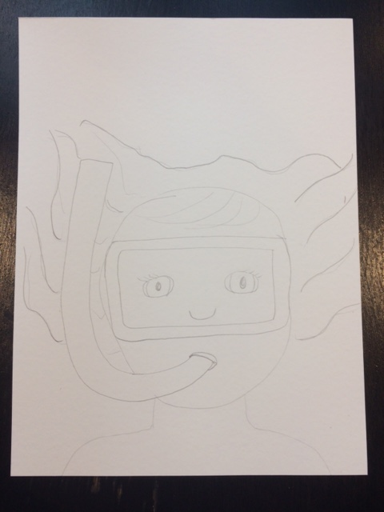
Now figure out where your mouth and the snorkel will go. Think about what your mouth would look like with a snorkel.
Draw your hair. Imagine what your hair would look like in the water.

Slide 13
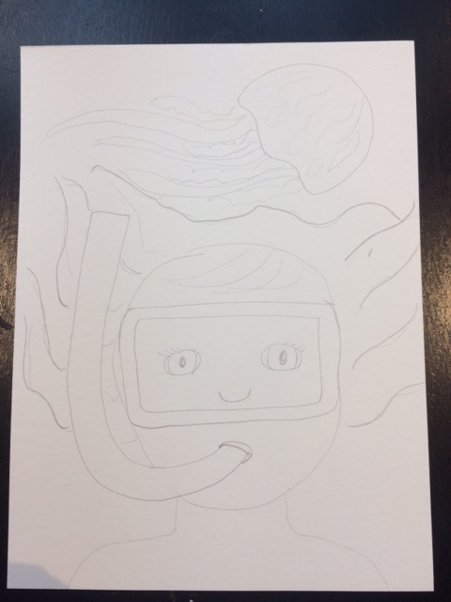
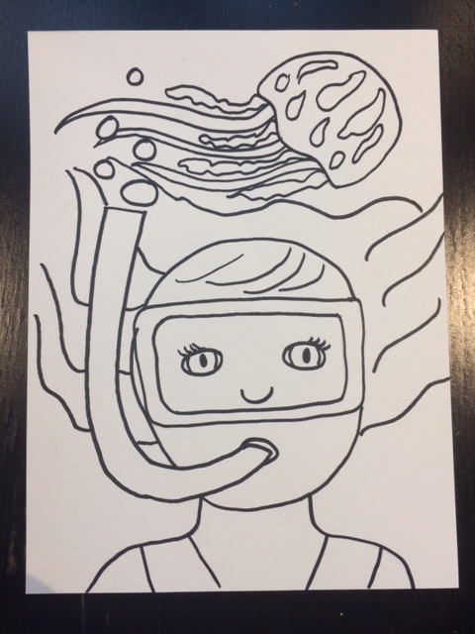
Now draw in your favorite sea animal. What sea creature do we need to protect?
Using a Sharpie, go over all your pencil lines so your drawing has a black outline.

Slide 14
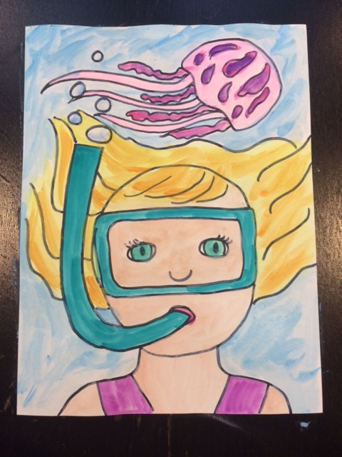
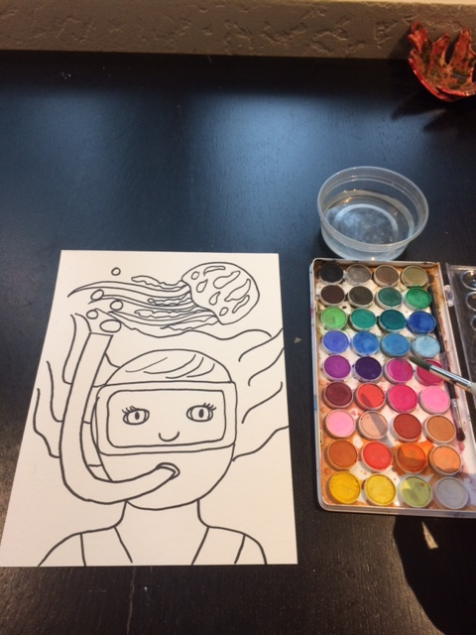
Finish by using water color paints to color in your drawing. Remember, only use a little water on your brush. Too much water will make everything sloppy and soggy.
Water color paint is fun to work with because you can layer the paint to make it more interesting.

