Slide 1
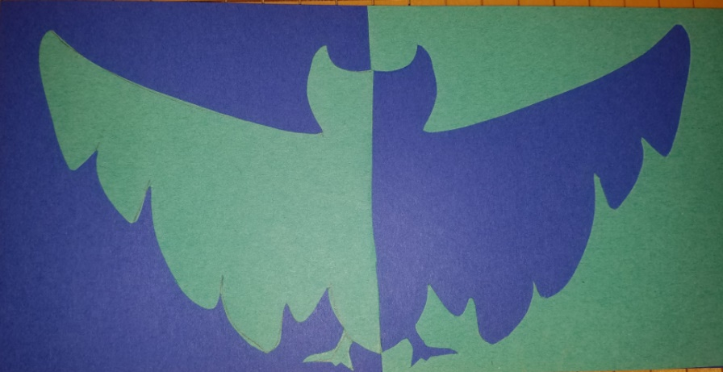
Positive and Negative Space
2nd Grade Art Project
Learning Concepts:
Shapes, Space
Last updated: 2/6/2020

Slide 2
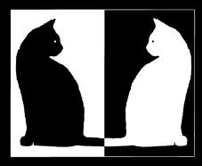
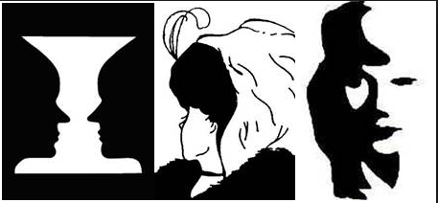
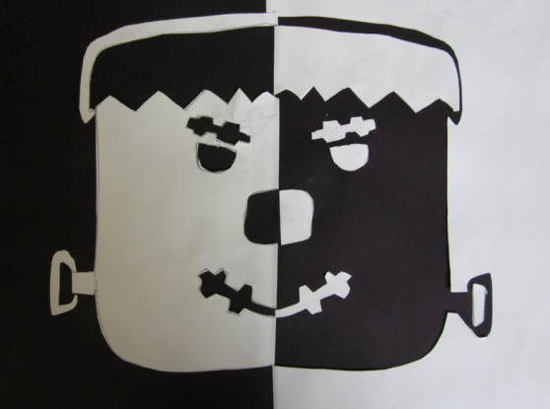
Positive and Negative Space

Slide 4
Penguin or Batman?

Slide 5
Balanced
… is the distribution of the visual weight of objects, colors, texture, and space. If the design was a scale, these elements should be balanced to make a design feel stable.

Slide 6
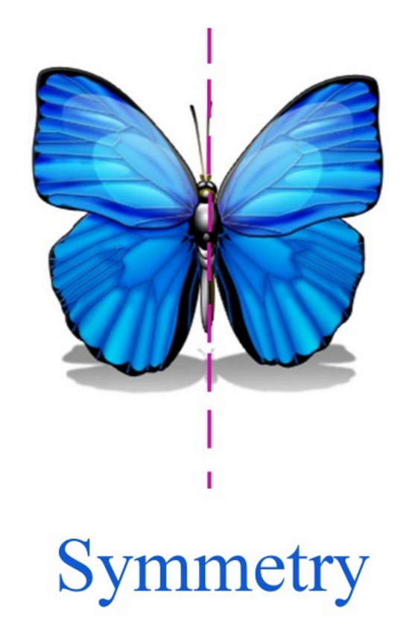
Symmetry

Slide 7
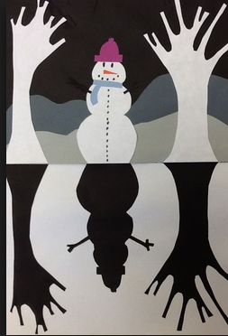
Key Vocabulary:
Space- the area above, below, between & through objects in a piece of art.
Positive Space-the main shapes or forms (main objects or shapes) in an artwork
Negative Space– the empty or non-interesting space between and around the main objects
Positive & Negative Space Reversal-visually switching back & forth between the positive & negative space. Positive space becomes negative & visa versa.
Symmetrical Balance– a design is the same or almost exactly the same on both sides

Slide 8
Escher’s tessellations
In these illustrations Escher is playing with the POSITIVE & NEGATIVE SPACE or figure-ground relationship in the images.
You see dark horsemen facing to the right and light horsemen facing the left. Each one fits perfectly in the spaces around the others like puzzle pieces.
The images changes based on what you focus on.

Slide 9
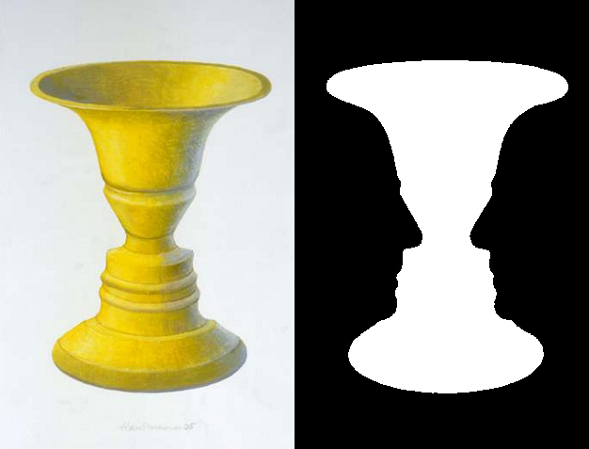
Rubin Vase
Figure – Ground relationship.
What do you see?
A Vase?
Figure
Two faces?
Ground

Slide 10
Which is Which?
Positive Space – Your Hands
Negative Space – is the space around your hands
The heart shape is created in the negative space between your hands.

Slide 12
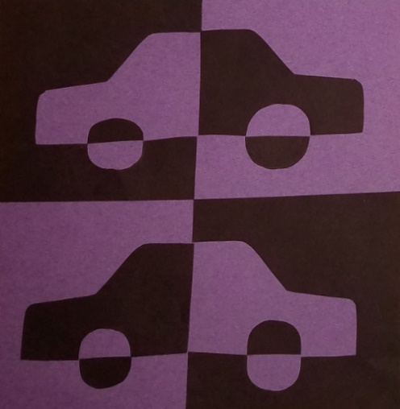
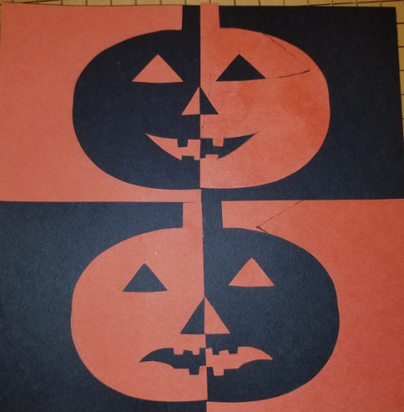
Today’s Project
You will create a series of images that show a figure/ground (backGROUND) relationship with positive & negative space.

Slide 13
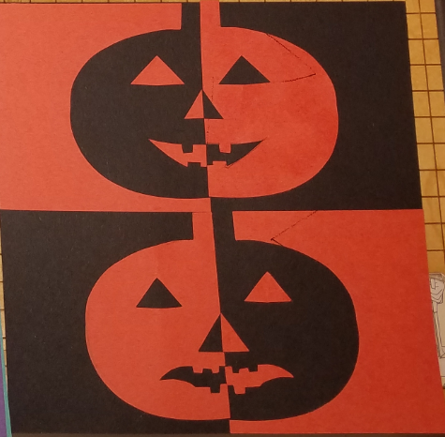
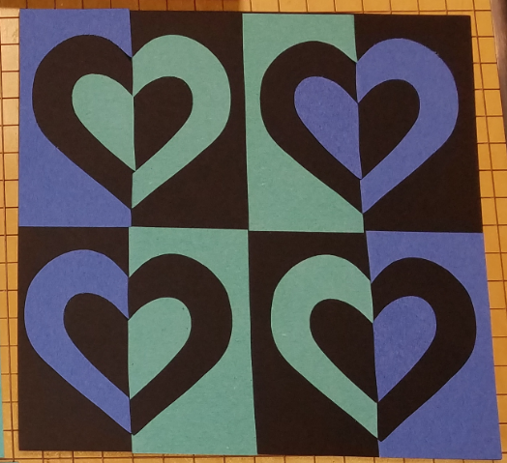
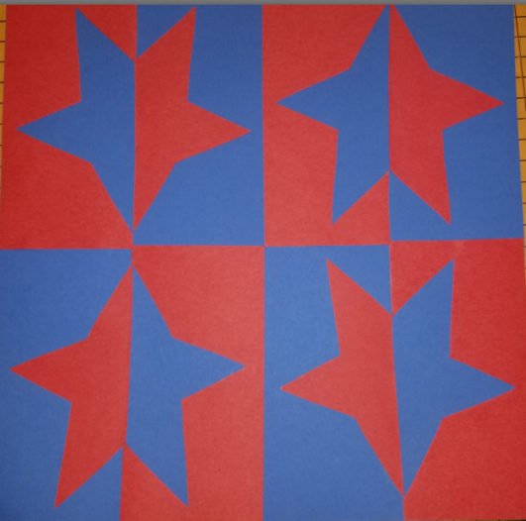
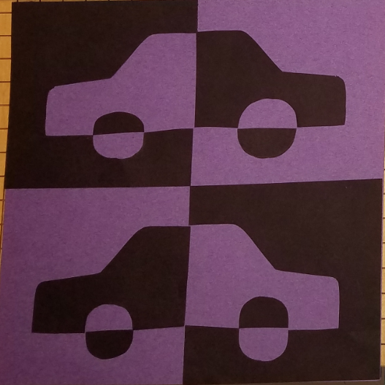
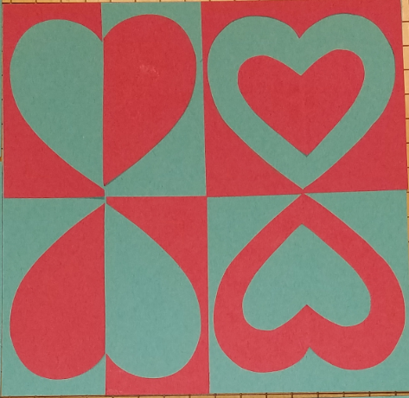
Ideas / Examples

Slide 14
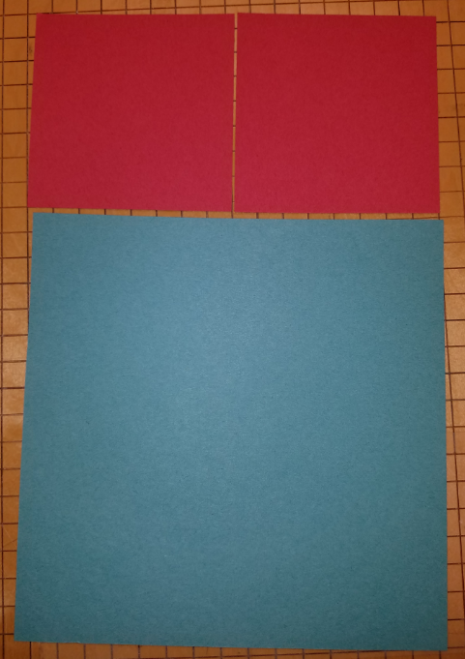
Materials
2 small squares of colored paper
1 large square of colored paper
Scissors
Pencil
Glue stick

Slide 15
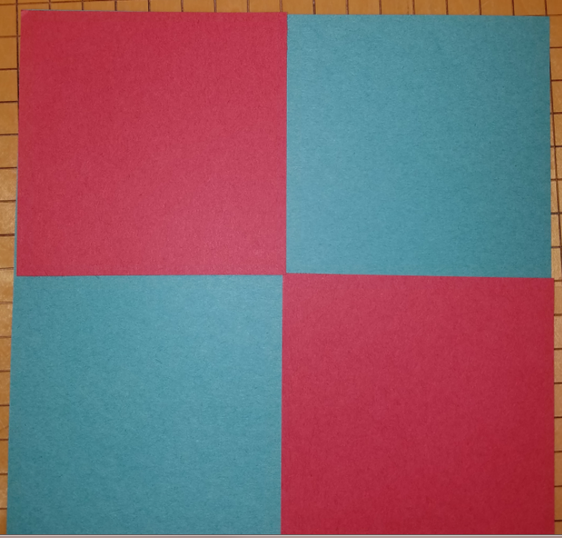
Steps
Choose two contrasting colors
Arrange the small squares onto your paper.

Slide 16
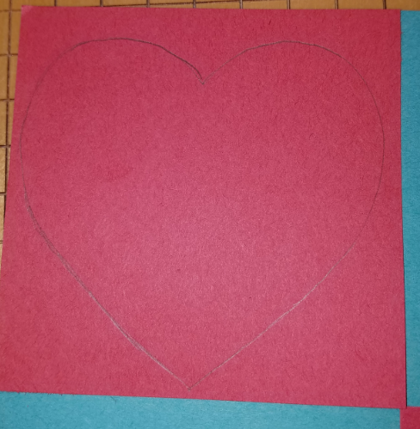
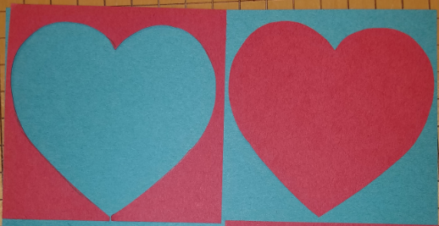
Steps
Draw Your design on the small square.
Cut the shape out
Do not throw anything away!
Lay the positive and negative shapes next to each other
Do this 2 times.

Slide 17
PREVIEW: This is what we are going to end up with after we cut both squares

Slide 18
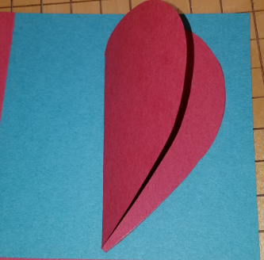
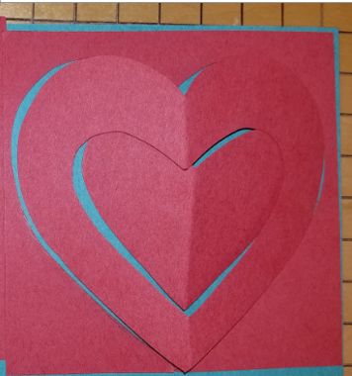
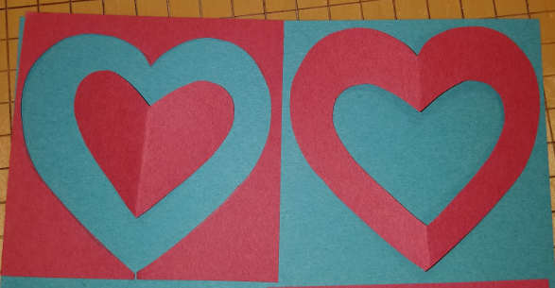
1st Shape
1. Take the first design and fold it in half symmetrically.
Cut out another design from the folded shape.
2. Lay the shapes opposite from each outer

Slide 19
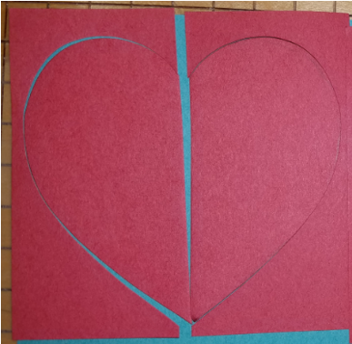
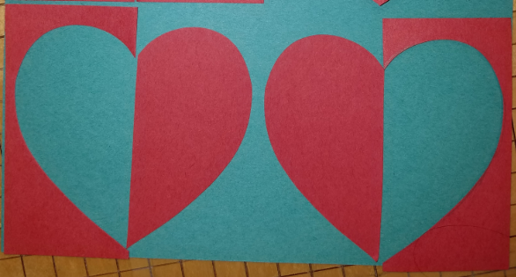
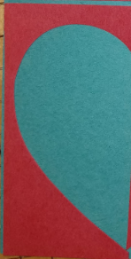
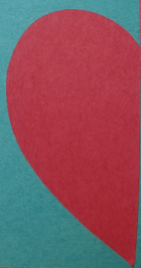
2nd Shape
Using the 2nd square, cut each piece in half.

Slide 20
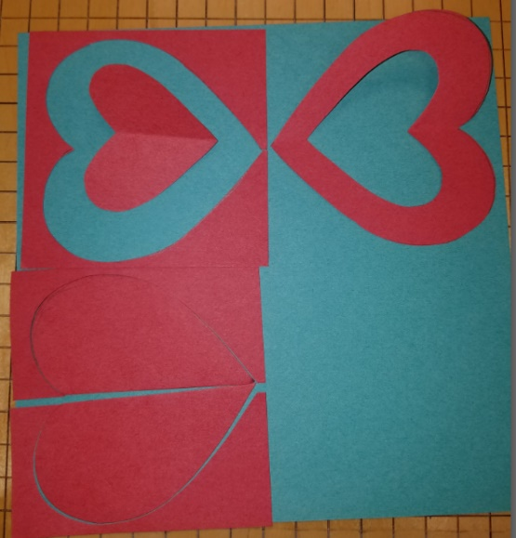
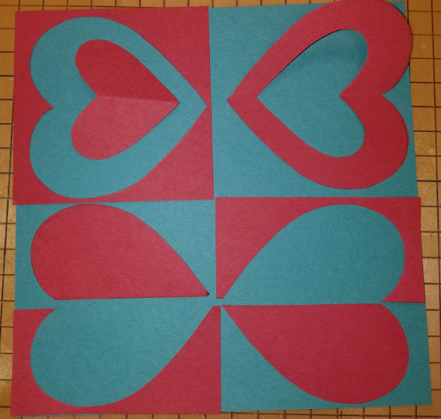
Final Step
1. Start with all shapes on the same side of the large square.
2. Flip every other piece over to the opposite side.
Remember balance and symmetry!

Slide 21
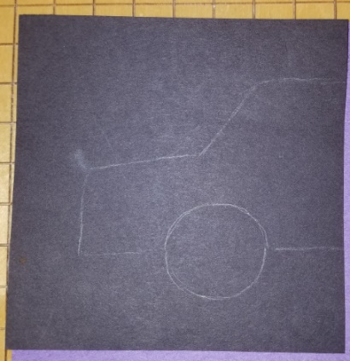
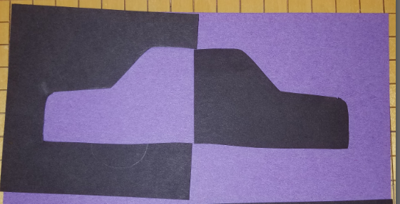
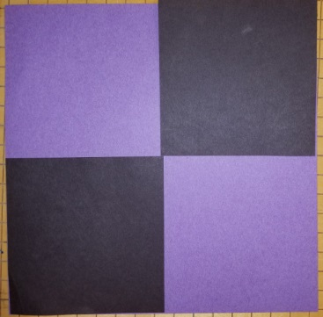
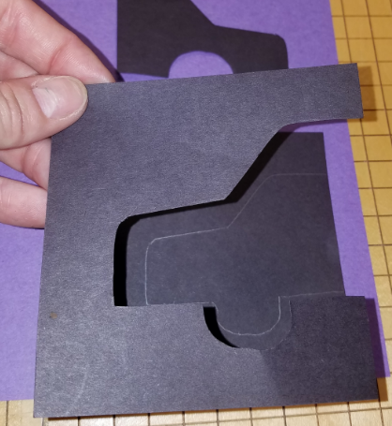
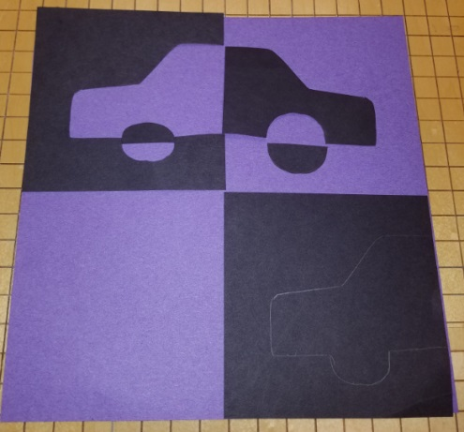
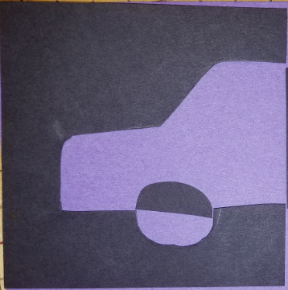
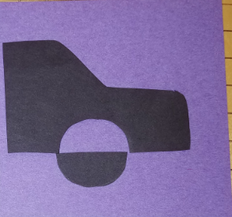
Another Design Idea

Slide 22
