Slide 1
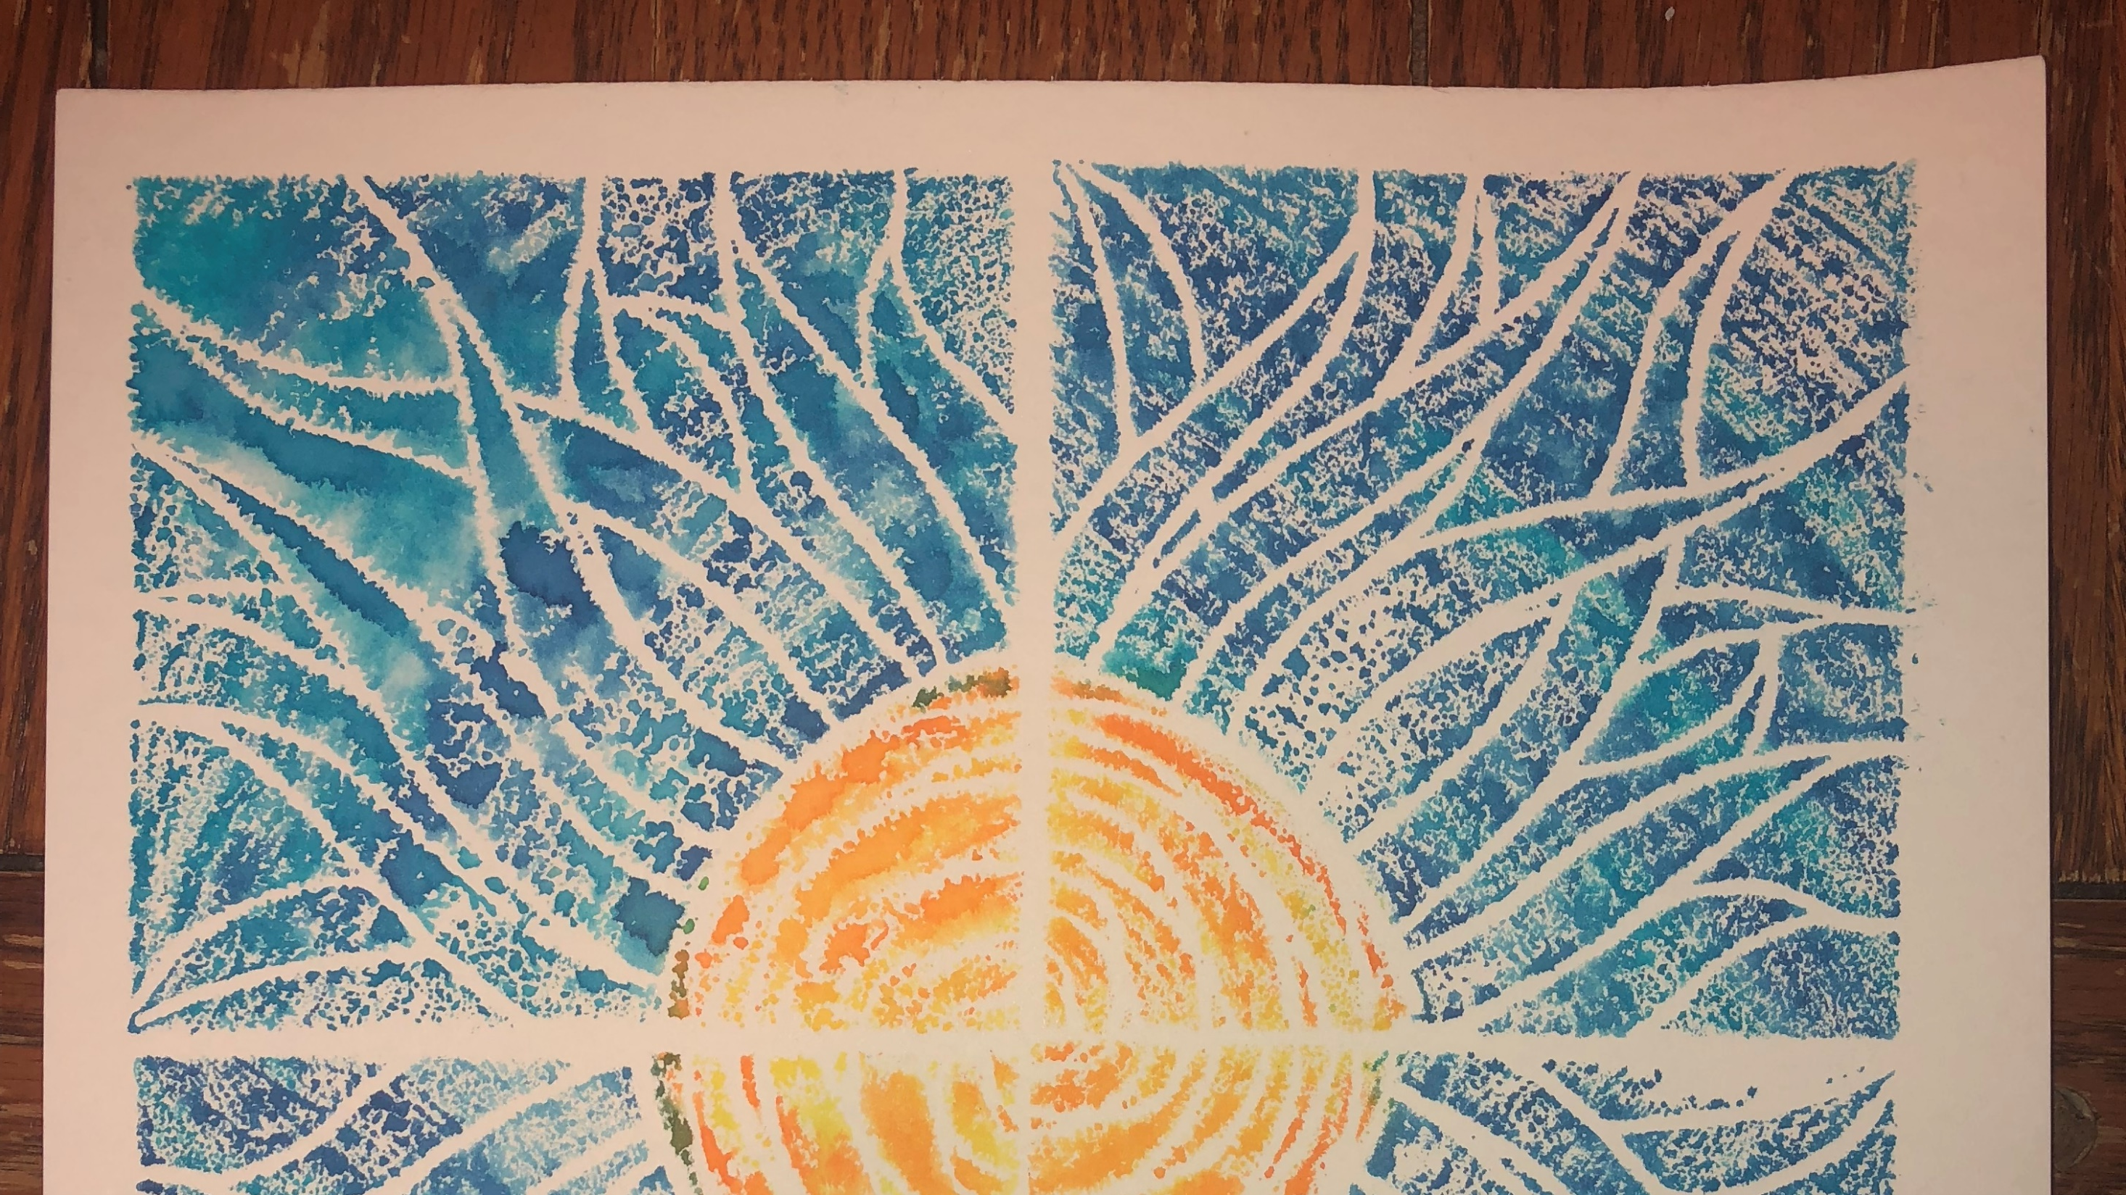
Printmaking
2nd grade

Slide 2
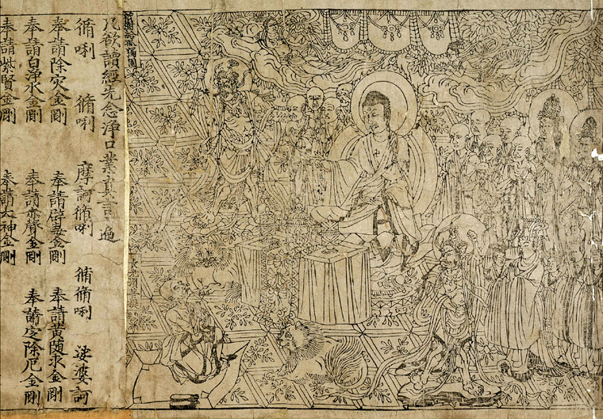
Printmaking - making pictures or designs by printing them from specially prepared plates or blocks.
Printmaking originated in China after paper was invented around AD 105. Relief printing appeared in Europe in the 15th Century, when the process of papermaking was imported from the East.
This image is the Chinese Diamond Sūtra, from the oldest known dated printed book in the world (AD 868)

Slide 3
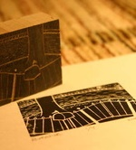
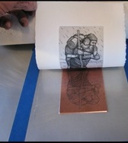
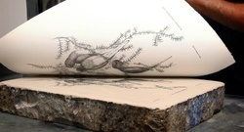
Process of Printmaking
Printmaking is where an artist creates an image using one material, (for instance wood, metal plate, styrofoam etc..) by etching, or carving lines into that material base.
Once the lines have been created, the artist then puts dye or paint over the material base, then carefully flips the material base over onto another material (usually paper)
The artist then presses down on the base to make an impression.
The artist carefully lifts the base off the paper, leaving one print behind.
The point of printmaking is to make several "prints" of the same image, in order to create the image you desire as an artist.

Slide 4
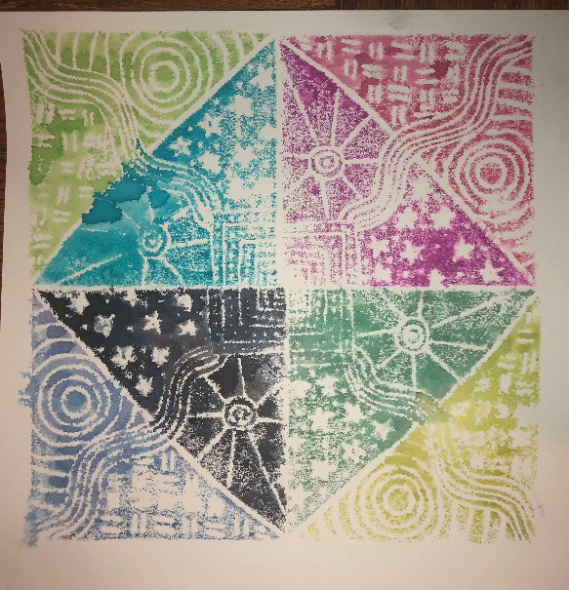
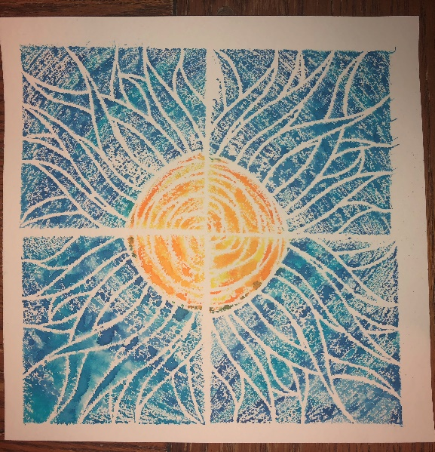
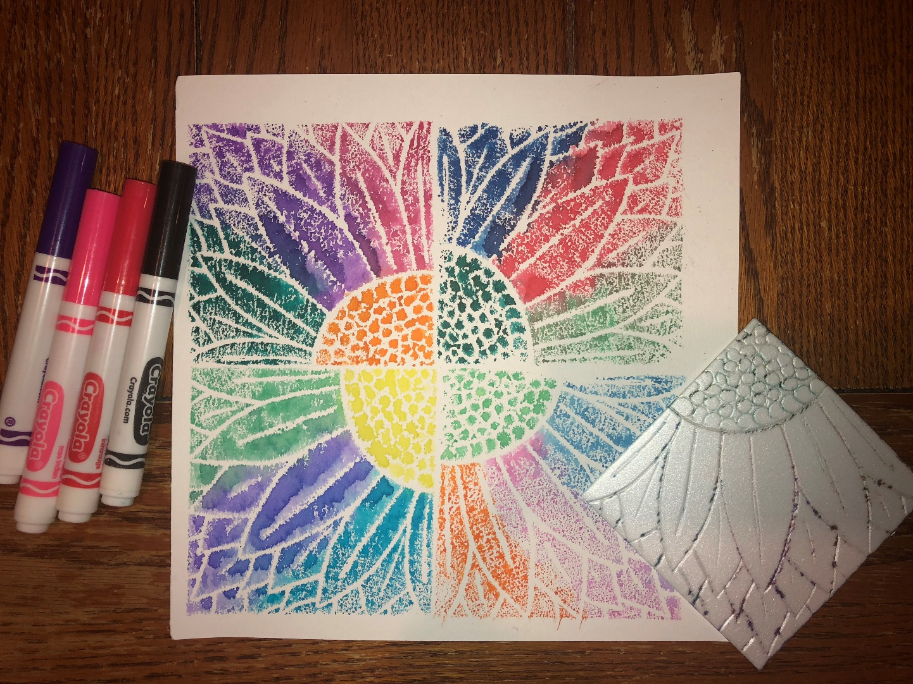
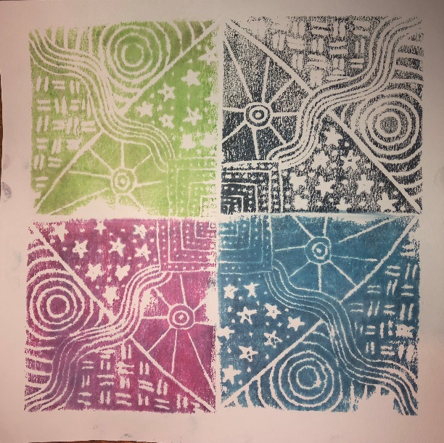
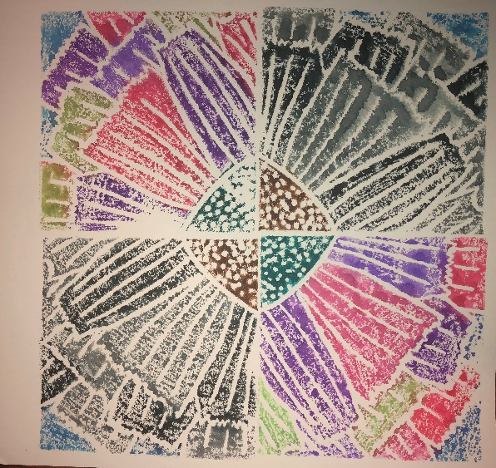
Let’s Make Some art!
Today we will be printmaking with Styrofoam and markers.

Slide 5
BEFORE YOU START ANYTHING….
WRITE YOUR NAME ON THE WHITE PAPER AND THEN FLIP IT OVER!

Slide 6
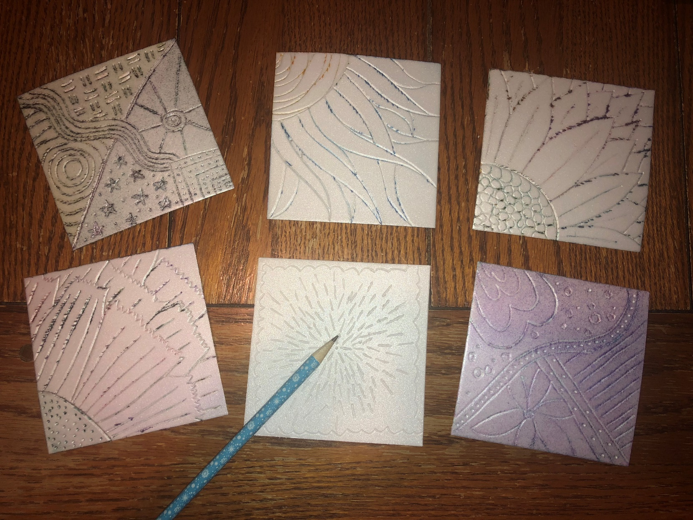
STEP 1: CREATING A PRINTING PLATE
We start with a piece of Styrofoam about 4 inches square.
Draw a relatively simple design in the Styrofoam. Drag the pencil through the Styrofoam as opposed to punching it down. We want the lines of your design to be carved into the Styrofoam.

Slide 7
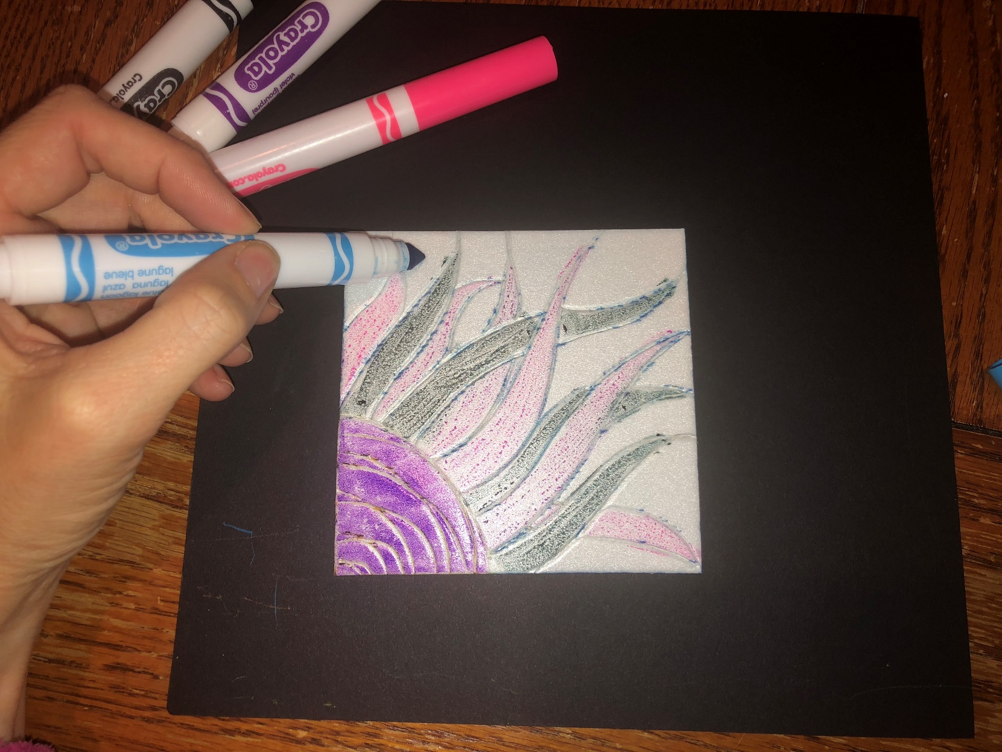
STEP 2: ADDING COLOR
After you have carved your outlines using a pencil you are ready to add color.
Using washable markers color the parts of the Styrofoam that remain raised. There is no reason to try to add color into the Styrofoam lines.
You can color all one color or use multiple colors. You can even try blending colors. You can’t go wrong!
Make sure to color the WHOLE plate. You don’t want any raised area without color.
**The colors will look faint. Don’t worry! They will brighten up when you print them.**

Slide 8
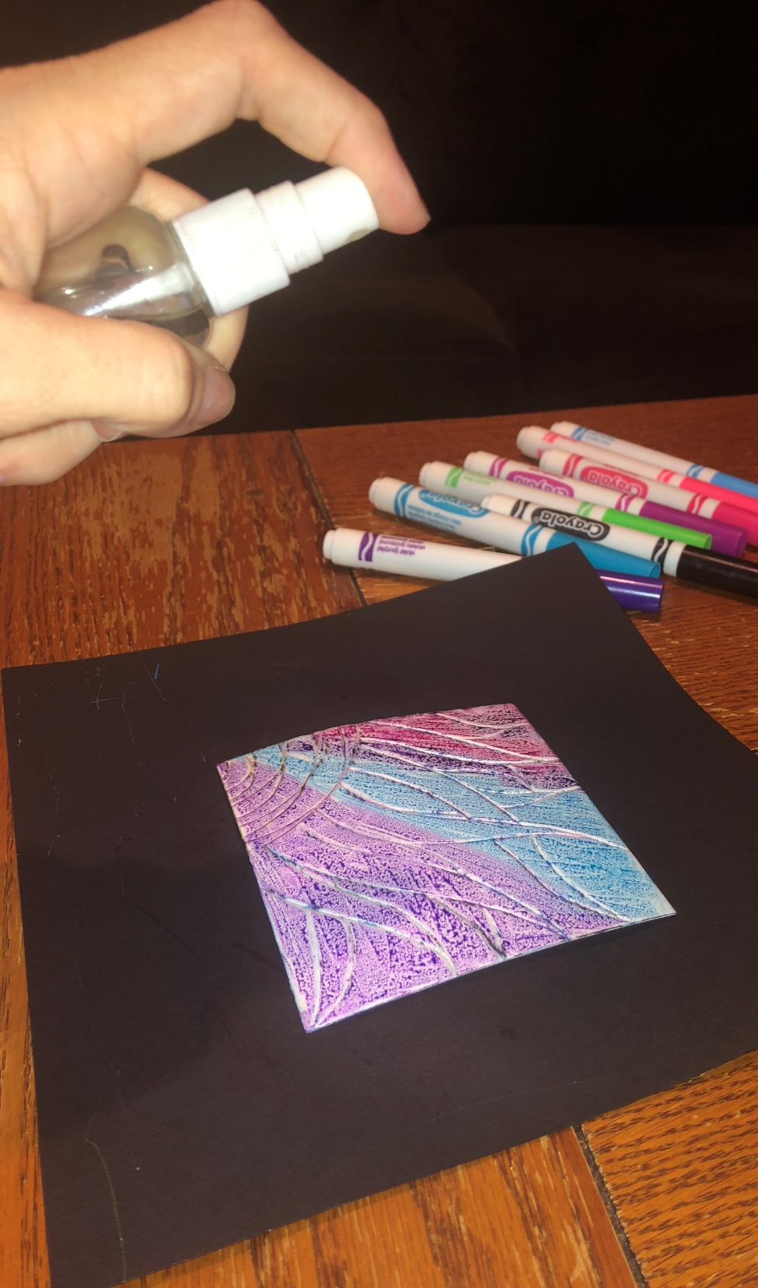
STEP 3: PRINTING
The colored printing plate should be sitting on the table face up.
Using spray bottle, spray 3 times from about 6 inches above printing plate. DON’T SPRAY TOO CLOSE!
Have your white paper ready and then carefully pick up your printing plate trying to touch only the sides.

Slide 9
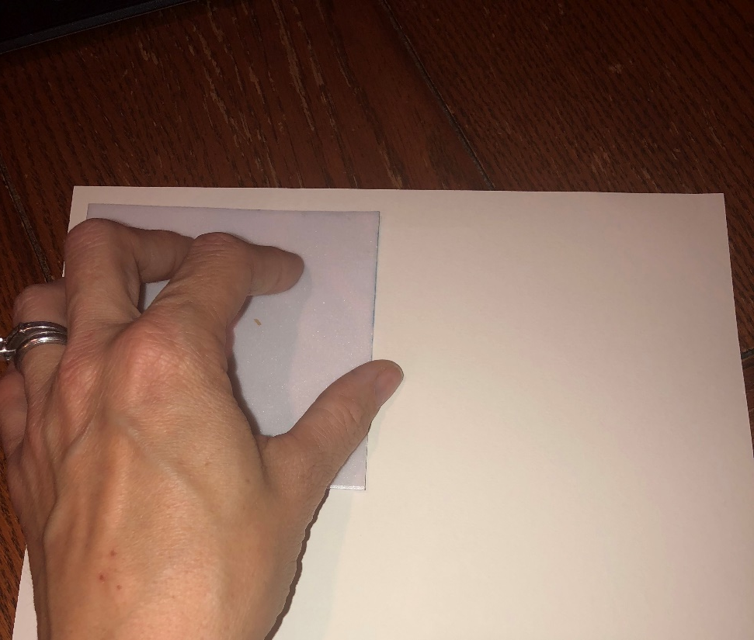
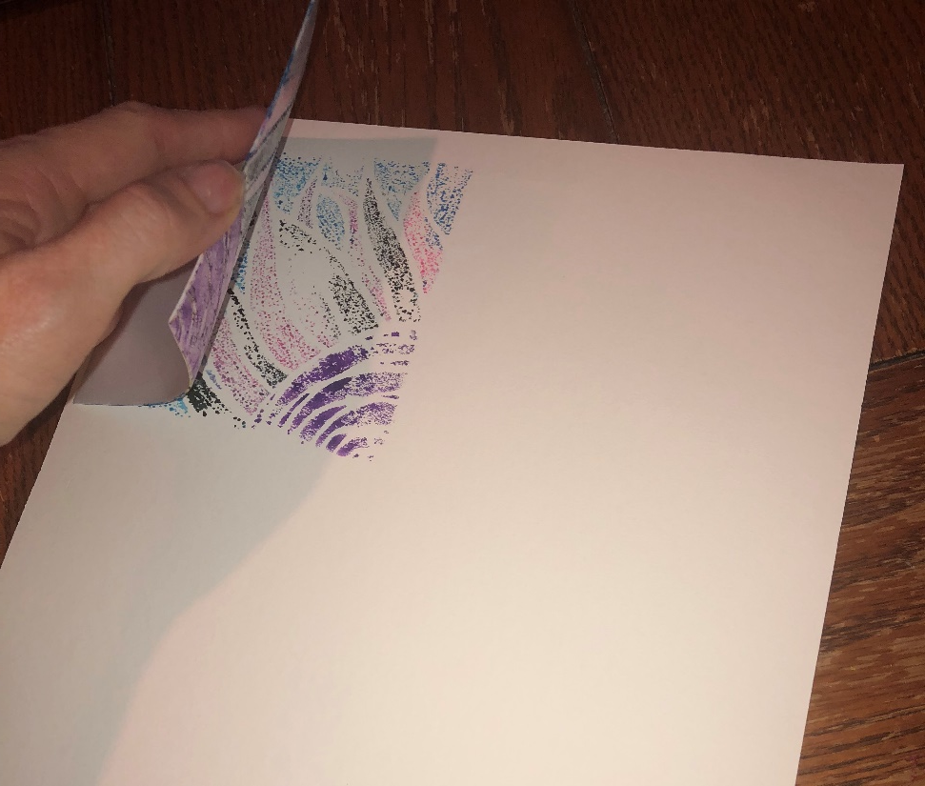
STEP 3: PRINTING
Carefully place the printing plate face down on the white paper starting from one corner. You will be repeating your print 4 times on this same piece of paper.
Press down on your plate without letting it move around. If it moves, your print will be smudged
Pull up your plate from one edge to reveal your print.

Slide 10
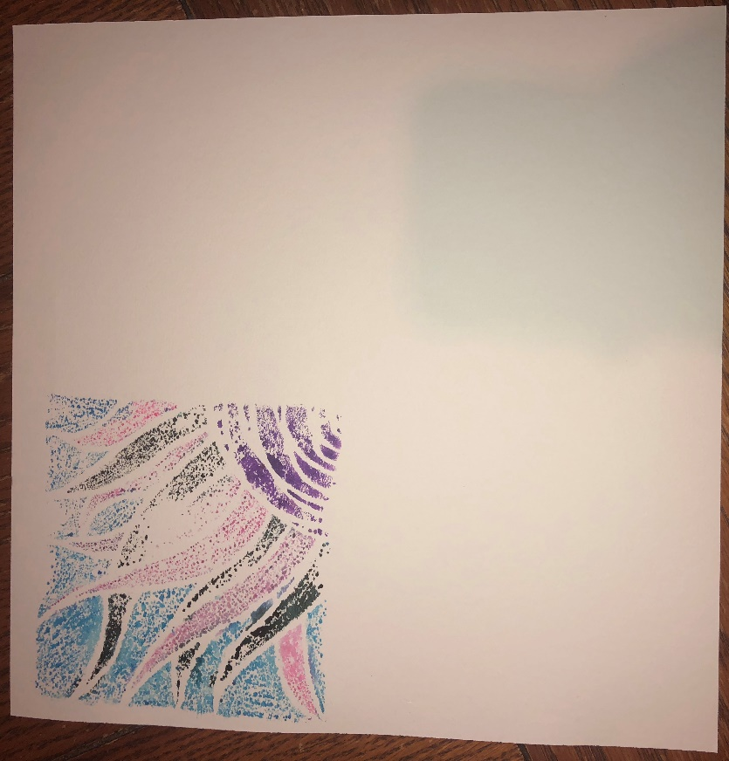
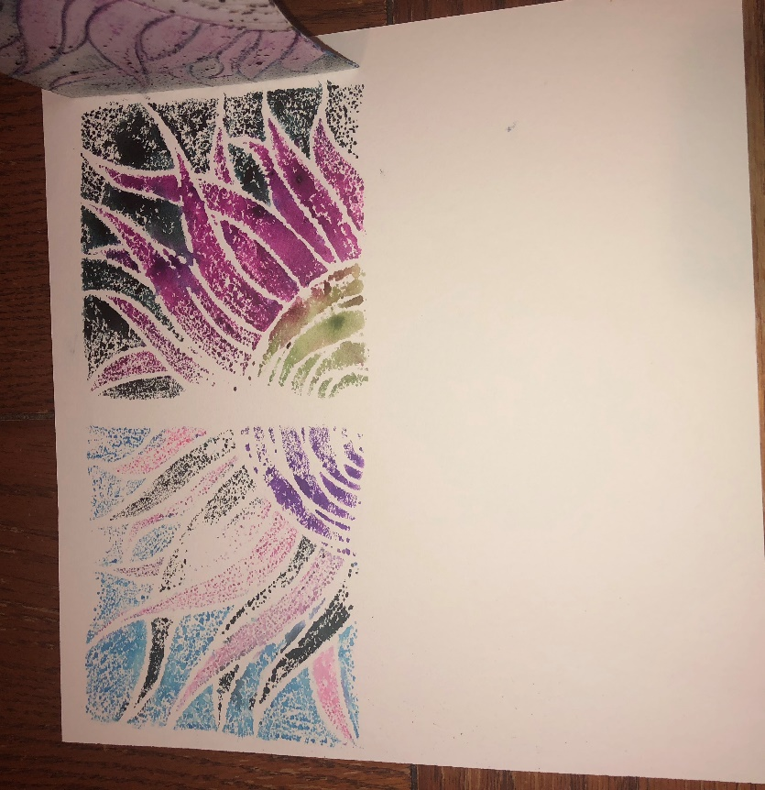
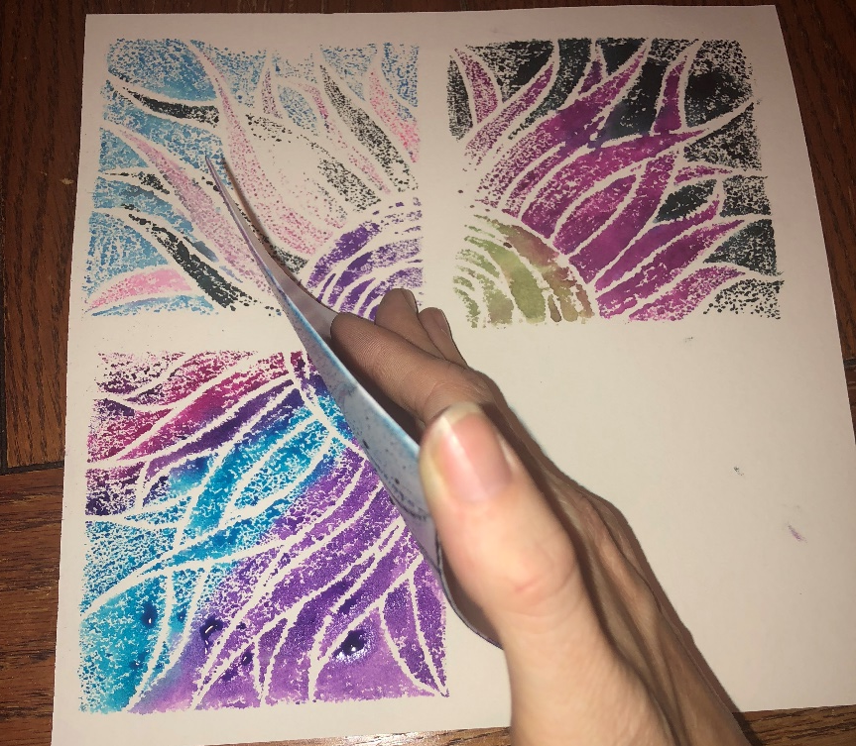
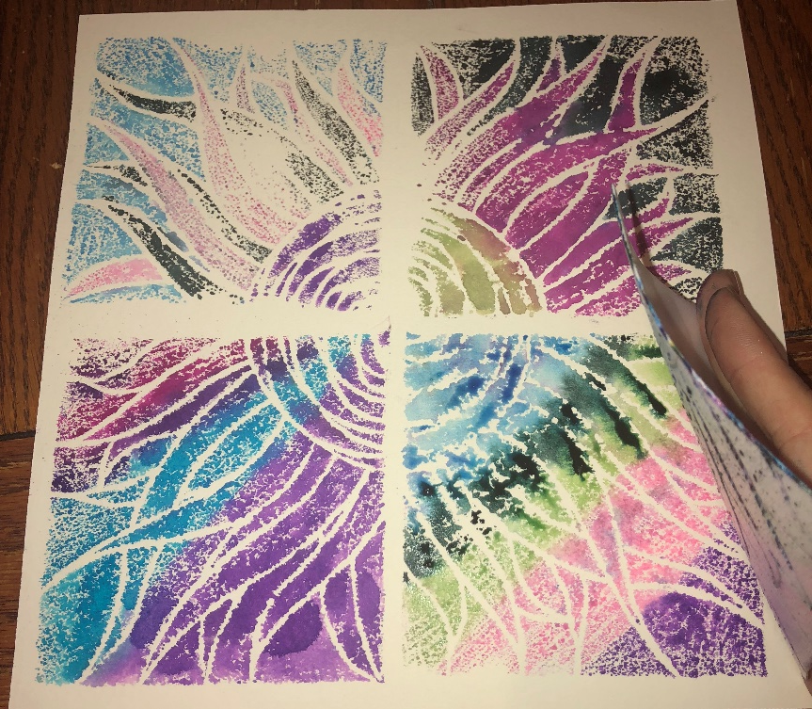
STEP 3: PRINTING
Using a paper towel, wipe off your printing plate.
Recolor your printing plate again with markers. You may chose different colors this time.
Reprint using the same process as before, but in a different corner.
Repeat this process 2 more times.

Slide 11
For Docent:
Materials needed:
White watercolor paper (one per student)
4”x4” Styrofoam (one per student)
Crayola markers
Spray bottles
Dull pencils
Paper to cover tables
Paper towels (at least one per student)
Drying rack

