Slide 1
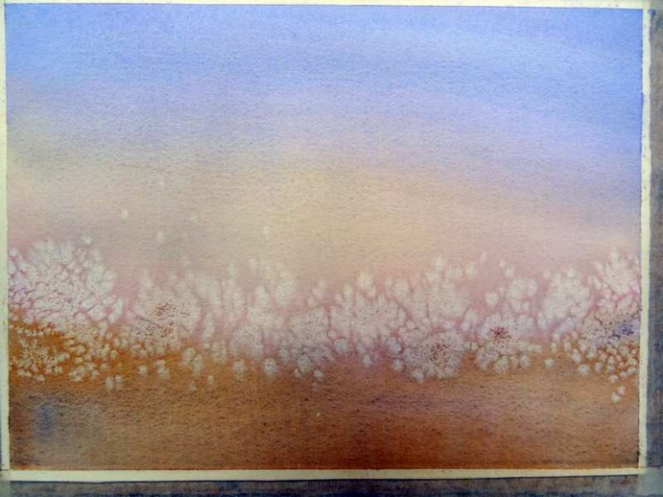
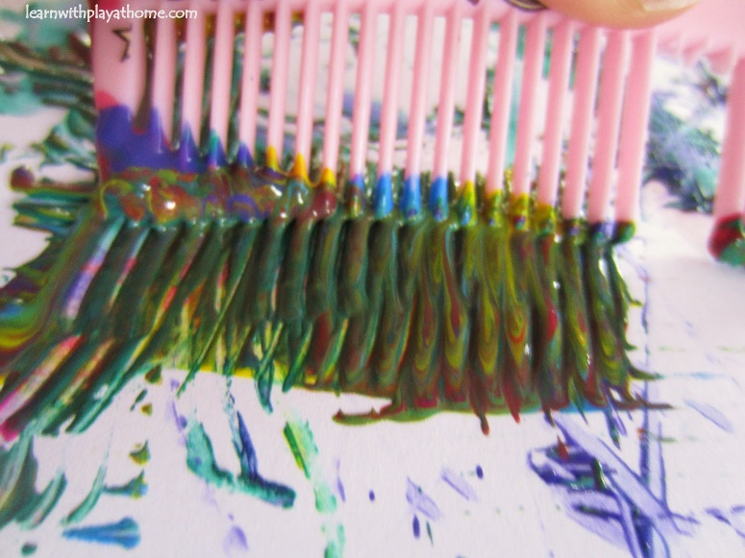
Salt, Comb, Sponge and Bubble Painting

Slide 2
Texture using paint and tools
We will be adding salt into our sea life art to create the feeling of sand and salty ocean water. Paint the bottom 1/3 of your paper with sandy brown, and the top 2/3 of the paper ocean blue. Your paint will have table salt mixed into the paint already
We will be painting a 1/2 sheet of white paper solid green, then using a comb to add lines of texture. These will be our sea weeds.
Using sponges, we will be blot painting in a random pattern without washing out our sponge. Each of you will get a small paper plate with a palate of light green, yellow, and light orange, blue and white. Fill your entire white paper blotting up and down with your sponge. Keep layering the colors as you go.
Have you ever painted with a straw and bubbles before? With your straw, gently blow into a mixture of dish soap, water, and tempura paint. Set your white paper over the bubbles to create circular images. This will eventually become your sea star and coral for your reef. Work together with the partner across from you. One creates the bubbles, while the other catches them on their paper.
Notes:
,

Slide 3
SET UP
Cover 4 tables (bubble painting, combing, salt, and sponge)
Supplies needed…
Bubble table-Dish soap, 8 containers (4 purple, 4 red), straws for each child, ½ sheet white tagboard paper. Mix a large squirt of dish soap with one color tempura paint, and some water. Stir aggressively to get the mixture bubbly.
Combing table-paint combs, ½ sheet tagboard, large paint brushes, small paint dishes, dark green tempura paint
Salt table-large sheet of white construction paper, light brown tempura paint, blue tempura paint, small paint dishes or reusable dishes with lids, table salt, water cup and paper towels for rinsing between colors.
Sponge table-sponges, large binder clips, 9x12 sheet of white tagboard paper, small paper plates for each child with very small amount of light green, yellow, orange, blue, and white tempura paint.

Slide 5
Salt-large sheet of white construction paper, light brown tempura paint with salt added, blue tempura paint with salt added.
Cover table. Write name on the back of a 12x18 white sheet of construction paper.
Draw a light pencil mark across the paper horizontally 1/3 of the way up from the bottom dividing the sand from the water.
Paint the bottom 1/3 of the paper brown. Be sure to scoop up the salt within the paint and spread as desired.
Paint the top blue scooping the salt and spreading it as you go.
Set in drying rack to dry completely.

Slide 6
BUBBLE PAINTING

Slide 7
Bubble table-Dish soap, 8 containers (4 purple, 4 red), straws for each child, ½ sheet white construction paper Mix a large squirt of dish soap with one color tempura paint, and some water. Stir aggressively to get the mixture bubbly
Cover the table with a waterproof table cover. Have kids write their names clearly on one side of their paper.
Mix red tempura paint with a large squirt of dish soap and a little water into 4 containers. Mix aggressively to get the bubbles going.
Mix purple tempura paint with a large squirt of dish soap and a little water into 4 containers. Mix aggressively to get the bubbles going.
Have each child begin with their straw gently blowing into their paint.
Set the white paper over the top of the colored bubbles creating an image on the paper. Repeat with both purple and red. Have kids work together, one blowing bubbles, while one catches the paint on their paper. Only use one straw per kid! Repeat until desired result.
This will be used to create coral and a sea star
Wipe down table as best you can and get ready for the next group.

Slide 8
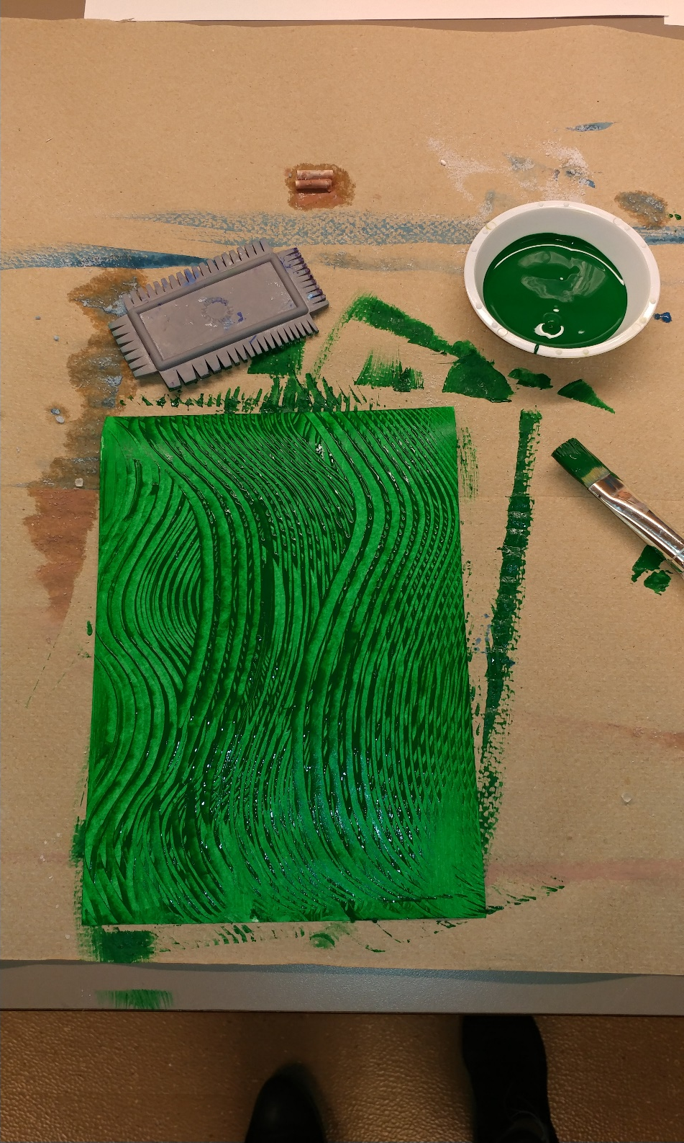

Slide 9
Combing table-combs, ½ sheet tagboard, large paint brushes, small paint dishes, dark green tempura paint
Cover the table. Have kids write their name clearly on one side.
Use a large piece of paper as a mess mat under each child’s work.
Have kids paint their entire light green ½ sheet of paper with dark green paint.
Let them experiment with the comb tools to add lines of texture.
Throw the mess mat if needed and replace for the next group.

Slide 10
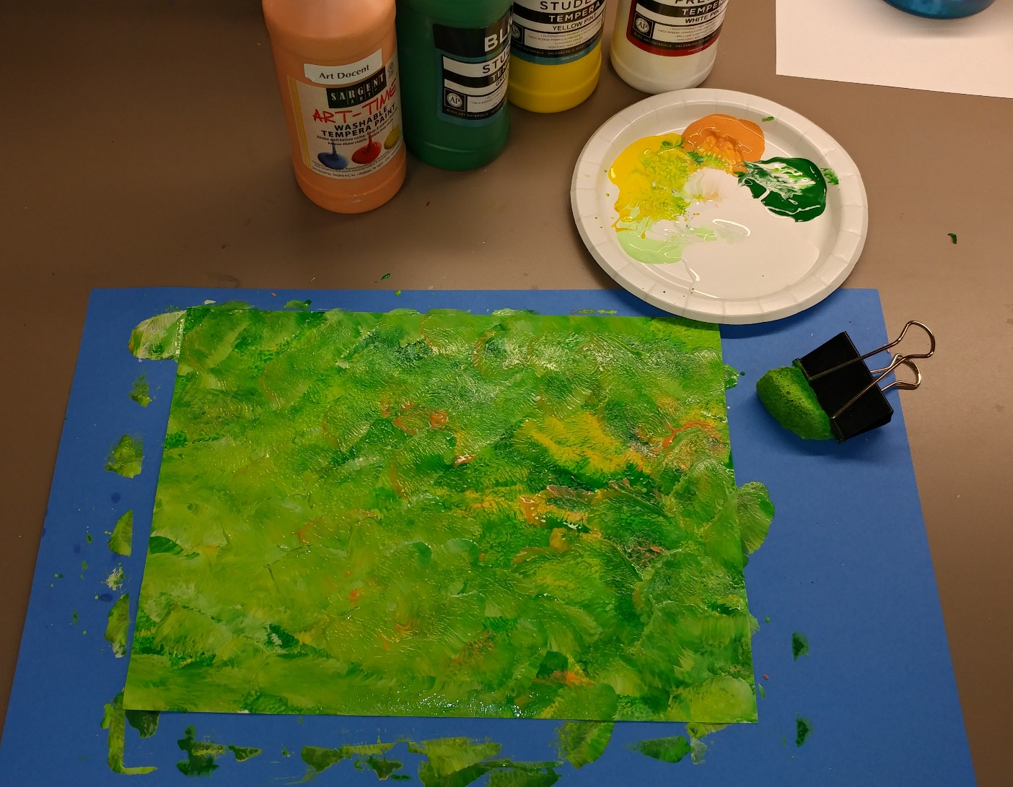

Slide 11
Sponge Painting-sponges, binder clips, 9x12 sheet of white construction paper, small paper plates for each child with small amount of light green, yellow, orange, and white
Cover table. Have kids write name on their 9x12 sheet of white paper
Give each child their small paper plate with very small amount of each of 5 tempura colors, green, yellow, white, and orange and blue.
Using a large binderclip pick up the sponge and begin adding color in a random pattern. Mix white in to create lighter colors across the paper. Fill the entire paper. Let dry
Throw the plates in the garbage when finished. Quickly rinse the sponges and give the next group of kids new plates of paint.

Slide 12
ASSEMBLING – the next lesson
In the classroom-Before the lesson, find each of the child’s pieces and have them together ready to go. I always pre-mount the background onto the large black paper for a more polished look. If doing this step, be sure to transfer the child’s name before using tacky glue to glue it down.
Use the templates provided to trace and cut out shapes for the reef art.
Use the turtle and fish templates with your 9x12 sponge art. Trace onto the white unpainted side. Cut on your lines. Use extra pieces to create your own sea life ideas.
Draw long wavy lines parallel to each other on the white unpainted side using the longest part of your dark green combed painting piece. Cut along the lines. Taper the tops to give the image of tall sea grass. Make some smaller, skinnier, or put some together to make a clump of weeds.
Trace the sea star onto the unpainted side of your red and purple bubble art. Use extra pieces to create additional sea life if you choose. (smaller stars, fish, jellyfish…)
Set your pieces onto your background and decide how you would like it to look.
Use the tacky glue with popsicle sticks or glue brushes to glue the pieces down.

