Slide 1
Materials needed
Stand Up Self Portrait heads
Ovals on copy paper – 1 per student (some originals are in art docent closet – make copies for your class)
Colored pencils (students should have them in class)
Beads, buttons and yarn for embellishment
Glue guns

Slide 2
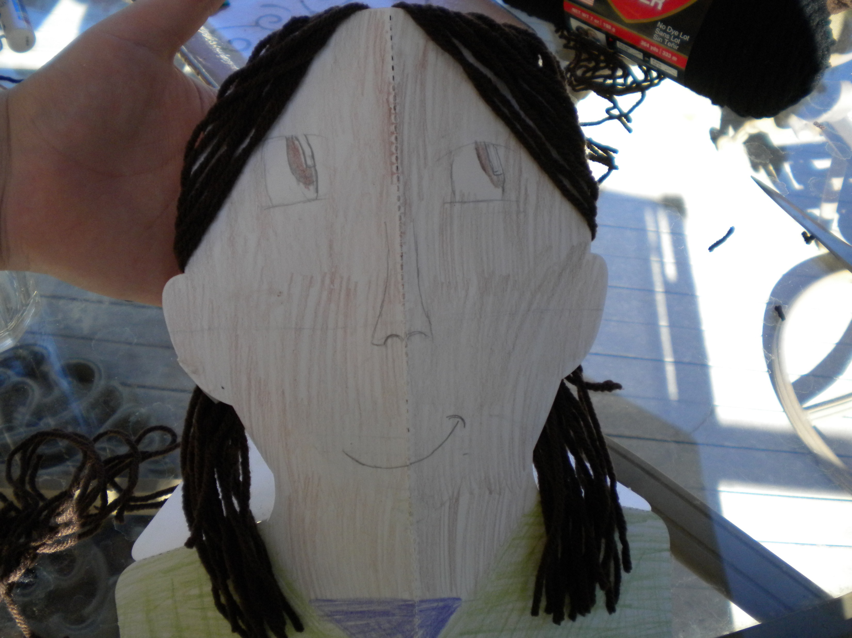
Stand Up Self Portraits

Slide 3
What is a self-portrait?
A self-portrait is a picture of yourself created by yourself!
Many artists throughout history have done self-portraits.

Slide 4
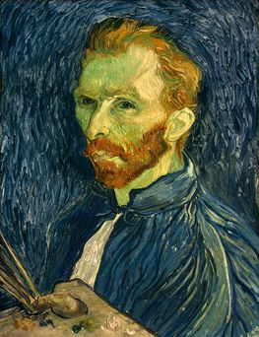
Some famous self-portraits
Vincent Van Gogh

Slide 5
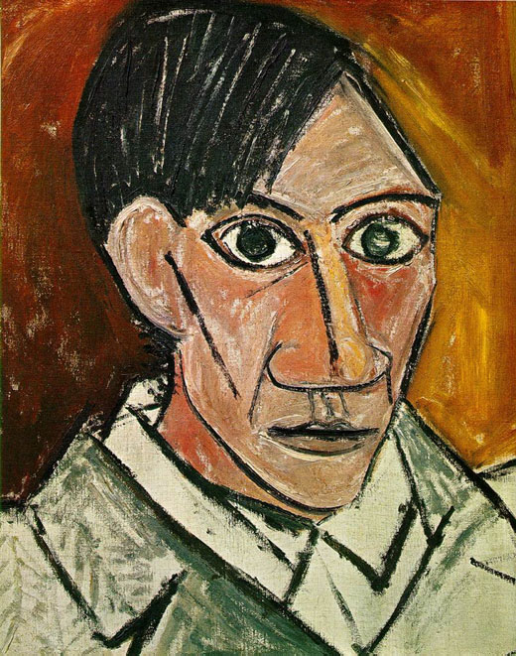
Pablo Picasso

Slide 6
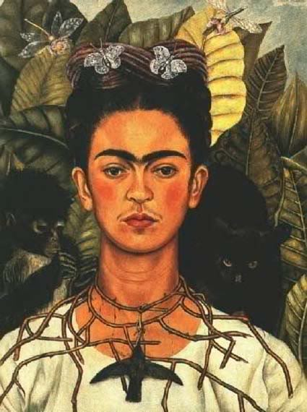
Frida Kahlo

Slide 7
How to draw a face
Observations: In realistic art, it is very important to make observations. We are going to make observations about our faces.
Place your right hand on top of your head, palm down. Then, place your left hand on your chin, palm down. Look at your neighbor - Where are his/her eyes? (In the middle, right in between the hands.) Where is his/her mouth? (Down near the chin.)
Today you will learn how to observe your own face and draw a self-portrait. First, we will learn how to draw the correct proportions, and then you will draw your own face.
Practice with “Joe” and “Susie”. First, we will be learning facial proportions by drawing an imaginary person – “Joe” or “Susie”. Take your oval on scratch paper. Note that a face is mainly oval shpaed (not round!).

Slide 8
Eyes: The eyes are located exactly ½ way down on the head. Center the eyes along the horizontal line. Each eye is about 1/5 the width of the head, so there should be an ‘eye’s width’ between the two eyes. Draw the pupils and the eyebrows.
Nose: The nostrils are located ½ way between the eyes and the chin, centered on the vertical line. The outer edges of the nostrils look like two parentheses. Make the two parentheses and the holes for the nostrils. Connect the two holes with a ‘u’ shaped wavy line.
Mouth: The mouth is connected to the nose and is located ½ way between the nose and the chin. Draw two vertical lines that connect the nose to the lips. Now draw the lips. The edges of the lips line up with the pupils in the eyes.
Ears: The ears extend from the eyebrows to the bottom of the nose. Draw the ears.
Neck: Place your hands along the side of your neck. Notice that your neck extends nearly all the way to your ears. Draw your neck, starting by the ears and making it nice and wide.
Hair: The hair does not sit on top of the crown of the head, but extends down onto the forehead and around to the ears. Now draw the hair.

Slide 9
Make your Stand Up Self Portrait
Hand out mirrors, erasers, and stand-up portrait heads to each student. Instruct the students to look at themselves in the mirror and observe how their facial proportions are similar and different to "Joe and Suzie’s" proportions. Using their sketch notes, ask the students to draw their self-portraits on the stand-up portrait head.

Slide 10
Steps for your self-portrait
Use colored pencils to sketch your face.
Use light pressure at first so that you can erase if you need to.
Remember what you learned about placement of the different parts of the face!
Use your own special features in your artwork!
Add yarn, beads and buttons if you’d like.

