Slide 1
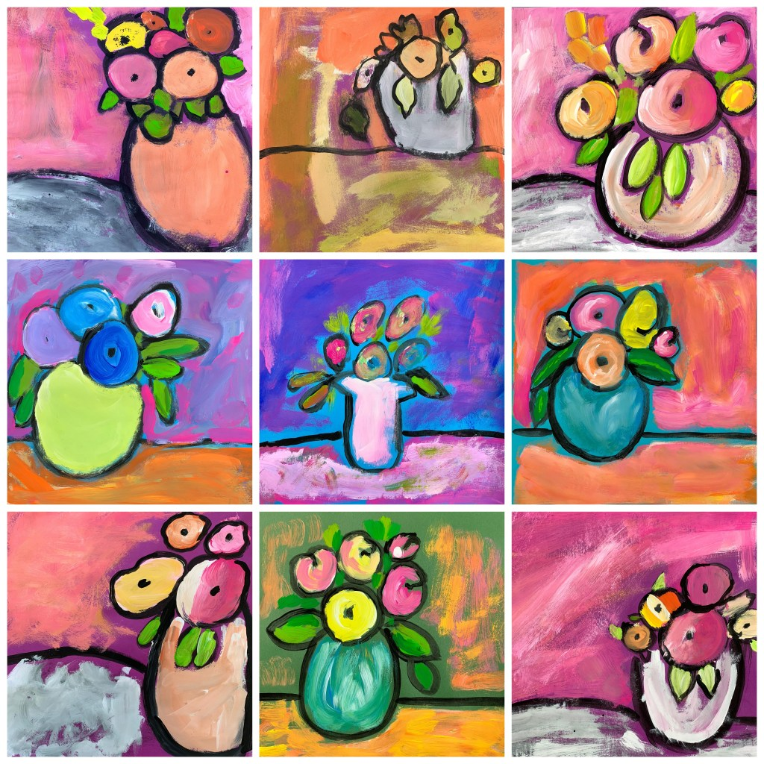
Still Life
Inspired by Berthe Morisot

Slide 2
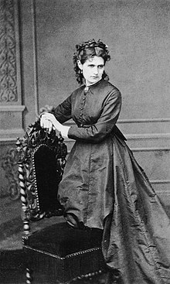
Berthe Morisot
Berthe Morisot was born in Bourges, France on January 14, 1841.
Berthe excelled artistically because she had such a supportive family. She would frequent the Louvre in Paris, and copy paintings created by master artists.
Berthe cultivated her artistic talents and achieved success at an early age with acceptance to the Paris Salon at age 23.
She created landscapes, portraits and still-life paintings
For more than 30 years she created paintings that have helped guide the direction of French art.
Berthe Morisot died on March 2, 1895 in Paris, France.

Slide 3
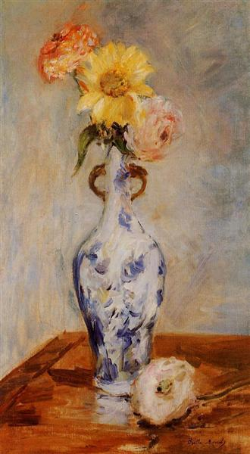
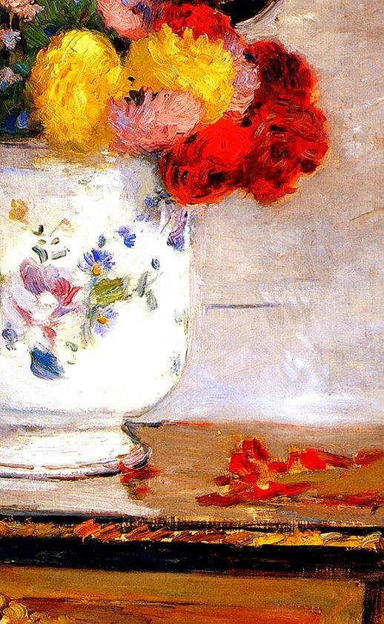
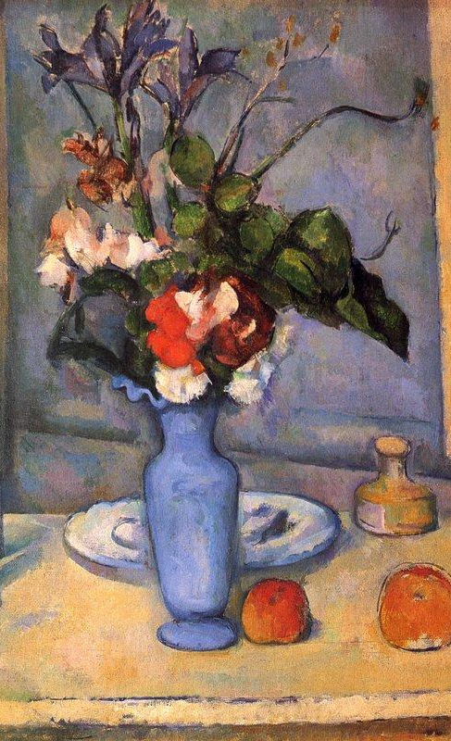

Slide 4
Our Project…
MATERIALS:
12” x 12” construction paper in different colors
Tempera paint
Medium round and flat paint brushes
Water cups for cleaning brushes.

Slide 5
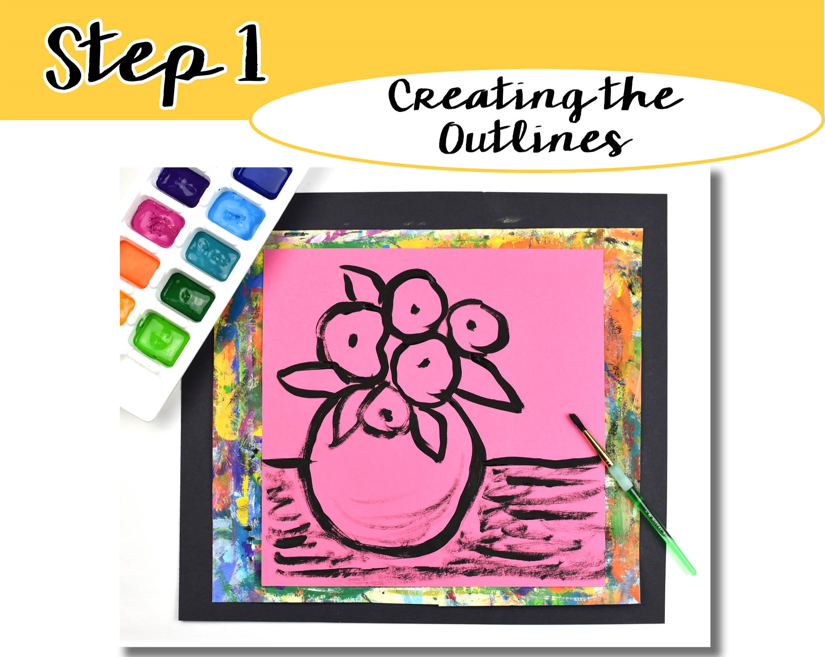
Select a piece of 12” x 12” colored construction paper.
Use black tempera paint and a medium round brush to create a large vase.
To help visualize the size of the vase, place your hand on the paper as a reference.
At the top of the vase add 5 to 6 circle shapes for flowers. Put dots in the center of each circle. Add a few leaves amongst the flowers.
Paint a horizontal line across the paper approximately half way up from the bottom edge. This line is the edge of the table.
**Make sure to keep the line on the outside of the vase. Do not paint across the vase.**
Clean any excess black paint off the brush by wiping it in the table top area of the construction paper.

Slide 6
Use a flat brush to mix white tempera paint with the black, creating a grey shade.
Fill in the table top. Make sure not to add too much white. This will help the background paper color show through.

Slide 7
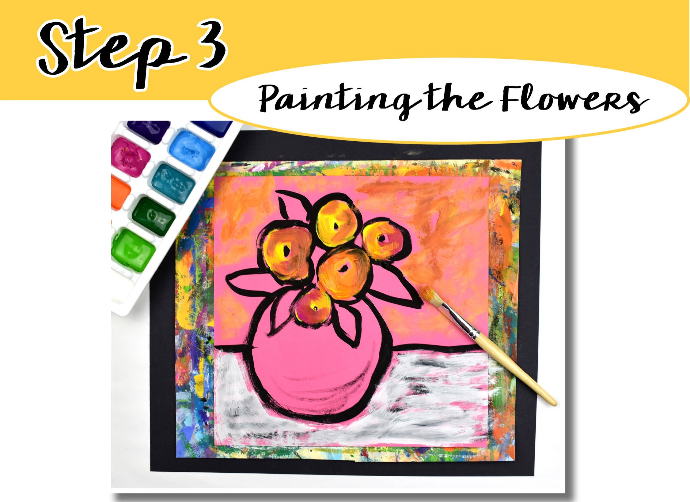
Continue with the flat brush. Paint the flowers using bright warm colors such as yellow, orange, and magenta.
Gently tap the brush into the paint (start with the lightest color first) and fill in the circles. Make sure to overlap the brushstrokes in a circular motion.
Add a small amount of white paint to the colors to create various tints of the original colors.
Wipe any excess paint off the brush onto the paper above the table line. This will establish the wall color.
When painting, always start with the lightest color first then progress to the darker colors. This will keep your colors from looking muddy. Make sure to clean your brush in between colors.

Slide 8
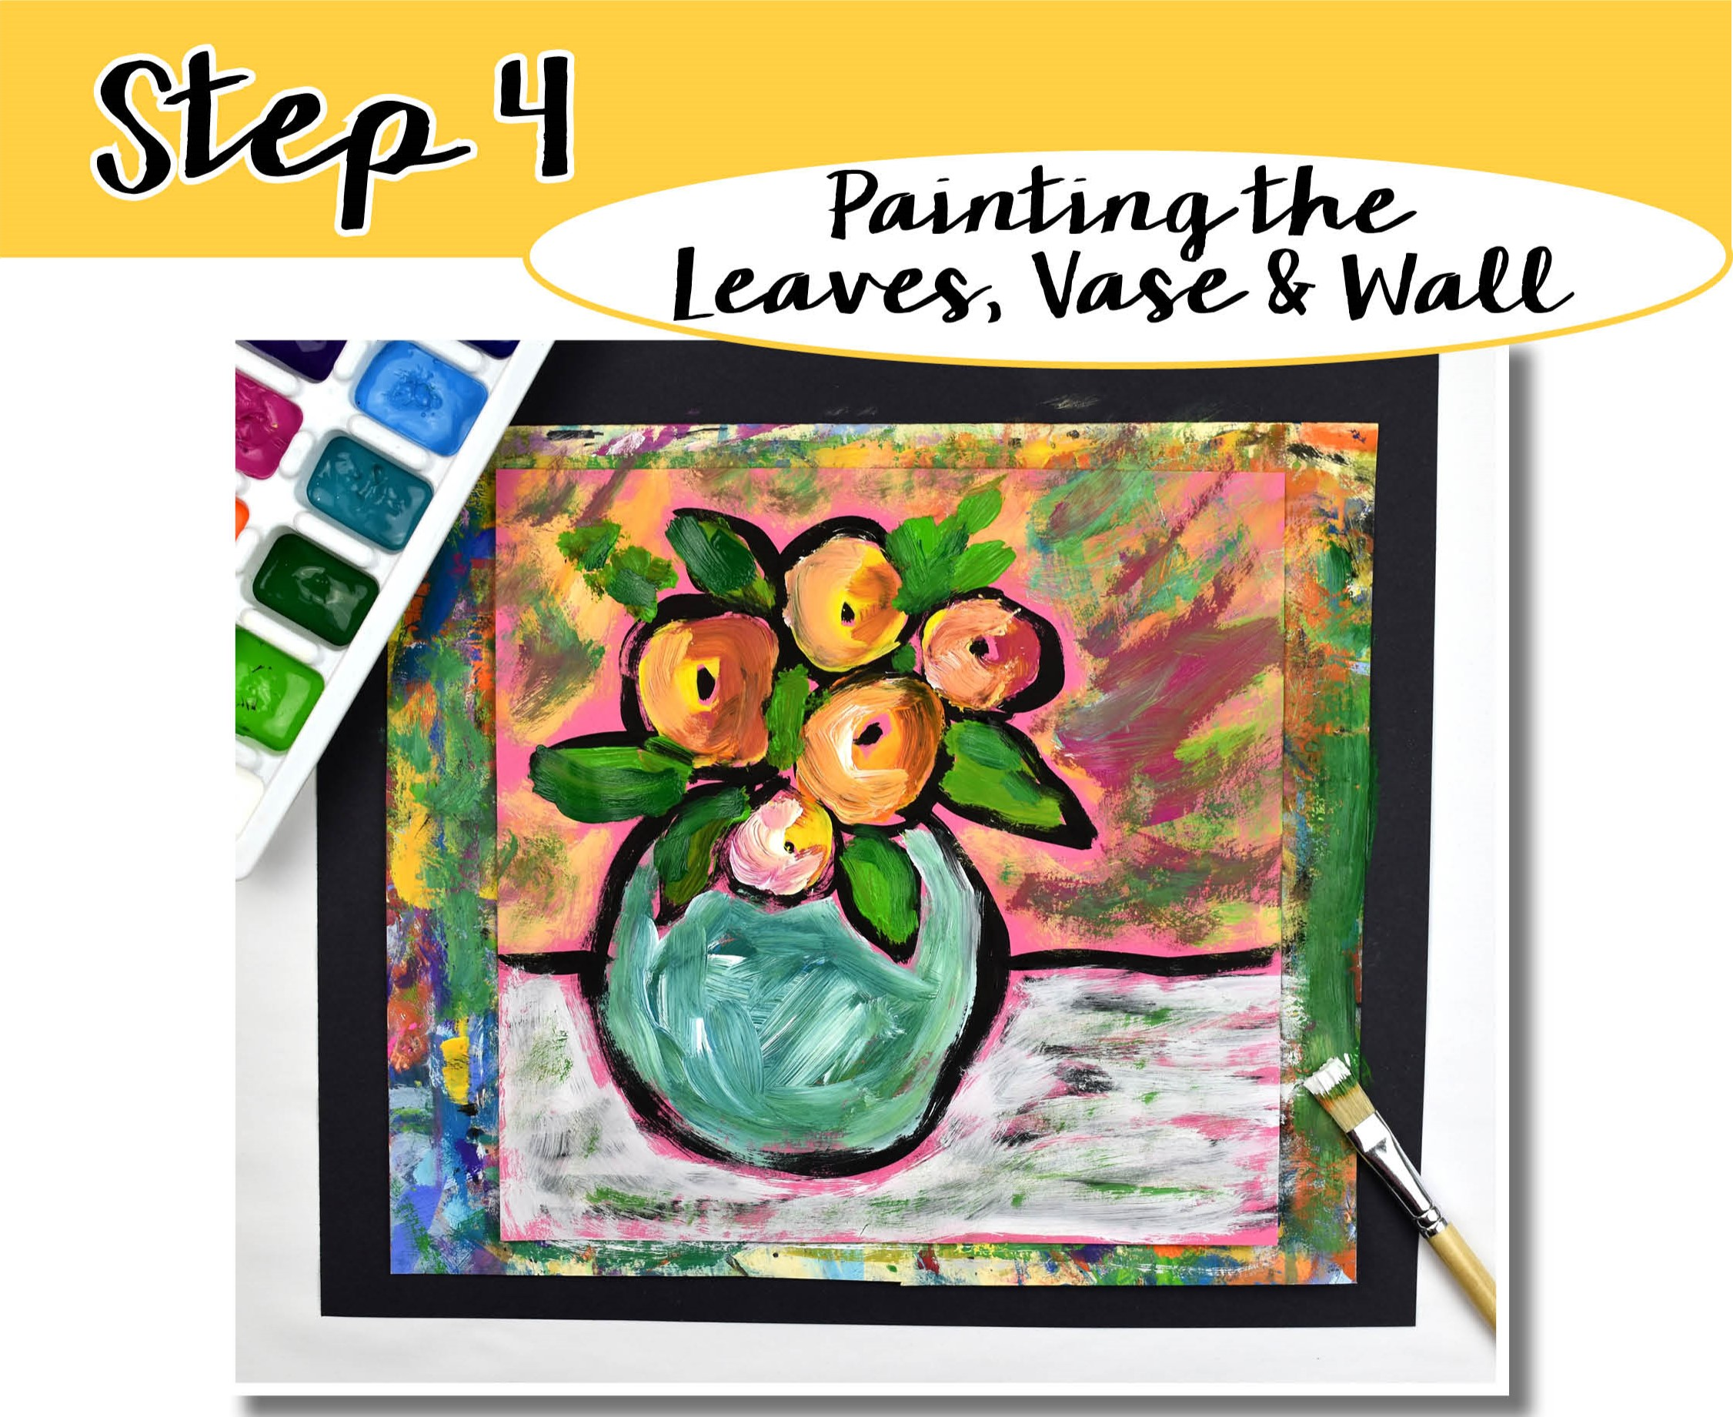
Continue with the flat brush. Paint the leaves green. Start with light green and move onto dark green.
Choose one color for the vase and fill in with short, overlapping brushstrokes. Add some white to create a tint but don't over blend the colors.

Slide 9
