Slide 1
ART! ART! ART!
WELCOME TO 2nd GRADE ART!

Slide 2
ART RULES
All classroom rules apply.
HAVE FUN!
Raise your hand and ask for help BEFORE you get frustrated.
I don’t want your art to be “perfect” there is no such thing as perfect in art. Just let it be yours.
KEEP IT POSITIVE when talking about your work and other classmate’s work.
Stand back and take a look – 5 feet rule
Sometimes less is more – especially when we work with paint!
HAVE FUN!

Slide 3
Line and Color in Art
Basic Elements of ART are:
LINE
Shape
Form
Texture
COLOR
Space

Slide 4
LINE
Lines are all around us.
LINE – a continuous path of a moving point through spae which can vary in width, direction, length, curvature, texture, and color.

Slide 5
Line
Which directions do lines go?
horizontal vertical
diagonal
How do lines look?
solid dashed
dotted
What shapes and patterns can lines have?
straight zigzag
wavy
Today we are going to be making lines with pieces of tape.

Slide 6
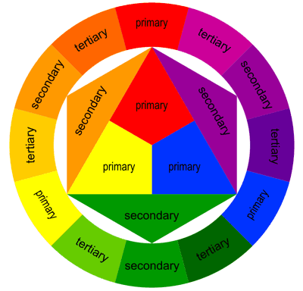
Color
Primary Colors - red, blue, yellow
Secondary Colors - Mix primary colors to create secondary colors - green, orange, purple
Tertiary (tur-shee-er-ee) Colors - Mix either a primary color with a secondary color or two secondary colors to create tertiary colors

Slide 7
Color
Warm Colors
*We will be using these today in our fall tree project
Cool Colors

Slide 8
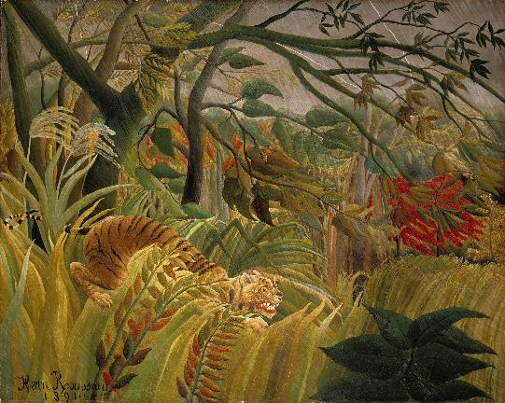
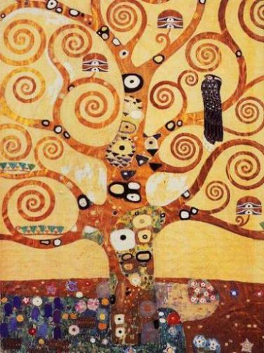
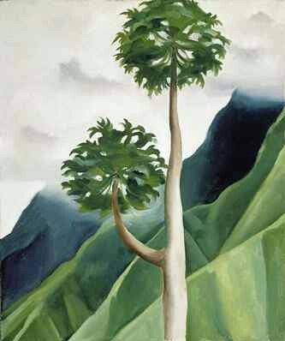
Examples of Trees in Art
Tiger in a Tropical Storm
By Henry Rousseau
Tree of Life
By Gustav Klimt
Papaya Tree
By Georgia O’Keeffe

Slide 9
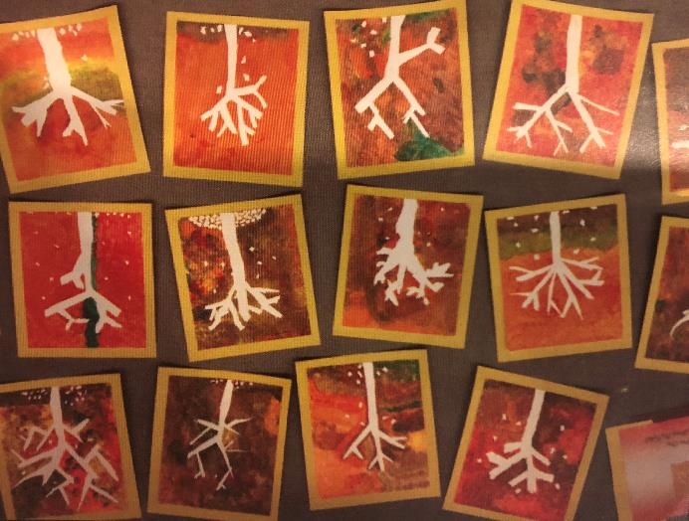
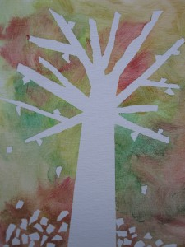
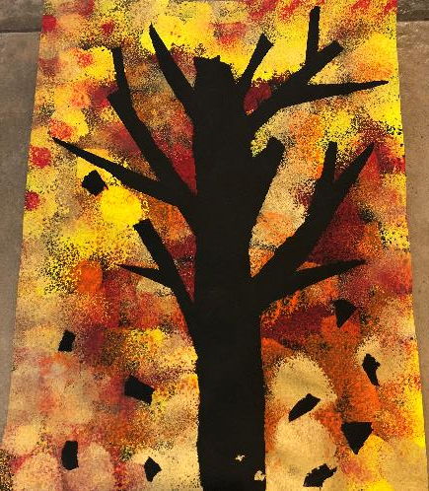
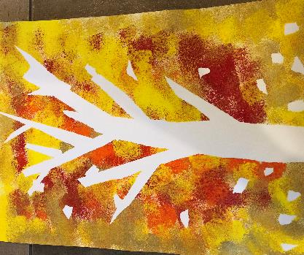
Fall Trees
Examples of what we will create today…

Slide 10
Material list:
White or black paper
Pencil for writing name on back
3 strips of blue painters tape
Tempera paint – red, yellow, orange, and gold (maybe a little green)
Sponges

Slide 11
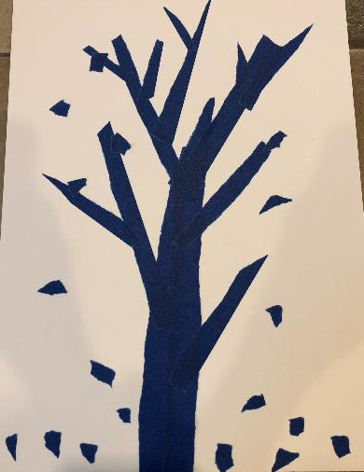
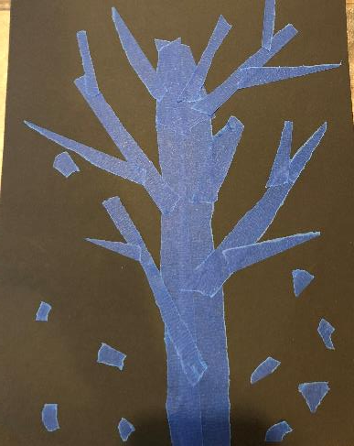
- Pick white or black paper for your background - Pencil your name on the back of your paper
Start by taping your tree form. Rip your tape to the size pieces you want.
2. You can rip smaller pieces to look like falling/fallen leaves.
3. Press firmly on tape.

Slide 12
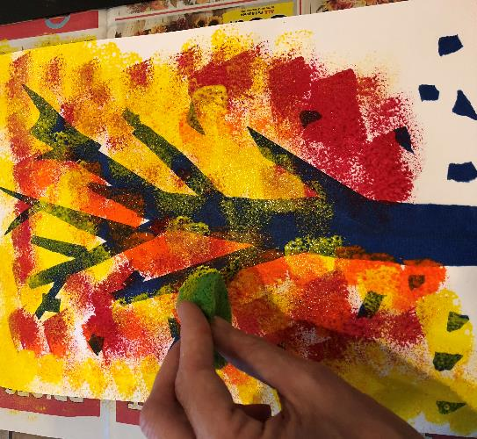
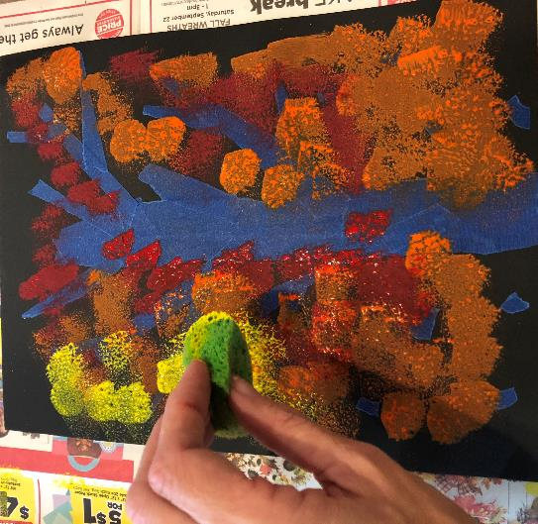
3. Using sponges, dab paint all over your paper. You can dab different colors on top of each other to create mixed and blended colors.

Slide 13
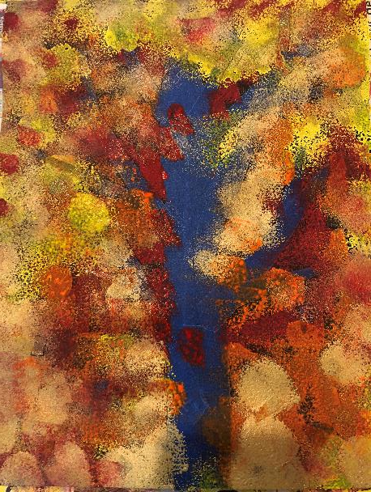
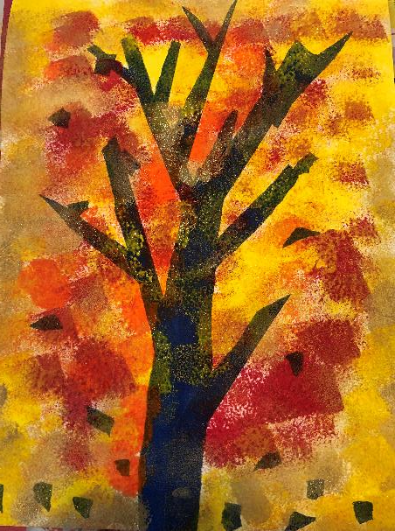
4. Make sure to cover all white or black space with paint.

Slide 14
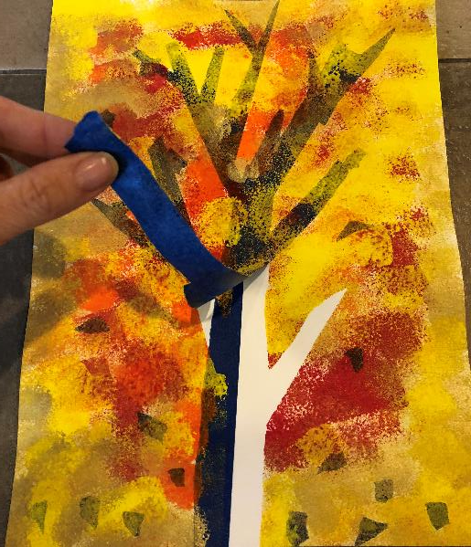
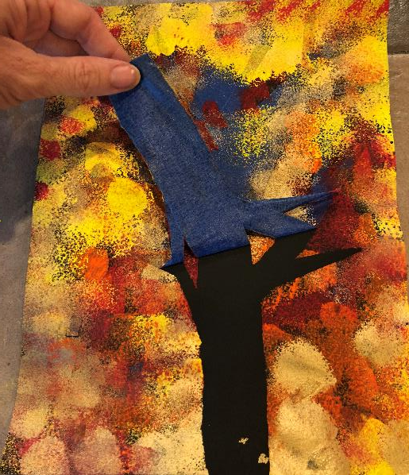
5. When the paint dries, the tape will be peeled off to reveal the tree (either by you or an adult).

