Slide 1
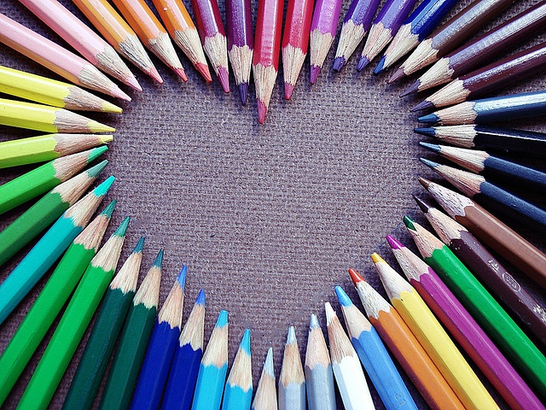
ART! ART! ART!
WELCOME TO 2nd GRADE ART!

Slide 2
Artist
Rooster and Bird Torn Paper Collage
Nancy Standlee

Slide 3
Eileen Downs “Feed the Birds”
Elizabeth St. Hilaire

Slide 4
Elizabeth St. Hilaire Torn Painting
“I tell people that I work quickly because I need to maintain the looseness and spontaneity of my art. If I labor over my work, overwork it, you can tell. I never want to lose the painterly, impressionistic look I have achieved, so I work quickly, move fast, stay loose. Also, I love what I do. I enjoy painting and the finished product. I paint as many hours as I can each day.”

Slide 5
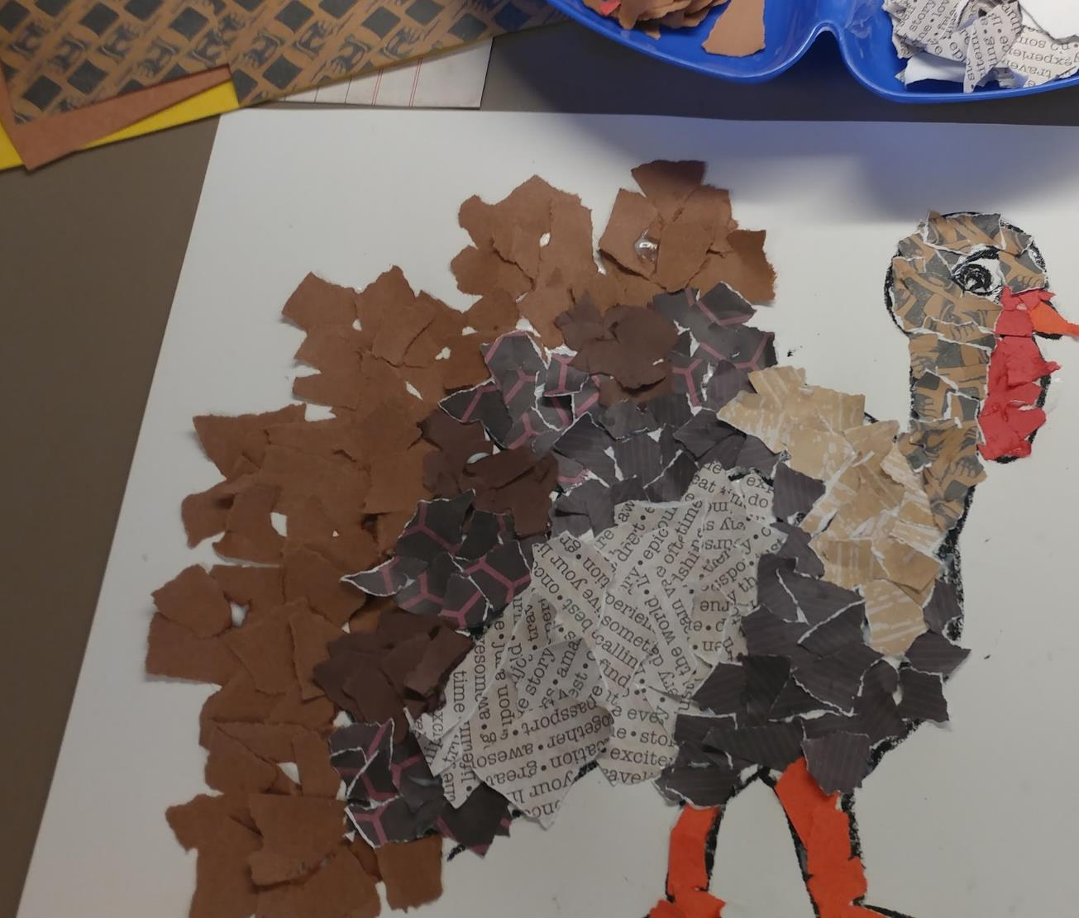
2nd Grade
Ripped Turkey
Materials needed-
Large construtction paper
Many different fall colored papers
Glue in a cup and a q-tip dipper
Black crayon or oil pastel
Pencil

Slide 6
Material list:
12″ x 18″ construction paper
Scraps of fall colored papers, greens reds and oranges for the eyes, beak and gobble.
Glue cup and q-tip
Black oil pastel or crayon

Slide 7
Pencil your name on the back of your paper
Start with one large circle for the main body. It should be on the lower third of your paper to leave room on top for the neck/head, and large feathers
Next draw the neck and head circle. Add the beak triangle shape. Add a large eyeball.
Add a large wing tucked down.
Add a layer of small wings off the circle body. Layer them over each other.
Add a layer of longer feathers. Layer them over each other too.
Add 2 legs. Add a gobble under his beak. Add a collar of feathers around his neck.

Slide 8
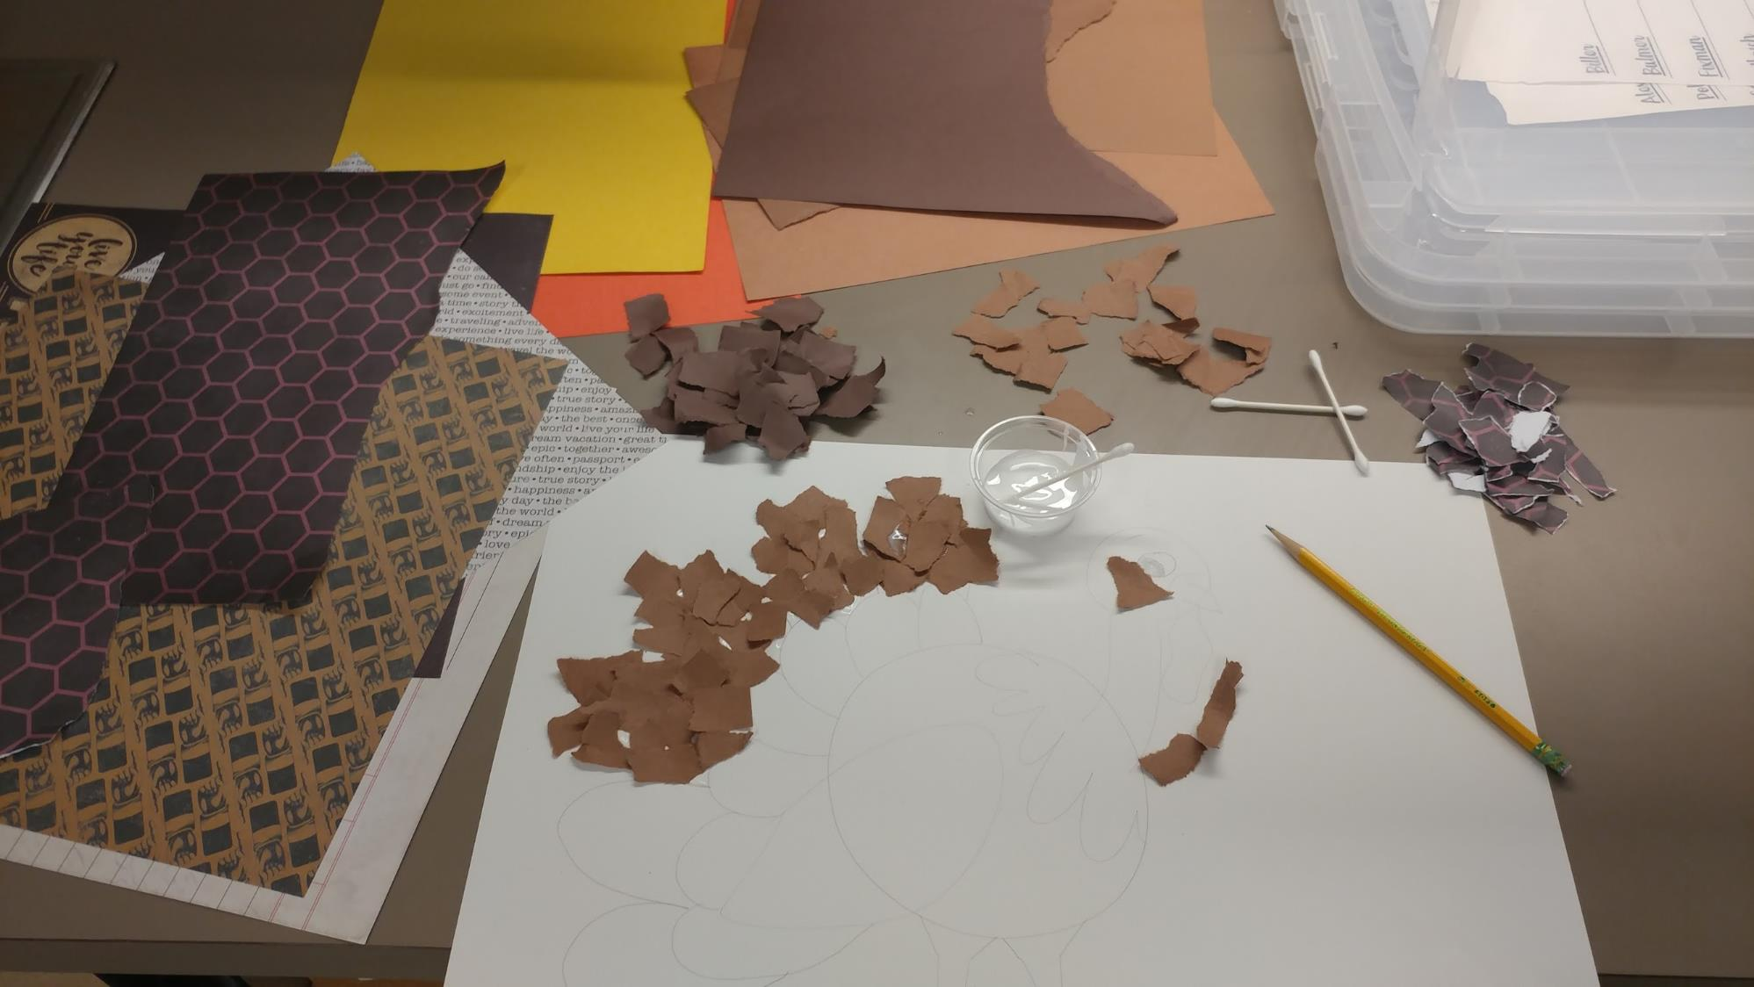
Time to rip! Choose a few of your favorite papers. Rip into small pieces. Alternate different papers in a pattern to set the feathers apart from each other. Use light colors against dark colors.

Slide 9
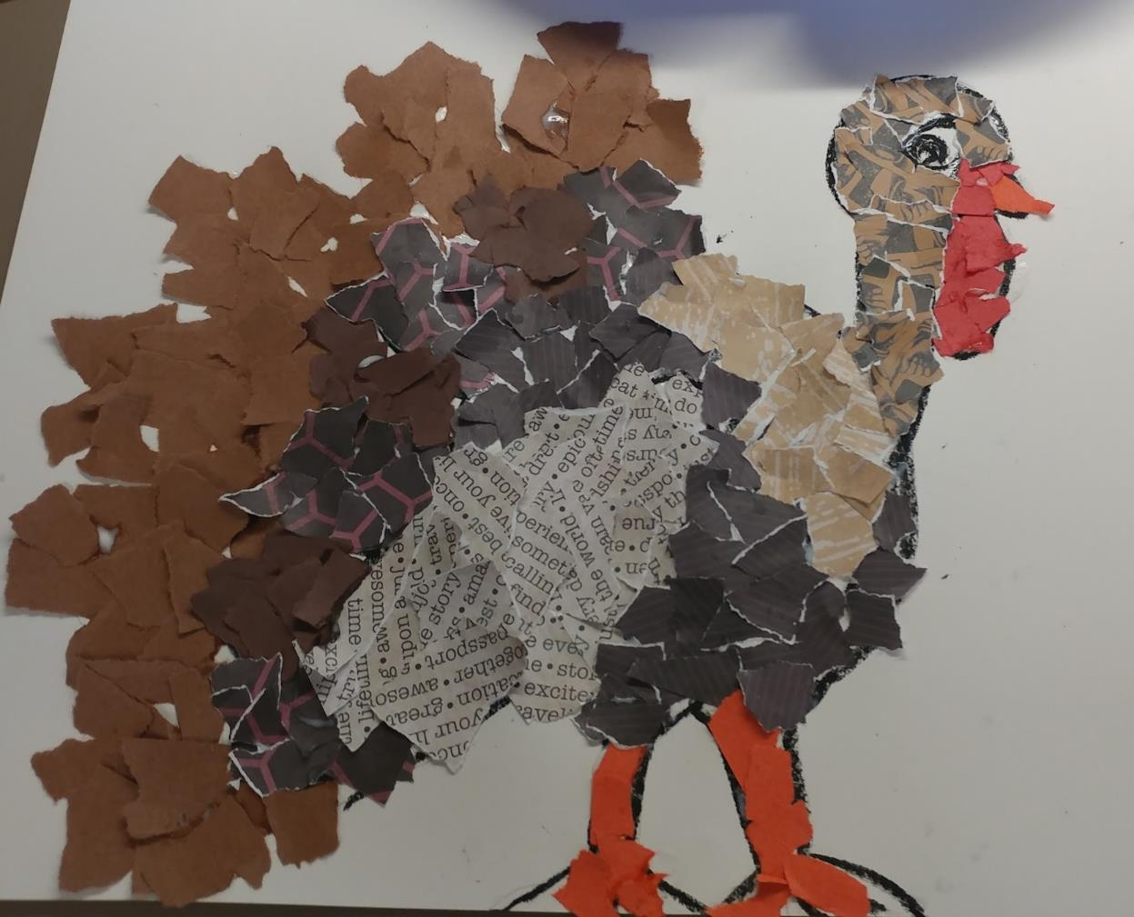
I am grateful for: my family, my friends, and my school!

