Slide 1
Kandinsky Circles and Radial Weaving
2nd Grade

Slide 2
Wassily Kandinsky (1866-1944)
Kandinsky was born in Russia into a musical family.
He studied law and economics in school and became a lawyer.
He began painting at the age of 30.
He moved to Germany and then France where he lived for the rest of his life.
He is considered the pioneer of ABSTRACT ART.

Slide 3
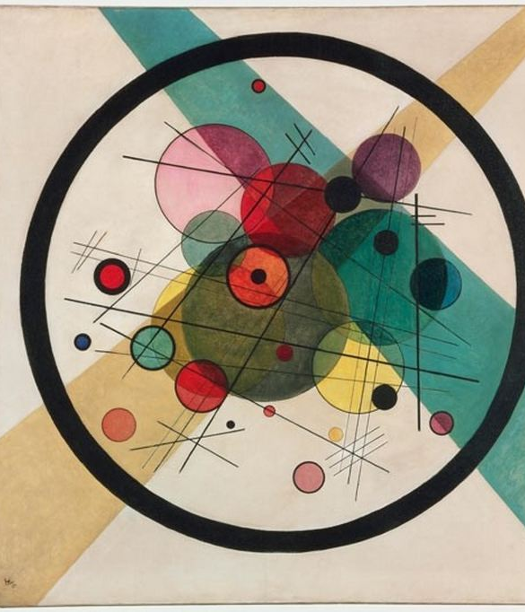
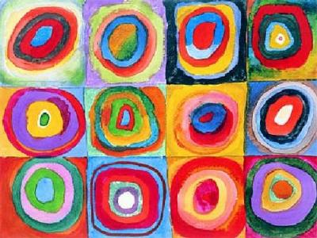
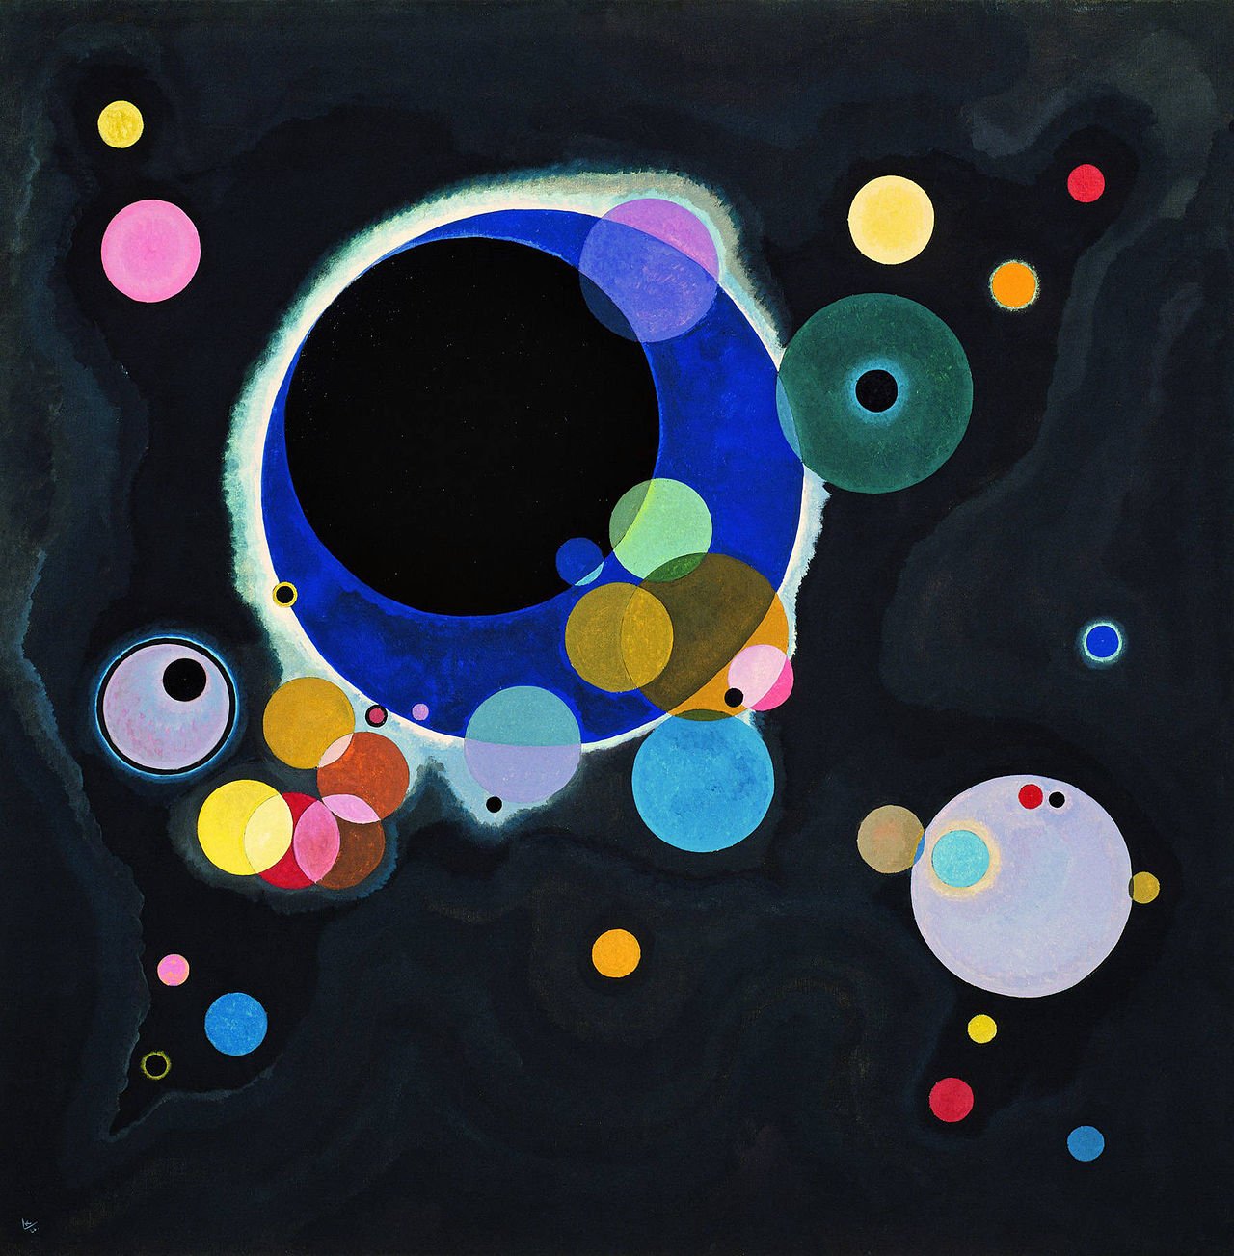
A few of Kandinsky’s most famous works
Circles in a Circle, 1923
Squares With Concentric Circles, 1913
Several Circles, 1926

Slide 4
When he created his art, color was very important to him.
He believed color could express feelings in the same way as music.
As an artist, he felt he could almost hear colors make musical sounds.
When you look at his painting, how do the colors make you feel?
If you could hear colors like Kandinsky, what would red sound like? What about blue? What about white?

Slide 5
RADIAL WEAVING
We are going to create a circular weaving using Kandinsky’s Circles as inspiration.
They will have a RADIAL DESIGN.
RADIAL - Radial means something that comes out from a center point…think sun rays
WEAVING is when we combine yarn or fiber together in an over-under pattern.

Slide 6
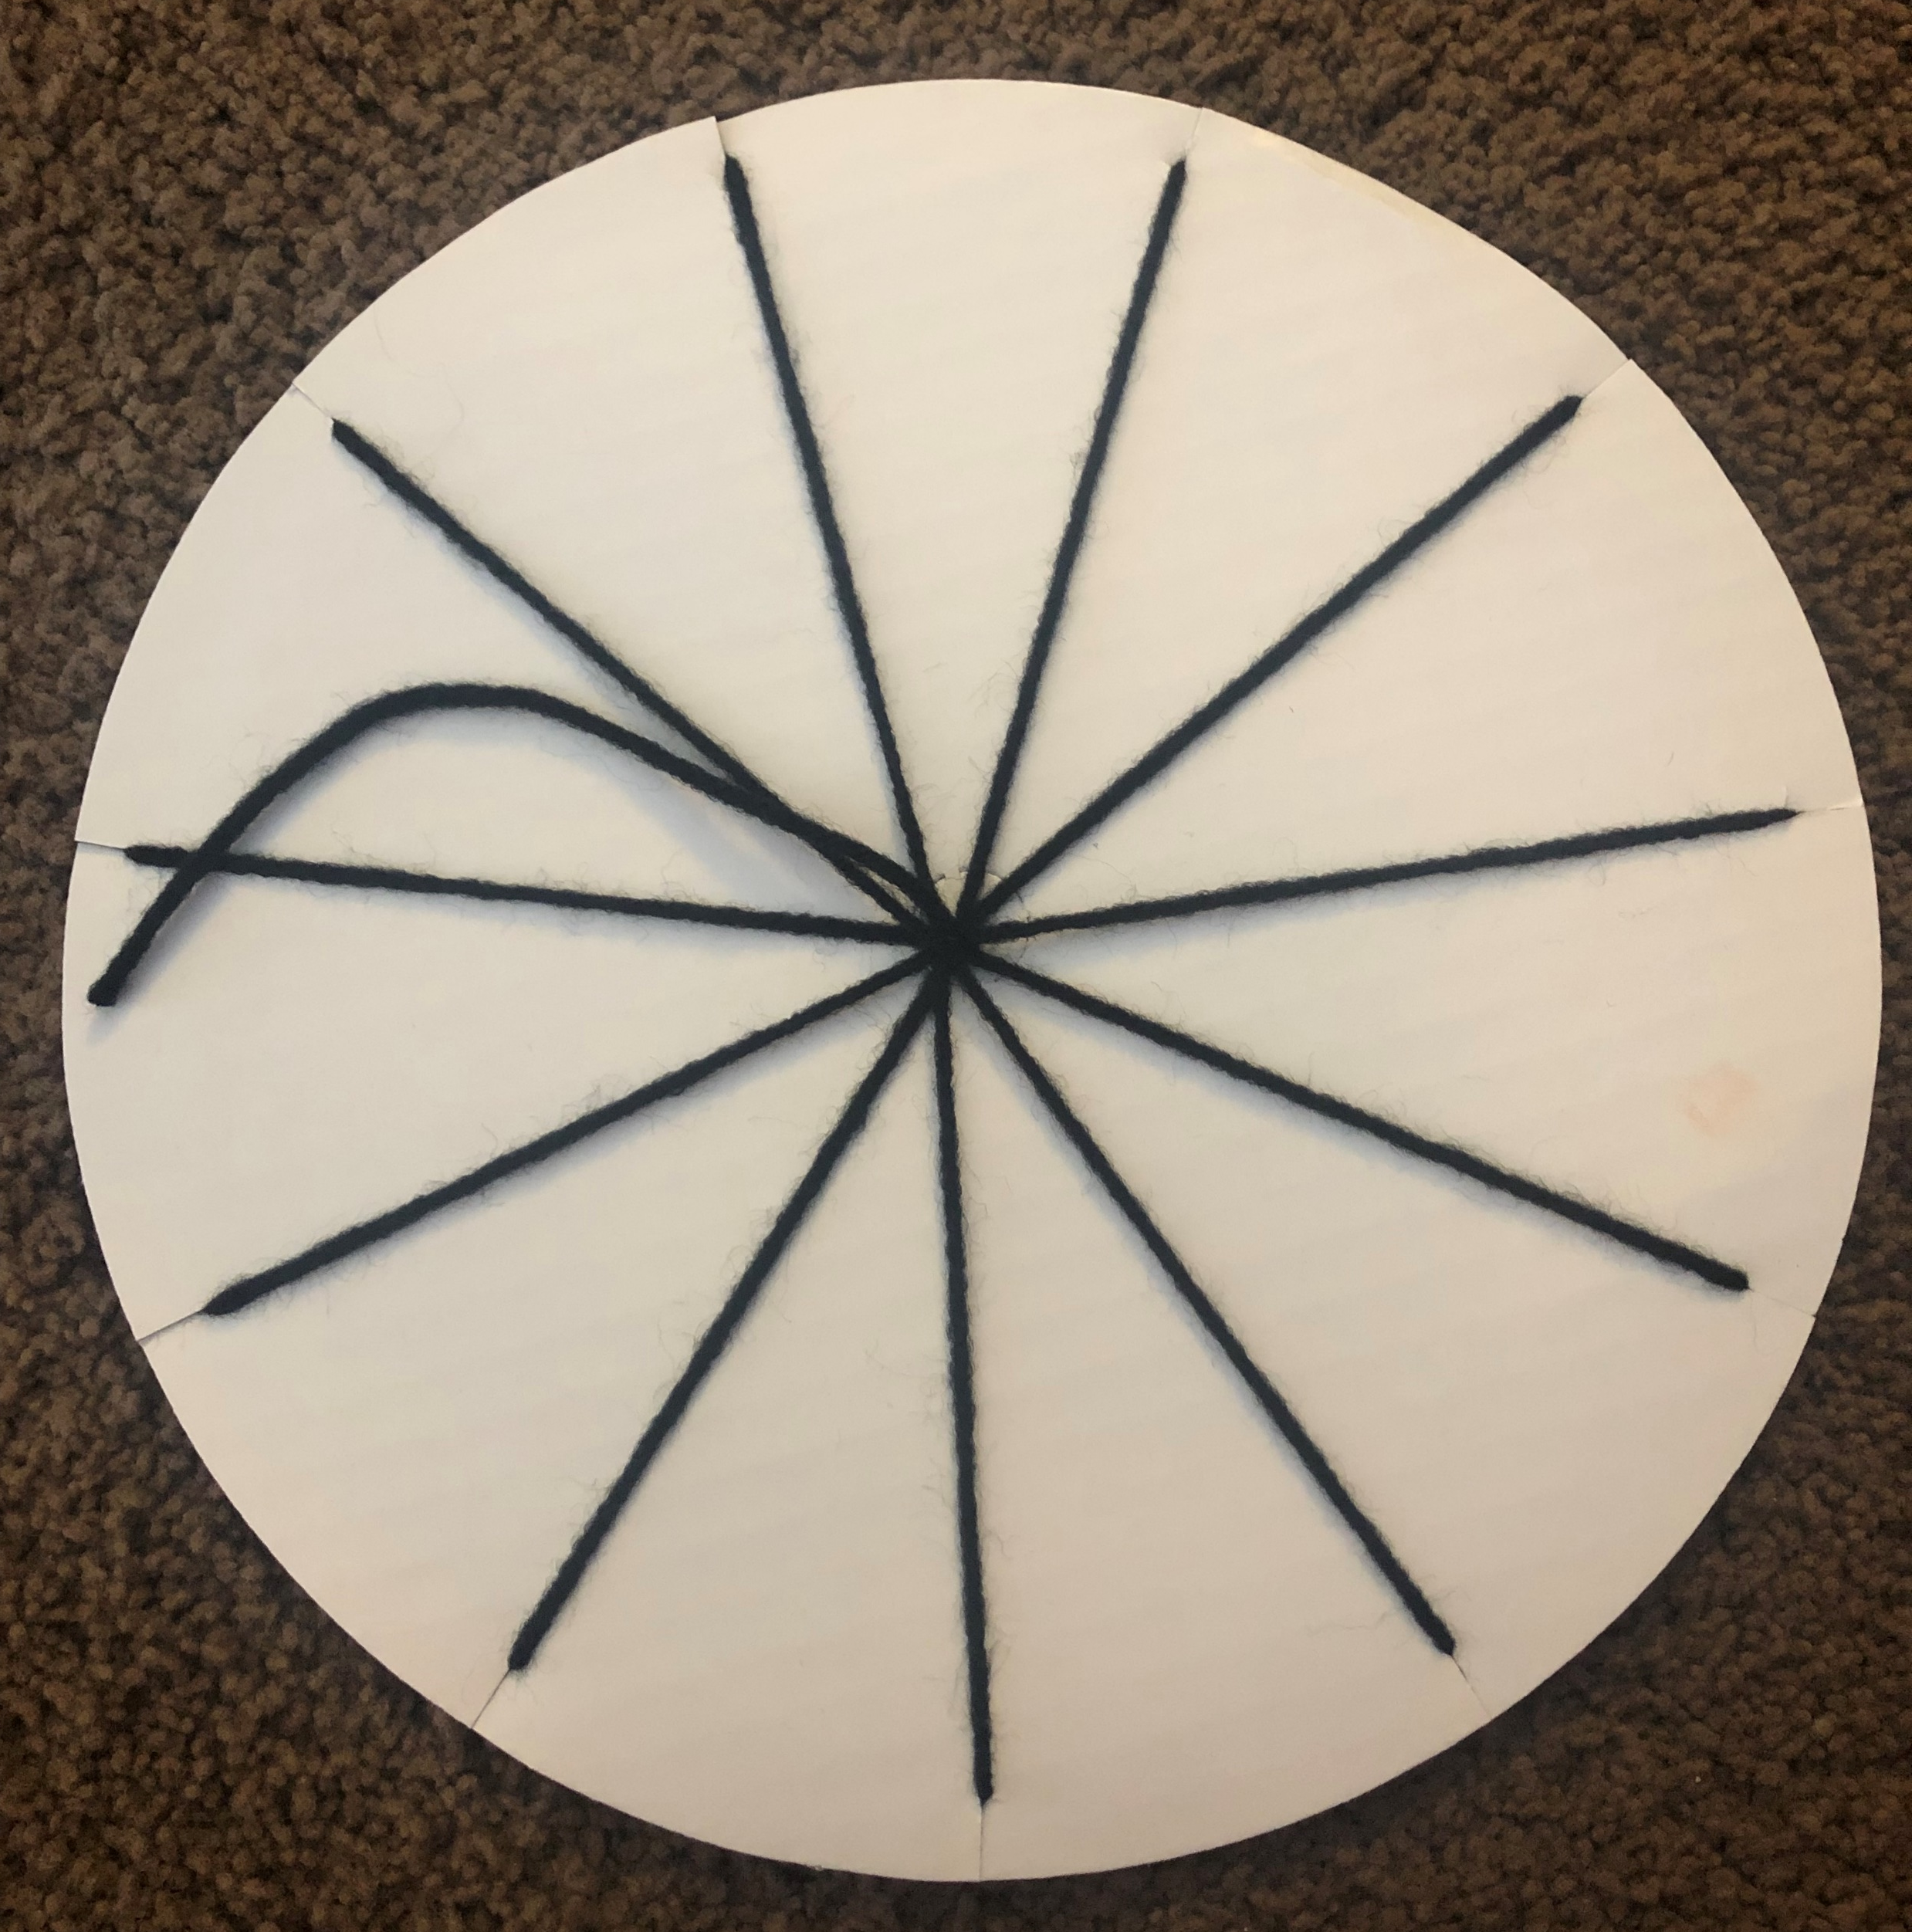
LOOM
A loom is a tool an artist can use to make a weaving. We often see weaving in rugs or clothing.
You will each receive a pre-strung cardboard loom. This is where you will create your weaving.
Notes:
Docent

Slide 7
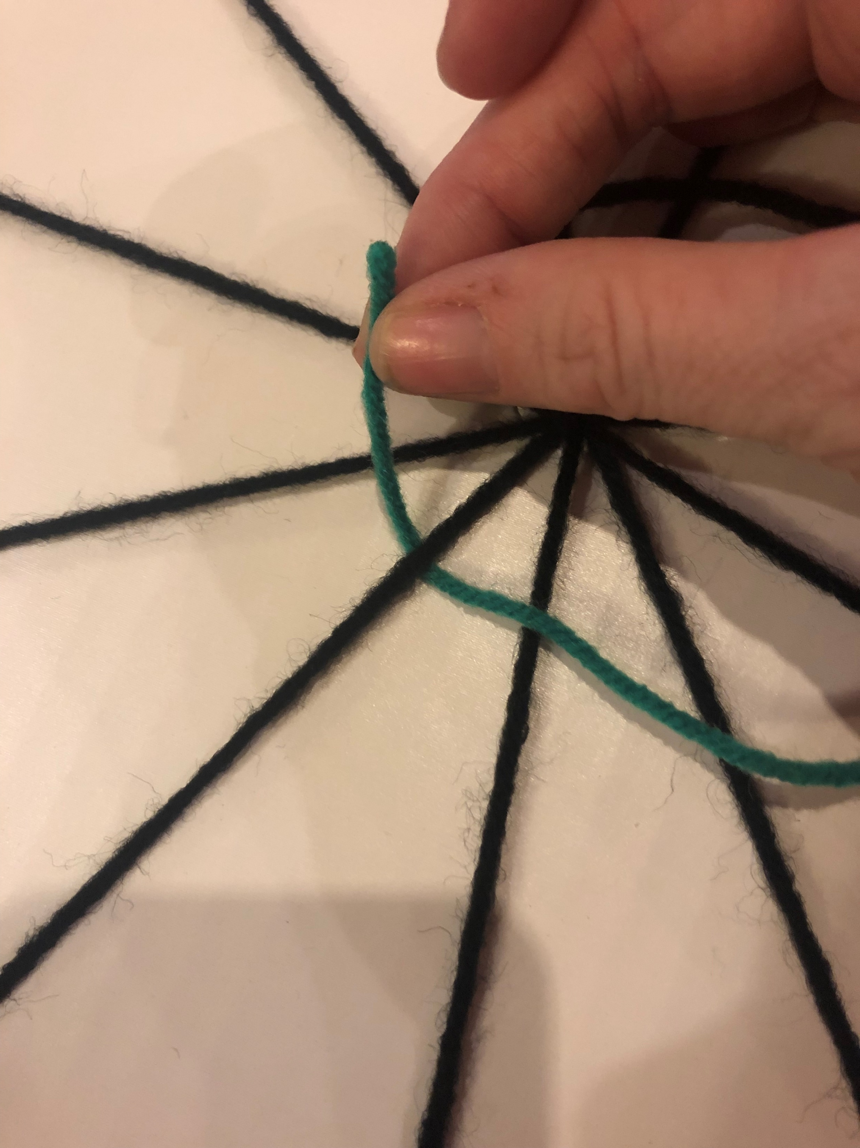
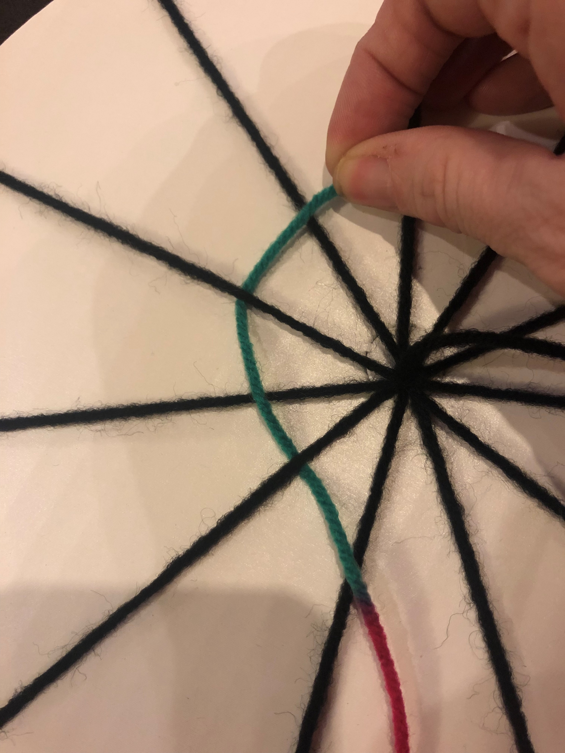
WEAVING
Select your first piece of yarn. You will be using multiple pieces of yarn to create your weaving.
Double-knot the end of your yarn to the short black yarn in the middle of your loom.
Take the other end of your yarn and start weaving around the circle in an over-under pattern.
Keep going in the same direction around your circle, over-under-over-under… pulling the yarn tight (but not too tight) as you go.
(ART DOCENT will demonstrate)

Slide 8
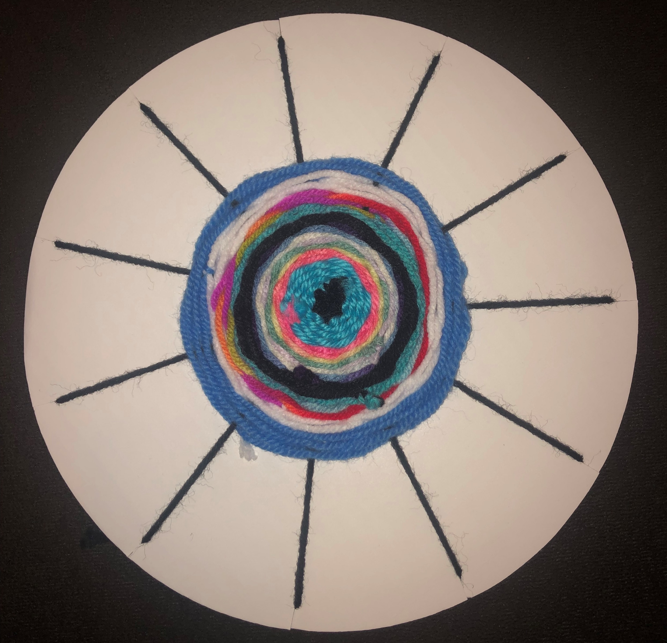
WEAVING continued
When there is only a few inches left of yarn, select a new piece of yarn and attach with a double-knot to the end on your loom.
Continue weaving in the same direction with the over-under pattern.
**When selecting yarn colors, think about using contrasting colors next to one another. Think about the colors in Kandinsky’s Circles.

Slide 9
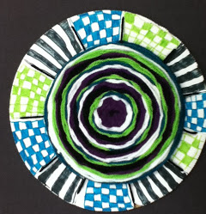
Optional Ideas:
Add a few beads as you go. Not too many though!
Decorate the visible edge when you are done with markers. Sharpies work best.

