Slide 1
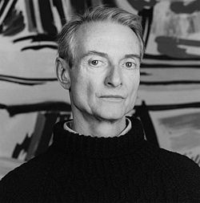
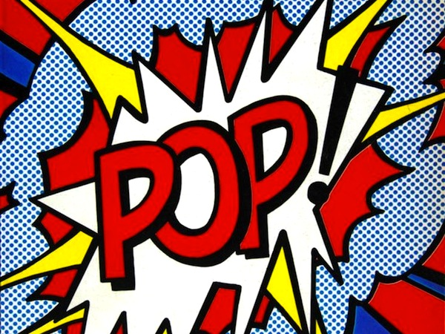
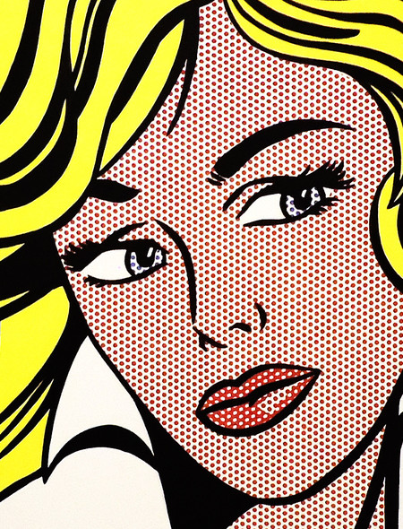
Roy Lichtenstein
Pop Art Self-Portrait

Slide 2
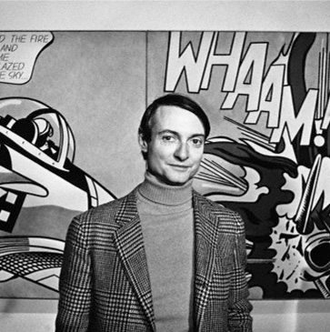
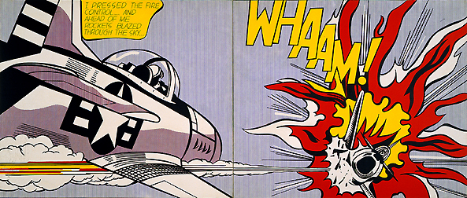
Roy Lichtenstein
Lived in NYC
American Pop Art artist
What is Pop Art?

Slide 3
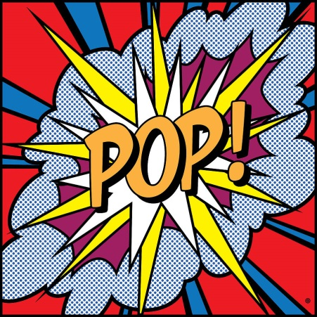
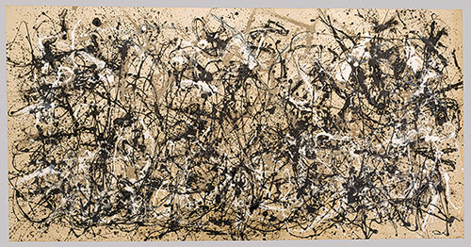
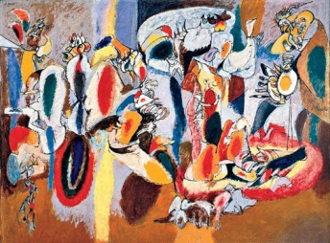
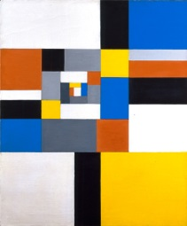
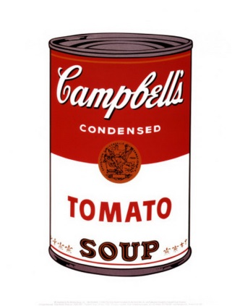
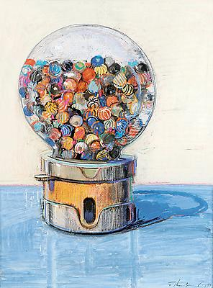
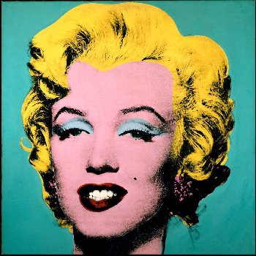
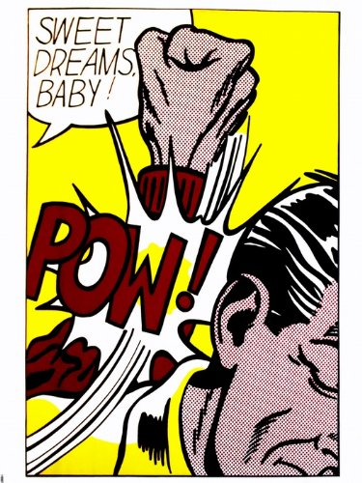
Pop Art is a British and American artistic style of 1950s-60s.
Most artists in 50s focused on emotions and feelings through abstract art
Pop Artists decided to do the exact opposite.
Pop Artists focused on the real world that people interact with every day:
Brands and logos
Common objects
Famous people
Comic books

Slide 4
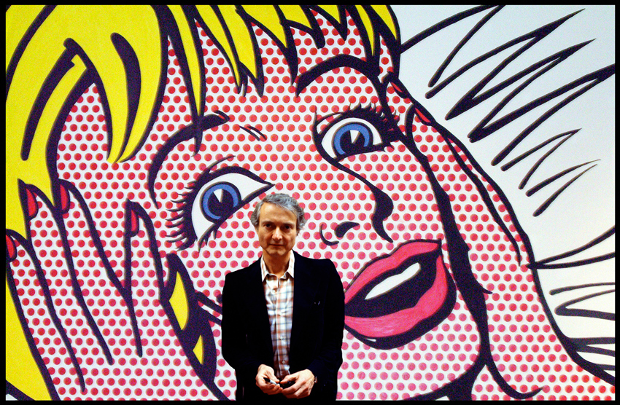
Roy was one of the founders of the Pop Art

Slide 5
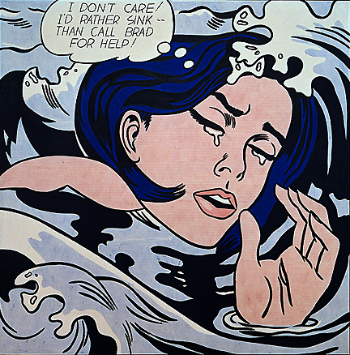
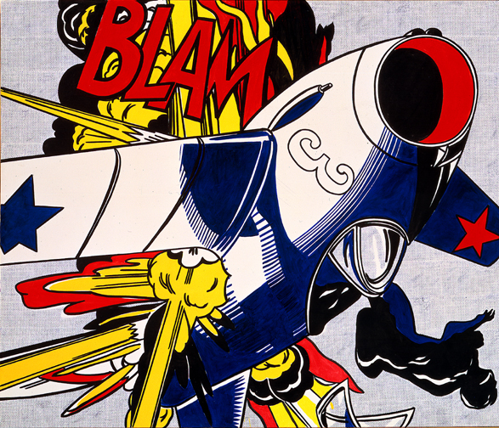
Have you noticed his art looks like comic books?
Why do you think he started to paint like this?

Slide 6
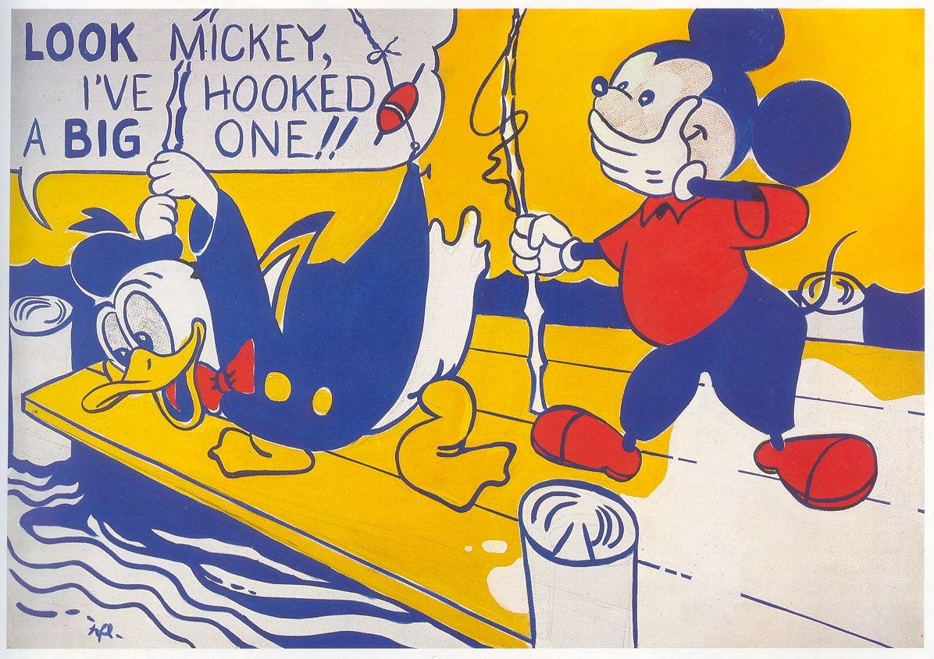
Because of his son.
Roy never really liked comic books that much.
But his son challenged him by pointing out to a Mickey Mouse comic book and saying, “I bet you can’t paint as good as that, eh, Dad?”
He did.

Slide 7
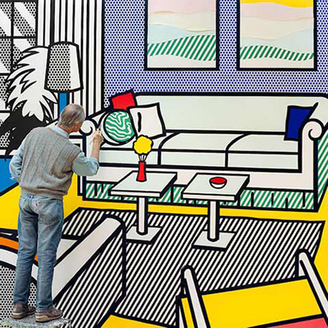
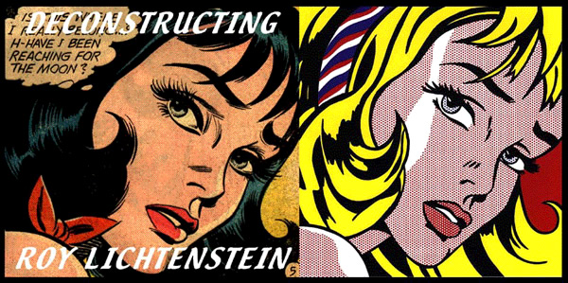
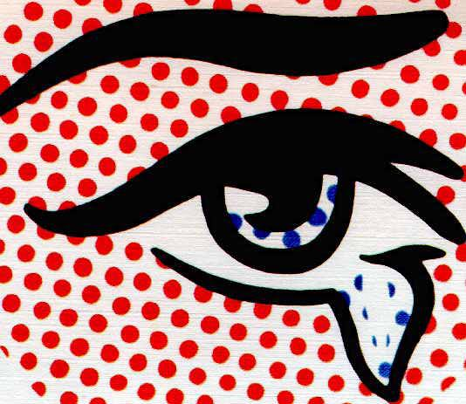
How is Roy’s art different from the comic books?
At first glance: not much
BUT
Roy’s paintings were huge
He focused on:
- thick black lines
- bold colors (mostly primary ones)
- dots
Why dots?

Slide 8
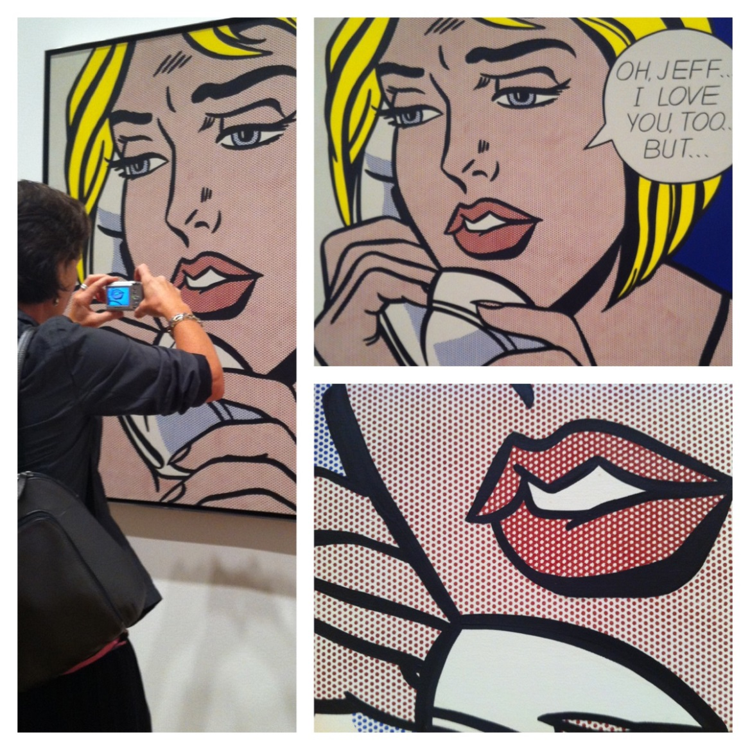
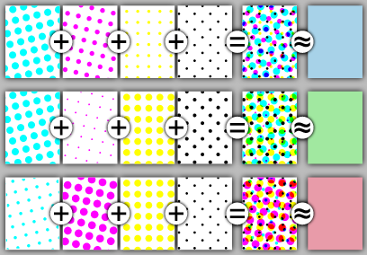
Ben Day Dots
Roy tried to capture the Ben Day Dots.
They were used for printing cheap colorful pictures, like comic books.
How? Like this:

Slide 9
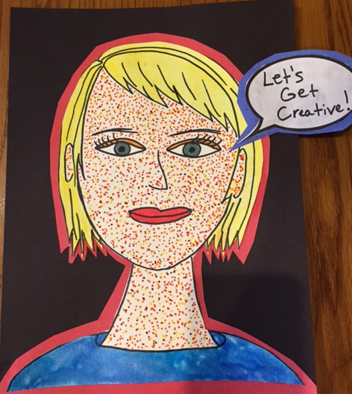
Let’s make some ART!

Slide 10
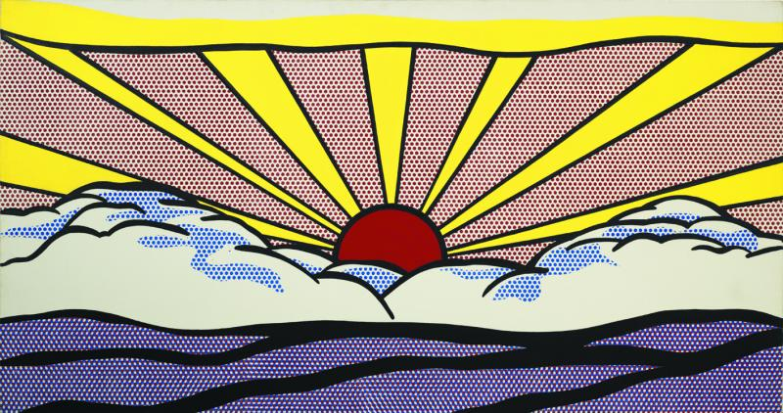
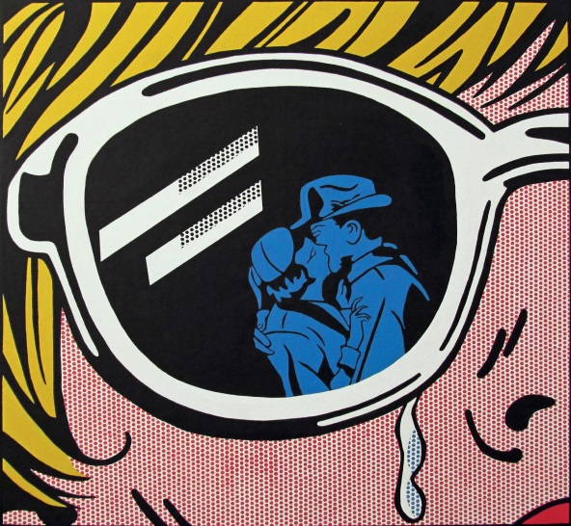
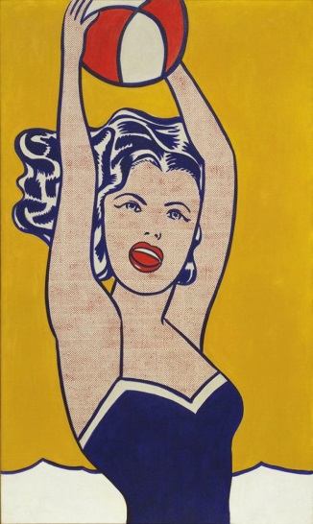
First: the primary colors
Roy used mostly primary colors in his art.
What are primary colors?
Primary colors are the most basic ones.
They cannot be made by combining other colors.
They are: yellow, red and blue.

Slide 11
Draw your self-portrait
Capture any emotion you want!

Slide 12
Draw your self-portrait

Slide 13
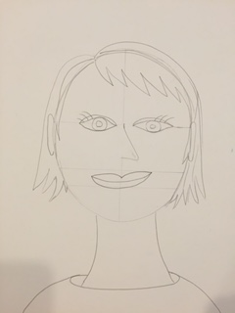
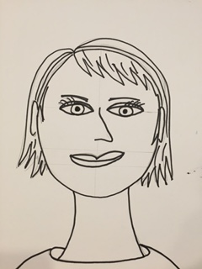
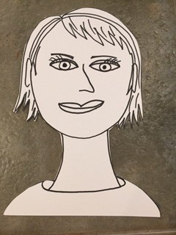
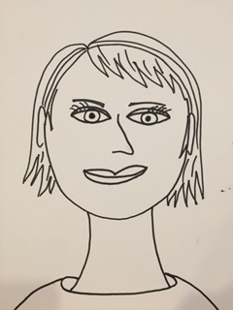
Draw your self-portrait

Slide 14
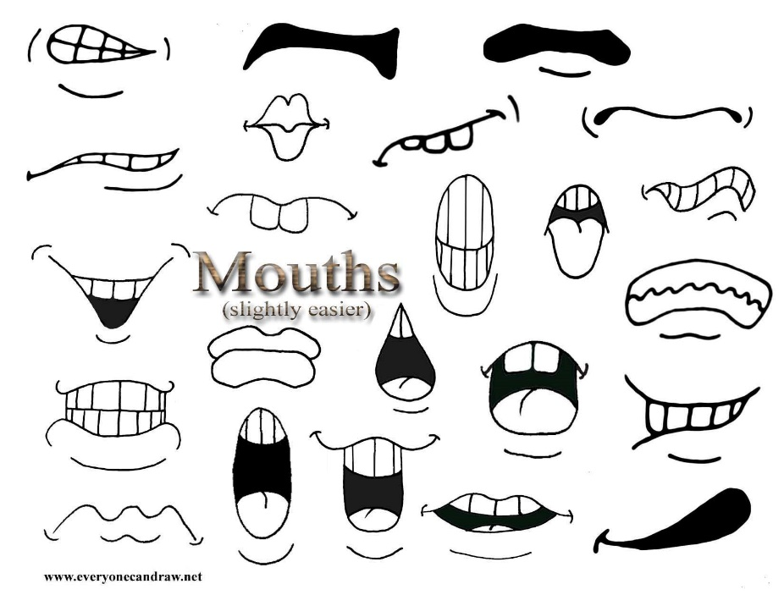
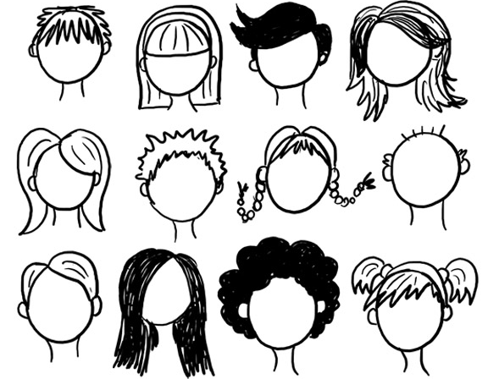
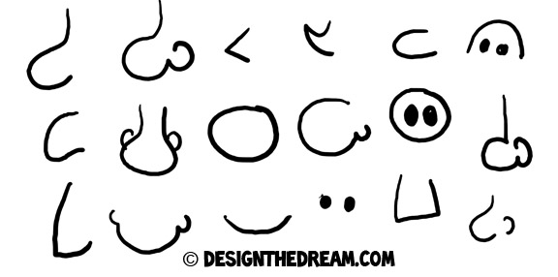
Some Examples:
EYES
Hair
Noses

Slide 15
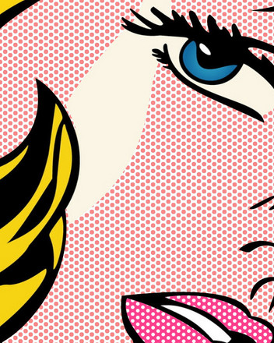
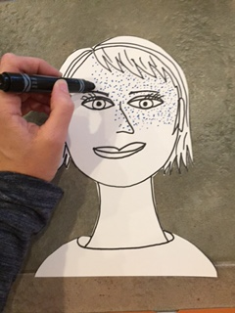
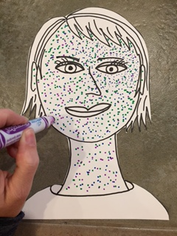
Add Ben Day dots

Slide 16
Paint it in with primary colors
Draw your portrait using PENCIL
Trace your lines with BLACK sharpie
Using a good eraser, erase all pencil lines
Cut out your portrait
Using markers, add dots to your portrait
Fill in the rest with water color
Glue it onto a piece of blue, yellow, or red paper
Cut a border around the edge of your portrait
What are you going to say?
Cut out a speech bubble
Glue it onto a blue, yellow, or red piece of paper
Cut it out again leaving a border
Add something you want to share with the world!
Glue it to your portrait

