Slide 1
Australian Aboriginal Dot Art
3rd grade

Slide 2
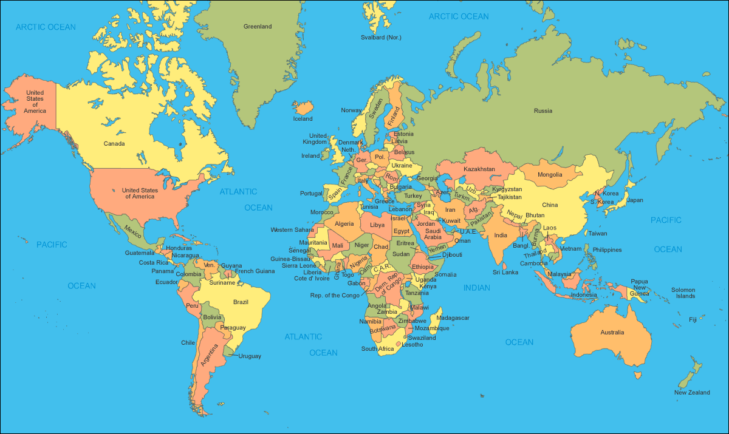
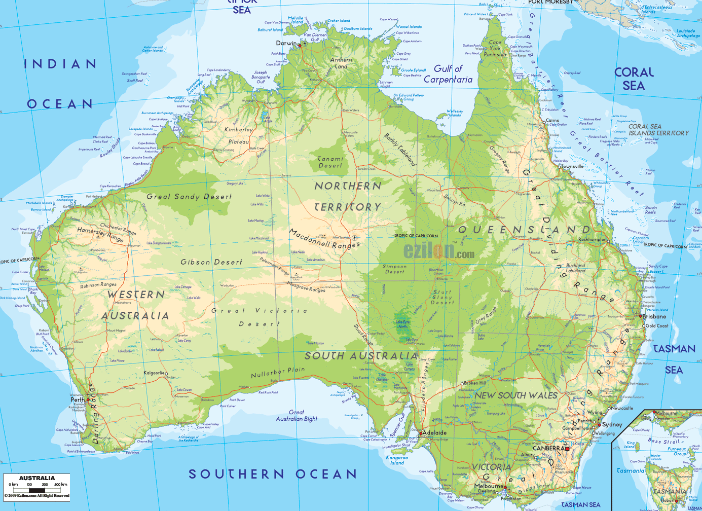
Australia

Slide 3
DOT PAINTING
Indigenous people of Australia (Aborigines) used dot painting as a way to tell stories or record ritual practices. They used the pictures as a guide as they told stories.
Often times the stories were secret, and only certain members of the tribe were allowed to know the story. So, they would paint dots all over the picture as a form of camouflage. Only those “in the know” were able to decipher the hidden pictures within.
One of the most common stories told in dot paintings is the Aboriginal creation story – Dreamtime. It is fitting since the pictures and the music all have a dreamy quality to them.

Slide 4
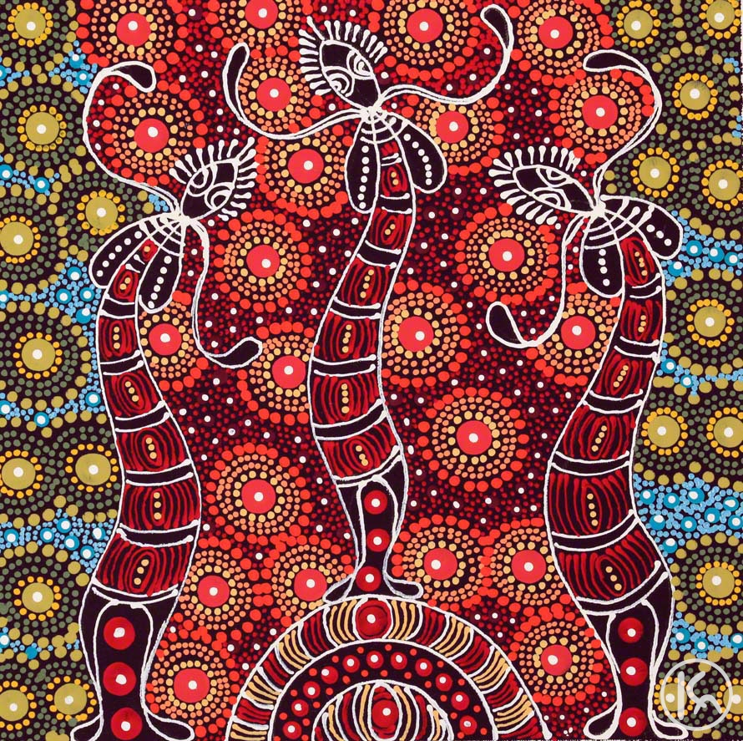
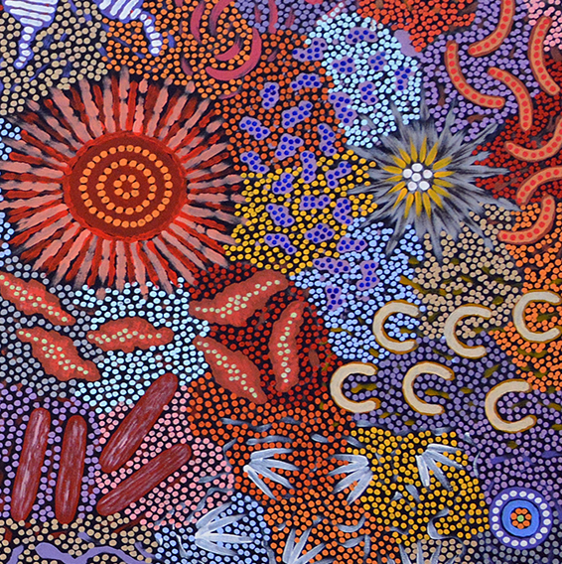
Artist: Michaelle Possum Nungurrayi
Title: Womens Ceremony
Artist: Colleen Wallace Nungari
Title: Dreamtime Sisters

Slide 5
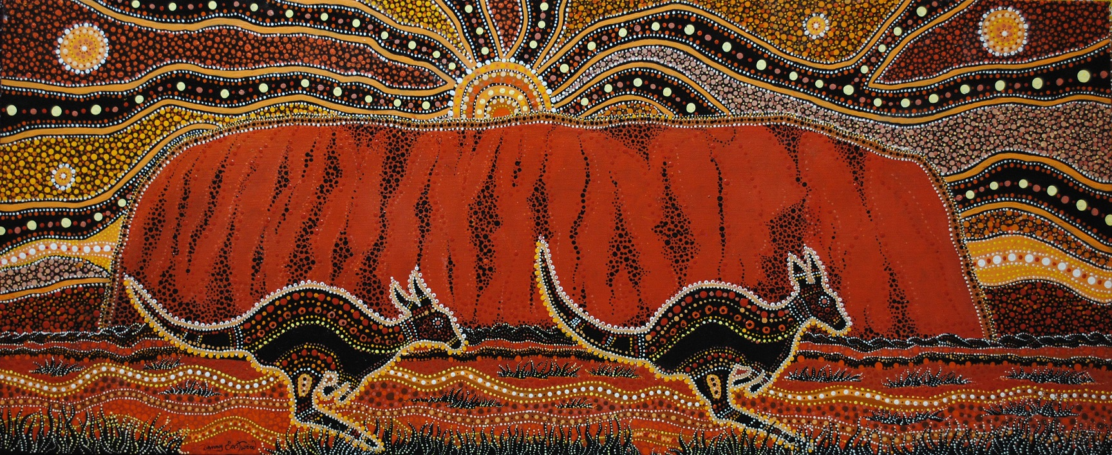
A painting of Uluru, by the famous Aboriginal artist, Danny Eastwood

Slide 6
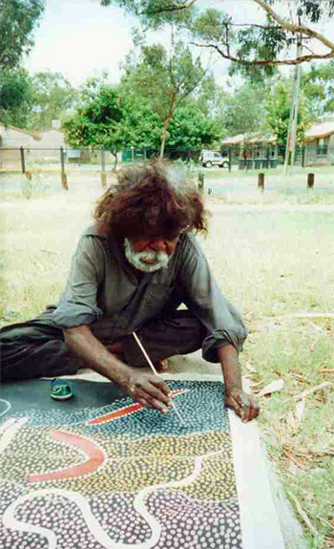
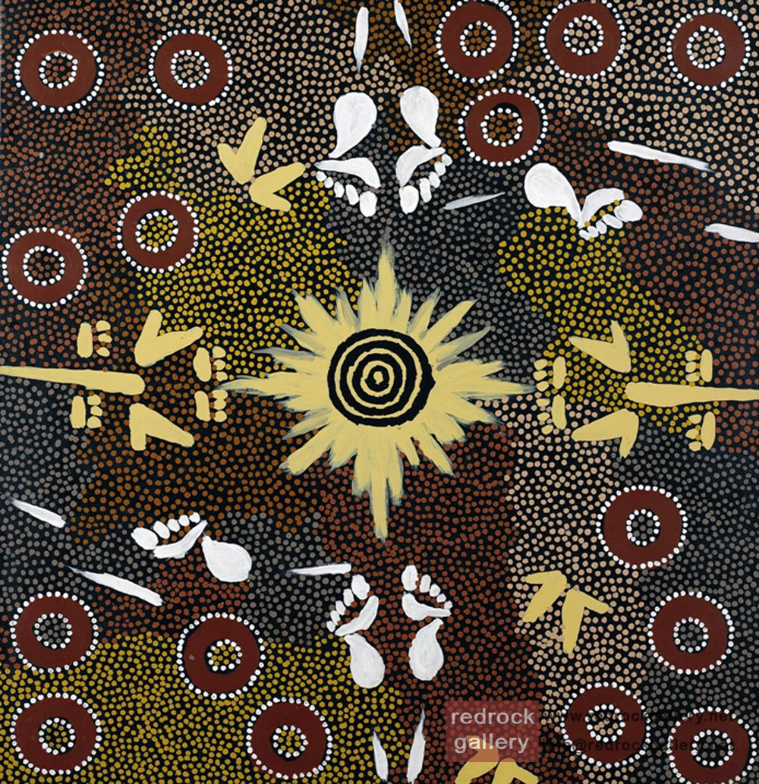
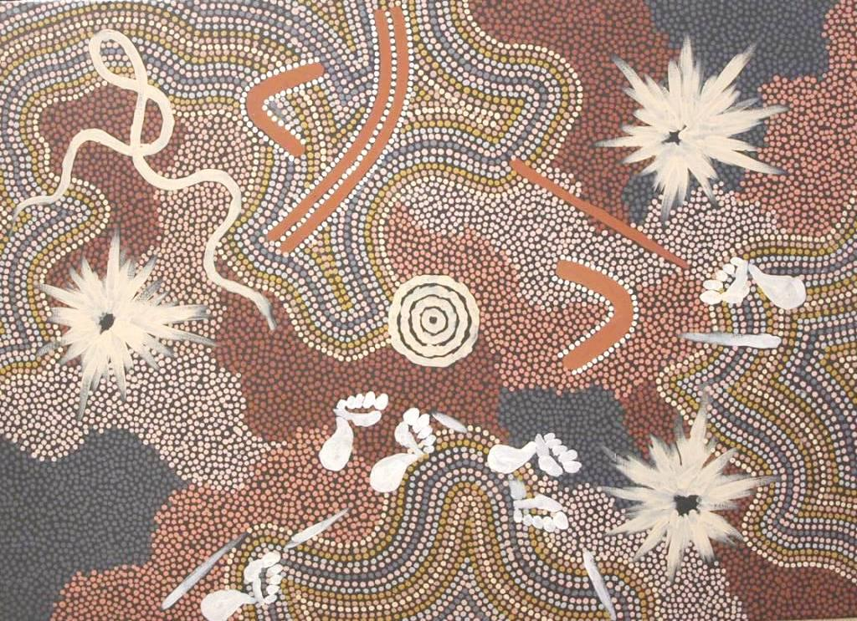
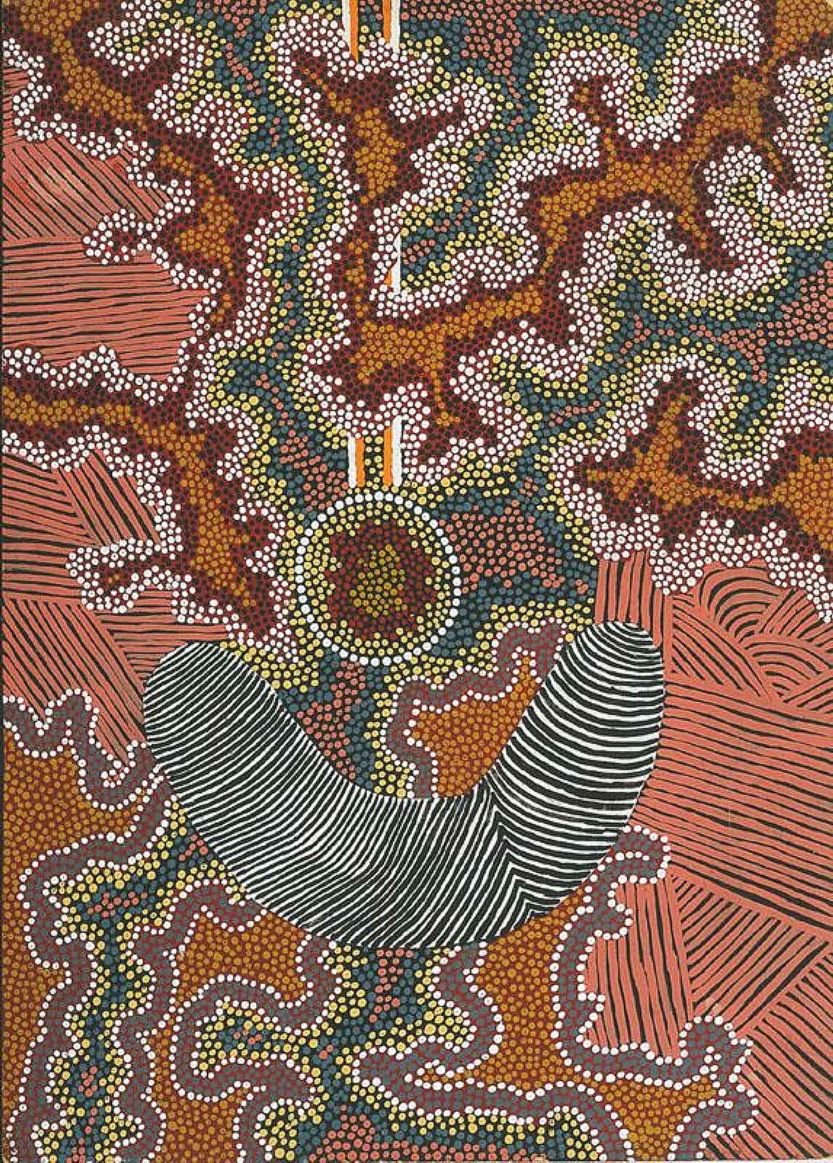
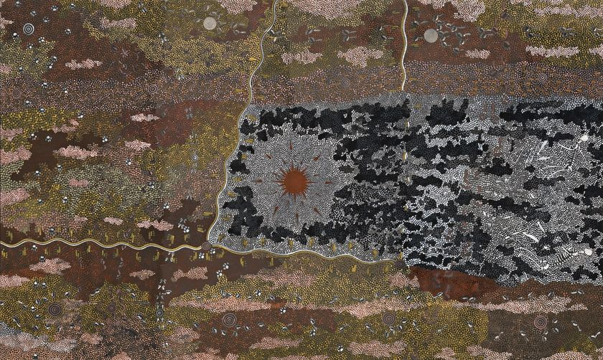
Artist Clifford Possum Tjapaltjarri

Slide 7
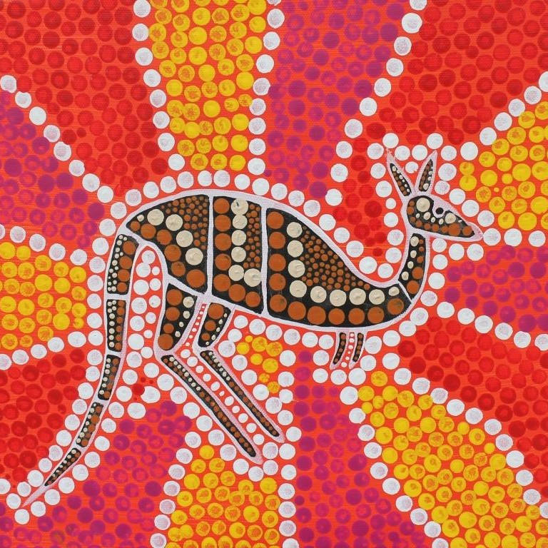
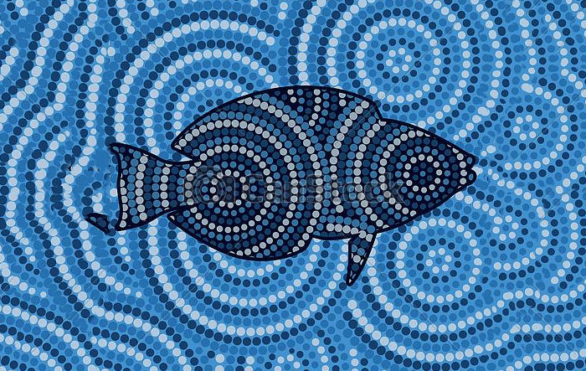
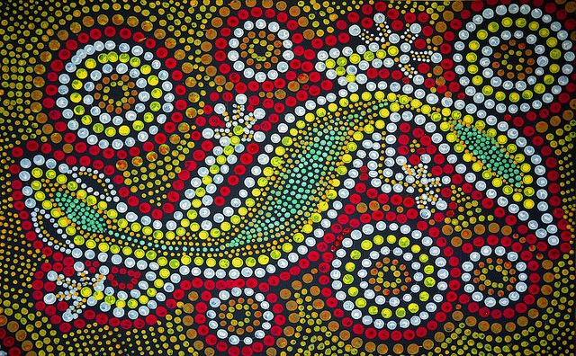
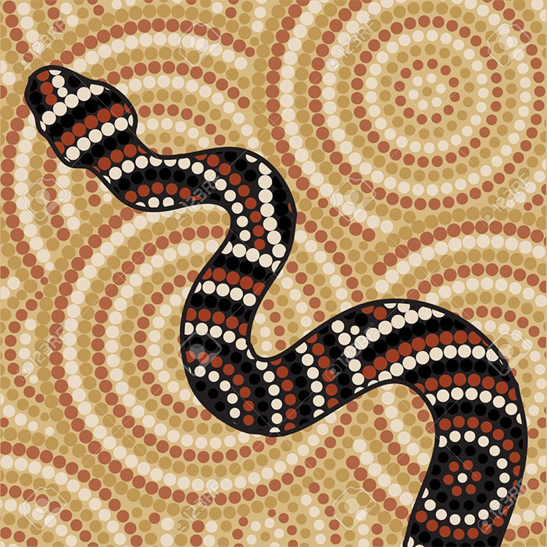

Slide 8
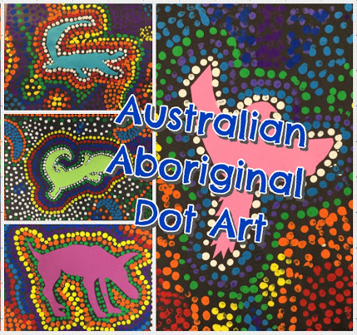
Let’s make some art!
MATERIALS:
Black construction paper
Tempera paint
Animal cut outs
Glue
Q-tips
Scratch sticks

Slide 9
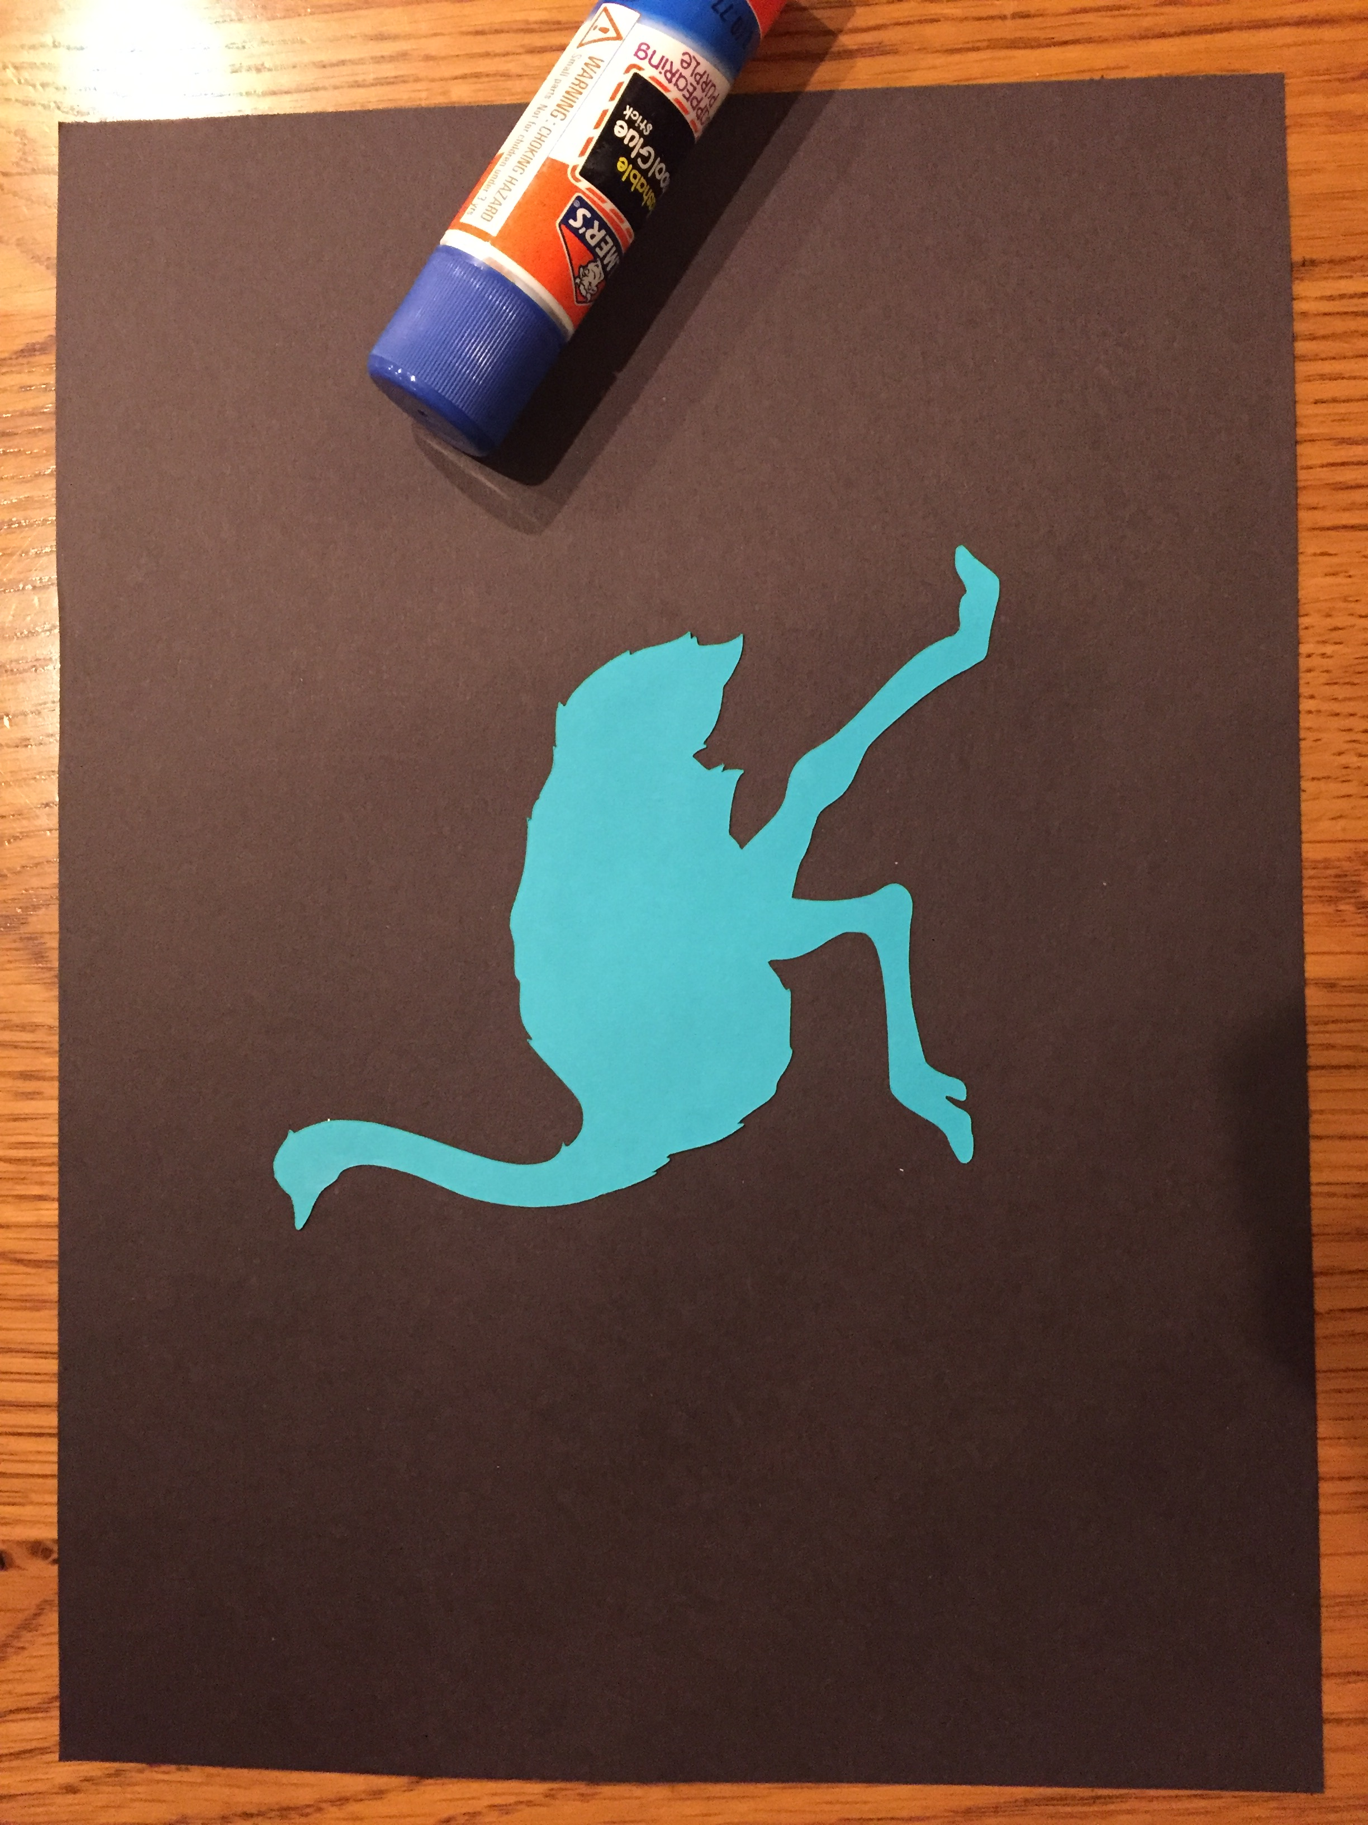
Write your name on the back of your black paper.
Choose an animal.
Glue it to your black paper.

Slide 10
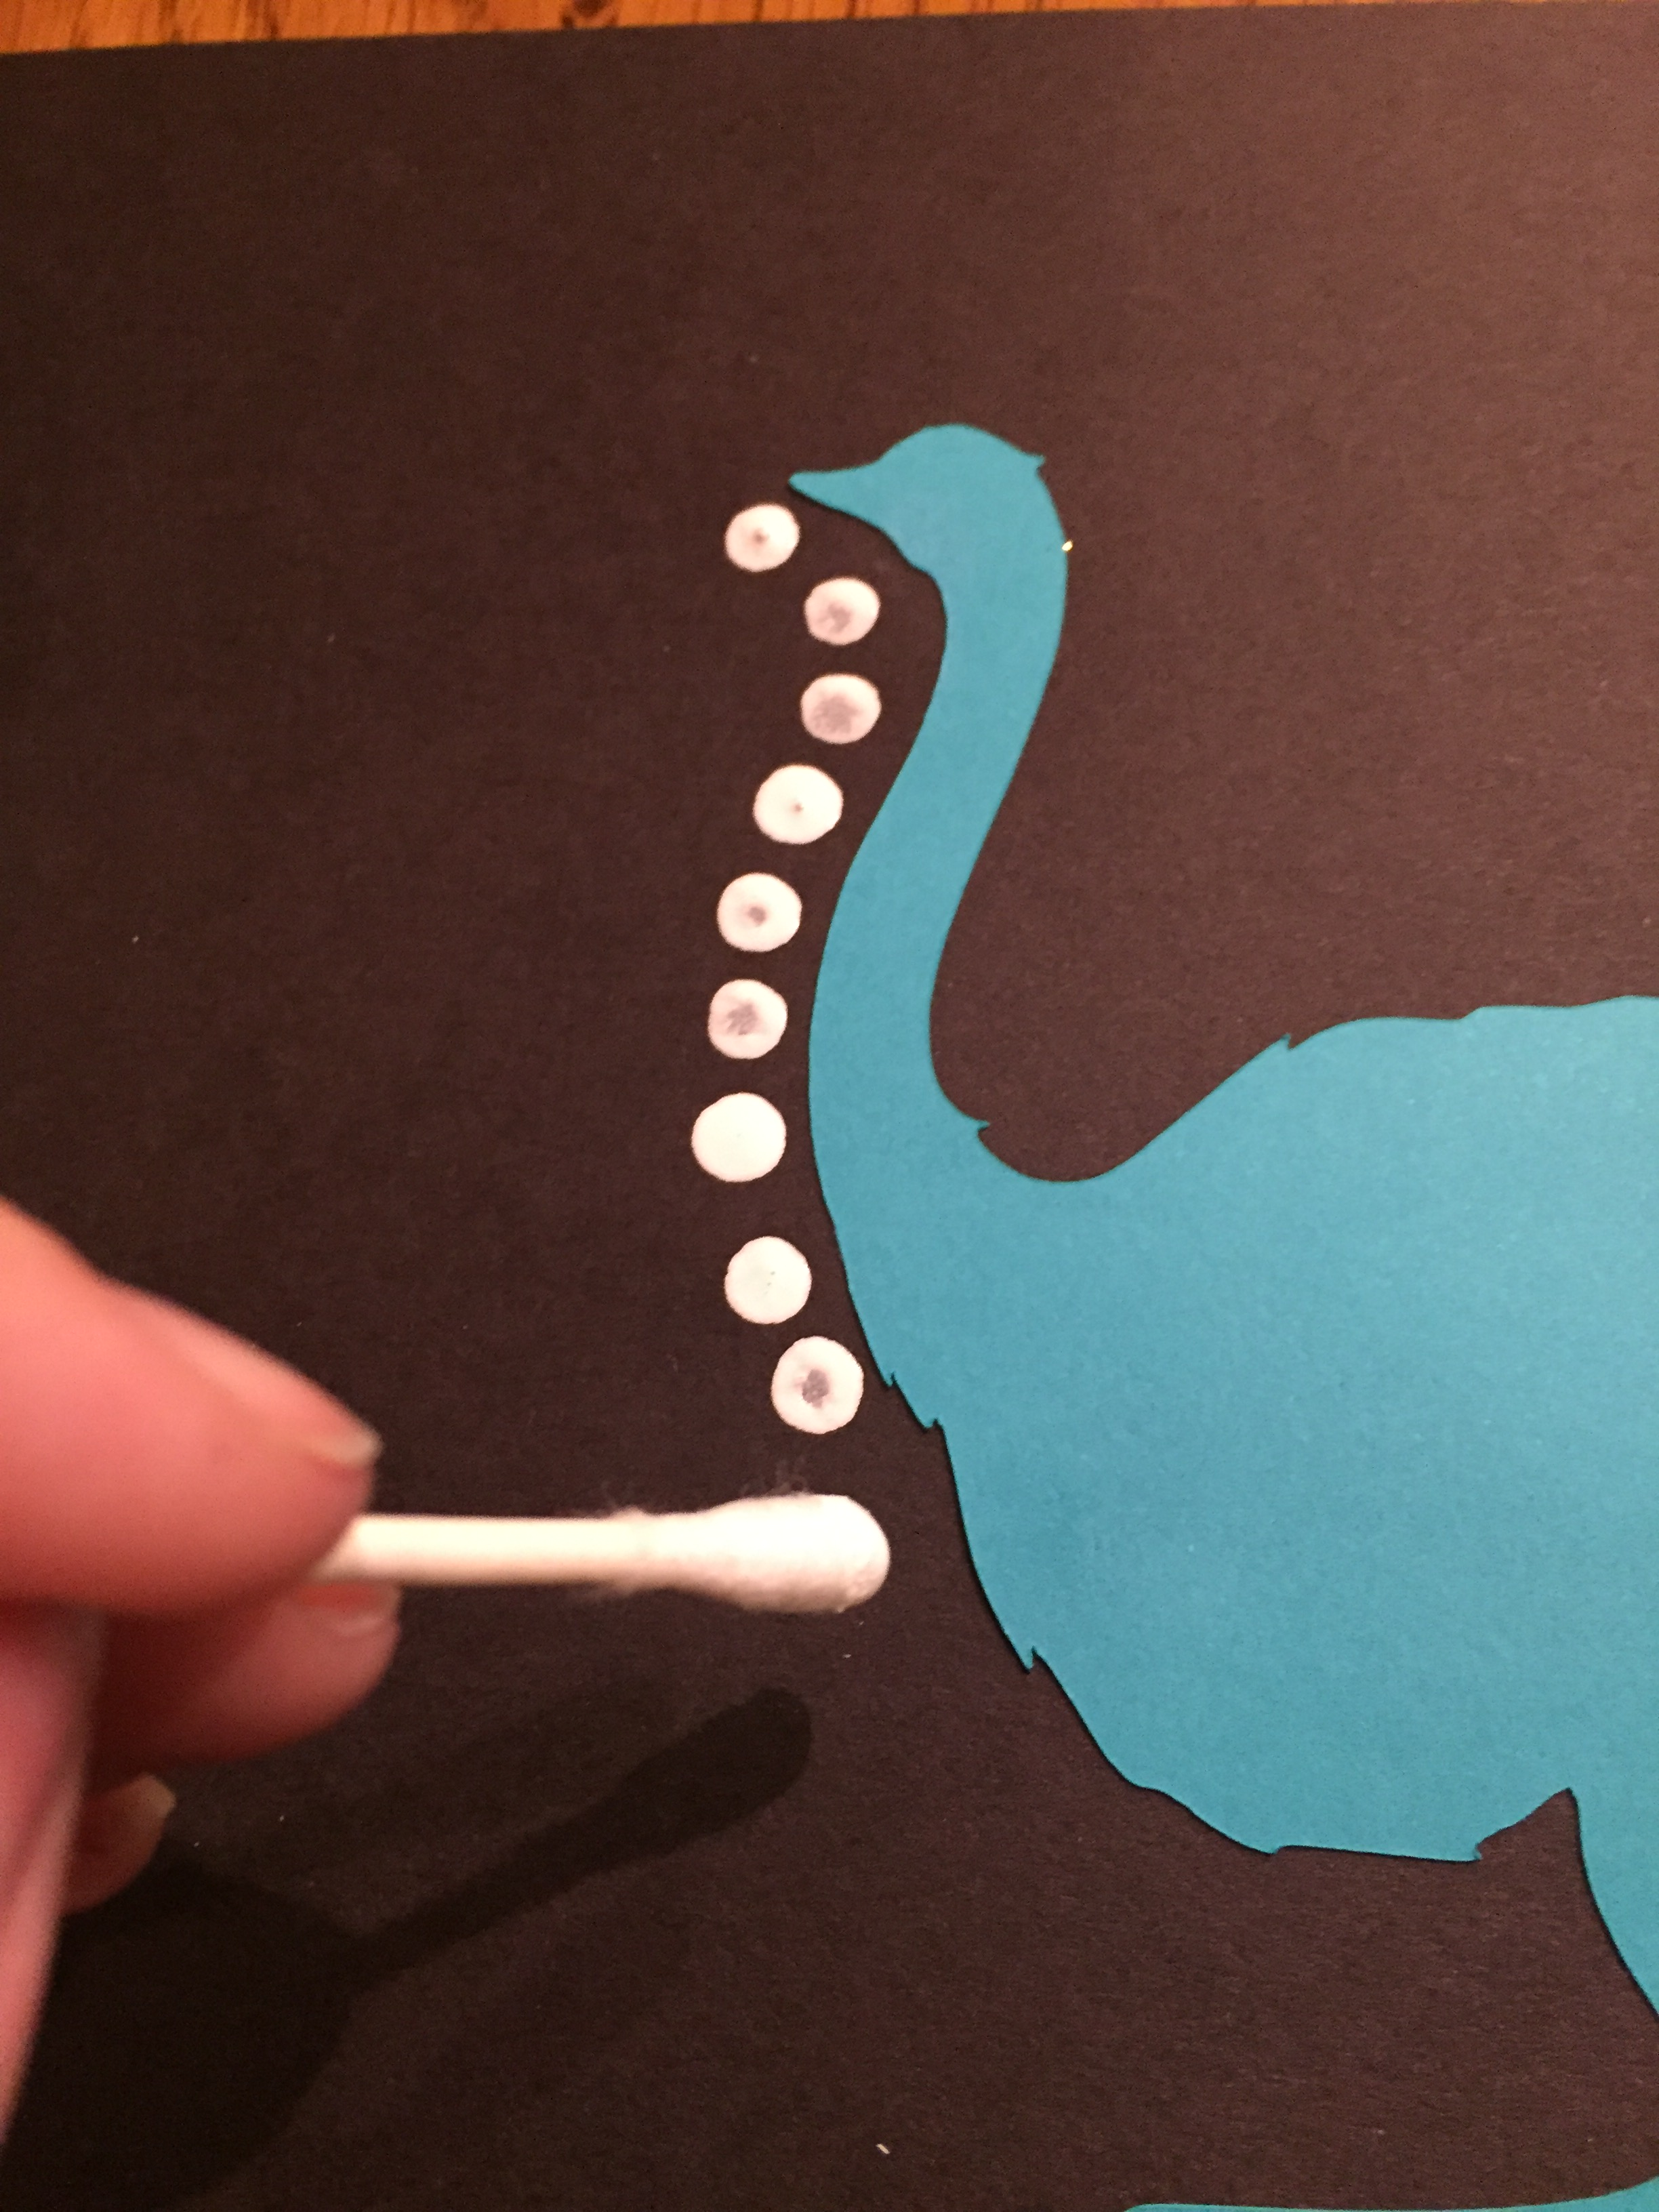
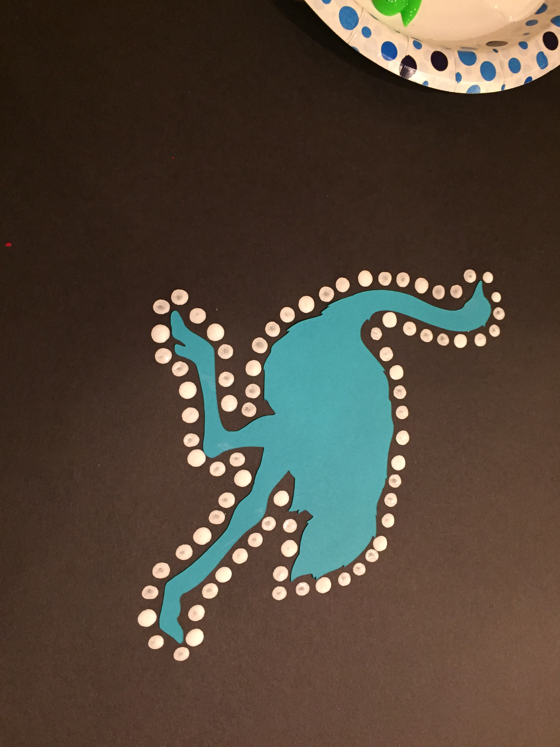
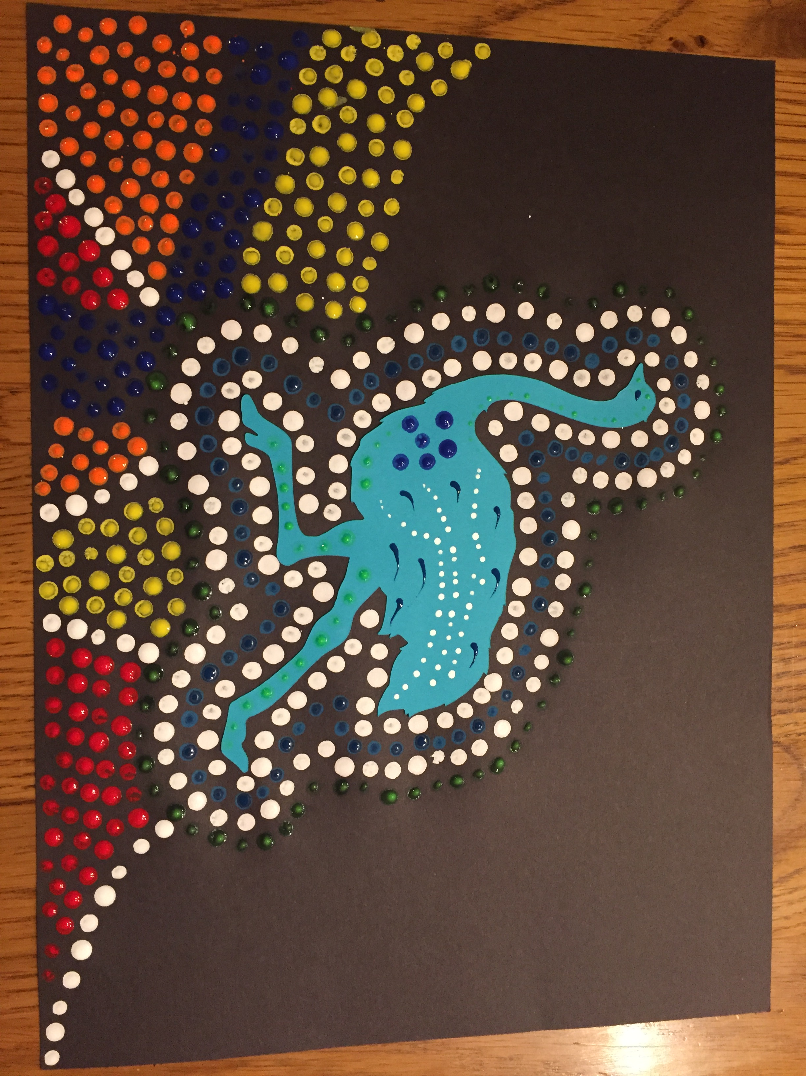
4. Start dotting!

Slide 11
