Slide 1
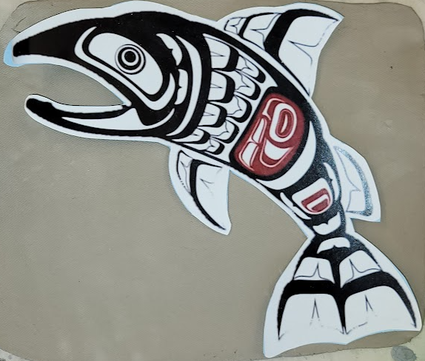
Northwest Coastal Native American Hanging Salmon
Last updated: 5/6/2023
Notes:
Here is a photo of today’s project.
Use this website to become familiar with the design shapes of the NW Coastal Tribes
https://ravenpublishing.com/blogs/pacific-northwest-native-american-art/northwest-coast-art-basic-formline-elements-and-shapes

Slide 2
Add finished salmon photos here
Project is so new, we don’t have
any photos to show you yet!
Notes:
Hi my name is _____________ and this is ____________. We are ____& ______’s moms. We are your art docents this year. (Docent usually means a specific kind of volunteer who teaches art or is a guide at a museum.) We have some other volunteers here to help you today too like_____________.
Today we will be working on part one of a clay project . Since you have been studying Salmon in the third grade, we are going to be making clay salmon platters.

Slide 3
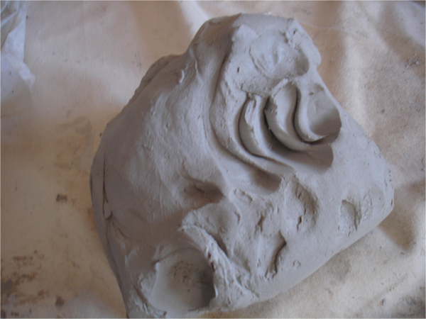

Slide 4
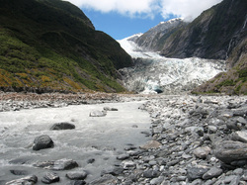
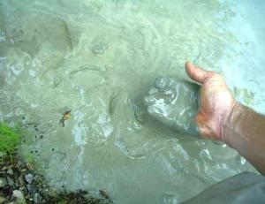
What is clay?
Minerals from the earth – specifically silica and alumina. Clay is found near rivers where small particles of rock are carried down to a lower part and collect together to form clay.
Clay characteristics –
Plastic when it’s wet –clay can be pushed, stretched, stamped, or impressed
Shrinks as it dries
Hardens as it dries – when wet it has no structural strength. Bone dry clay, before heated, is quite brittle
Clay vitrifies when subjected to sufficient heat – clay becomes hard, durable, waterproof
Notes:
What is clay?
Minerals from the earth – specifically silica and alumina. Often clay is found near rivers where small particles of rock are carried down to a lower part and collect together to form clay.
Clay characteristics –
Clay is plastic when it’s wet –clay can be pushed, stretched, stamped, or impressed
Clay shrinks as it dries
Clay hardens as it dries – when wet it has no structural strength (can slump or distort if handled roughly) Bone dry clay, before heated, is quite brittle
Clay vitrifies when subjected to sufficient heat – clay becomes hard, durable, waterproof

Slide 5
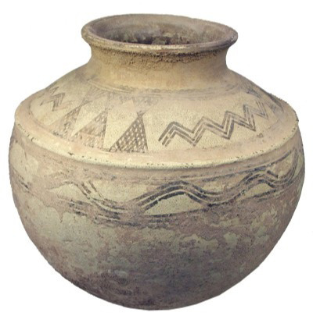
Clay pots have been around since 5000B.C.
6000 years ago!
Notes:
How long have clay projects been around?
Clay pots have been found in current day Iran and China that date back to 5000 B.C. – that’s more than 6000 years ago! People used clay to make containers for food and to make bricks to build houses ( baked clay mixed with straw called adobe). Back then they used fire to cook and harden the clay.

Slide 6
Clay Characteristics
Clay is plastic when wet – can be pushed, stretched, stamped, or impressed, with out losing it’s cohesion
Clay shrinks as it dries and when it vitrifies as water evaporates from the piece
Clay hardens as it dries – when wet it has no structural strength. It is very likely to slump or distort if handled roughly. Leather hard clay can support its own weight while still bending. Bone dry clay is quite brittle and must be handled with care.
Clay vitrifies when subjected to sufficient heat – clay becomes hard and durable, stoneware and porcelain become impervious to water and acids
Clay has memory – when you move, pull or push clay it remembers. For example, a slab project may curl as it dries.

Slide 7
Clay Stages
Slip – clay slurry, heavy cream consistency, used to glue together pieces
Wet/Plastic – soft workable clay, coils can bend without cracking but won’t stick to your hands
Leather-Hard – has been allowed to dry completely, it no longer contains environmental water. Clay will shrink as it dries about 10%- 15%. Clay should be dried slowly.
Green ware – all unfired ceramic ware.
Bisque – after first firing, still water permeable and hard enough to hand easily
Vitrified – clay has lost all moisture and has a crystalline structure that gives it strength and durability.

Slide 8
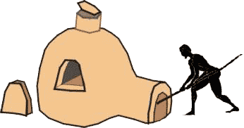
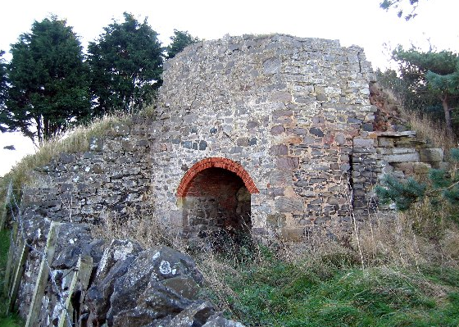
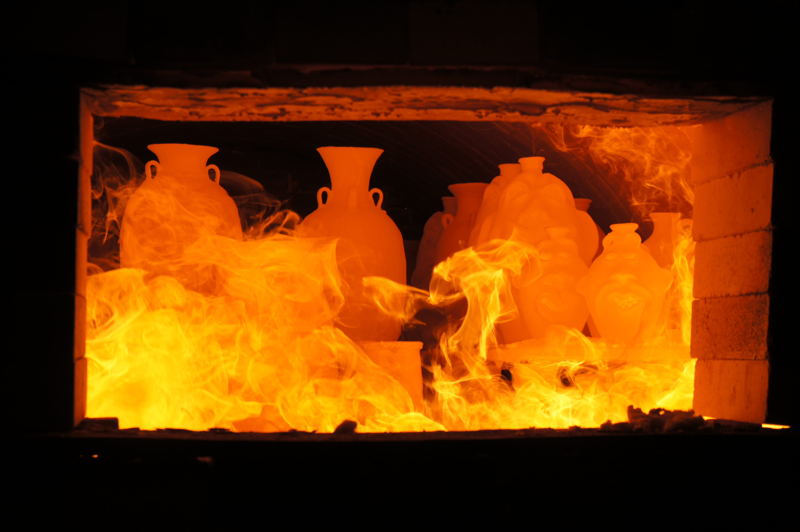
Baking with Fire!

Slide 9
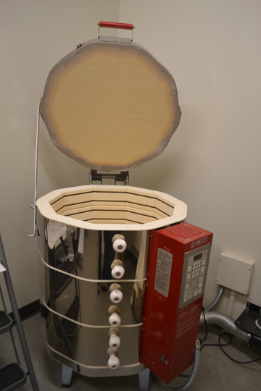
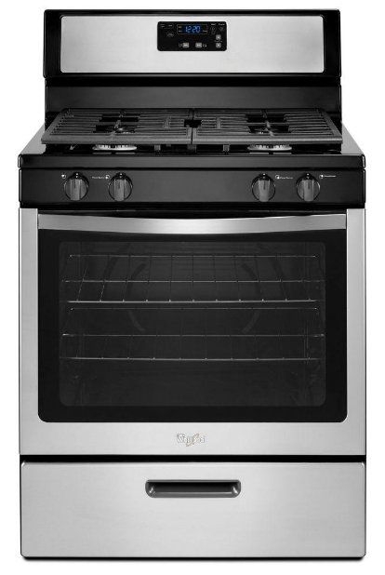
Electric Kiln
This kiln cooks at 2000 Degrees F !!!
This oven reaches 500 Degrees F
Now that is HOT!
Notes:
Today we use a special electric oven called a kiln to cook the clay. How hot does your kitchen oven at home reach when you are cooking food? 375 or 400 degrees F? Our kiln will cook your projects at about 1800 -2000 degrees F. (show photo of kiln)
Cooking in a kiln is called firing. This is important because it makes the clay stronger and more waterproof. Clay that has been kiln fired would not return to a soft state even if it were in water for a long time. That is because the extreme heat causes permanent physical and chemical changes to occur. These reactions, among other changes, cause the clay to be converted into a ceramic material.

Slide 10
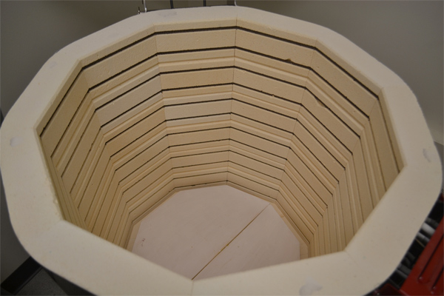
Notes:
These projects we make today will need to dry in the open air for a week or two (this is the greenware state-•Greenware (noun) is the term given to clay objects when they have been shaped but have not not yet been bisque fired, which converts them from clay to ceramic. Greenware may be in any of the stages of drying: wet, damp, soft leather-hard, leather-hard, stiff leather-hard, dry, and bone dry.)
When they are completely dry they will be fired in the kiln for the first time (bisque fired) and look like this when they are done (hold up a sample of bisque fired piece).
After that, I will come back and you will paint the projects with something called glaze which is a special liquid like a paint that’s made of bits of ground up glass. The piece will then be fired again in the kiln and will turn out like this (show a real glaze fired piece).
Getting started:
Students receive one canvas cloth on the desk, one slab of clay, dull pencil for writing name, cutting knife, texturizing tools (tongue depressors, screws, pinecones, marker caps, etc.), tagboard template of project, tray for project drying, bowl with few drops of water for fingertip smoothing)

Slide 11
Our Project Today
After we are finished with the project today, it will need to dry in the open air for about 7 days
This is the greenware state-• Greenware (noun) is the term given to clay objects when they have been shaped but have not fired
Greenware may be in any of the stages of drying: wet, damp, soft leather-hard, leather-hard, stiff leather-hard, dry, and bone dry.
When they are completely dry they will be fired in the kiln for the first time (bisque fired)
bisque fired converts them from clay to ceramic
After that, I will come back and you will paint the projects with something called glaze which is a special liquid like a paint that’s made of bits of ground up glass. The piece will then be fired again in the kiln and will turn out like this (show a real glaze fired piece).

Slide 12
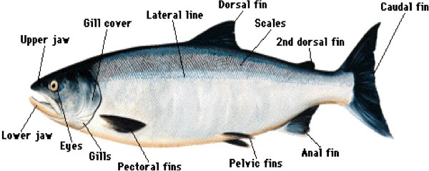
Anatomy of the salmon

Slide 13
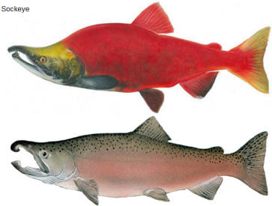
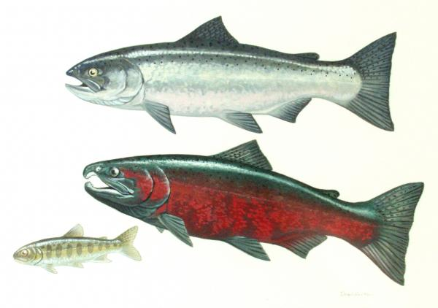
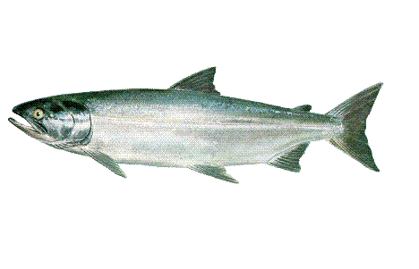
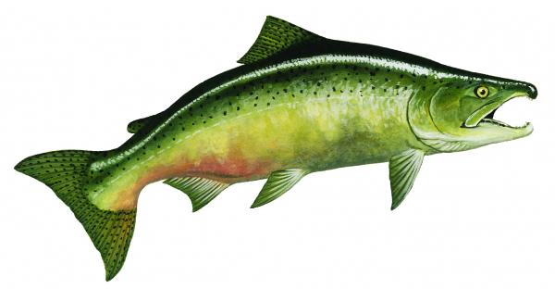
jfijfkdj
Notes:
This slide can be printed and used when glazing to give the students ideas for where to place color. This slide can be skipped if you don’t want to make realistic salmon colors and texture.

Slide 14
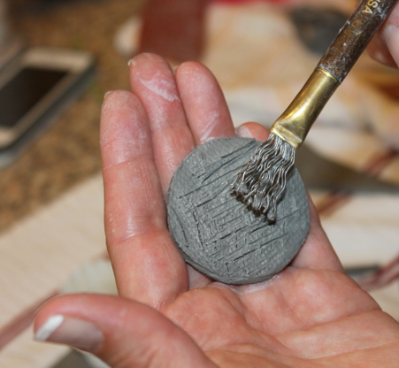
Steps for students to make a clay salmon hanger:
Choose the direction you want your fish to be facing.
Place the template on the clay slab and trace using the skewer in an upright manner all the way around the fish.
Remove template and carefully flip clay fish over to scratch your name and year on back with dull pencil.
Turn fish over and place clay fish aside for a moment.
Use scrap pieces of clay to practice with texturizing tools to see what effects will help you achieve the look of scales, fins, etc. (try the tip of the popsicle stick) using the NW COASTAL FORM LINE ELEMENTS
Take the clay salmon and draw shallow dividing lines with popsicle stick on the salmon to separate the different parts of the body (Don’t cut too deep!)
Use the scrap pieces of clay to create the eye and other raised details you want to add. No more than 3 layers high!
Remember to use the scoring technique to attach the pieces to the salmon.
Use the texturizing tools to add details like scales, ridges in the fins, eye, etc.
NW Natives use the following shapes:
Ovals, Circles, Cresents, L, W, and U.
Use a finger with one drop of water (not too much) to smooth all the edges so they won’t be jagged or sharp once fired.
Remove any clay crumbs from the salmon to give it its final clean appearance
Use the blunt end of the skewer to make a hole for hanging your fish.
Clean up – dunk hands in bucket of water first to get big chunks of clay off so they don’t go down the drain and clog it. Then wash with soap and water in sink.
Notes:
Your choice to use the single page instructions (this slide) or continue on to show them the step by steps with photos in the following slides.

Slide 15
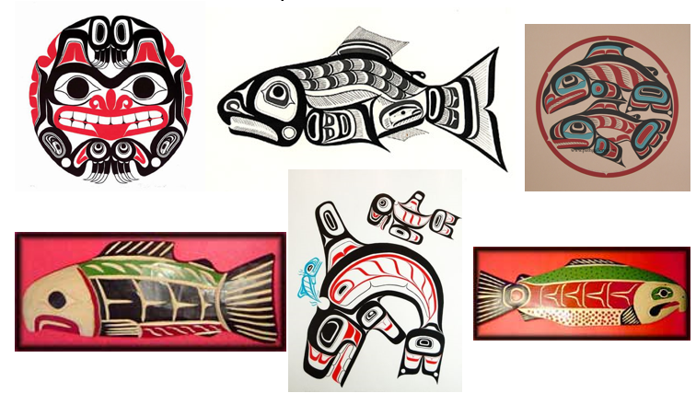
NW Coast Native Design What is unique about their artwork?

Slide 16
Shapes

Slide 17
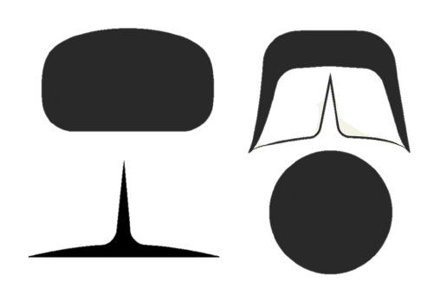
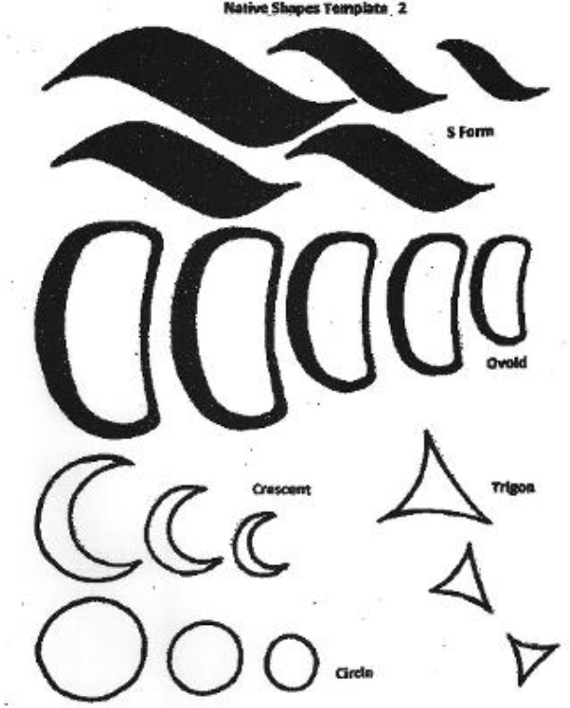
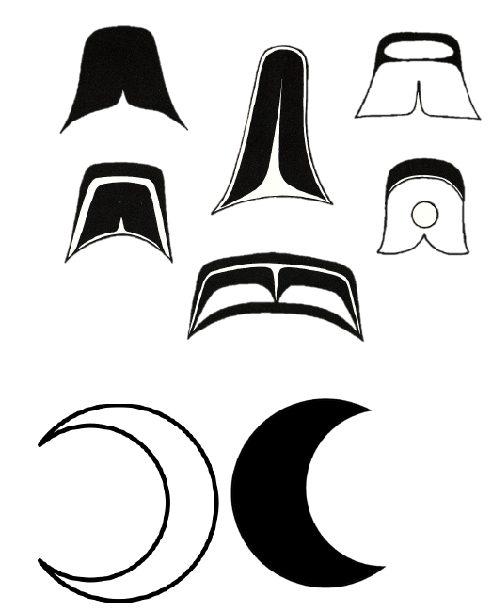
Common Shapes

Slide 18
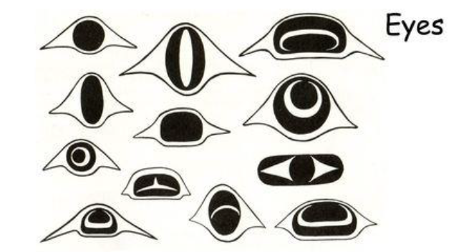
Eye Shapes

Slide 19
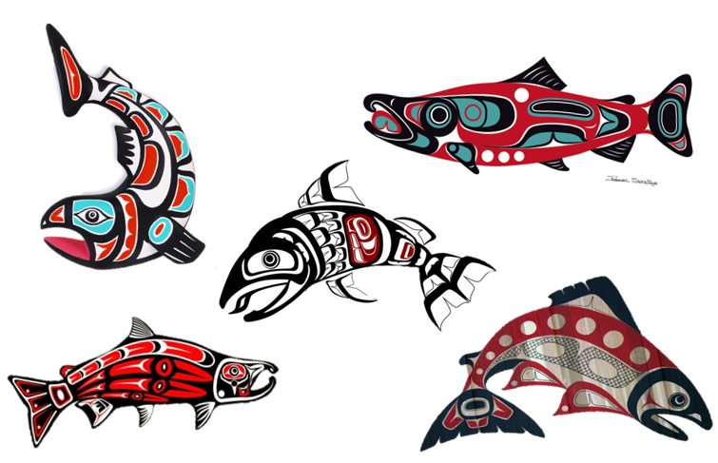
Design ideas
Notes:
Print this page out and put on each table so students have examples to use for placing their shapes.

Slide 20
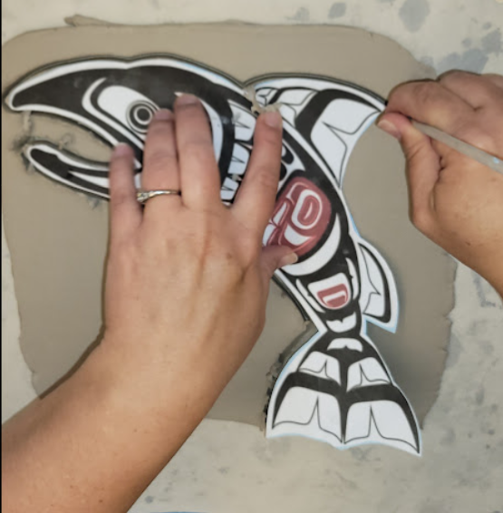
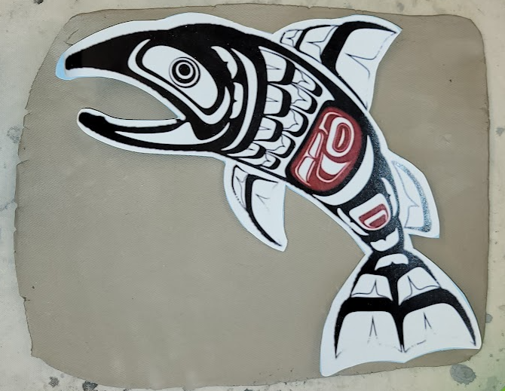
Making the Salmon
Step 1
Step 2
Place the fish template on the rolled sheet of clay so that it fits.
Trace the template with a thin object like a wooden skewer.

Slide 21
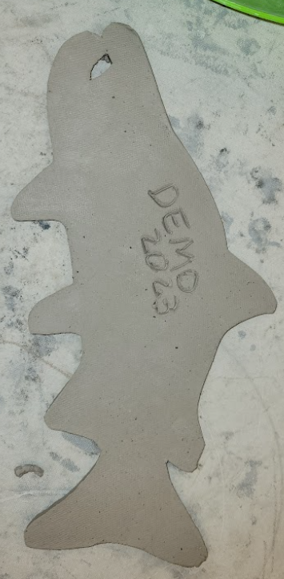
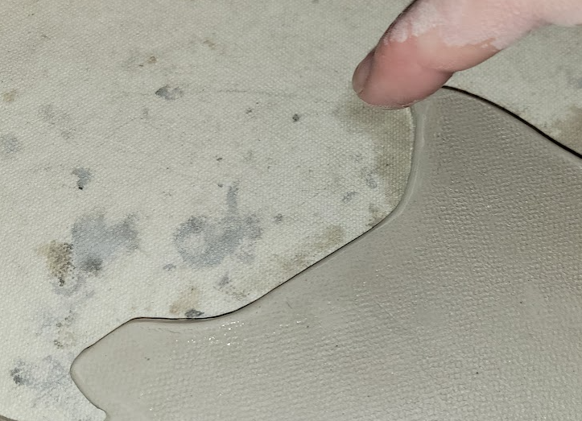
Next Steps:
Step 3 – Pull away the excess cut pieces
Save the excess scraps to practice your textures.
- scratch your name on the back of your fish.
Step 4 – With finger and a drop of water, smooth all rough edges
3
4

Slide 22
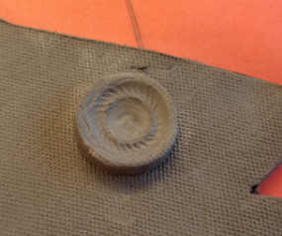
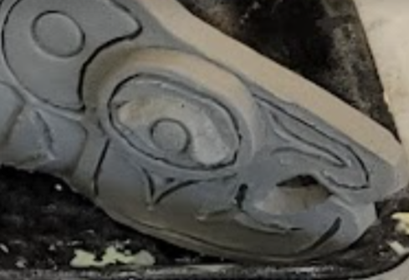
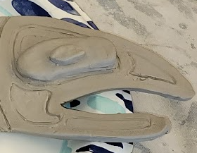
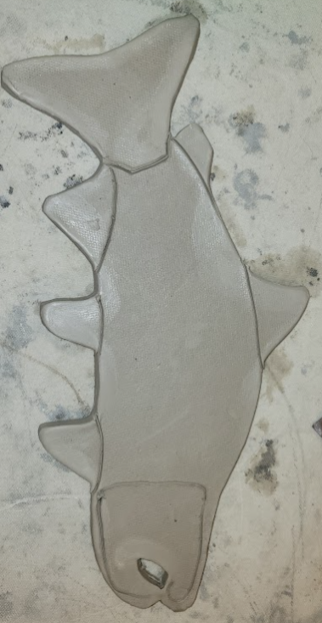
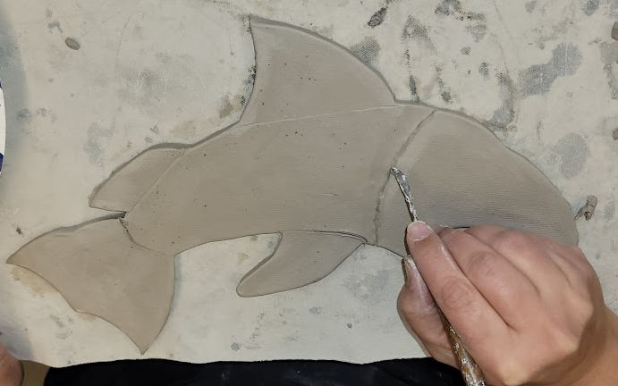
Eyes & Fins
5
Step 5 – Make an eye from the excess clay.
Step 6 - Define the fins and body parts
6

Slide 23
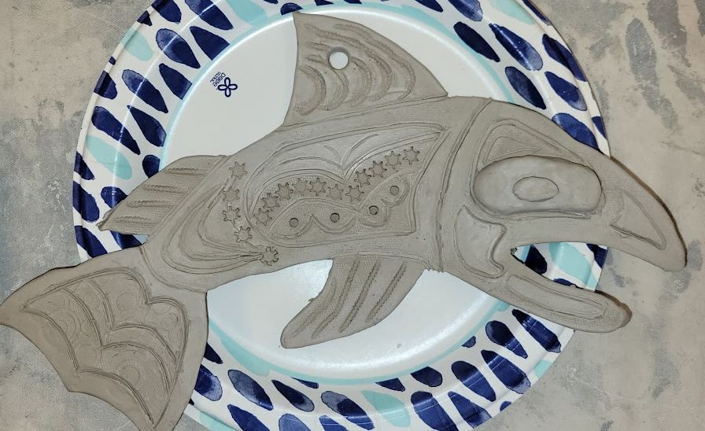
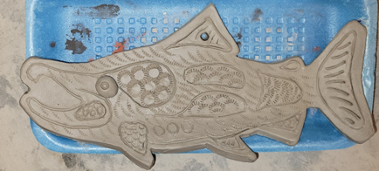
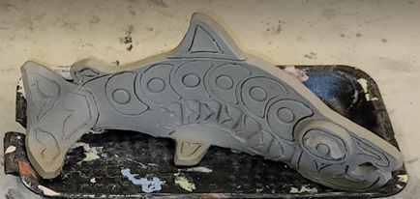
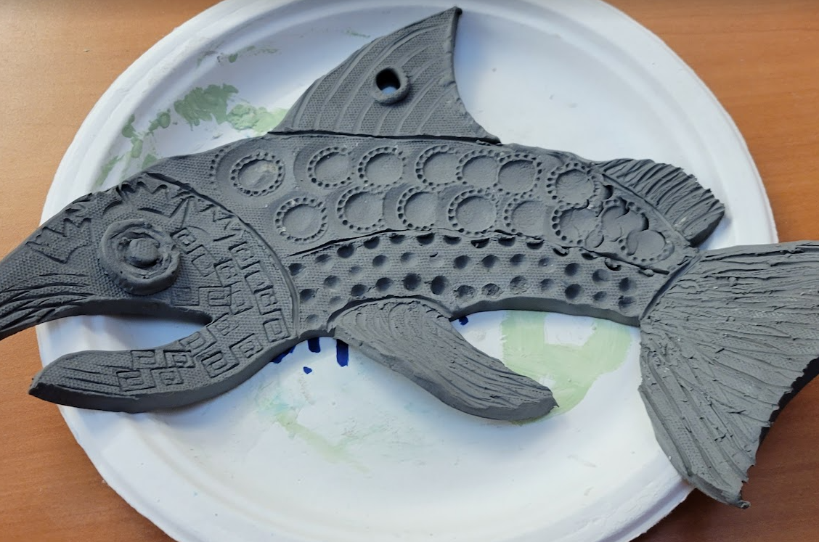
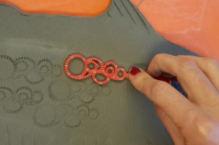
Designs and Texture
7
Use ovals, ovoids, circles, crescents, U, V, L, S to make your shapes.
Draw them with a popsicle stick or lightly press with a cookie cutter or other object in the tray.
Add texture if desired
Remember: don’t cut or press too hard when adding texture, or else it will cut through the fish. It will have a hole or weak part where you went too deep.

Slide 24
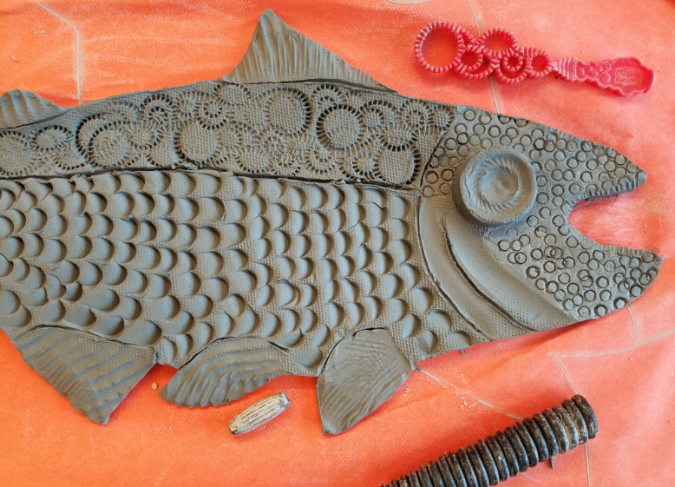
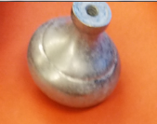
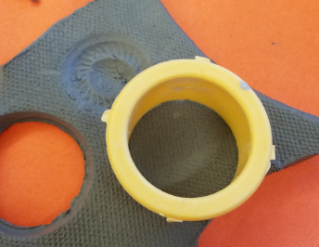
This Example used Tool:
This fish was made using:
Circle cookie cutter & Door knob for eye pattern
Popsicle stick for scales
Bubble wand for upper scales
Tube shaped bead
End of bead to make face
Side of bead to make fins
Telephone coil for larger fins
Paper clip to define body parts and fins

Slide 25
Adding the hole for hanging
With adult help, create the hole on the top of your salmon so that you can insert a ribbon into it for hanging later.
Using the flat end of the skewer stick, push the skewer all the way through the clay. While the end of the skewer is touching the table through the fish, make small circles while expanding the hole until it is about ¼ - ½” in diameter.

Slide 26
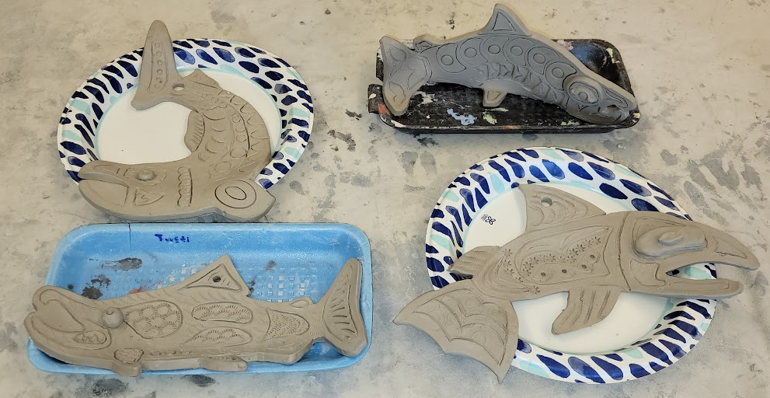
Getting it ready to dry
Carefully place your fish on a plate or tray, making sure the area with the hole stays flat (parallel to the table). This will allow it to lay flat against the wall when hung.
Shape the pieces that hang over the side into the desired shape you want when it is dry
These will need to air dry for 7+ days before they can be bisque fired.
We will come back together as a class to glaze your salmon later this month.

Slide 27
End of Wet Clay Lesson

Slide 28
Glazing
Glaze – mixture of ground glass, clays, coloring materials and water. It’s applied to a bisque piece by brushing, sponging, dipping, etc.
Glaze helps strengthen, decorate and waterproof an item.

Slide 29
Glazing Lesson
Student Instructions
Apply at least 3 layers of glaze
A layer is 1 thin coat that has dried
No double dipping colors with the same brush. Only 1 color per brush.
Rinse brushes well and dry them before changing to a new color.
Dab your brush into all the deep textures to ensure glaze gets into these places.
Use the correct size brush for the area you are glazing.
Leave NO WHITE bisque showing. Cover all areas of the front and sides of your project.
If you want areas of your project to be white, use white glaze.
Glaze is expensive, do not waste it.
Do not glaze the bottom (back) of your project.
Keep the lids on the cups when you are not using the color.
Rinse your brushes with warm soapy water when completely done.
Leave your project on the plate.

Slide 30
End of Presentation

Slide 31
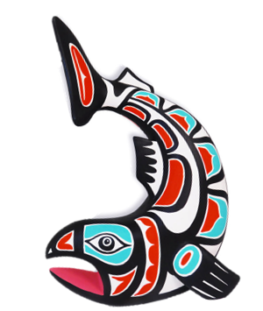
A tip for glazing….
3 Coats of glaze (dry between each coat)
Limit to 3 colors for the body and a 4th color for accent.
NW Tribal colors tend to be black, white, red, and a light blue, and or turquoise.
Provide 3 sizes of brushes (Medium, Small, and very small)
They will use one color per brush and rinse their brushes in between changing colors. They end up using 3-4 brushes per student.
Make sure they fill in all the deep grooves in their texture and all edges. Its okay to get a little glaze on the back side, we will stilt the items in the kiln to protect them from adhering to the kiln shelf.
Glaze is not blend-able. Which ever color is used last, will be the color seen.
Please wash the brushes until the water runs clear from the brushes. Any glaze left on the bristles will harden and make using the brushes harder (stiffer) for the next class.
Store the brushes in a cup, handle down, bristles pointing up.

Slide 32
Materials for Glazing Lesson
Butcher paper to cover tables
3 sizes of round glaze brushes per student
3-4 colors of glaze poured into 3oz To-Go cups with lids. (write color names on cups and lids)
Plus the glaze sample tile to show what the color will look like after it is fired.
Red, Black, Bright Blue, White, Turquoise
Water cup for rinsing brushes between colors.
Absorbent paper towels to dry brushes between rinsing (don’t want to add water to glaze, it will thin it out too much)
Paper plate or foam tray (fish stays on tray or plate while glazing and drying)
Picture examples of tribal art work to show color combinations.

Slide 33
Clay Prep – 1 week prior
Schedule the clay preparation date one 4-7 days before the first wet clay lesson.
Invite all the lead docents for each classroom to come prepare the clay and to practice making the lesson.
Takes approximately 1.5 hours to cut, roll, and pack enough clay for 5 classrooms.
Plus, another 45min to make a practice piece.
It is advisable that all docents practice making the same item that they will be teaching the students to make. This gives them a good understanding of any difficulties in how the clay responds when making the project.
Docents who have done this project before can provide valuable insight to new docents who are doing it for the first time.

Slide 34
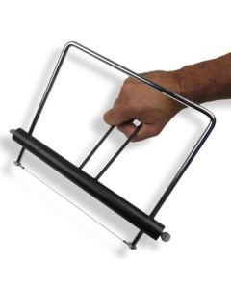
Notes to Docent – prepping the clay
Materials needed:
Adjustable clay slicer (and ruler for measuring)
set at 1” - 7/8” (reduces the amount of unintended waste)
Can get approximately 12-13 slabs from each full block of clay.
Table Top Clay roller (3 pieces)
Clay roller’s canvas sleeves & rubber mat (to prevent roller from sliding on table)
Canvas table clothes (2+) to protect table in between slicing and rolling (suggest putting butcher paper down first, for ease of cleaning tables after removing canvas)
Spray water bottle and plastic water buckets
Plastic Totes with lids
Plastic garbage bags, sliced into sheets
Wet sponges (5-7 per tote)
Wet Bar size terry cloth towel per tote

Slide 35
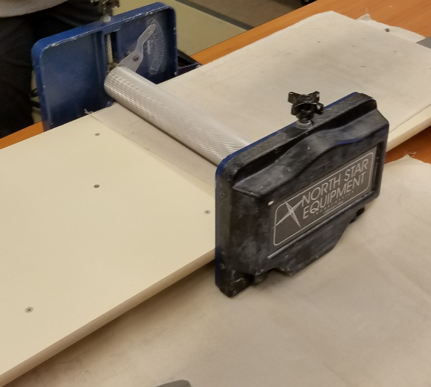
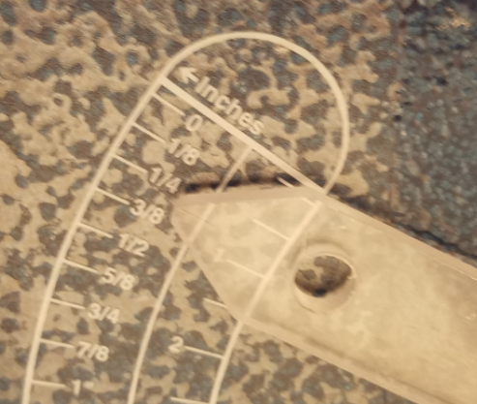
Rolling the Clay
Works best with 4-5 helpers for doing a whole grade level.
You will roll the clay twice at two different thicknesses.
1st roll – at 1/2” thick
2nd roll – rotate clay slab a quarter turn and roll again at slightly less than 3/8” thick .
Should come out large enough for the 10” fish template

Slide 36
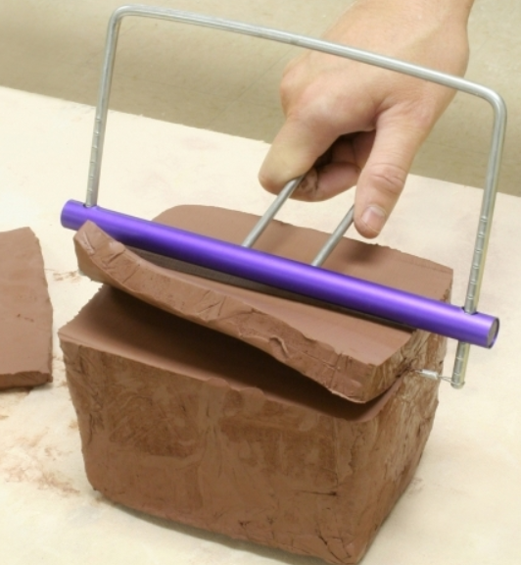
Notes to the Docent
Slicing and Rolling Clay:
Slice Clay slab 1” thick from the block of clay from the short end. Use a ruler to measure the wire slicer.
Set the clay roller to just shy of 1/2” thick
Roll clay
Take the piece that was just rolled and turn one quarter turn on the canvas
Set the clay roller to between 3/8^{th”} and ¼”
You should get approx. 12 slabs per 25 lb block
Store the clay slabs in the long totes with wet sponges in the bottom and plastic sheets between each layer of clay.
Spritz the slabs with water before adding plastic over the top of each layer.
Place a wet bar size towel over the last layer at the top. Tightly close the lid.
Write the number of clay slabs on tape on the outside of the tote.
Leave the totes in the Pod where the lessons will be conducted.
Place any extra slabs from your bin into the next bin when your class is over.
WARNING: Clay can not go down the drains. You must wash all the tools and your hands using the warm water in the 3 buckets.
Dump the dirty water into the garden beds outside. Shake out the canvas table cloths outside. Careful, dry clay dust is not healthy to breath.

Slide 37
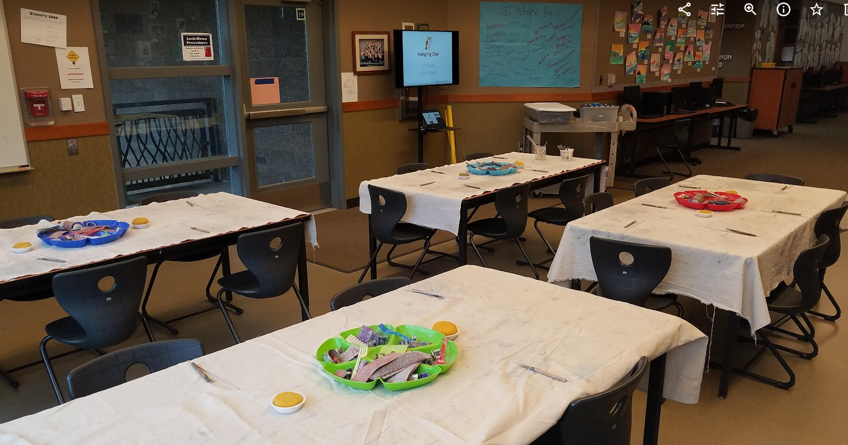
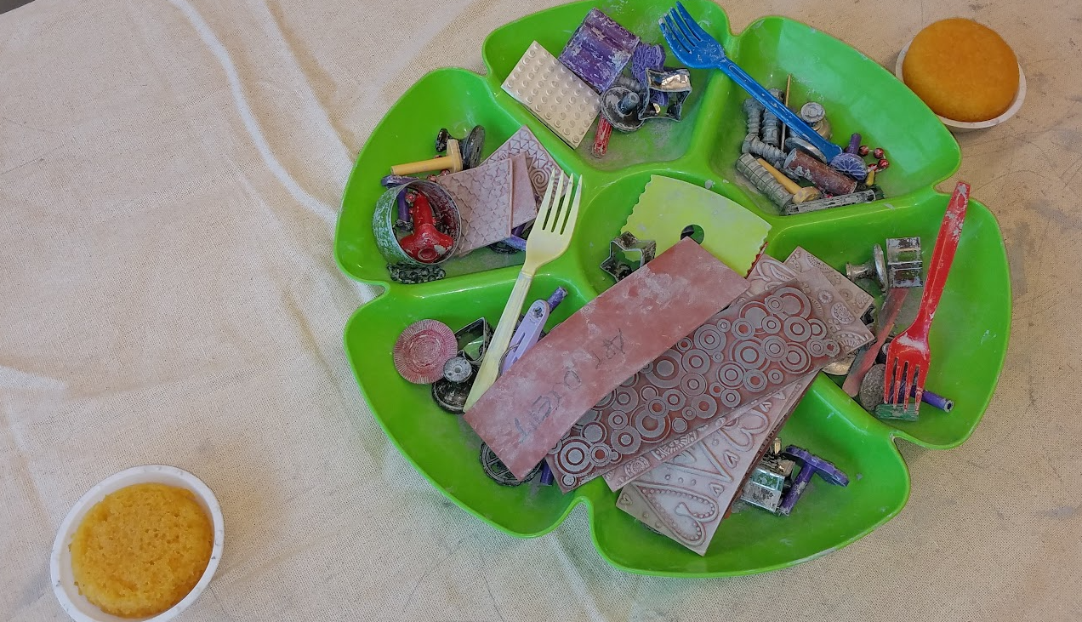
Setting up your classroom
Use the Pod at the end of your grade’s hallway wing.
Reserve the Art Docent TV that is in the PTSA office to run your PowerPoint as an MP4 file.
Save your lessons as MP4 files and they will run easily on the projector/TV. Request the PTSA Office key from the front desk. Reserve the projector prior to use. The reservation form is in the art room behind the paint brushes’ cabinet door.
Cover the tables with butcher paper then canvas.
Setout the texture tools, skewer sticks, and water cups.

