Slide 1
7 ELEMENTS OF ART
LINE
SHAPE
COLOR
VALUE
TEXTURE
SPACE
FORM
Notes:
These are the 7 Elements of Art. Artists use these seven elements, to compose a piece of art. Not every work of art contains every one of these elements, but at least two are always present. Today we will be focusing on LINE, SHAPE, and COLOR.

Slide 2
Continuous Lines
in art
Notes:
Can someone describe a continuous line?
How might using a single continuous line be used to make interesting art?
Do you think it would be easy or difficult to make art using a continuous line? Maybe both?
continuous – to keep going without stopping

Slide 3
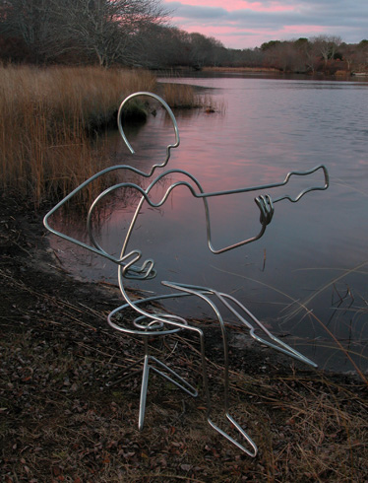
Steel Sculpture by Steve Lohman
Notes:
Steve Lohman makes line-art steel and wire sculptures

Slide 4
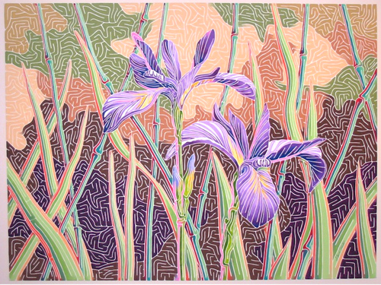
Geoff Slater One-Line Painting
Notes:
Geoff Slater (New Brunswick, Canada

Slide 5
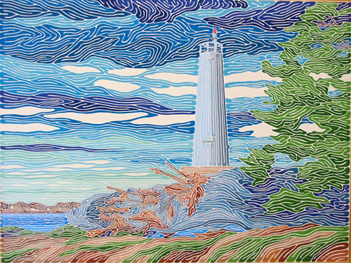
Notes:
Also Geoff Slater

Slide 6
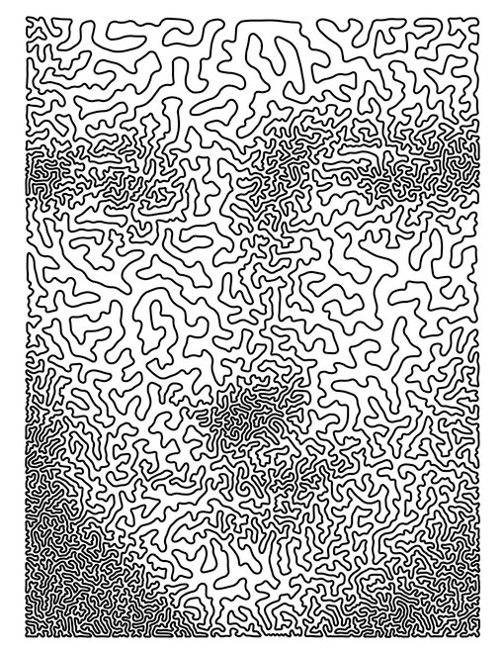
What Do You See?
Notes:
Can someone tell me what they see?
This continuous line gives us the impression of a face. It is an imitation of Leonardo Da Vinci’s Mona Lisa.

Slide 7
Notes:
The same image smaller. Can anyone explain why it’s easier to see the face when made smaller?

Slide 8
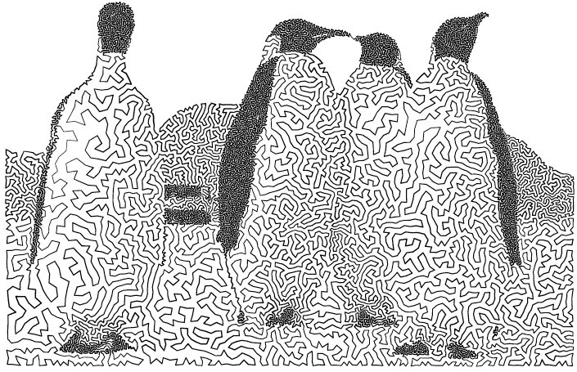
Notes:
This was made with the help of a computer to lay out many small dots that the artist then used to guide his line. This is called TSP art. It still uses one continuous line.
TSP art or travelling salesman problem art, invented/discovered by Robert Bosch, is an image which can be drawn with one single line.
If you draw it by hand you can use one single stroke without lifting your pencil. A salesperson wants to visit a number of cities in the shortest possible way; a city can only be visited once and he/she has to finish in the city were he/she started.

Slide 9
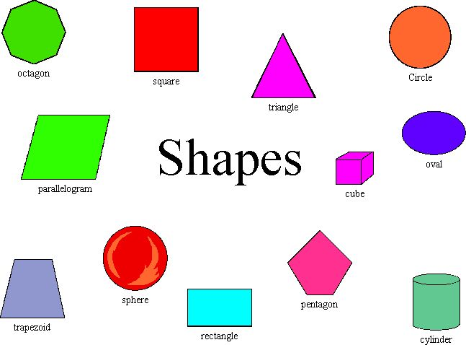
Geometric Shapes: shapes made with lines such as circles, triangles, or squares that have perfect, uniform measurements and don't often appear in nature.

Slide 10
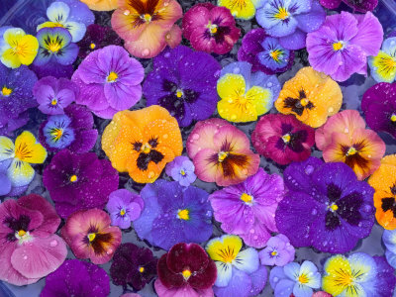
Organic Shapes: are associated with things from the natural world, like plants and animals.

Slide 11
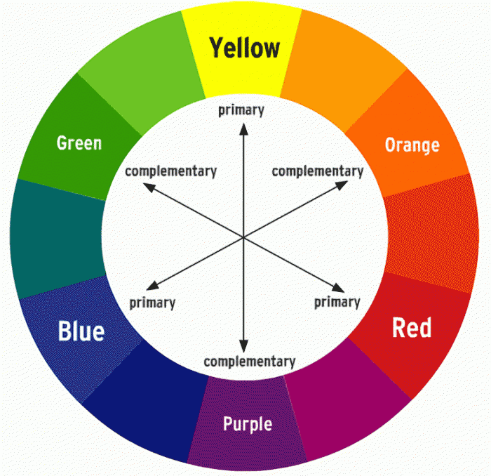
Warm Colors
Cool Colors
Color Wheel
Notes:
Discuss warm and cool colors as well as complementary colors on the color wheel.

Slide 12
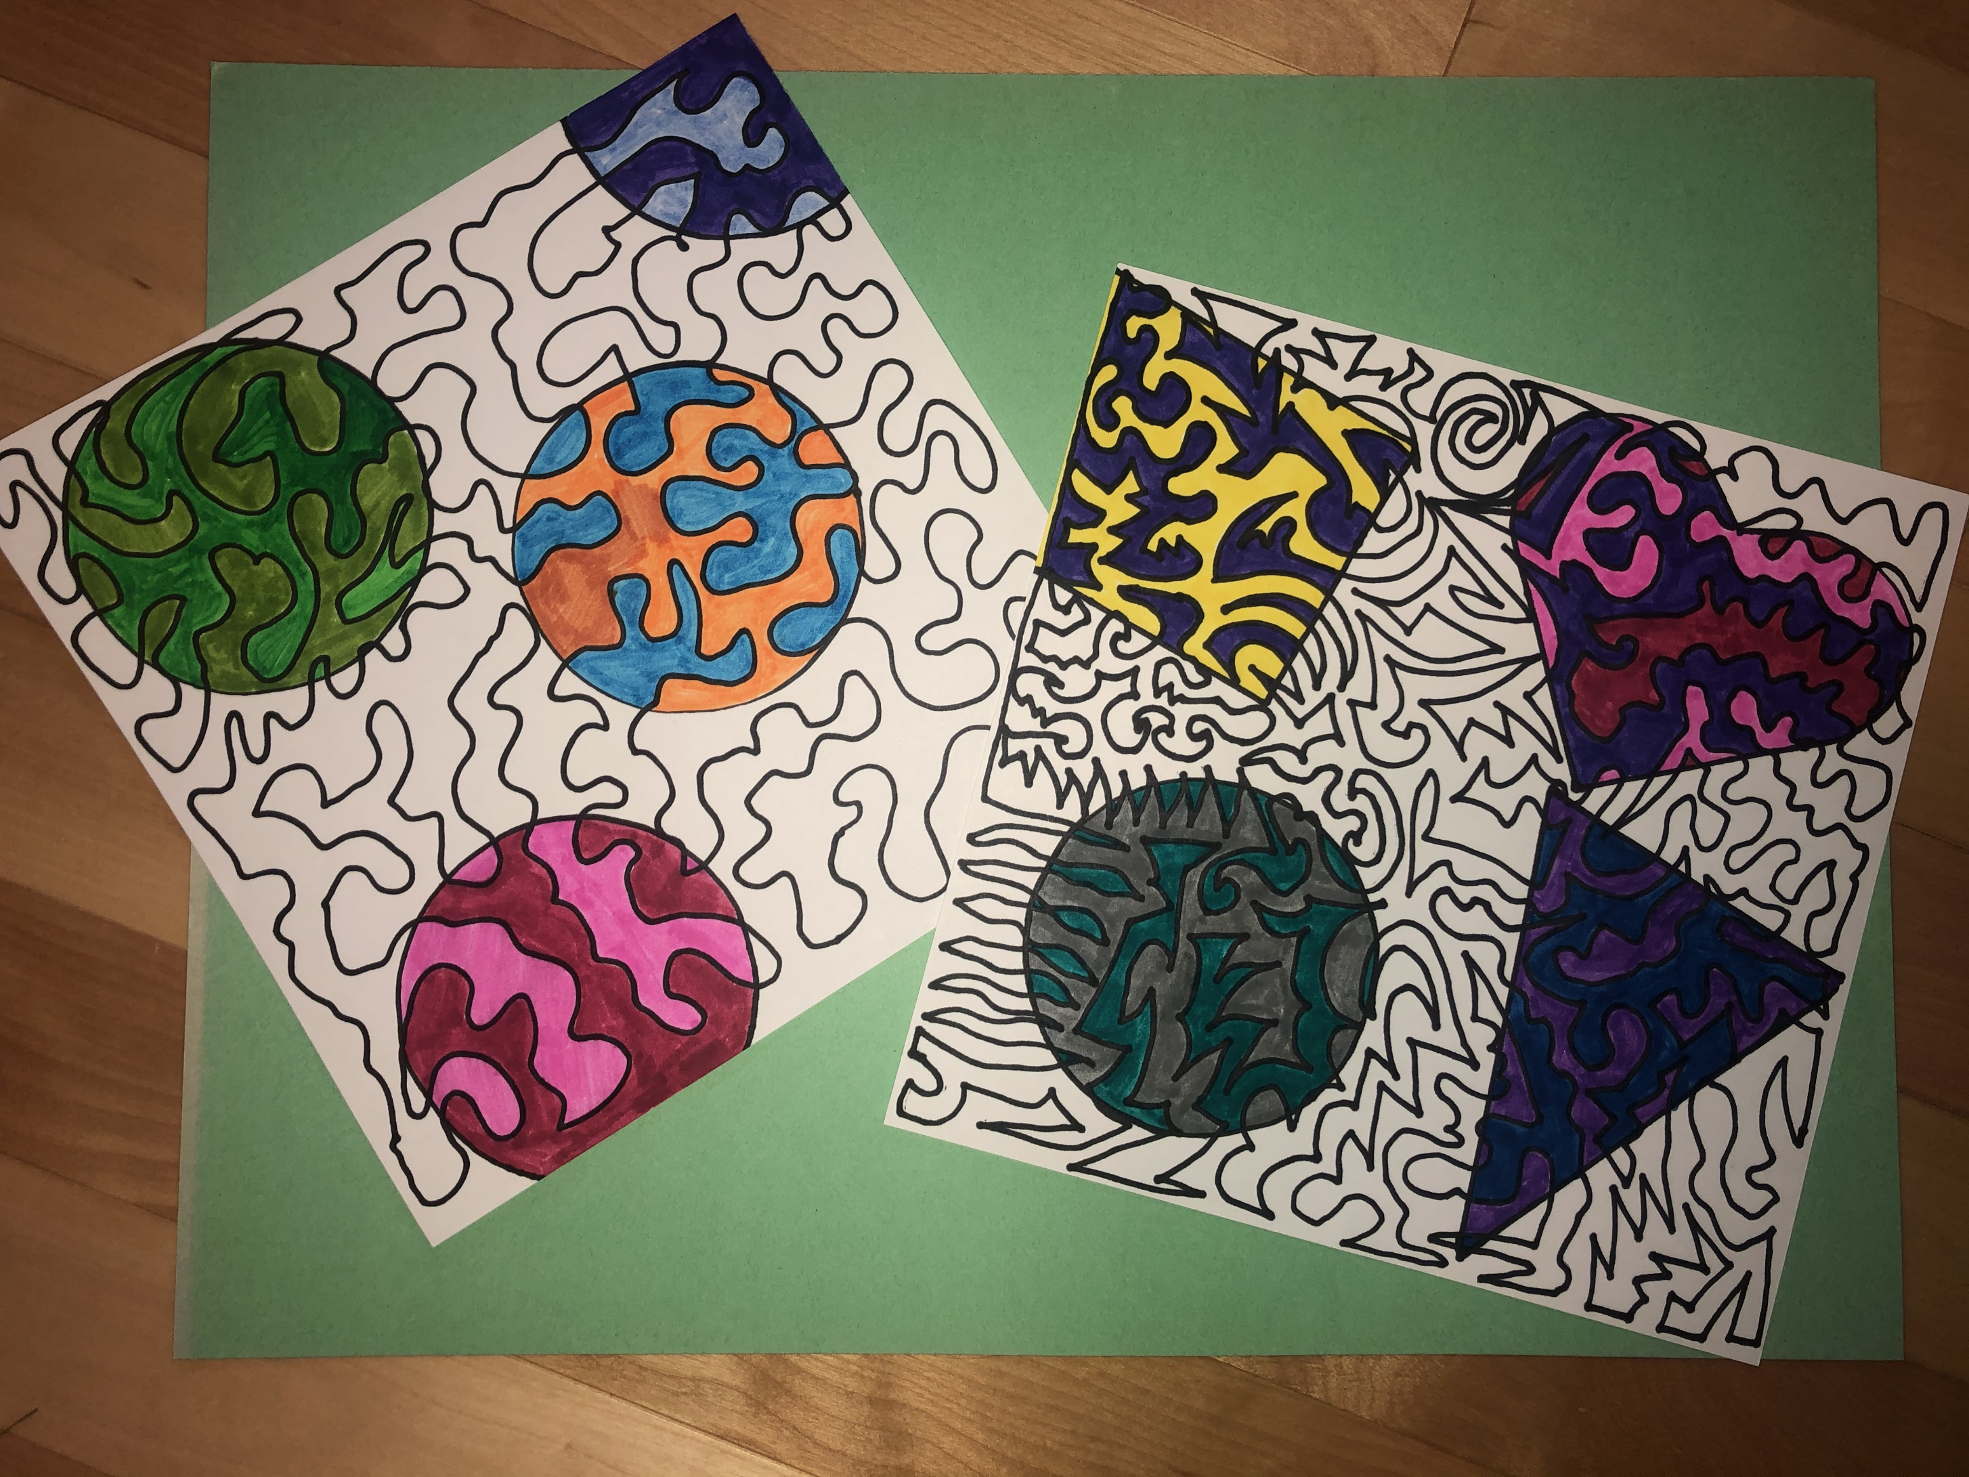
Notes:
An idea of what today’s project might look like.

Slide 13
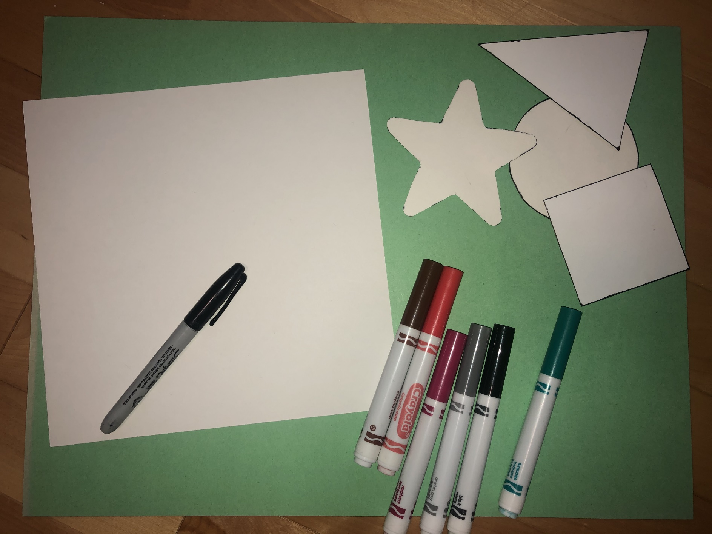
Materials:
White paper
Black Sharpie
Markers
Shape templates

Slide 14
Steps:
Write your name (NOT with a Sharpie) and flip over.
Start in one corner and draw ONE LINE – it can be curved, straight, zigzag, with angles, etc. The line has to fill the whole page and you may not pick up your Sharpie! The line may NOT cross itself. Also, the line has to end at the point it started.
Trace with Sharpie 3 or 4 geometric shapes on your sheet. Templates provided.
Choose 2 or 3 color markers per shape and color inside the shape, alternating colors. Think about color combinations (all warm, all cool, 2 complementary colors, etc.)

