Slide 1
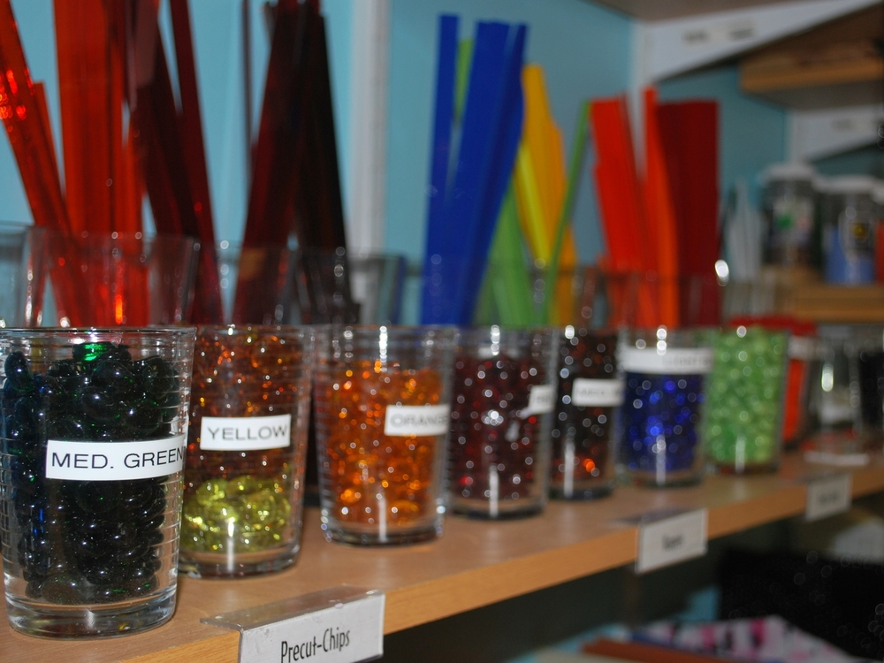
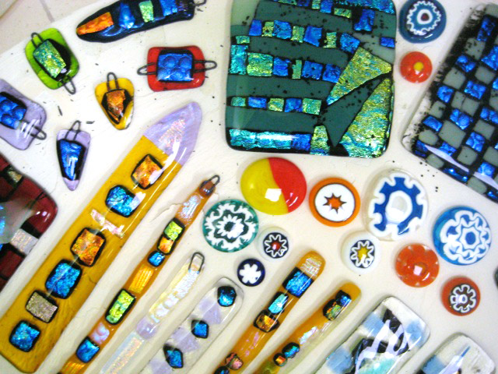
Glass Fusing
K to 2nd grade

Slide 2
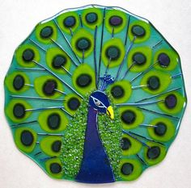
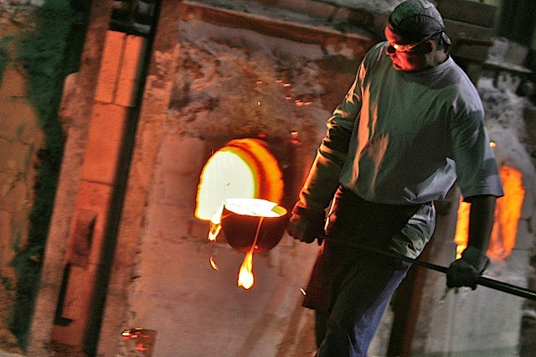
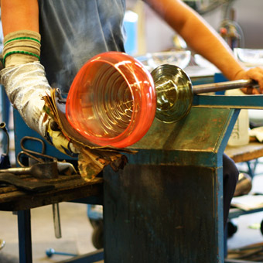
Glass
Glass is made from a mixture of sand, lime and soda.
When these ingredients are heated together, they form a liquid glass. This liquid glass is made into sheets by cooling and flattening.

Slide 3
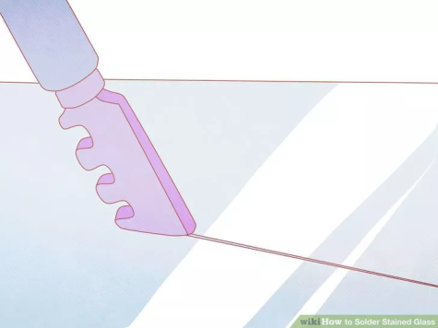
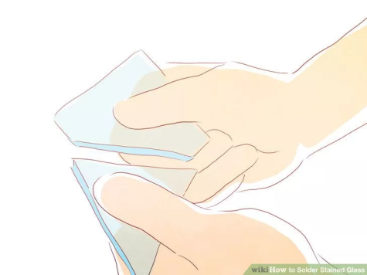
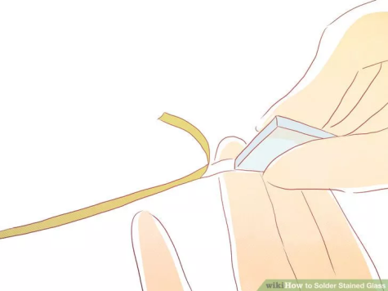
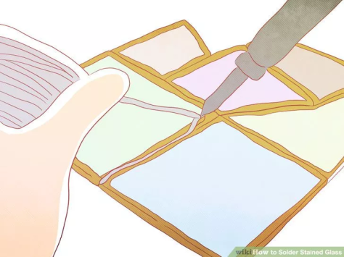
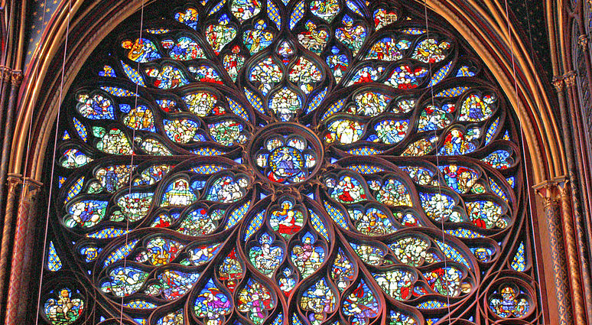
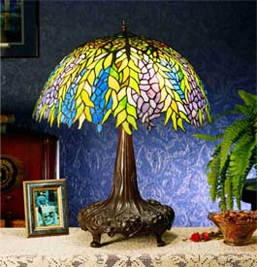
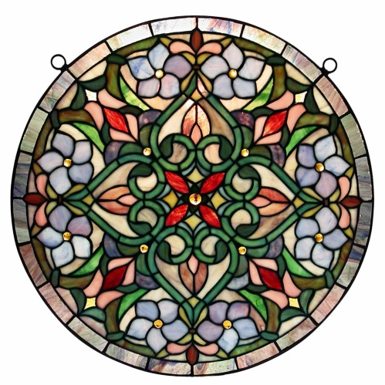
Stained Glass
is known as a “cold glass” technique because the artist does not heat the glass, though they heat the solder onto the lead or foil that holds the glass pieces together.
Score the glass
Break it along the lines
Wrap the pieces in copper and solder it together

Slide 4
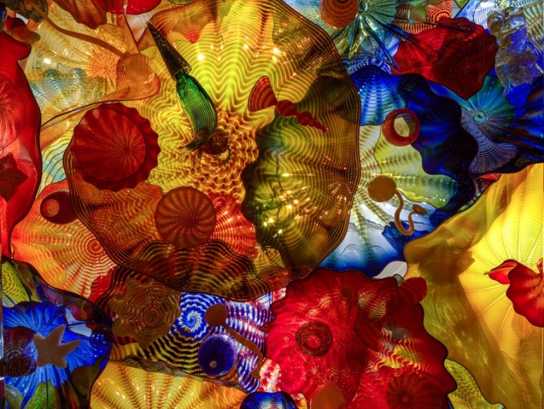
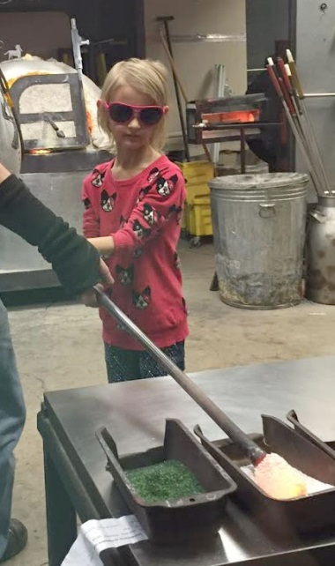
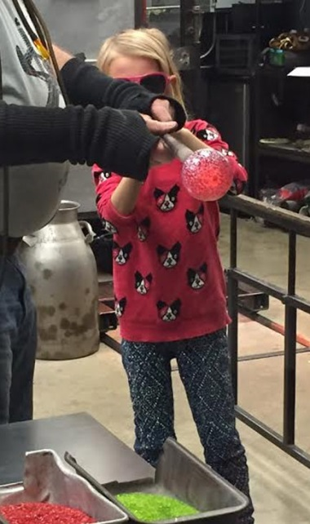
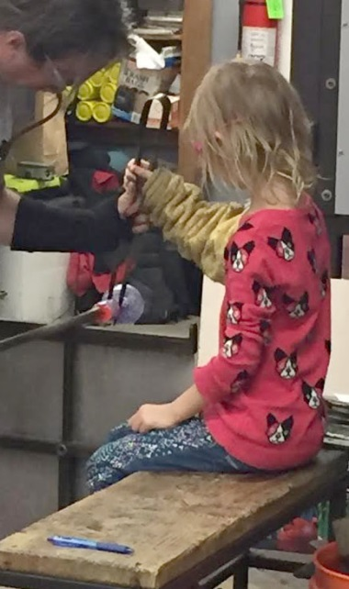
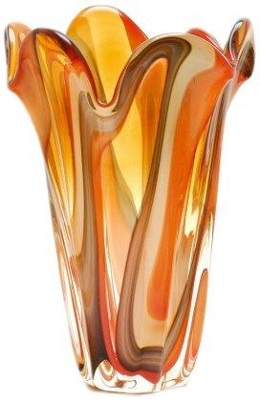
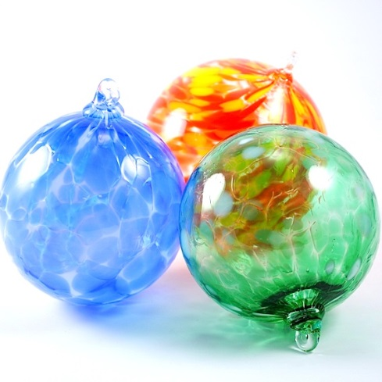
Blown glass
is known as a “hot glass” technique because it is formed by the artist while the glass is 1000 degrees.
Gather the glass
and color it
Blow it and shape it
Shape it some more
and break it off
the metal tube

Slide 5
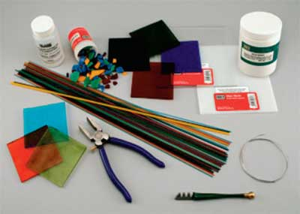
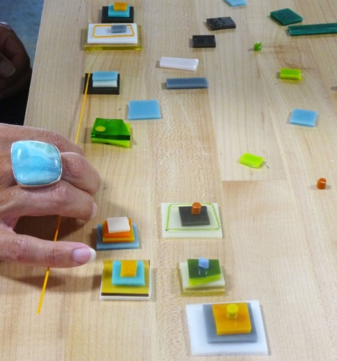
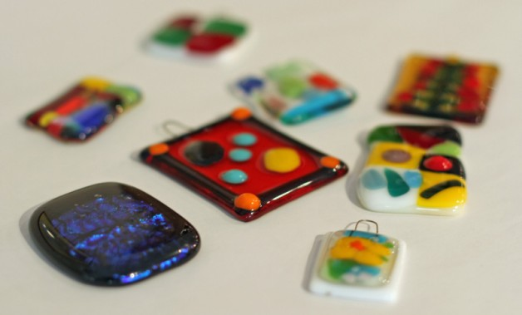
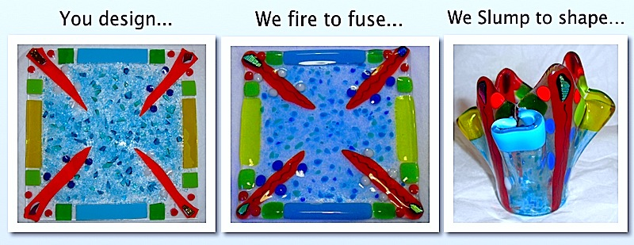
Fused Glass
is known as a “warm glass” technique because it is formed in a kiln and the artist interacts with the glass, after firing in the kiln, when it is warm.
Score and cut your glass
Assemble it (glue it)
Melt it in the kiln
You can also fire it again to ‘slump’ the piece
Into a shape you want, like a bowl:

Slide 6
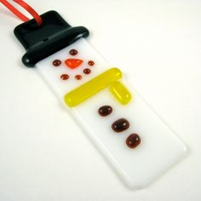
Let’s make some ART!

Slide 7
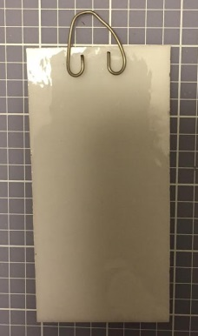
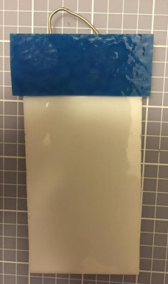
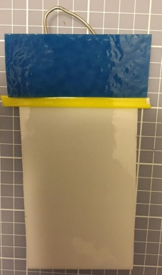
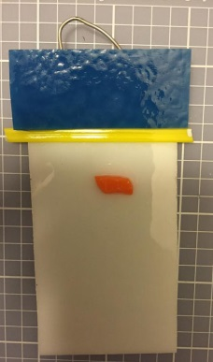
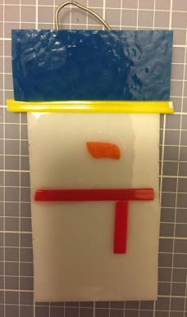
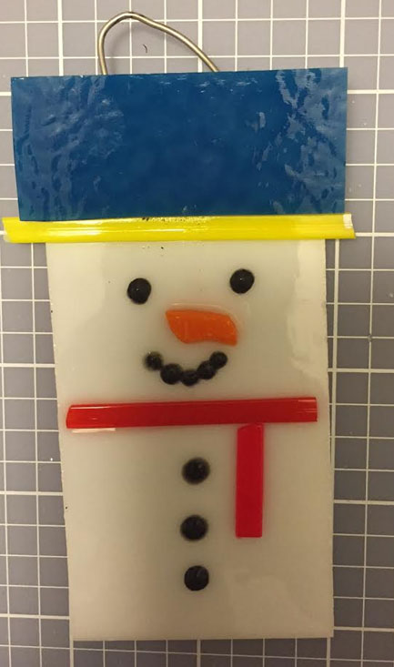
Let us make a snowman
Use just a little bit of the glue
Use the black liquid glass for eyes, mouth and buttons
Mix and match colors as much as you like
Don’t forget the wire
Write your name on the paper plate

