Slide 1
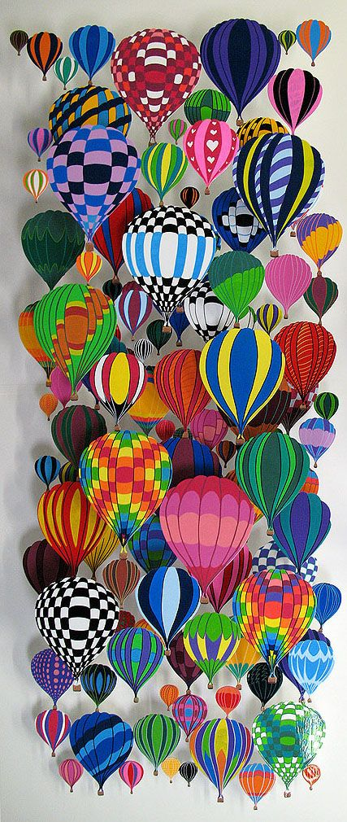
Hot Air Balloons Class Project
Color

Slide 2
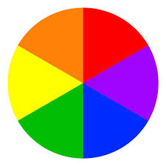
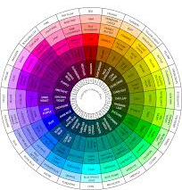
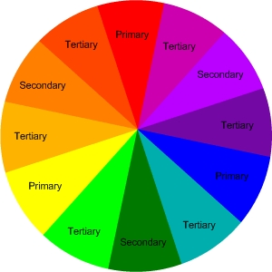
Let’s talk about color
Modern artist now arrange color on a “Color Wheel.” They can be very simple, showing the primary (red, yellow, blue) and secondary colors (orange, green, purple), or they can be very complicated, showing many different colors.
We’re going to use the standard color wheel, which shows primary colors, secondary colors, and tertiary colors (made by mixing a primary color with the secondary color next to it- like red orange or blue green).

Slide 3
Colors that are opposite from each other on the color wheel are called Contrasting Colors. They always look good together. That’s kind of strange since one is a warm color and the other is a cool color.
But there’s some other color groupings that look good together.
Analogous Colors are three colors right next to each other. They look great together.
Triadic Colors are three colors that form a triangle on the color wheel.

Slide 4
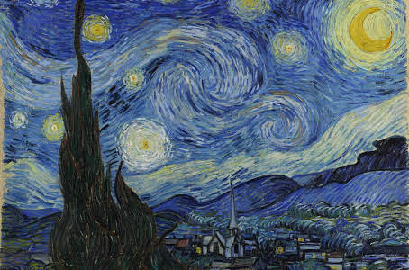
Vincent Van Gogh
Vincent Van Gogh was one of the most famous painters of all time. He was an impressionist painter, meaning he didn’t try to make his painting look super real. Instead he tried to give the impression of what he was looking at. Most people know him for his Starry Night.
But he created over 2,100 pieces of art, most created in the last two years of his life! He was considered a failure and a madman. But his use of color was truly groundbreaking. He often used colors that other artists had not thought of using together.

Slide 5
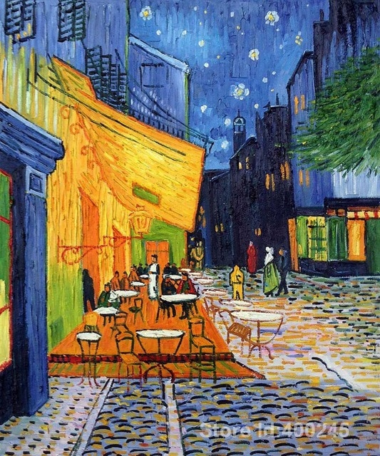
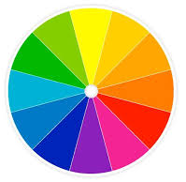
Paintings by Van Gogh
What are the two main colors you see in this picture? Look at the color wheel. What would those colors be called?
Complementary Colors

Slide 6
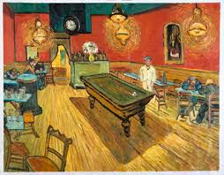
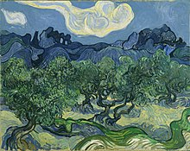
What are the main colors you see in this picture? Remember what that is called?
Analogous Colors

Slide 7
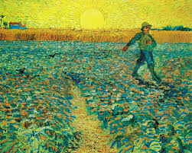
Remember what three colors in a triangle is called? Notice how those three colors really make each other pop on the page? Your eye really likes how the colors interact with each other.
Triadic Colors

Slide 8
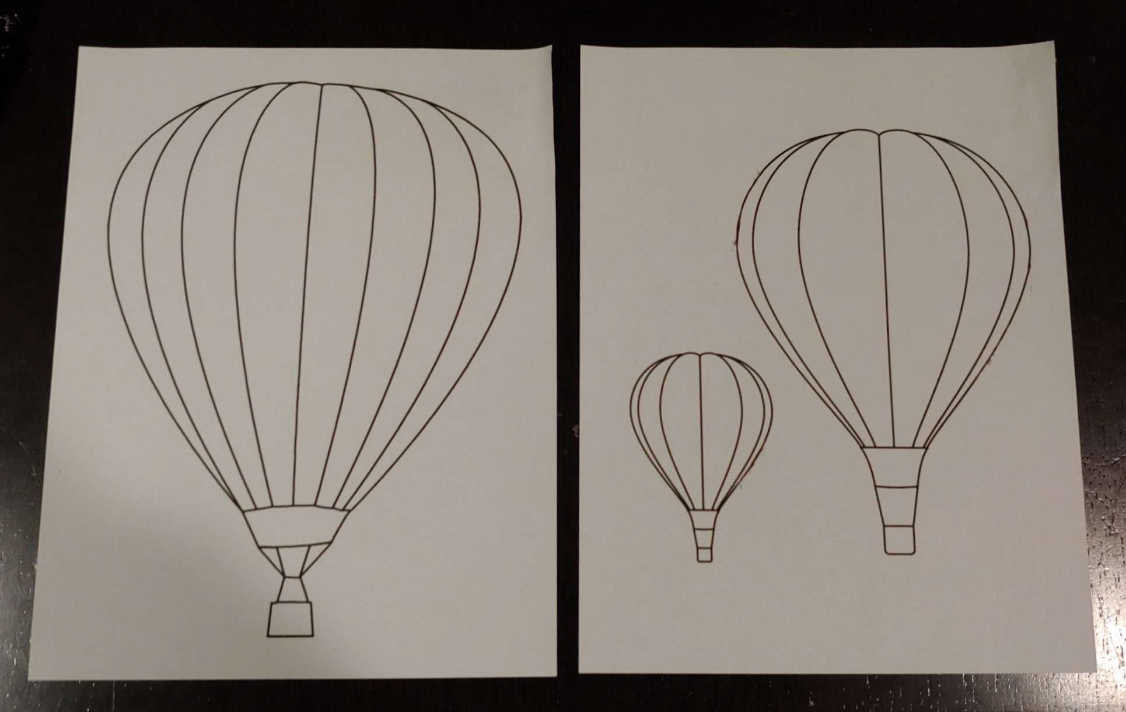
Hot Air Balloons
We’re going to color hot air balloons and put them all together on the wall in a collage.
There are two different sheets of hot air balloons. Pick one sheet.

Slide 9
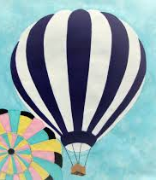
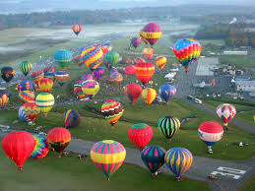
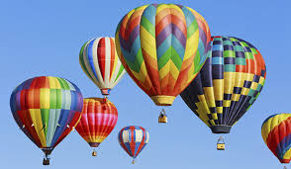
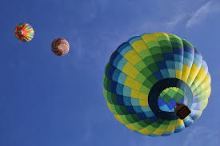
Write your name on the back of your balloon. Remember, we are going to cut these out, so please write them in the middle of the balloons.
Pick your colors for your balloons. Try either contrasting colors, analogous colors, or triadic colors.
Plan out how you want to color your balloon- do you want to make a pattern? Do you want to alternate colors?
When you’re finished coloring the balloon, cut it out.

