Slide 1
Let’s FACE IT!
3RD GRADE ART PROJECT

Slide 2
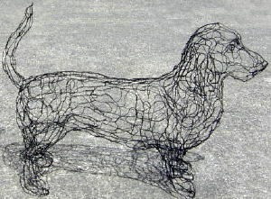
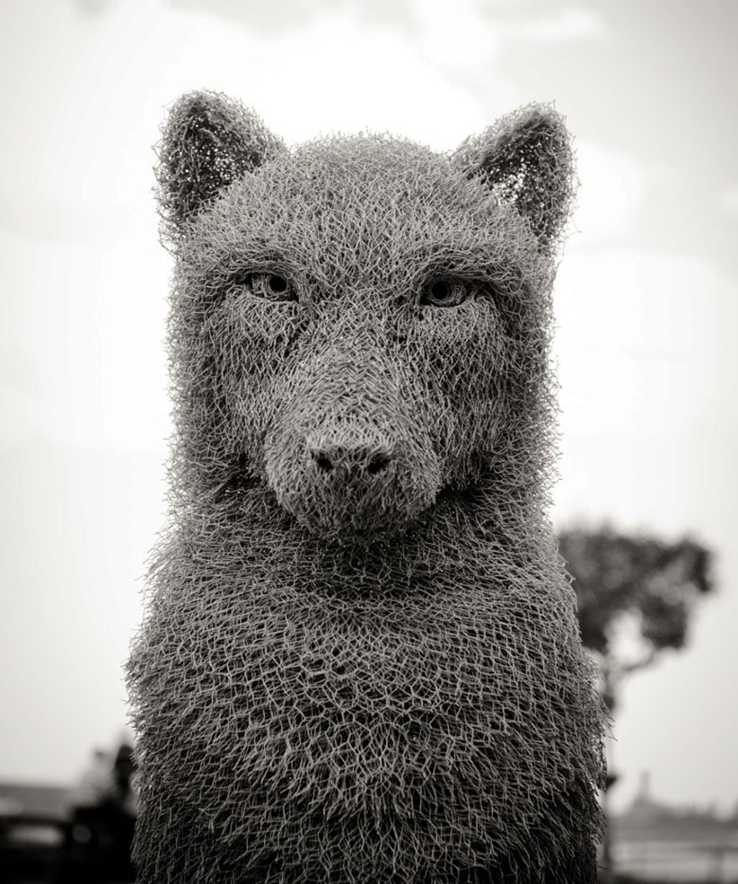
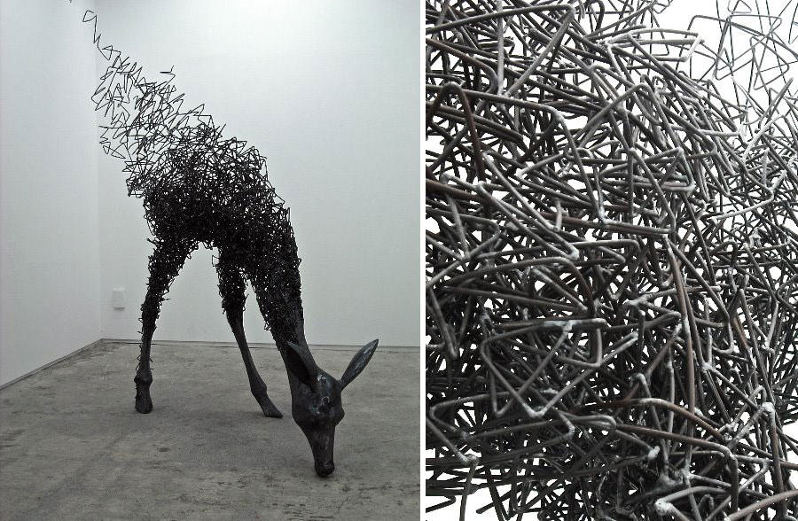
Wire art WHAT IS WIRE SCULPTURE?
WIRE is metal that has been drawn into a long, thin rod or thread. SCULPTURE is art in three dimensional form. WIRE SCULPTURE is any art made from wire.
Wire sculptures can be made from man-made meshes, from lightweight chicken wire and grid-type field fencing to heavy gauge grating. It can be bent and formed with bare hands, with pliers and jigs, with hammers and molds. There are no rules, no limits, no restrictions.

Slide 3
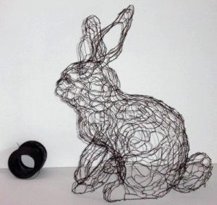
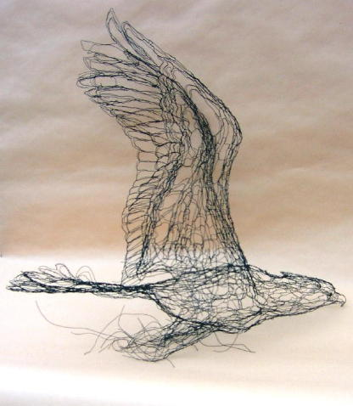
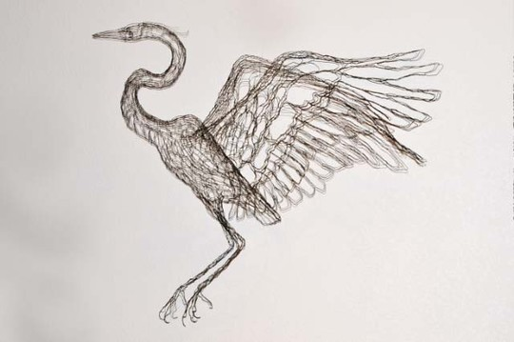
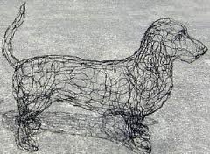
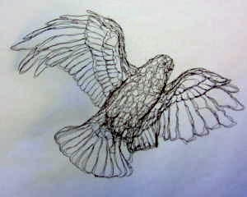
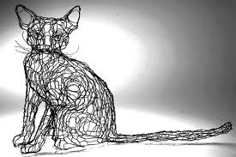

Slide 4
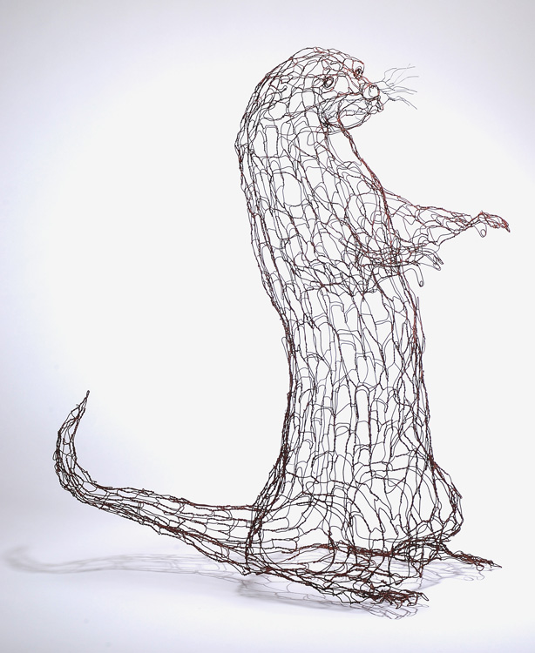
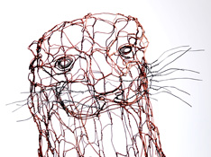
Here are some wire sculptures of otters that would be at home at Creekside!

Slide 5
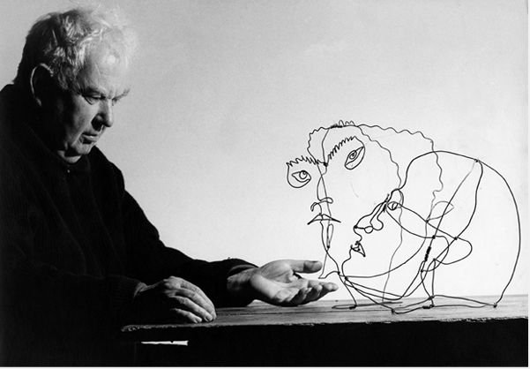
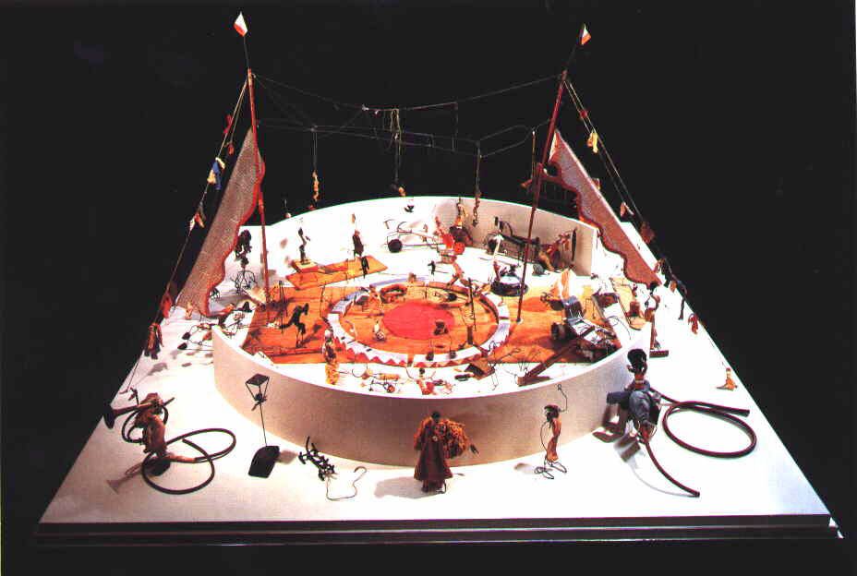
ALEXANDER CALDER
Alexander Calder was born in Philadelphia, the son of a well-known sculptor and educator and his wife, a talented painter. Calder's grandfather, also a sculptor, executed the figure of William Penn that graces the dome of the city hall in Philadelphia. Though he was brought up in an artistic atmosphere, Calder's own inclinations were mechanical. He trained as a mechanical engineer at the Stevens Institute of Technology in New Jersey, studying such things as descriptive geometry, mechanical drawing, and applied kinetics—the branch of science that deals with the effects of force on free-moving bodies—in preparation for receiving his degree in 1919.
After working at a number of jobs that allowed him time for travel and reflection over the next few years, Calder decided to explore his growing interest in art. Calder also did freelance work as an illustrator for the National Police Gazette for about two years. In 1926 he had his first one-man exhibition of paintings at the Artist's Gallery in New York City. While concentrating on painting, Calder also worked on wood sculpture, and when he visited Paris in 1926 he continued to carve.
Calder's first significant recognition as an artist came when he exhibited his now-famous miniature circus with its animated wire performers at Paris's Salon des Humoristes in 1927. The idea for the toy figures can be traced back to sketches he made in 1925 while reporting on the circus for the Police Gazette. Made from wire, rubber, cork, buttons, bottle caps, wood, and other small "found" objects, Calder's circus includes lions, acrobats, trapeze artists, elephants, a ringmaster, and numerous other figures. Unlike many art works of the period, the unusual creation drew crowds from outside the artistic community as well as within, and the thirty-year-old artist found himself suddenly widely known.

Slide 6
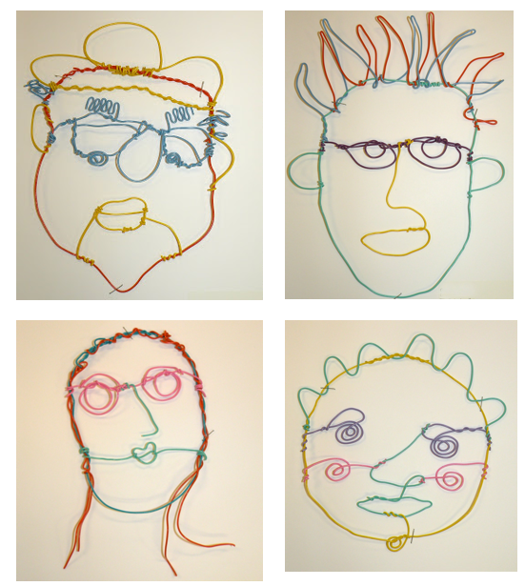
LET’S
GO
HAVE
FUN
AND
MAKE
ART!

Slide 7
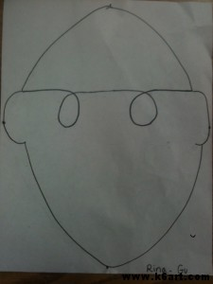
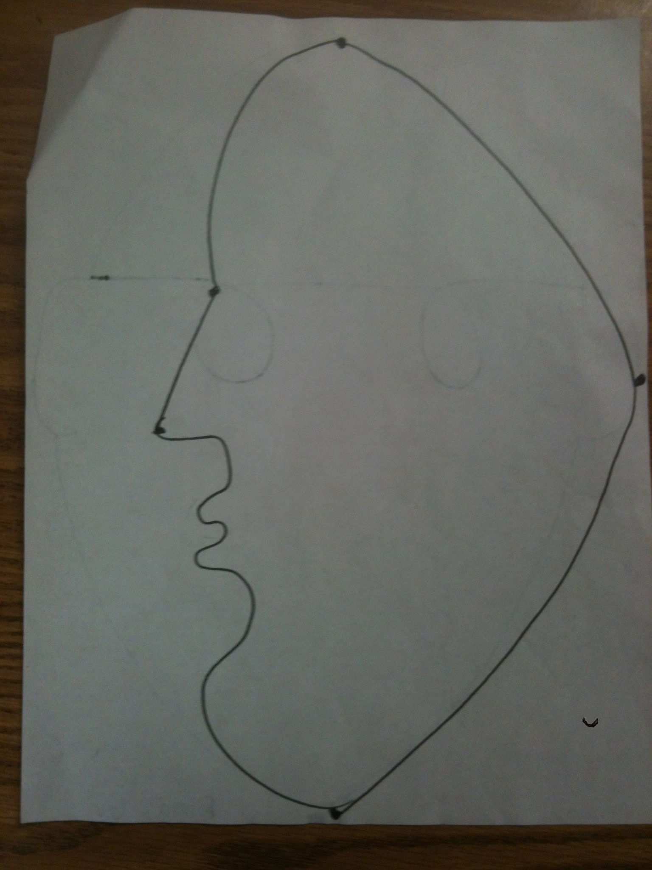
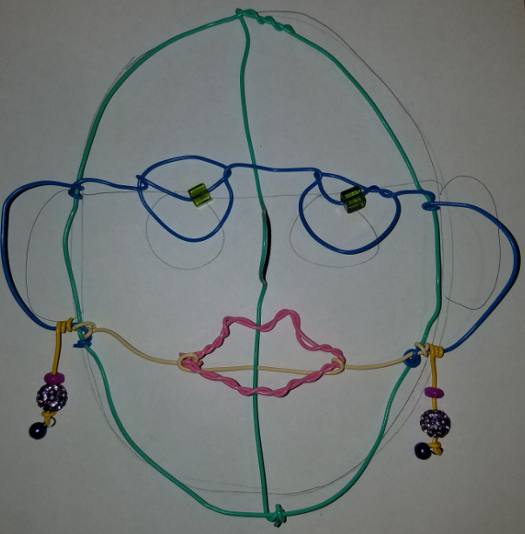
Step 1
Part 1
Part 2
Turn paper over: the black lines from the first side should be visible!
Draw a simple profile of a face, including nose and lips. The profile should touch the top, bottom of the oval (seen from the other side of paper)
Using a sharpie, draw (or trace) a front view OVAL of the face.
Make a simple contour face with ears and eyes.

Slide 8
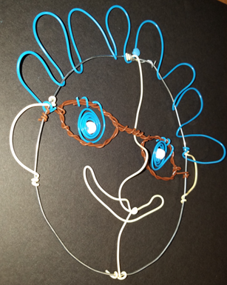
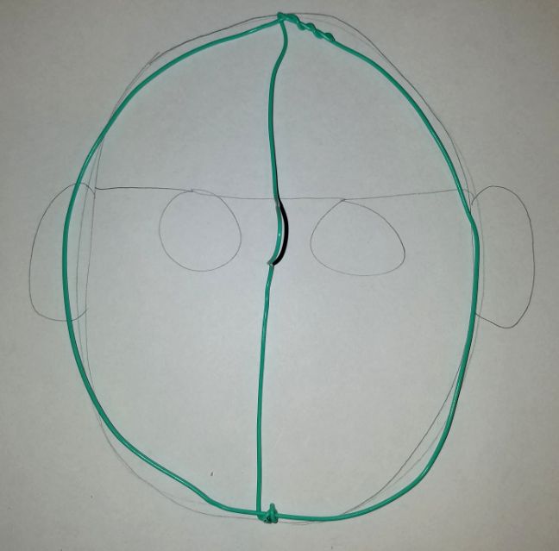
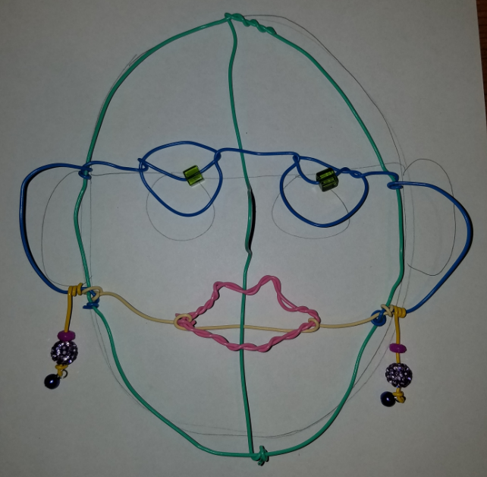
Step 2
Making Nose & Mouth
Using the profile side of the paper,
Option 1: Profile Mouth
Start with the center of your wired and bend the wire to make the nose.
Keep bending wire to make eye, lips, and chin.
Leave the ends long and straight for now.
Option 2: 2D Mouth
Create only the nose and eye bends.
2D mouth instructions on later slide.

Slide 9
Step 2A
Attach the profile
Attach the profile to the center of your oval.
Wrap the long ends around the top and bottom of the oval.

Slide 10
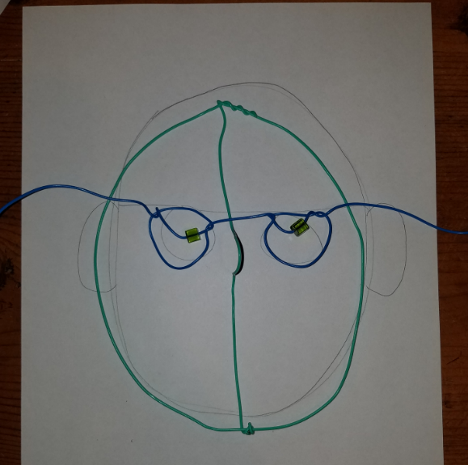
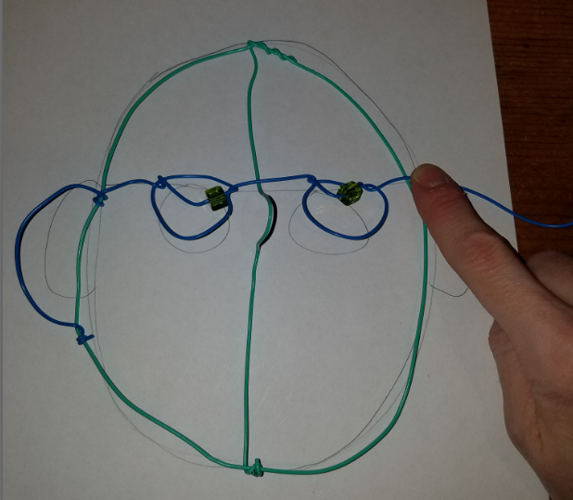
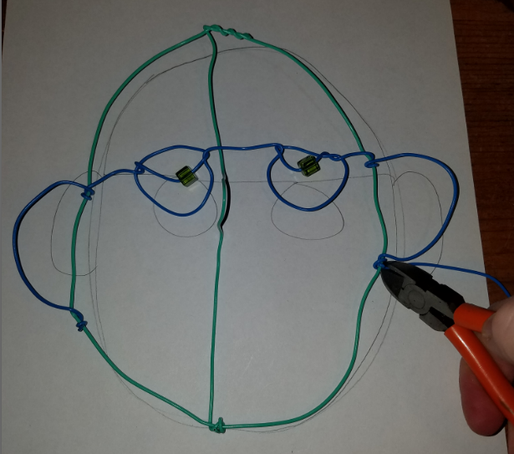
Step 3
Make the eyes and ears
Take a long straight colored wire. Lay it across the bridge of the nose (perpendicular).
Bend the oval for the first eye. Then bend it again to make a second eye.
Wrap the long ends around the side of the face oval, and leave a loop to create the ear, and wrap the wire at the bottom of the ear.
Do the same for the other ear.
Clip the extra wire off when both ears are attached.

Slide 11
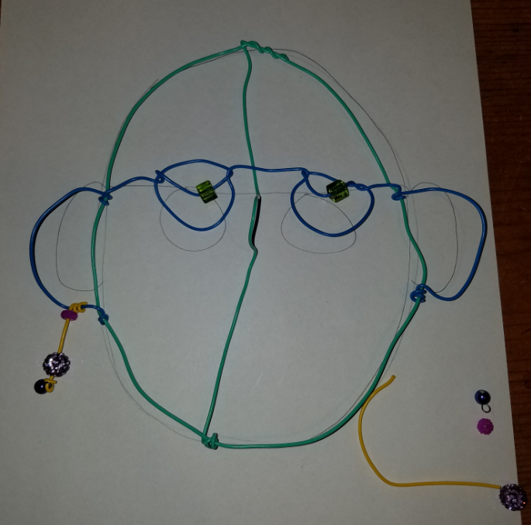
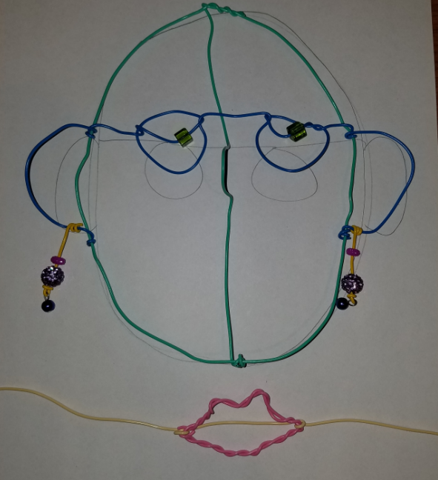
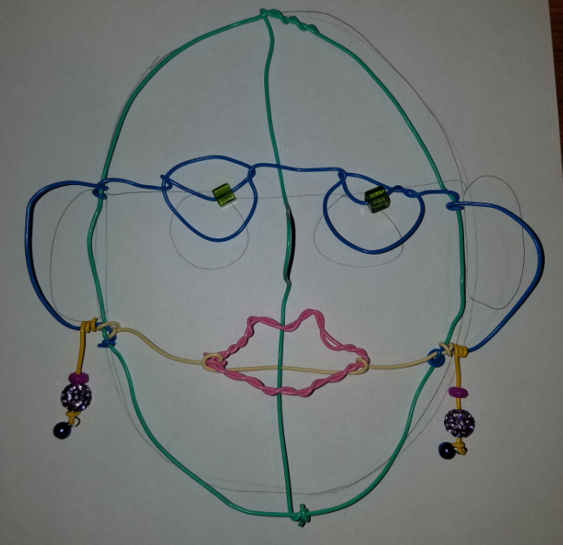
Step 4
Mouth (Option 2)
Earrings (optional)
If you choose to make a 2 dimensional mouth: Shape your colored wire into the shape you desire. (these lips were double wrapped to create a thicker look)
Attach it to another long wire.
Attach the new wire (with lips attached) to the bottom of the ears.
Add earrings at this time, if you wish. Or you can wait until later…

Slide 12
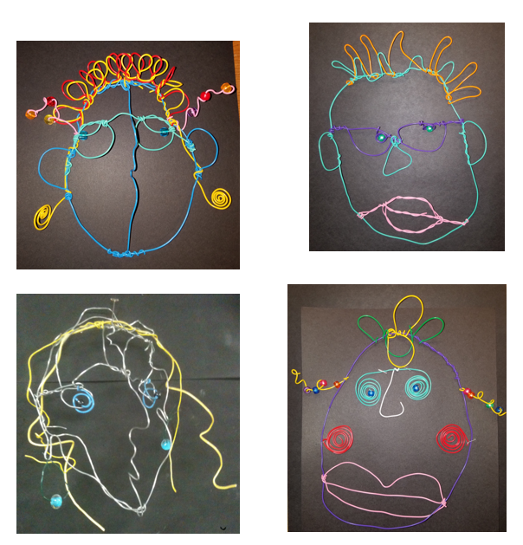
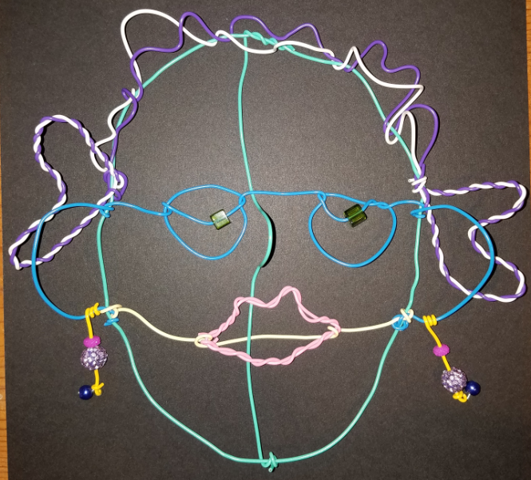
Step 5
Hair
Add hair, as desired.

Slide 13
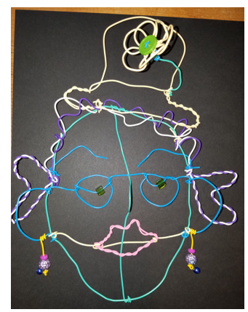
Final
Add embellishments

