Slide 1
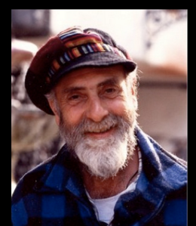
Friedensreich Hundertwasser
(1928-2000)

Slide 2
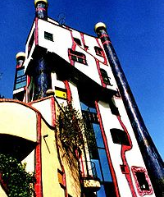
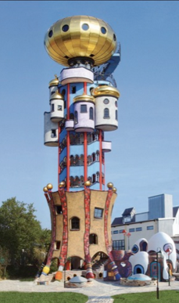
Friedensreich Hundertwasser
He was an Austrian artist and architect who is best known for the colorful buildings he designed.
The buildings of Hundertwasser are very recognizable: straight lines are few, there is use of bright colors and many of his buildings have turrets.

Slide 3
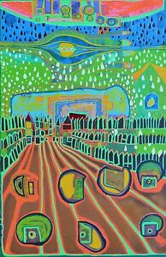
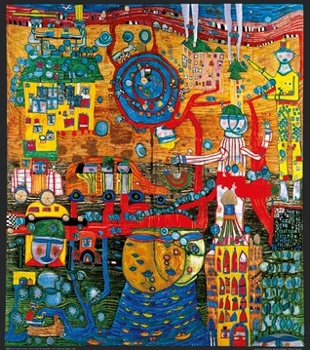
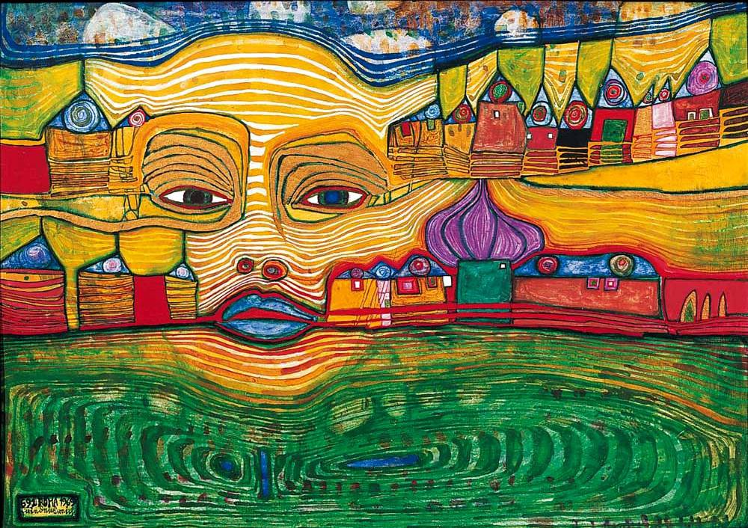
Paintings
The paintings of Hundertwasser have exuberant colors too and undulating lines.

Slide 4
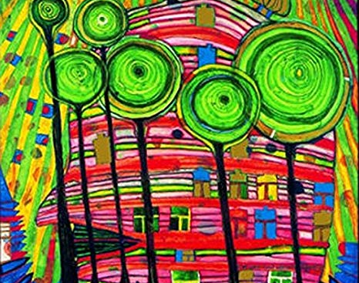
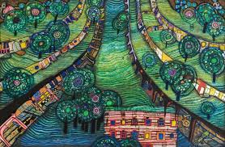
Lollipop Trees
…this is our inspiration for today’s project

Slide 5
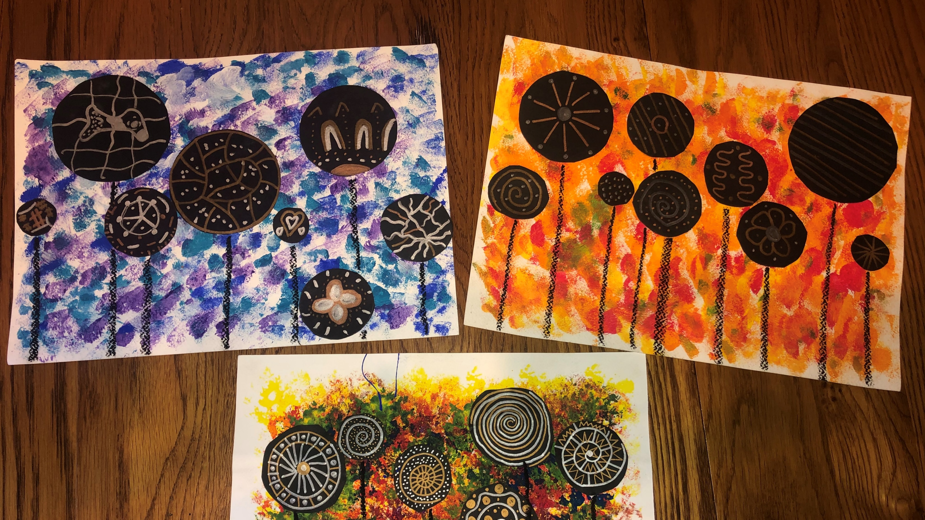
Metallic Lollipop Trees (3rd grade project)

Slide 6
Materials:
Instructions:
Watercolor paper
Tempera paint
Sponges
Black cardstock
Scissors
Metallic sharpies
Black oil pastel
Glue Sticks
Set out 3-4 different colors of paint on paper plates (you could have one plate with cool colors and one plate with warm colors on each table)
Use the sponge to add the colors in layers to the paper.
I tell the kids to not over sponge/rub the paint as it will just turn into a big brown mess!
Set aside to dry.
Handout Types of Line and Types of Pattern sheet and talk about how to use them in the circles.
Next, the kids can draw circles with pencil and cut out from black cardstock. Encourage them to not be too tiny.
Decorate the circles with the metallic sharpies (on the side without pencil marks).
Arrange the circles on the paper and glue in place.
Use the oil pastel to draw lines (trunks) down to the bottom of the paper.

Slide 7
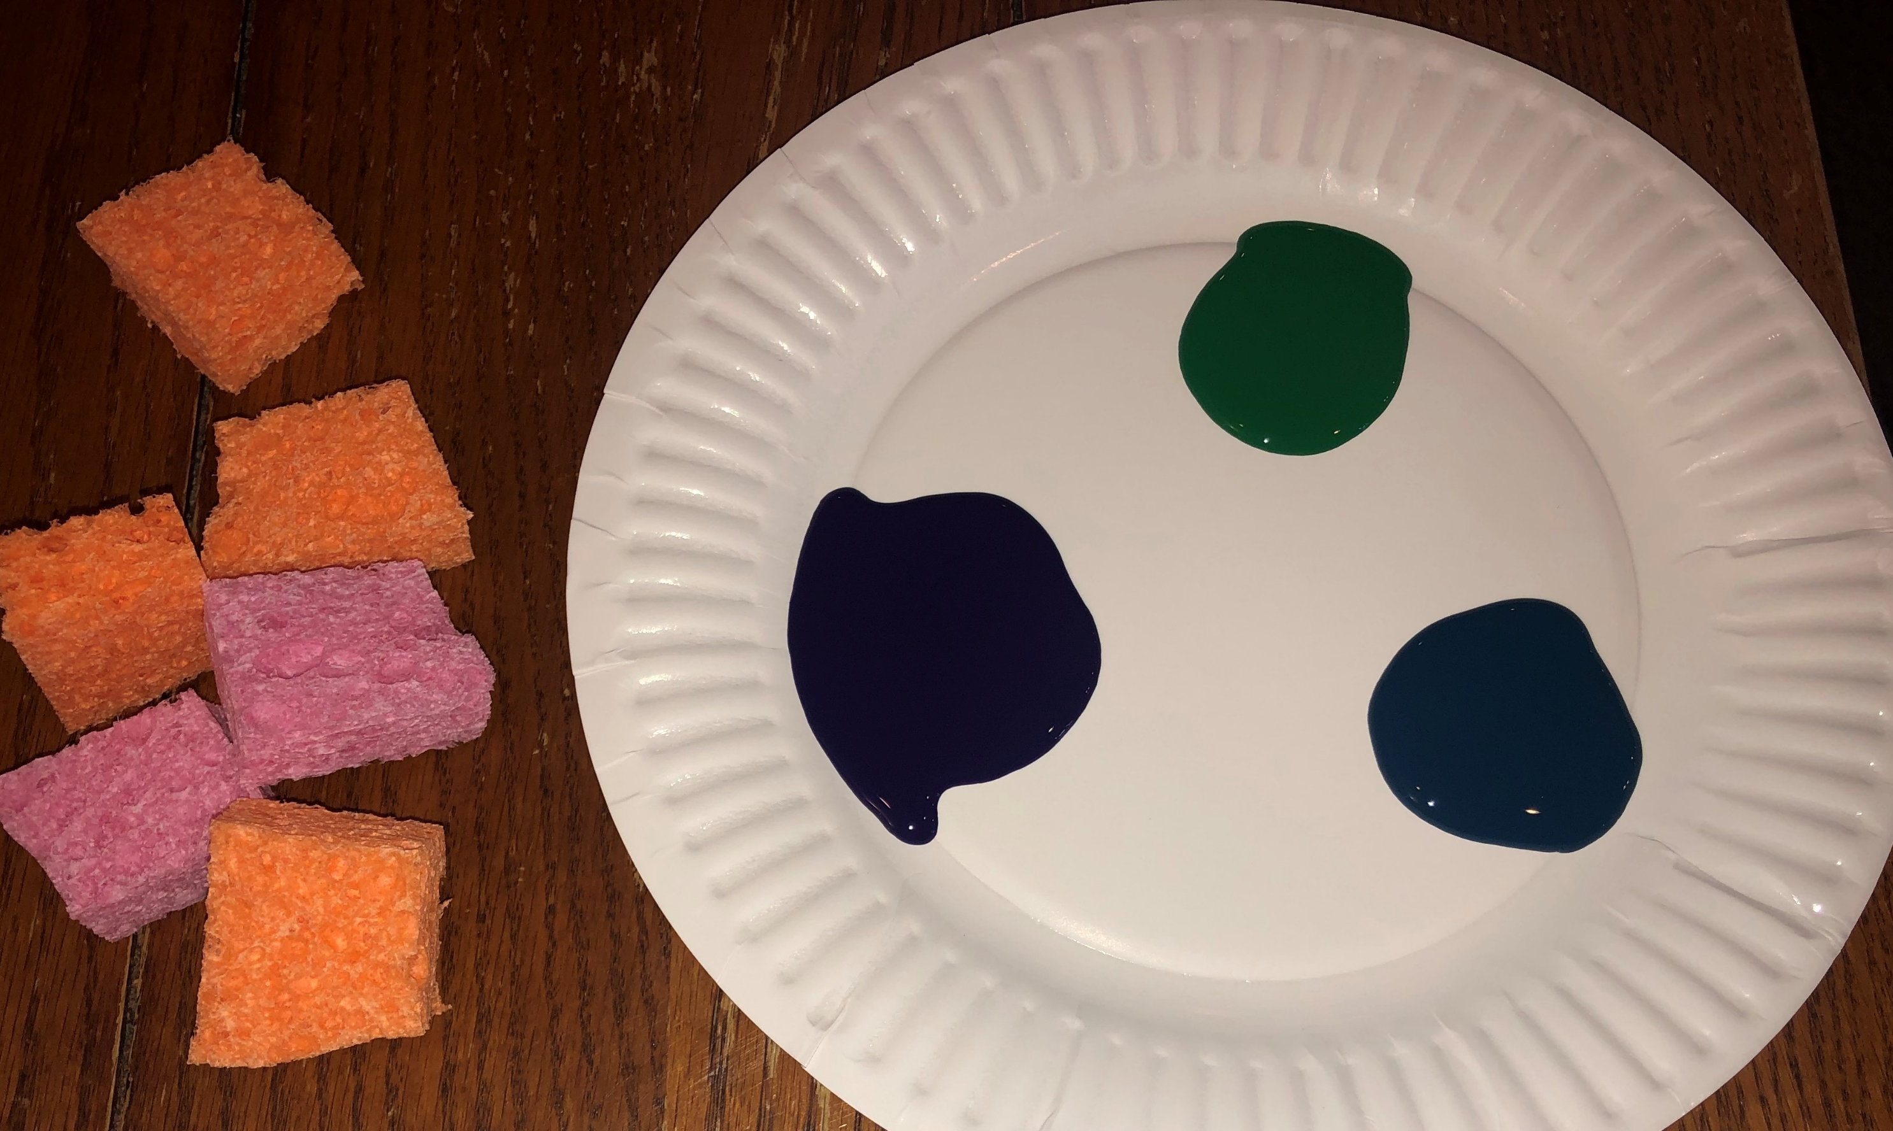
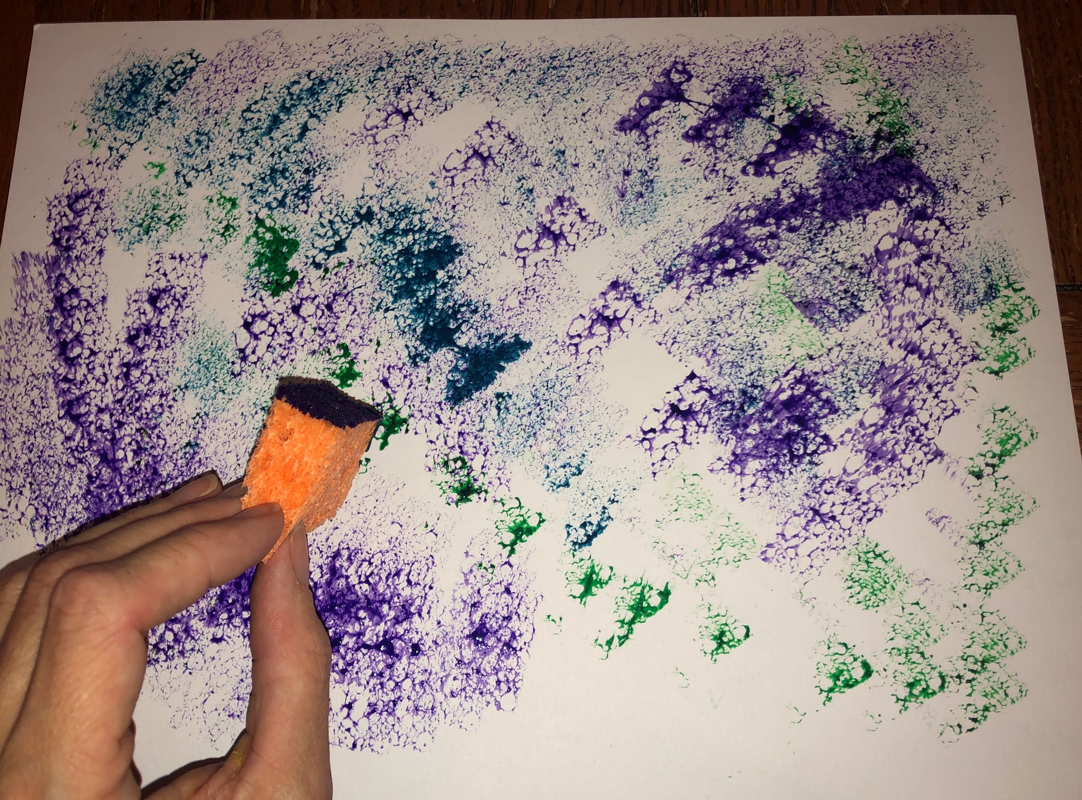
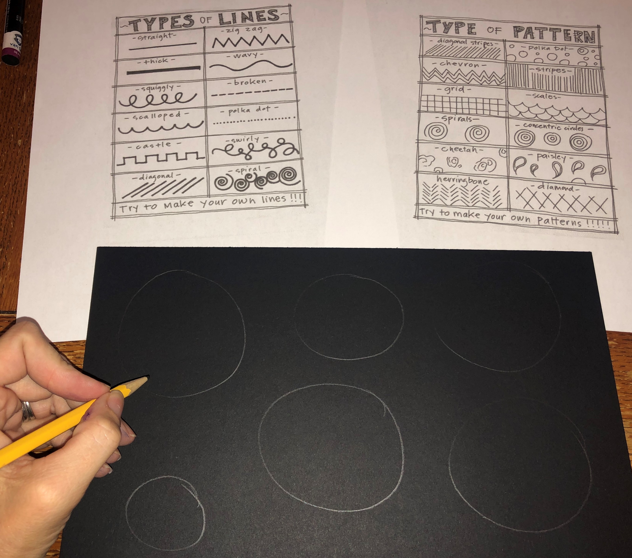
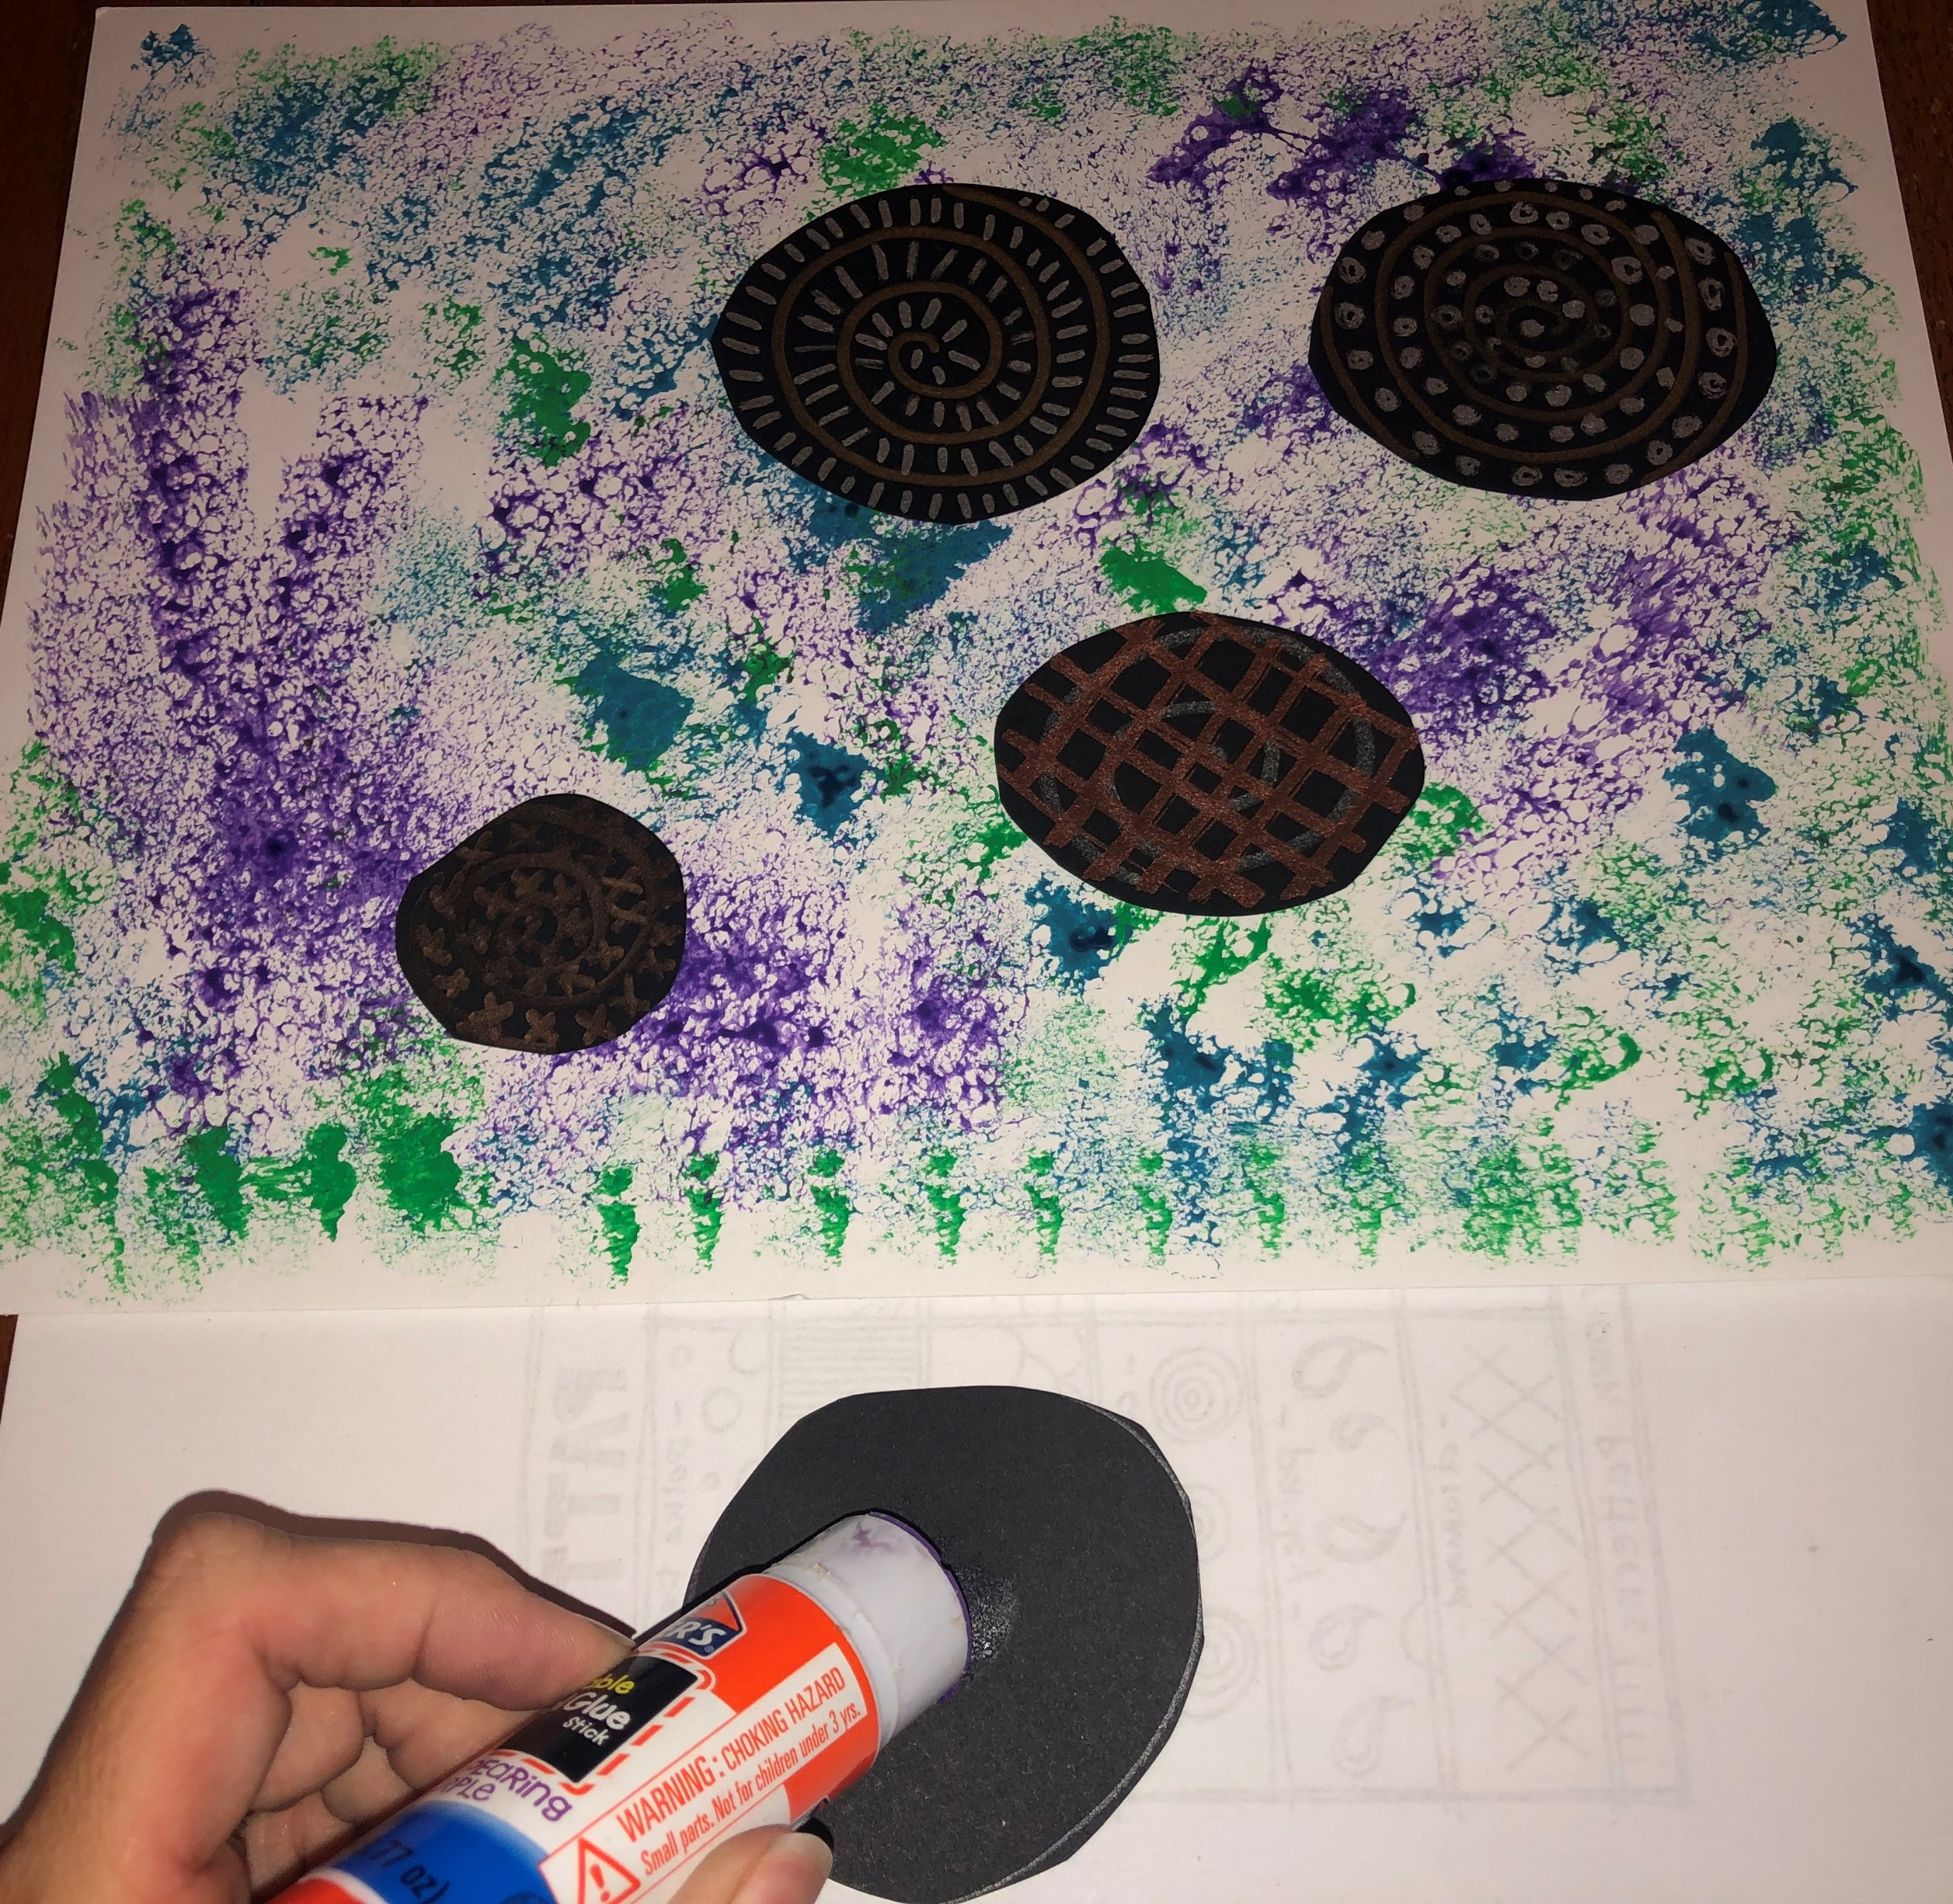
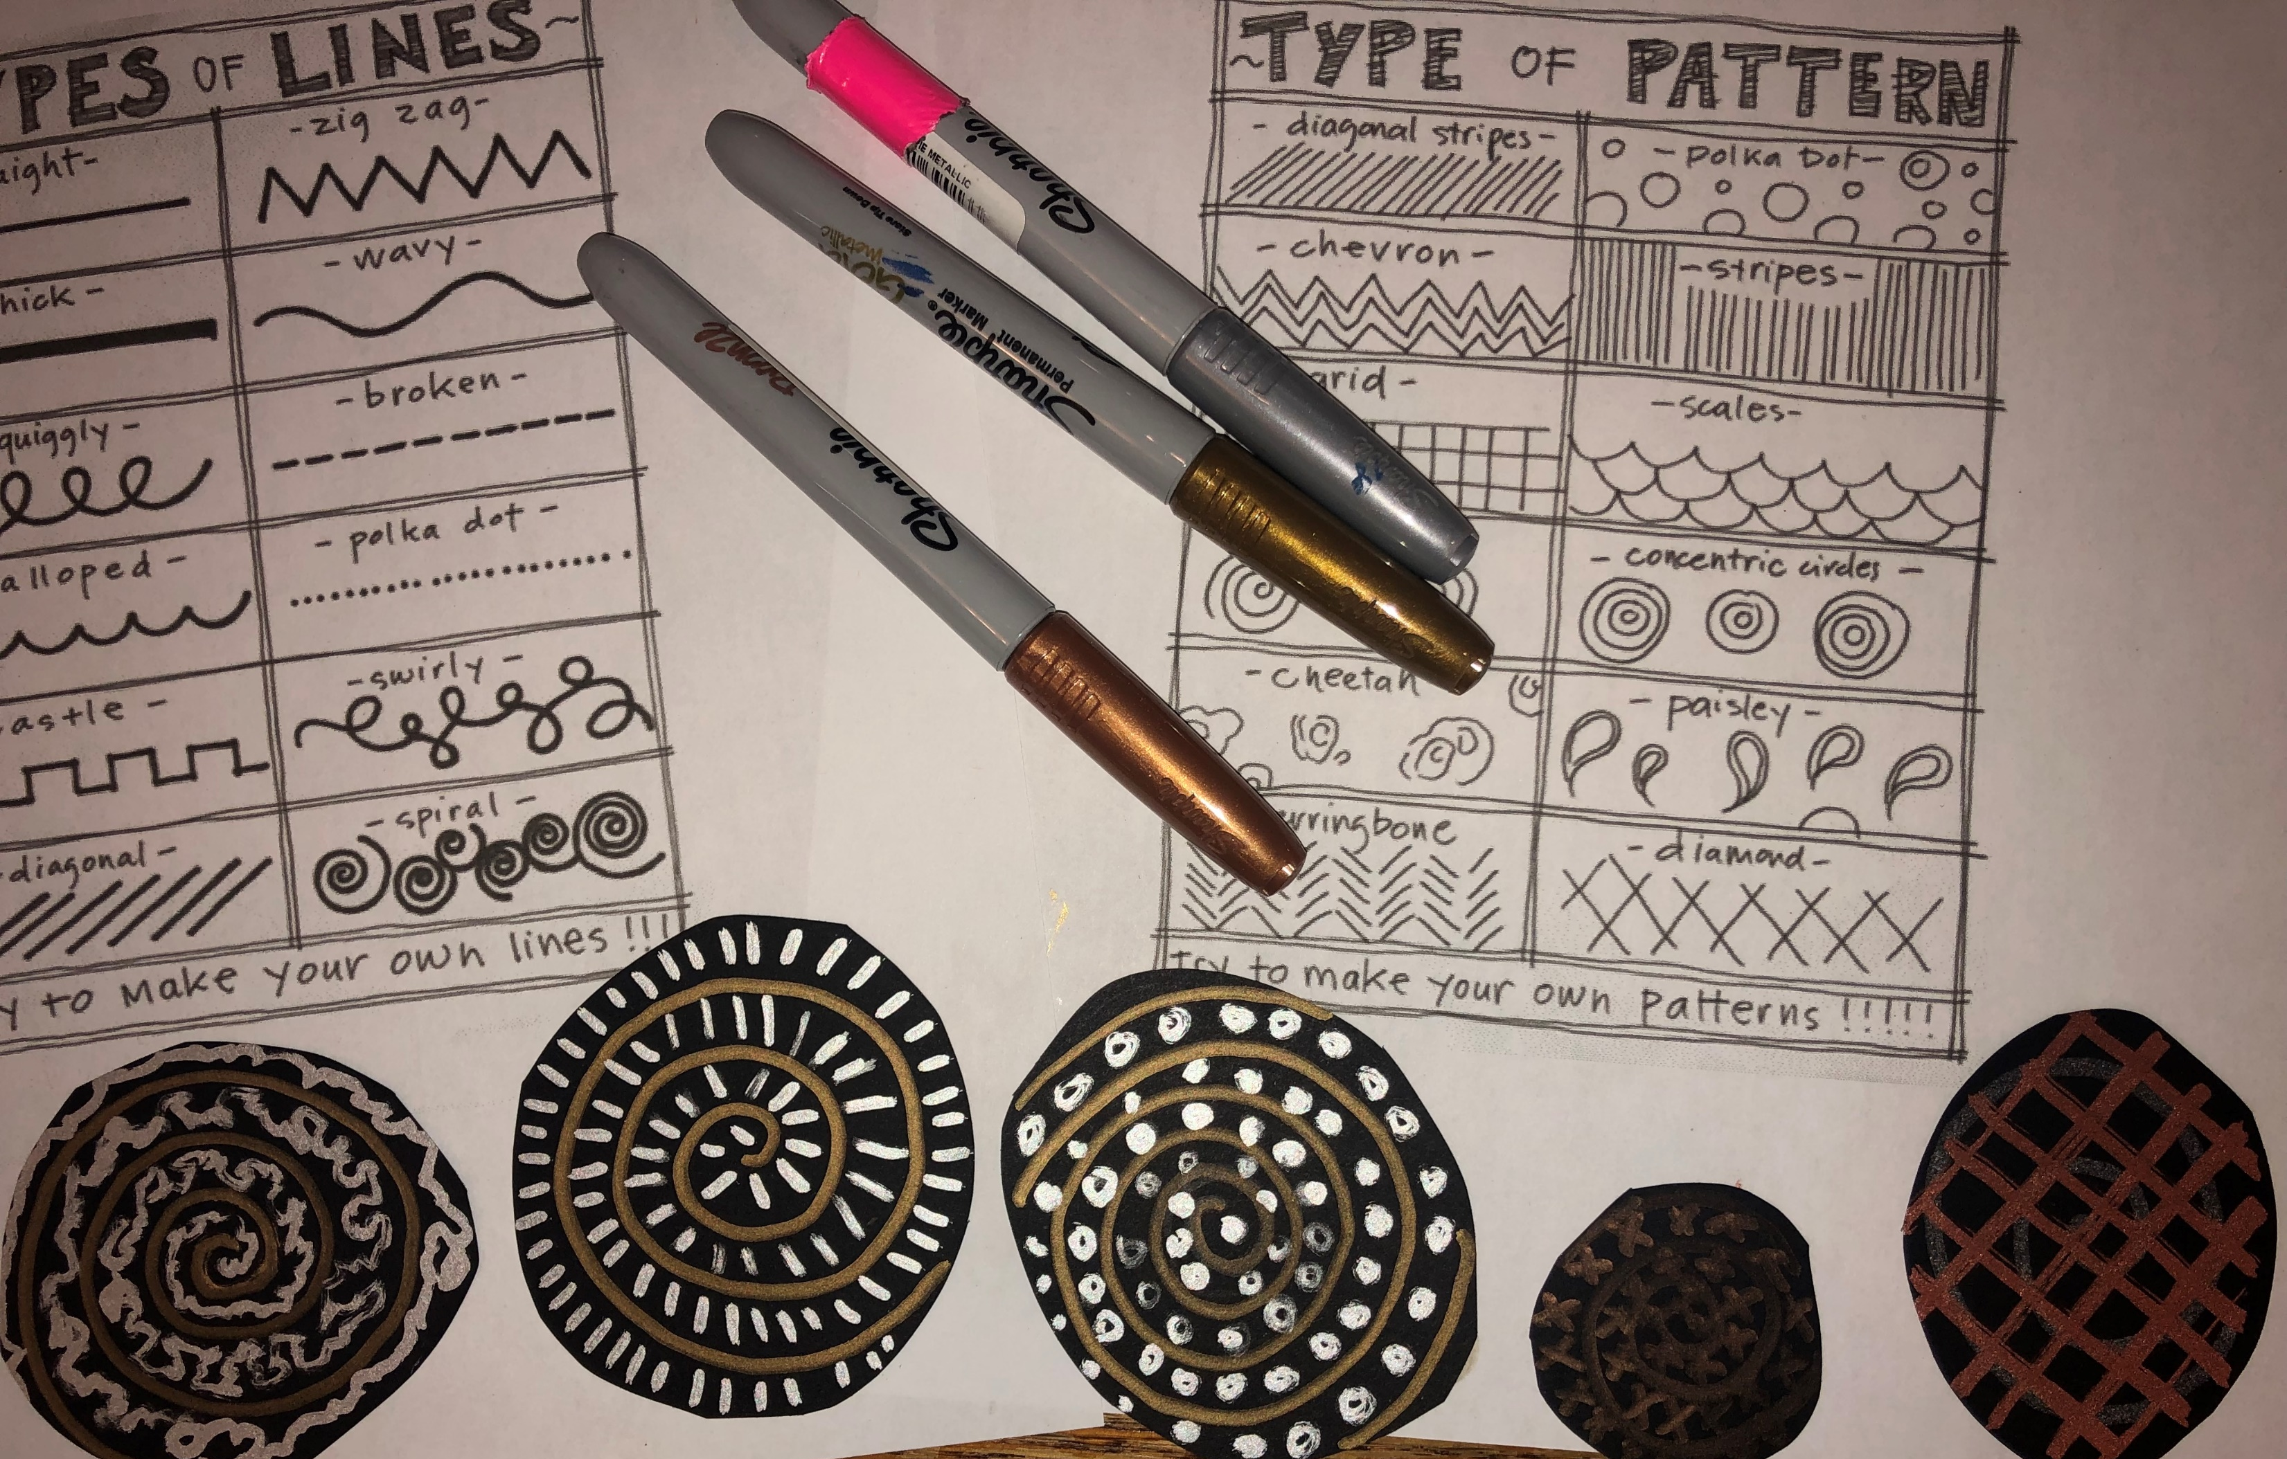
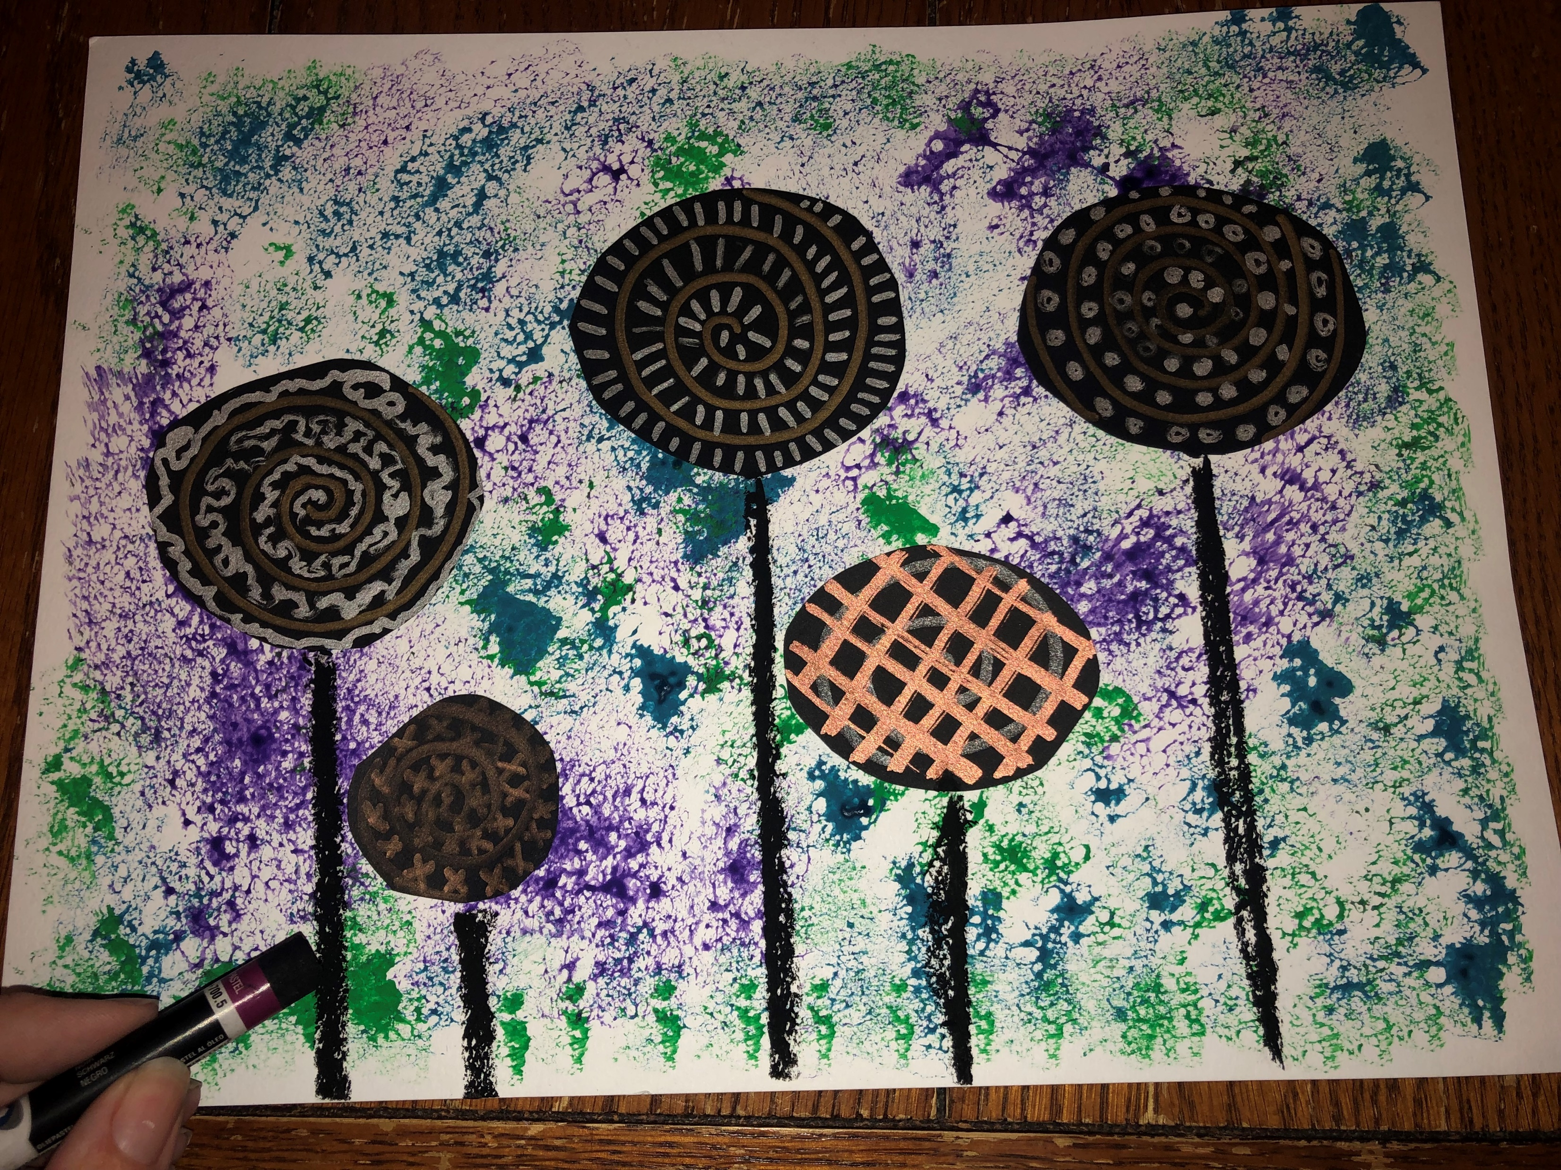
STEPS:

