Slide 1
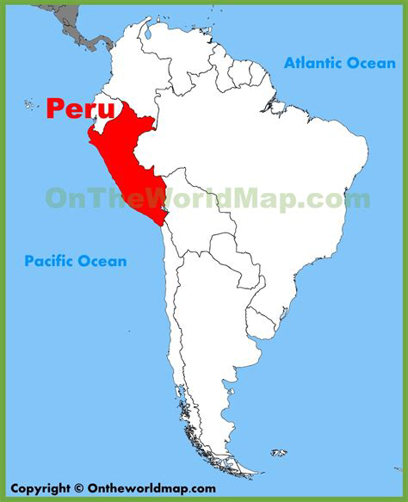
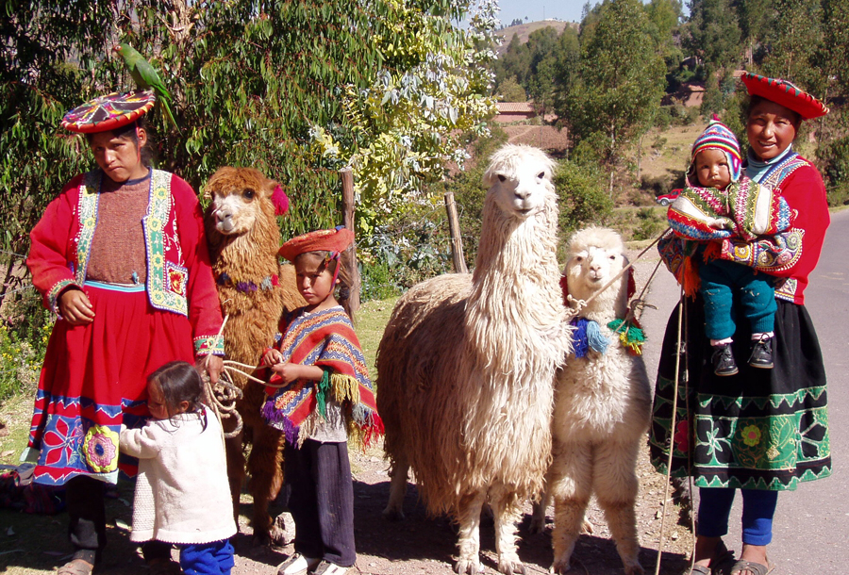
Peruvian Llamas
With traditional textile patterns

Slide 2
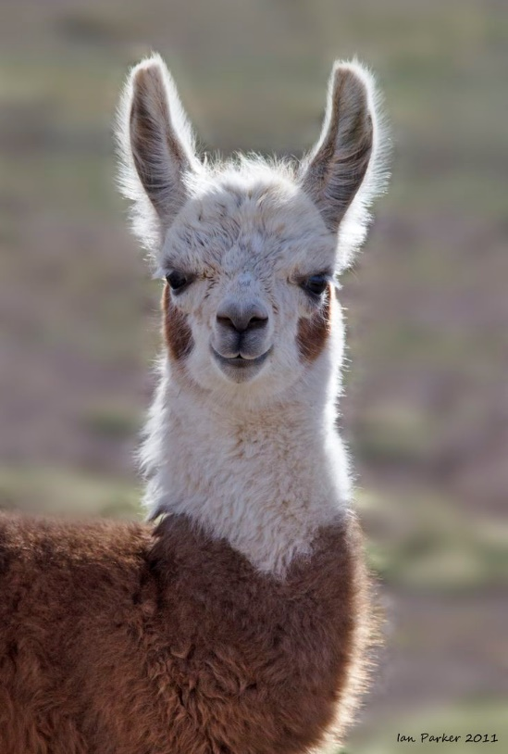
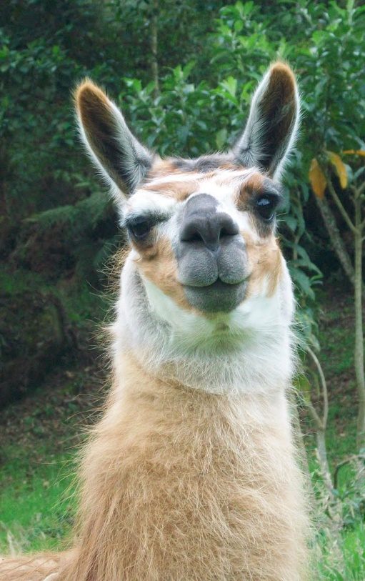
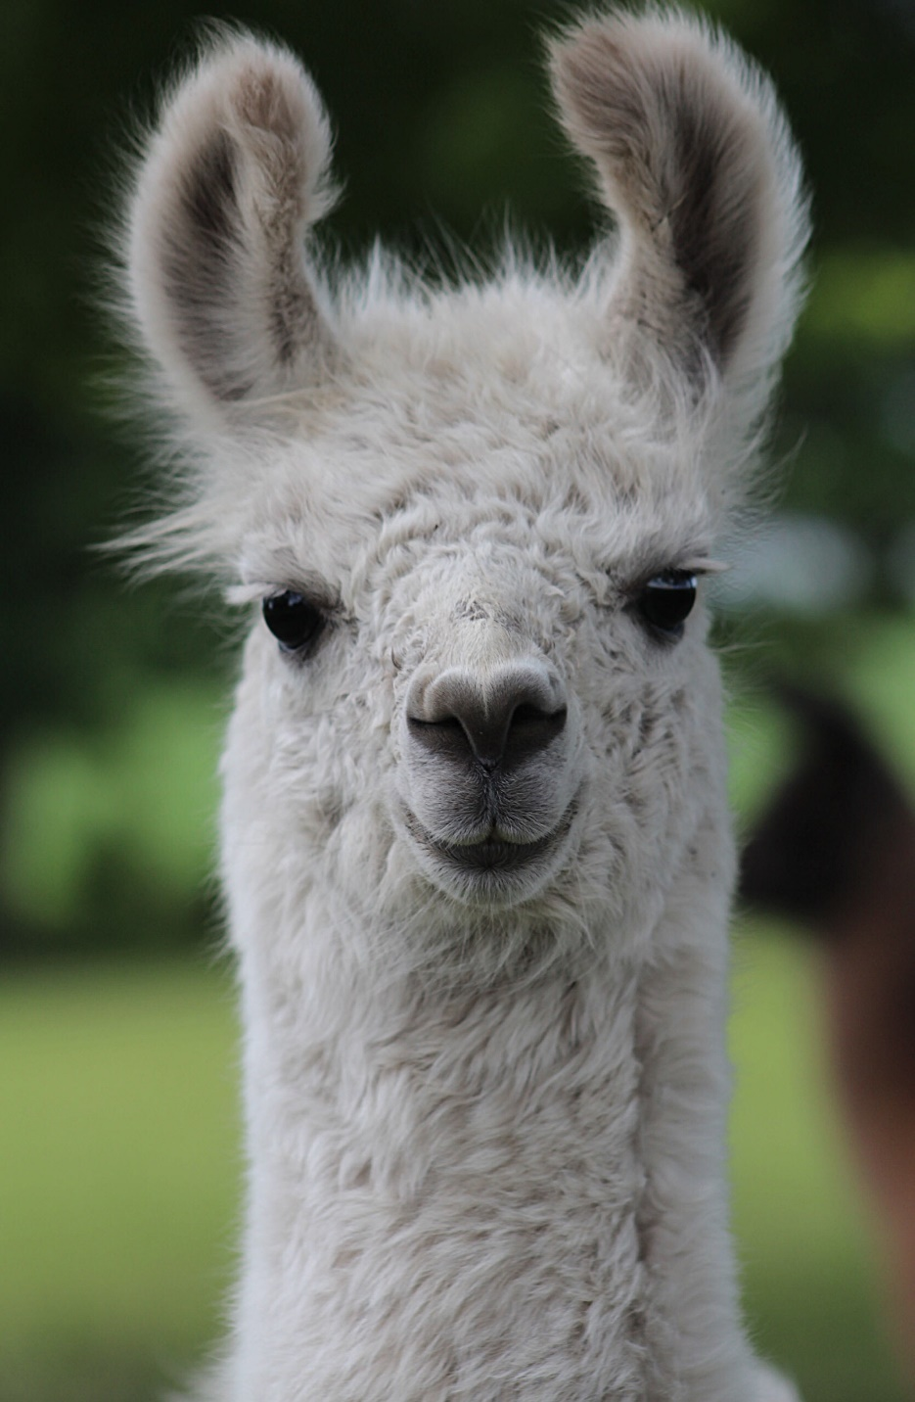
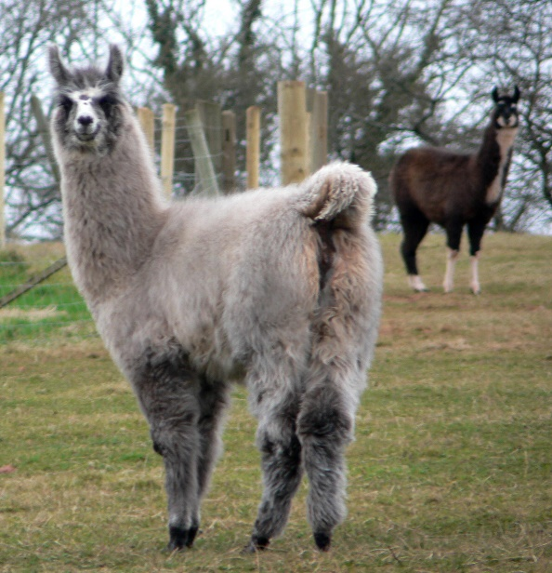

Slide 3
Peruvian Llamas
There are over 7 million llamas in South America.
Llamas are highly intelligent animals and they are easily trained.
They are raised for their wool, to carry loads ands pull carts and are a very important part of life in the villages of Peru.
Llamas are part of the camel family and can survive many weeks without water.
Llamas can grow to 6ft tall and live for about 20 years.
Llamas are social animals and like to live with other llamas.
They are naturally tame and never bite but may spit when agitated.

Slide 4
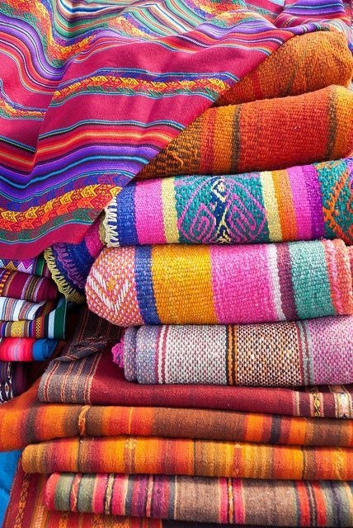
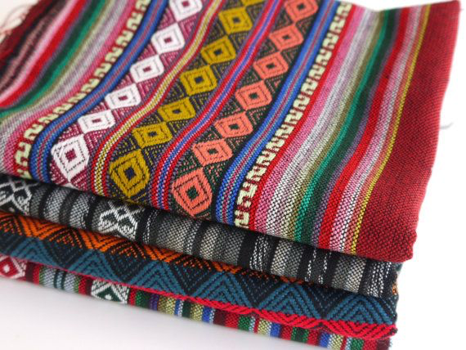
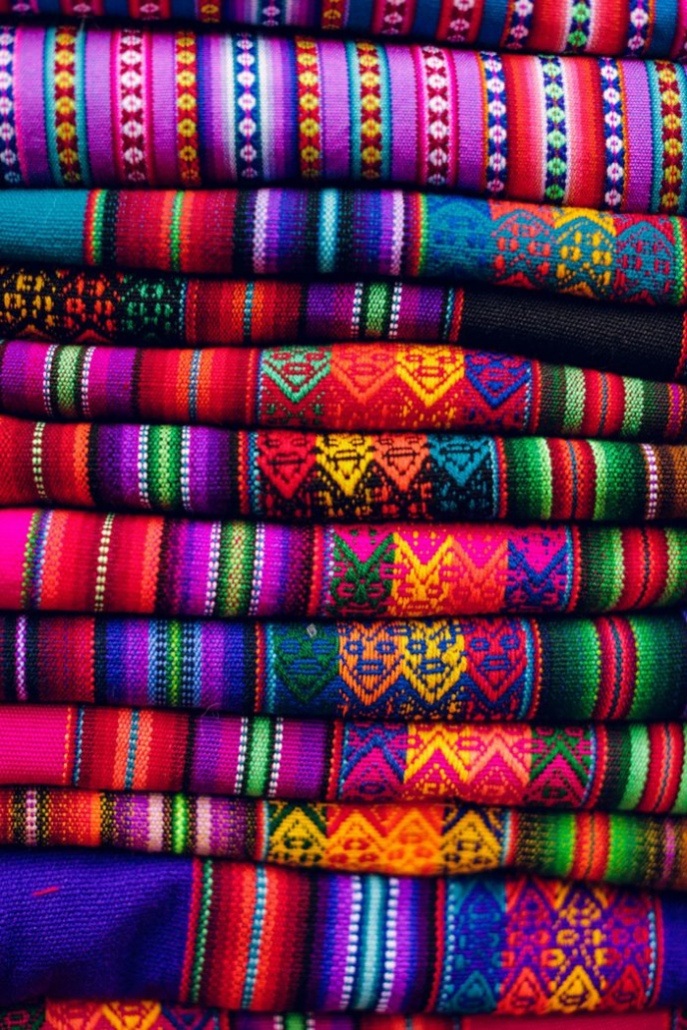
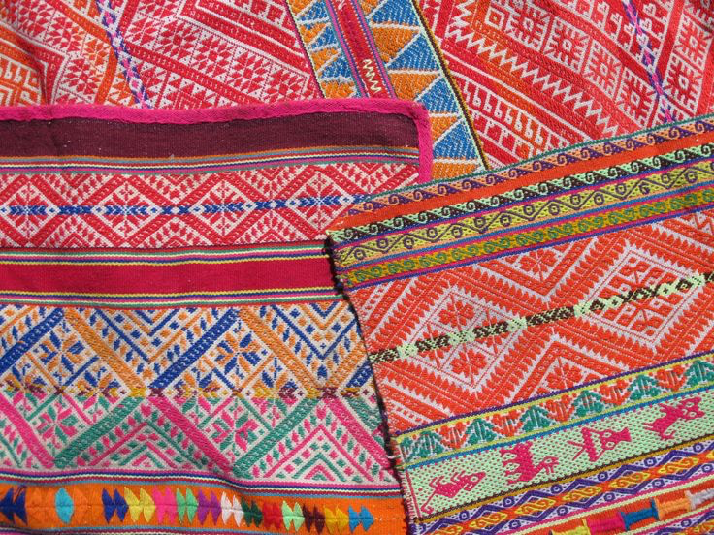

Slide 5
Peruvian Textiles
Wool is sheared from the llamas. It is then washed, dyed and hand spun into yarn.
The yarn is used to create beautifully patterned and brightly colored textiles that are used to make blankets and clothing.
Yarn made from llama fiber is soft, lightweight, remarkably warm and water-repellant.
Llamas wool comes in a range of colors including black, gray, beige, brown, red and white and is dyed using berries and vegetables.
Ready to create your own llama? Here we go!

Slide 6
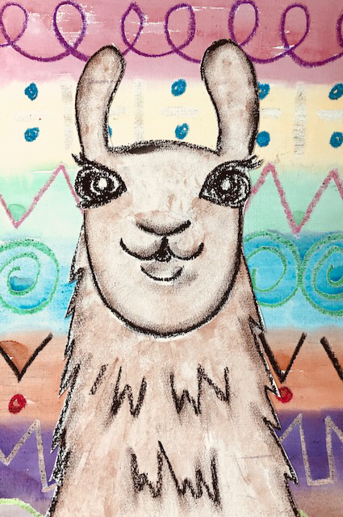
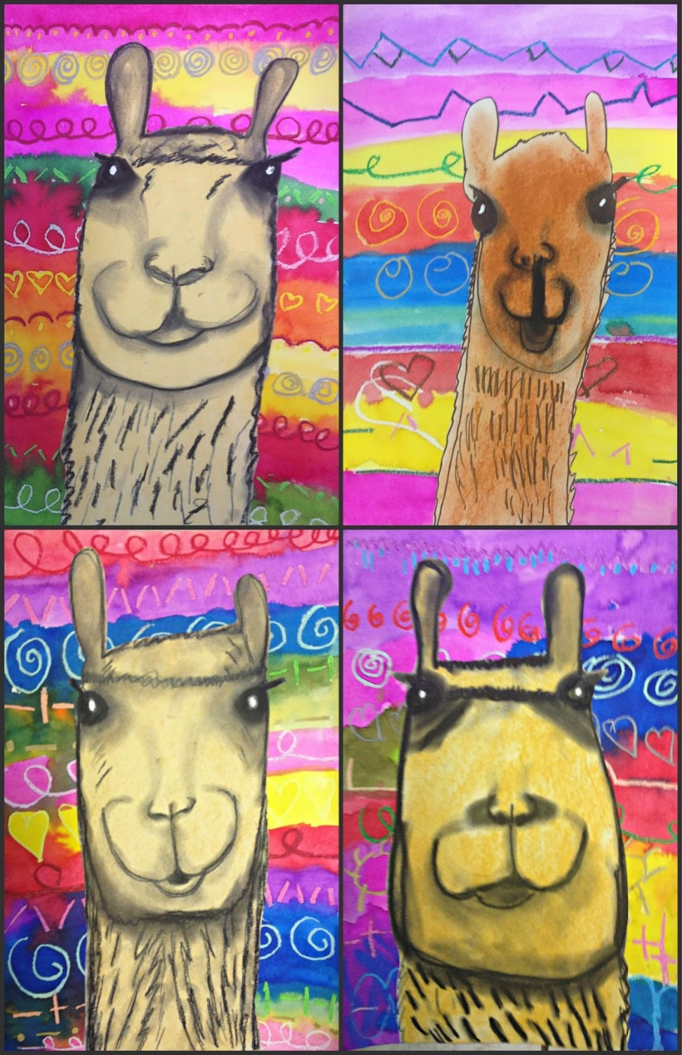

Slide 7
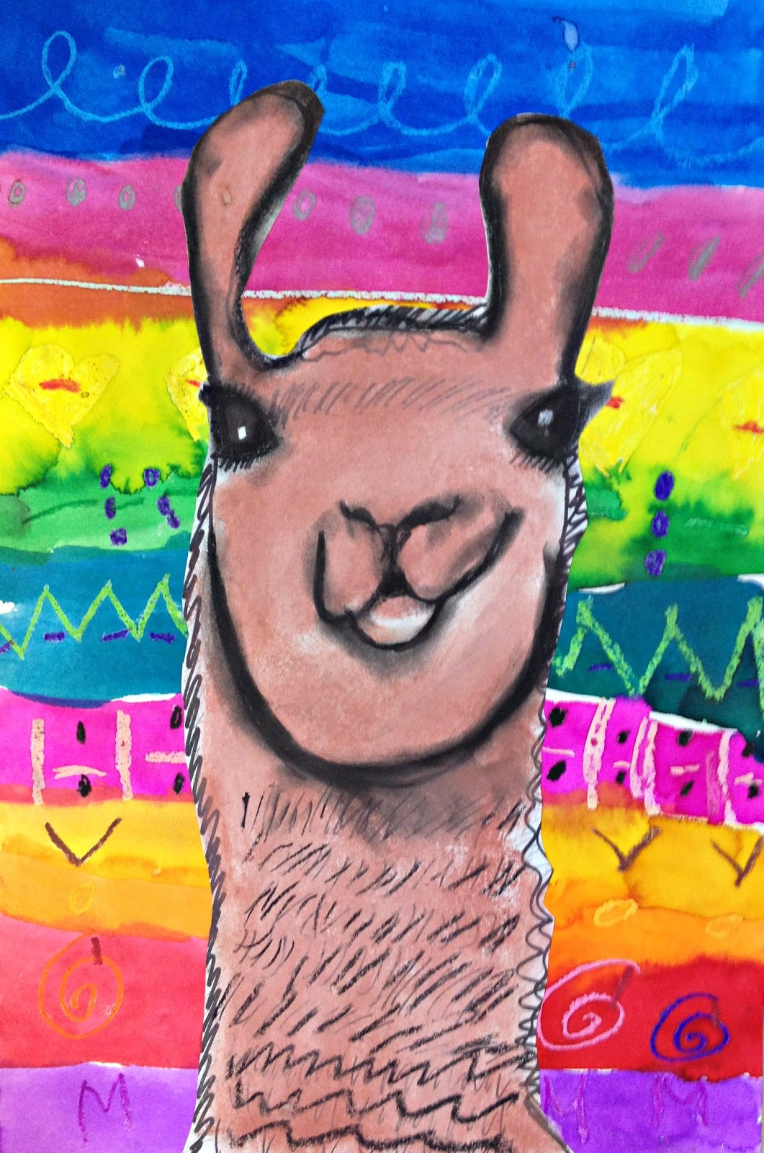
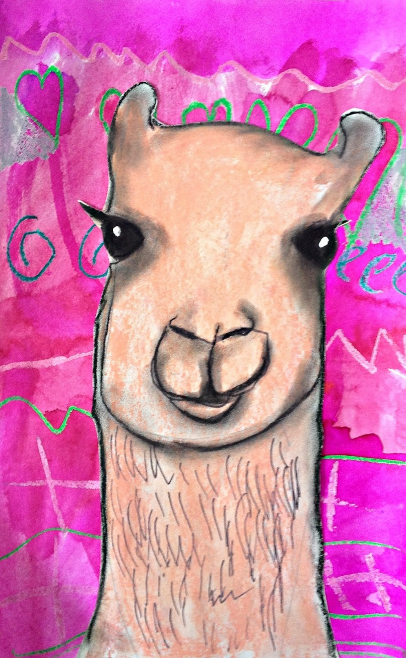
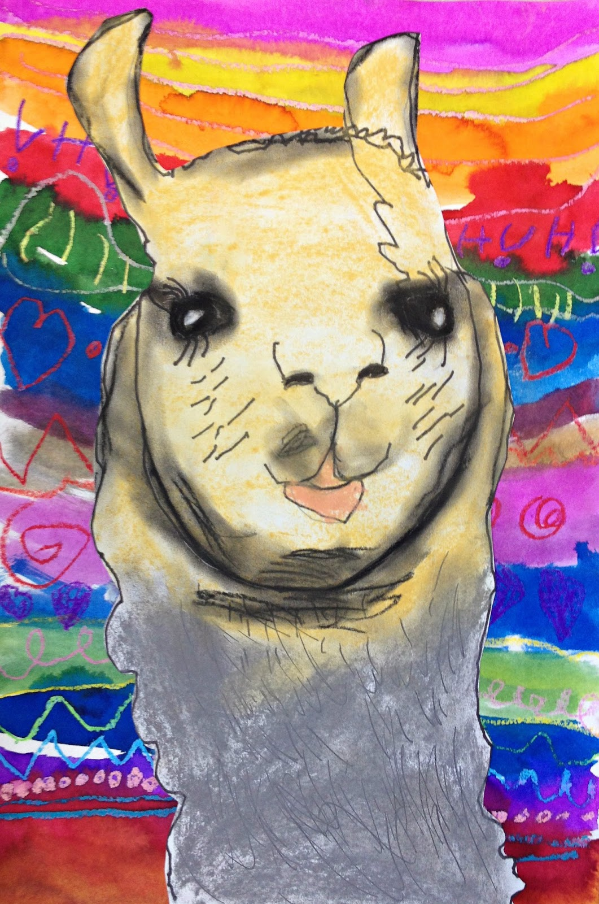

Slide 8
SUPPLY LIST:
1 large watercolor paper
1 smaller watercolor paper
Sketch pencil
Watercolor palette, small water bottles
Oil pastels
Scissors
Glue
Cups of water
paint brushes

Slide 9
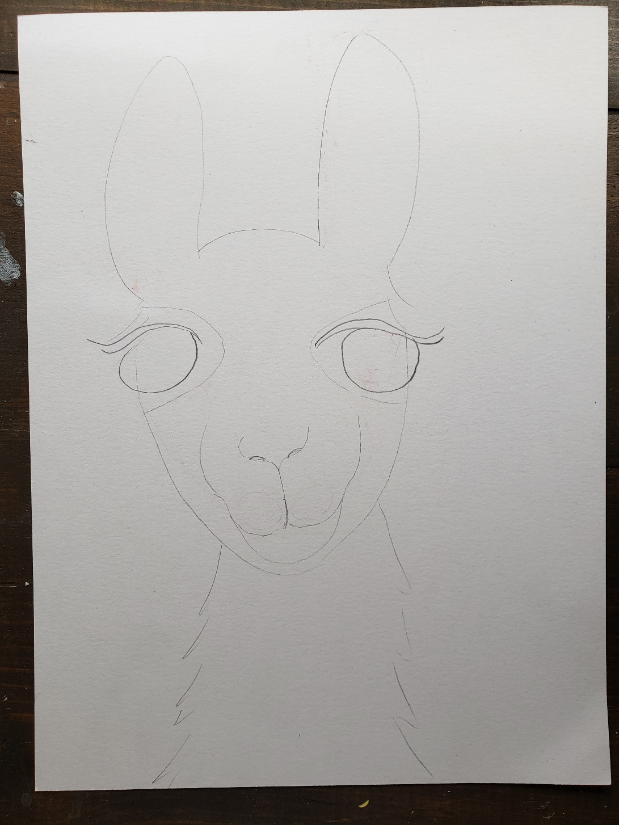
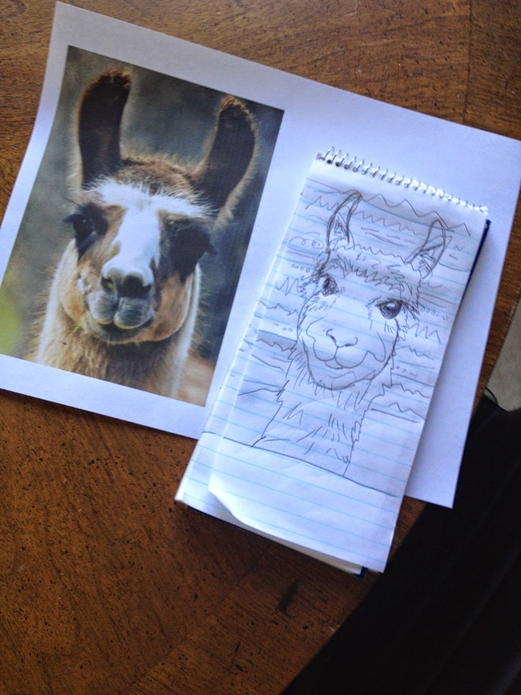
Start with your llama sketch
Write your name on the middle of the back of your paper.
Using a pencil draw the llama starting with the top of the head and ears. Work your way down to the face and then add the neck. Next add your eyes. The eyes should go out off the head a bit. DO NOT fill in the eyes with pencil. Next add nose and mouth detail. Sketch long eyelashes.

Slide 10
Paint your llama using browns and tans. Leave your eyes blank for now. Use a little water with your paints. A dry brush gives the painting texture and looks more like the hair on the llama. Experiment with blending the colors on your paper, not in the palette.
Once you are satisfied with the llama coloring, use your white oil pastel to add a small circle inside the eye.
Outline your llama using the black oil pastel. Be sure to include lashes and nose details!
Fill in the inside of the eye with black watercolor paint.
Fill in any white space using just a brush dipped in clean water.

Slide 11
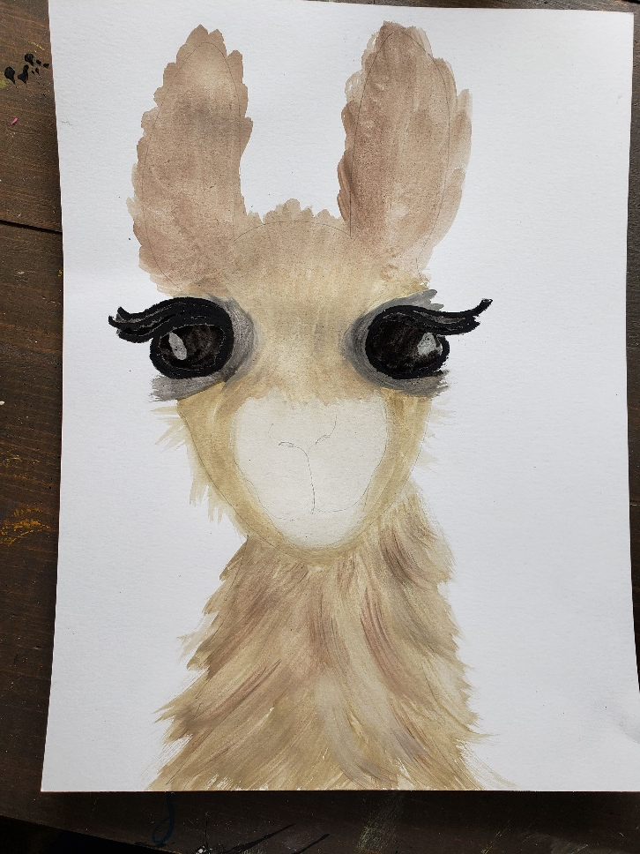
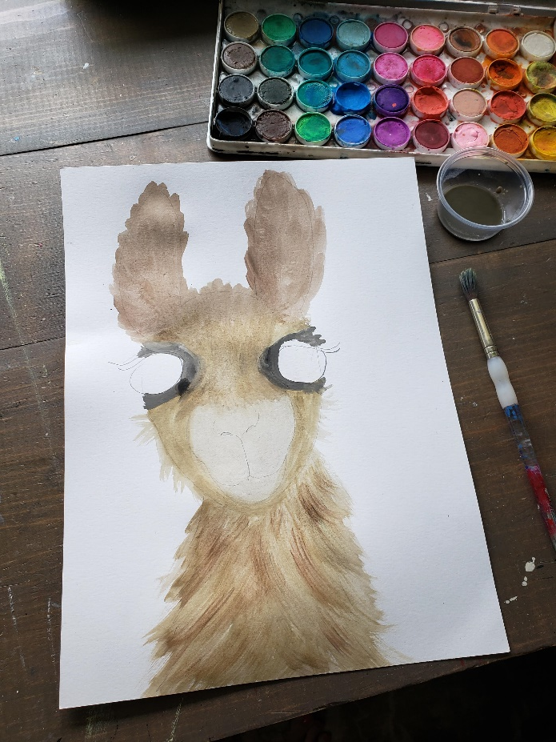
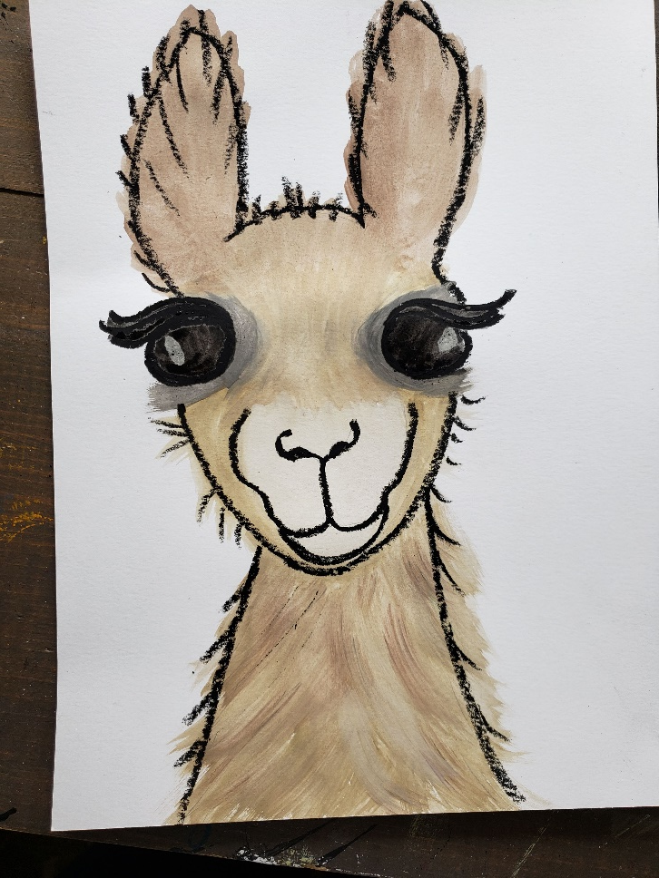
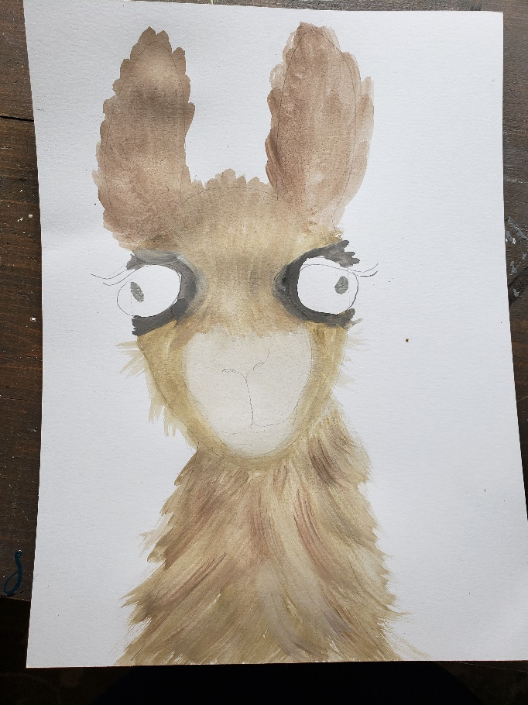
1. Paint the llama, blending colors.
Choose a lighter color for nose,
And a dark gray around eyes.
3. Paint in the eyeball using black watercolor. Outline lashes with black oil pastel.
2. Draw a small circle inside the eyeball using a white oil pastel
4. Outline the entire animal using the black oil pastel.

Slide 12

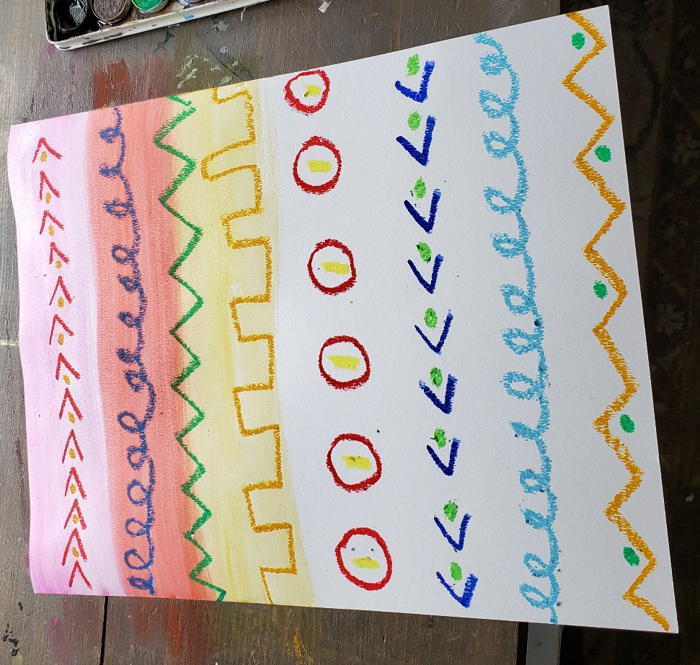
Next Start your textile inspired background
Start with your name on the back! Then be sure it is set vertical, or tall like a tree in front of you.
Using your oil pastels in bright colors, add different types of patterns across the page from left to right. Zig Zag, swirls, waves, dotted, dashed, line with a dot…
Try and keep the patterns straight across the page.

Slide 13
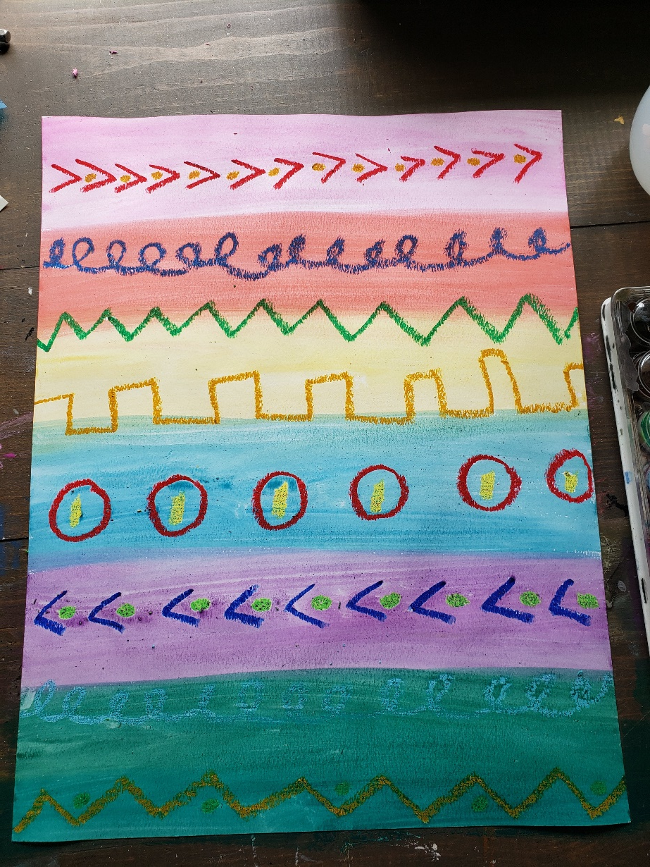
Using bright watercolors, paint each line across. You can carefully blend the colors on the paper to bleed into each other.

Slide 14
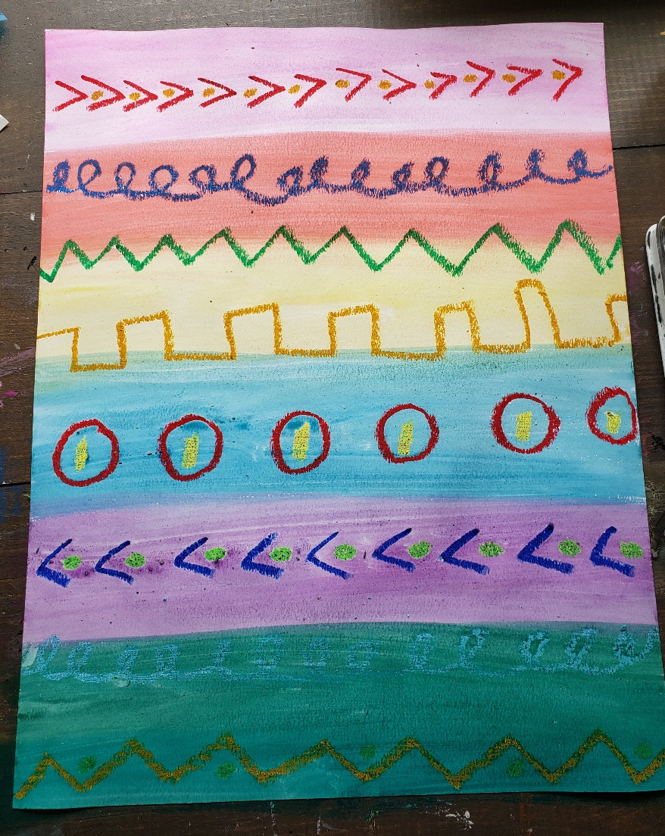
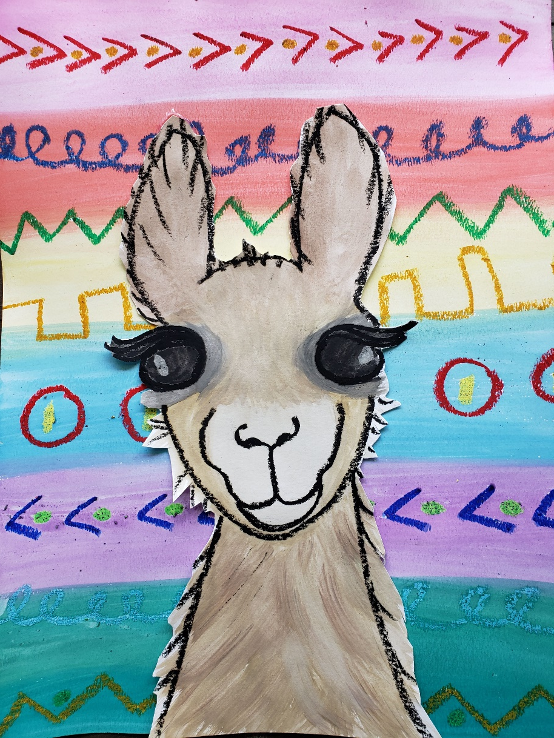
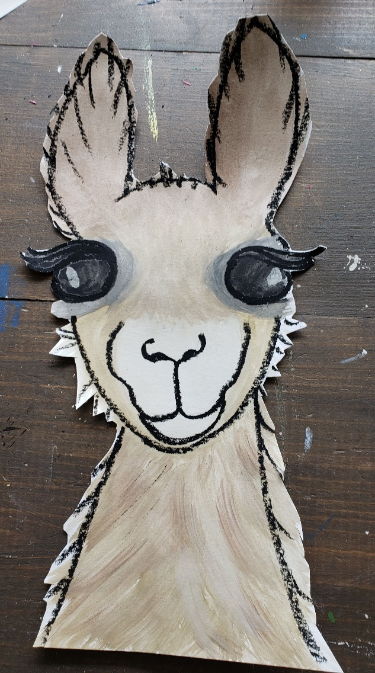
Adult helpers will cut the llamas out and hot glue them onto your colorful backgrounds.

