Slide 1
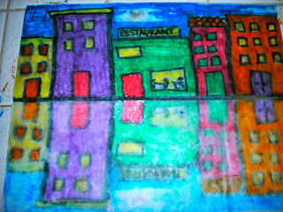
Cityscape Reflection Art

Slide 2
First step
Fold your paper in half horizontally
Draw a horizontal line ½-1” above your fold line and also along your fold line with a black pen. This will define your sidewalk.

Slide 3
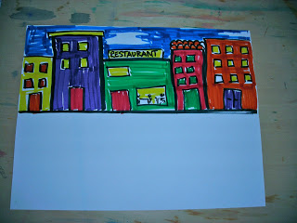
Draw a street view of a place you have been
Start by outlining your buildings in black
Color them in and add details
Examples could be:
Downtown Seattle
Issaquah Highlands
Any city you’ve visited
Your neighborhood, if you live in a place where buildings are close together

Slide 4
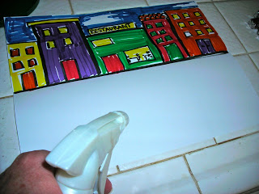
Create a reflection
Have an adult volunteer spray the bottom half of your paper with water
Fold over and rub gently so that your artwork makes an impression. If it’s not working, have them spray a bit more.

Slide 5
Tadaa! Your street view reflection is complete!
If you have time, you may want to touch up the top drawing with color.

