Slide 1
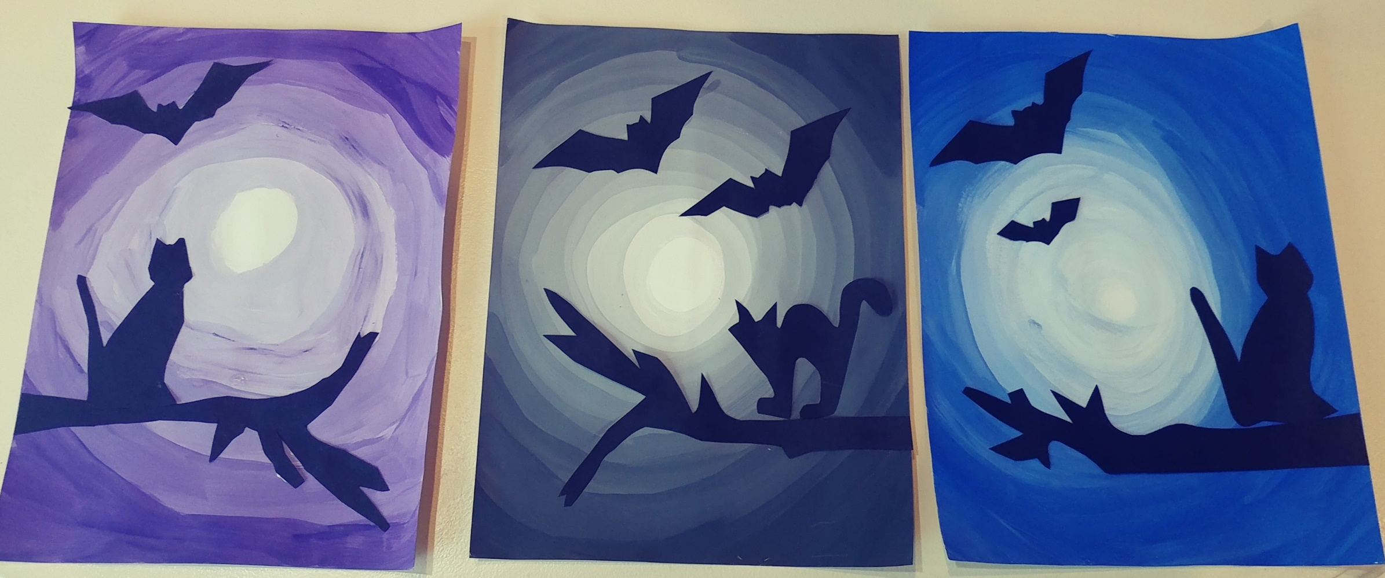
Bats at Night
Learning about gradation and color value.

Slide 2
Color Value
Value is the lightness or darkness of a color.
Black is a dark value or low value.
White is a light value or high value.
We use color to shade things, and make our pictures look more awesome!

Slide 3
Tint versus Shade
A TINT is when you add white to a color to change the value.
A SHADE is when you add black to a color to change the value.
Today we will be adding a color to white to create a slightly different shade of our starting color

Slide 4
Gradation: Gradation is a minute change from one shade, tone or color to another. We will gradate our painting from pure white, to black, purple or blue.

Slide 5
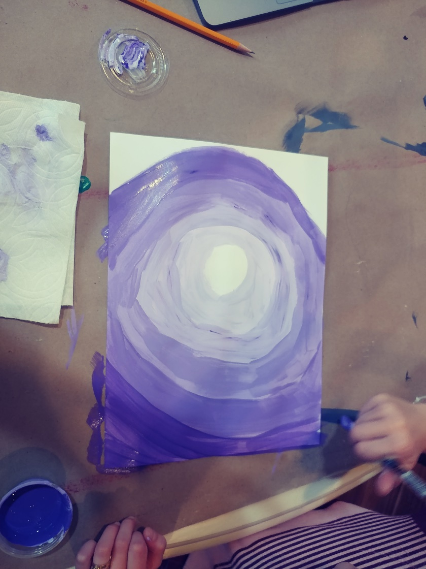
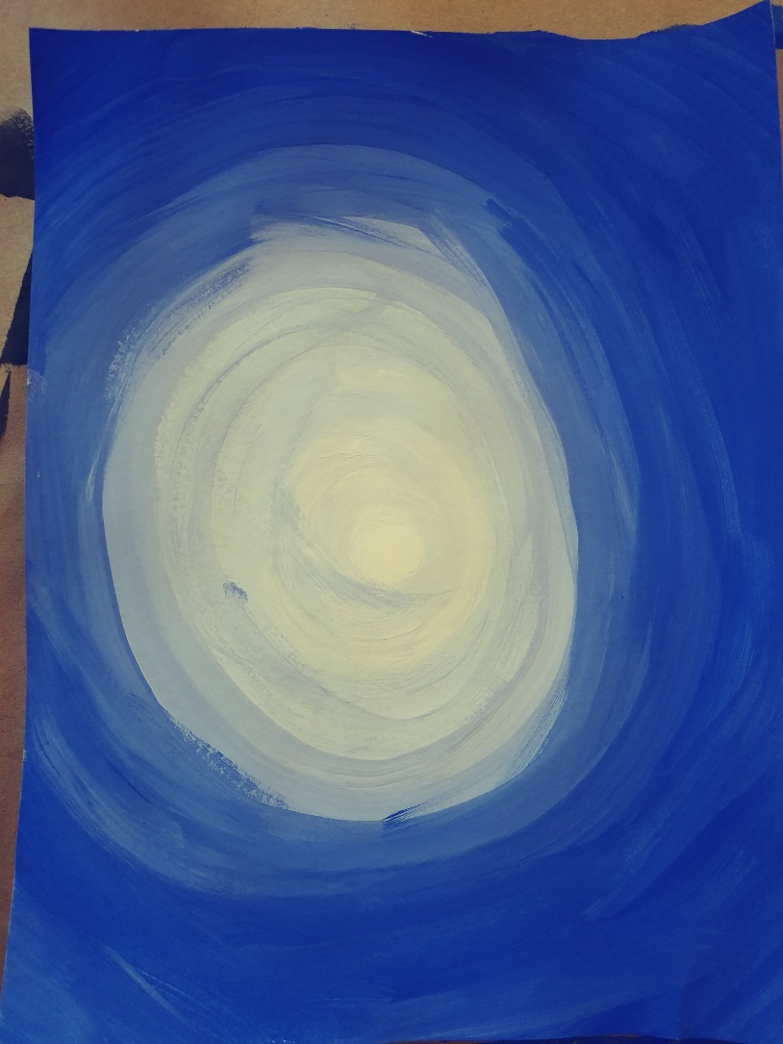
Let’s create our own gradation of color!

Slide 6
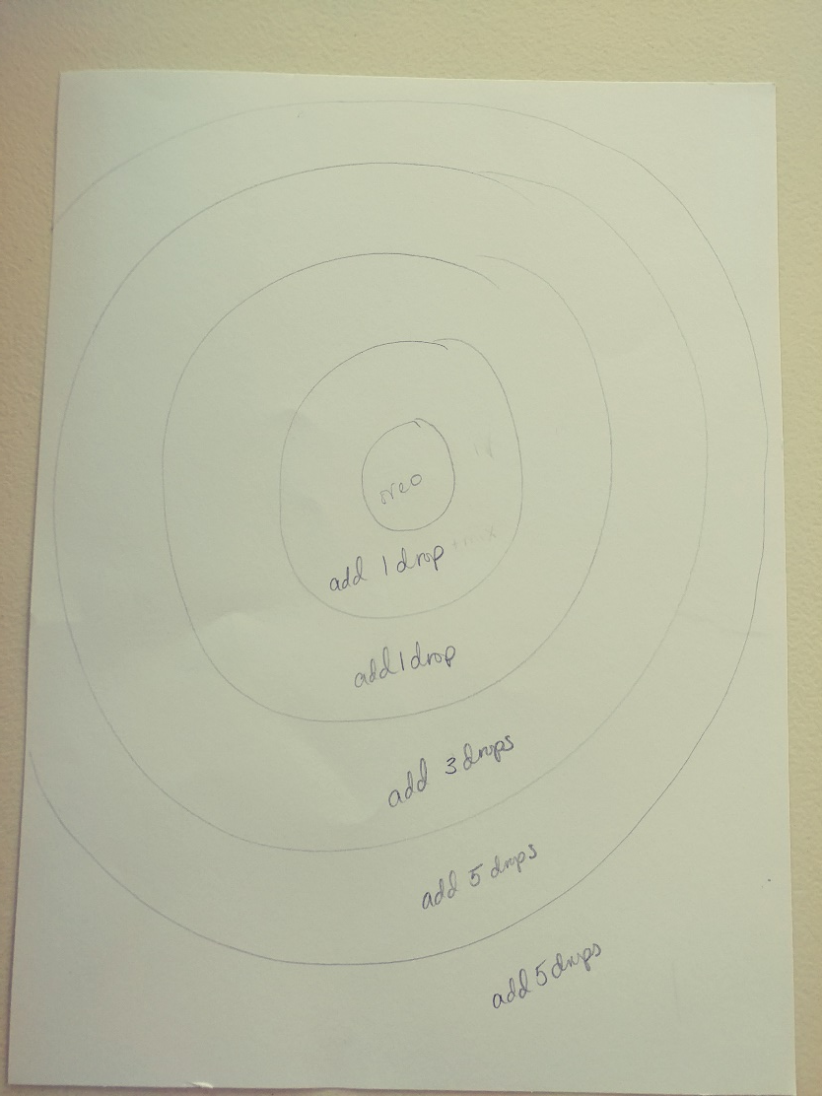
Let’s give ourselves a guide to follow while we are painting our gradation spiral.
-Draw a circle lightly with pencil about the size of an oreo.
-Lightly draw an outline around the “oreo” about 1 inch.
-Outline that circle again lightly about 1 inch farther.
-Continue lightly drawing the circles even when they go off the page, roughly 2 additional outlines with some going off the page.

Slide 7
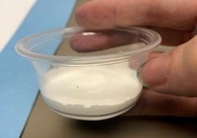
Begin with your lightest color value (white)
Begin with a cup of white paint for each student.
Paint inside the “oreo” circle white.
Add one drop of purple, black, or blue. Mix well.
Paint the next ring around the “oreo” with your
new color.
Add three drops of color. Mix well. Paint the next ring with your new color.
Add 10 drops of color. Mix well. Paint the next ring with your new color.
Add 10 drops of color. Mix well. Paint the next ring with your new color.
Last one! Add 10 more drops and paint all the remaining white space around the edges.
Set it aside to dry and move onto your silhouette shapes
Notes:
Docents, start with about 2 tablespoons of white tempura paint in a small container.

Slide 8
Add your silhouette shapes in black
Work on tracing or drawing some night time objects such as bats, tree branches, cat, or owl onto black paper. Focus on two or three objects, and one branch. We have templates for you to trace and use if you choose. Trace onto black paper and cut out your objects.
Using the tacky glue and popsicle sticks as your glue spreader, attach your night objects onto your finished painting. The branch will be at the edge of the page…no floating branches!
Please make sure your silhouette shape has all pencil lines facing down.
The Perspective of the painting will give us a feeling of distance between the moon and our objects on the branch.

Slide 9
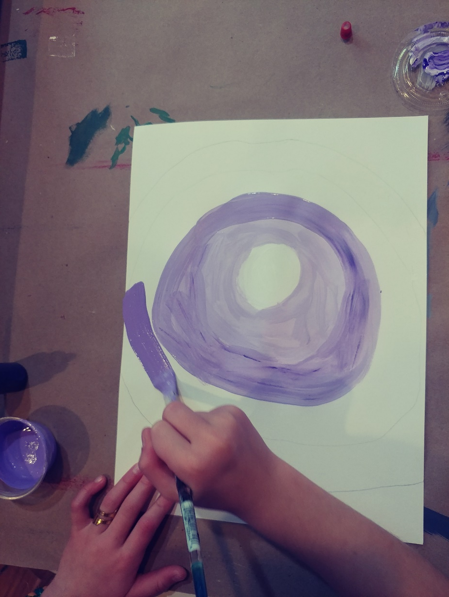
Progression of shading by adding color drops to white.
1 DROP OF COLOR ADDED,
THEN 3 DROPS
WHITE INSIDE THE CENTER CIRCLE

Slide 10
CONTINUE ADDING 10 DROPS OF ADDITIONAL COLOR PER RING.
FINISH ALL WHITE SPACE.

Slide 11
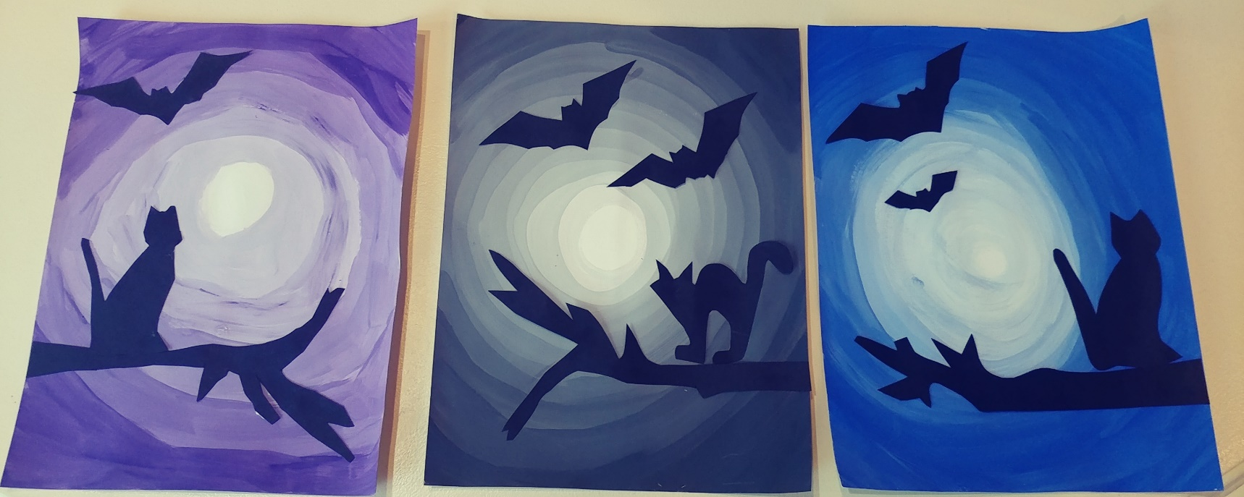
Using templates provided, trace and cut out subjects for your spooky night photo. Be sure to attach your branch to the side of the paper so it is not “floating”.
IMPORTANT! Be sure to glue your subjects with your pencil lines down so we do not see your lines. It looks much more professional!

