Slide 1
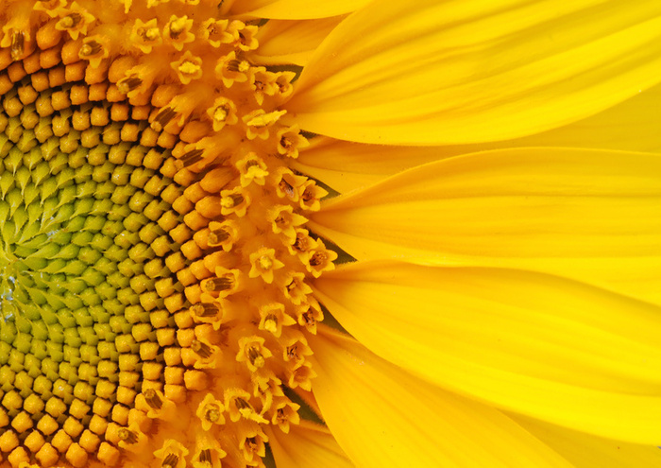
ART! ART! ART! ART!

Slide 2
ART RULES
All classroom rules apply.
HAVE FUN!
Raise your hand and ask for help BEFORE you get frustrated.
I don’t want your art to be “perfect” there is no such thing as perfect in art. Just let it be yours.
KEEP IT POSITIVE when talking about your other classmate’s work.
Stand back and take a look – 5 feet rule
Sometimes less is more – especially when we work with paint!
HAVE FUN!

Slide 3
Today you will learn
Perspective shading blending batiking

Slide 4
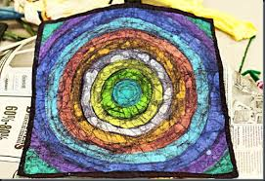
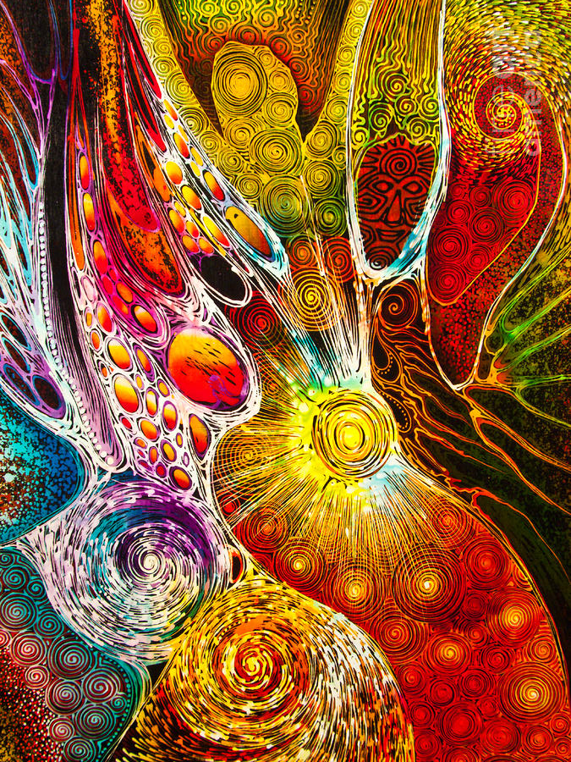
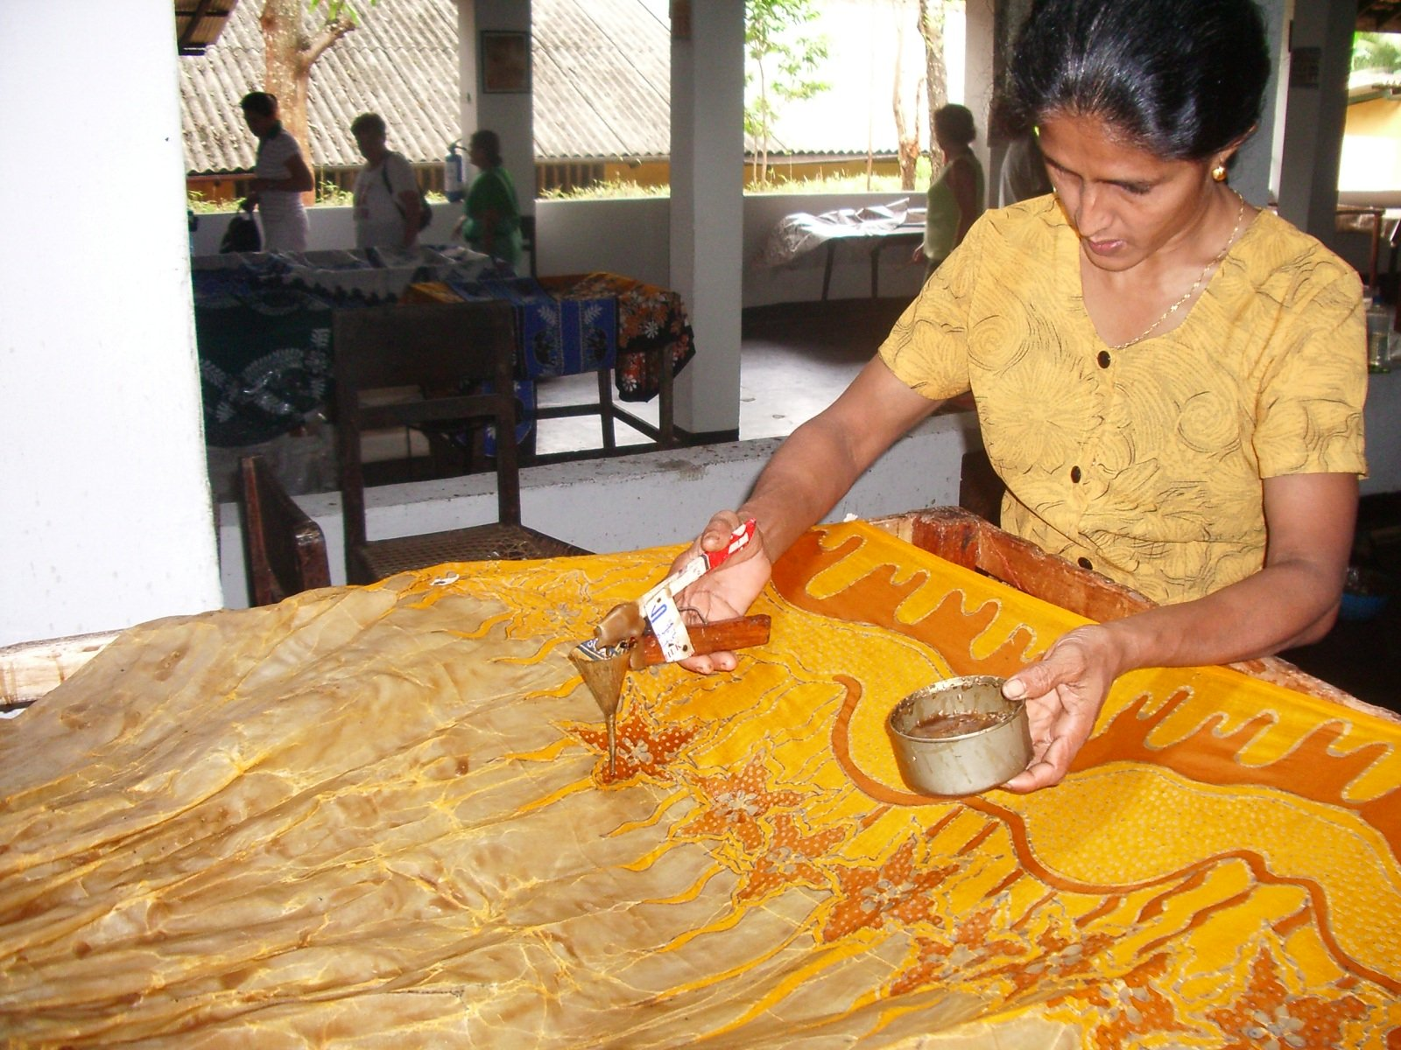
BATIK
a fabric printed by an Indonesian method of hand-printing textiles by coating with wax the parts not to be dyed.

Slide 5
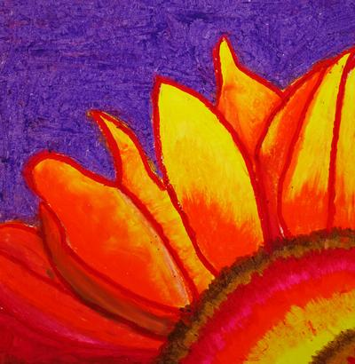
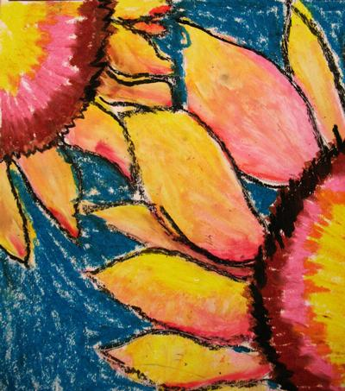
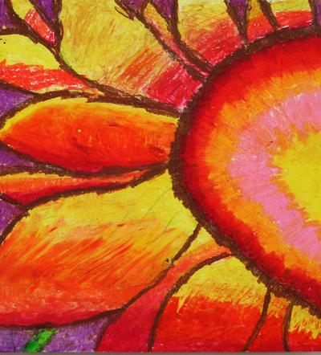
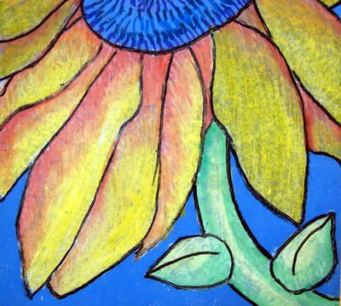
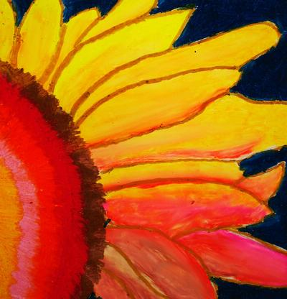
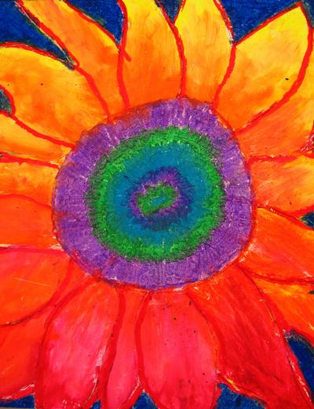

Slide 6
Write your name in pencil on the back of your white paper
Start in the corner of the paper with a pencil and draw a circle falling off the page. Find the center of that arc you just drew and add a flower petal. A slight smile and a slight frown make a petal.
Continue to add more petals. Some can be slightly skinnier, or shorter or longer. Look at some examples of sunflower images…

Slide 7
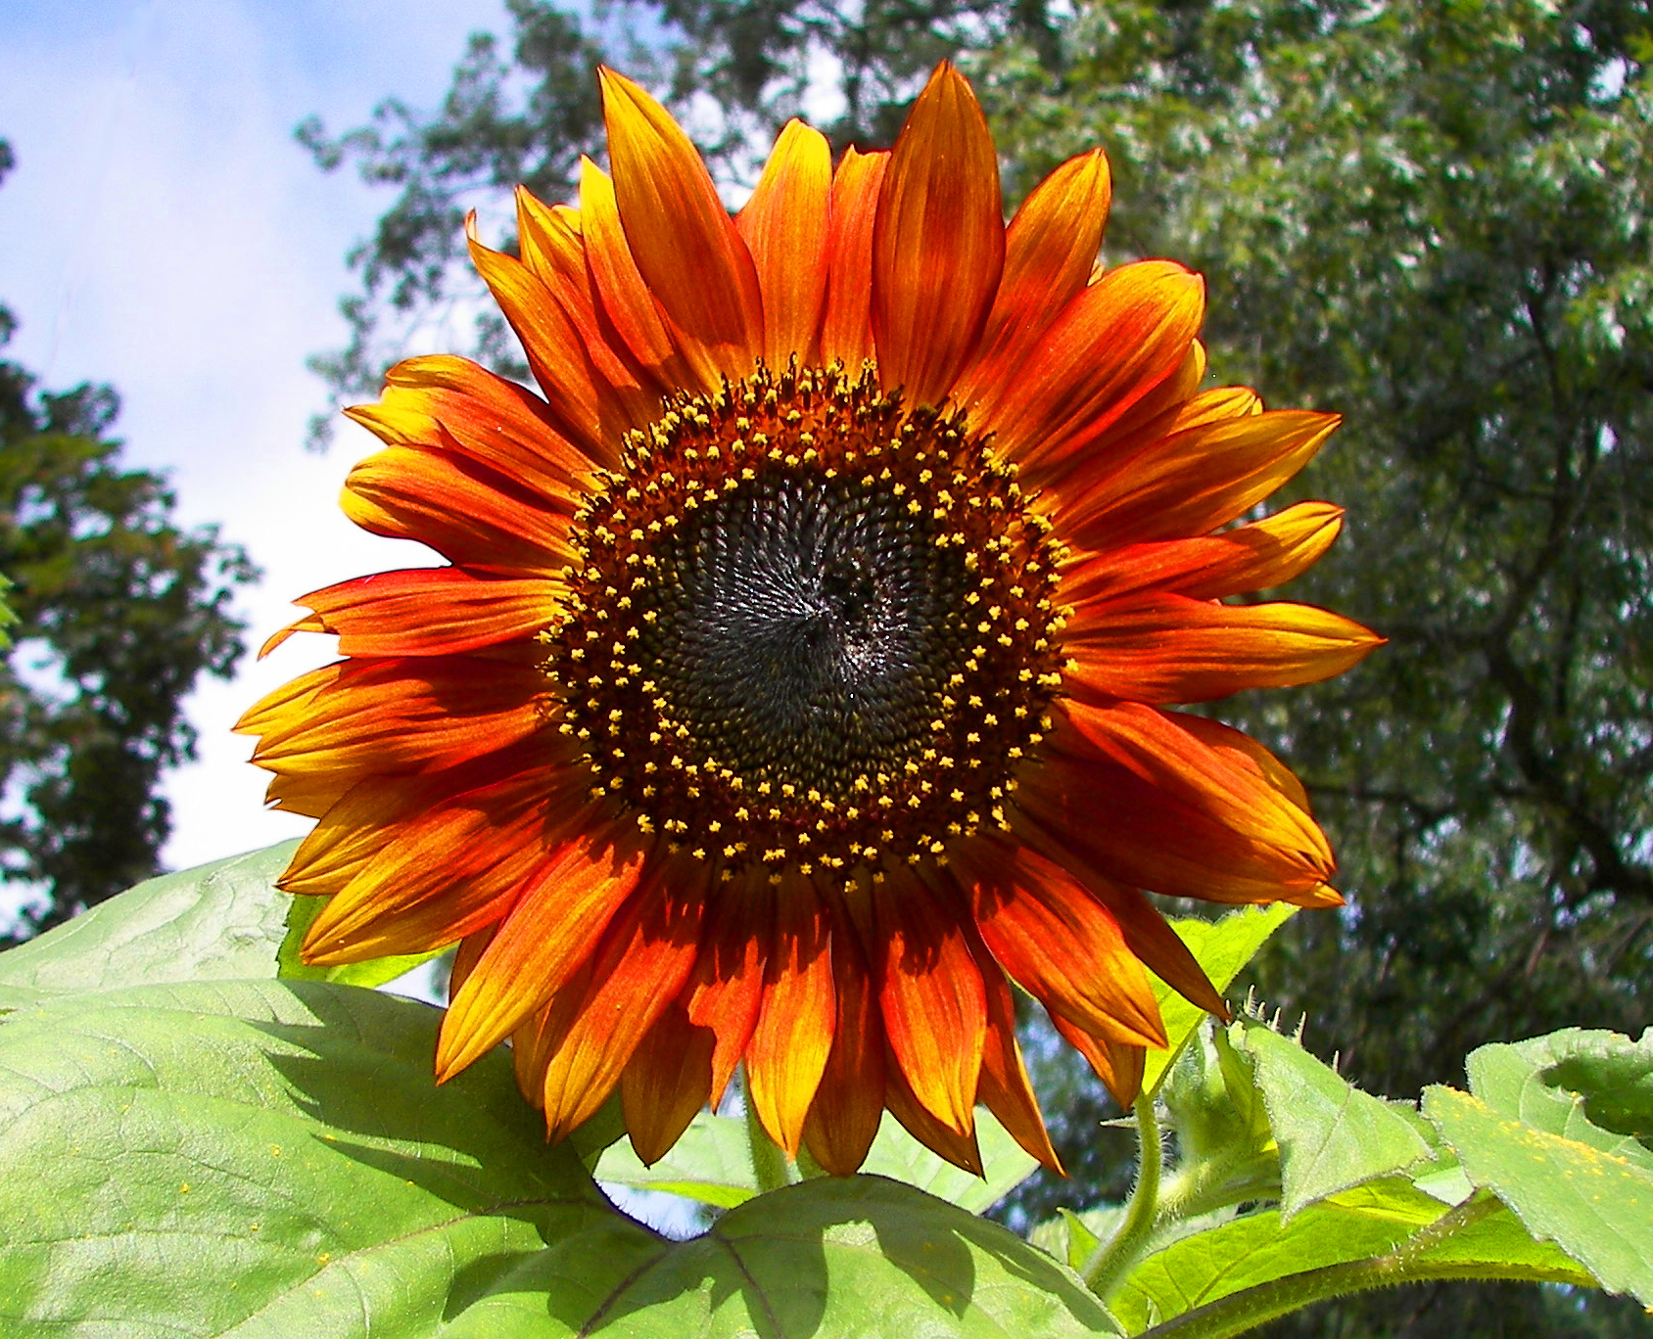
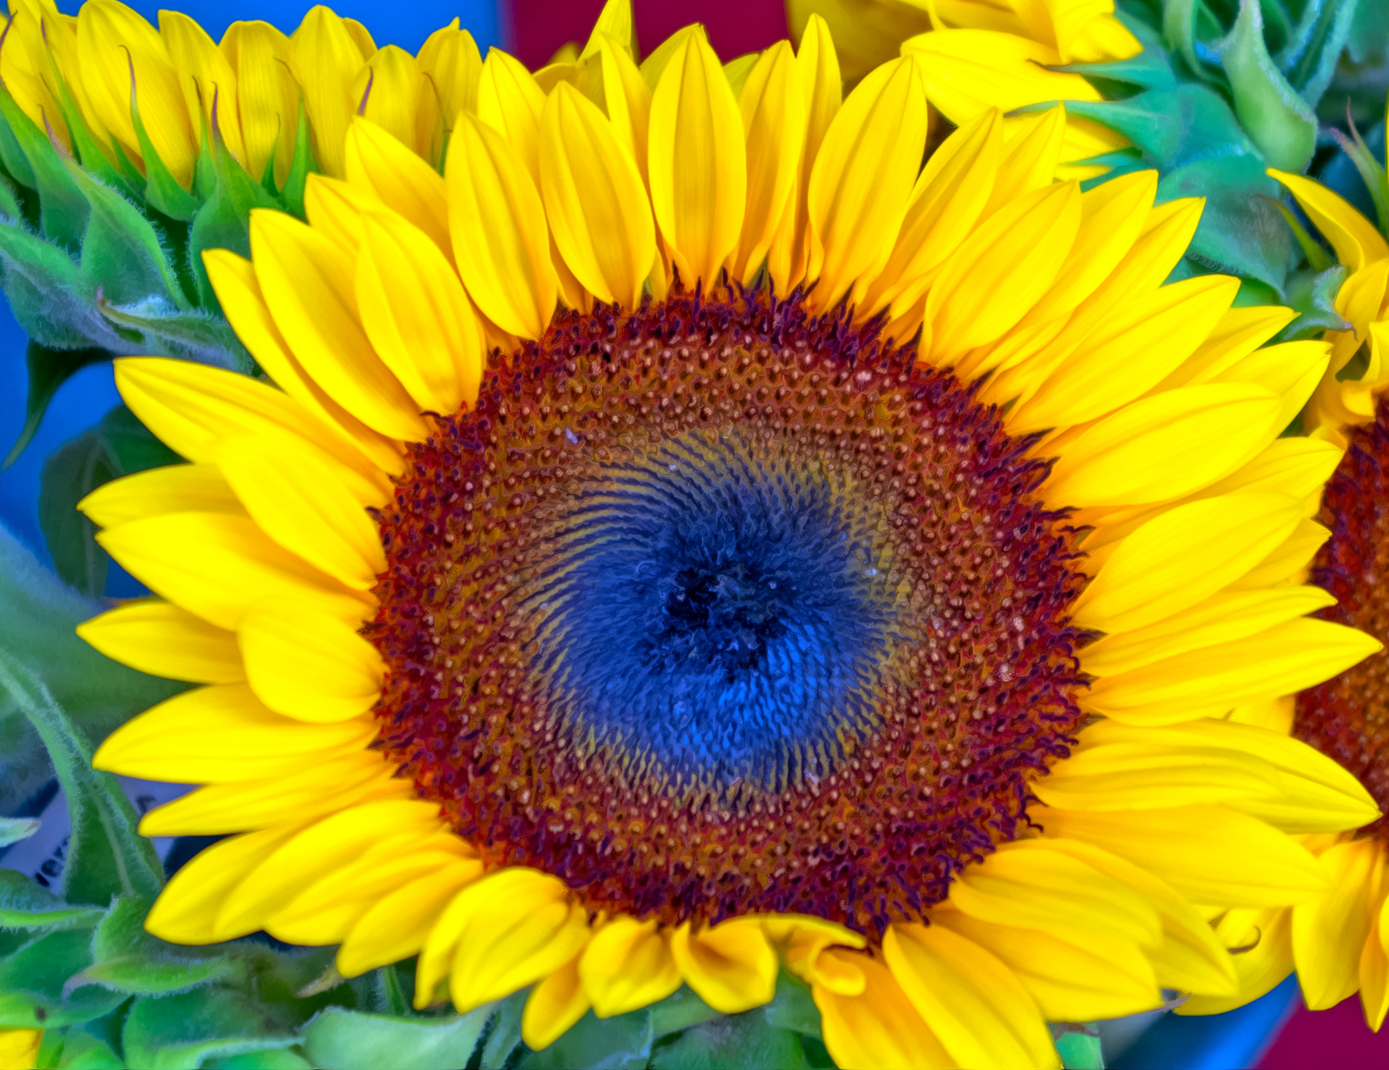
This Photo by Unknown Author is licensed under CC BY-NC-ND
This Photo by Unknown Author is licensed under CC BY-SA

Slide 8
First, trace over your pencil lines with black or brown sharpie.
Next choose a pattern of 3-4 colors of oil pastel. Start with the darkest color at the center of the sunflower, and get lighter.
Create another pattern for the petals using another 3-4 colors.
You should leave some white space. We will be blending the colors to fill that space.

Slide 9
After all your color is on, take a paper towel and carefully begin to blend the pastels together. Be sure to use short motions and gently hold the end of the paper. It is best to work from the bottom rubbing up and away from you. Continue blending until all the pastel lines are blurred.

Slide 10
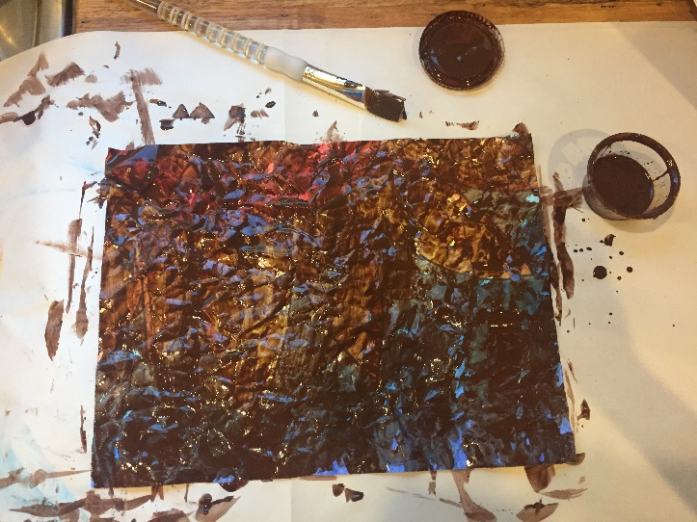
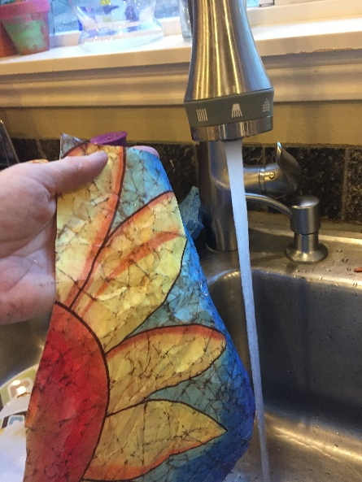
Now…the fun part! Take your paper and gently as possible crumple it into a ball.
Gently uncumple and do it again.
Once again, gently uncrumple the paper and set it as flat as you can in front of you. Try not to use your hands to spread it out flat. Your oils will smear. Just gently press it open, or use a paper towel to pat it down.
We will be painting over our crinkled lines with watered down brown tempura paint giving our art a batiking effect. After you have painted over the entire paper, bring your art to the sink and we will rinse it off.
This Photo by Unknown Author is licensed under CC BY-SA

