Slide 1
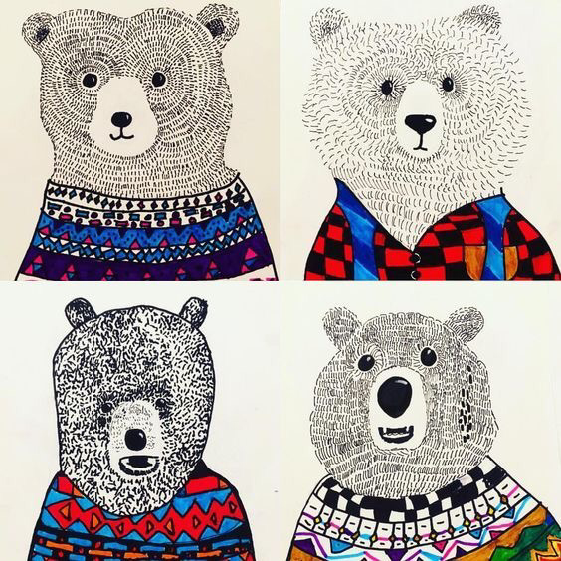
Chilly bears
Sharpie Art
A lesson about texture

Slide 2
TEXTURE
Texture both tactile and visual. (You can feel it and see it)
TACTILE TEXTURE is the quality of a surface, such as rough, smooth, sticky, fuzzy or soft. A real texture is one you can actually feel with your hand, such as a piece of sandpaper, a wet glass, or animal fur. It can also be created by an artist.
VISUAL TEXTURE is the visual quality of a surface. It is the result from painting or drawing as the real texture. Visual texture is the illusion of texture created by an artist.
Today we will be creating an illusion of fur on our animals. What will your fur feel like? Bristly and rough, or soft and fluffy? You will use different lines and shapes to create the way you would like your animal to feel.
“Durer Hare Engraving”
How do you think it would feel if you touched this rabbit?
How long do you think it took him to create the fur?

Slide 3
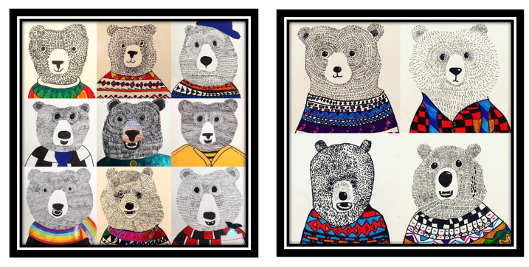
Here are some examples of what you could make today

Slide 4
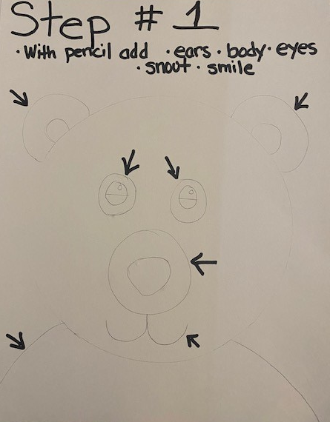
Step one - pencil
Start by using your pencil VERY LIGHTLY to
add, ears, eyes, snout, smile, body to the circle on your page or start from scratch with your own circle
1St Draw the snout, and ears. Think about where they should be on the face
2nd Draw the eyes, nose and mouth
3rd Draw body. Shirt, sweater, dress.
Make your Bear your own.

Slide 5
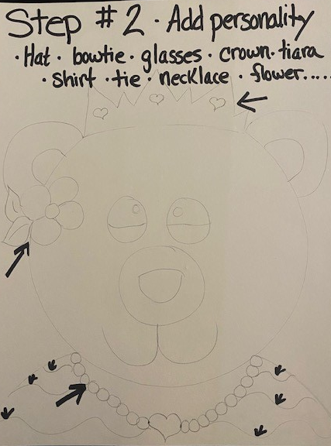
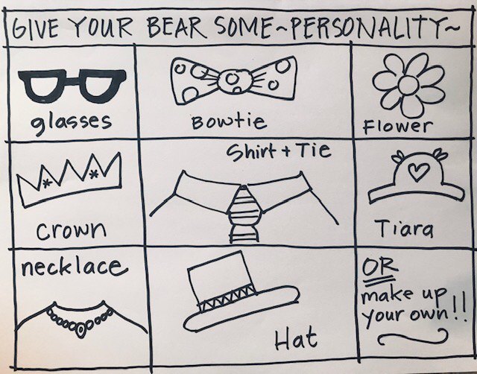
Step two – give your bear some personality
Add some fun things to dress up your Bear.
Don’t overdo it, less is more!
Here are some ideas but there are MANY more.

Slide 6
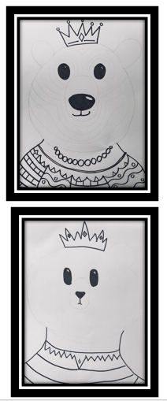
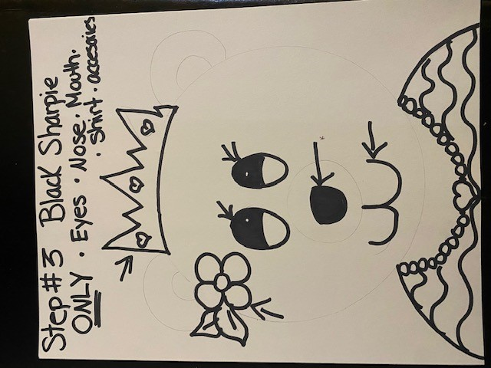
Step three – black sharpie
Use your black sharpie to outline the
EYES, NOSE and MOUTH only – do not outline the bears head or ears or snout around nose
Trace over your sweater and accessories with the black sharpie too.
Leave the head and ears alone for now.
Add patterns and designs to their clothing

Slide 7
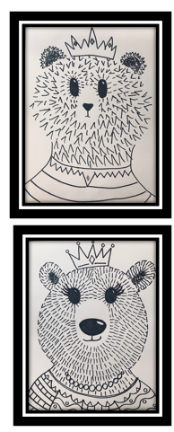
Step four – fluffy!!!!!!!
Using your black sharpie, start using little lines
to create the fur on the bear’s face.
Start around the eyes and move out around the
nose and towards the outside of the face
You can use short straight lines or soft flicked lines
Keep going until you fill in the whole face and neck
Remember, there are no mistakes – trust yourself!
Look around, everyone’s Chilly Bear is different.
OPTION Outline bear’s face and ears, consider using dotted line.

Slide 8
Optional step Add guide lines for your fluff
Feel free to pre draw lines very lightly with pencil. Lines can be used as a guide to follow as you add your fluff.

Slide 9
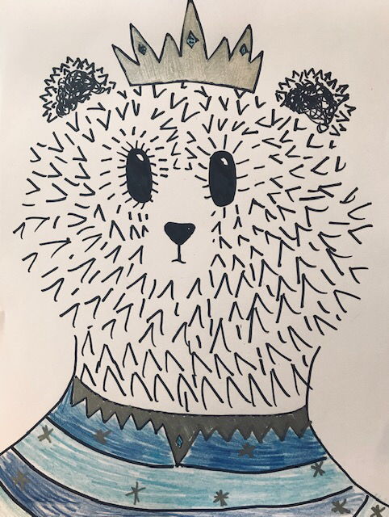
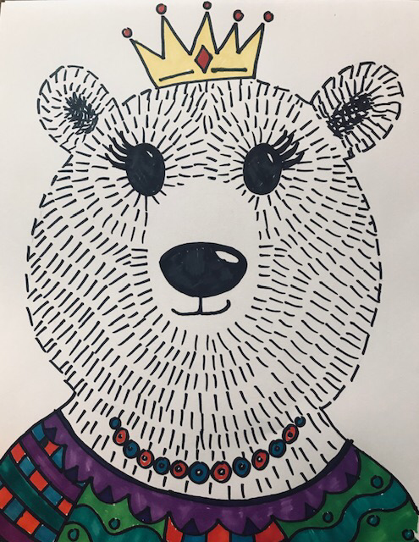
Step five – colored sharpies
Now, use your colored markers to color in the sweater and accessories ONLY.
Do not color in the face, they are supposed to stay black and white. Imagine our animals are winter foxes, polar bears, and artic hares,
TA-DA!

Slide 10
