Slide 1
RECYCLED ART

Slide 2
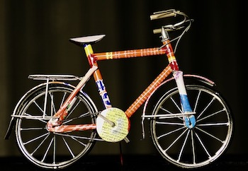
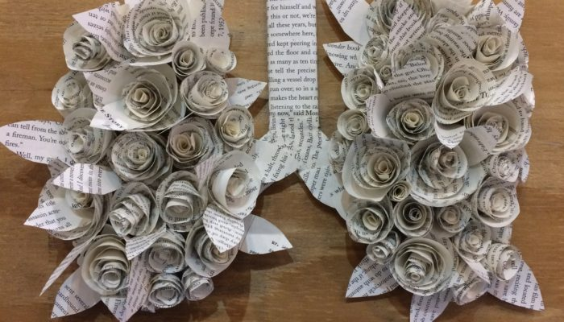
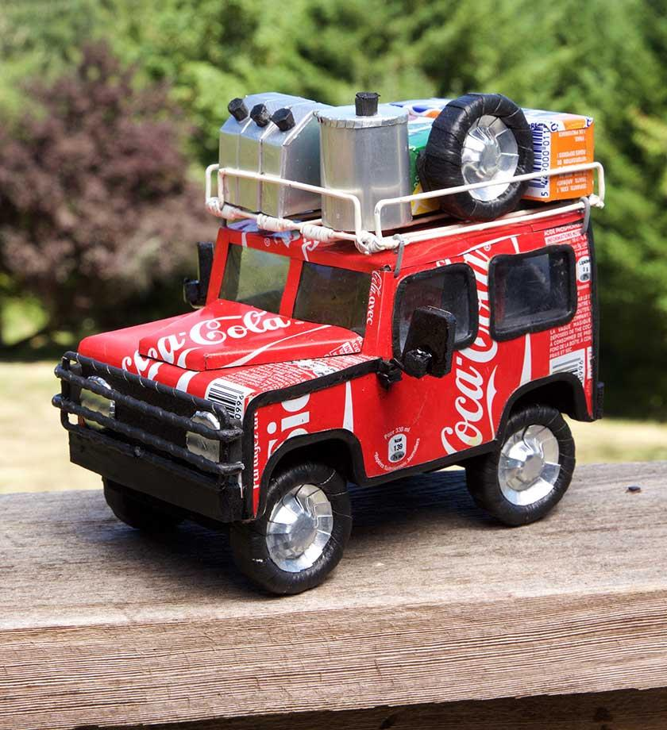
What Is Recycled Art?
In this lesson, we will learn how some artists make new work from old stuff.
Art can be made out of many things, including discarded materials and trash.
Think of everything you do during the day that generates empty boxes, bottles, plastic wrap and other things you throw away.
Did you know you can use that stuff to make art?
Artists who make recycled art take those materials and make them into something new.
There is no limit to what kinds of materials can be used.

Slide 3
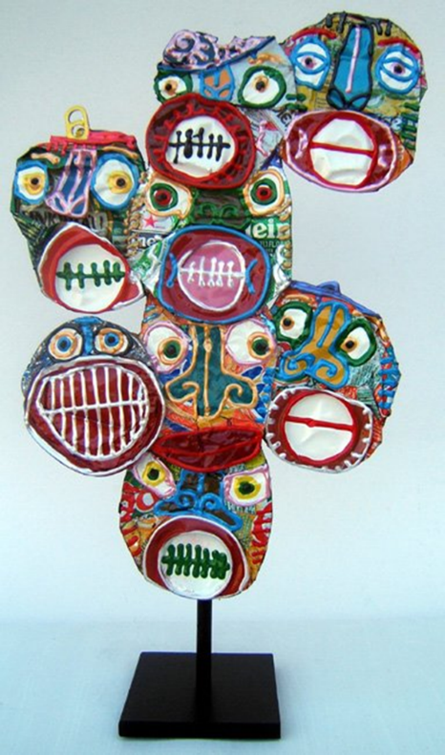
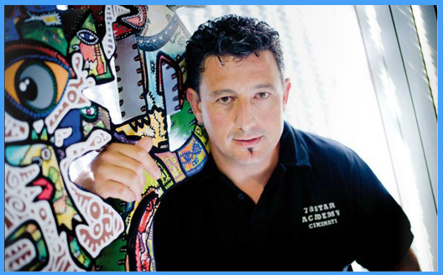
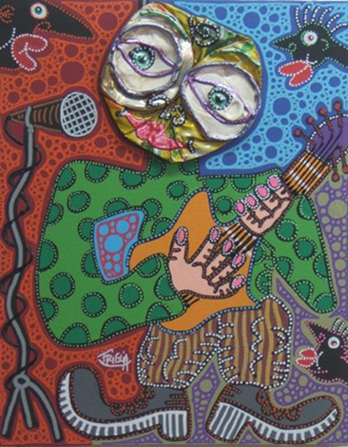
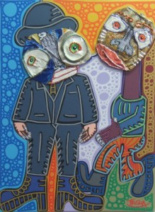
D i d i e r T r i g l i a
Triglia was born in France in 1966.
He is a self taught artist who has proven himself as an important New Generation artist in the world of French and International collectors.
Triglia brings a mixture of characters and primitive symbols that create a personal mythology.
He uses joyous, playful and vibrant colors.
Didier Triglia creates heads out of crushed cans and then he paints them.

Slide 4
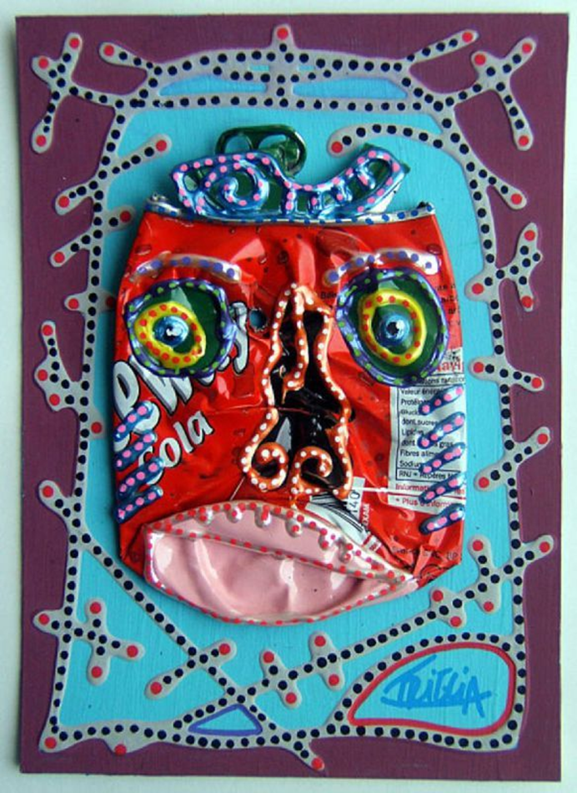
“I do not crush, they already are”
For Didier Triglia, the sight of a crushed can signifies the beginning of the adventure. He does not crush the cans himself, but wanders around finding cans that have been crushed already in the streets.
Triglia uses a variety of colors and characters.
They are sometimes sad, funny or angry. His creations are so human like that you can almost forget the can.
Are you ready to begin your artistic adventure ?

Slide 5
Materials Needed
Empty soda cans
• Construction paper
• Permanent paint
• Colored Sharpies
• Squeezable paint/puffy paint
• Glue

Slide 6
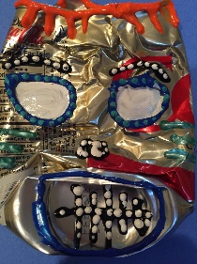
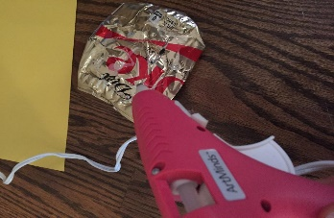
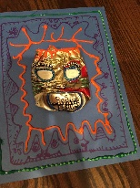
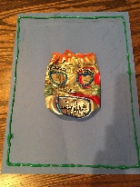
Instructions
Step 1
Pick a can and a piece of colored construction paper.
Step 2
Attach can to paper using glue. Adult will do this.
Step 3
Design a background for the can. Draw the border first using a sharpie to create patterns. Patterns can just be lines, or squiggles with no facial details for the background.
Step 4
Use permanent paint to design the face. Use puffy paint to outline the face features: eyes, eyebrows, hair, mouth and nose. After you have done outlines go ahead and dot all borders with an accent puff paint.

Slide 7
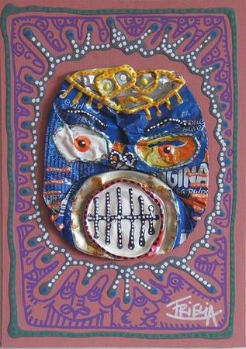
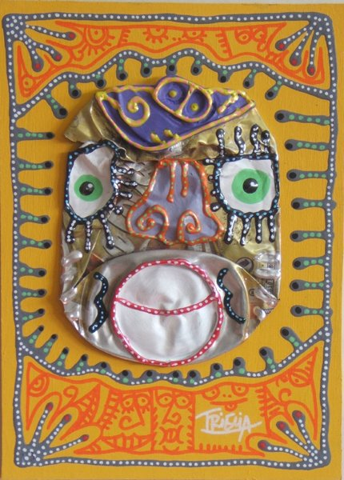
The End

