Slide 1
Foil Figure Sculptures
Inspired by the work of Alberto Giacometti

Slide 2
Before we look at Giacometti’s work…
We are going to do some quick drawing of stick figures. You have a piece of paper with 6 sections. Get your pen or pencil ready…

Slide 3
Ready for some quick drawing?
Take a pen or pencil and in one of your rectangles you’re going to draw a stick-figure person.
You only have ten seconds to draw it, so be quick. Ready? Go…
In the next rectangle draw a stick-figure of a person who is running.
Think about how your elbows and knees bend when you run, and try and capture that in your sketch. But again you only have ten seconds to draw it, so be quick! Go!
In your third rectangle, you have ten seconds to draw a stick-figure who is feeling sad. Ready? Go!
Next, draw a stick-figure who is comforting the one who is feeling sad. How does your body look when you are being kind to someone else? Go!
Draw someone who is feeling happy. How does that look? Be quick – draw!
And then in your final rectangle, draw someone doing anything you like. Ready? Ten seconds…go!

Slide 4
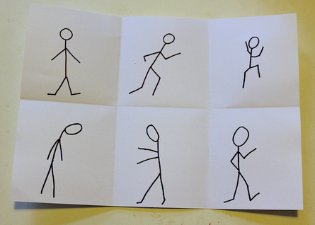
Think about how the simplest of stick-figures can convey strong emotions such as sadness and happiness, and how a few simple lines, drawn in just ten seconds, can show movement and action.

Slide 5
Now, let’s meet Alberto Giacometti…

Slide 6
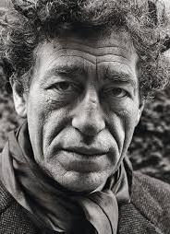
Alberto Giacometti (1901-1966)
Born and lived in Switzerland
He began painting, drawing, and sculpting from a very early age and explored many art forms throughout his life.
He is most famous for his tall, thin figures made of bronze.

Slide 7
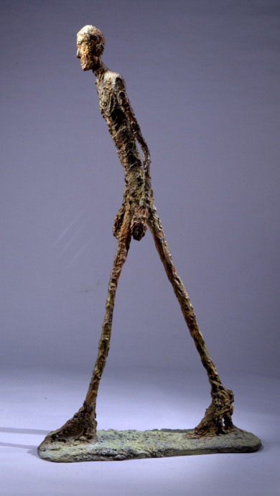
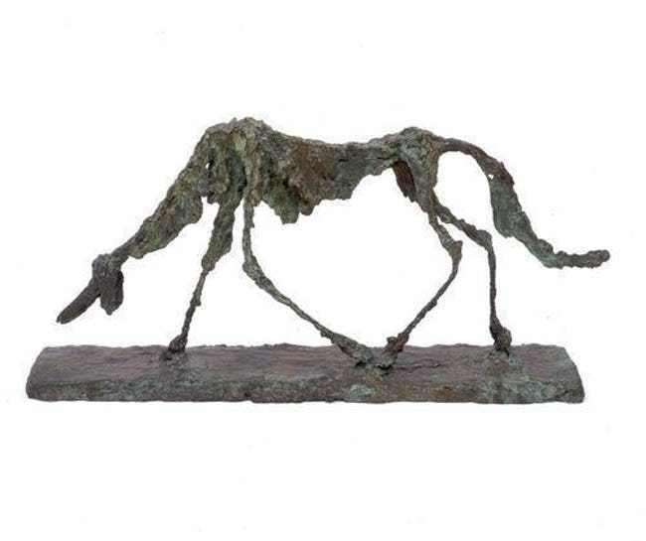
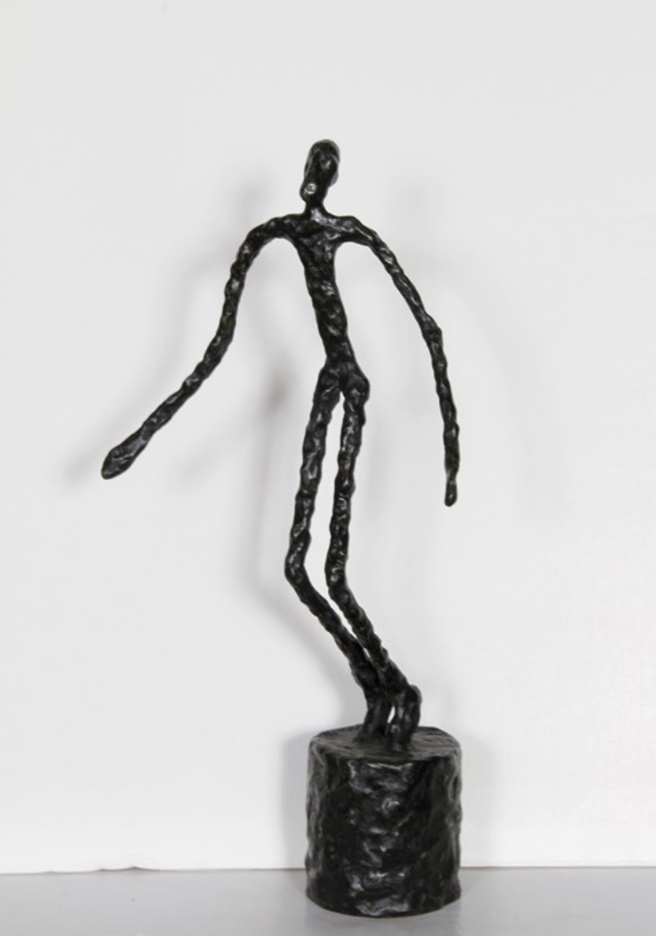
Dog
Walking Man
Running Man
Do you notice the proportions? The arms and legs are elongated.

Slide 8
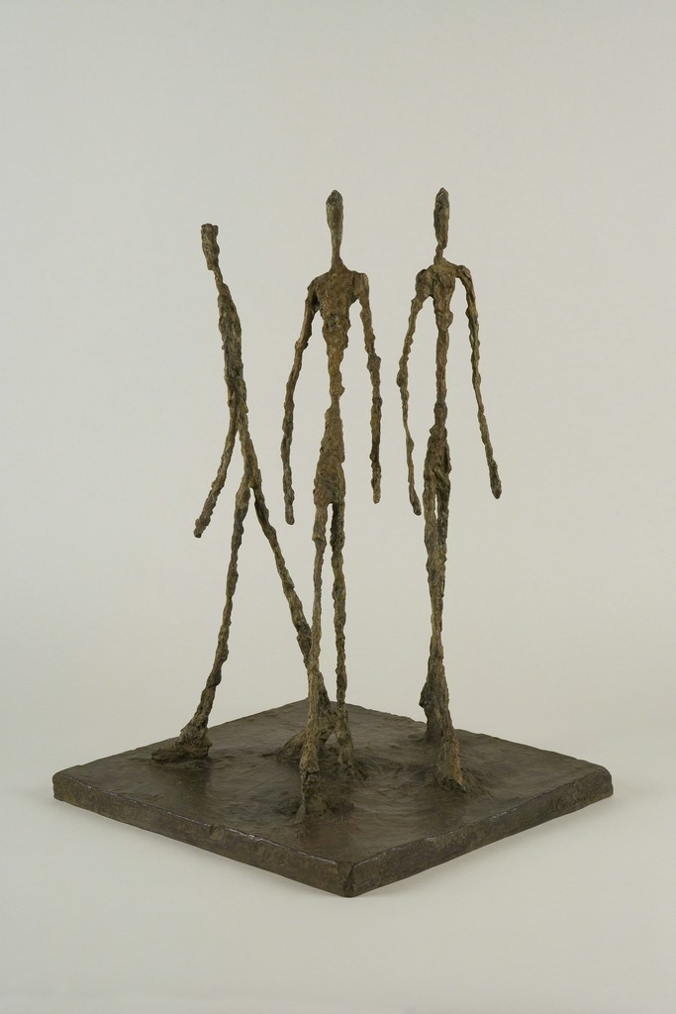
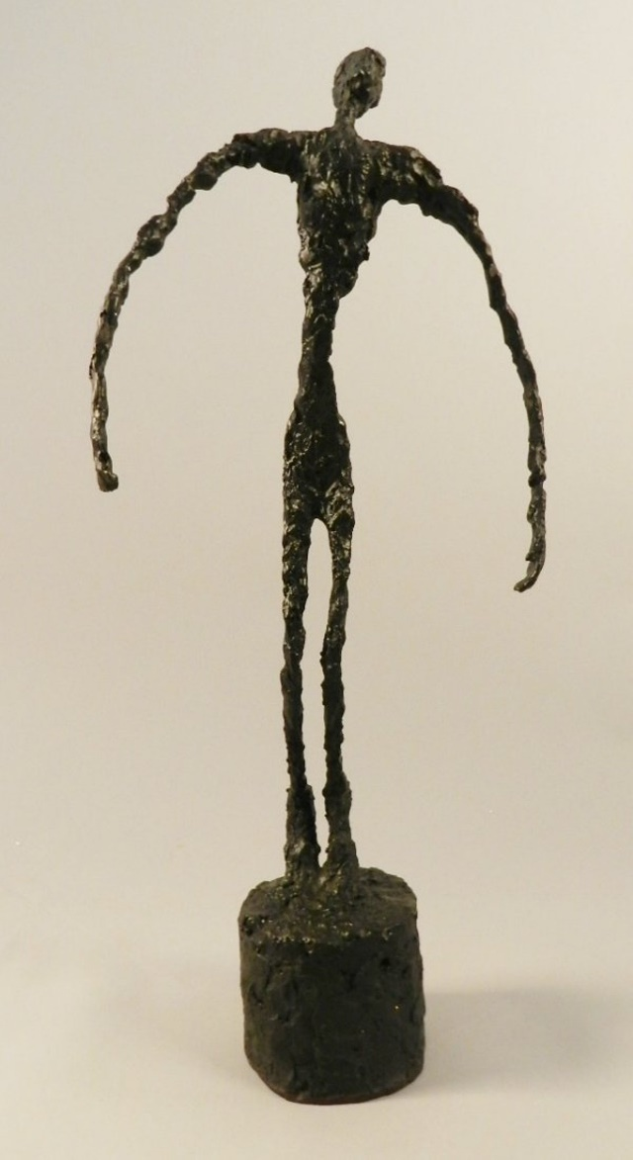
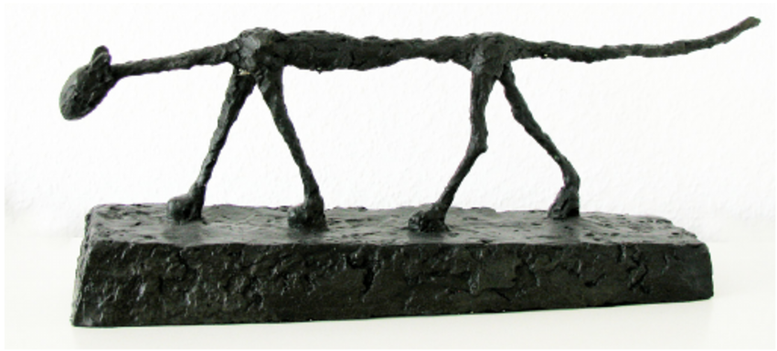
Cat
Three Men Walking
Falling Man

Slide 9
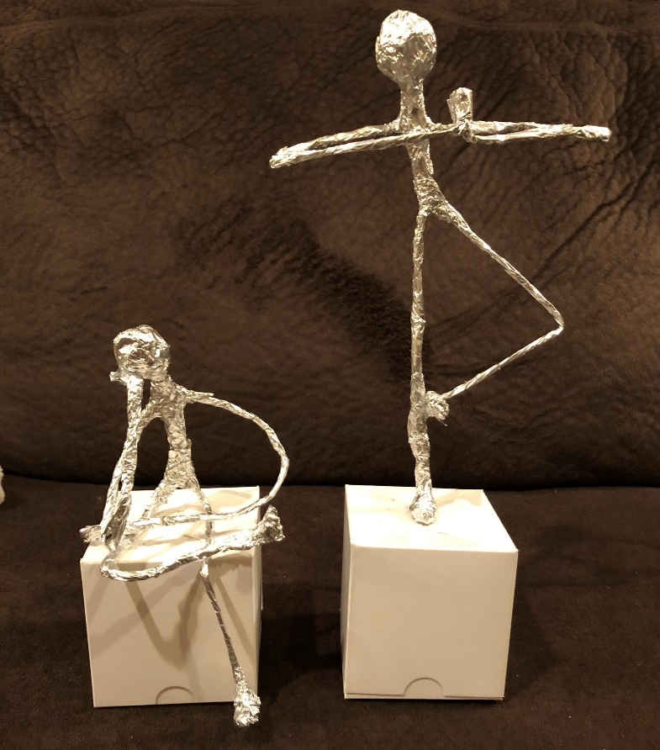
Now, let’s make Foil Figure Sculptures
We’re going to turn flat kitchen foil into sculptures of people, inspired by the figures that Giacometti created.
Materials needed:
2 pieces of foil
2 large pipe cleaners
Scissors
White box
Hot glue

Slide 10
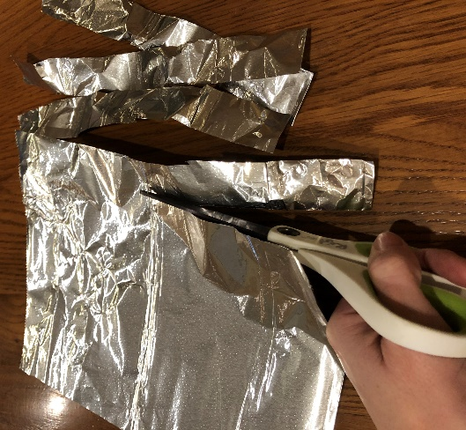
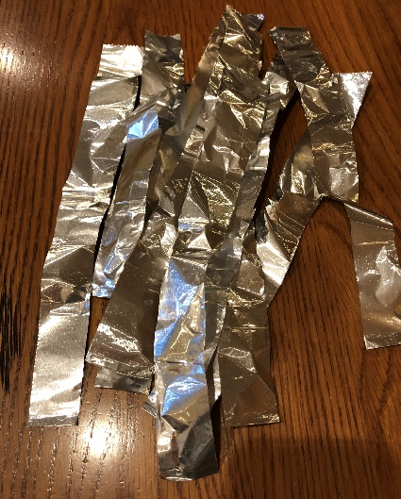
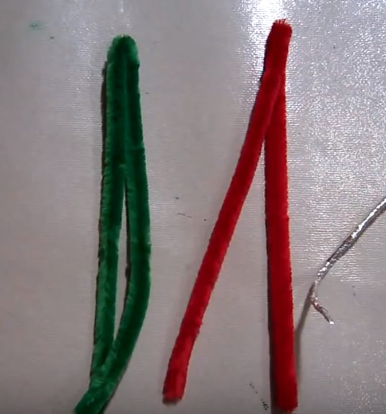
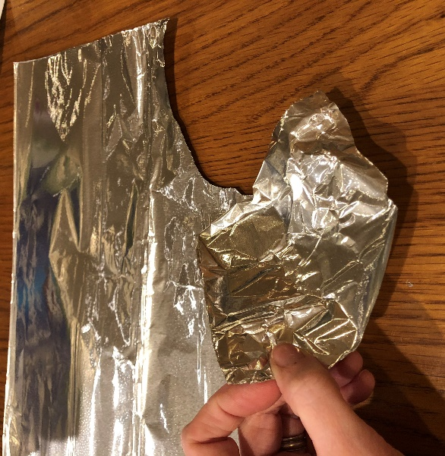
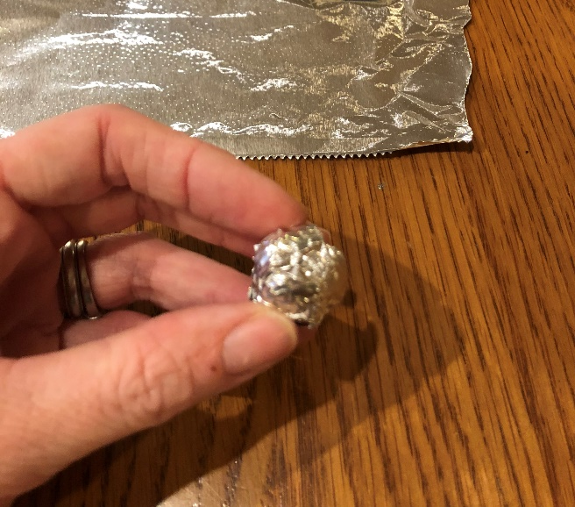
1. Cut one large piece of foil into strips (about 1 inch wide each).
2. Fold both pipe cleaners in half.
3. Tear a piece of foil from your 2nd large piece to ball up and make a head.
**Your head should be small (about the size of a marble). If it is too big your figure will be top heavy.**

Slide 11
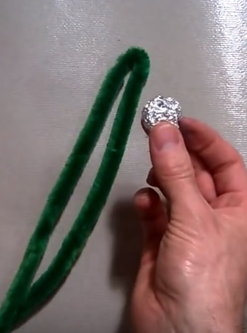
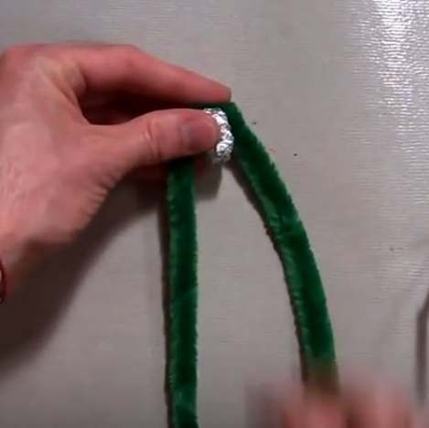
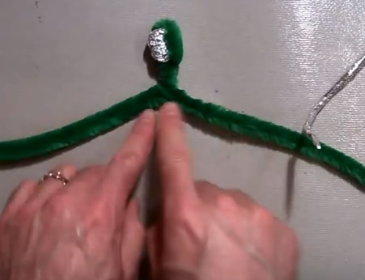
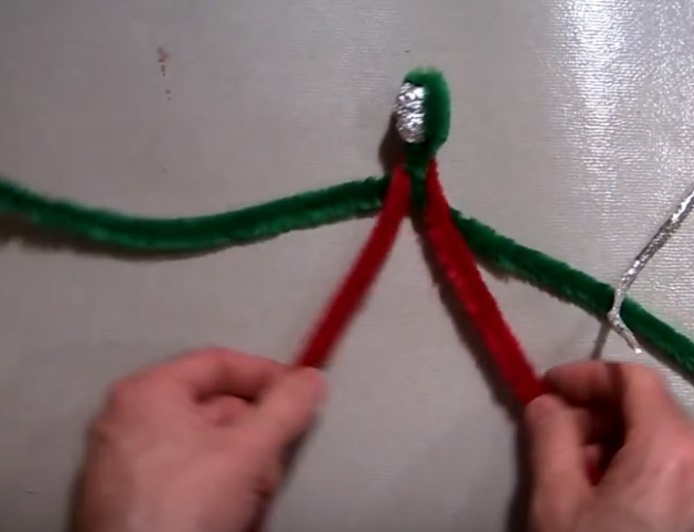
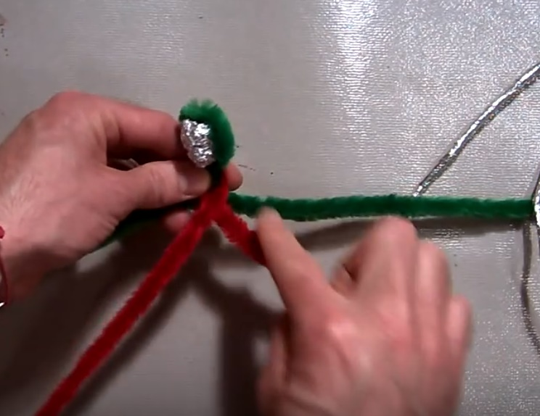
4. Put one pipe cleaner around the head and twist. This will be your neck.
5. Put the other pipe cleaner around the neck.
6. Cross the two sides of the 2nd pipe cleaner.

Slide 12
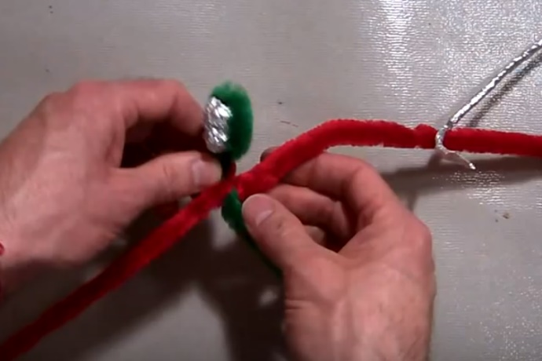
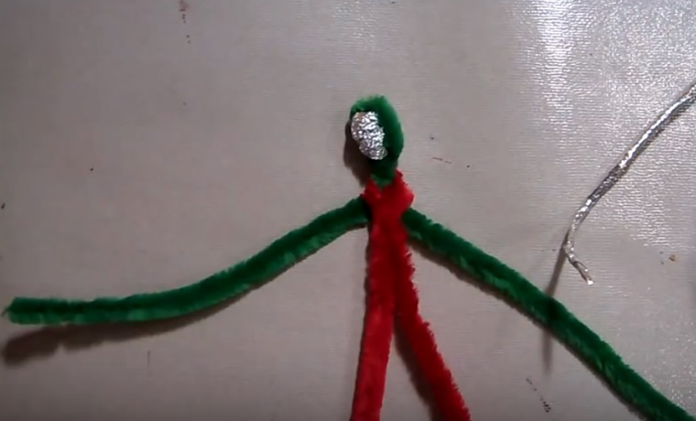
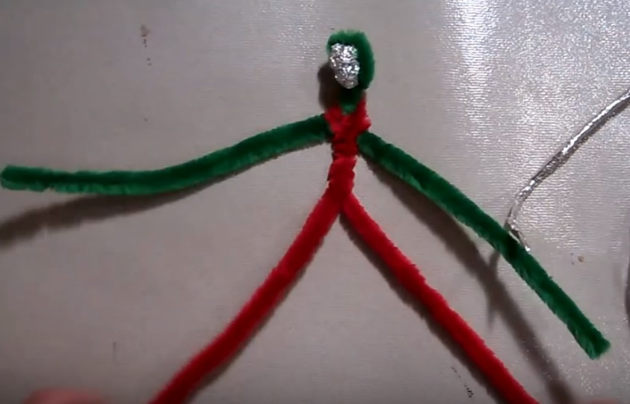
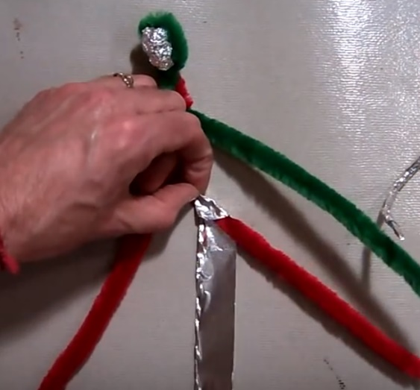
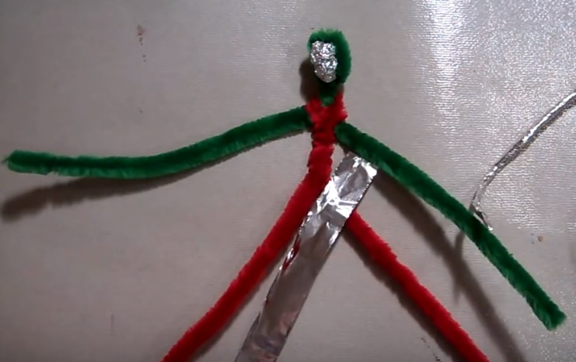
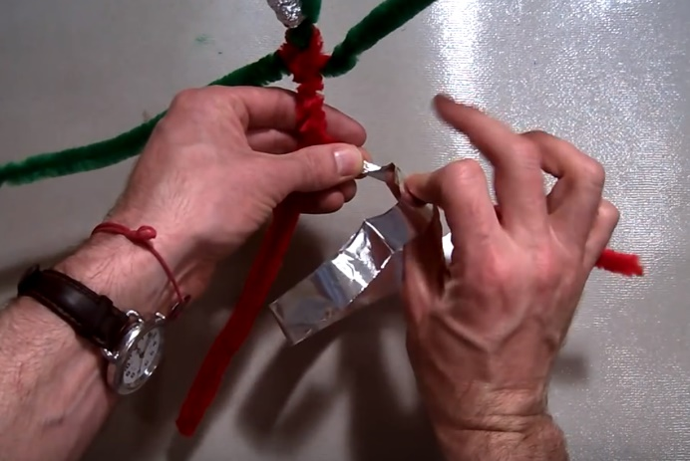
7. Bring each side behind, up, and over each shoulder.
8. Twist to create a torso.
9. Wrap each limb with the strips of foil. Pinch the foil as you wrap.

Slide 13
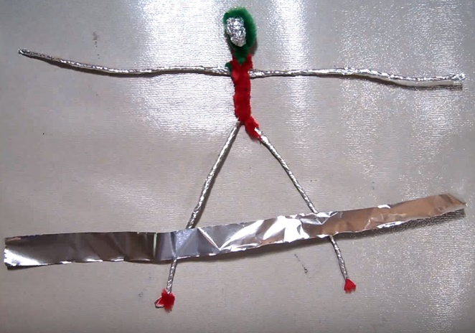
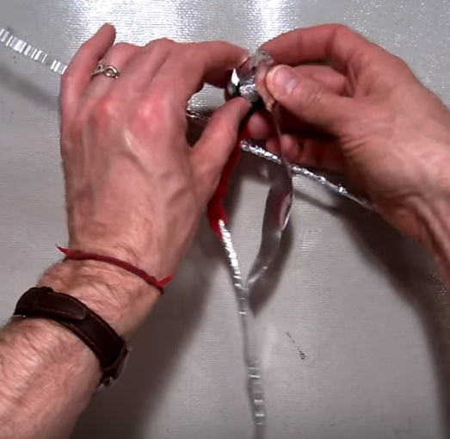
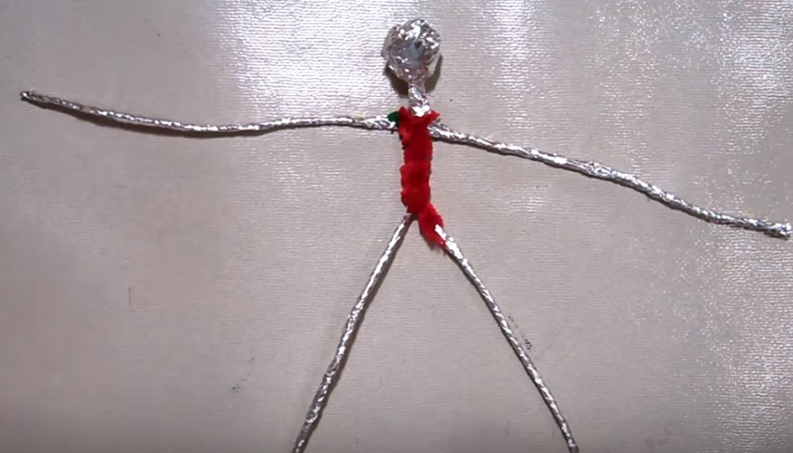
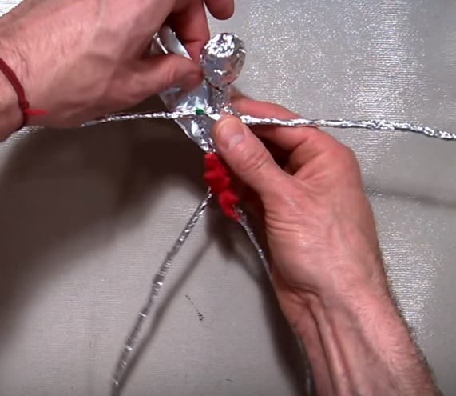
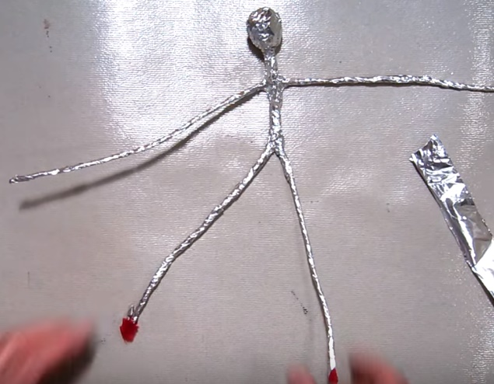
10. All 4 limbs should now be wrapped.
11. Wrap foil around the head and neck.
12. Now wrap the torso. Be gentle with the foil and try to cover all exposed pipe cleaner.

Slide 14
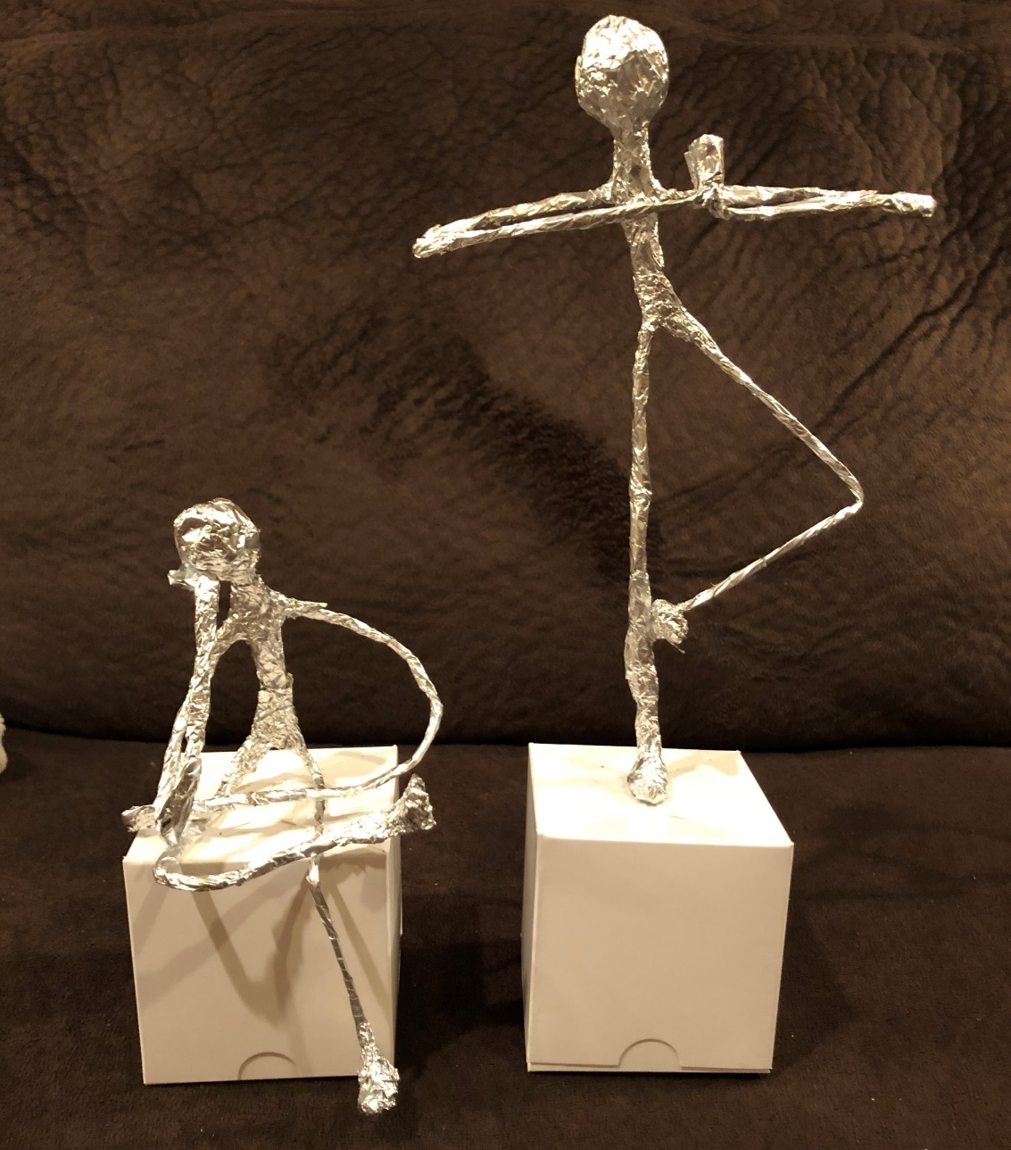
13. Using your leftover foil, add things such as feet to your figure. Use your imagination.
(Write your name on the inside of your box.)
14. Pose your figure on your white box with the top flap opening on the bottom. It can be standing or sitting.
15. Take your figure and box to an adult with a glue gun to attach.

