Slide 2
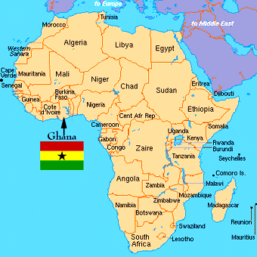
History of Kente Cloth
Kente cloth originated in the west African country of Ghana.
It was originally worn by royalty, wealthy, or highly respected people.
Today it is worn by all, mostly for special occasions.
Men tended to wear it toga style; or tied over one shoulder. Women traditionally wear Kente cloth as a wrap-around dress or skirt.
It is a beautiful brightly colored woven cloth. It has bright colors, with snappy geometric patterns.

Slide 3
Each color and each pattern in the kente cloth has a special meaning.

Slide 4
Traditional Kente Cloth in clothing

Slide 5
Examples of Kente cloth Patterns

Slide 6
Today we are making Kente style woven paper using a stamping technique and patterning
Take a 10x9 piece of black construction paper and set it horizontally in front of you.
With your ruler laid in the center of the paper place a pencil dash on each 1 inch mark.
Fold the paper so that you can see the dashes down the center of the fold.
With your scissors, cut using your dashes as guides from the center out, but DO NOT cut through! Continue cutting each dash line straight as you can.

Slide 7
STEP 2- PRINTMAKING! Wrap a hefty piece of yarn or twine around a wood block. Tie it tight. You can criss cross or leave straight. Dip the block into a thin pile of gold paint and stamp away. You can stamp over your paper as you like. Set Aside to dry on your desk. Using oil pastels, give each of the 3 long strips of solid paper patterns or bright color using the images of the kente cloth as inspiration.

Slide 8
WEAVE!
Weave your finished strips through your stamped grid. Alternate so that it is every other space. The weaving process lends itself to geometric patterns as opposed to curved lines.
For a finishing touch, use scissors and create a fringed look by cutting slits on all the ends of your paper.

