Slide 1
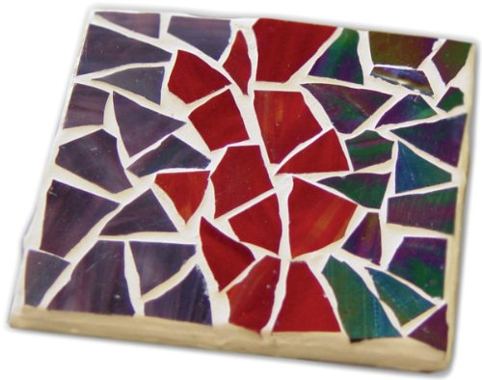
Mosaics
4th Grade Glass Mosaic Tile Project
This Photo by Unknown Author is licensed under CC BY-SA

Slide 2
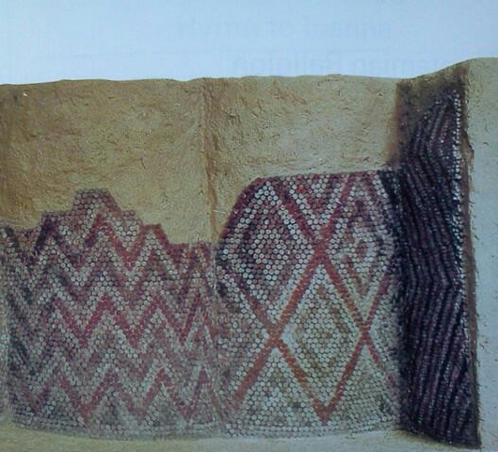
Mosaic
A mosaic is a picture or pattern made with small pieces.
Historically they were made of ceramic tile or stone which was set into cement.
Some Mesopotamian decorations made of small ceramic cones have been found on columns, from 3000 BCE, have been found in modern day Iraq.

Slide 3
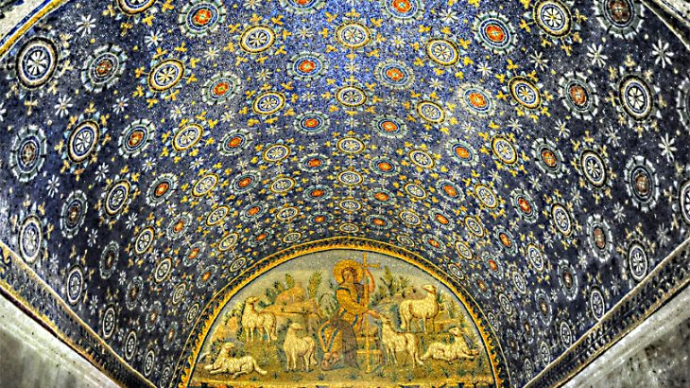
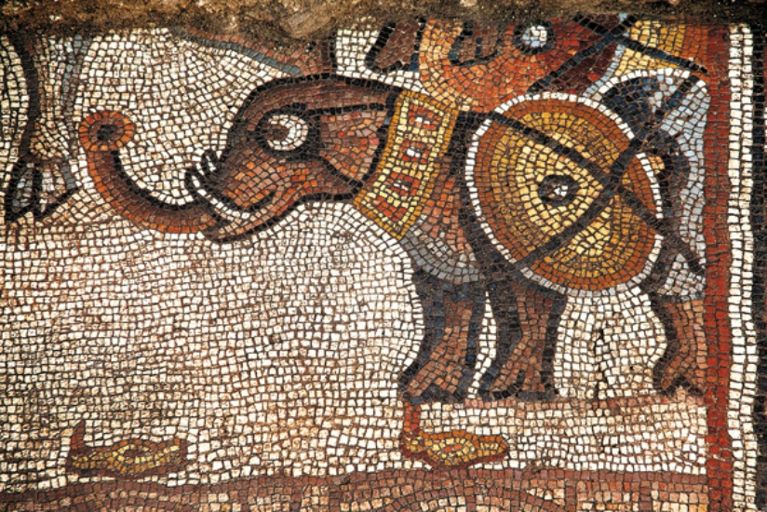
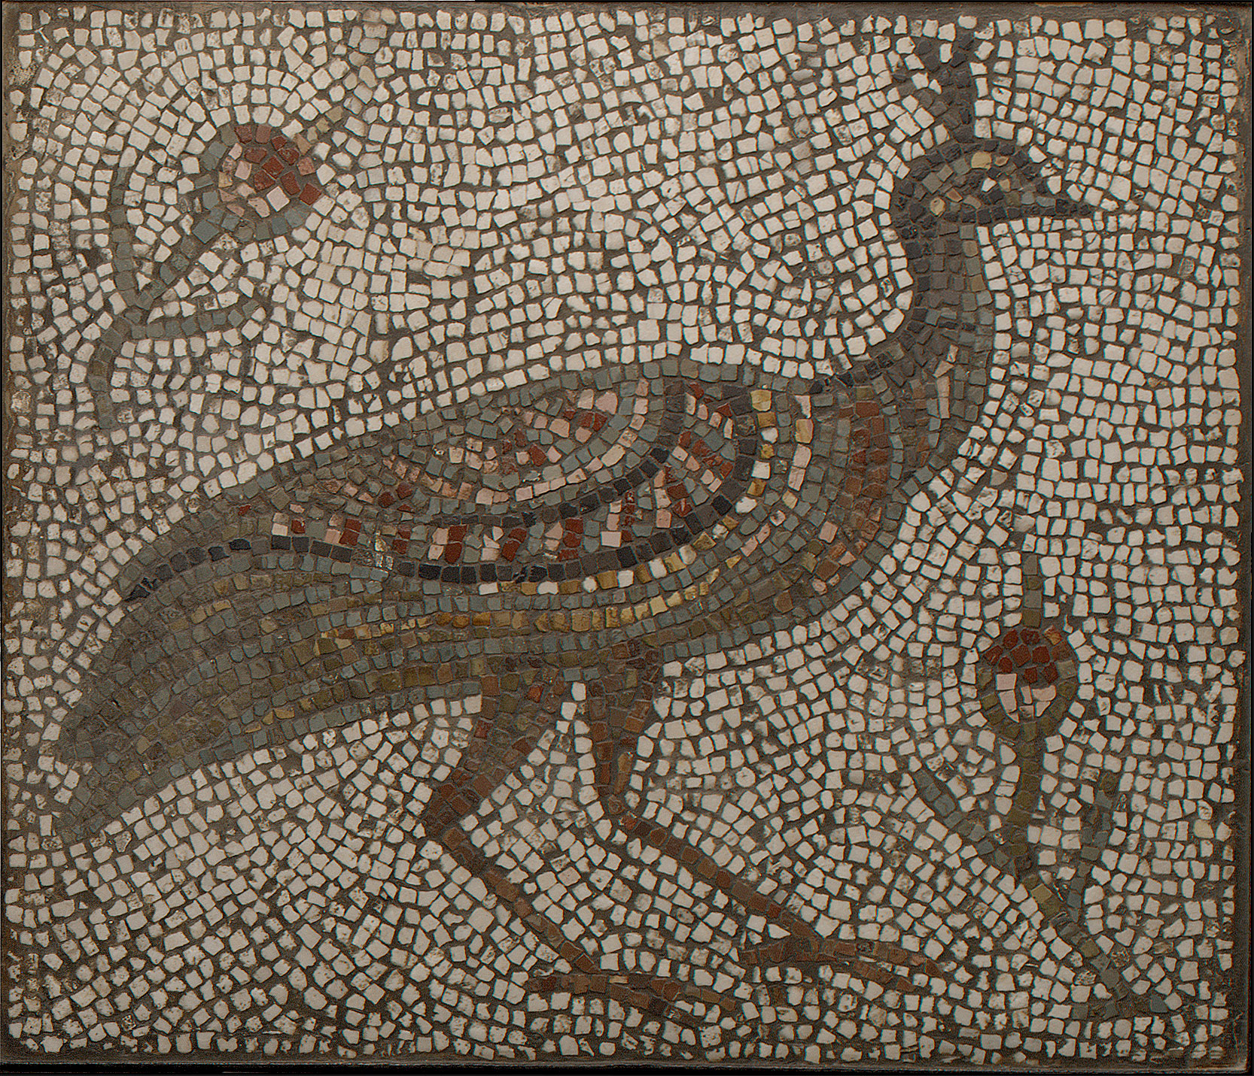
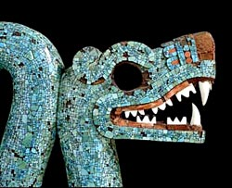
Mosaic depicting Alexander the Great discovered in Israel from the 5th century
Ceiling mosaic in Ravenna, Italy from the 6th century
The Romans and other ancient people made elaborate mosaics which covered whole floors, walls or even buildings.
Mosaics were practical because they were easy to wash and helped to keep the house cool. They were also beautiful.
Today we make mosaics with many different materials for many different purposes.
Aztec mosaic from the 15th century
Peacock floor mosaic from the 3rd century

Slide 4
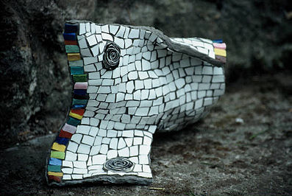
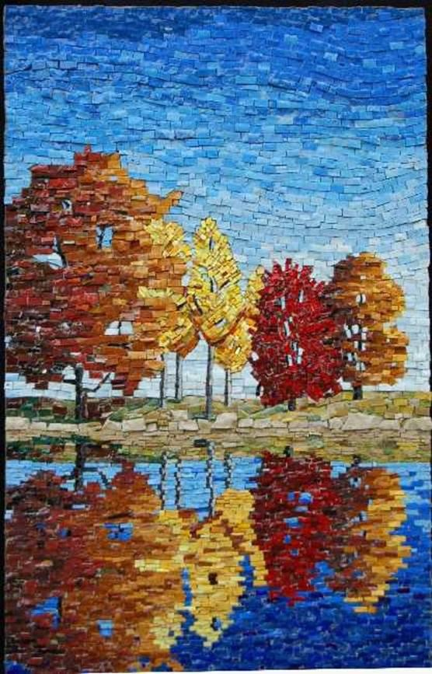
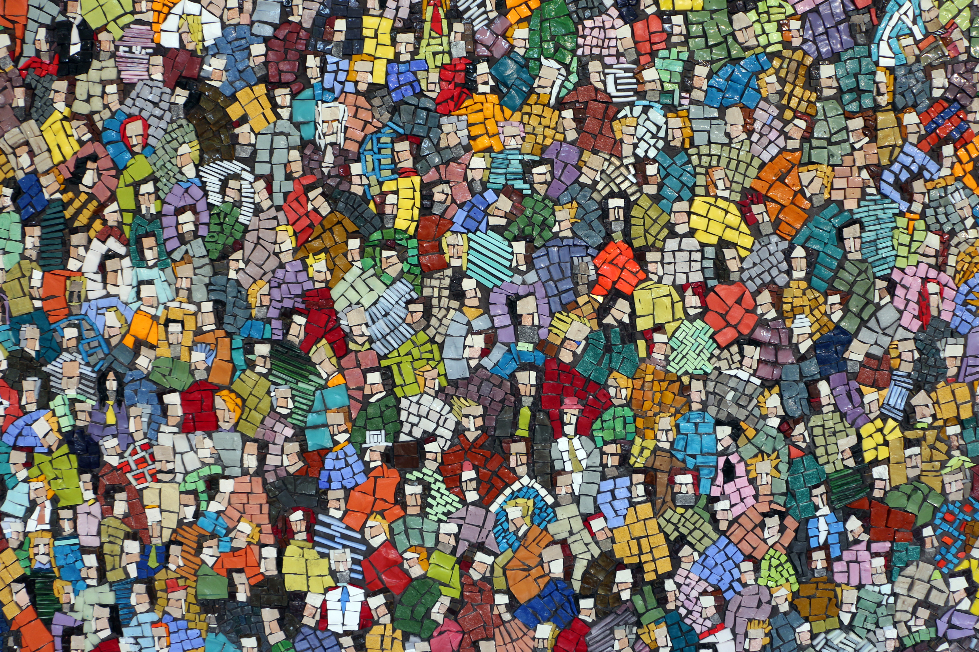
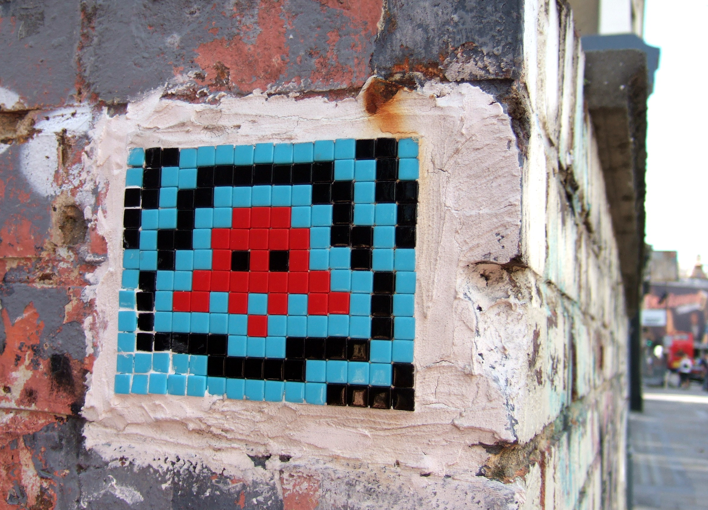
Modern Mosaics
Mosaics have developed into a popular craft and art, and are not limited to professionals.
Today's artisans and crafters work with stone, ceramics, shells, art glass, mirror, beads, and even odd items like doll parts, pearls, or photographs.
Running Rug, 2001
Trees mosaic by Sue Giannott
Folla by Luca Barberini 2009
Videogame pixel art by French artist Invader

Slide 5
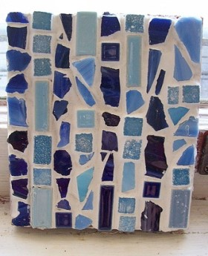
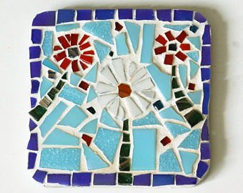
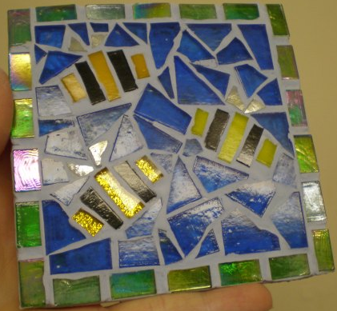
Let’s create some art!
This Photo by Unknown Author is licensed under CC BY-NC-SA

Slide 6
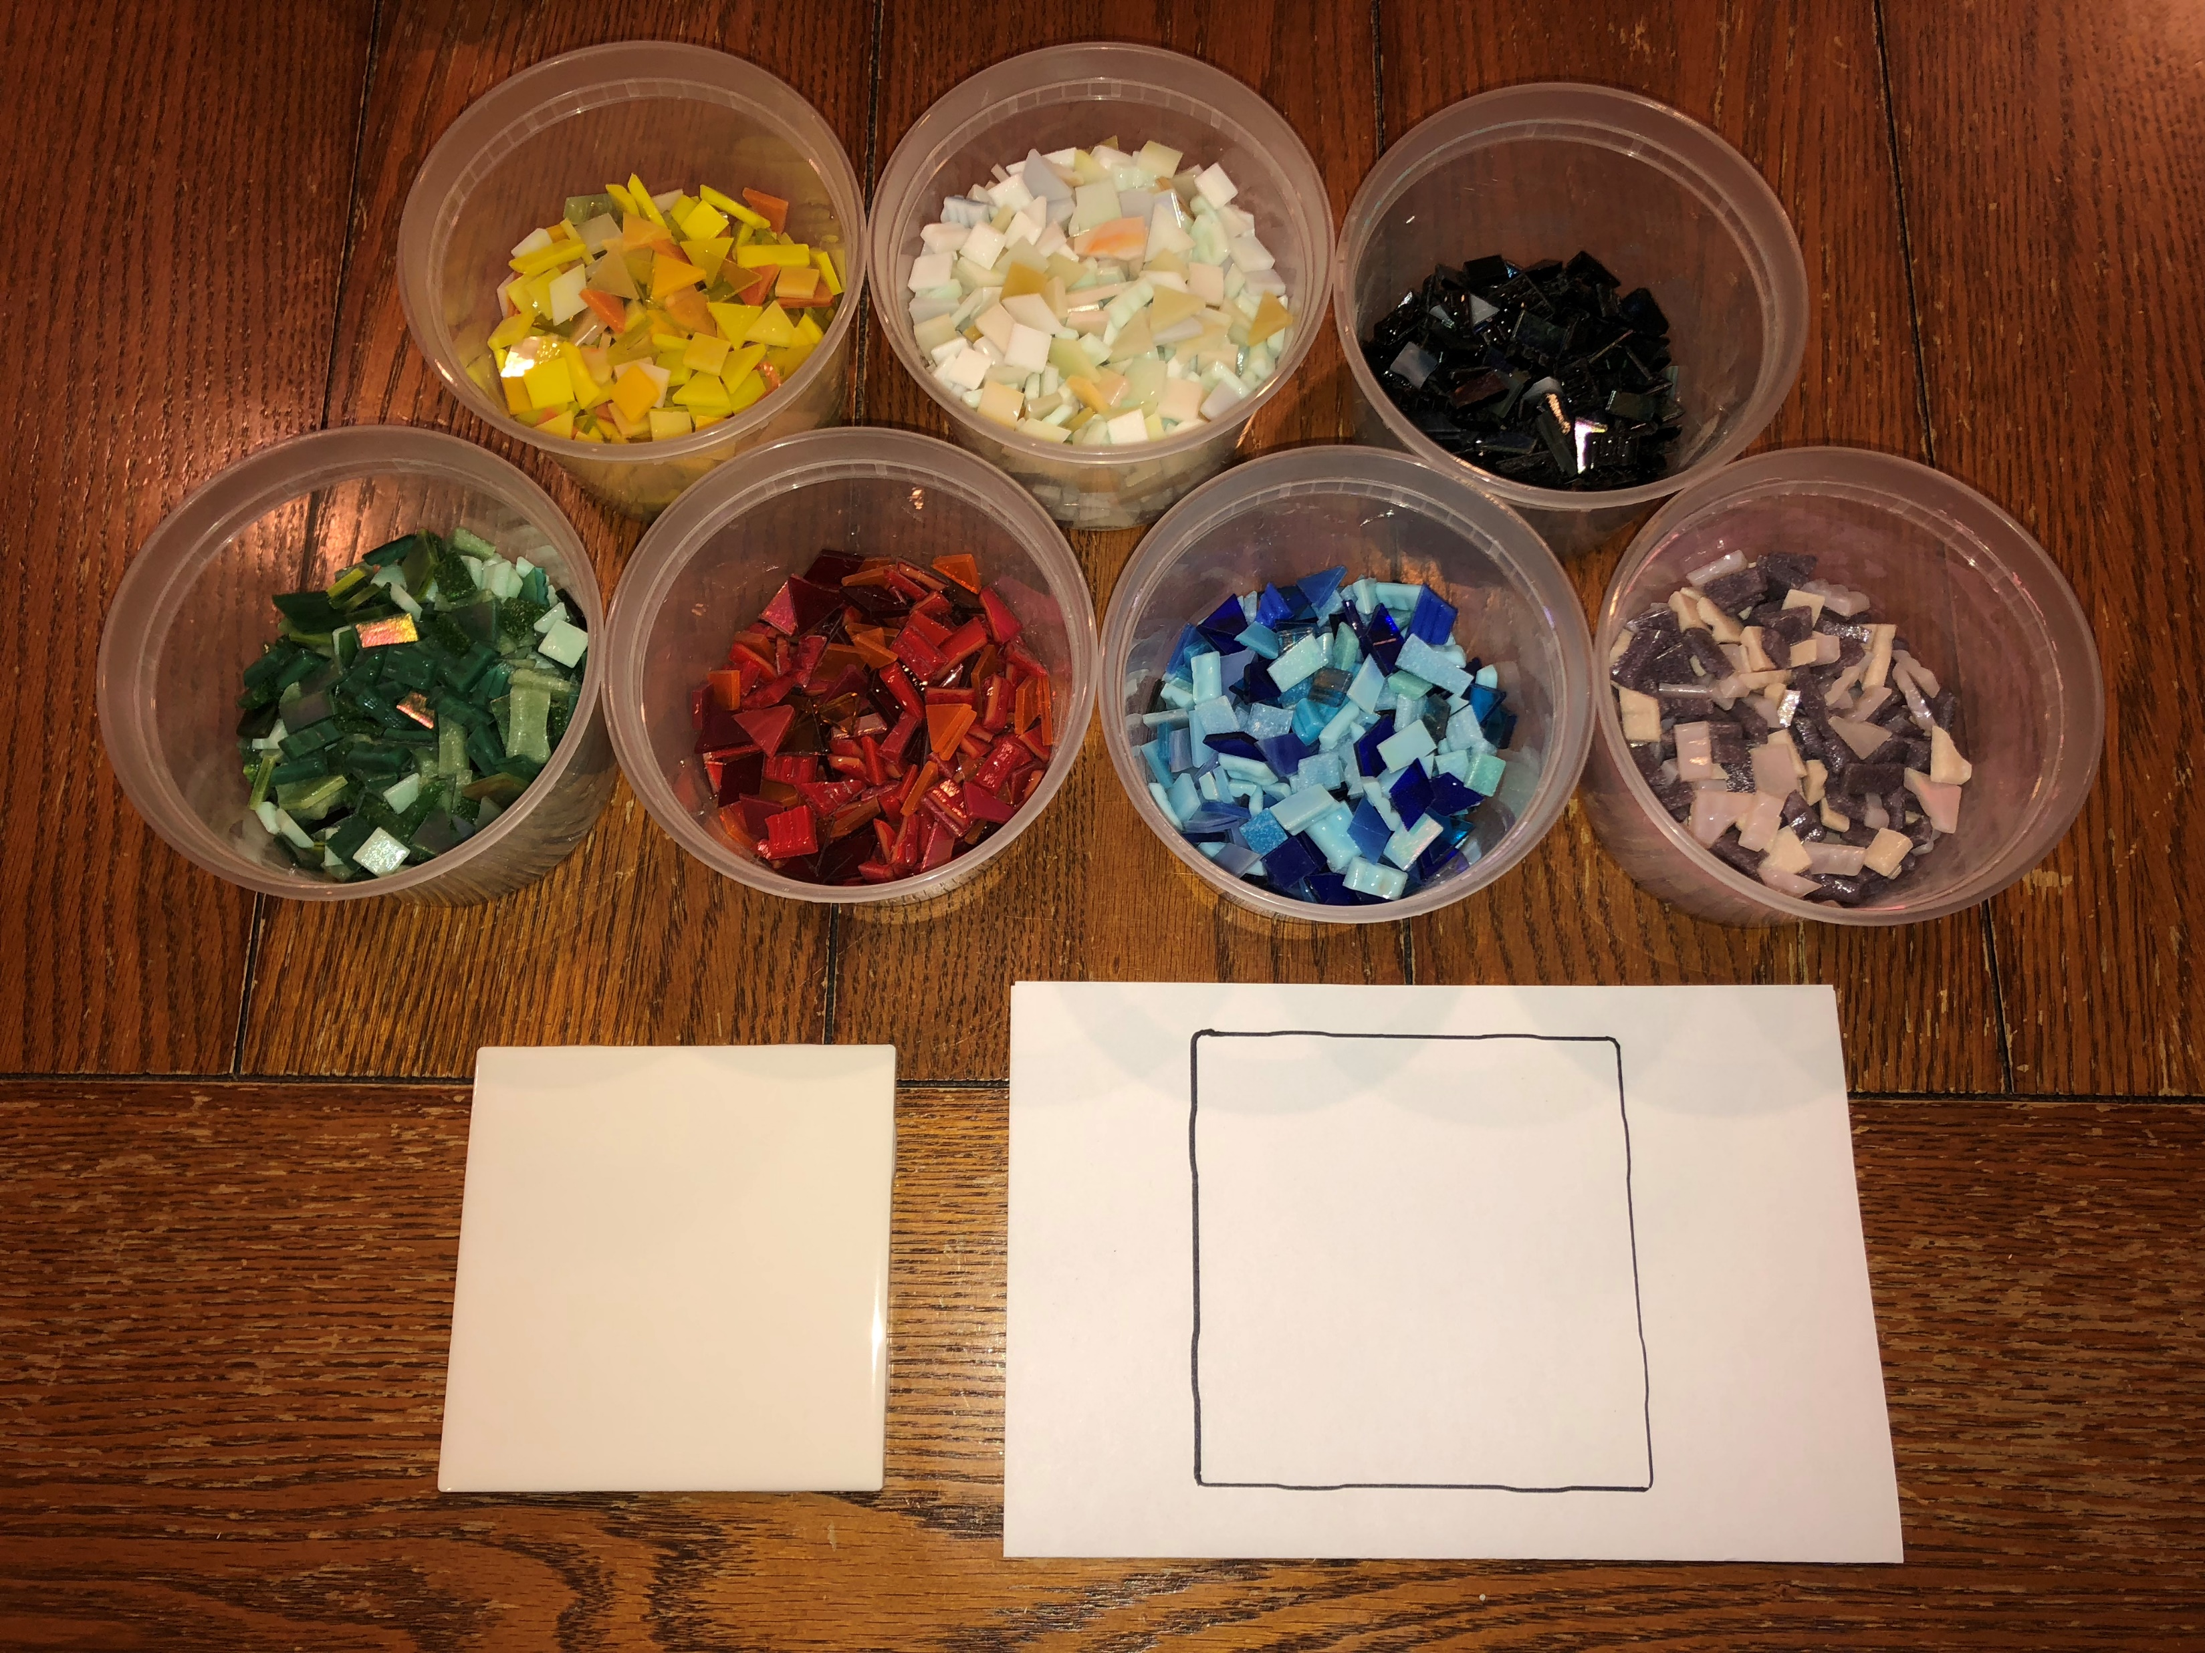
Materials
Instructions
White 4”x4” tile
Paper template to arrange your glass on
Weldbond glue
Sharpie
Pieces of craft glass
Remember – THIS IS GLASS! The edges are dull, but they can still cut you. Please be careful when handling the pieces of glass.
Think about what you want your tile to look like.
What colors do you want to use? Warm? Cool?
Do you want to create a picture (this is hard) or just do an abstract?
Do you want to have a border around the edge?
WRITE YOUR NAME with the black Sharpie on the back of your tile.
Select your pieces of glass. Make sure to put back any pieces you don’t end up using.
Arrange glass on paper template.
Glue the glass to your tile.
Make sure that none of your pieces of glass stick off the edge of your tile.

Slide 7
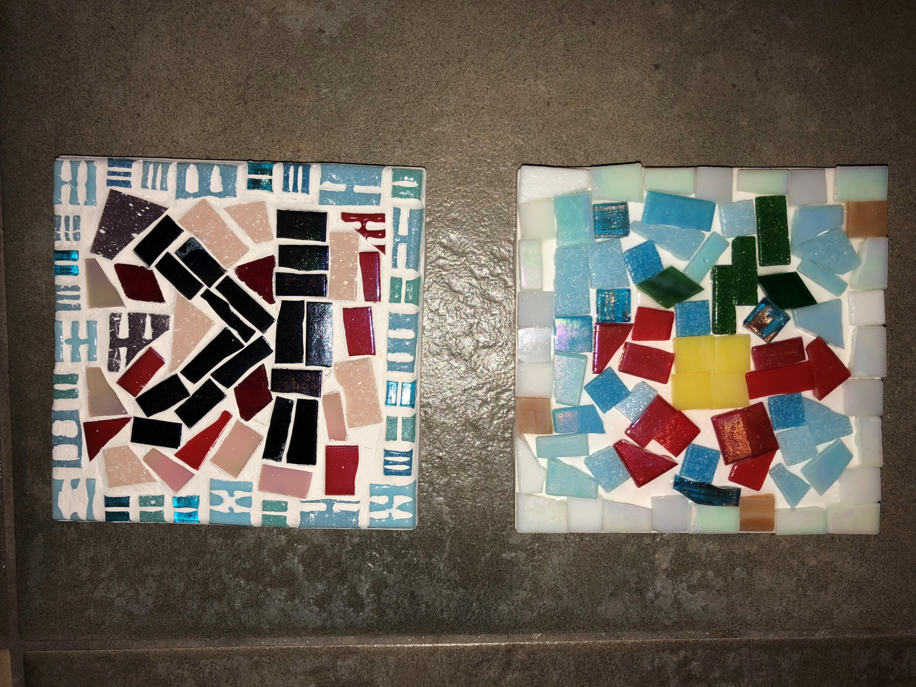
Last Steps…
Glue will be allowed to dry for a minimum of 24 hours.
Art docent will apply grout to tiles filling in all the empty space.
Grout will we allowed to dry for a minimum of 24 hours.
Without grout
With grout

