Slide 1
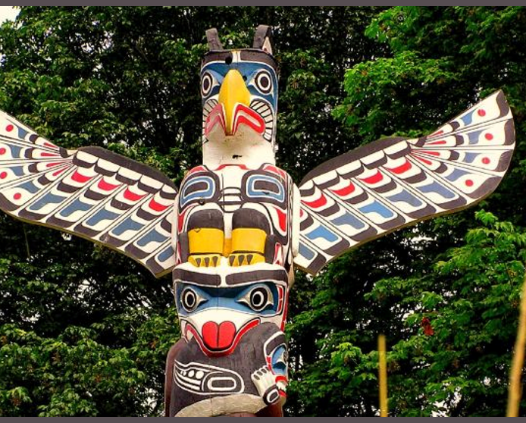
NW Native Totem Animals
Edited for 4th grade 2024

Slide 2
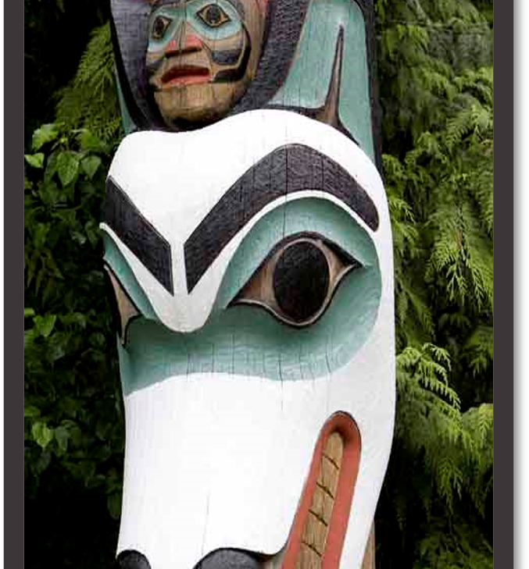
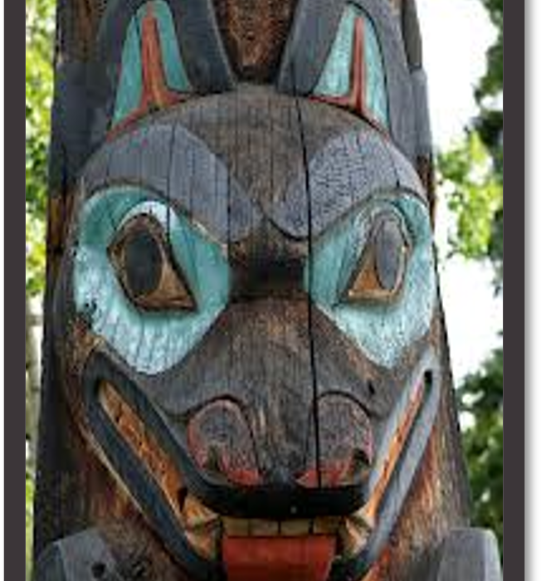
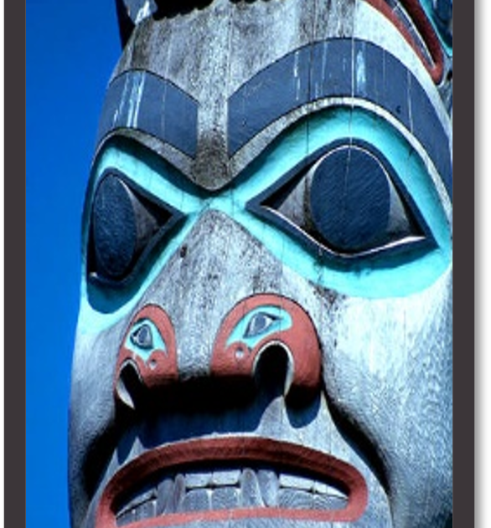
What do you know about Totem Poles?

Slide 3
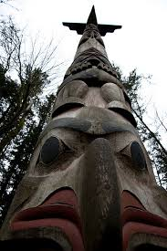
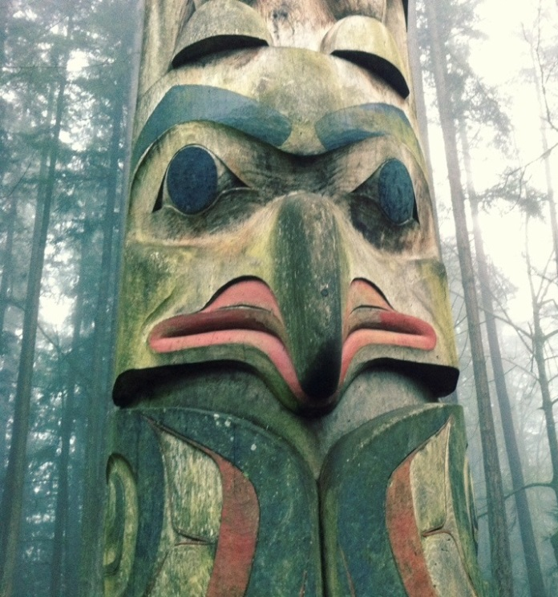
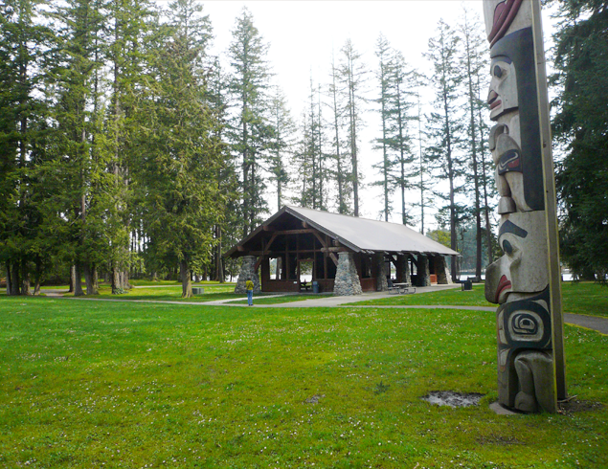
Totem Poles in Sammamish?
Yes!
There’s a totem pole at Beaver Lake Park.

Slide 4
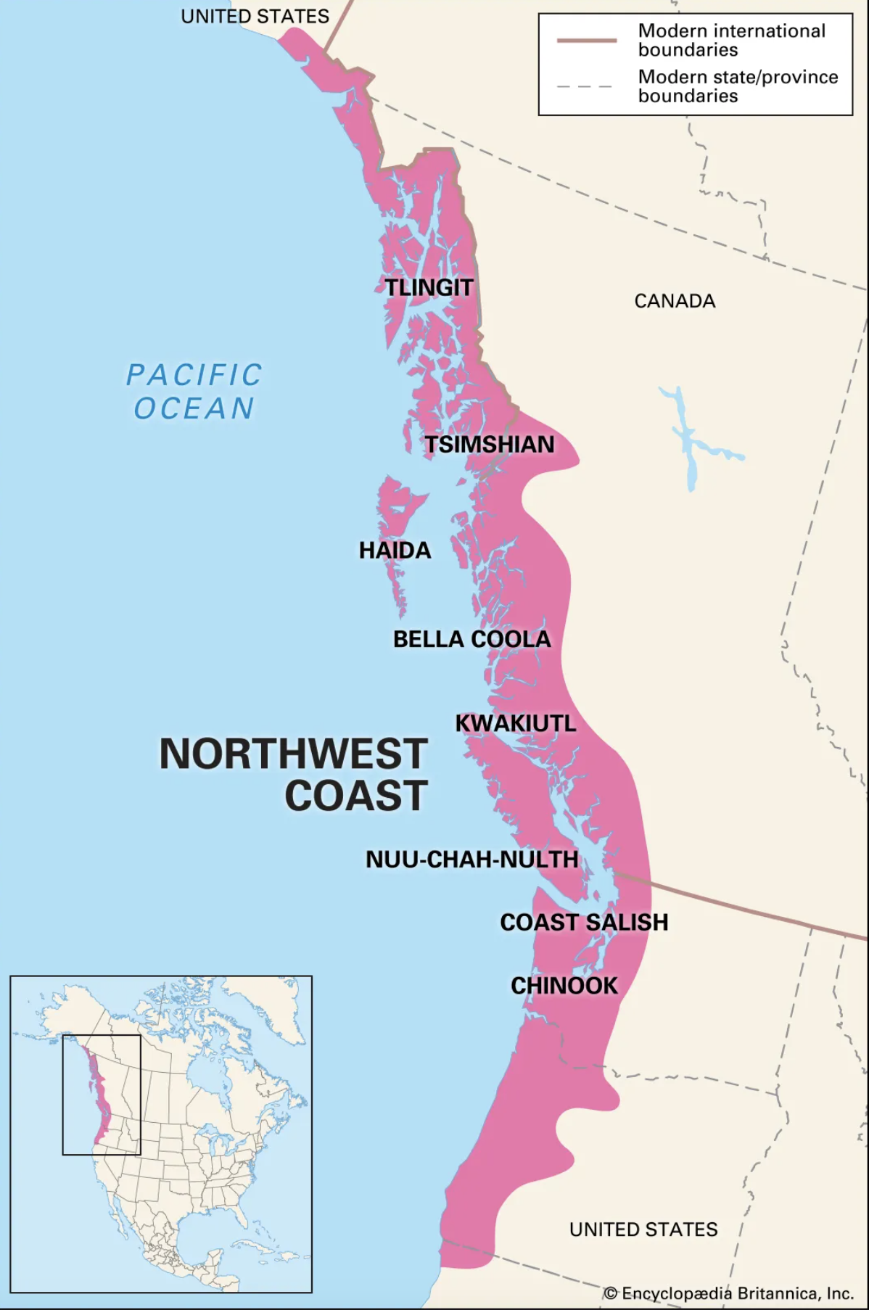
History & Facts
Totem poles were carved as early as the 1700s, but were much smaller than what we are use to seeing today
Totem poles were and still are made by native tribes living along the Pacific Ocean in the northwest corner of the United States, British Columbia in Canada--and some tribes of southern Alaska.
Totem poles are carved from large tree trunks, -- mostly Western Red Cedar. Few examples of poles carved before 1900 survived.
Each animal on a totem pole has a specific meaning as varied as the cultures that make them. They may recount familiar legends, clan lineages, or notable events. Some poles celebrate cultural beliefs while others are mostly artistic.
Figures depicted on totem poles are very stylized.

Slide 5
Native NW Coastal Shapes

Slide 6
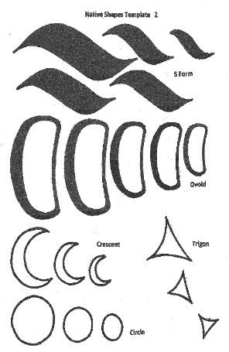
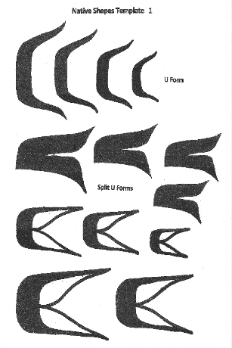
Basic Form Line Shapes

Slide 7
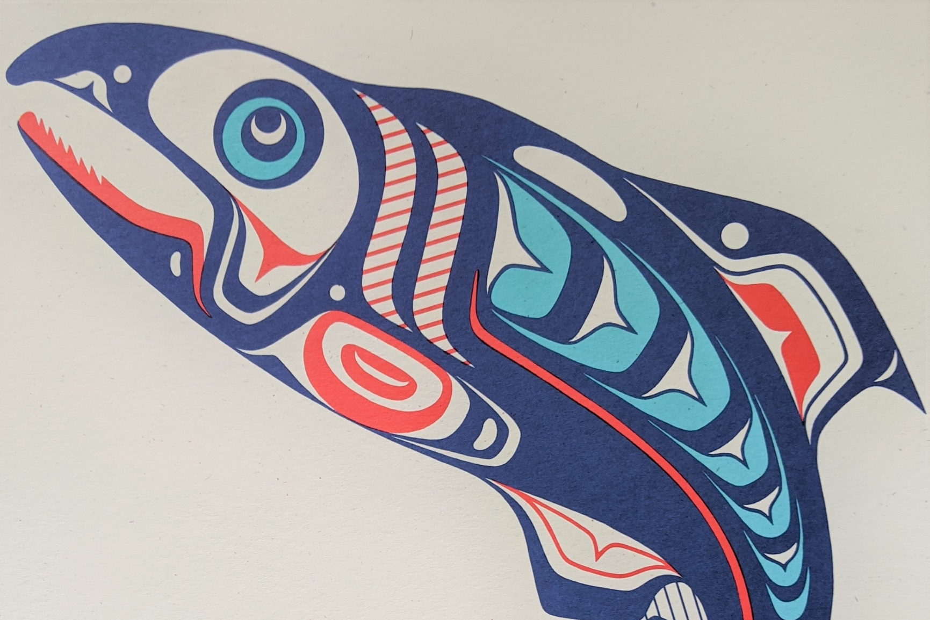
How shapes show up in art...
Circle
Split U
U Form
Ovoid
S Form
L Form
Crescent

Slide 8
NW Coastal Colors
Color dyes were made from natural elements ground up materials into a powder and mixed with a binding agent such as salmon eggs. Colors were used to help tell a story. What colors would you pick for your story?
Red Incredients: Red ochre, sumac berries, beets, cranberries Meaning: Blood, War, Valor, sometimes mountain and earth
Black Ingredients: charcoal, graphite Meaning: Power, Cold, Night, Disease, Death
Blues Ingredients: petals, alfalfa flowers, sunflower seeds, blueberries Meaning: Sincerity, Peace, Paradise, and Happiness
Browns Ingredients: walnut shells, birch bark Meaning: Animals, Death, but mostly used for skin color
Greens Ingredients: moss, algae, grass juice Meaning: Fertility, Frowth, Freedom
Yellows Ingredients: Onion skins, goldenrod stems and flowers Meaning: Power, Divinity, Complete control
Whites Ingredients: Limestone and clay Meaning: Purity, Peace, and Happiness

Slide 9
Totem Animal Meanings
OTTER Trusting, inquisitive and bright – loyal friendship
OWL Wisdom
RAVEN Creation & knowledge – bringer of the light, catalyst of change.
SALMON Dependability and renewal – a provider
KILLER WHALE Traveler & guardian – symbol of good
BEAVER Creative, artistic and determined, industrious
BEAR Strength, learned humility, teaching
WOLF Intelligent & Leadership – Strong sense of family
EAGLE Great Strength, Leadership and Prestige

Slide 10
NW Coastal Colors
Red Incredients: Red ochre, sumac berries, beets, cranberries Meaning: Blood, War, Valor, sometimes mountain and earth
Black Ingredients: charcoal, graphite Meaning: Power, Cold, Night, Disease, Death
Blues Ingredients: petals, alfalfa flowers, sunflower seeds, blueberries Meaning: Sincerity, Peace, Paradise, and Happiness
Browns Ingredients: walnut shells, birch bark Meaning: Animals, Death, but mostly used for skin color
Greens Ingredients: moss, algae, grass juice Meaning: Fertility, Frowth, Freedom
Yellows Ingredients: Onion skins, goldenrod stems and flowers Meaning: Power, Divinity, Complete control
Whites Ingredients: Limestone and clay Meaning: Purity, Peace, and Happiness
Color dyes were made from natural elements ground up materials into a powder and mixed with a binding agent such as salmon eggs. Colors often told part of a story. What colors would you pick for your story?

Slide 11
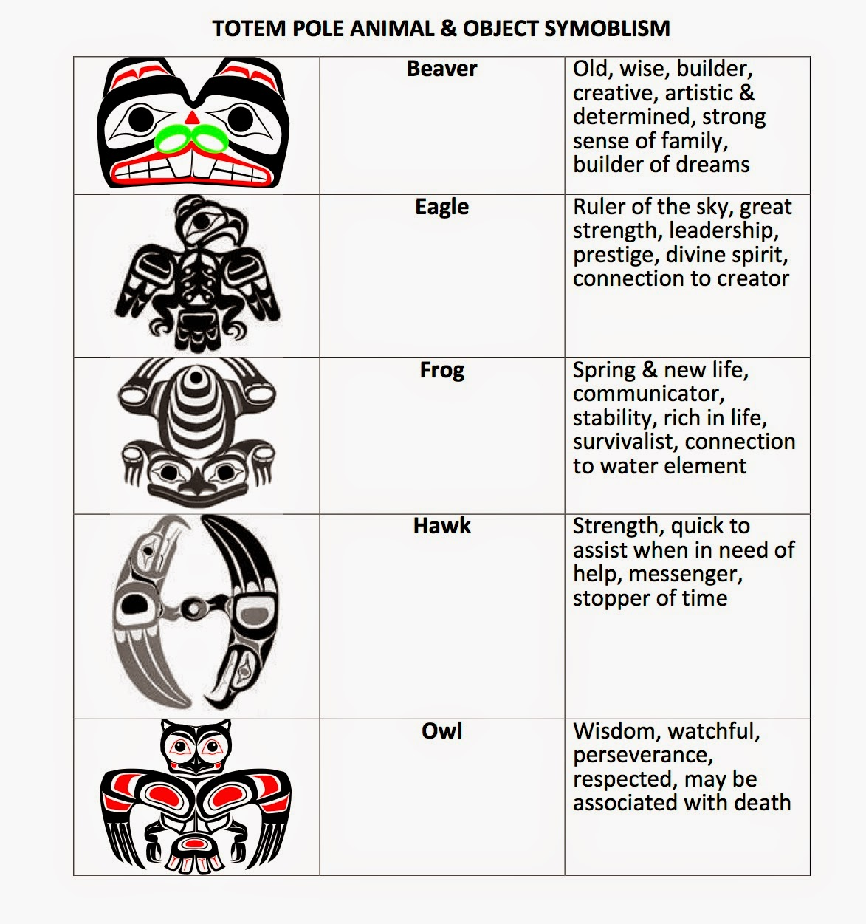
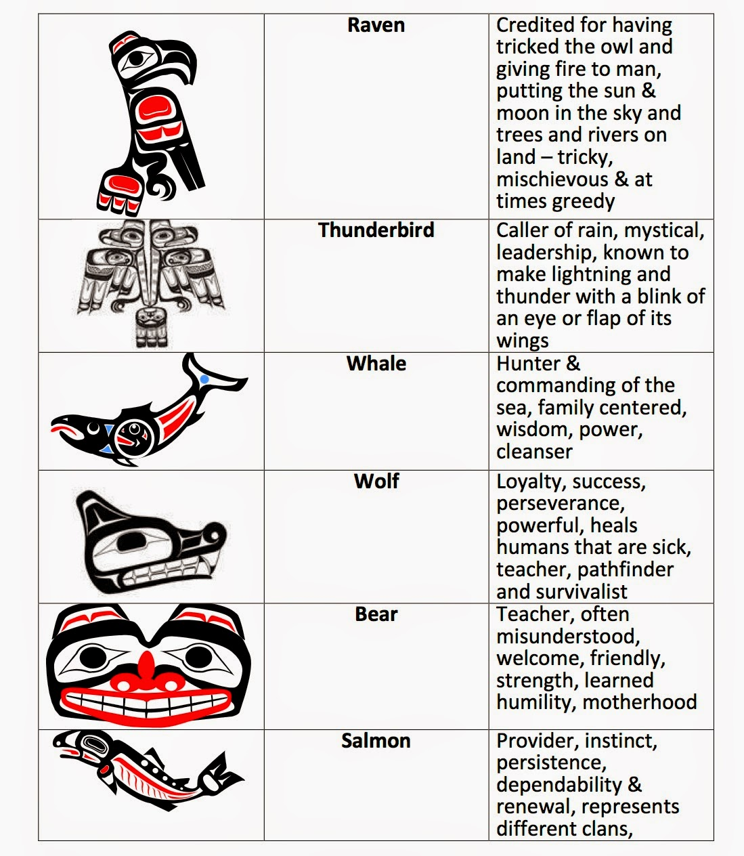

Slide 12
Eagle

Slide 13
Otter

Slide 14
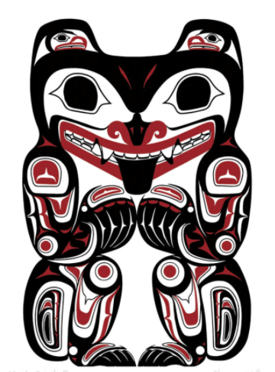
Bear

Slide 15
Orca Whale

Slide 16
Owl

Slide 17
Owl 2

Slide 18
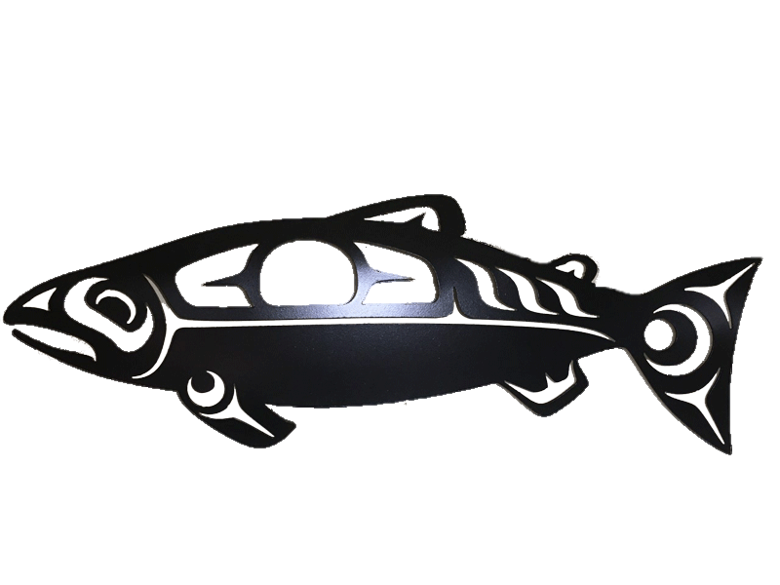
Salmon

Slide 19
Wolf

Slide 20
Bear

Slide 21
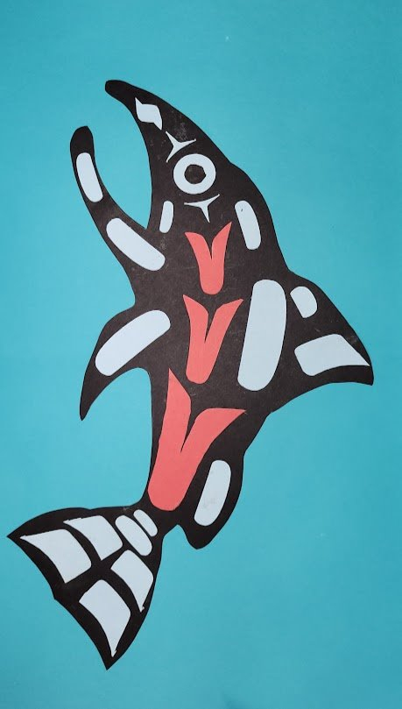
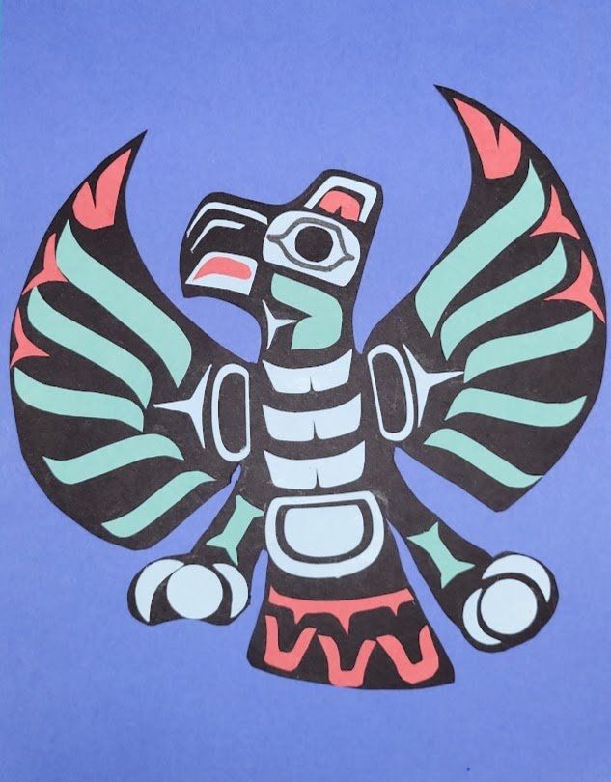
Examples

Slide 22
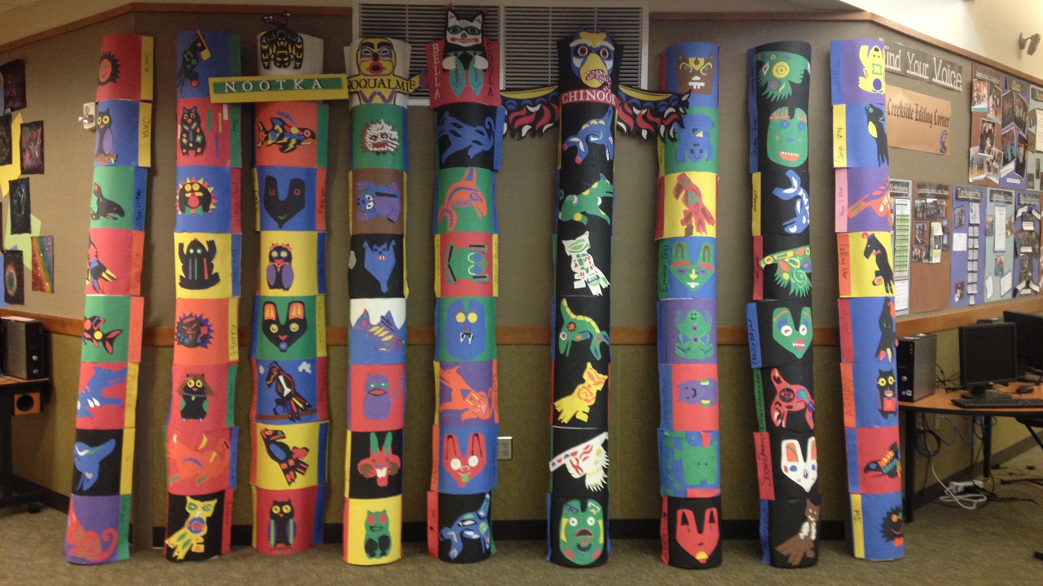
Create your classroom totel poles

Slide 23
Directions to Students
Pick your totem spirit animal
Trace it onto the large black construction paper
Cut out your animal
Choose 2-3 colors of smaller construction paper
Light Blue, Teal, White, Red
Choose one color to be your ACCENT color (the one that POPS out)
Use the stencils to trace out your L, S, U, and Ovum shapes.
Lay out ALL your shapes BEFORE you glue them down
Stay symmetrical and balanced
Glue your shapes to your animal
Glue your finished animal to a large colored background paper.
Write your name on the Back of the colored paper

Slide 24
Prep Materials
Pencils
Fine Tip Sharpie (for drawing eyes if needed)
Large black construction paper (for animal shapes)
Animal Templates
Form Line Shape stencils or copies of shapes
Colored Construction Paper for Background mounting
4 colors of construction paper cut into smaller squares (for making the shapes)
Glue sticks
Scissors
Damp paper towels (per student) to wipe hands in between gluing small shapes onto animal.
Finished Projects can be hung on bulletin boards or you can use the half round cement tubes (2 per “Pole”) and lean them against the corridor walls.

Slide 25
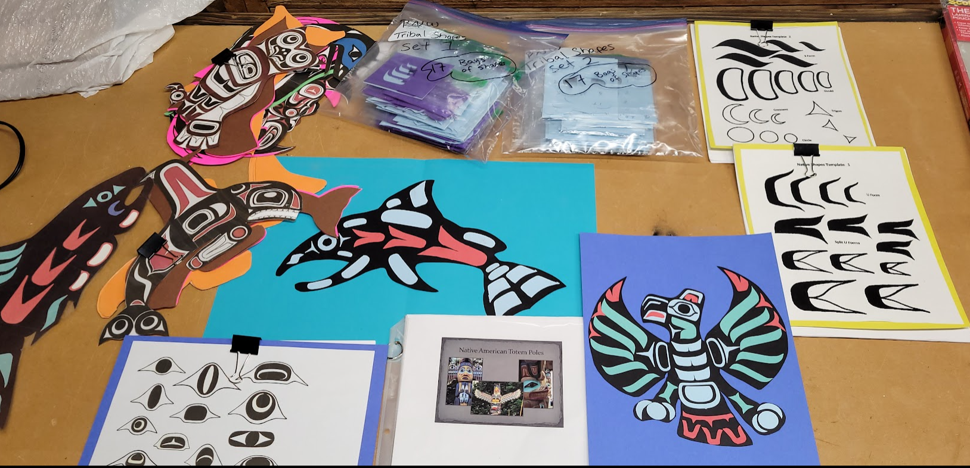
Supplies needed

