Slide 1
Vincent Van Gogh Landscape Paintings

Slide 2
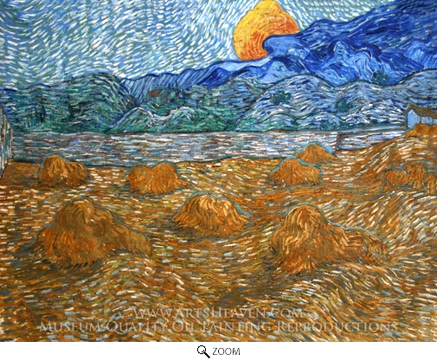
About Van Gogh
* Vincent van Gogh was one of the great Dutch painters. He lived from 1853 to 1890.
* He worked as an art dealer, then a minister, and finally became a full time artist at the age of 27. He collected Japanese prints, and was inspired by the impressionist painters that were popular at the time.
* Throughout his life, he was close with his younger brother, Theo. The letters between the brothers is what allows us to know so much about Vincent’s life.
* Van Gogh suffered from anxiety and mental illness. He died in France, at the age of 37. Theo died 6 months after his brother.
* Even though he painted for a short time van Gogh produced over 2100 art works. He only sold one painting in his lifetime. However, after his death, his paintings have sold for some of the largest sums in history. His painting The Starry Night (1869) has become one of the most celebrated art masterpieces of all time.
* Vincent van Gogh’s sister-in-law, Theo’s wife, worked hard to edit the letters that the brothers wrote to each other, she is also the one who organized an exhibition of Vincent’s art after his untimely death.
* Van Gogh pioneered the art movement that came to be known as Expressionism, and dramatically influenced the art of the 20th century, and specifically the Fauves (The Wild Beasts) and German Expressionism.

Slide 7
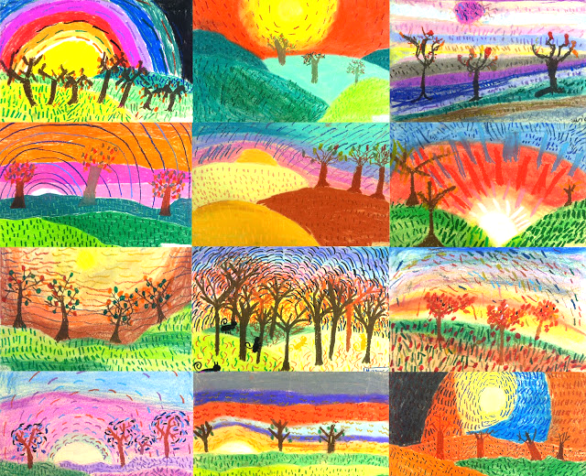
Today we are going to create Van Gogh like art

Slide 8
Vocabulary
Resist- Technique that uses several layers to expose or define a design in negative space
Lines/Texture- Thick, Thin, Jagged, Swirl
Space- Foreground, Middleground, Background
Movement- the appearance of action or motion
Irregular pattern- Elements are repeated randomly
Proportion- The relationship of one element to the whole composition

Slide 9
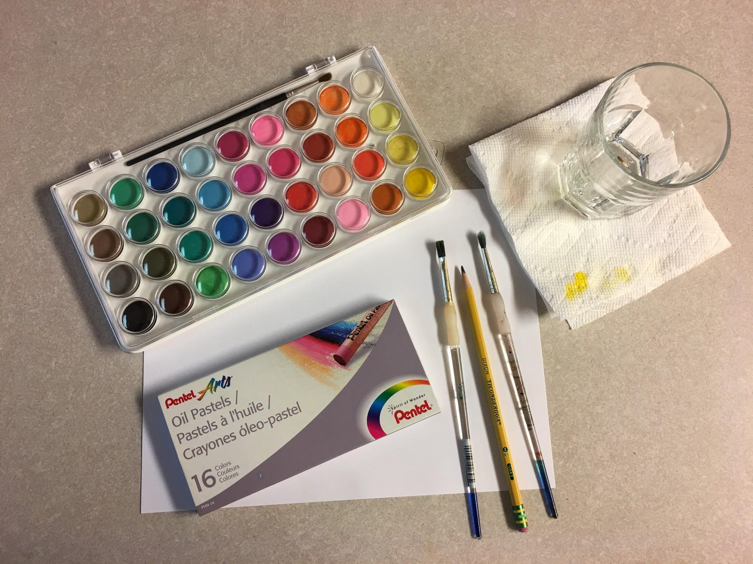
Supplies
Watercolors
Oil Pastels
White Cardstock
Med/Sm Brushes
Water Cups
Paper Towels
Pencils

Slide 10
Write your name and date on the back of the paper
2. With light pencil strokes draw your scene
Only Hills, Trees, and Sun
3. To draw a tree remember the bottom MUST be bigger than the extensions (branches). They also get smaller the farther away from the base of the tree they go.

Slide 11
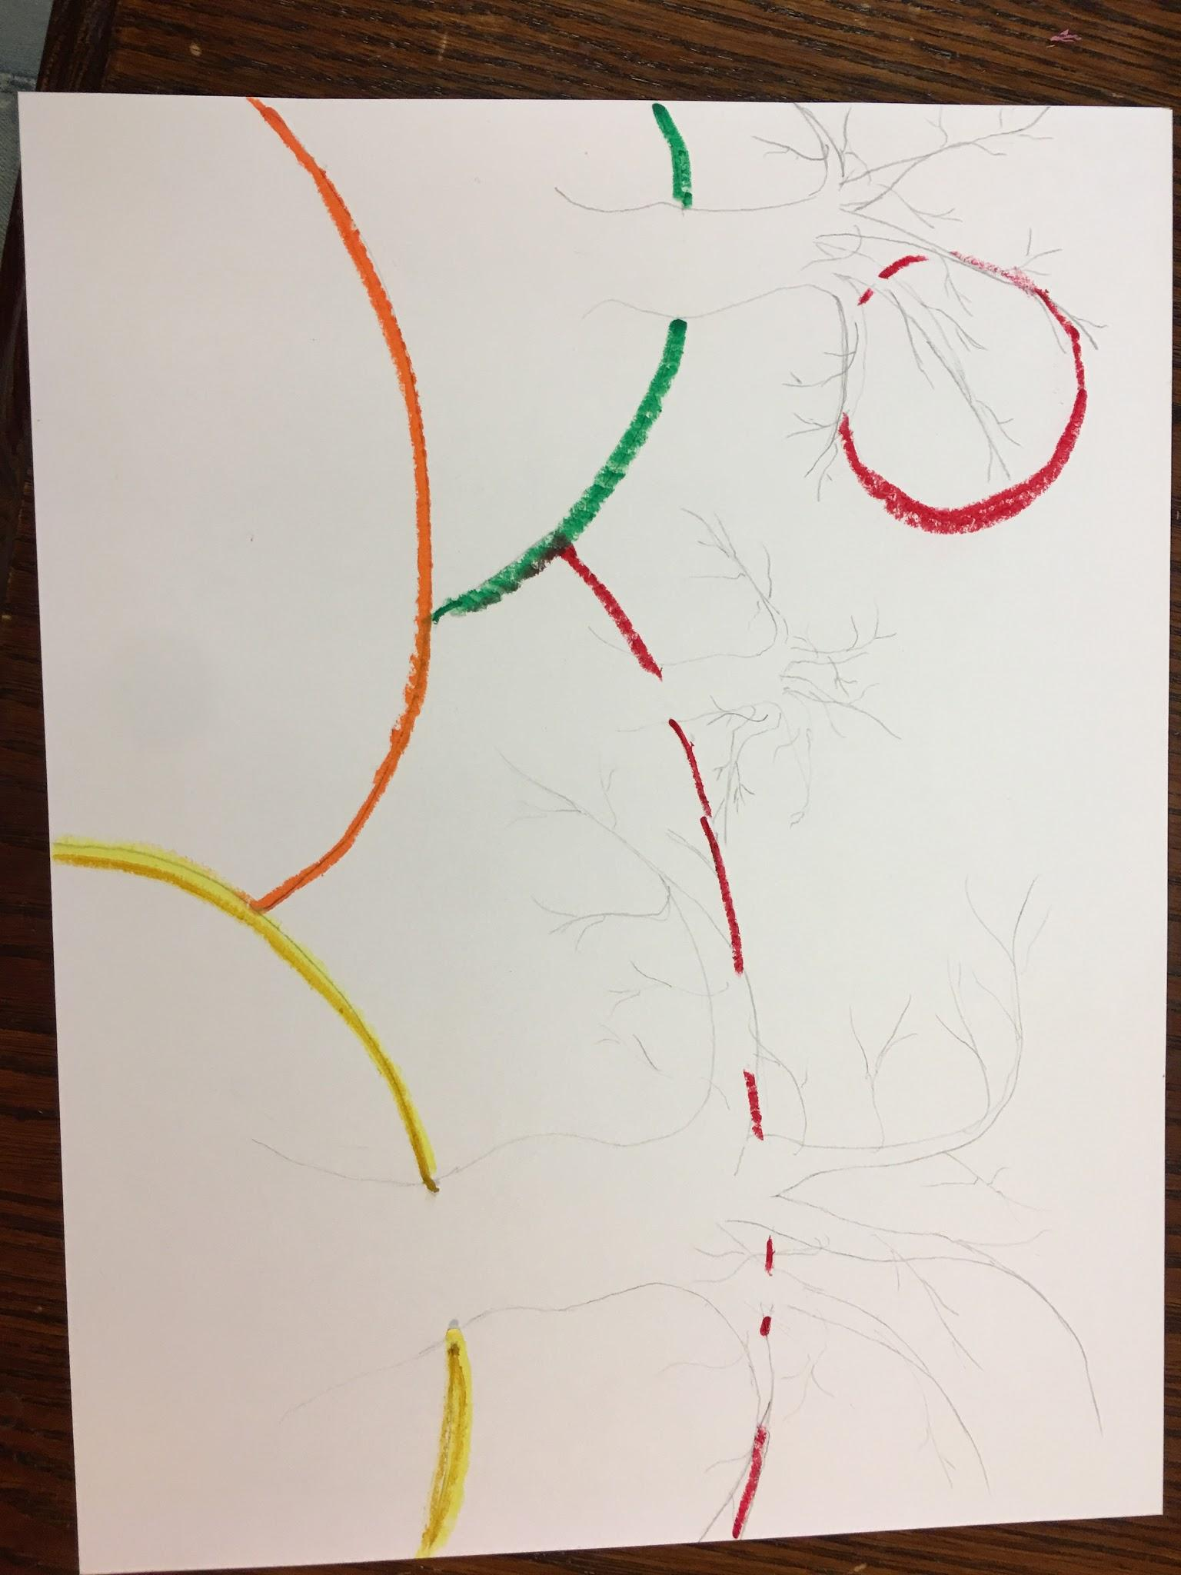
4. When you have your outline the way you want it use oil pastels to trace your lines

Slide 12
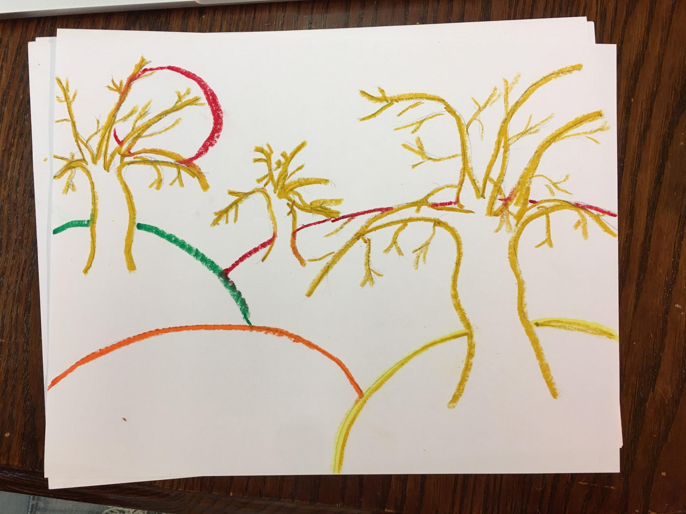
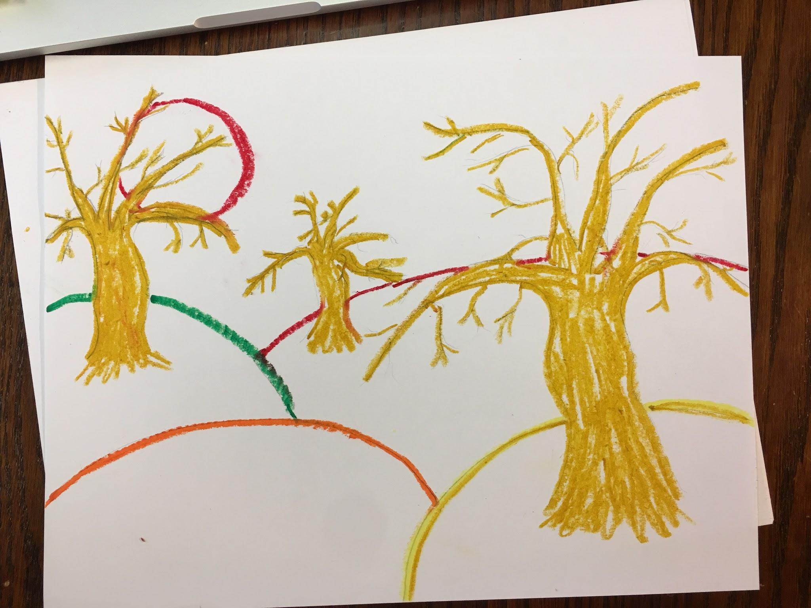
5. For the trees, you want to start thinking about what colors you want to see in the background.

Slide 13
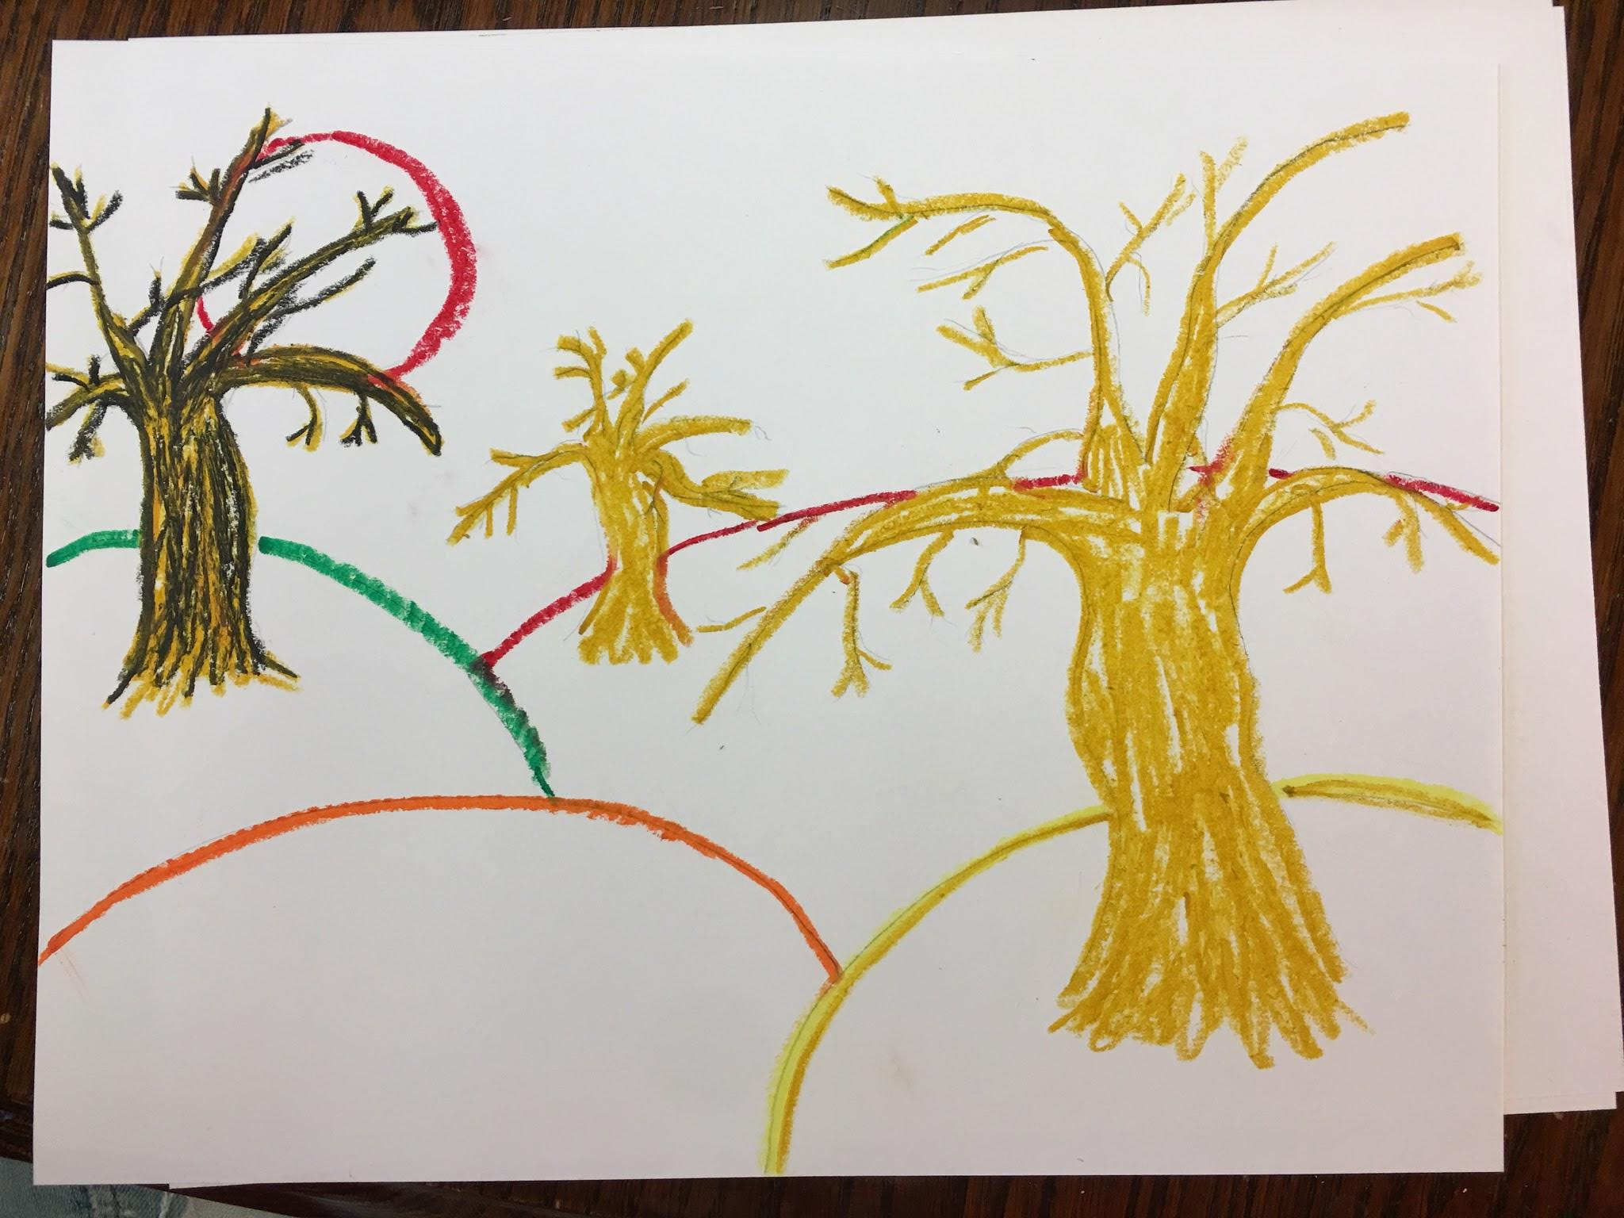
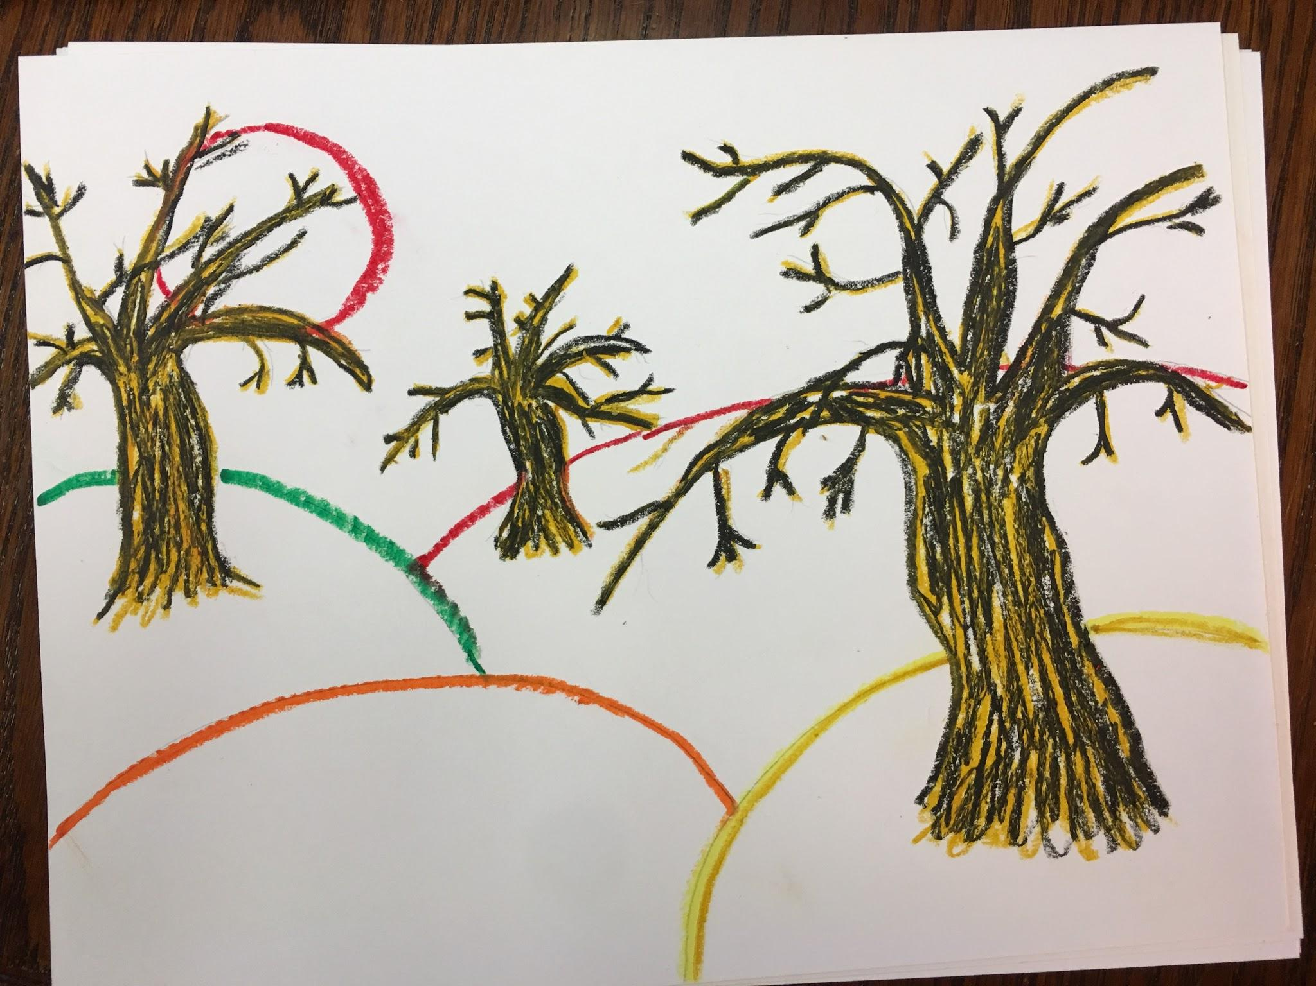
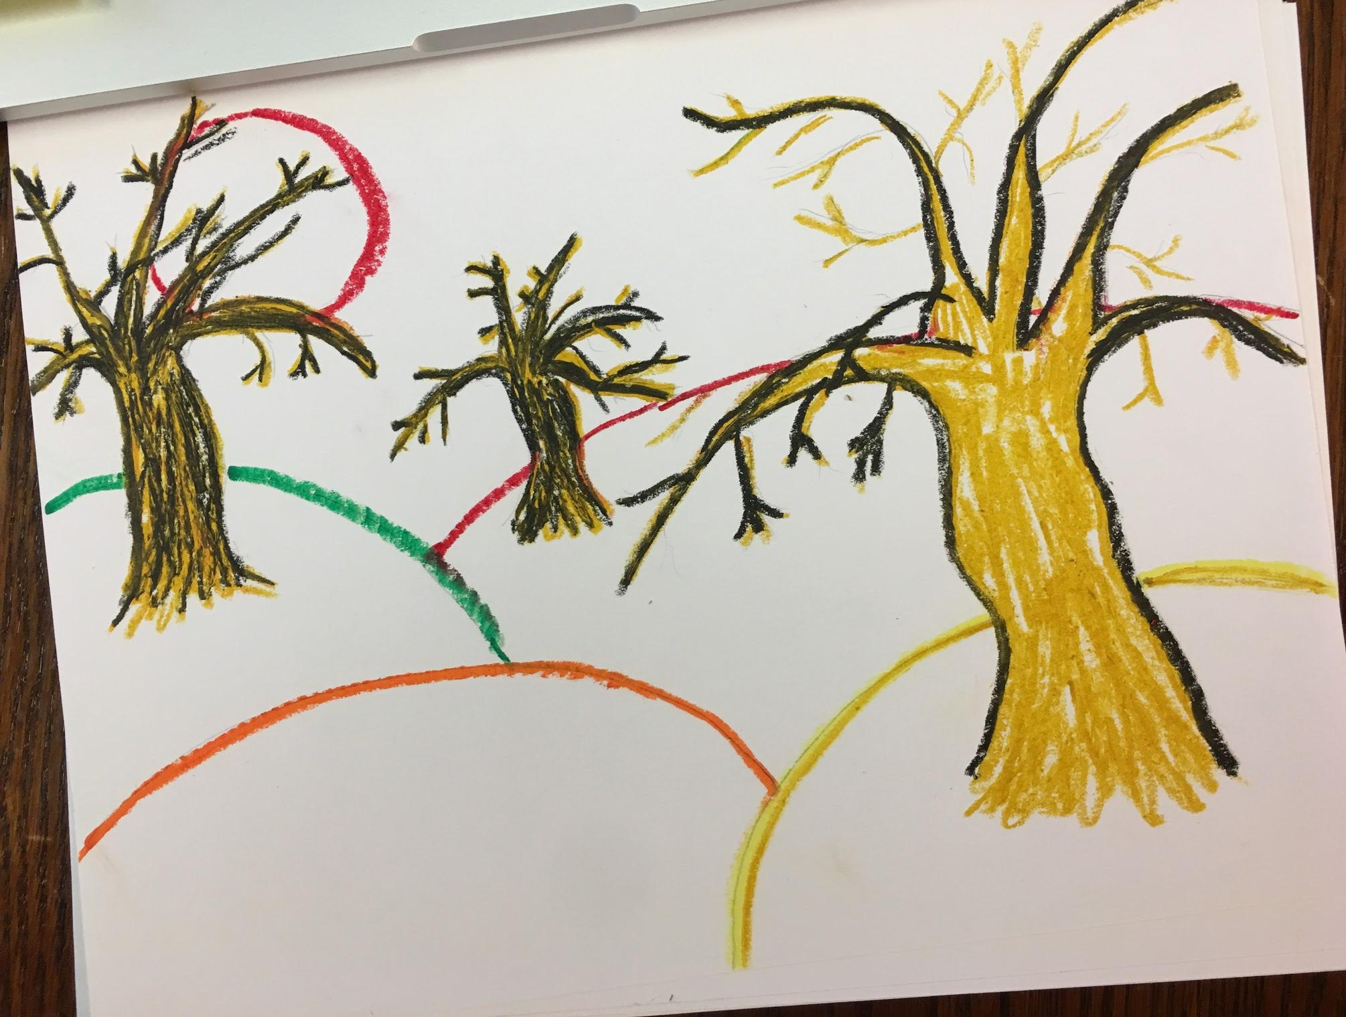
6. When you add the second layer you can see how the trees take on a new depth

Slide 14
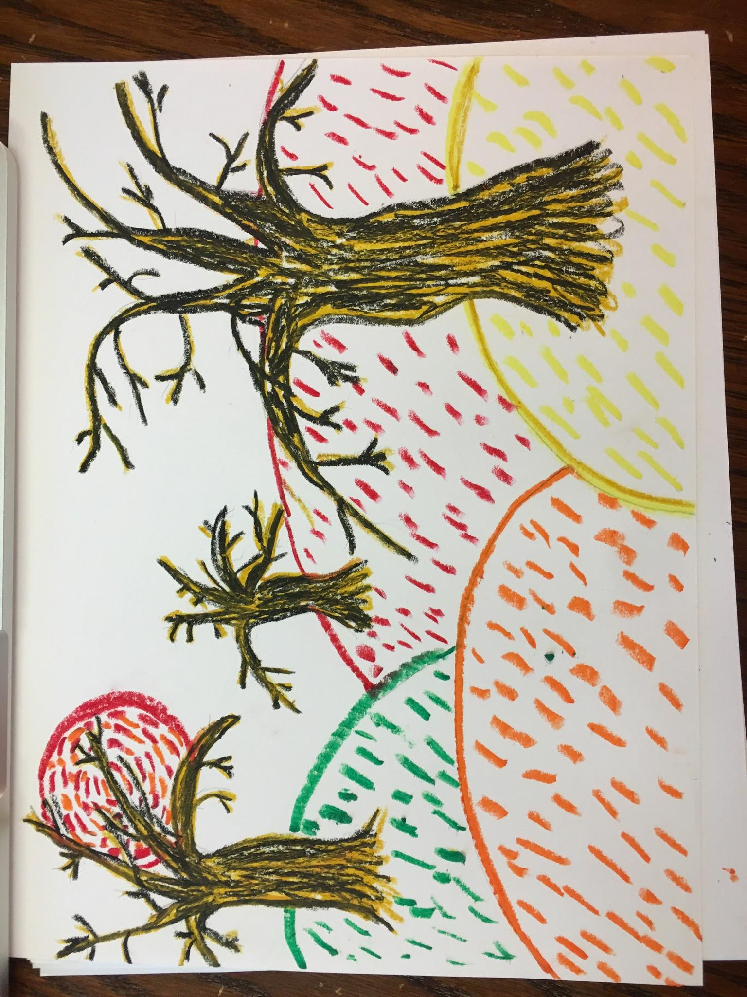
7. When your trees are done add the dashes
Make sure they follow a pattern. Even if it’s a random pattern.
For the sun think about what you want it to say. Is it putting off lots of heat or is there a wind? Heat may look like straight line dashes and wind swirl dashes.

Slide 15
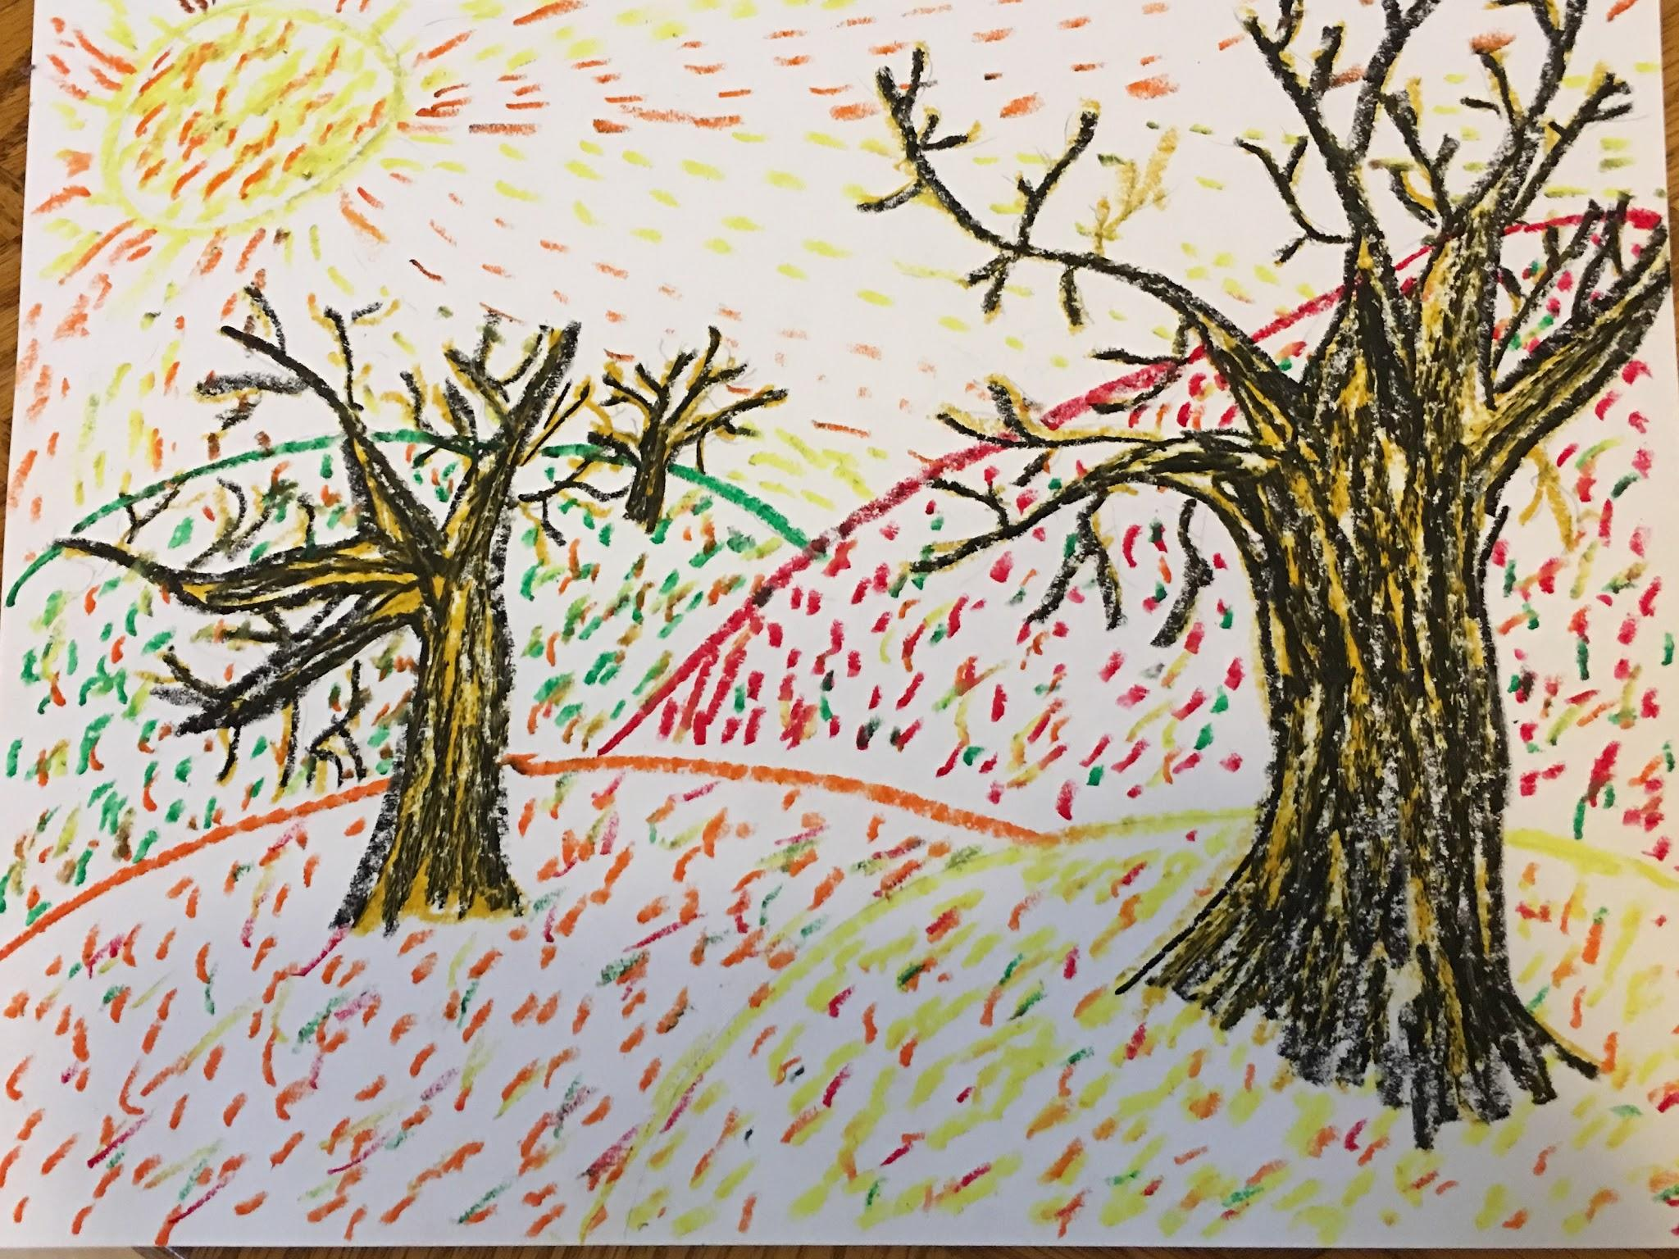
8. I have added depth by adding more colors to the hills. This sun is giving off heat.

Slide 16
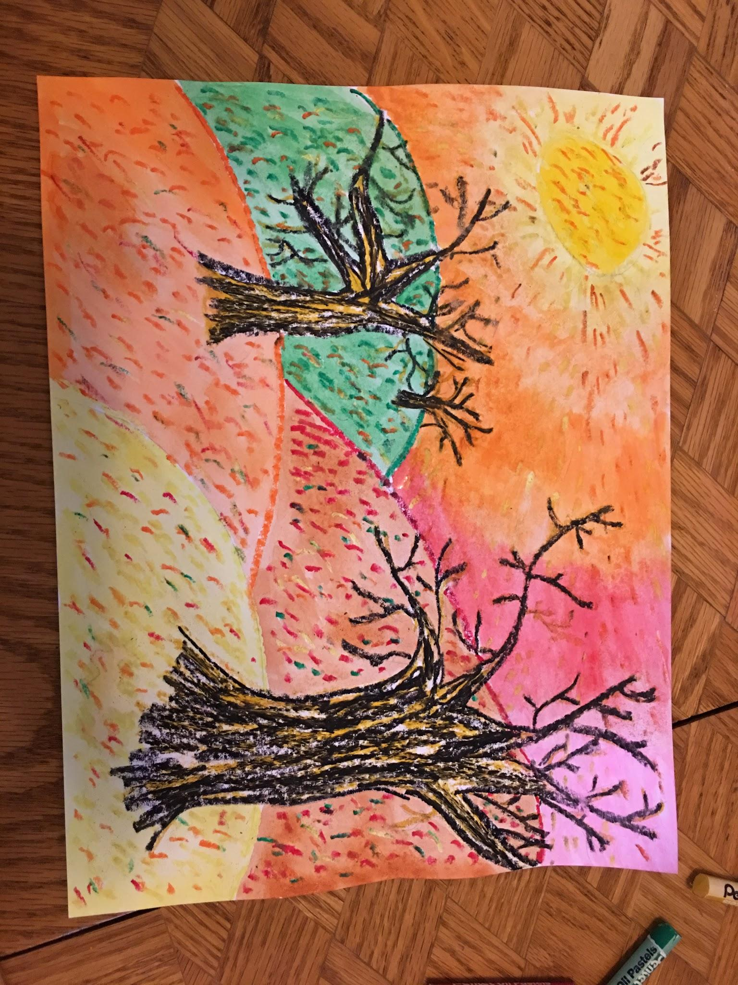
9. Add your watercolor. I chose to use the same color for my hills as I used for my oil pastels. You can see how the oil pastels resist the watercolor. You also may blend your watercolors in the sky.

Slide 17
10. After you let your art dry you can add extra touches to add depth to your art! I went back and added more gold.

