Slide 1
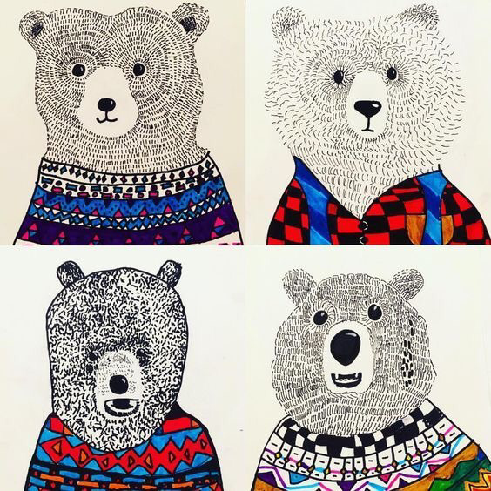
Chilly bears
Sharpie Art
A lesson about texture

Slide 2
TEXTURE
Texture both tactile and visual. (You can feel it and see it)
TACTILE TEXTURE is the quality of a surface, such as rough, smooth, sticky, fuzzy or soft. A real texture is one you can actually feel with your hand, such as a piece of sandpaper, a wet glass, or animal fur. It can also be created by an artist.
VISUAL TEXTURE is the visual quality of a surface. It is the result from painting or drawing as the real texture. Visual texture is the illusion of texture created by an artist.
Today we will be creating an illusion of fur on our animals. What will your fur feel like? Bristly and rough, or soft and fluffy? You will use different lines and shapes to create the way you would like your animal to feel.
“Durer Hare Engraving”
How do you think it would feel if you touched this rabbit?
How long do you think it took him to create the fur?

Slide 3
TODAY, WE WILL MAKE OUR OWN VERSION OF THESE CHILLY ANIMALS IN THEIR WINTER SWEATERS.
Remember, all classroom rules apply during art class.
If you need some help, raise your hand before you get too frustrated, don’t wait – we are here to help you out!
Be kind to yourself and others when you talk about our art.
Sit back, relax and enjoy this time to get creative.
Watch how everyone’s art will turn out differently.
HAVE FUN!!!

Slide 4
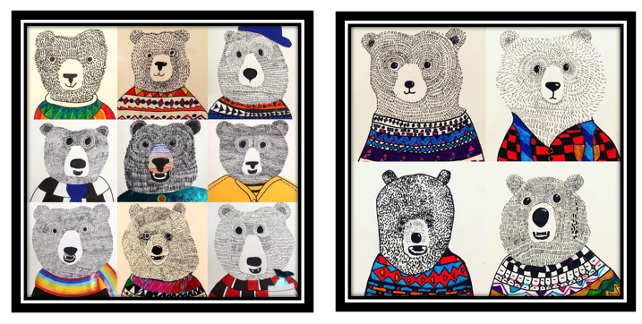
Here are some examples of what you could make today

Slide 5
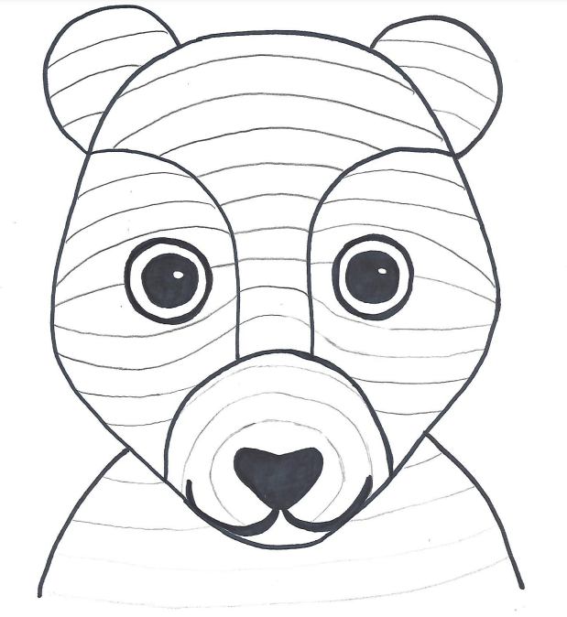
Step one - pencil
Start by using your pencil VERY LIGHTLY to
draw out the shape of the face
Use the WHOLE paper – take up space!
Draw the ears and the body
Draw the snout, and ears. Think about where they
should be on the face
Draw the eyes, nose and mouth
Make your animal your own!

Slide 6
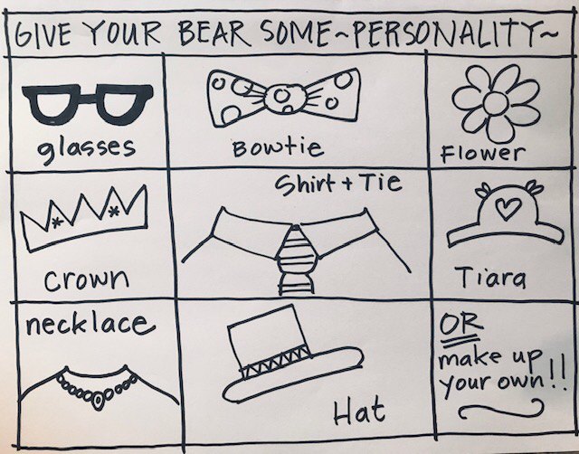
Step two – give your bear some personality
Add some fun things to make your bear original
Don’t overdo it, less is more!
Here are some ideas but there are MANY more.

Slide 7
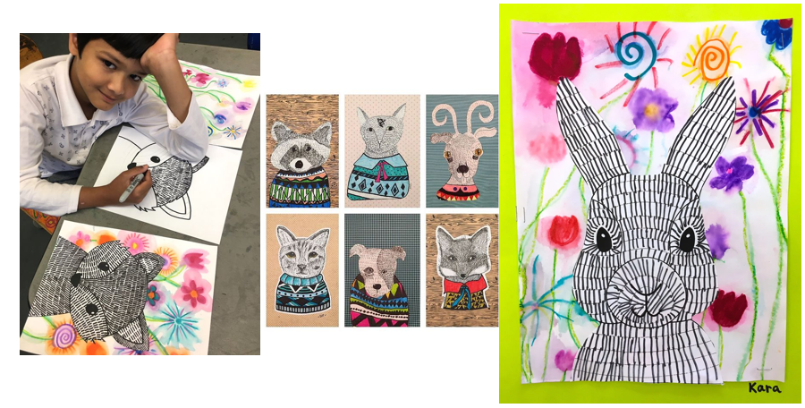

Slide 8
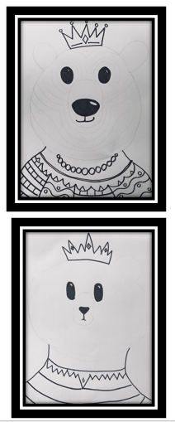
Step three – black sharpie
Use your black sharpie to outline the
EYES, NOSE and MOUTH only – do not outline
the bears head or ears
Trace over your sweater and accessories
with the black sharpie too. Erase any visible pencil
Lines from under your sharpie line.
Leave the head ears alone for now.
Add patterns and designs to their clothing

Slide 9
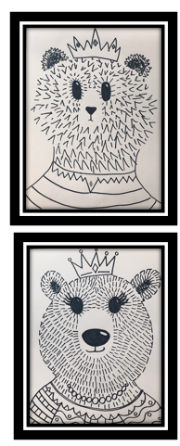
Step four – fluffy!!!!!!!
Using your black sharpie, start using little lines
to create the fur on the bear’s face.
Start around the eyes and move out around the
nose and towards the outside of the face
You can use short straight lines or soft flicked lines
Keep going until you fill in the whole face and neck
Remember, there are no mistakes – trust yourself!
Look around, everyone’s Chilly Bear is different.
OPTION Outline bear’s face and ears, consider using dotted line.

Slide 10
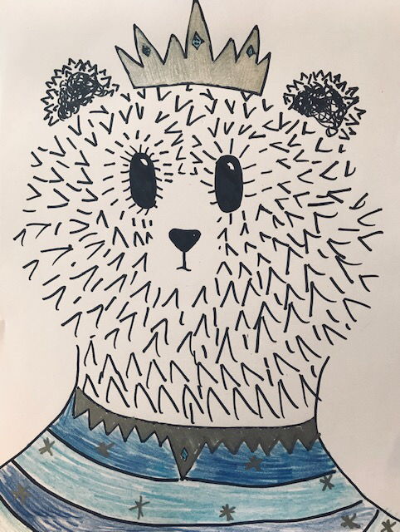
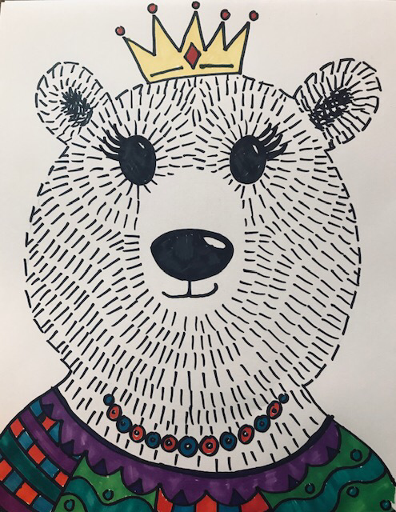
Step five – colored sharpies
Now, use your colored sharpies to color in the sweater and accessories ONLY.
Do not color in the face, they are supposed to stay black and white. Imagine our animals are winter foxes, polar bears, and artic hares,
TA-DA!

Slide 11
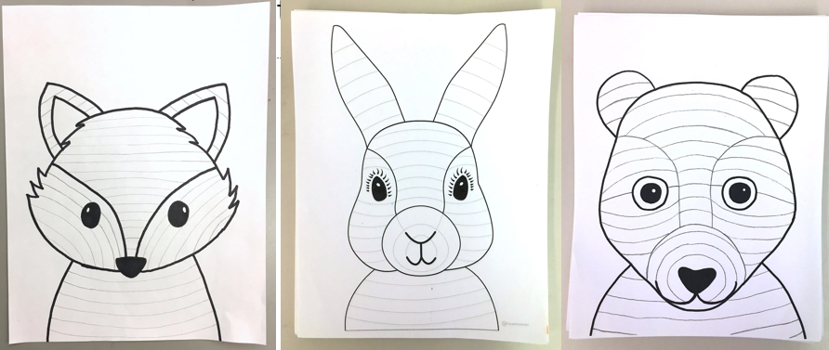
Other Animals too!

