Slide 1
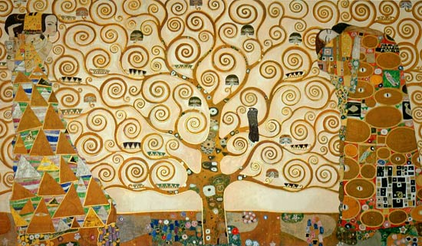
Tree of Life, 1905
Notes:
The Artwork: Tree of Life: Is a symbol used in many artworks and many religions . In most cases, The Tree of Life is used to signify health and longevity. Gustav Klimt painted with brightness and boldness and this is what he has shown in this painting . A large canvas is used to make this painting and detail is filled in every corner. To give a wonderful grand finish to this artwork, Klimt used gold leaf paint. There's a lot of symbolism behind the Tree of Life . The symbolism is really located in most cultures, all over the globe and is located in each and every aspect with the paintings.

Slide 2
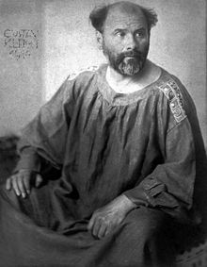
GUSTAV KLIMT
Born in Austria July 14, 1862
Died February 6, 1918
He liked to draw portraits and landscapes.
He went through a phase where he liked to paint with gold leaf.
Tree of Life is his most famous mural and the only landscape that he created during his “golden period.”
Notes:
Background notes for the art docent (From Blick.com and gustav-klimt.com):
Gold leaf is an ultra-thin layer of pure gold used by crafters to create a gilded appearance on projects such as picture frames, sculptures and book bindings. Applying it can be can be very labor-intensive and challenging for beginners. It is extremely fragile by nature, and will adhere to almost any moistened surface. Professional gilders suggest it could take months of practice to become proficient at gilding.
Gustav Klimt (1862- 1918) was an Austrian Symbolist painter and a member of the Vienna Art Nouveau movement.
His major works include paintings, murals, sketches and other art objects. Klimt's primary subject was the female body. He also painted landscapes.
Gustav Klimt was born in Austria, the second of seven children-- three boys and four girls. His father, Ernst Klimt, was a gold engraver, who earned very little. Klimt lived in poverty for most of his childhood.
In 1876, at age 14, Klimt was awarded a scholarship to the Vienna School of Arts and Crafts, where he studied until 1883, and received training as an architectural decorator. His brother Ernst, who, like his father, was an engraver, also enrolled in the school. Klimt began a career painting interior murals in large public buildings.
In 1897, Klimt was the leader of the Secession. This was a group of Austrian artists dedicated to artistic freedom and a style of art known as art nouveau. He began painting landscapes and portraits of wealthy Viennese ladies, receiving the support of loyal patrons. The radiant women in his portraits seem to appear in a kaleidoscope of geometric shapes, spirals, flowers, and golden decorations. Klimt also painted pictures of women that symbolized the cycles of life and death. His art celebrated love, beauty, and motherhood. Two of his most famous paintings are Portrait of Adele Bloch-Bauer I (1907) and The Kiss (1907-08;).
Klimt died on February 6, 1918, in Vienna.
As he worked and relaxed in his home, Klimt normally wore sandals and a long robe with no undergarments. His simple life was somewhat cloistered, devoted to his art and family and little else except the Secessionist Movement, and he avoided café society and other artists socially. Klimt's fame usually brought patrons to his door, and he could afford to be highly selective. His painting method was very deliberate and painstaking at times and he required lengthy sittings by his subjects.
Klimt's paintings have brought some of the highest prices recorded for individual works of art. In 2006, the 1907 portrait, Adele Bloch-Bauer I, was purchased for the Neue Galerie in New York by Ronald Lauder for a reported US $135 million, surpassing Picasso's 1905 Boy With a Pipe (sold May 5, 2004 for $104 million), as the highest reported price ever paid for a painting.
Art historians note an eclectic range of influences contributing to Klimt's distinct style, including Egyptian, Minoan, Classical Greek, and Byzantine inspirations. Klimt was also inspired by the engravings of Albrecht Dürer, late medieval European painting, and Japanese Rimpa school. His mature works are characterized by a rejection of earlier naturalistic styles, and make use of symbols or symbolic elements to convey psychological ideas and emphasize the "freedom" of art from traditional culture.

Slide 3
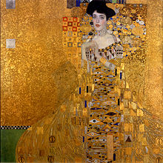
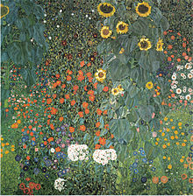
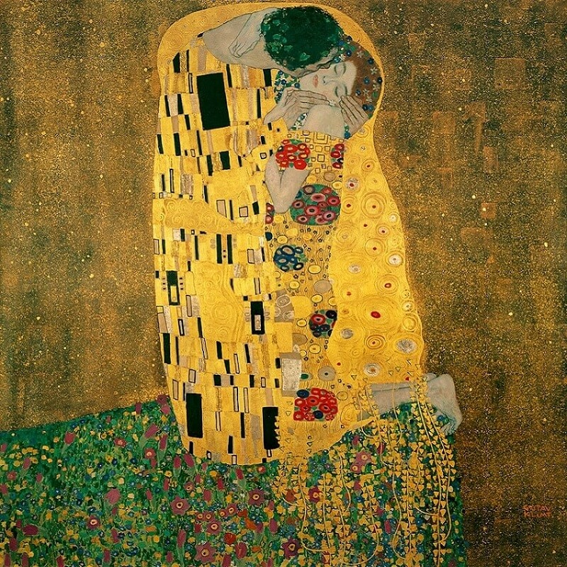
The Kiss

Slide 4
PRINCIPLES OF ART
Lines and curves are marks that span a distance between two points (or the path of a moving point). As an art element, line pertains to the use of various marks, outlines and implied lines in artwork and design. A line has a width, direction, and length. They have a start and an end.
Shape - two dimensional objects containing length and width.
Pattern - means the repetition of an element (or elements) in a work.
Emphasis – Area in a work of art that catches and holds the viewer’s attention.
Notes:
Klimt used pattern in most of his work, often repeating rectangles, scales, spirals, and circles, as well as vining forms. The emphasis is his works was often a female figure. Pattern and emphasis are both found in the Tree of Life painting.

Slide 6
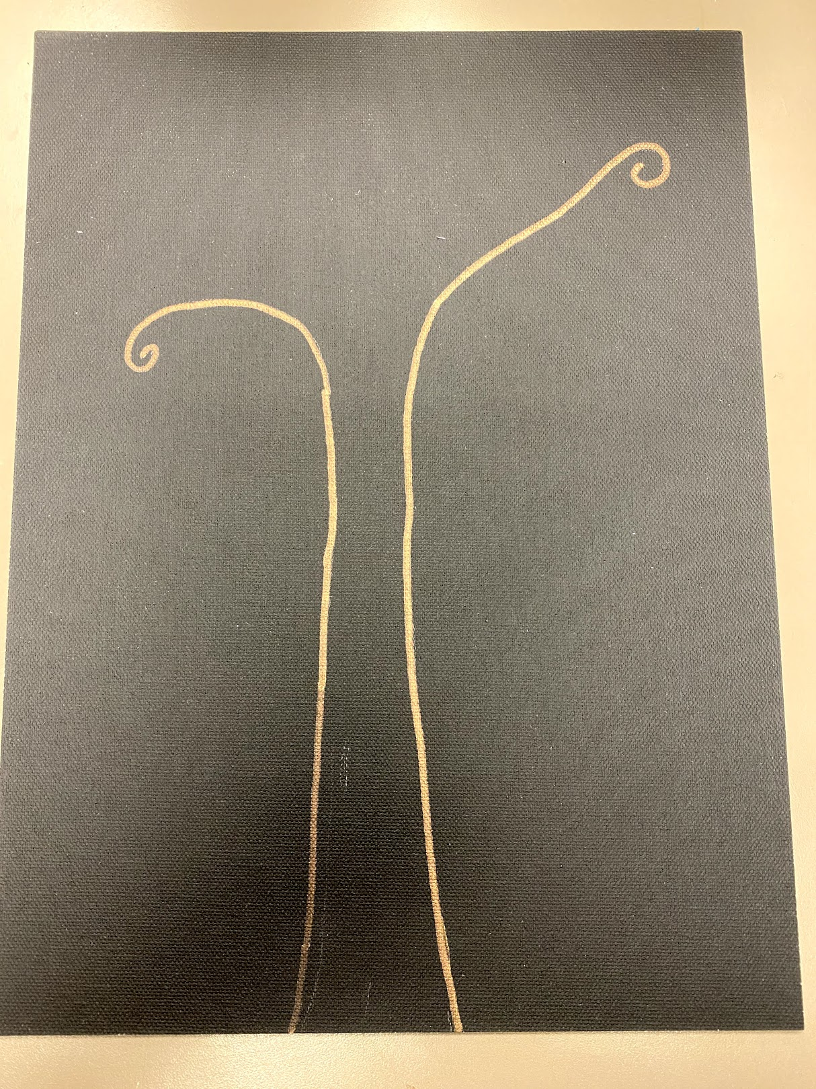
Write your name on the back of the canvas.
With a pencil, start by drawing the tree trunk and the swirling top branches.
The base of the trunk can be 3-4 fingers wide and taper slightly as you draw upwards.
Think about filling the length of the canvas.
Trace your pencil lines with the bronze or silver metallic Sharpies.

Slide 7
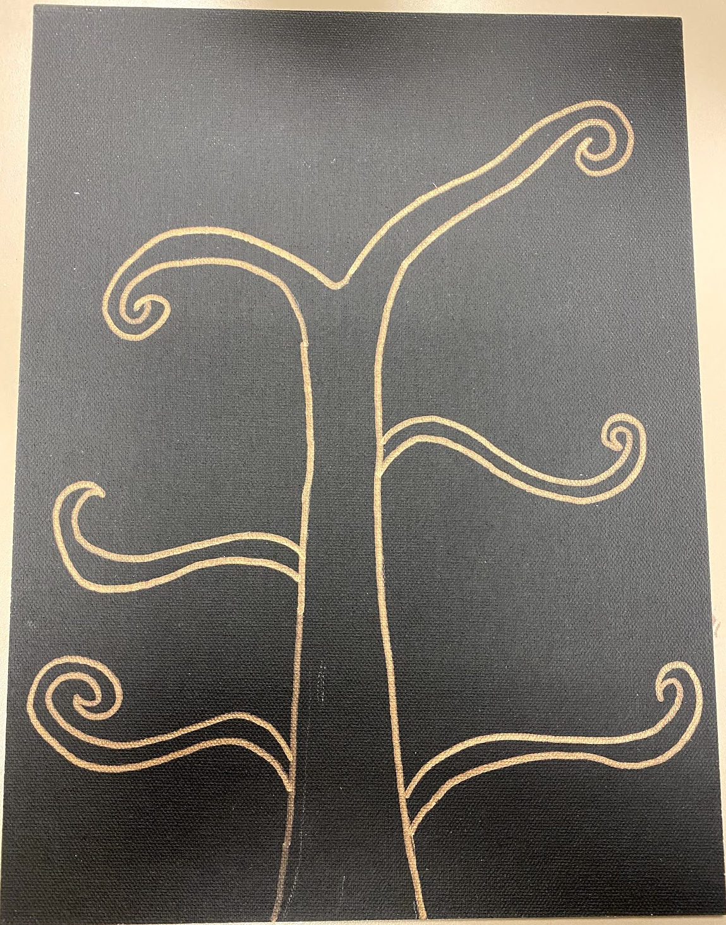
Once you are comfortable with the swirling motion, you can stop using the pencil and just use the Sharpie.
Aim for at least 6 major branches.

Slide 8
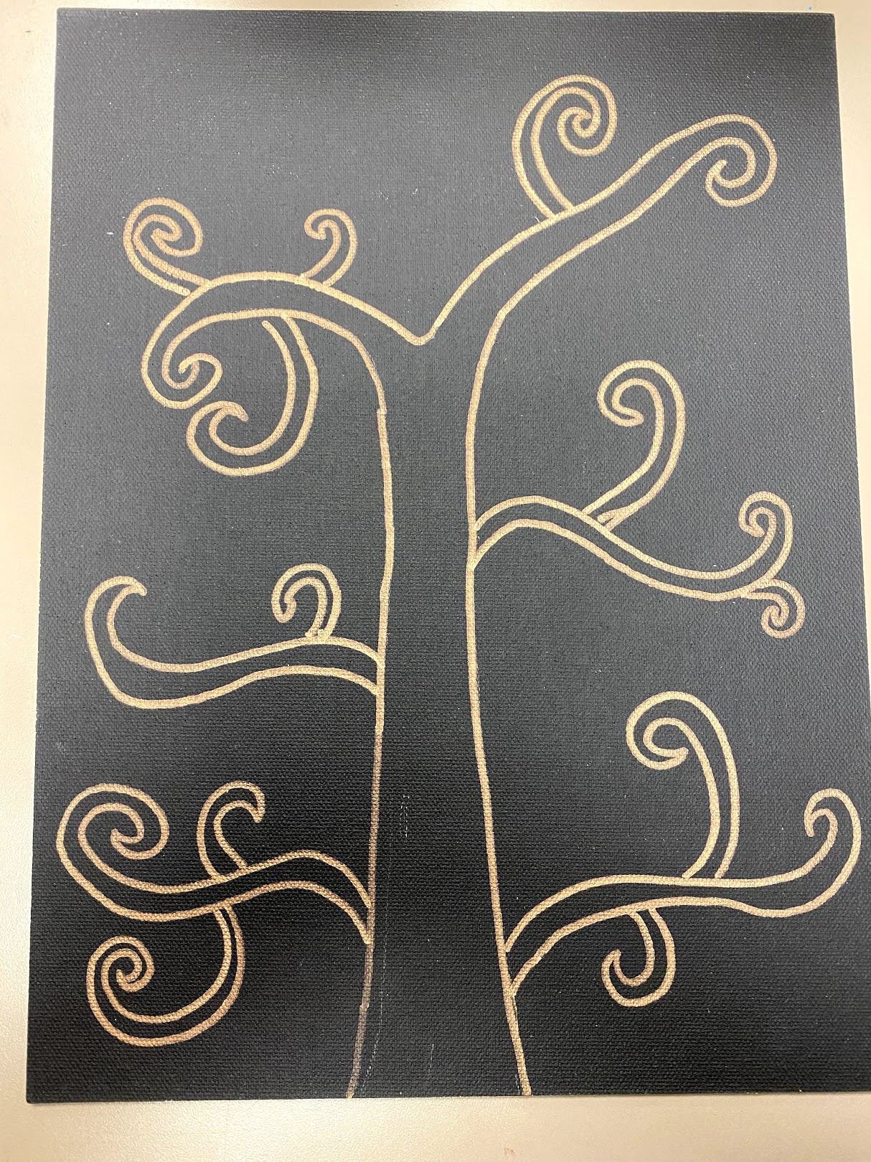
Add additional swirls – 2-3 per branch.
Think about varying direction and length.

Slide 9
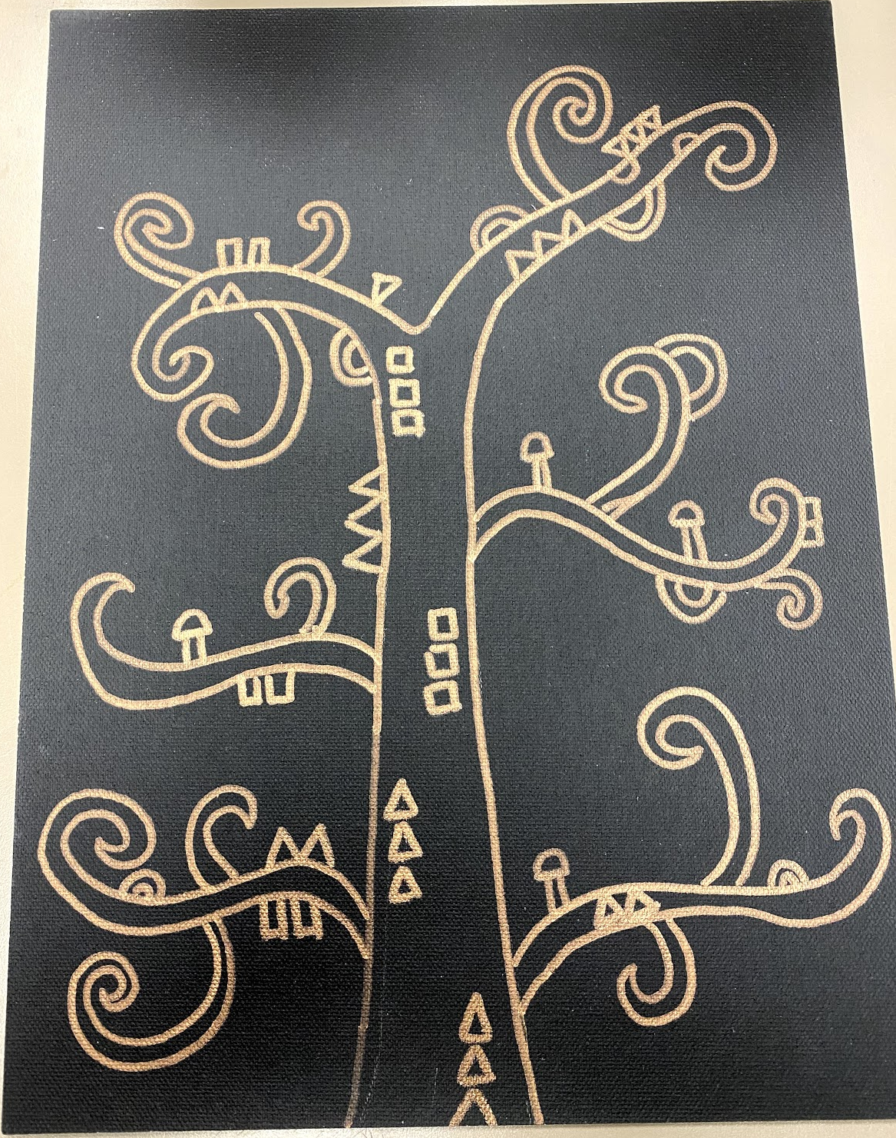
Once you have completed your tree outline, we will begin to add pattern.
Choose 3-4 geometric patterns and repeat them throughout the trunk and branches.
Klimt used several repeating triangle and circle patterns in his piece.

Slide 10
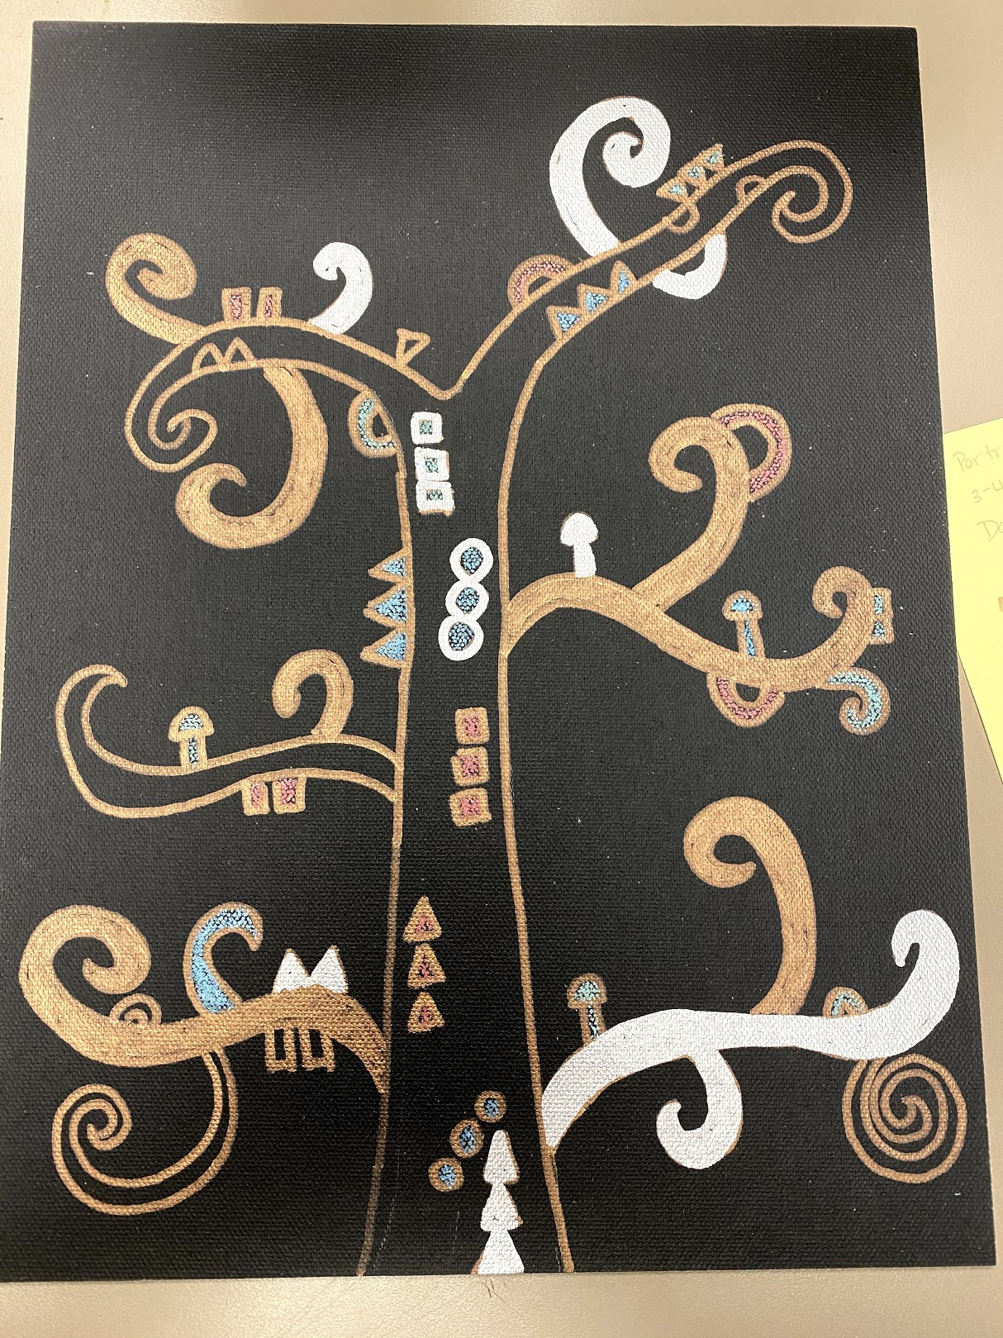
Start coloring in your tree.
You can use a combination of the bronze and silver metallic sharpies and the metallic oil pastels.

Slide 11
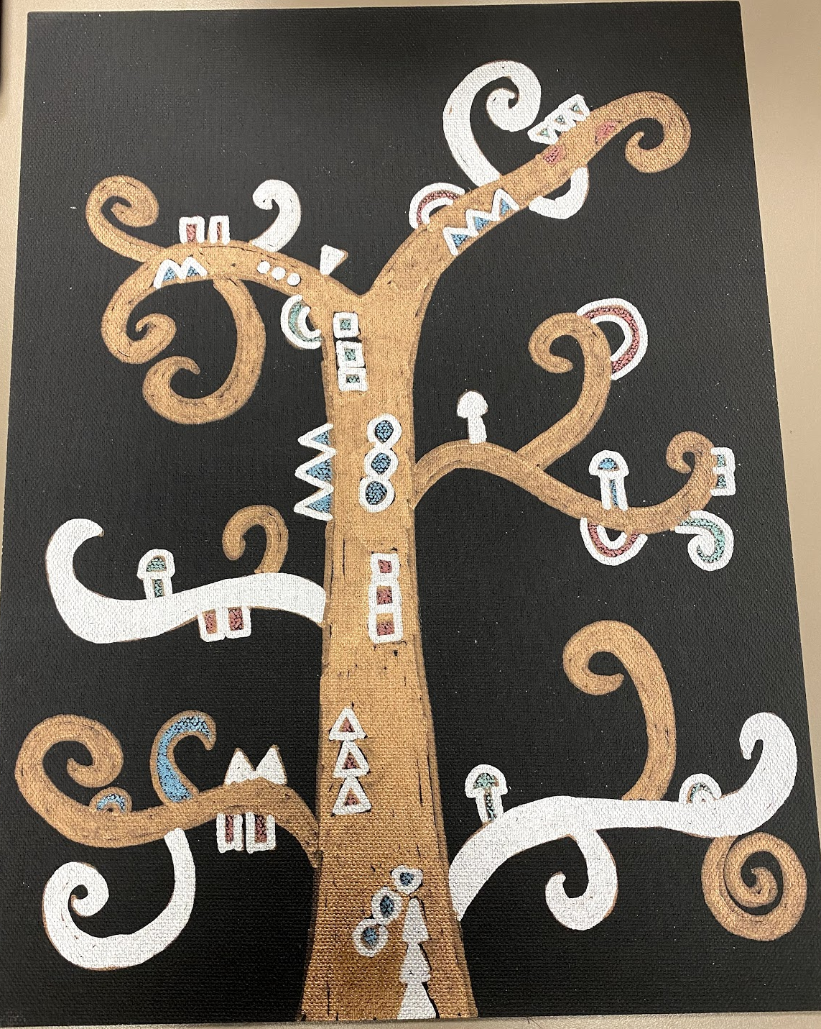
If you are using the metallic oil pastel to color in a pattern on a bronze branch, the color will pop more if you outline the pattern in silver.
Alternately if you are coloring the tree in silver, try outlining your colored shapes in bronze.

Slide 12
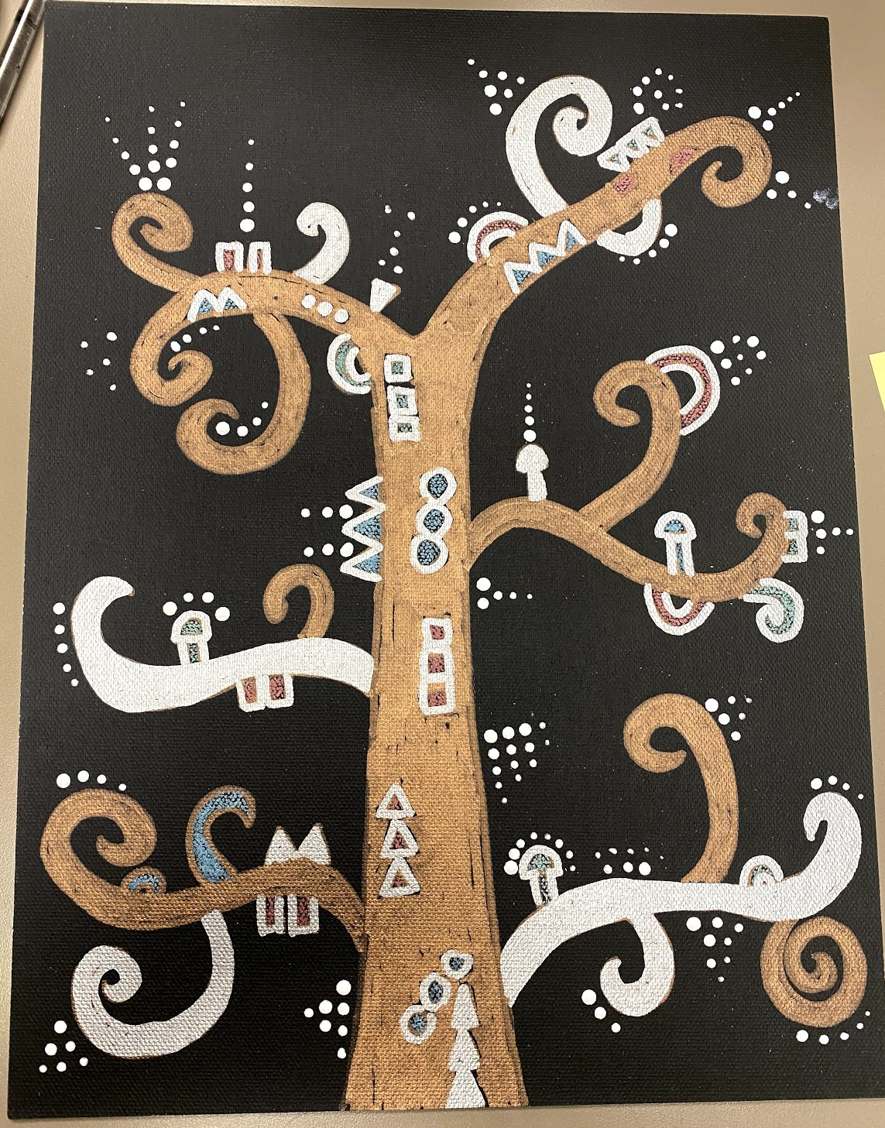
Dip the bottom of your brush in white acrylic paint and add dots of paint to areas you would like to highlight.

Slide 13
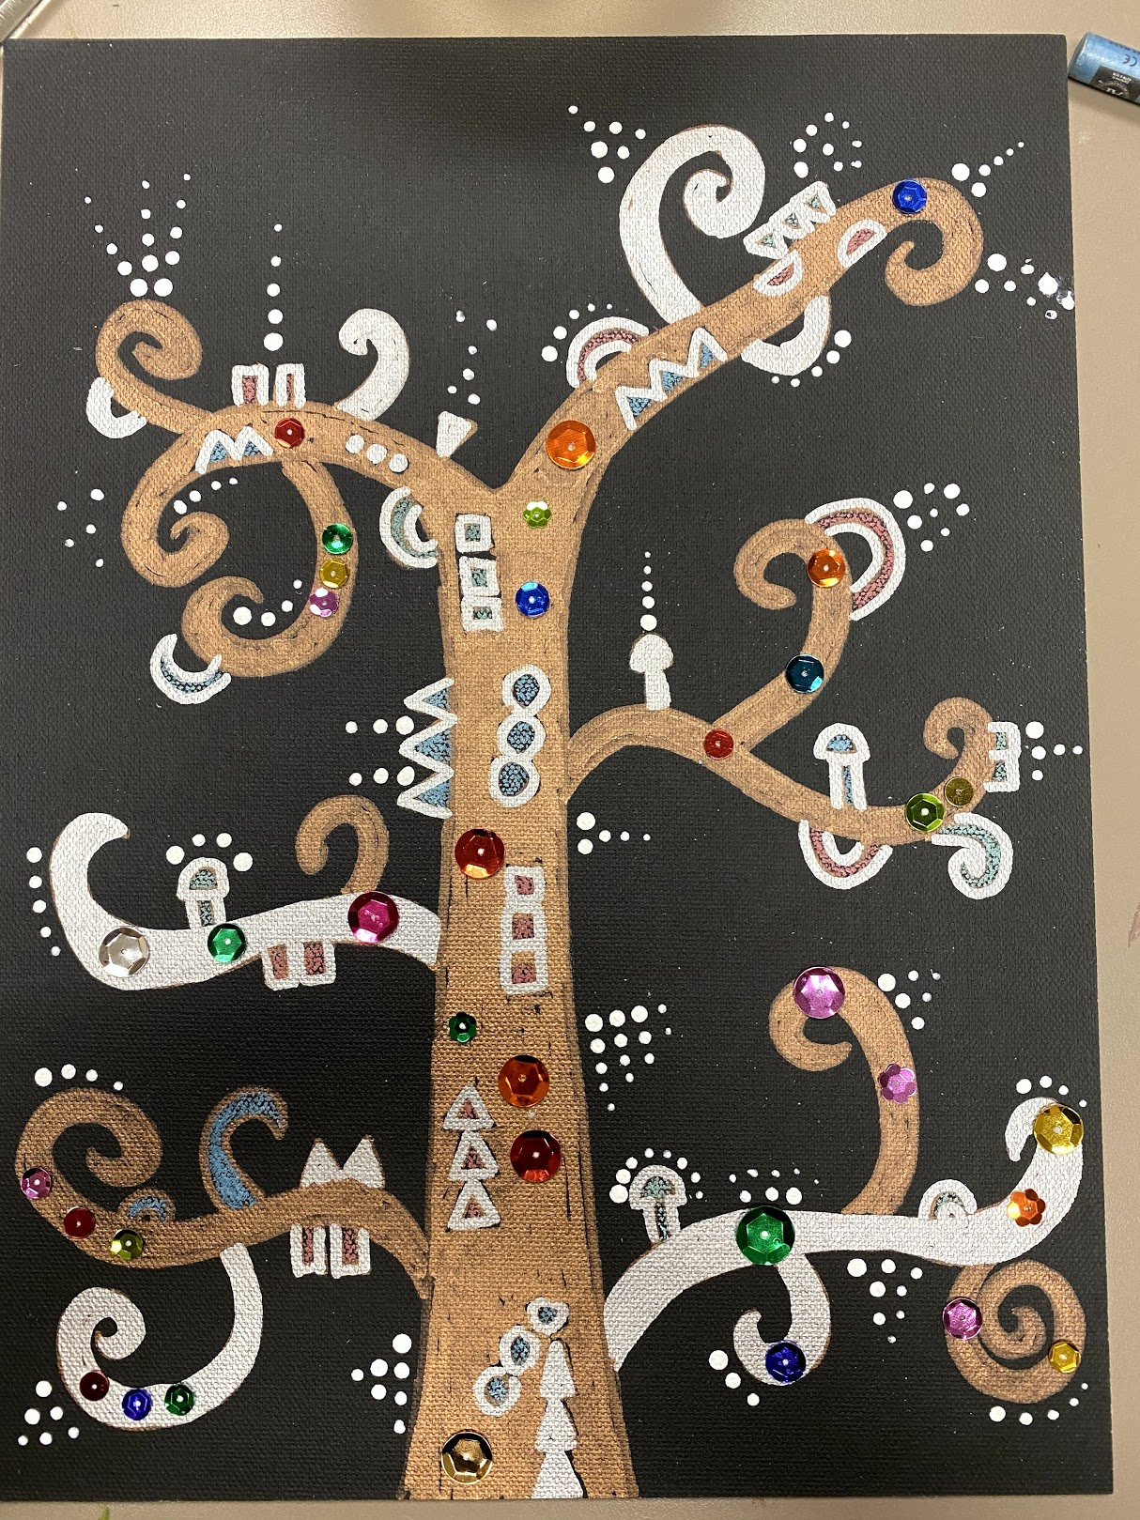
You may add sequins for additional color and texture.
It is good to be RANDOM with your sequin additions! These are your embellishments and add emphasis to your branches.
Use tacky glue to add sequins.
Take entire top off tacky glue bottle.
Squeeze bottle, use toothpick or end of small black brushes to get a dot of glue.
Dot the glue on the canvas. Add sequin. Continue.

Slide 14
Notes to Docent
Supplies Needed:
Black poster board or canvas board 9 x 12
Metallic Sharpies – Gold, Bronze, Silver
Metallic Oil Pastels (or paint) – for fine details
White Acrylic Paint & Fine tip paint brushes
Sequins
Pencil for sketching branches
Tacky glue in small containers
Q-tips for applying tacky glue
Drying rack
Butcher Paper to cover tables
Sample projects
Notes:
Gold metallic paint
Black paint
White paint
Small tip paint brush (#6 works well)
Sharpie to write name on back
Pages with step by step adding branches
PowerPoint presentation on jump drive and hard copy
Hairdryers to speed up drying process
Disposable plates as pallet for paint
Aprons/smocks for adults
Tshirt smocks for kids

