Slide 1
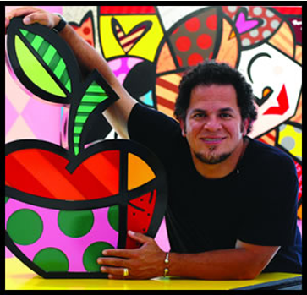
ROMERO BRITTO

Slide 2
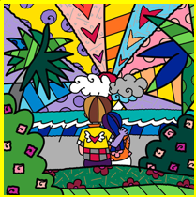
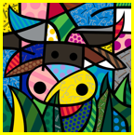
ROMERO BRITTO is a considered a pop artist.
He uses vibrant colors and patterns to emit hope and happiness through his work. Also, used elements of Cubism (Picasso) and graffiti in his art.
He is from Brazil, but now lives in the Miami, Florida.
His work can be found all over the world but has been commissioned to be in JKF Airport, Cirque Du Soleil, the Super Bowl and more.
He was also the official artist of the 2010 World Cup.
He donates a lot of his art to charitable organizations.

Slide 3
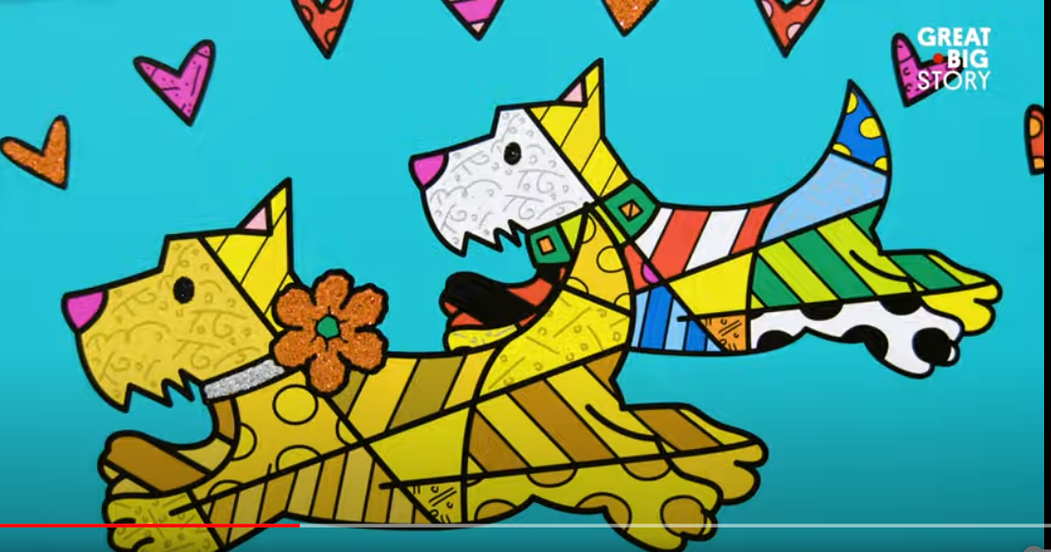
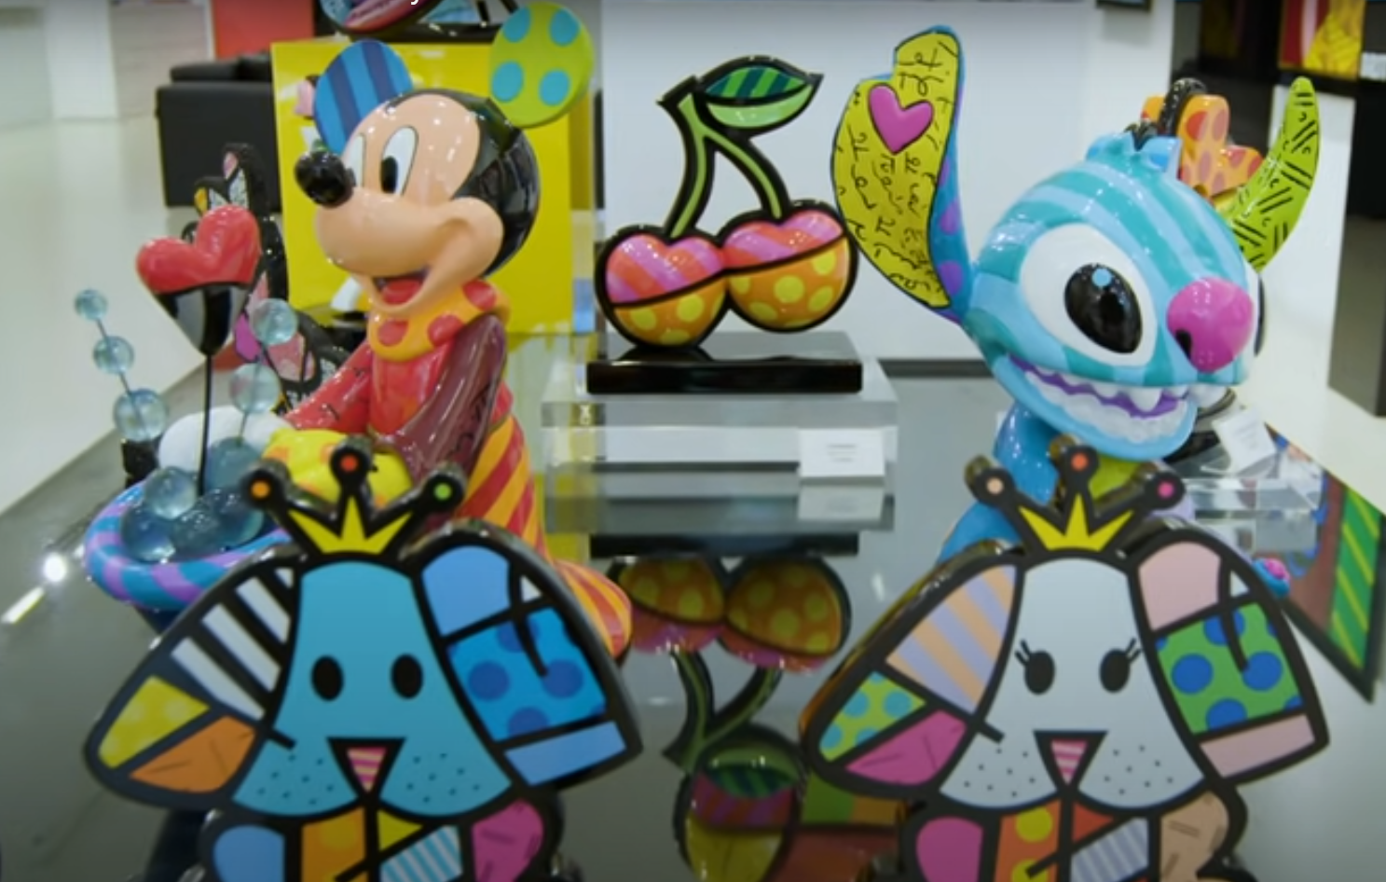
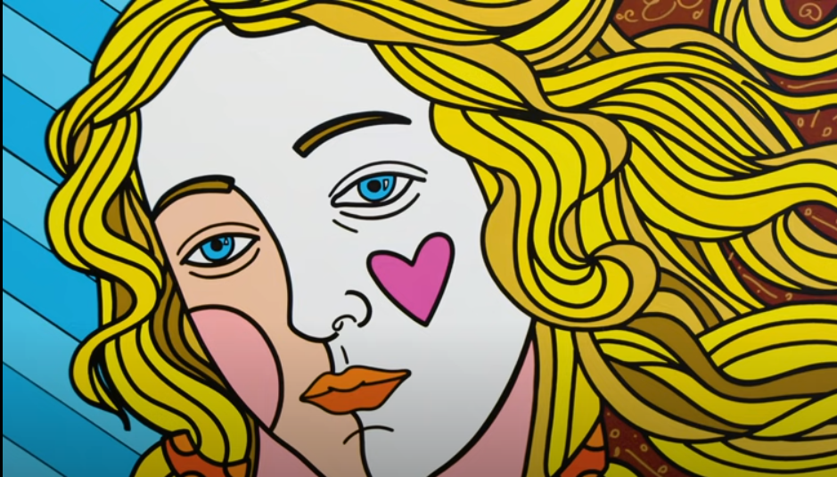
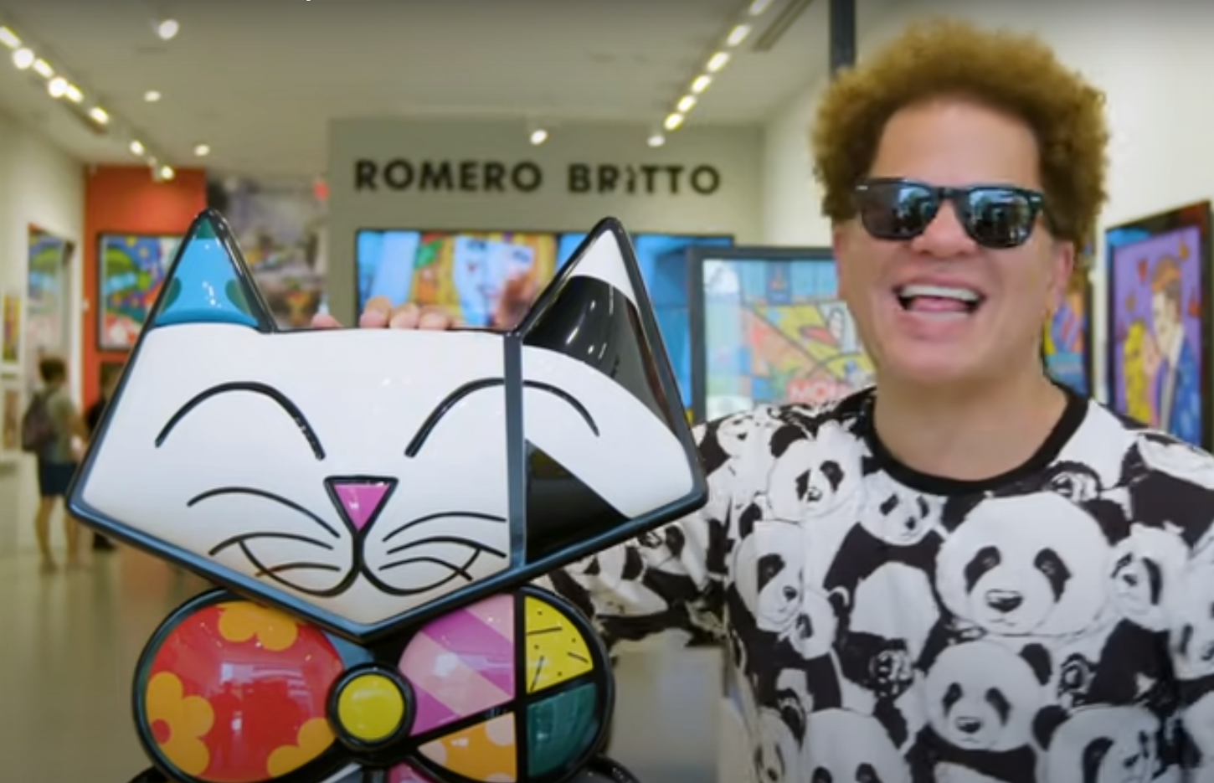
Who is Romero Britto (Most Licensed Artist)
https://www.youtube.com/watch?v=DFQRHjCOLy0

Slide 4
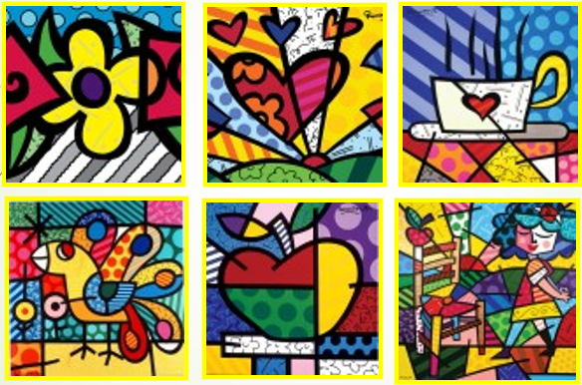
What techniques do you notice that Romero Britto use in most of his works?
Patterns
Cool Colors
Warm Colors
Contrasting
Bright Colors
White is used as a Color

Slide 5
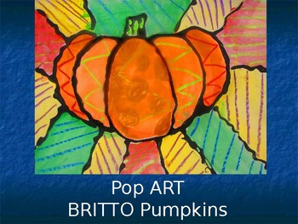
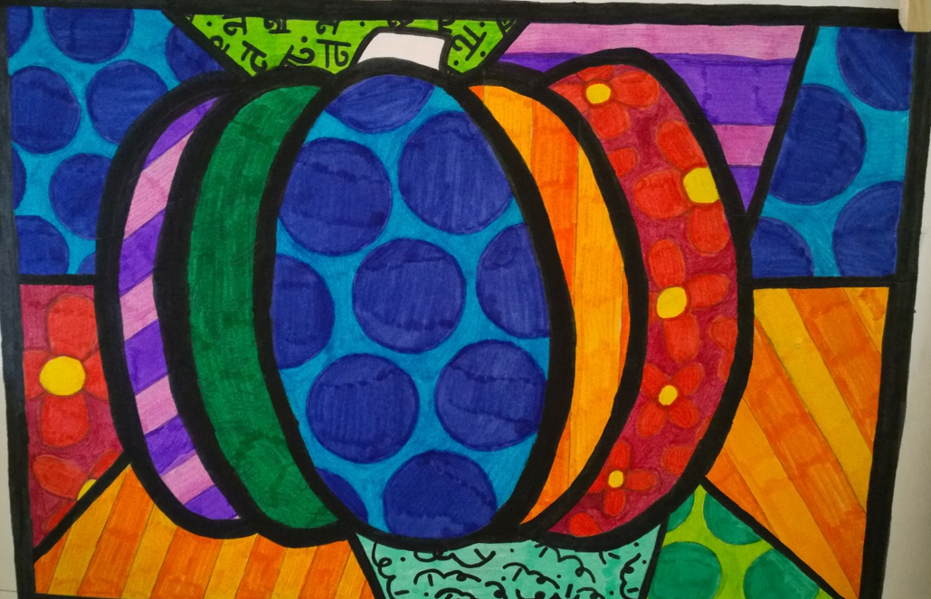
Today’s Project
Pumpkins

Slide 6
Instructions: Drawing the Background
Write your name on back of paper
With a pencil, lightly sketch the background lines (dividing lines)
DRAW 3 LINES for your background
Free hand
Does not need to be symmetrical or balanced
Depending on which pattern shape you used, you should have about 6 sections.

Slide 7
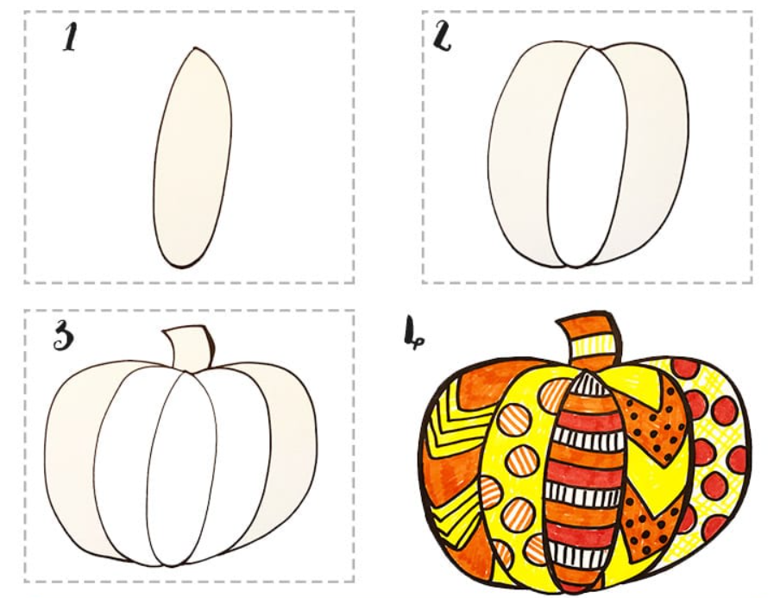
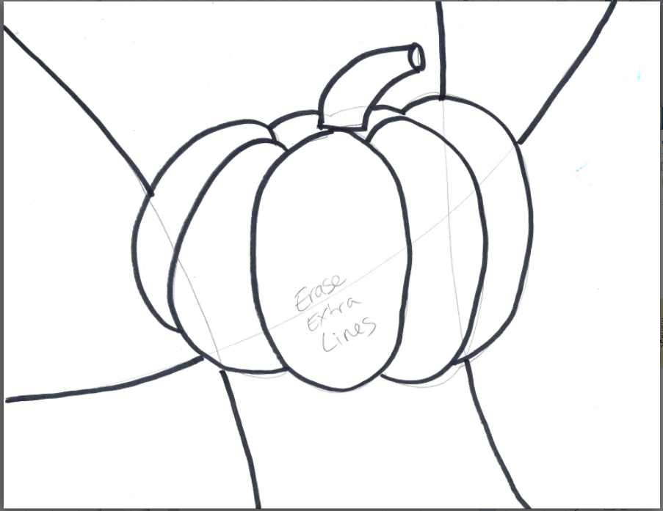
Instructions: Drawing the Focal Object
Lightly sketch your Pumpkin in the center of your paper.
Go big
Create 5 pumpkin sections
Erase the background lines that are in the center of your pumpkin
Using Fine Tip Sharpie (thicker sharpie)
Trace your pumpkin lines
Trace your background lines
Erase any remaining pencil marks

Slide 8
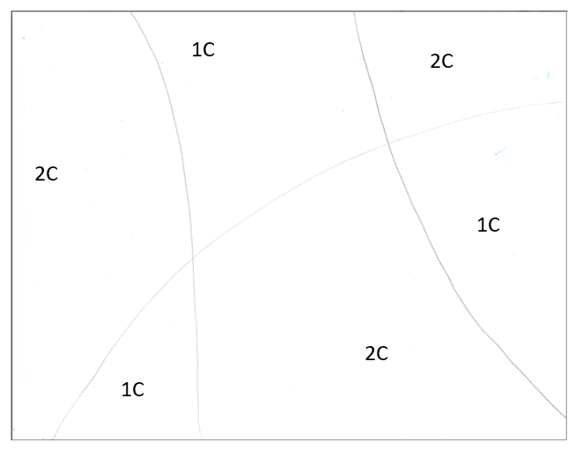
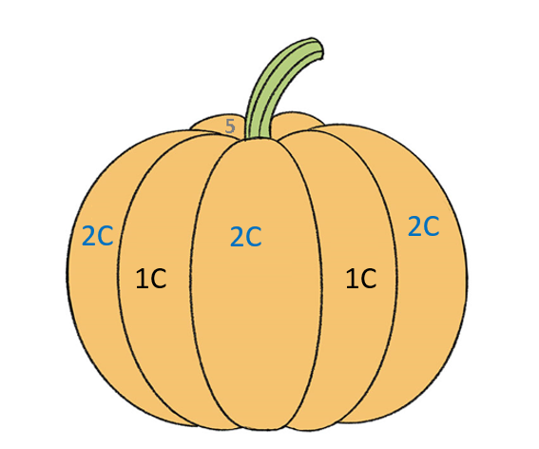
Instructions: Add Patterns
With pencil or ultra fine sharpie, add different patterns to each section of the background and Focal Object. (Pumpkin)
Use Roll A Britto pattern sheet to guide you.
Assign each section of your background a number (represented by the column number 2-5)
Write it very lightly to be erasable.
Alternate 1C and 2C patterns on your pumpkin sections
Write it very lightly to be erasable.
Roll the dice. Then draw the pattern in the column the dice number rolled.
Keep it simple!
Adjacent sections should not use the same pattern (or similar pattern)
1C = 1 Color Pattern
2C = 2 Colors Pattern

Slide 9
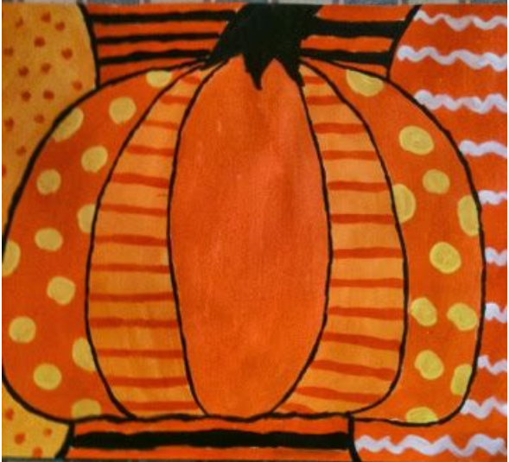
Instructions: Adding Patterns
Pumpkin Examples

Slide 10
Instructions: Adding Color
Choose COOL colors for your background
Choose WARM colors for your pumpkin or word. (or the opposite)
Start Coloring in your focal point
Use LIGHT Colors FIRST
Use DARK Colors LAST
Use Contrasting colors to make shapes POP!
Use good slow straight up and down or side to side strokes. Leaving NO white spaces.
Slow strokes will fill in all the white spaces and give an even color.
Tips:
It's okay to leave some areas white if that's part of your overall design, but in general, go for lots of color!
The trickiest part of this project is to keep your design "readable" .... try not to get so carried away with your patterns and colors that it becomes too "busy"!
Hint: Erase any pencil you don’t want showing throw marker. Pencil will not erase once colored over with markers!

Slide 11
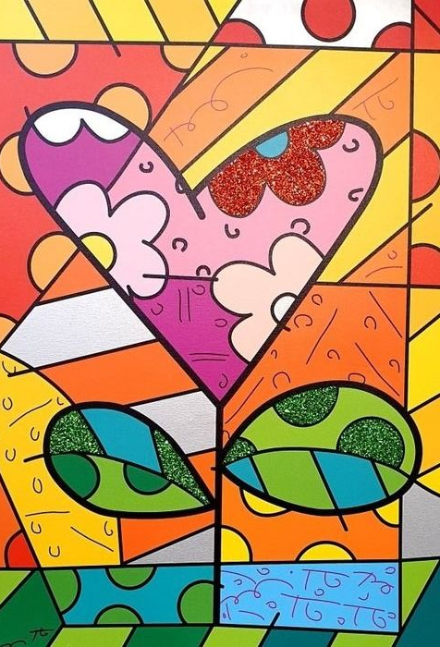
Finishing:
Optional –
To add real POP to your completed work, add glitter to one detail of your picture.
A heart
A Leaf
A Flower
Shapes
Use a fine tip paint brush to paint on the glue.
Sprinkle one color of glitter over the glue.

Slide 12
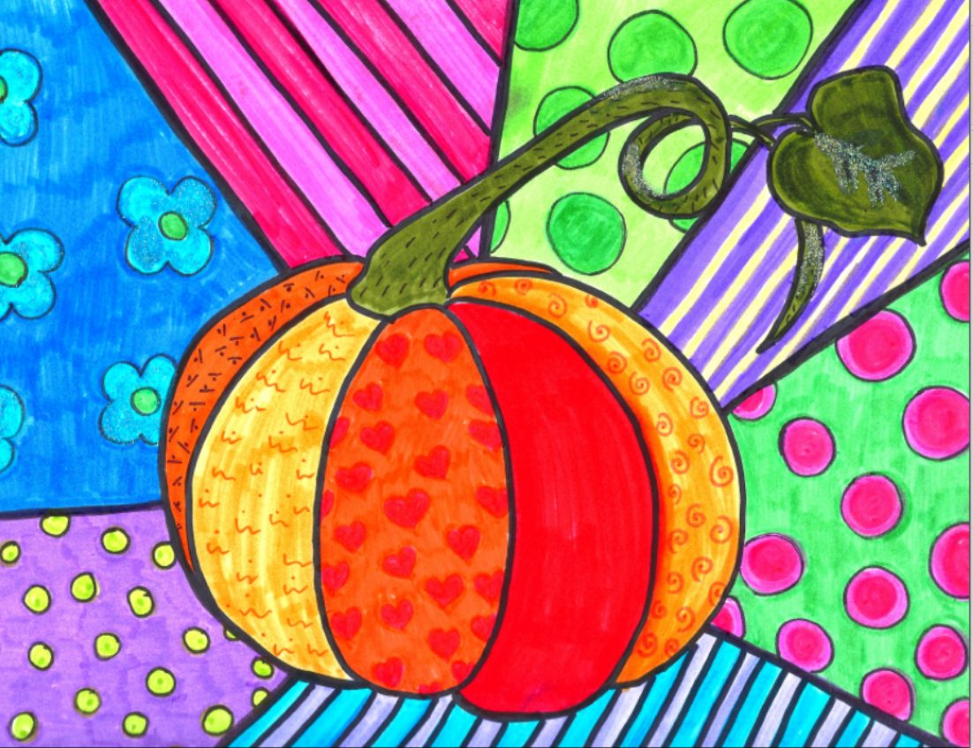
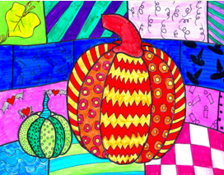

Slide 13
End of Pumpkin Presentation

Slide 14
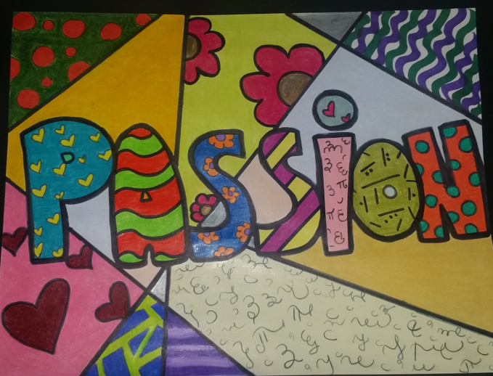
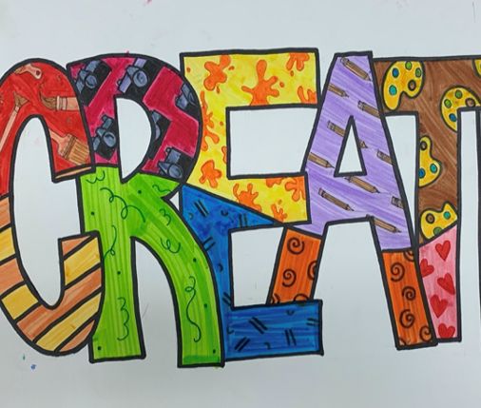
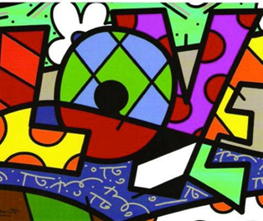
Today’s Project
Words!

Slide 15
Instructions: Drawing the Background
Write your name on back of paper
With a pencil, lightly sketch the background lines (dividing lines)
DRAW 3 LINES to create the sections.
Should come up with 6 sections.
Free hand
Does not need to be symmetrical or balanced

Slide 16
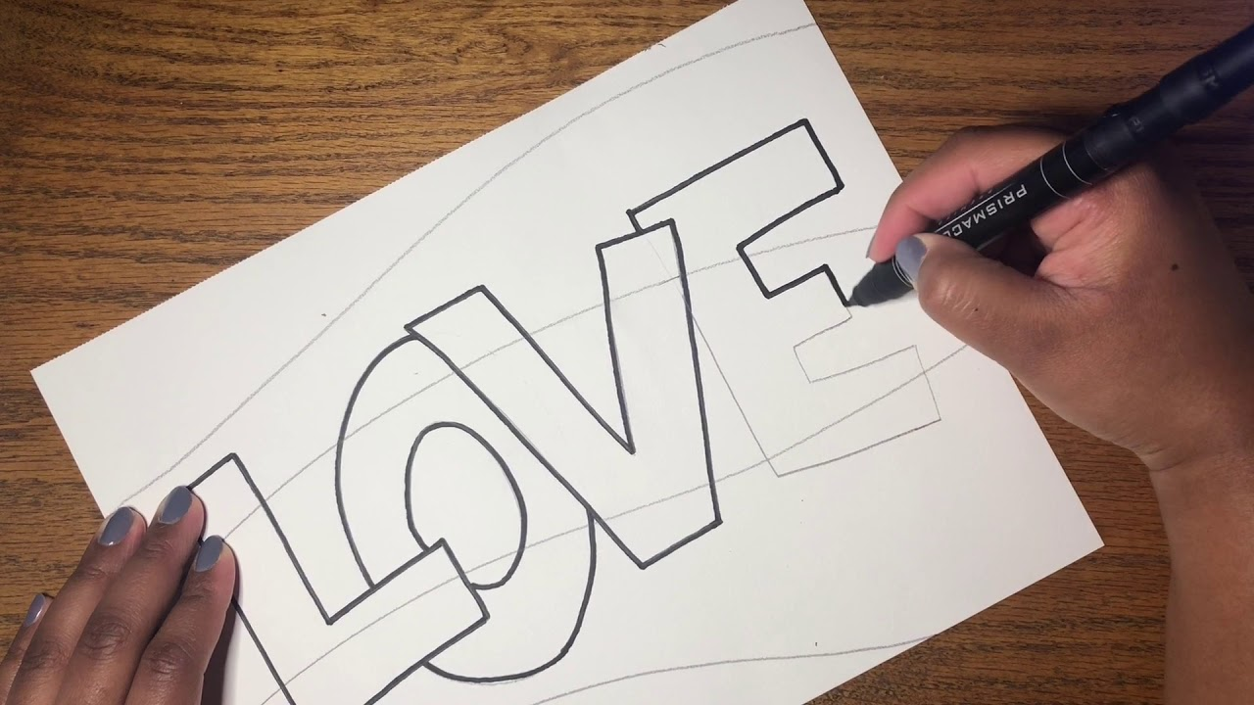
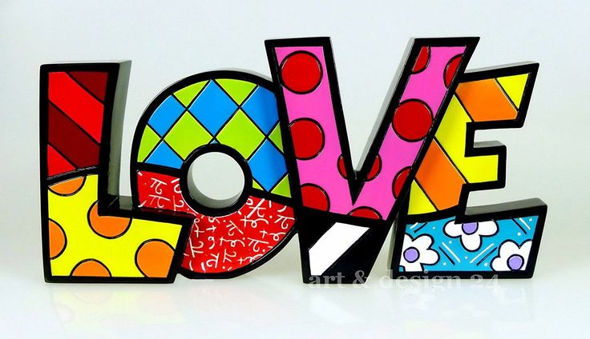
Instructions: Drawing the Focal Object
Lightly sketch your word.
Tall Narrow Block Letters
Each letter should be touching the next letter.
Center the word so you have 2-3 inches from the edge of paper on all sides.
Using Fine Tip (the thicker Sharpie), trace your pencil marks to outline your letters and your background lines
Erase any remaining pencil marks
With a pencil, divide each letter into 2 sections (3 at max)
Does NOT need to be symmetrical or balanced per letter.

Slide 17
Instructions: Add Patterns
With pencil or ultra fine sharpie, add different patterns to each section of the background and Focal Object.
Use Roll A Britto pattern sheet to guide you.
Assign each section of your background a letter (represented by the column letters)
Write it very lightly to be erasable.
Alternate 1C and 2C patterns on your WORD sections (or different 2C patterns next to each other)
Roll the dice. Then draw the pattern from the column the dice number rolled.
Adjacent sections should not use the same pattern (or similar pattern)
Keep it simple!

Slide 18
Instructions: Adding Patterns
Add patterns to your letters

Slide 19
Finishing:
Optional –
To add real POP to your completed work, add glitter to one detail of your picture.
A heart
A Leaf
A Flower
Shapes
Use a fine tip paint brush to paint on the glue.
Sprinkle one color of glitter over the glue.

Slide 20
Docent Information:
Materials Needed:
Smooth white 80# paper (9x12) (Bristol Smooth works best)
Markers in Bold Bright colors (fine tip and broad tip) – preferably 12 – 16 color choices
Pencils & Erasers (for sketching and erasing pencil marks)
Sharpies – Black – Ultra Fine and Fine tip (1 set per student)
Pattern Examples (ie: Roll A Britto, and dice)
Optional materials:
White Scratch paper to test markers and to prevent running off the page onto desks)
Rulers
Glitter – ultra fine
Elmer’s glue (in To-Go cups w/lids)
Fine tip paint brushes (for spreading the glue in small areas)
Paper to catch glitter when dusting off and putting back into bottles

Slide 21
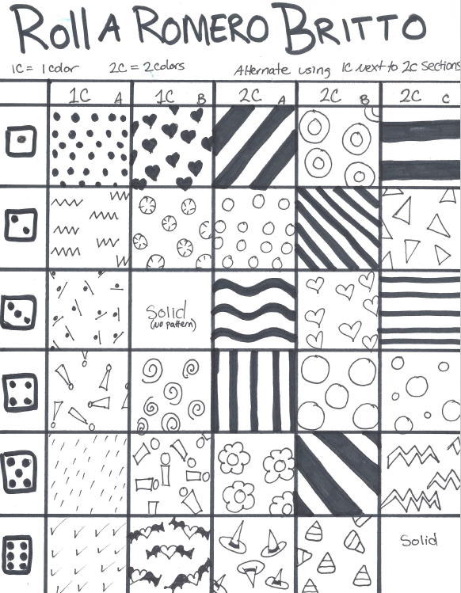
Notes:
PDF file of this sheet is stored on the 5th Grade Thumb drive and online Art Docent Website.

