Slide 1
RECYCLED ART
In this lesson, we will learn how some artists make new work from old stuff.
LAST UPDATED 4/4/2023

Slide 2
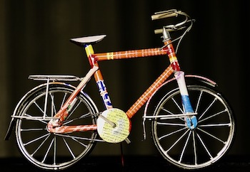
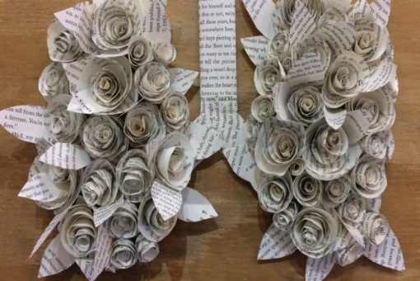
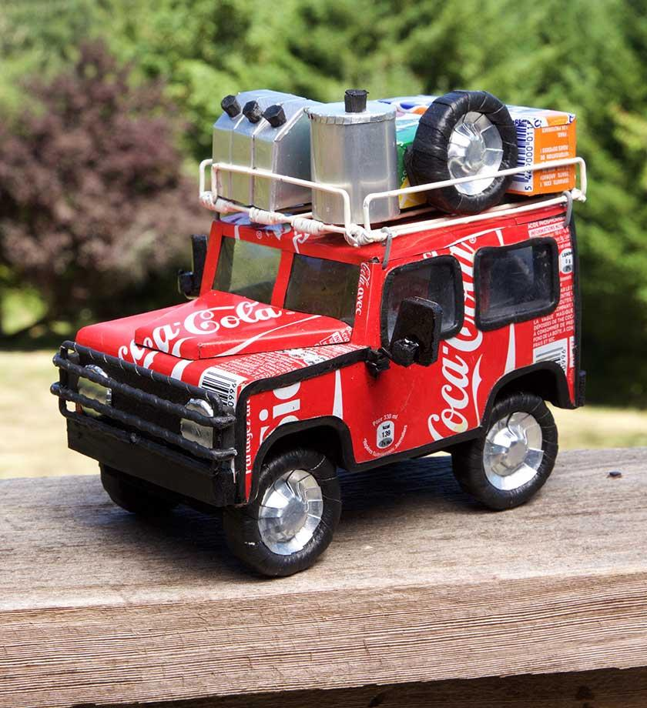
What Is Recycled Art?
Art can be made out of many things, including discarded materials and trash.
Think of everything you do during the day that generates empty boxes, bottles, plastic wrap and other things you throw away.
Did you know you can use that stuff to make art?
Artists who make recycled art take those materials and make them into something new.
There is no limit to what kinds of materials can be used.

Slide 3
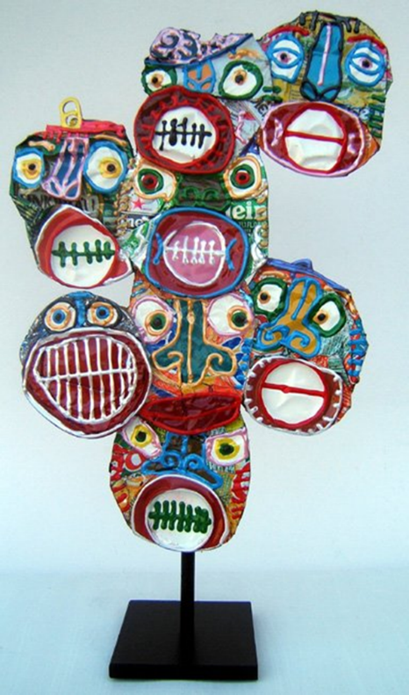
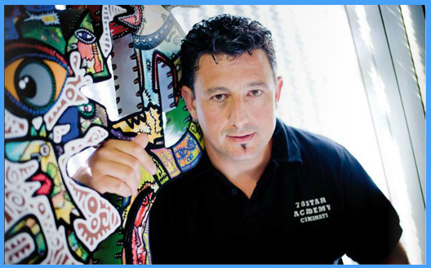
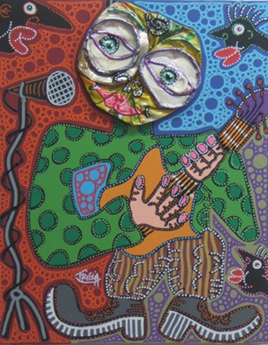
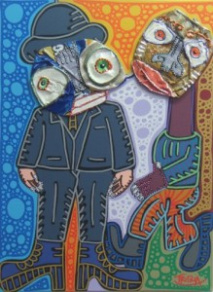
D i d i e r T r i g l i a
Triglia was born in France in 1966.
He is a self taught artist who has proven himself as an important New Generation artist in the world of French and International collectors.
Triglia brings a mixture of characters and primitive symbols that create a personal mythology.
He uses joyous, playful and vibrant colors.
Didier Triglia creates heads out of crushed cans and then he paints them.

Slide 4
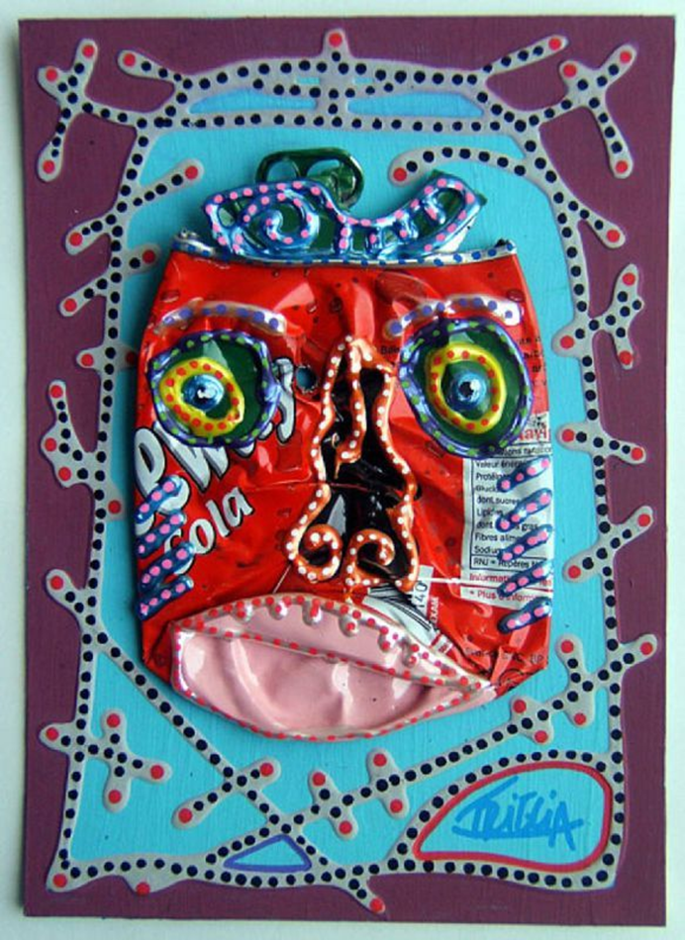
“I do not crush, they already are”
For Didier Triglia, the sight of a crushed can signifies the beginning of the adventure. He does not crush the cans himself, but wanders around finding cans that have been crushed already in the streets.
Triglia uses a variety of colors and characters.
They are sometimes sad, funny or angry. His creations are so human like that you can almost forget the can.
Are you ready to begin your artistic adventure ?

Slide 5
Materials Needed
Empty soda cans – Precrushed
• Paper paper (neon cardstock 8.5x11, Colored Tagboard cut to 11x14)
• Permanent paint (Acrylic)
Paintbrushes size 0-4
Water cups w/water
Absorbent paper towels (to wipe hands or brushes) per student
• Colored Sharpies Or Paint Pens
• Squeezable paint/puffy paint
• Hot Glue
Aileen’s Tacky Glue

Slide 6
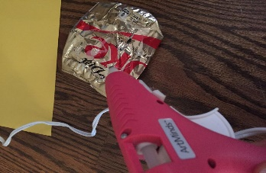
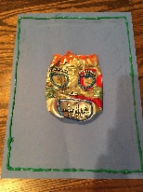
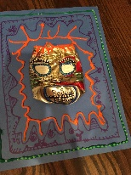
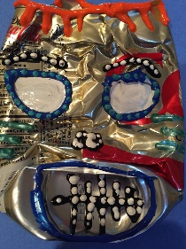
Instructions
Step 1
Pick a can and a piece of colored cardstock paper and a larger background tag board of contrasting color.
Step 2
Attach can to paper using glue. Adult will do this.
Step 3
Design a background for the can. Draw the border first using a sharpie (or paint pens, or thin brushes with acrylic paint) to create patterns. Patterns can just be lines, or squiggles with no facial details for the background.
Step 4
Use permanent paint to design the face. Use puffy paint to outline the face features: eyes, eyebrows, hair, mouth and nose. After you have done outlines go ahead and dot all borders with an accent puff paint.

Slide 7
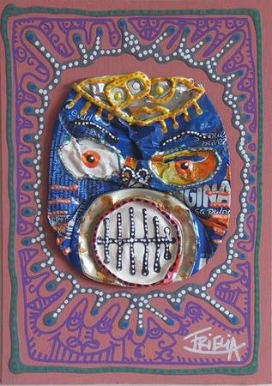
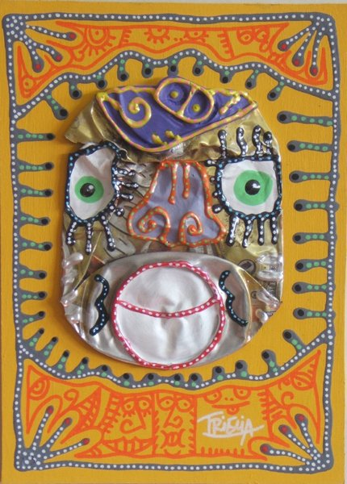
The End

Slide 8
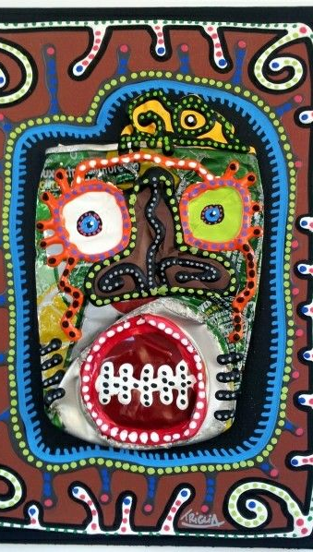
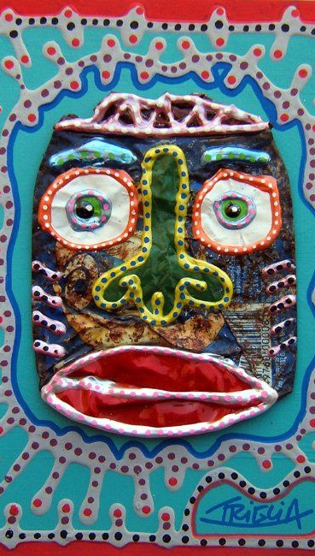
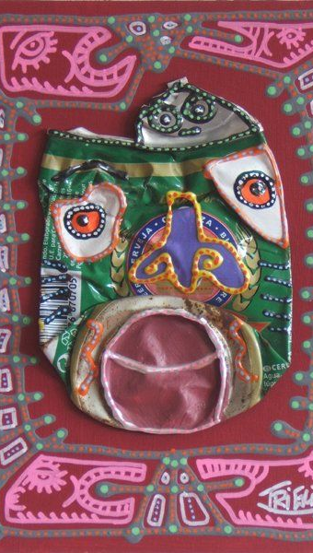
Print out of Ideas

Slide 9
Notes to the Docent
Setup:
Use the end of hall Pods to allow sharing of supplies and it can get messy.
I didn’t pour acrylic paints out for every table, rather I let the students decide if they wanted to use paint and to come get a small cup of it from the front of the room. I prefilled the water cups, but I left them on the sink counter for them to grab as needed. This greatly reduced the wasted paint and the number of brushes and paint palettes to wash.
I set out one set of puff paints per table. These are organized using the larger water cups (which holds 1 bottle of each color). There are 5 cups with a rainbow supply of puff paints. (Btw, I learned that many kids didn't know what puff paint was, so plan on explaining it to them. It can be squeezed on or painted on). I transferred some puff paint colors into squeeze bottles with metal tips to give them smaller dots and lines. I placed two metal tip bottles on each table. Students borrowed from other tables if they wanted a different color.
Each table got their own set of paint pens. I explained how to use them. Shake, press down on scrap paper (butcher paper) to get the paint flowing, then draw on your project.
New pens need to be pressed longer.
LIDs MUST be put back on the pens immediately after use. I discouraged them from using the pens from filling in large areas which would use up the paint and we would run out before the last class gets to use them. I placed whole box of pens (1 set) per table. The kids took them out of the box and put them all back too.
I used 5 tables with 4-5 seats. I set out the tag board and pre-chose the neon card stock in a contrasting color for every seat. This greatly reduced the amount of time by not allowing students to pick their own colors from a stack.
I dumped all the crushed cans on the short skinny table across from the printer on the carpeted area of the hallway. They came in from outside, turned left to pick their can. I told the students to pick out a can that "speaks to them or inspires them" then go find a seat based on the color of their can and the paper colors already at the seat. No swapping colors.
I walked them through using Aileen's tacky glue to draw on a border of glue and a skinny circle in the center of the card stock. Then turn it over and center it onto the tag board. Press down firmly and use a hard object (like glue bottle, paint pen) to press it down more to flatten the glue and smooth out the edges so they lay flat.
I plugged in the glue guns 15 minutes before class. I used 3 guns at the sink counter. The teacher, my son, and I each took a station and we released the tables one by one, with the table closest to the counter first. We asked each student to place their can exactly where they wanted it on the paper and then we quickly glued the hot glue to the areas of the can that contacted the paper. Do this quickly, as the glue starts to harden fast.
While the students waited at their tables for their hot glue turn, I instructed them to use the paint pens to draw their borders. We want large thick borders. They can use paint pens to outline then acrylic paint and brushes to fill in to make thicker.
I used the TV and PowerPoint to show the project in the Pod. The USB thumb drive is in the bin for you too.
I left the PPT instruction slide up on the screen while we glued the cans onto the card stock. Then when everyone was glued, I switched the slide to the last one that shows examples.
I showed the artist's signature on his artwork and had the kids sign their name on the front of their artwork too.
See photos of class set up for more ideas. I also wrote on the whiteboard some tips on using the supplies.
When the kids finished, they placed their artwork on the black metal shelves by the white board. The puff paint takes forever to dry. Be very careful as it is super easy to smudge their borders. Don't use the shorter drying rack, as there is not enough separation between layers with the thick cans attached.

Slide 10
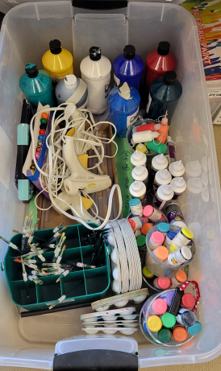
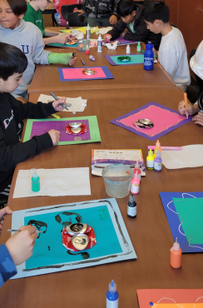
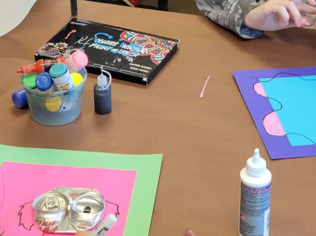
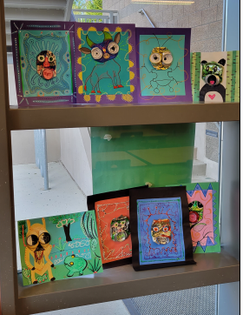
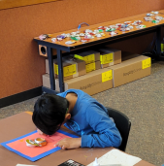
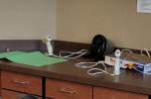
Classroom setup ideas
Water cup[ used to hold 1 set of puff paint colors, 1 box of paint pens, 1 Aileen’s Tacky
Glue per table.
Bin with all the supplies used. Paper stored elsewhere.
Pre-crushed soda cans
Hot Glue station.
Displaying example work on window sill.

Slide 11
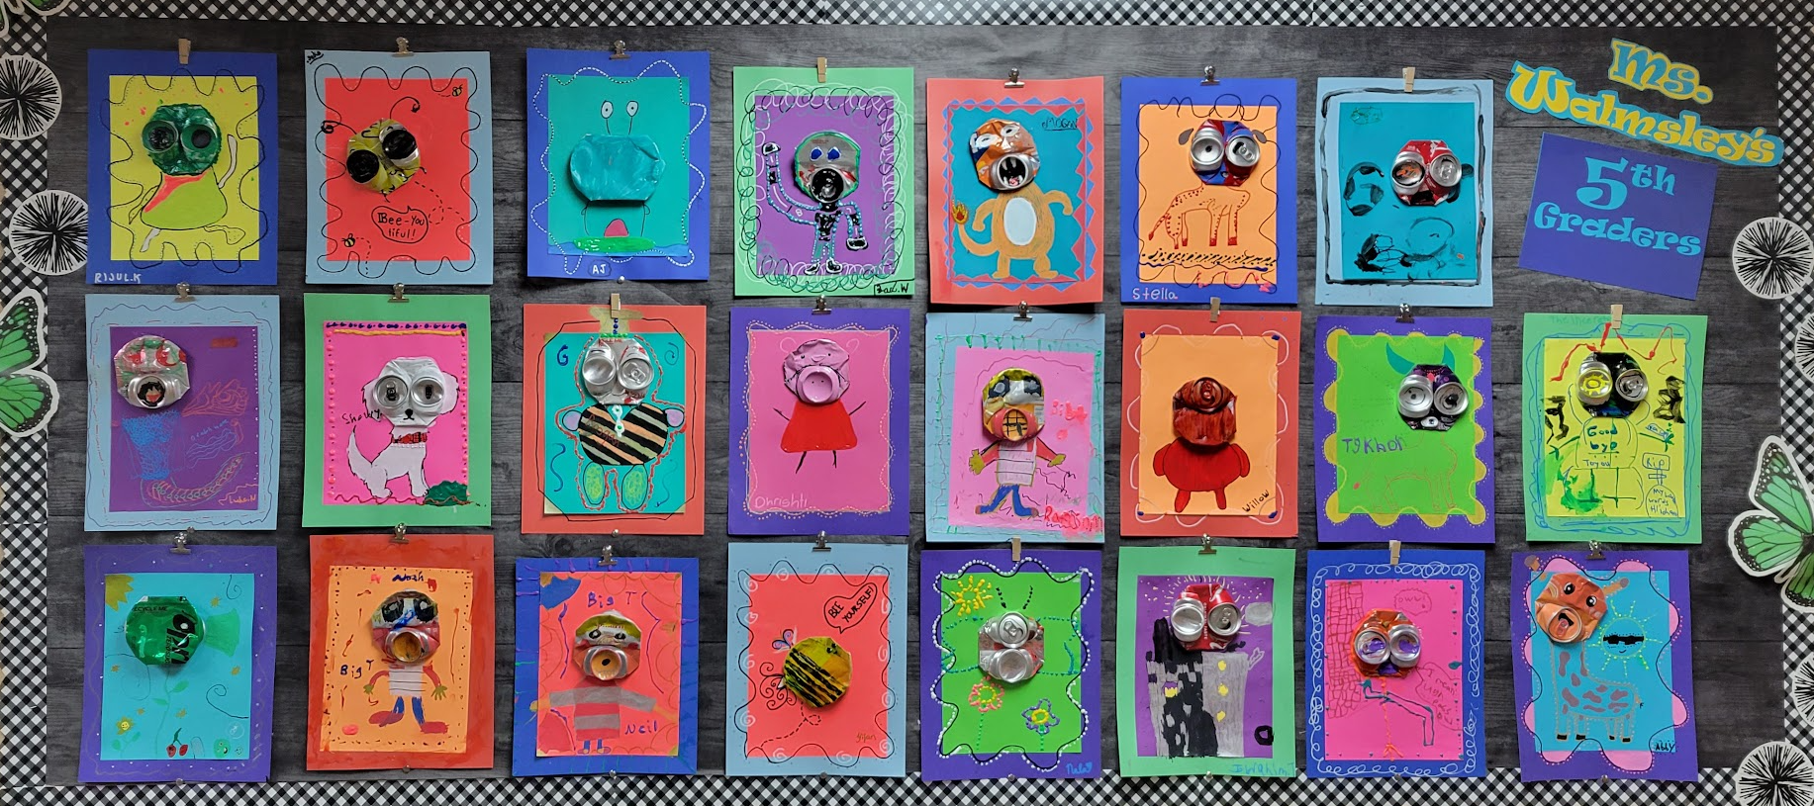
Displaying Art

