Slide 1
Metal Embossing
5th Grade

Slide 2
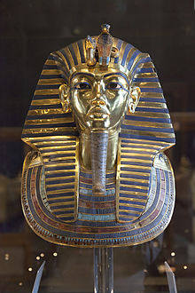
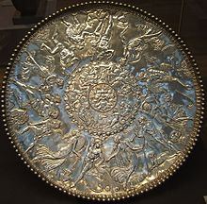
Types of Metal Embossing
Repoussé (re-poo-say) is a metalworking technique in which metal is shaped on the back side with tools to create a raised design on the front side of the metal.
Chasing is the opposite of repoussé and is used to refine the design from the front of the work by sinking the metal.
Famous examples of Repoussé and Chasing
The Mummy mask of Tutankhaman
The Statue of Liberty
The Great Plate of Bacchus

Slide 3
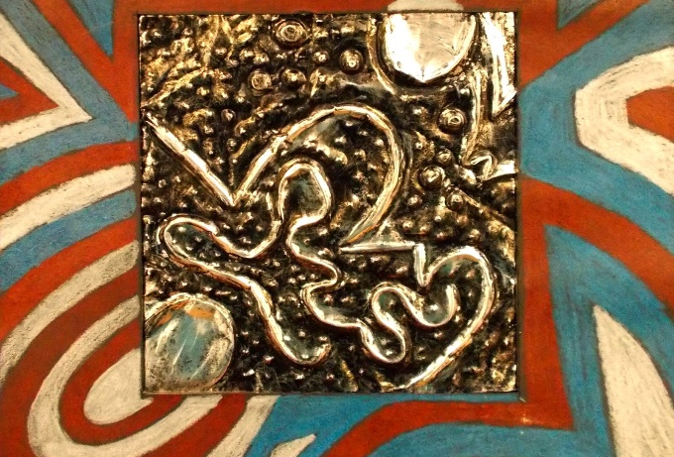
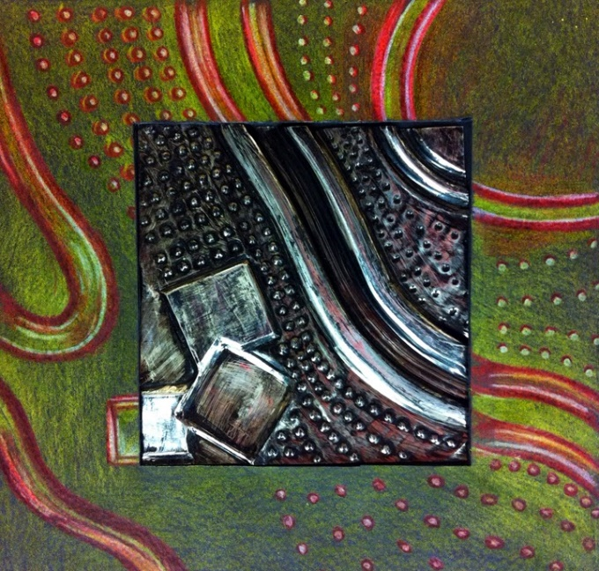
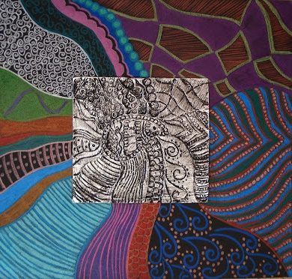
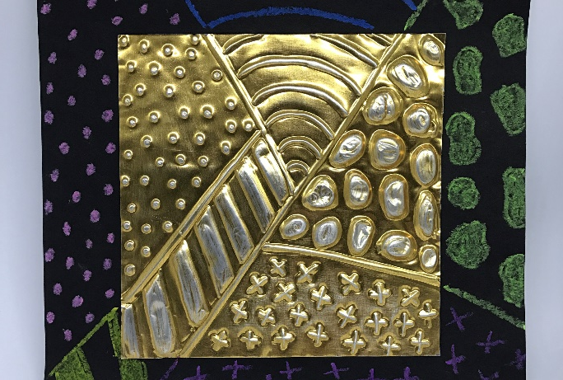
Today’s project…

Slide 4
MATERIALS
Per student:
1 foam mat
1 dull pencil
1 piece of 2”x2” metal
1 piece of 6”x6” metal
1 piece of black cardstock
4 sticky dots
Colored pencils
Metallic Sharpies
Pattern sheets
If antiquing:
Black tempera paint
Large paint brushes
Paper towels
**REMINDER: The metal is sharp on the edge and can cut you. Please handle with care!

Slide 5
STEP 1: EMBOSSING
Practice – You need a DULL pencil (a colored pencil works well), a small (2”x2”)piece of metal, and a piece of foam on which to place the metal.
See how much depth you can create. Push hard enough to poke through the metal. This will help you see the amount of pressure needed to emboss without poking through.
You want to build depth slowly by going over lines multiple times.
You can work from both sides of the metal.
Emboss your designs on your larger (6”x6”) piece of metal (also place on the piece of foam)
**CHOICE** Decide which side you want facing up. Silver or Copper?
Lines – Draw some lines that divide your piece into several different sections. They can be straight or curvy.
Texture – Draw a different pattern in each section. You can work on the front and the back of the material to create different patterns. You may use your smaller piece of metal to practice.

Slide 6
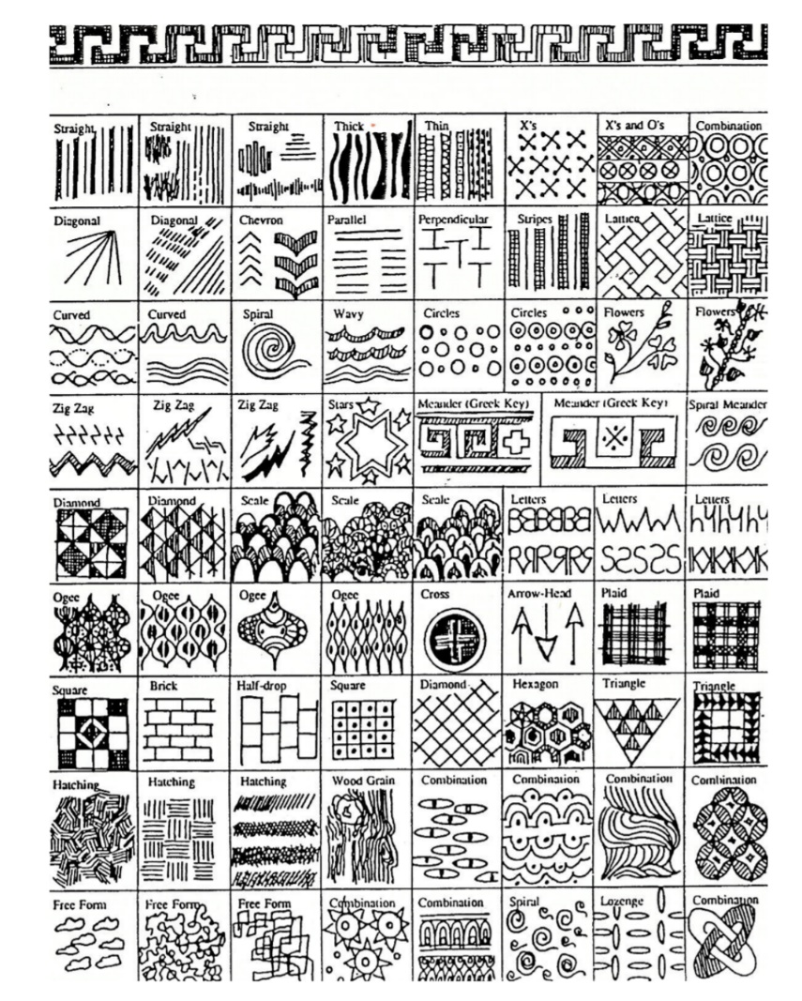
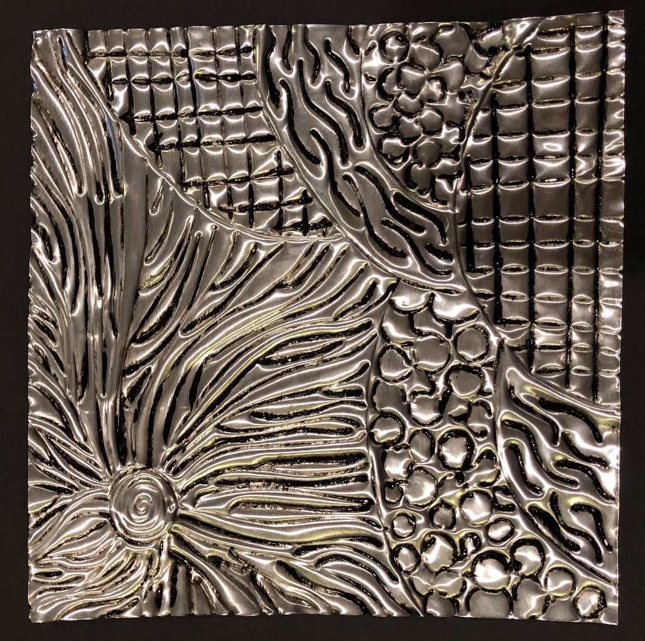
STEP 1: EMBOSSING (continued)
Need Ideas?
Take a look at some of the sample pieces. You can also get pattern ideas from the handout.

Slide 7
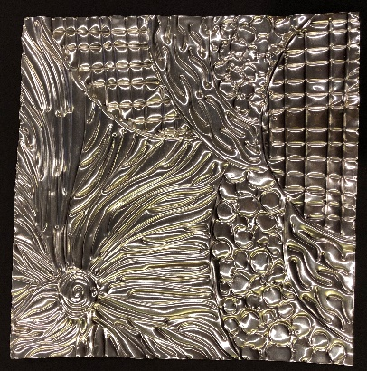
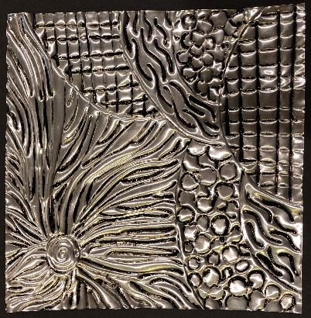
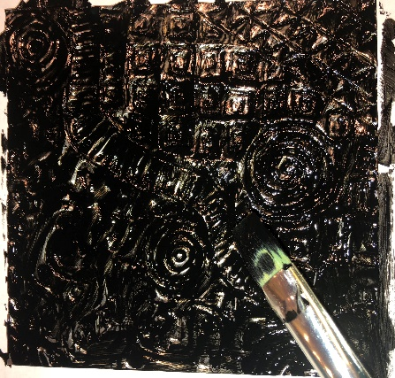
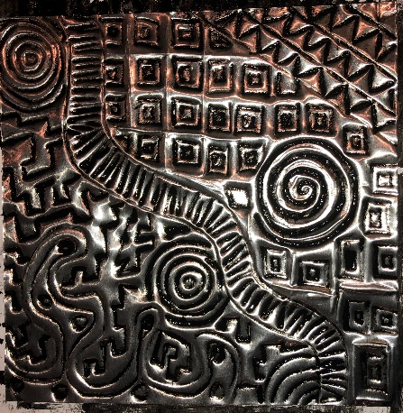
**CHOICE** Decide which side you want to display.
STEP 2: ANTIQUING (OR NOT)
**CHOICE** Decide if you want to antique your metal piece.
Not antiqued Antiqued
Cover the front of your metal piece completely with black tempera paint. Make sure to get in all the crevices.
Wipe mostly off with a paper towel. Just a little bit of black paint should be left behind in the crevices.

Slide 8
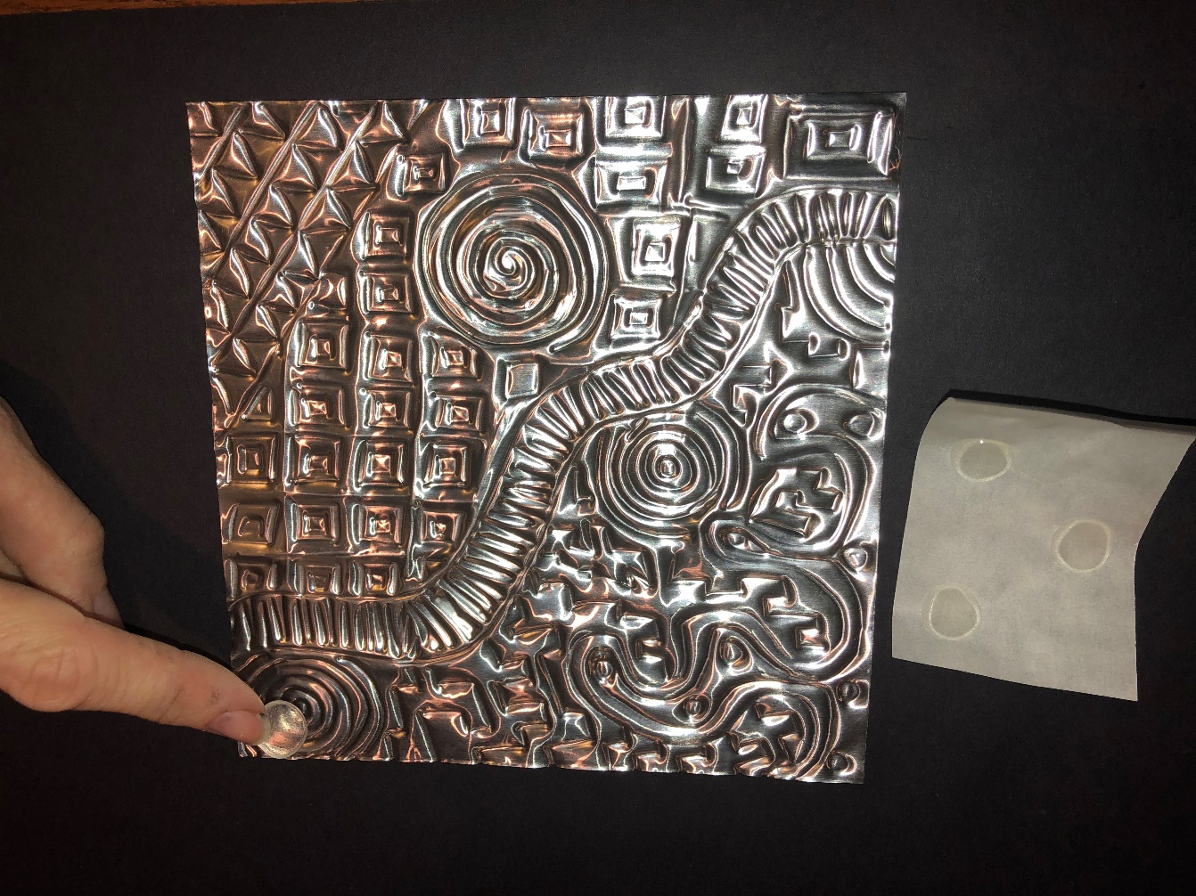
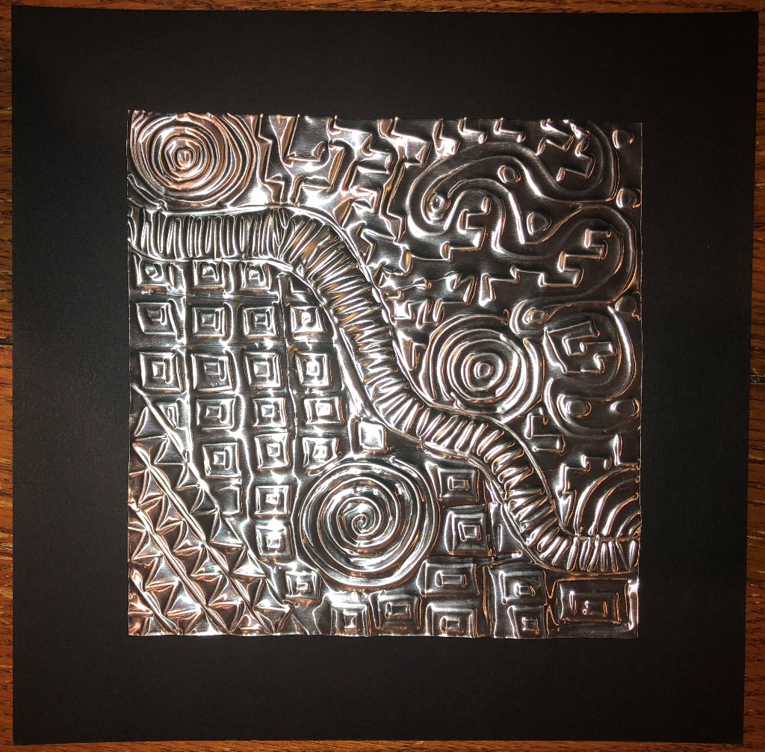
STEP 3: MOUNT ON BLACK PAPER
Get 4 sticky dots and place one on each corner of the back of your metal piece.
Stick to the middle of a black piece of tag board.
Push on the corners to make sure they stick.

Slide 9
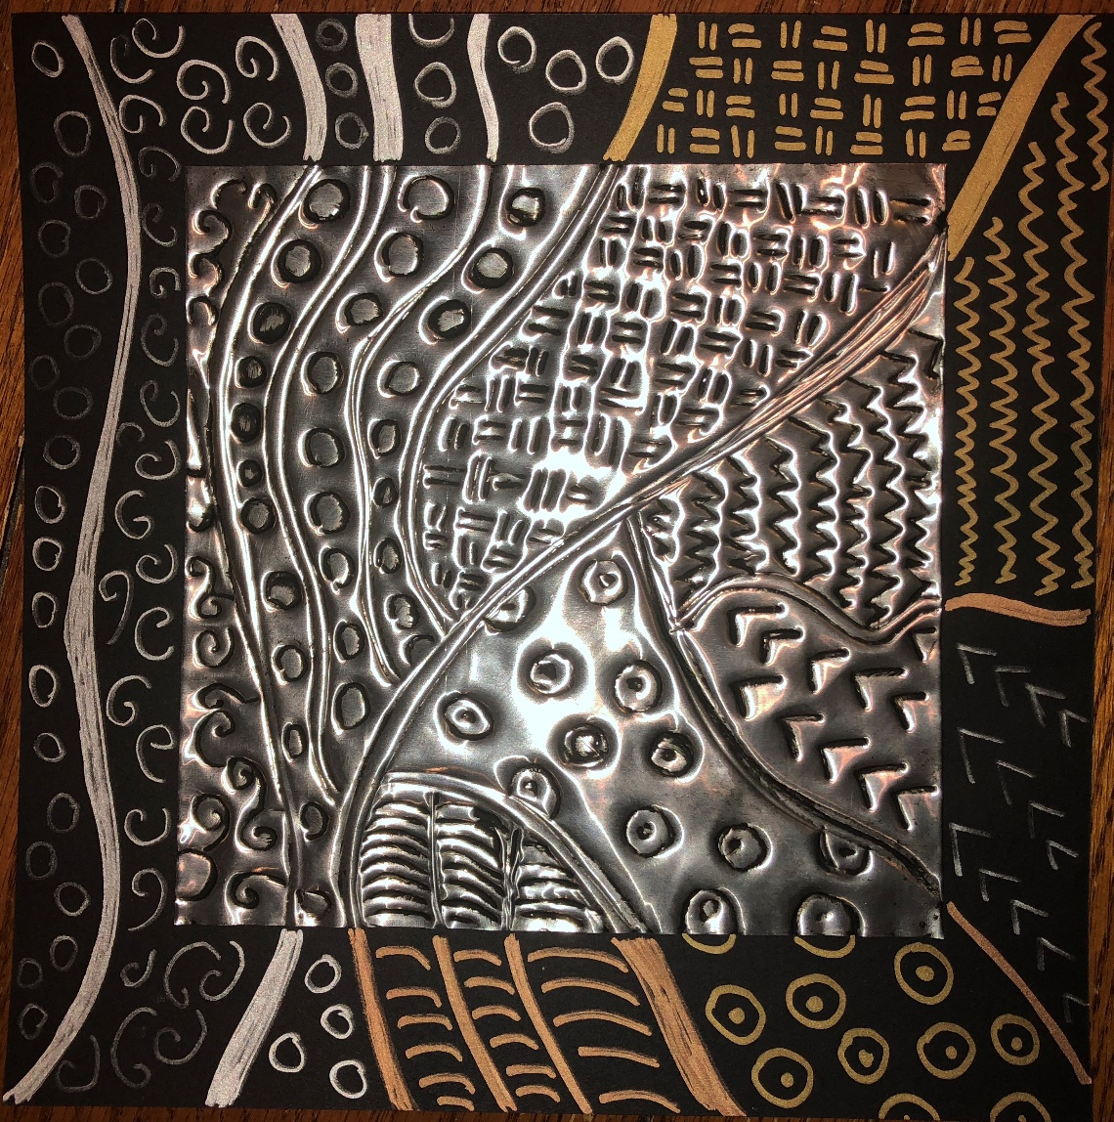
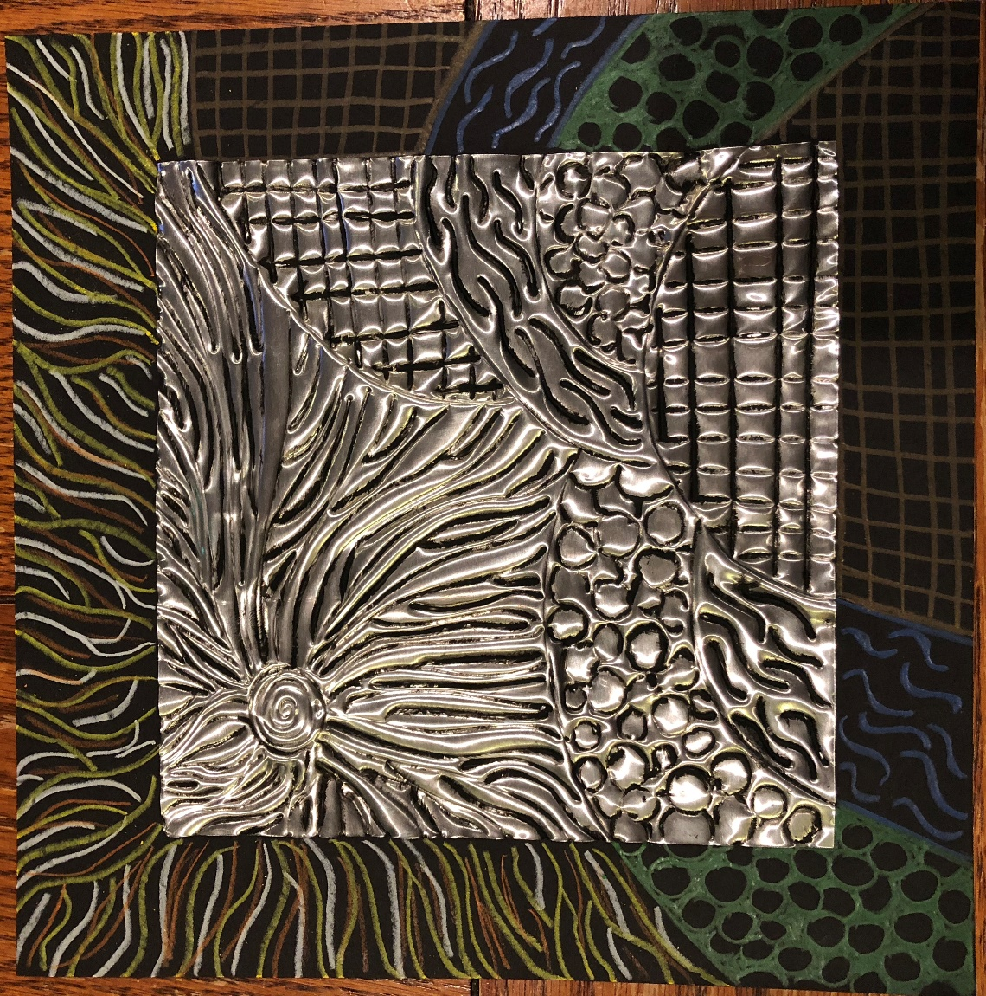
STEP 4: CONTINUE PATTERNS ON BLACK PAPER
**CHOICE** Decide if you want to use colored pencils or metallic Sharpies.

