Slide 1
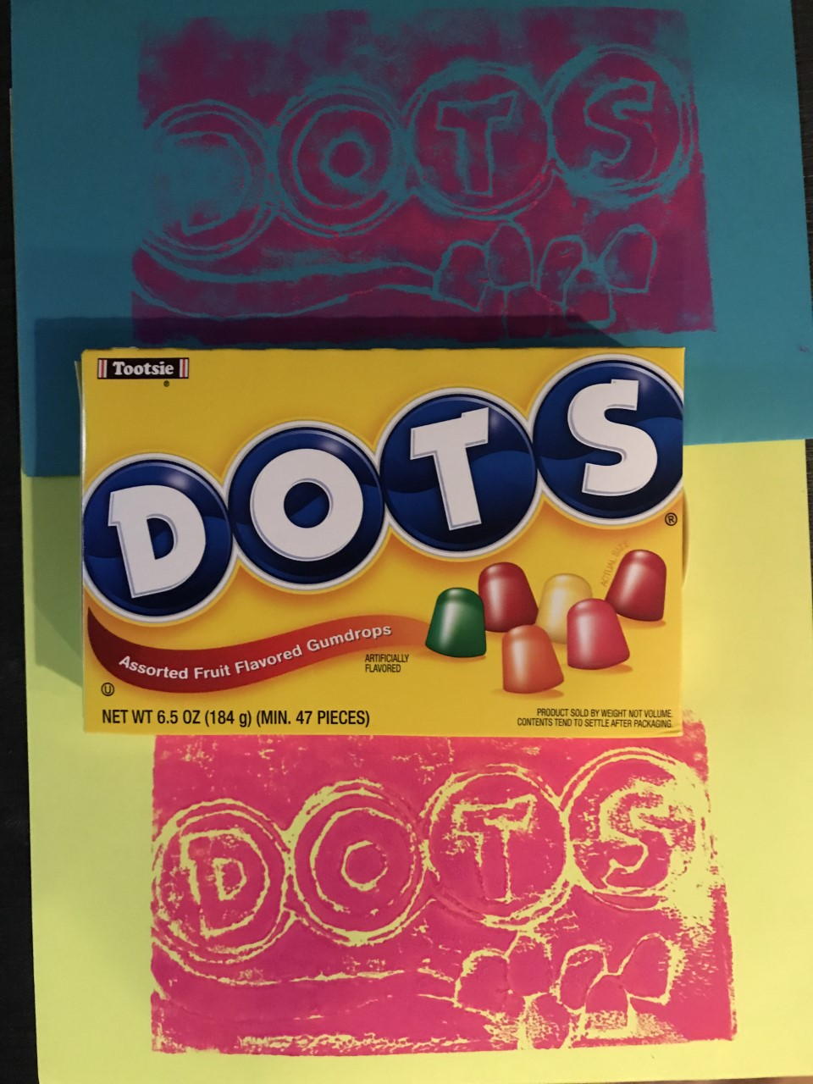
Printmaking Candy
Art Element:
Line
Master Artist:
Andy Warhol
Notes:
Lesson time 75 Minutes

Slide 2
Master Artist:
Andy Warhol
American, 1928-1987
Andy Warhol was a modern artist, best known for creating the Pop Art movement.
When Andy was only 8 years old, living in Pennsylvania, he caught a disease that left him
bedridden. While in bed recovering, his mother taught him to draw to pass the time. When he finished high school, he decided to study art at Carnegie Mellon University. He went on to become a commercial artist. After doing this for awhile, he decided to experiment with a new style of art called Pop Art – in this style, he created images of commercial goods, such as soup cans. In one art project, he painted 200 Campbell’s soup cans. He often used printmaking to create these works of art. He also liked to create art using people’s pictures, such as Marilyn Monroe. He would repeat the same image over and over, but play with color and
effects. Even after his death, his work still is sought by art collectors. His painting called
“Green Car Crash”, sold at auction in 2007 for $71.7 million dollars!

Slide 3
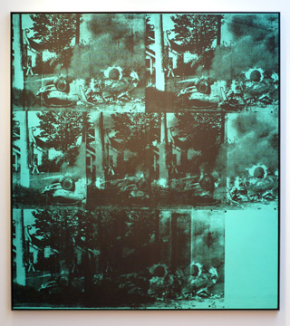
Green Car Crash 1963

Slide 4
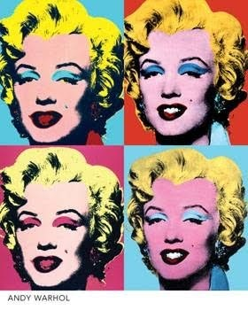
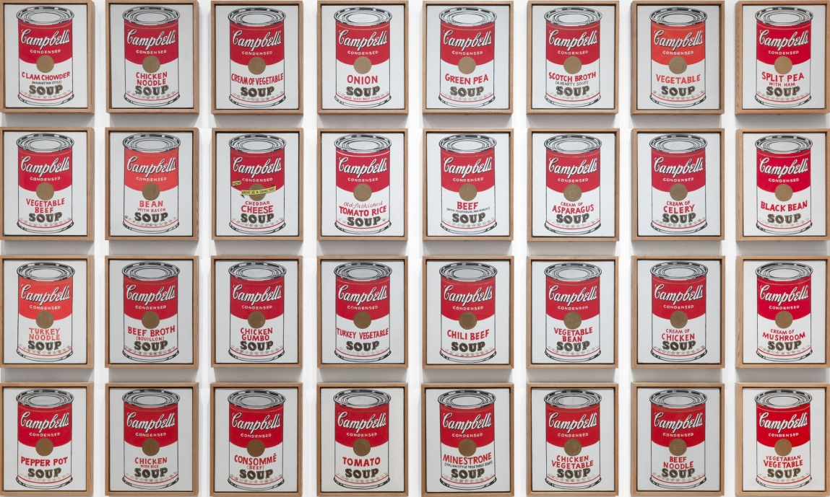

Slide 5
Medium:
Today we will use an object to “make prints”...
we are using Styrofoam scratch foam and
making our own print plates , based on a favorite candy
Art Element:
Line: lines can be wavy, straight, zig-zagged, criss-crossed, etc. An artist can show an image/ idea with a single line or multiple lines. Today, your candy image will be made of various lines

Slide 6
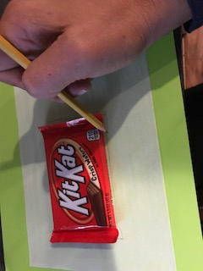
Lesson Steps
1.Choose which candy you would like to use for your print plate –take a minute to study its details –its overall shape, the font/ lettering used, the details, the edges of the packaging or any textures you see
2.Now, using your pencil, draw the outline of your candy shape, filling the tracing paper with your shape.

Slide 7
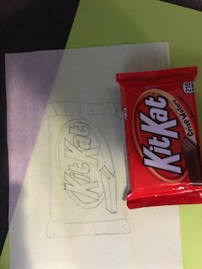
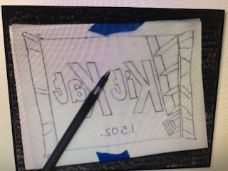
3. Next, add the lettering of your candy (if applicable)Finally, add any details you observe (packaging design, texture, images on the wrapper) * important: leave out very tiny details, such as weight or calories you see in fine print... these will not print well
4. Now you are ready to transfer this design to your print plate. Use 2 small pieces of blue painter’s tape to tape down your design (backwards!) on your Styrofoam sheet. If you tape it on front ways, your print image will come out in reverse.

Slide 8
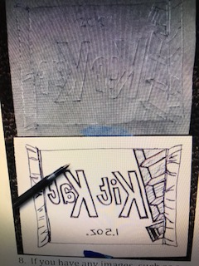
5. Using your ball point pen, trace over all your lines using firm pressure.
6. Carefully, remove one side of your tape and check to see you have transferred all the lines and details. If you have, remove the tracing paper.
Now, go over all of your lines again, using firm pressure and making all the lines wider. Remember that anywhere you have dark, thick lines, your paper color will show through. You do not need to make darker lines around the edge of your candy, as you will be cutting it out. Just focus on the inside lines.
8. If you have any images, such as a
strawberry, on your wrapper, you may
choose to black them out with your
pen (this will allow the paper color to
show through)

Slide 9
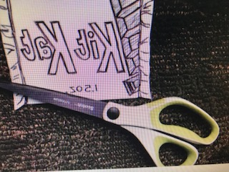
9. When you are satisfied with your work, have a parent helper check it. If they think it looks good, you may now CAREFULLY cut around your candy image.

Slide 10
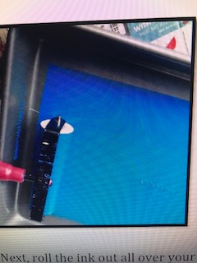
10. Now you are ready to print! Take your print plate to a print station
11. Select 4 different colors of paper to print on. Write your name on all 4 pieces with a pencil.
12. To print your candy image, first roll through the ink until you hear a “tick tick” sound. This means that the ink is thin enough to print with (and it won’t blob up in your ridges/ lines you just carved)

Slide 11
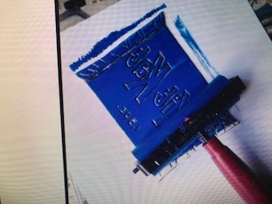
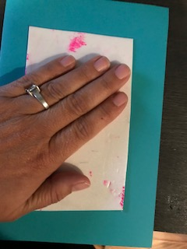
13. Next, roll the ink out all over your candy print plate (on top of one sheet of scrap paper). When it is evenly covered, turn it over carefully and position it in the center of your first sheet of paper. Using the back of your hand, apply even pressure and rub all over the print plate.

Slide 12
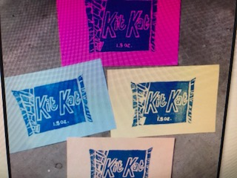
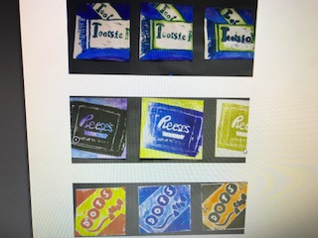
14. Now, carefully “peel to reveal” your image. Voila! You have created a candy print!
15. Repeat using the other 3 sheets of paper. Please use a new sheet of scrap paper underneath each time you roll ink for a new print. If you have a misprint, just make a new one.
16. Lay your prints in the specified drying area.
17. Clean up your area and wash up!

Slide 13
Art Docent Prep: Gather the following:
Tracing paper, Pencils
Candy boxes or photo copies
Ball point pens
Scratch foam
bright papers cut–enough for 3-4 per student
printing ink that will have good contrast with the bright papers
student should choose one color ink and print all 3/4 with that, otherwise it is messy to wash off print plates and dry to change colors
Cookie sheets
Brayers (rollers)
Paper to cover tables
Scrap paper(lots)
Blue painter’s tape
Wipes or paper towels for cleanup
To set up the print
stations:
Put 2 brayers (rollers) on each cookie sheet, and one cookie sheet per table or station. Do not squeeze out and roll out ink until kids are ready to print –it dries very quickly.
The rollers and cookie sheets will wash off easily using a paper towel and water.
When prints have dried, you can trim up the images using a paper cutter, then mount them (either with glue stick or tape runner tool) in a series on large black construction paper or poster board (either horizontally or in a square)

