Slide 1
Seahawks Painting
Please get out a sharpened pencil, a good eraser, and a ruler

Slide 2
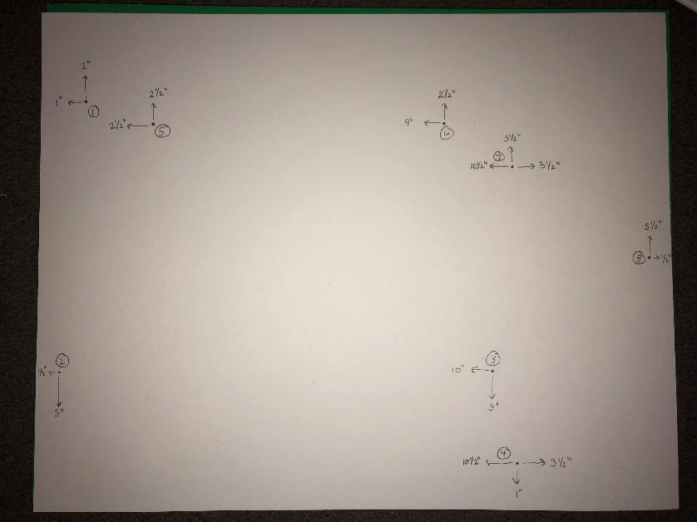
Dots
Only do 1 – 4 right now
Notes:
.5” from the side draw a light curve for the edge of the beak.

Slide 3
Connect dots 1 – 4 and then place dots 5 – 8

Slide 4
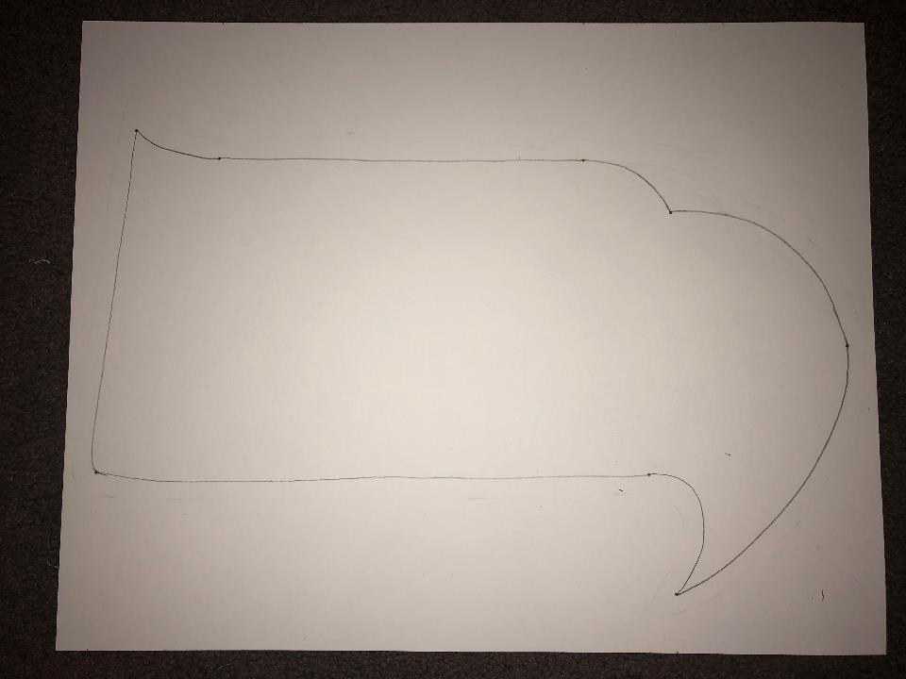

Slide 5
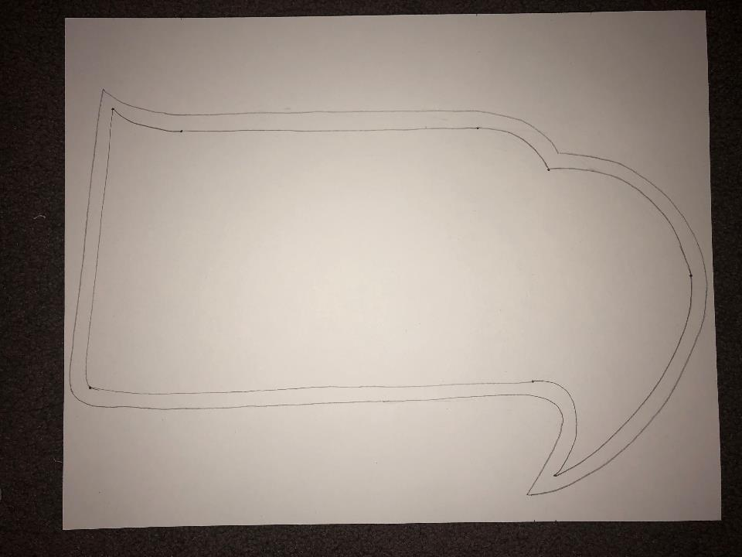
Draw a parallel line around the outside (1/4” away)

Slide 6
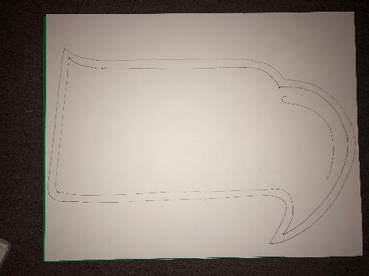
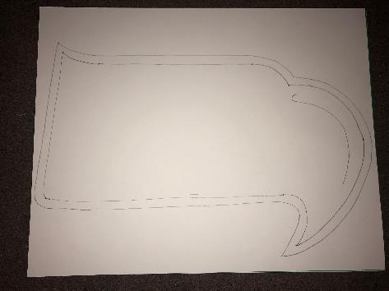
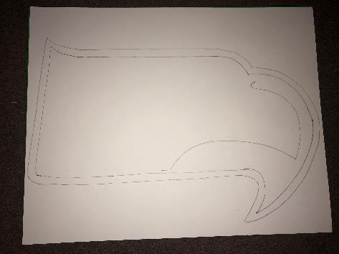
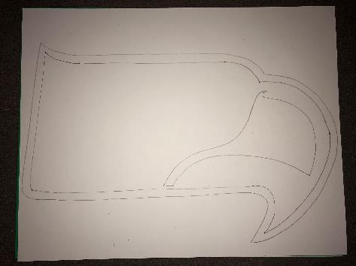

Slide 7
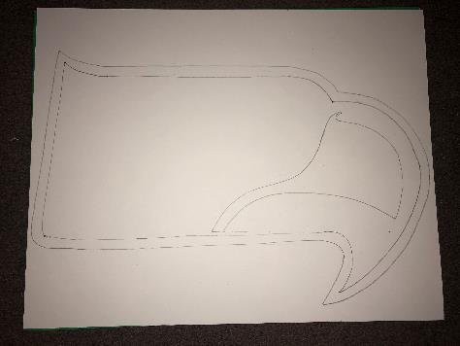
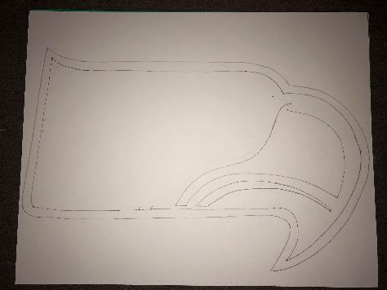
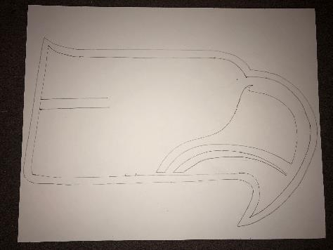

Slide 8
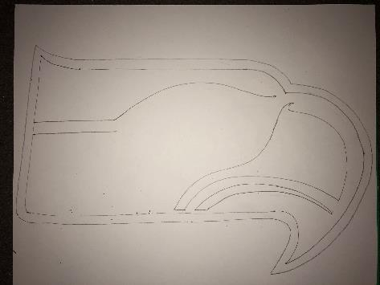
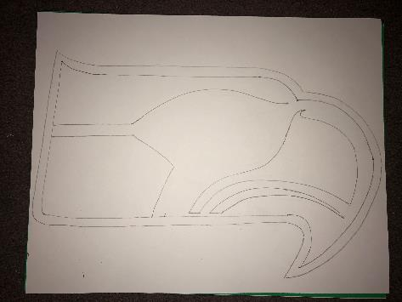
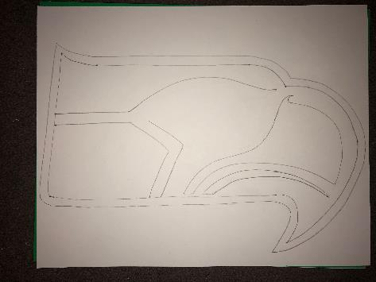
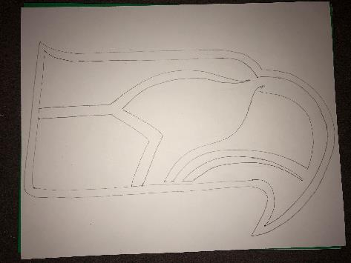

Slide 9
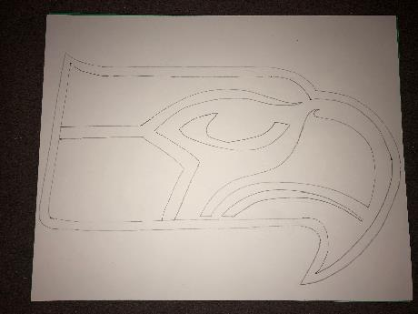
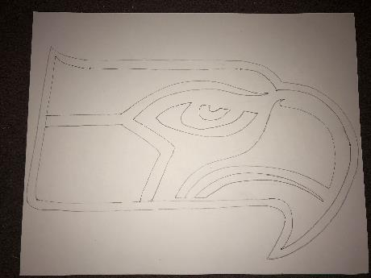
Painting tips and techniques
Use smooth slow strokes with your paintbrush.
Have the right amount of paint on your brush.
Be sure to fully clean and dry your brush between colors.
Outline your edges slowly before filling in with paint.
Slowly cover all pencil lines.
When lifting your brush, always lift towards the center, never off the edge.

Slide 10
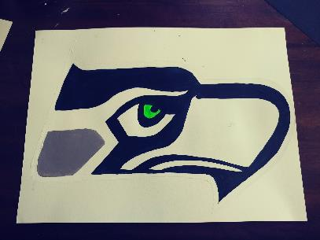
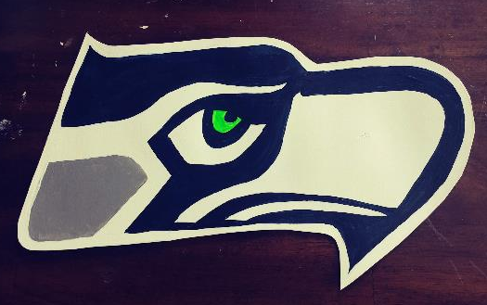
Start painting all the white spaces, including the outside border.
Fill in the green eye
Paint the one gray space
Finally, finish filling in Seahawk blue.
Be careful of your wrist touching and smearing the paint!
Use a small brush to outline the edges before filling in with paint
Go back and give another coat where needed, and clean up lines.

