Slide 1
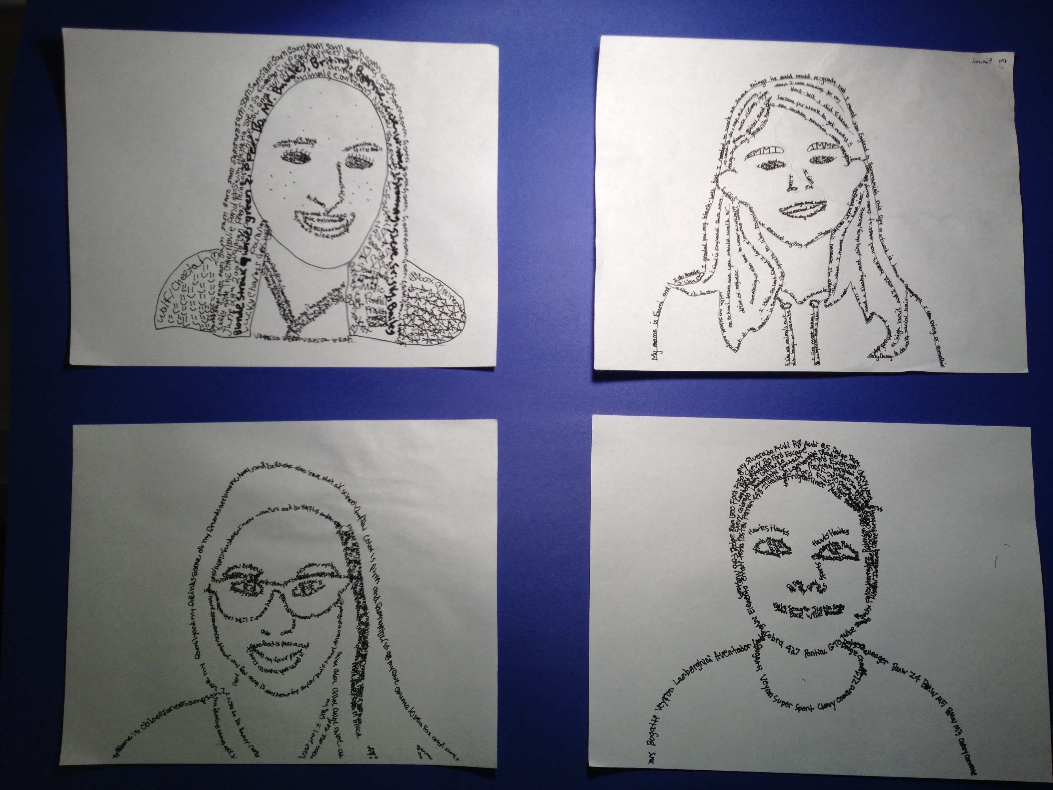
Combining Self-Portraits & Micrography
Notes:
Micrography: artwork created from text that forms an image when viewed at a distance.
Element of Art:
Line: A continuous path of a moving point through space which can vary in width, direction, length, curvature, texture and color.
Supplies needed:
-8.5x11 inch Student photographs in black and white
-Pencil
-Eraser
-Fine Point Sharpie
-Ultra Fine Point Sharpie
-8.5x11 inch White copy paper
-tape for hanging in window while tracing
-camera
-printer
-window or light box
From Wikipedia:
Micrography (from Greek, literally small-writing – "Μικρογραφία"), also called microcalligraphy, is a Jewish form of calligrams developed in the 9th century, with parallels in Christianity and Islam,[1] utilizing minute Hebrew letters to form representational, geometric and abstract designs. Colored micrography is especially distinctive because these rare artworks are customarily rendered in black and white.

Slide 2
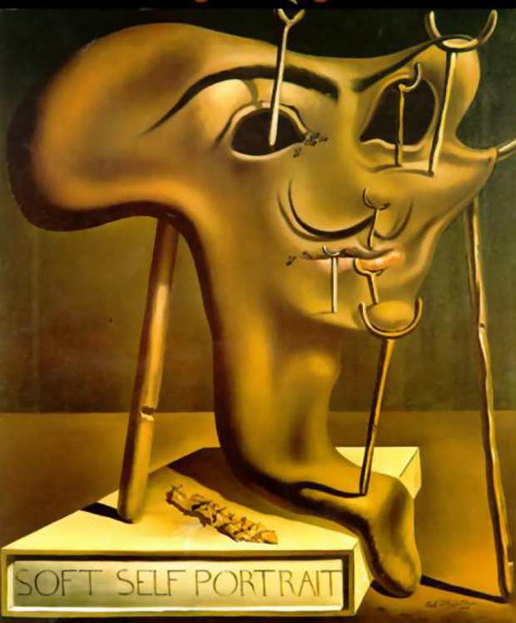
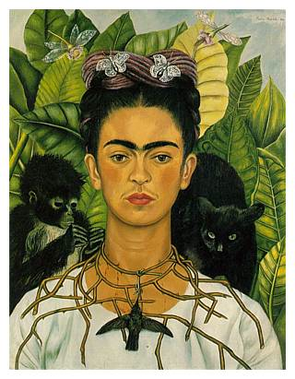
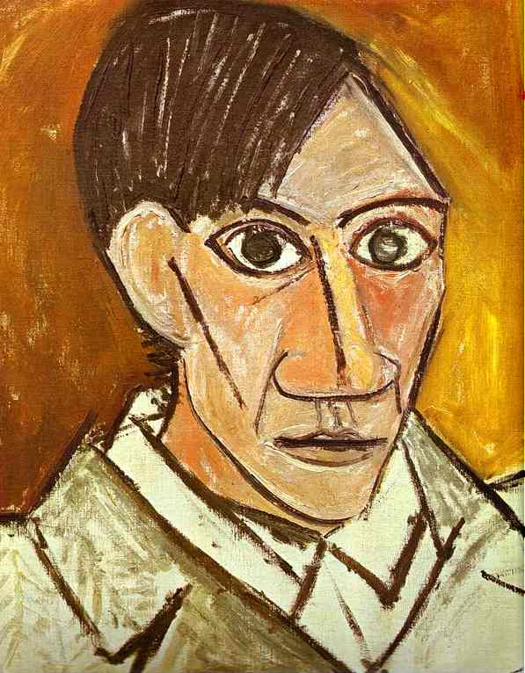
But first, let me take a selfie . . .
Salvador Dali
Spain
Frida Khalo, 1940
Mexico
Pablo Picasso,1907
Spain
Throughout history, long before cell phones, artists have “taken selfies”
buy painting self portraits. Here are some famous examples.

Slide 3
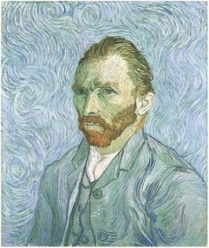
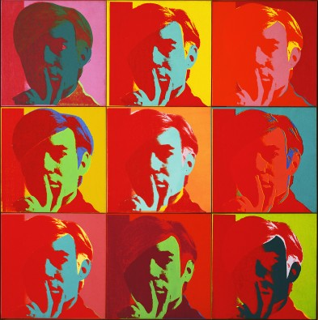
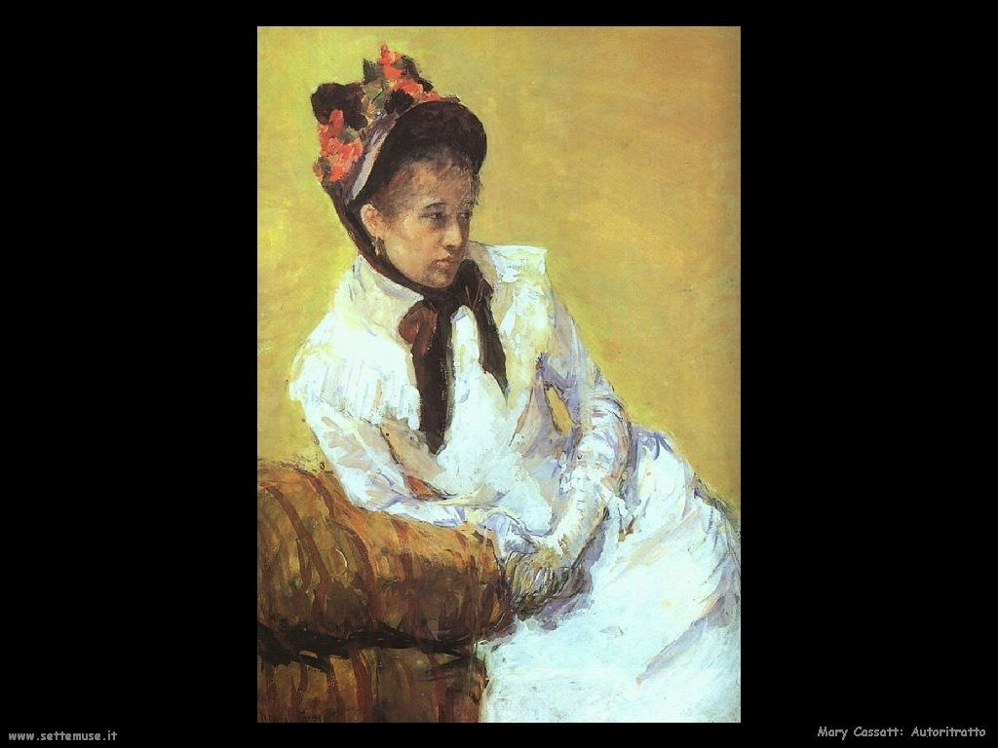
More “Selfies” of Famous Artists
Vincent Van Gogh, 1889
Netherlands
Andy Warhol, 1966
United States
Mary Cassatt, 1878
United States

Slide 4
Micrography
Artwork created from text that forms an image when viewed at a distance, creating an interplay between the text and image.
Element of Art
Line
A continuous path of a moving point through space which can vary in width, direction, length, curvature, texture and color.
Not to be confused with a similar word:
Mi-cro-pho-tog-ra-phy – [mahy-kroh-fuh-tog-ruh-fee]
A small photograph requiring optical enlargement to render in visible detail

Slide 5
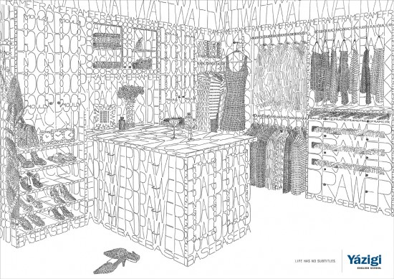
Examples of Micrography Art

Slide 6
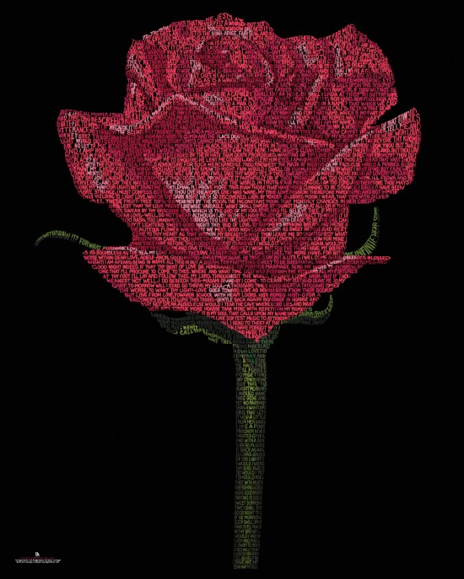

Slide 8
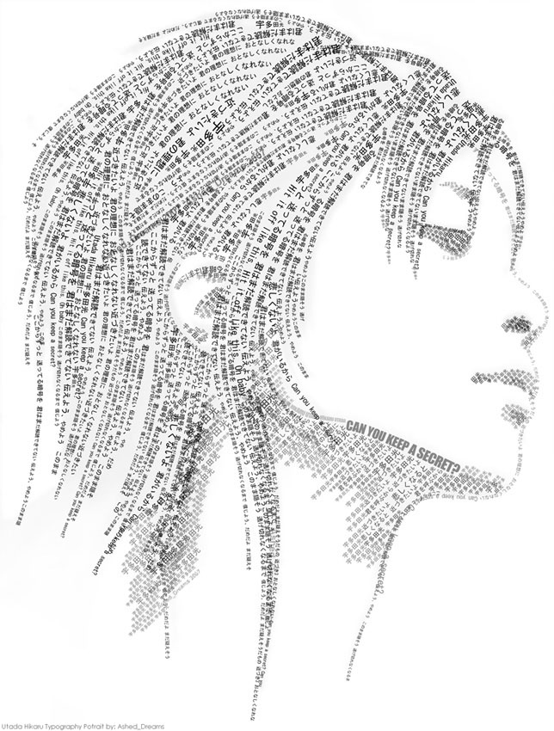

Slide 9
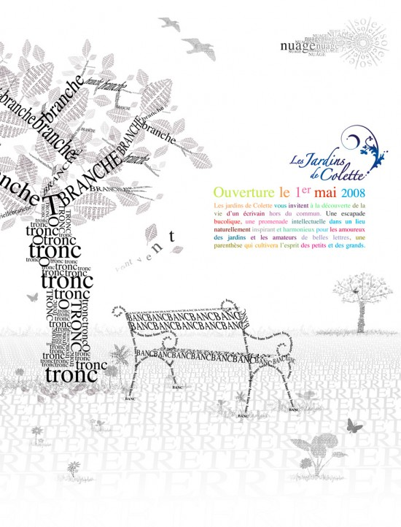

Slide 10
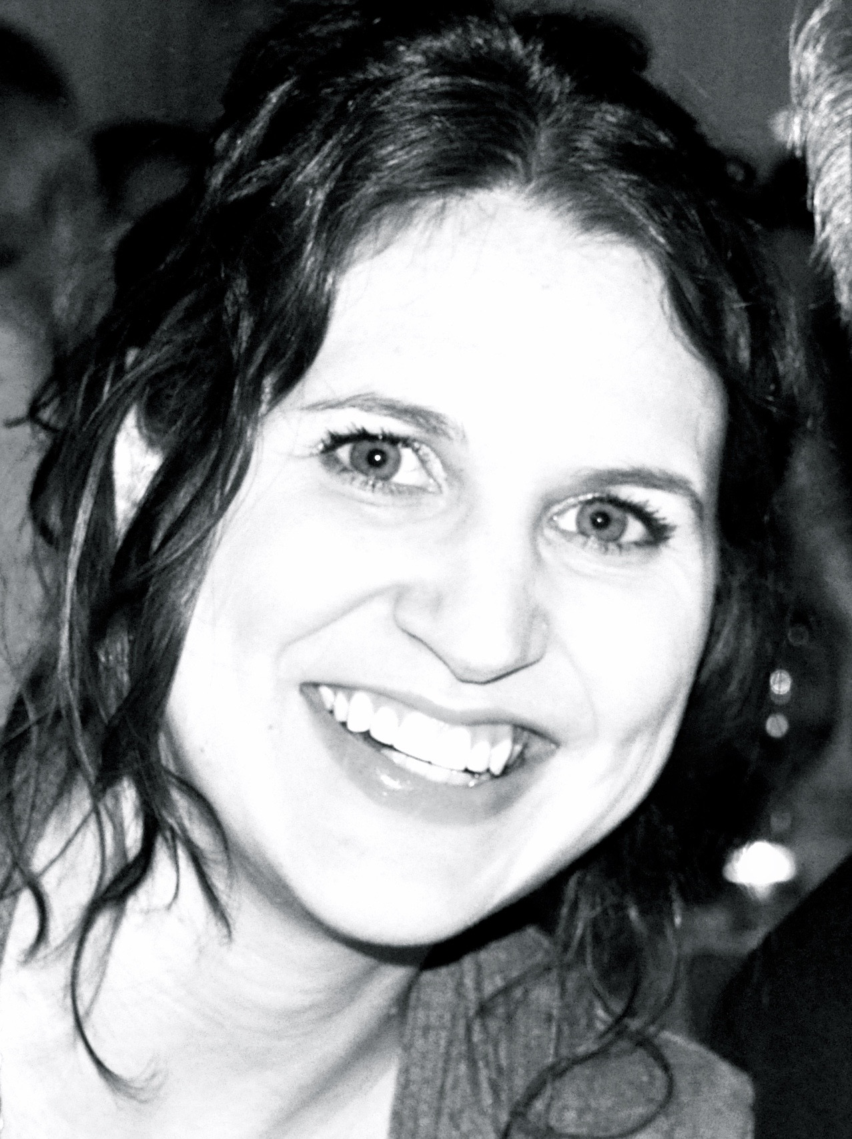
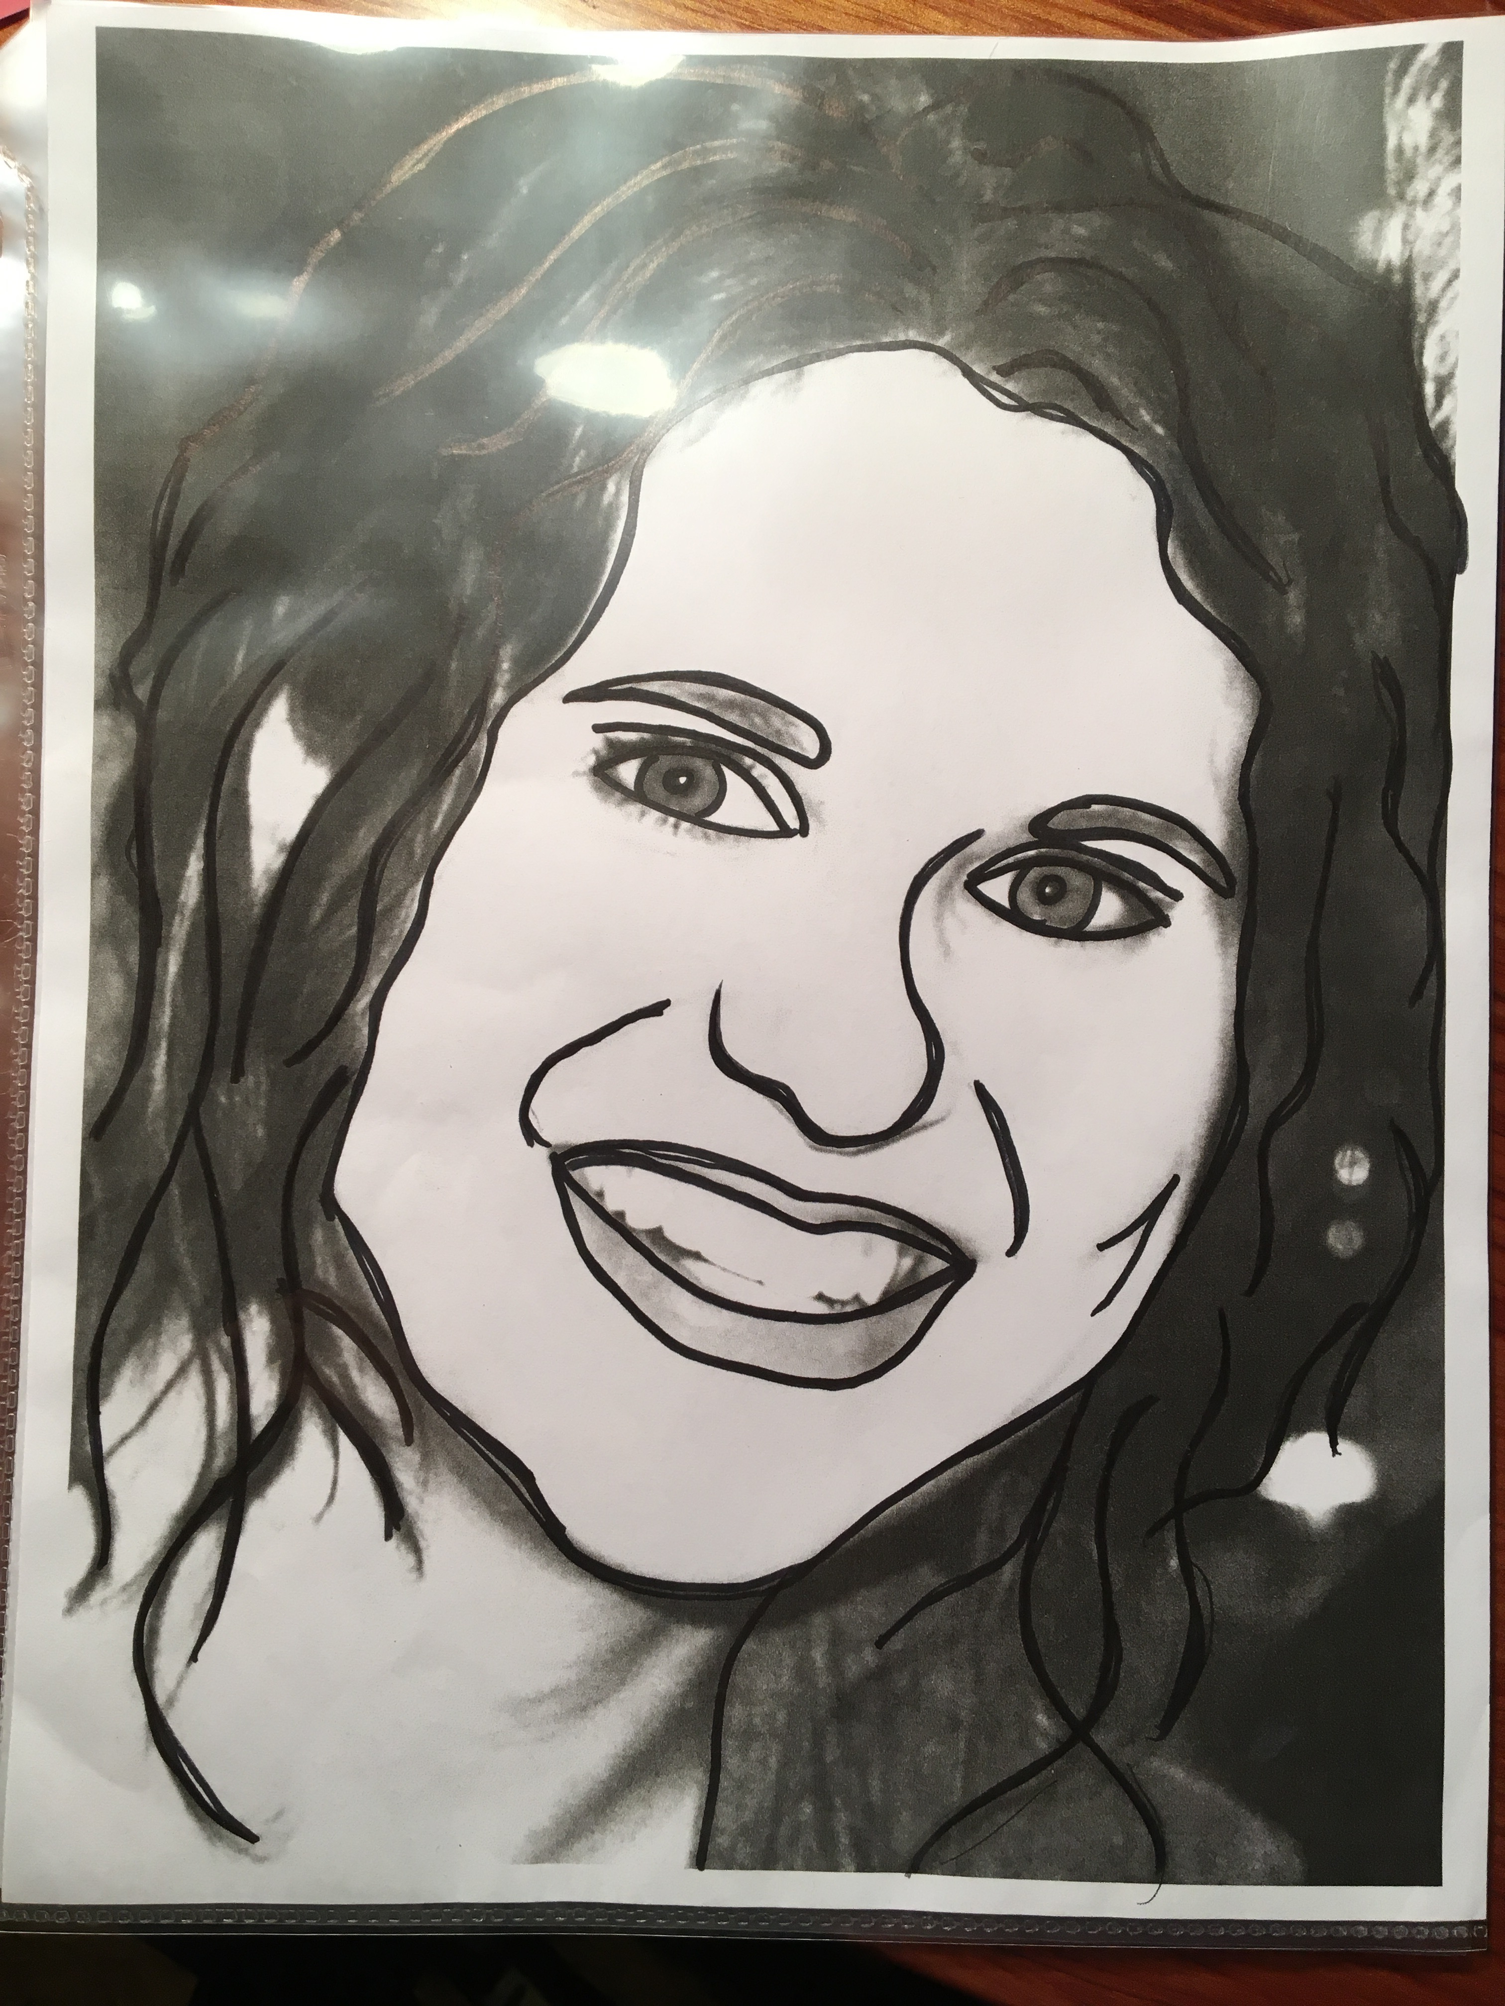
Today’s Lesson
Micrography Self-Portraits
Step 1
Take a head shot picture and print a black and white copy on 8.5x11 inch piece of copy paper.
Step 2
Trace basic outlines of the face with larger fine tip sharpie (neck, shoulders, eyebrows, hairlines).
Avoid tracing individual teeth.
Do NOT make a triangle for the nose – just the bridge and nostrils of the nose (it will be more of an “L” shape).

Slide 11
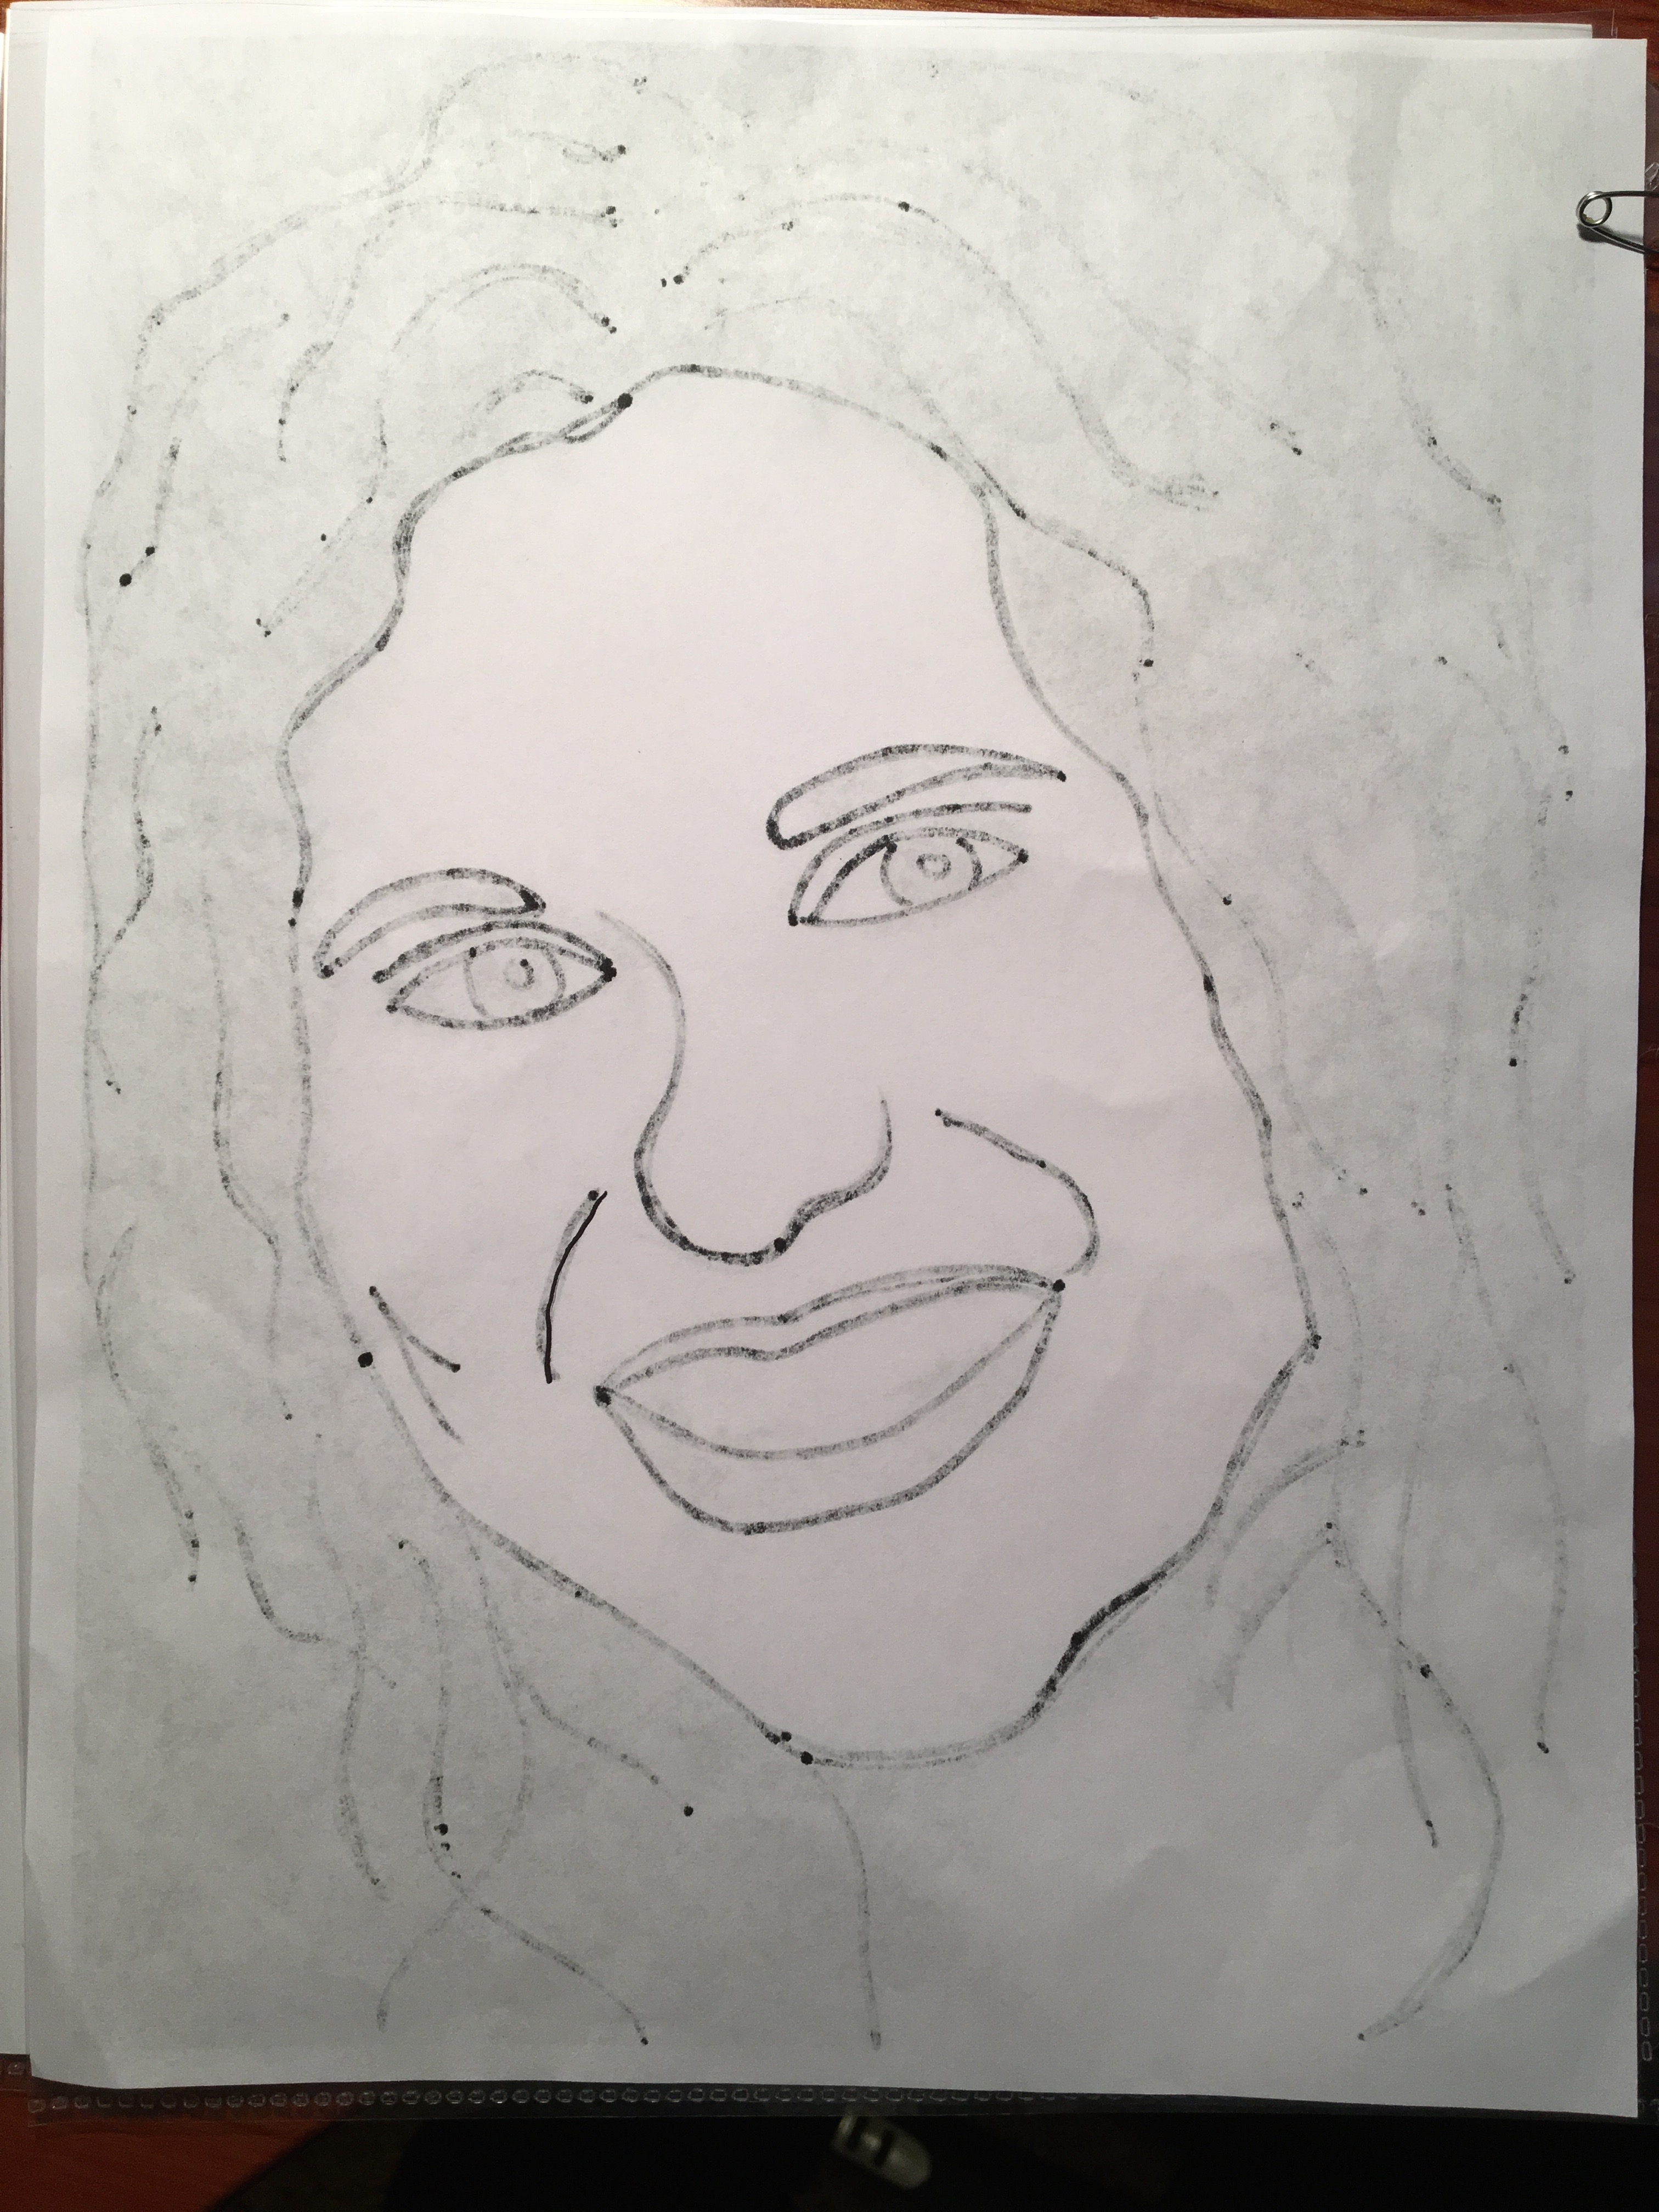
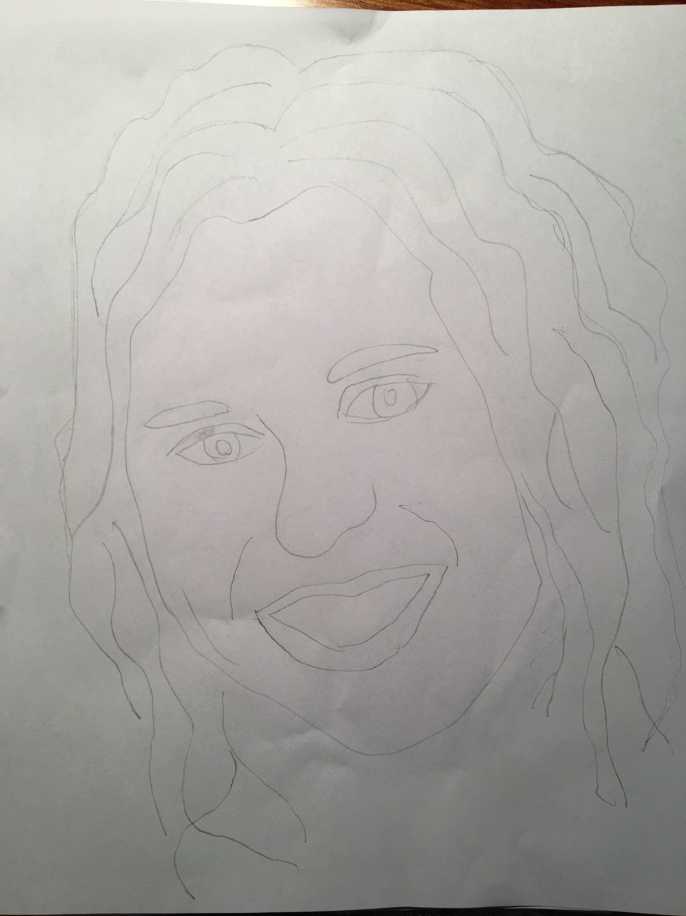
Step 3
Flip photo over and hang it in window or use a light box (sharpie lines should show through to the back of the page from the photo side). Tape plain white copy paper over it.
Step 4
Trace outlines LIGHTLY with pencil on copy paper.

Slide 12
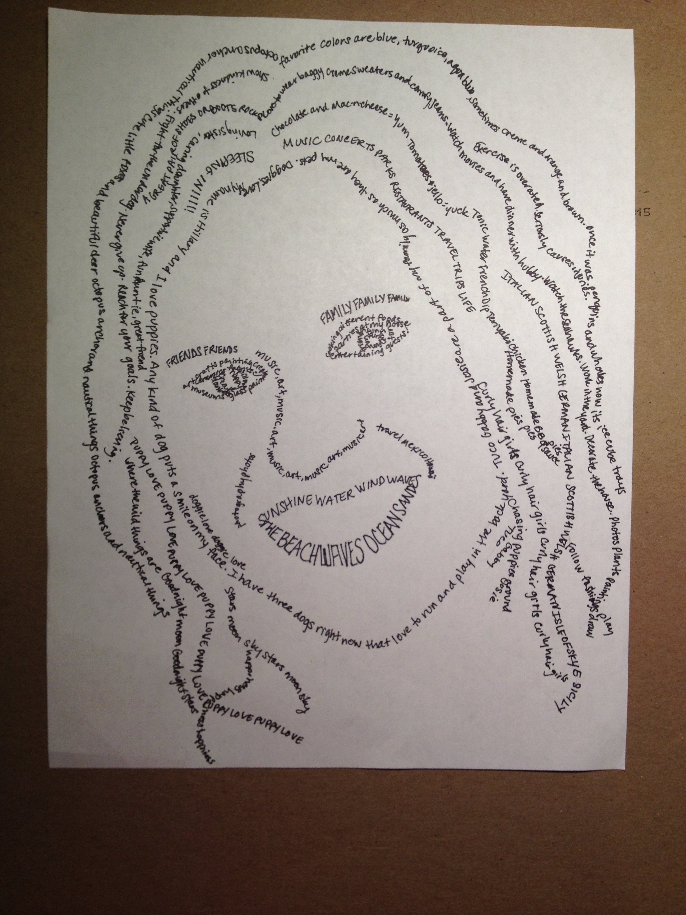
Step 5
Take copy paper to desk and with smaller sharpie (ultra fine tip) write words or sentences that describe you as you follow the pencil lines. Large spaces of hair can be filled in with words or left as an outline. The size of the letters can be stretched bigger to fill in a space like the lips or eyebrows. Students may want to use prompts like favorite color, sport, etc. or write list of positive characteristics about themselves ahead of time and transferred to the portrait.
Step 6
Erase pencil lines.

Slide 13
Who is this?

Slide 15
Writing Prompts
Lyrics to songs
Sayings
Character traits
Things about you
Favorite things
Memorable experiences
Tell a story
Friends and Family Names
Pets
Places you traveled to
Games & Characters
Heroes
Sports teams or players you enjoy
What inspires you
TV Shows
Books
Movies
Things you like to do
Important dates(i.e. Birthdays)
What makes you smile
Food
*Write in different languages you may know; mix it up a bit.

