Slide 1
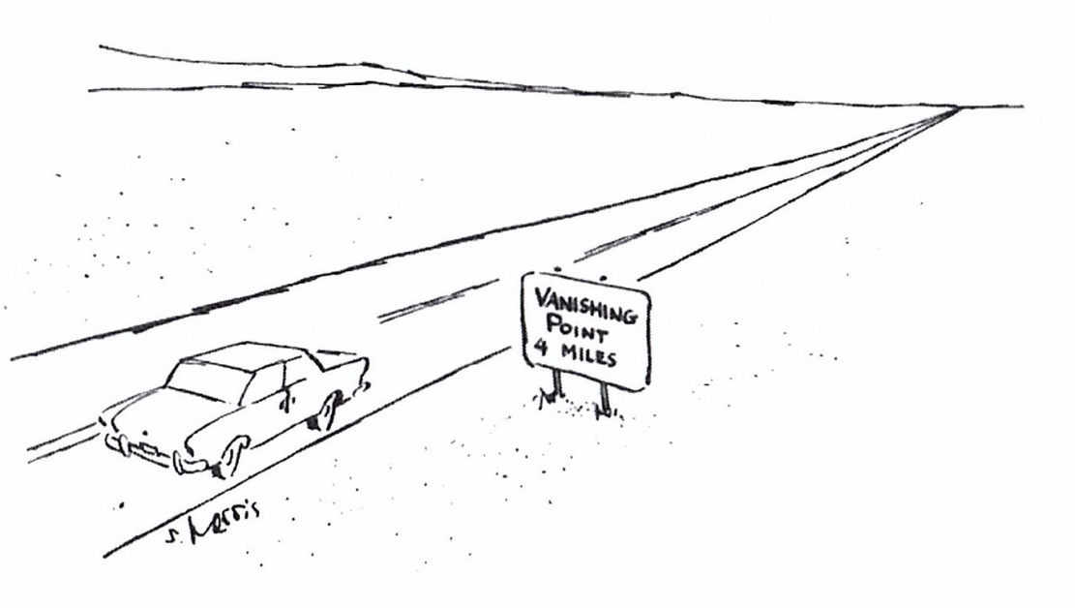
Artist Techniques for Creating the
Illusion of
Depth and Space
Linear
Perspective
&
Atmospheric
Perspective
Creekside Art Docent February 2019

Slide 2
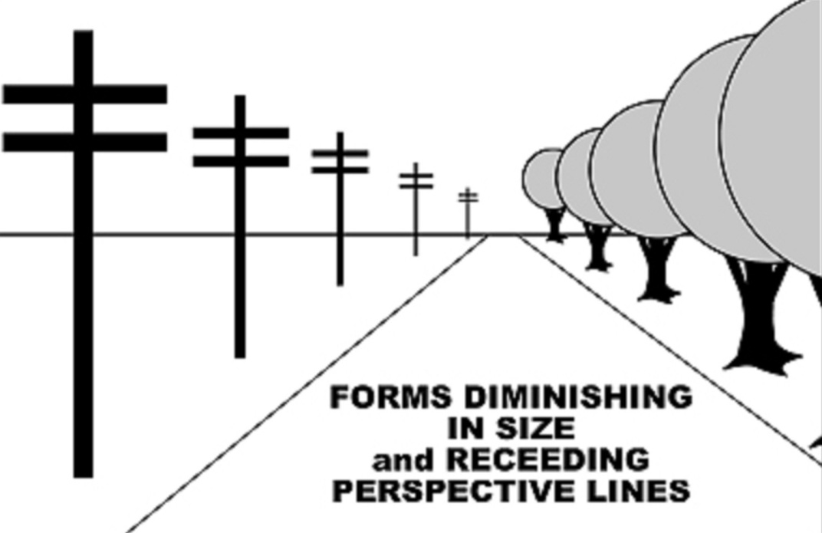
Today's Art Project:
We are using the Single-point (or One-point) Linear Perspective technique to create a scene that creates the illusion of Depth and Space.
We will keep in mind:
As distance grows between the observer and an object, the apparent size is reduced.
Lines that are parallel in reality appear to converge or move toward each other as apparent distance increases.
Objects that are nearest in the scene are larger.
Objects that are more distant are smaller.

Slide 3
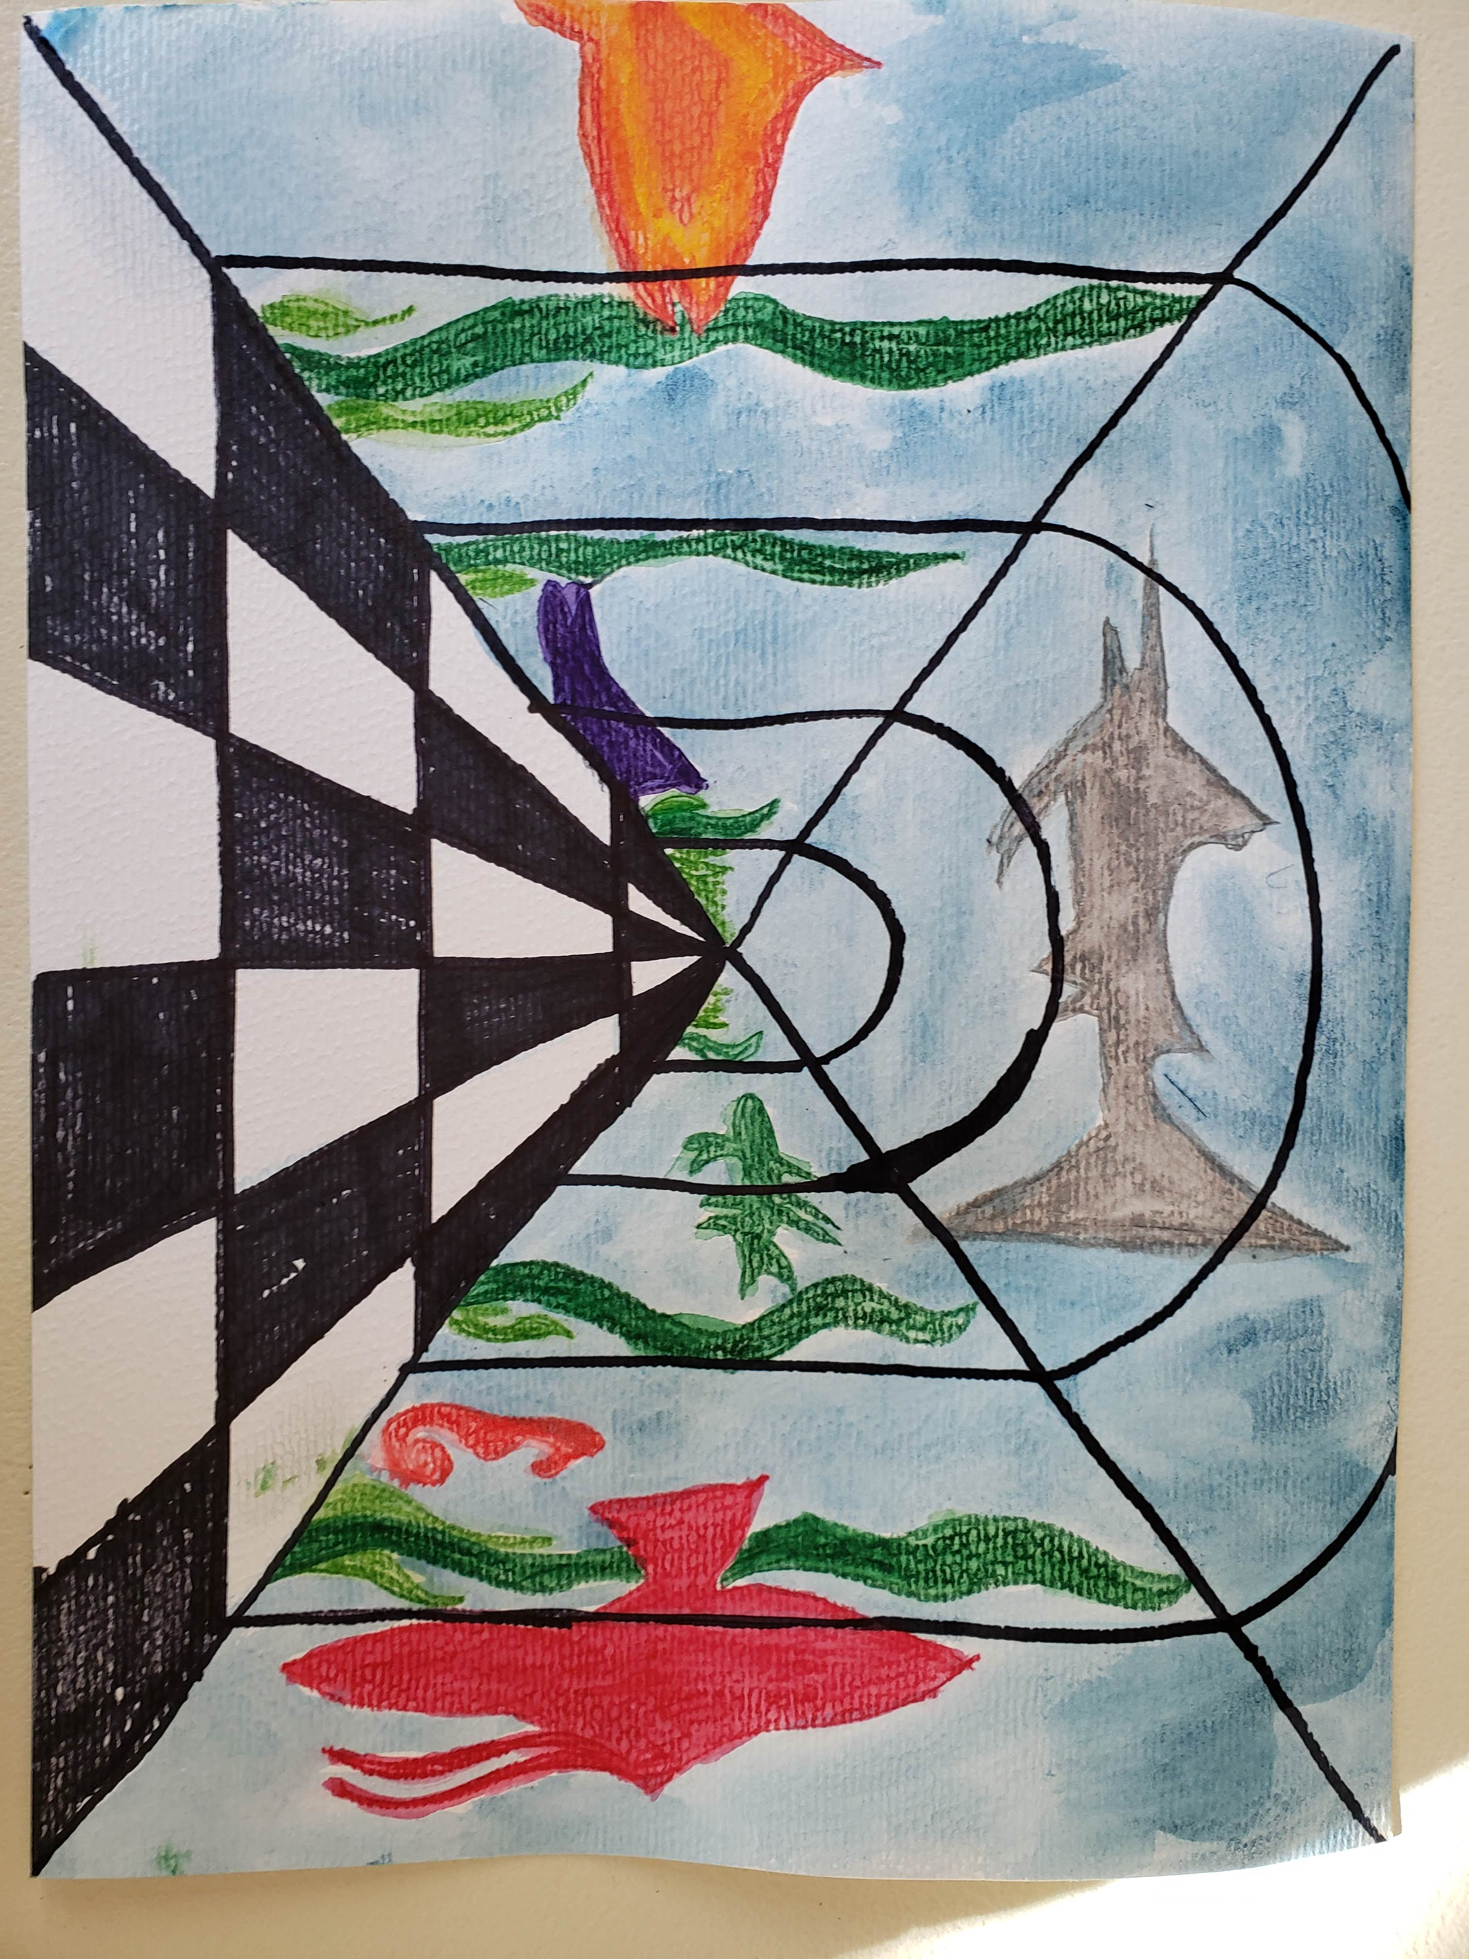
Today's Art Project:
Underwater Perspective

Slide 4
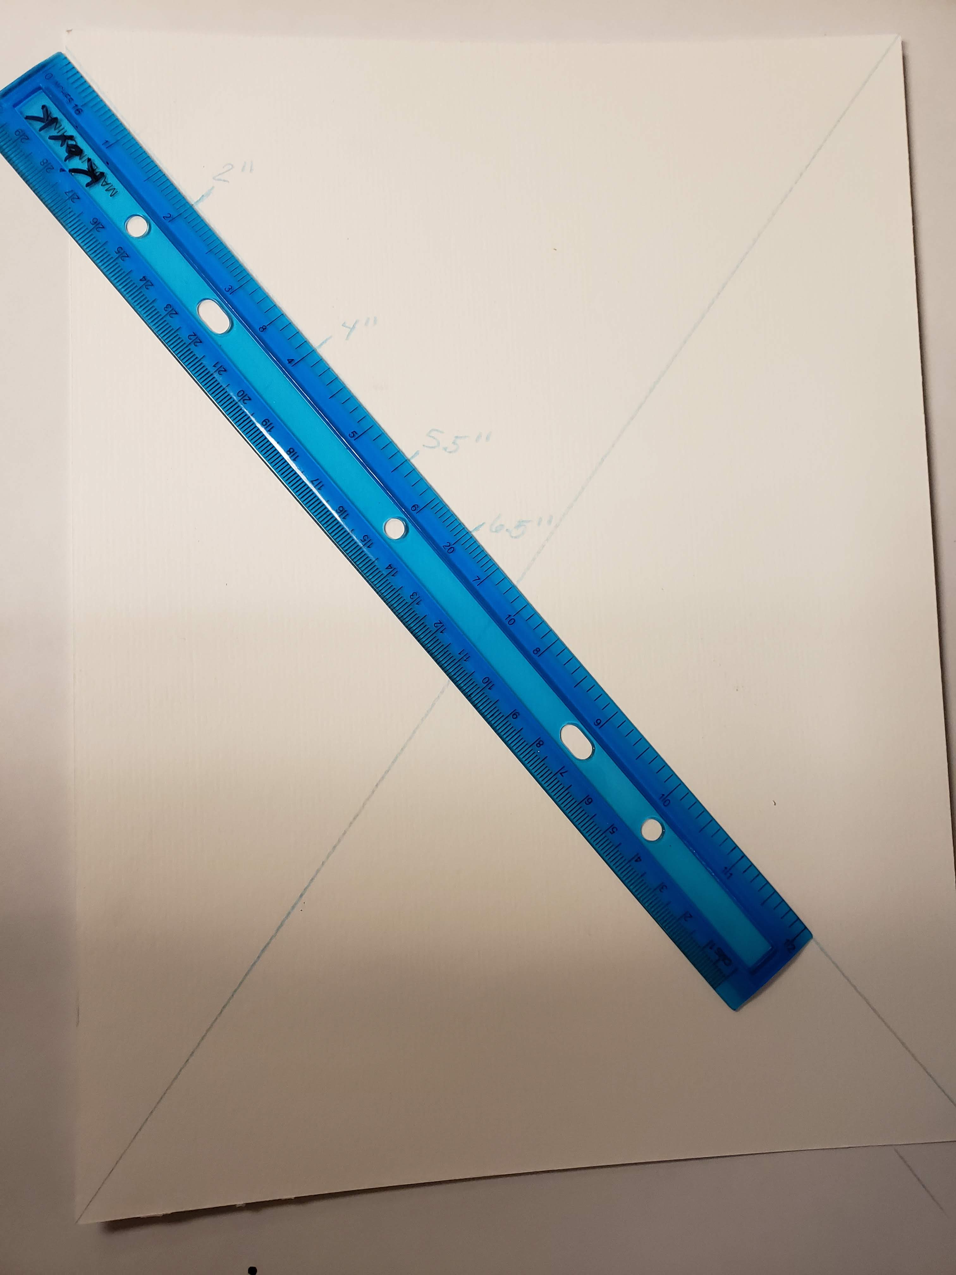
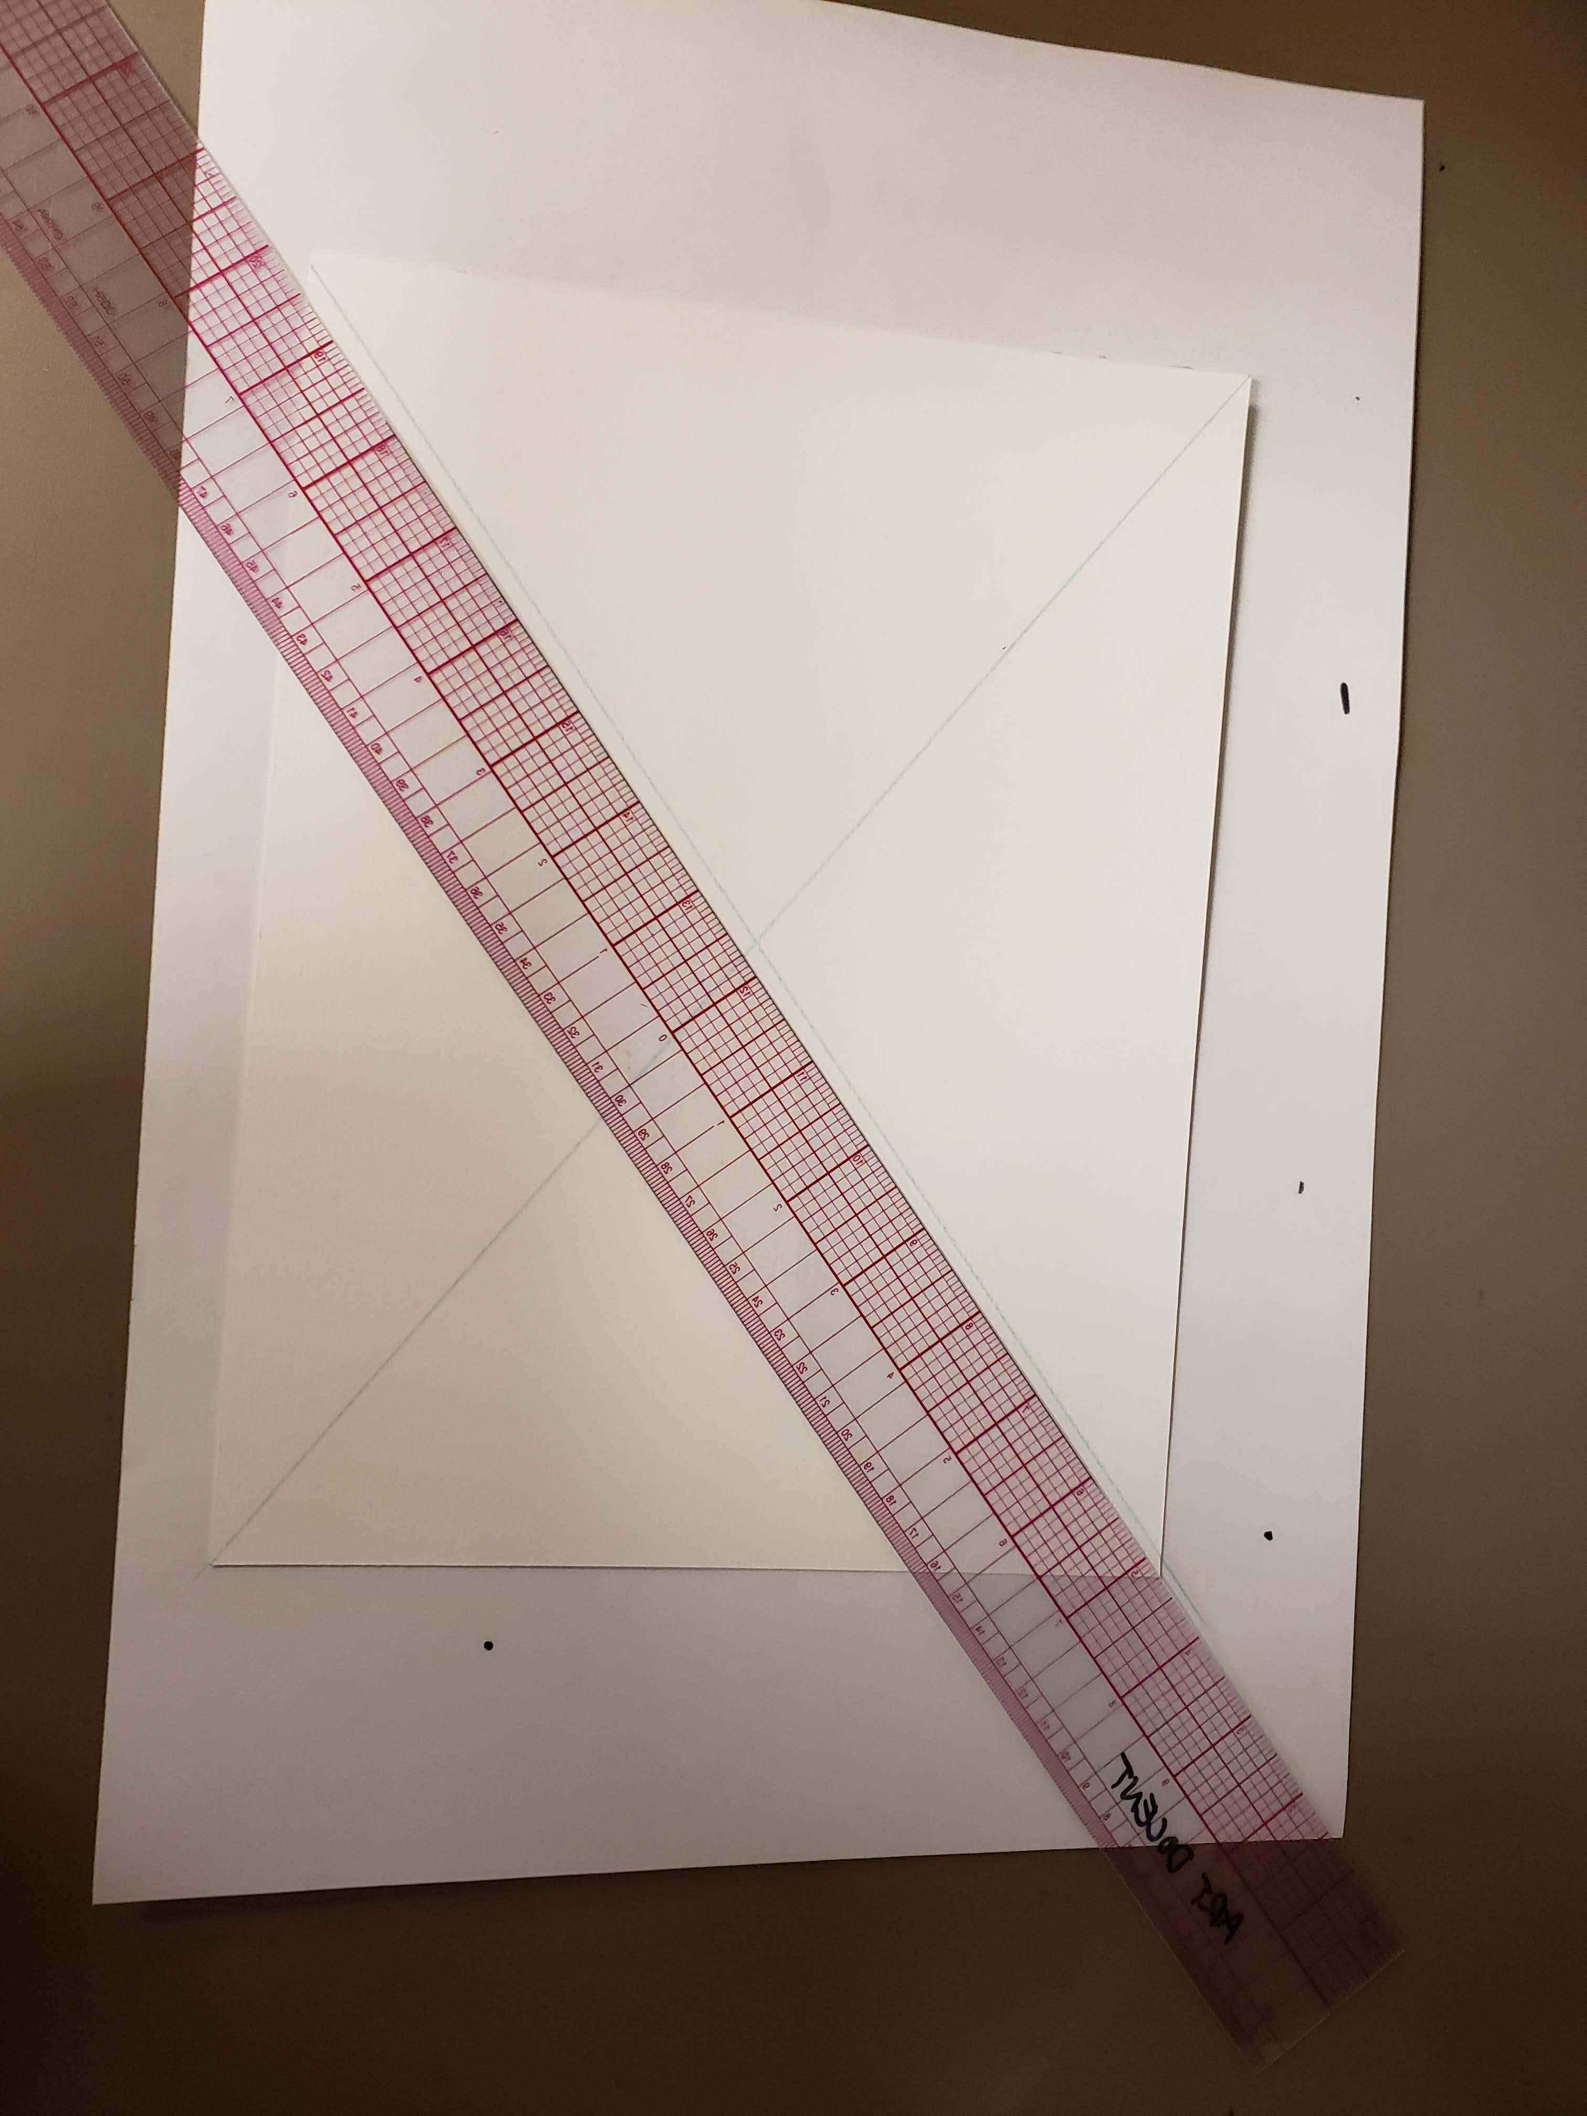
Draw Linear Perspective Lines:
Begin by using a large straight edge to draw a line from corner to corner creating a large X
Then use your ruler lined up from the corner and place marks at each of these measurements…2” 4” 5.5” 6.5”. REPEAT turning your paper so you are always measuring from the outside corner.

Slide 5
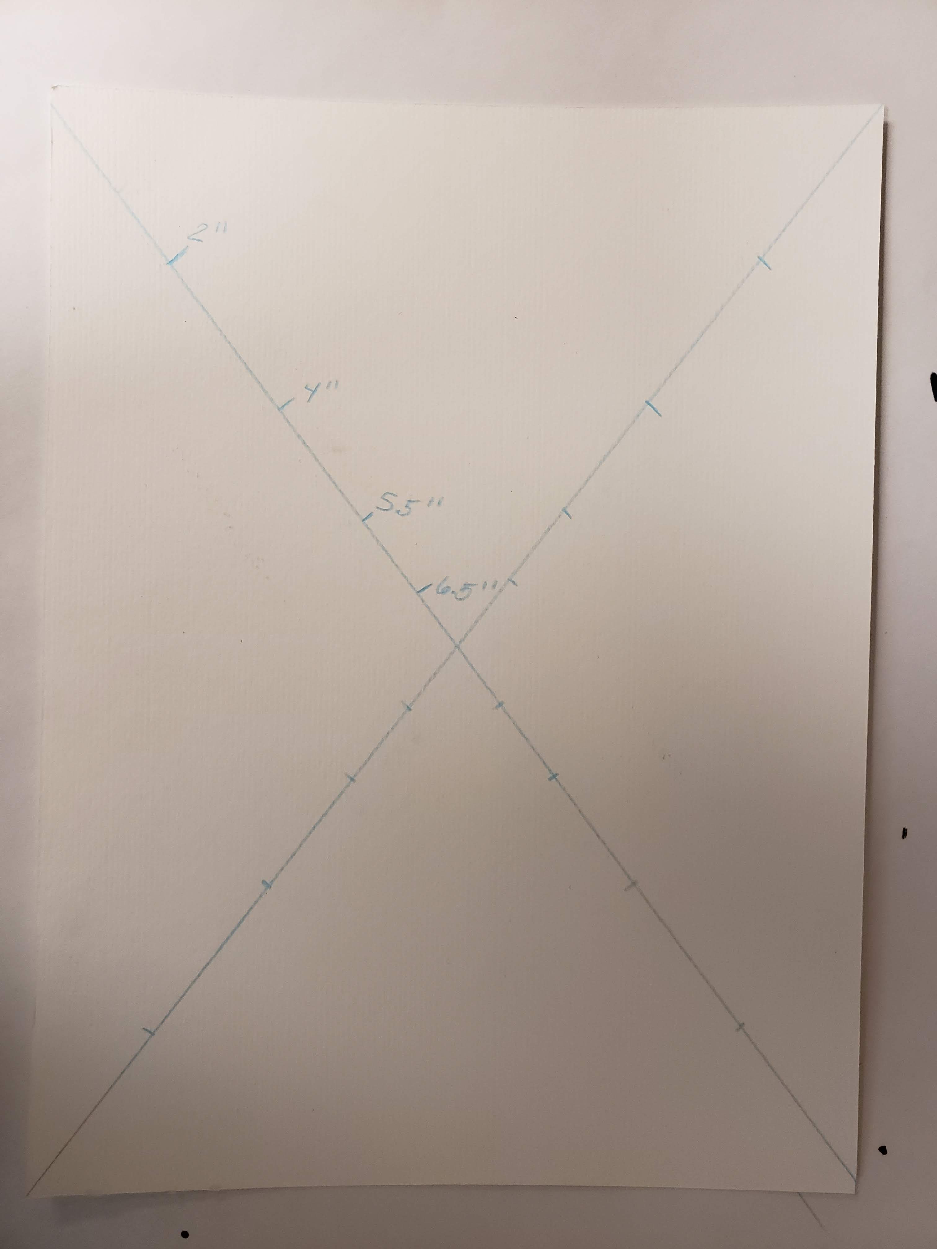
The point where they cross is called the
VANISHING POINT.
Vanishing Point

Slide 6
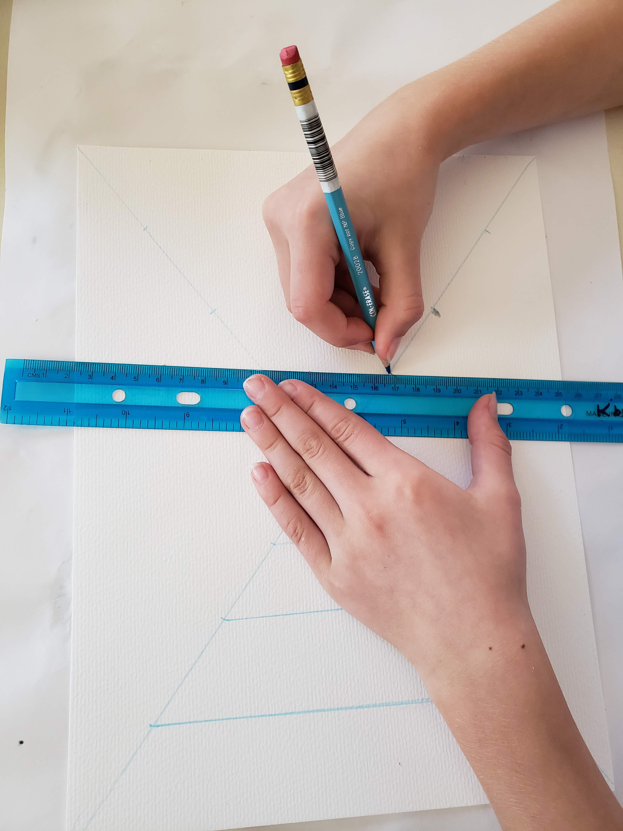
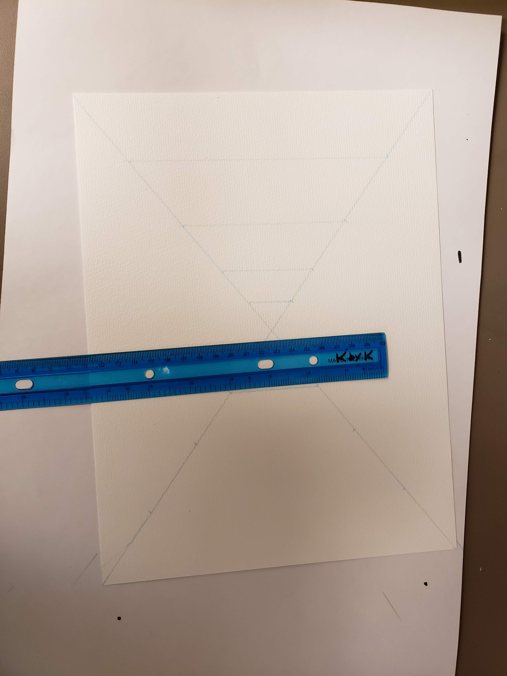
Connect the dots to create vertical lines. There should be 4 vertical lines on each side of the center point.

Slide 7
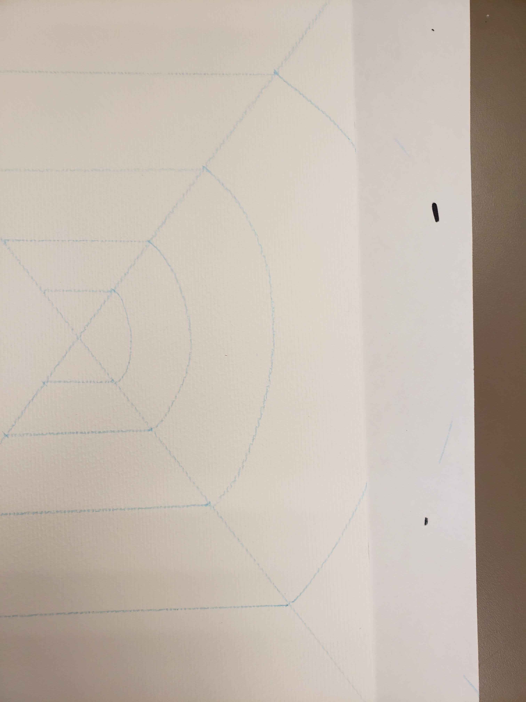
Free hand a curved line to create the arched ceiling from point to point on the top of your paper. You can erase the line if you need to re start it. The last points will go right off the paper.

Slide 8
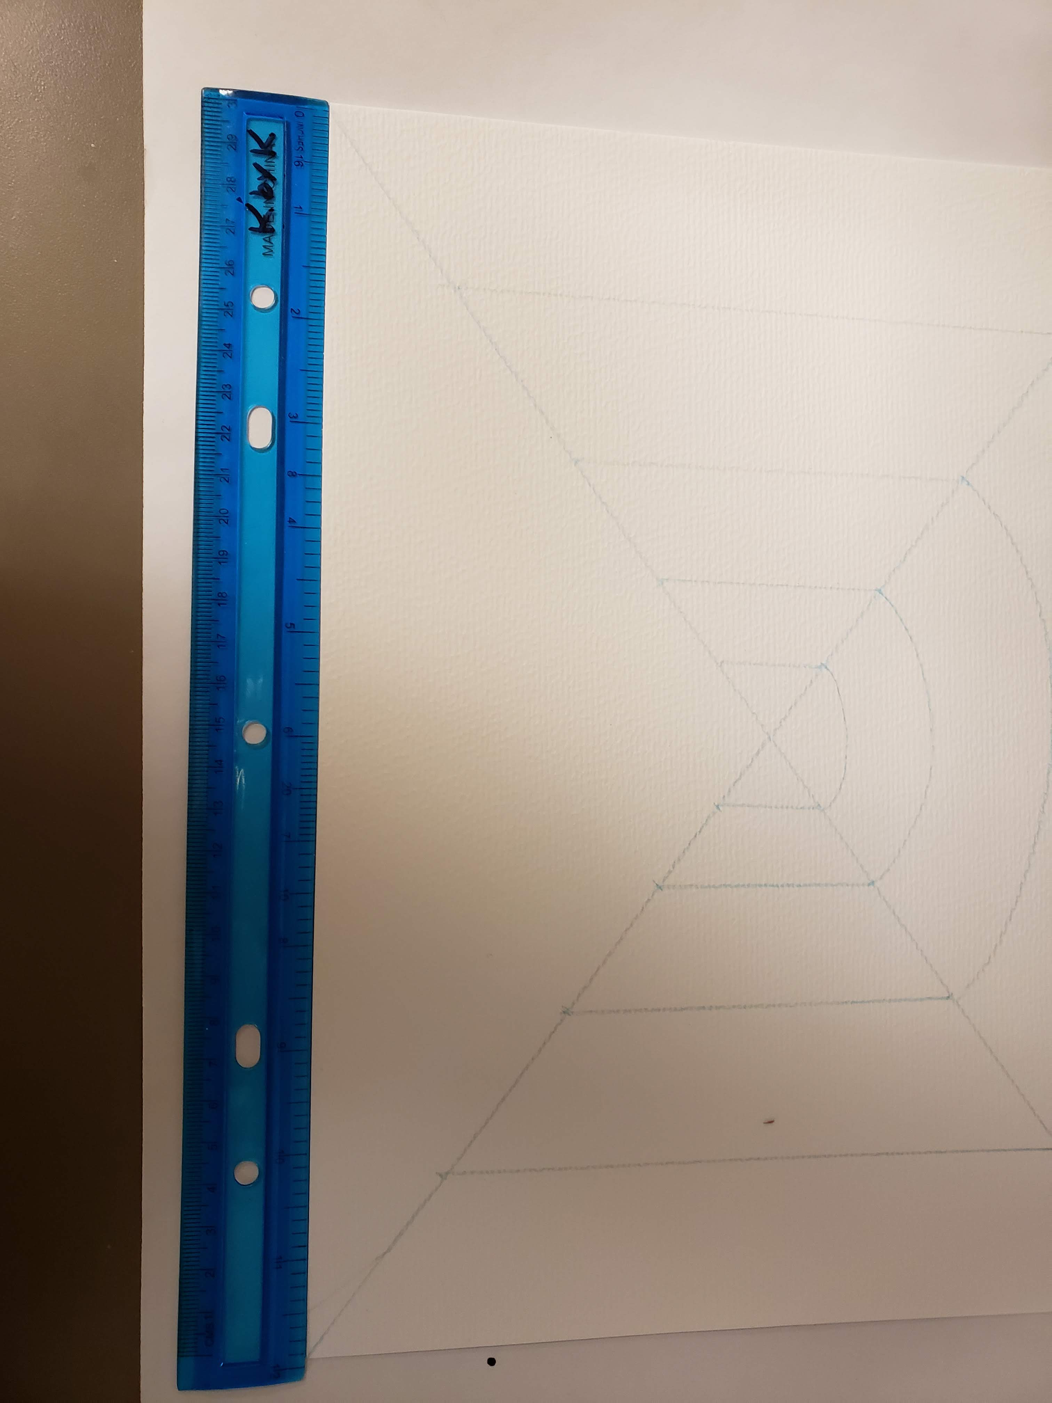
Lets add our checkerboard floor!
Using your ruler along the bottom of your paper, make marks at each of the following measurements…2” 4” 6” 8” and 10”.

Slide 9
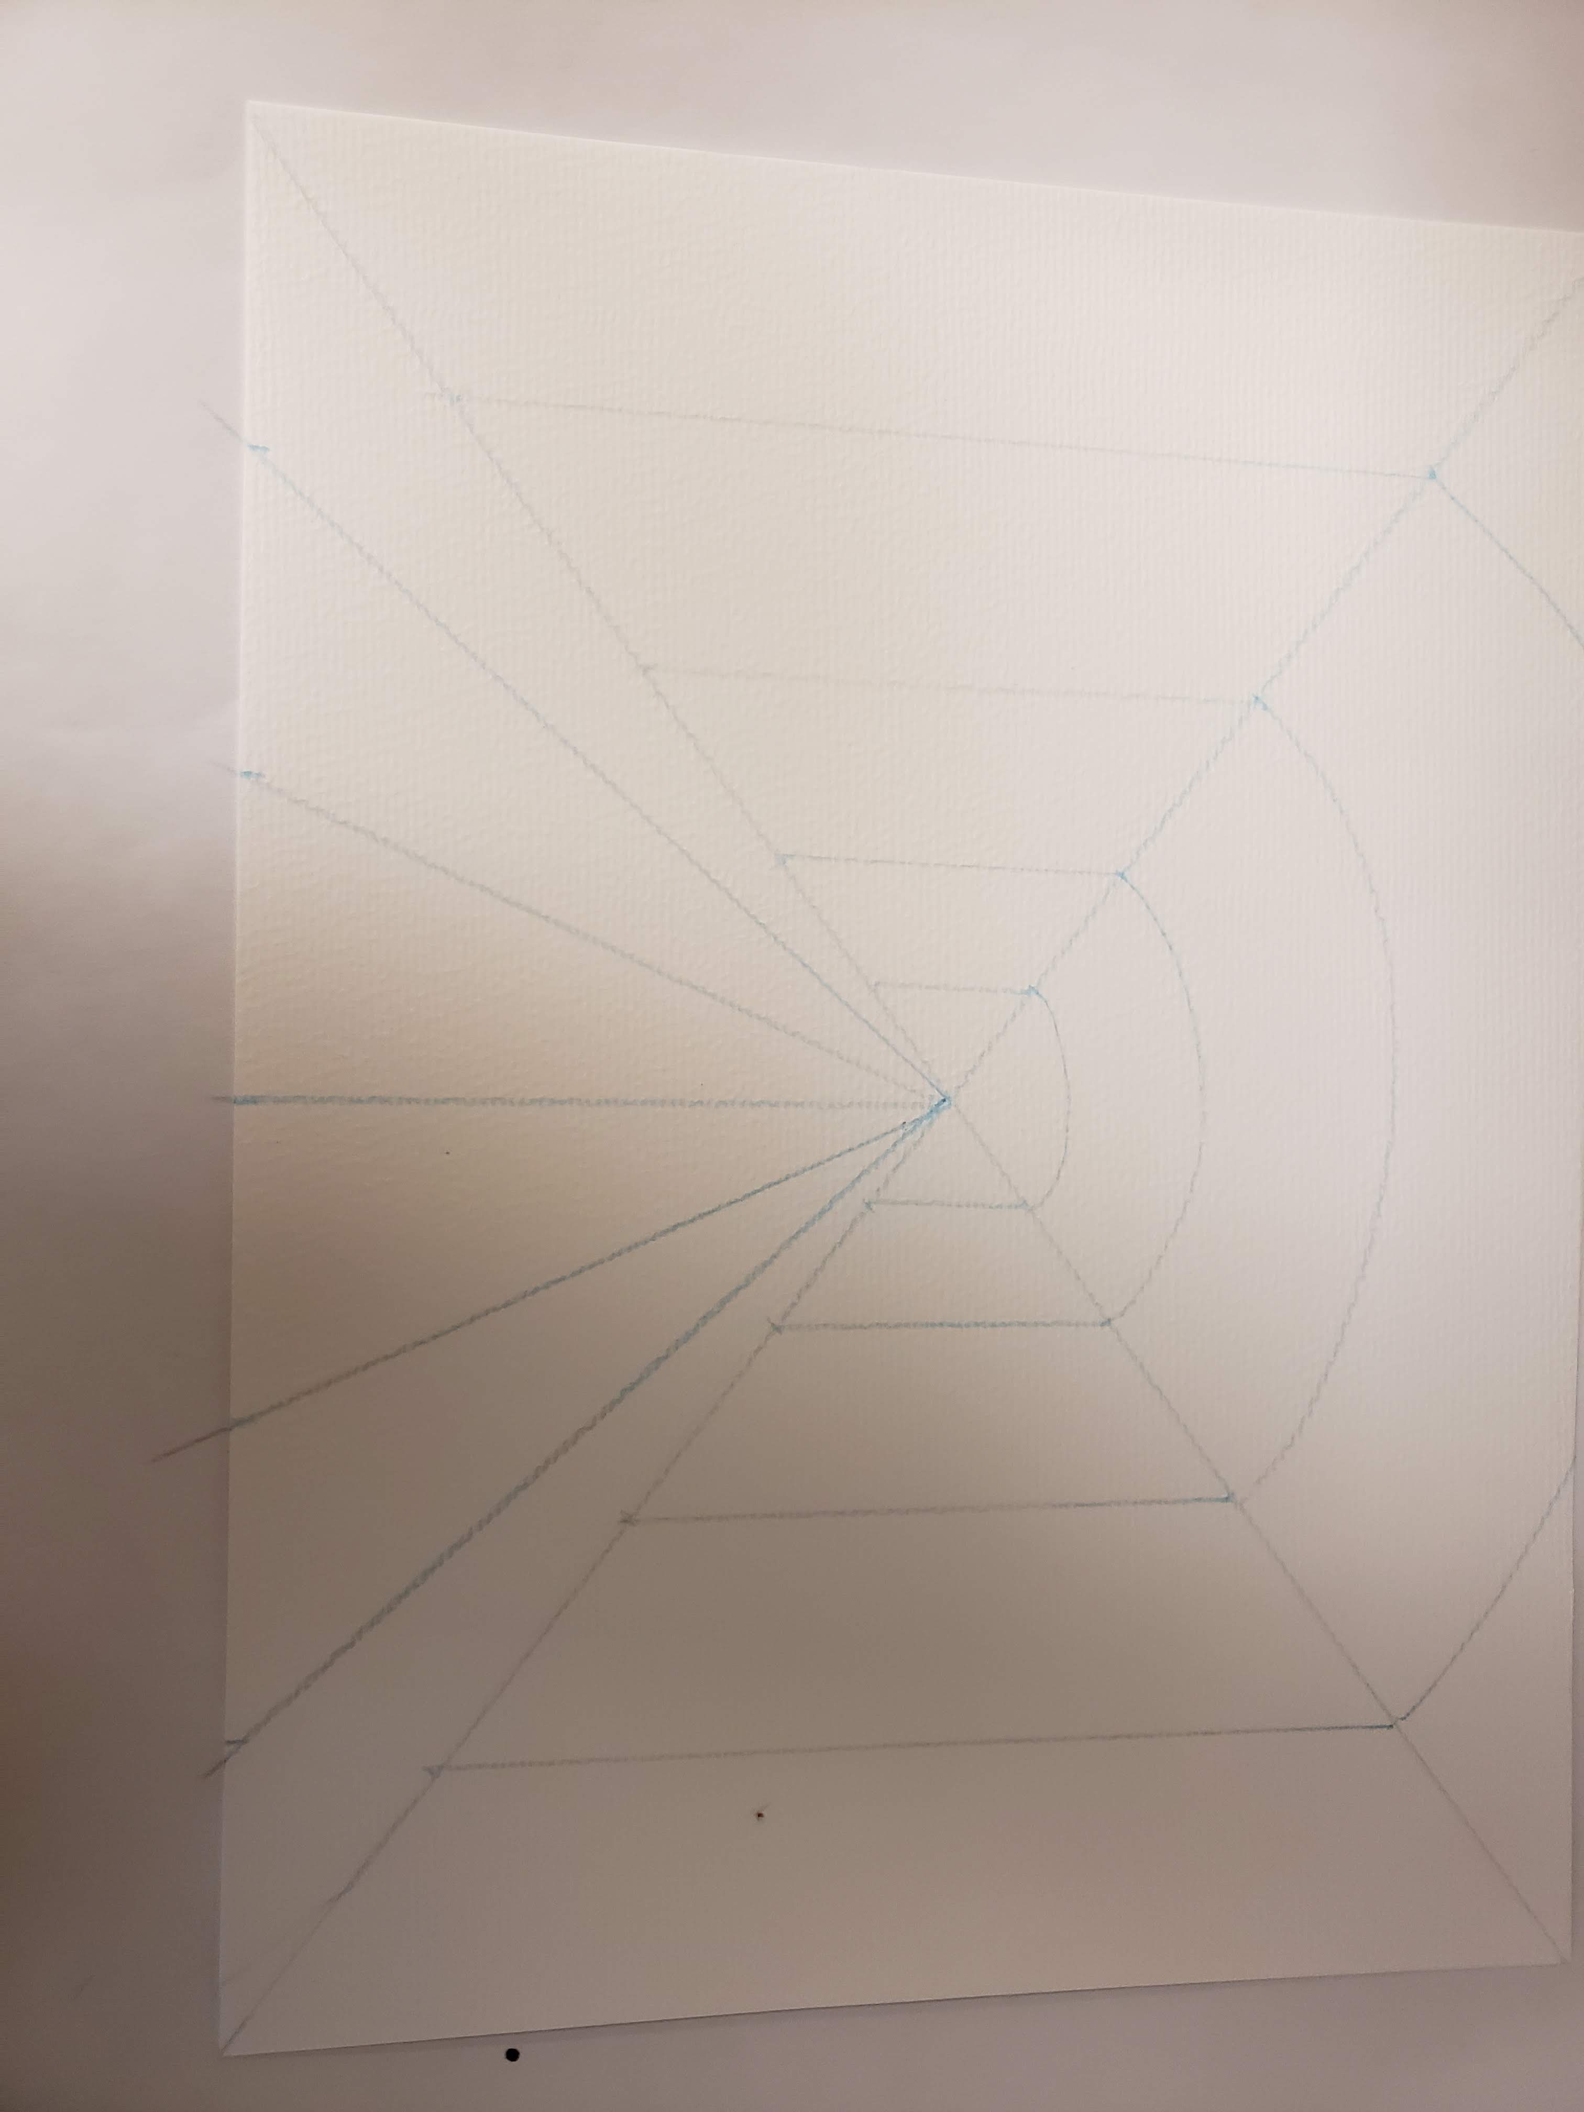
Add Perspective Lines:
Using your ruler start at the perspective point in the center of your paper and draw a straight line to each of your marks.

Slide 10
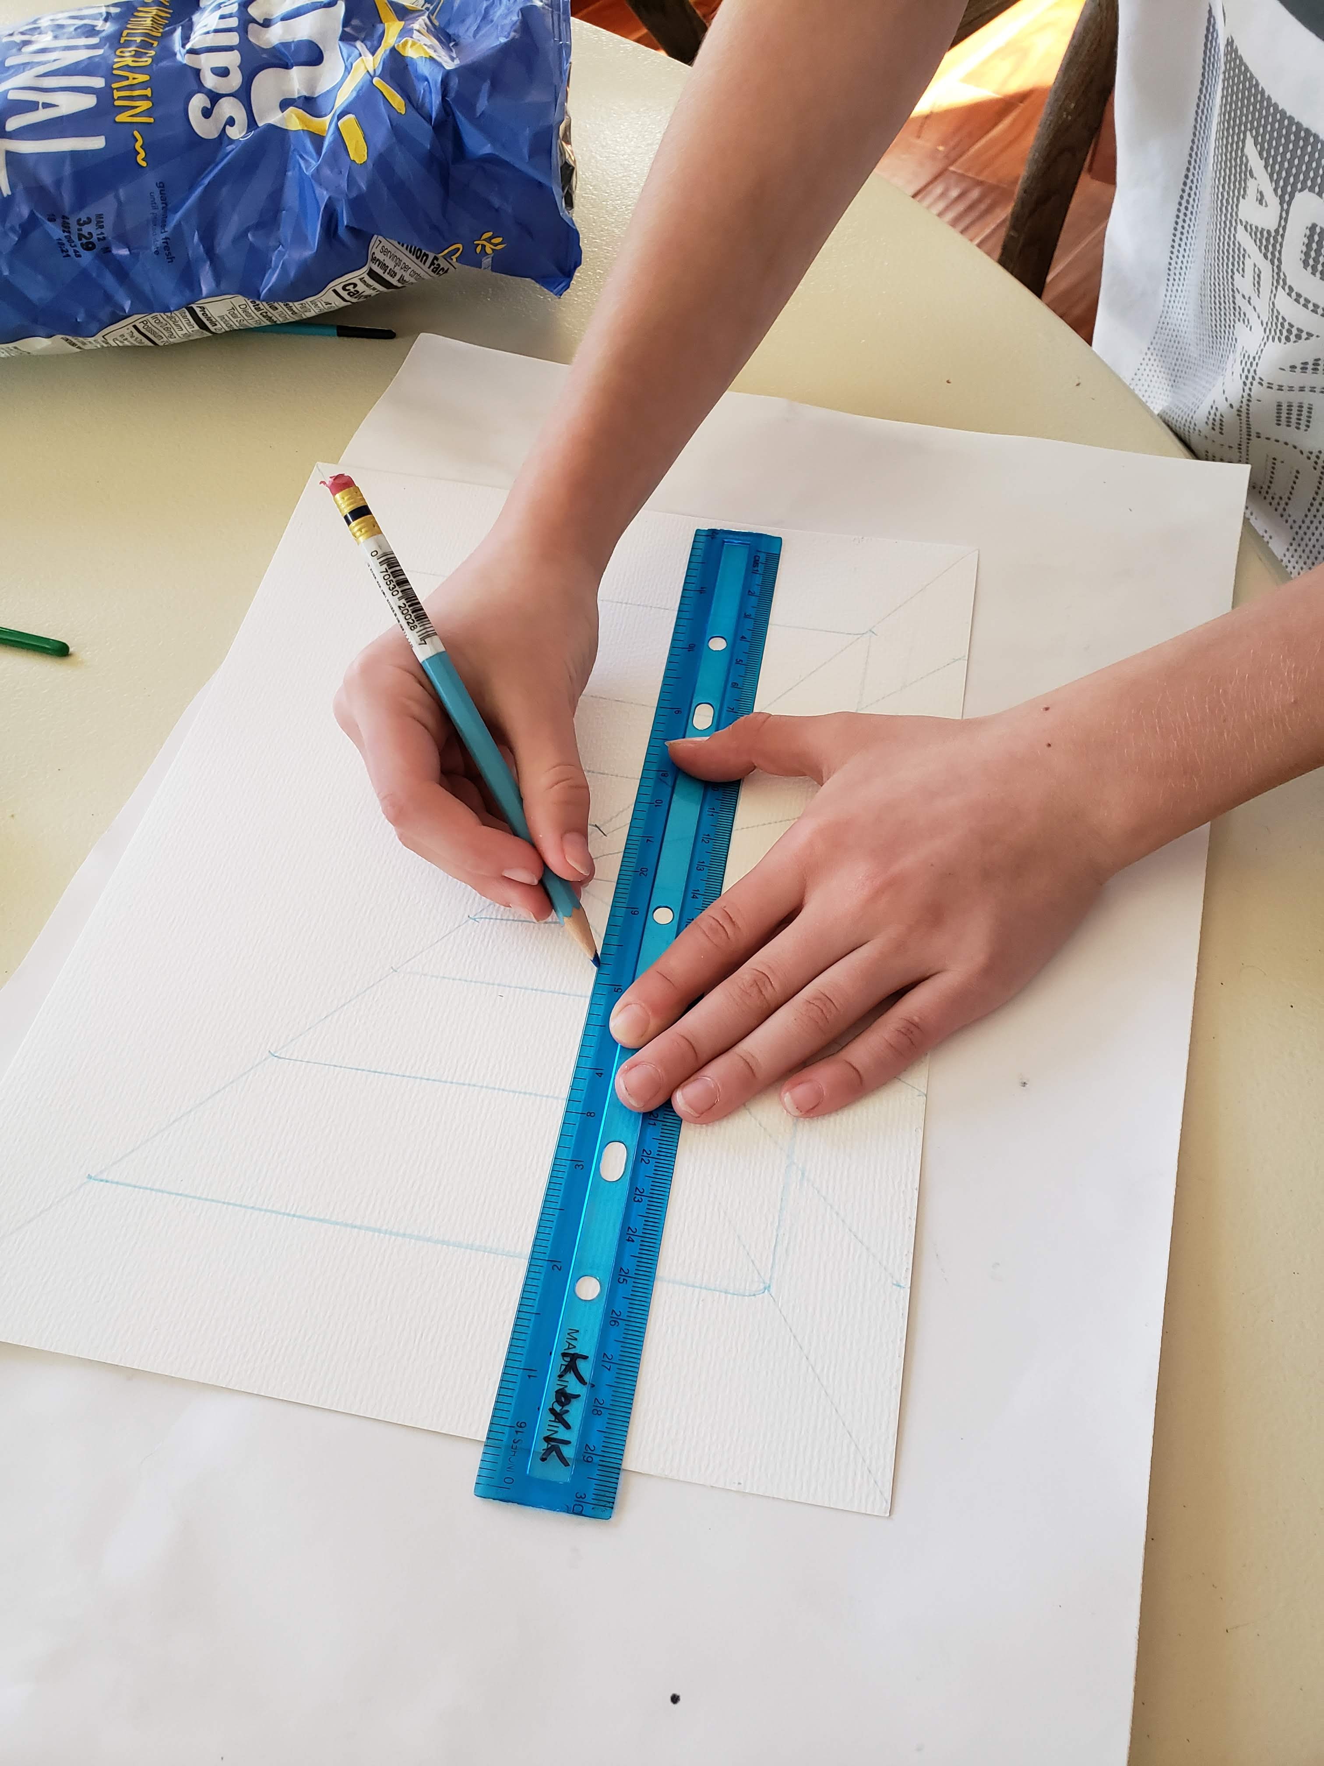
Using your ruler as a straight edge, match up your ruler along the bottom of the paper and draw a line ONLY between the X for the floor, not across your entire paper. Move the ruler up and use your new blue line as the bottom. Continue moving up…you should have 4 horizontal lines when you are done.

Slide 11
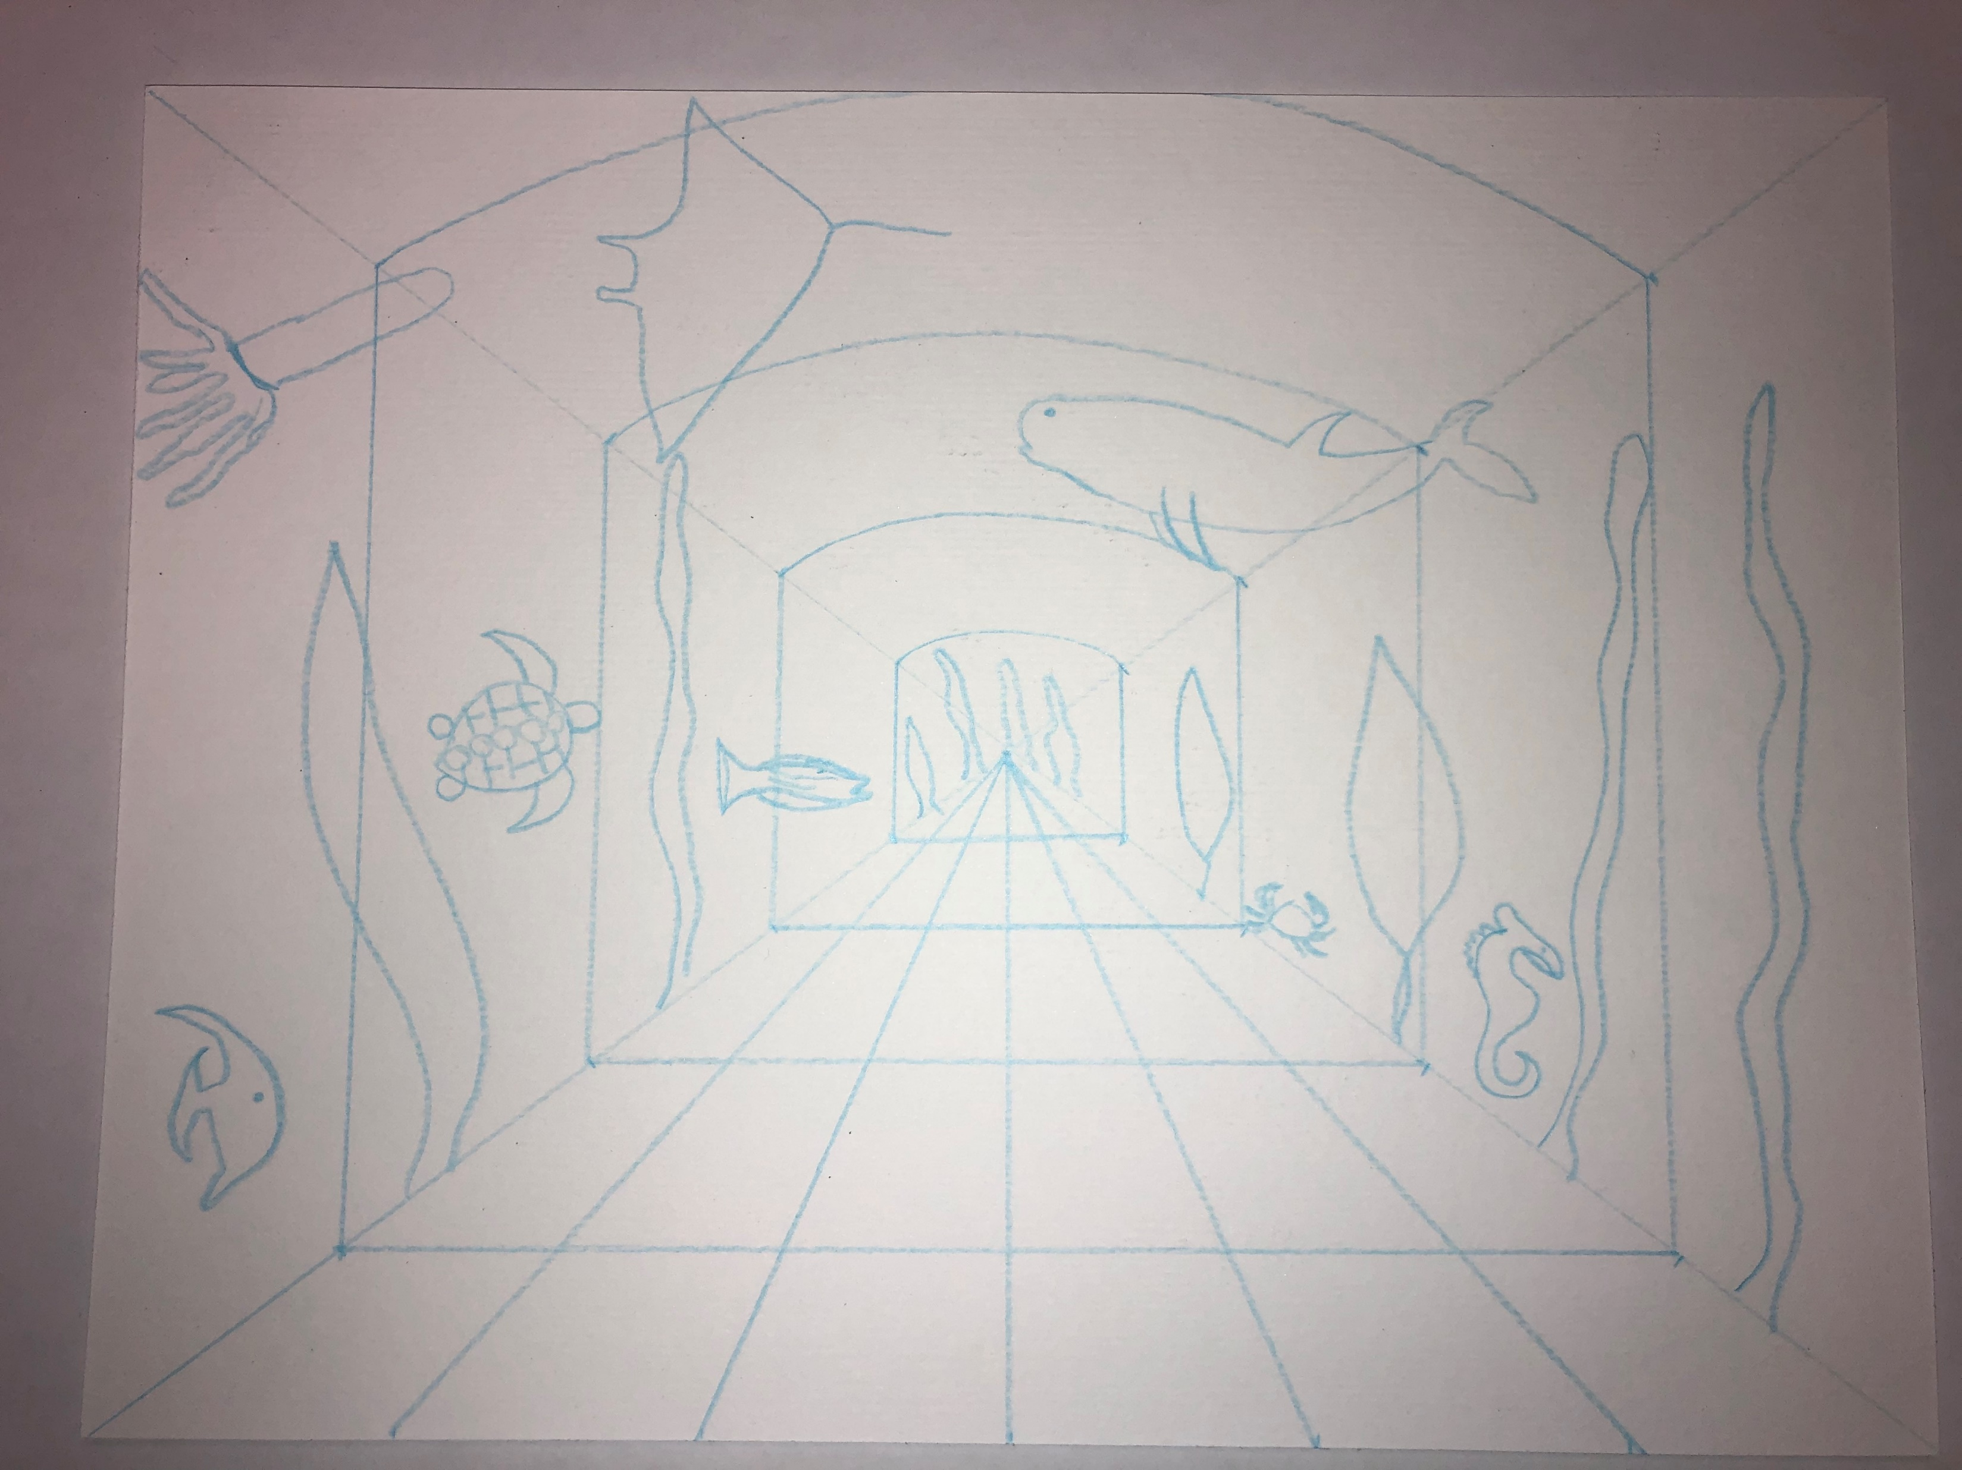
Add your underwater plants and animals. Start with a few plants and 4-5 fish/creatures. Think turtles, sharks, starfish, seahorse, octopus, etc… Larger creatures closer, and small creatures farther away towards the center. Draw right over the blue lines. DO NOT DRAW ON YOUR FLOOR!

Slide 12
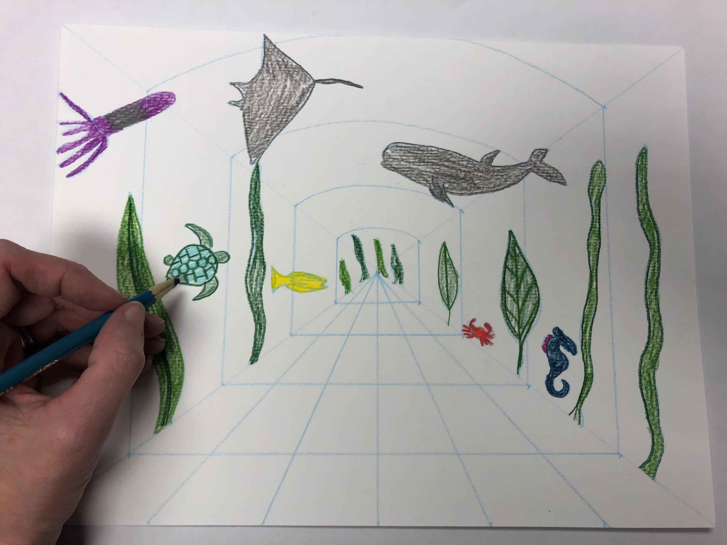
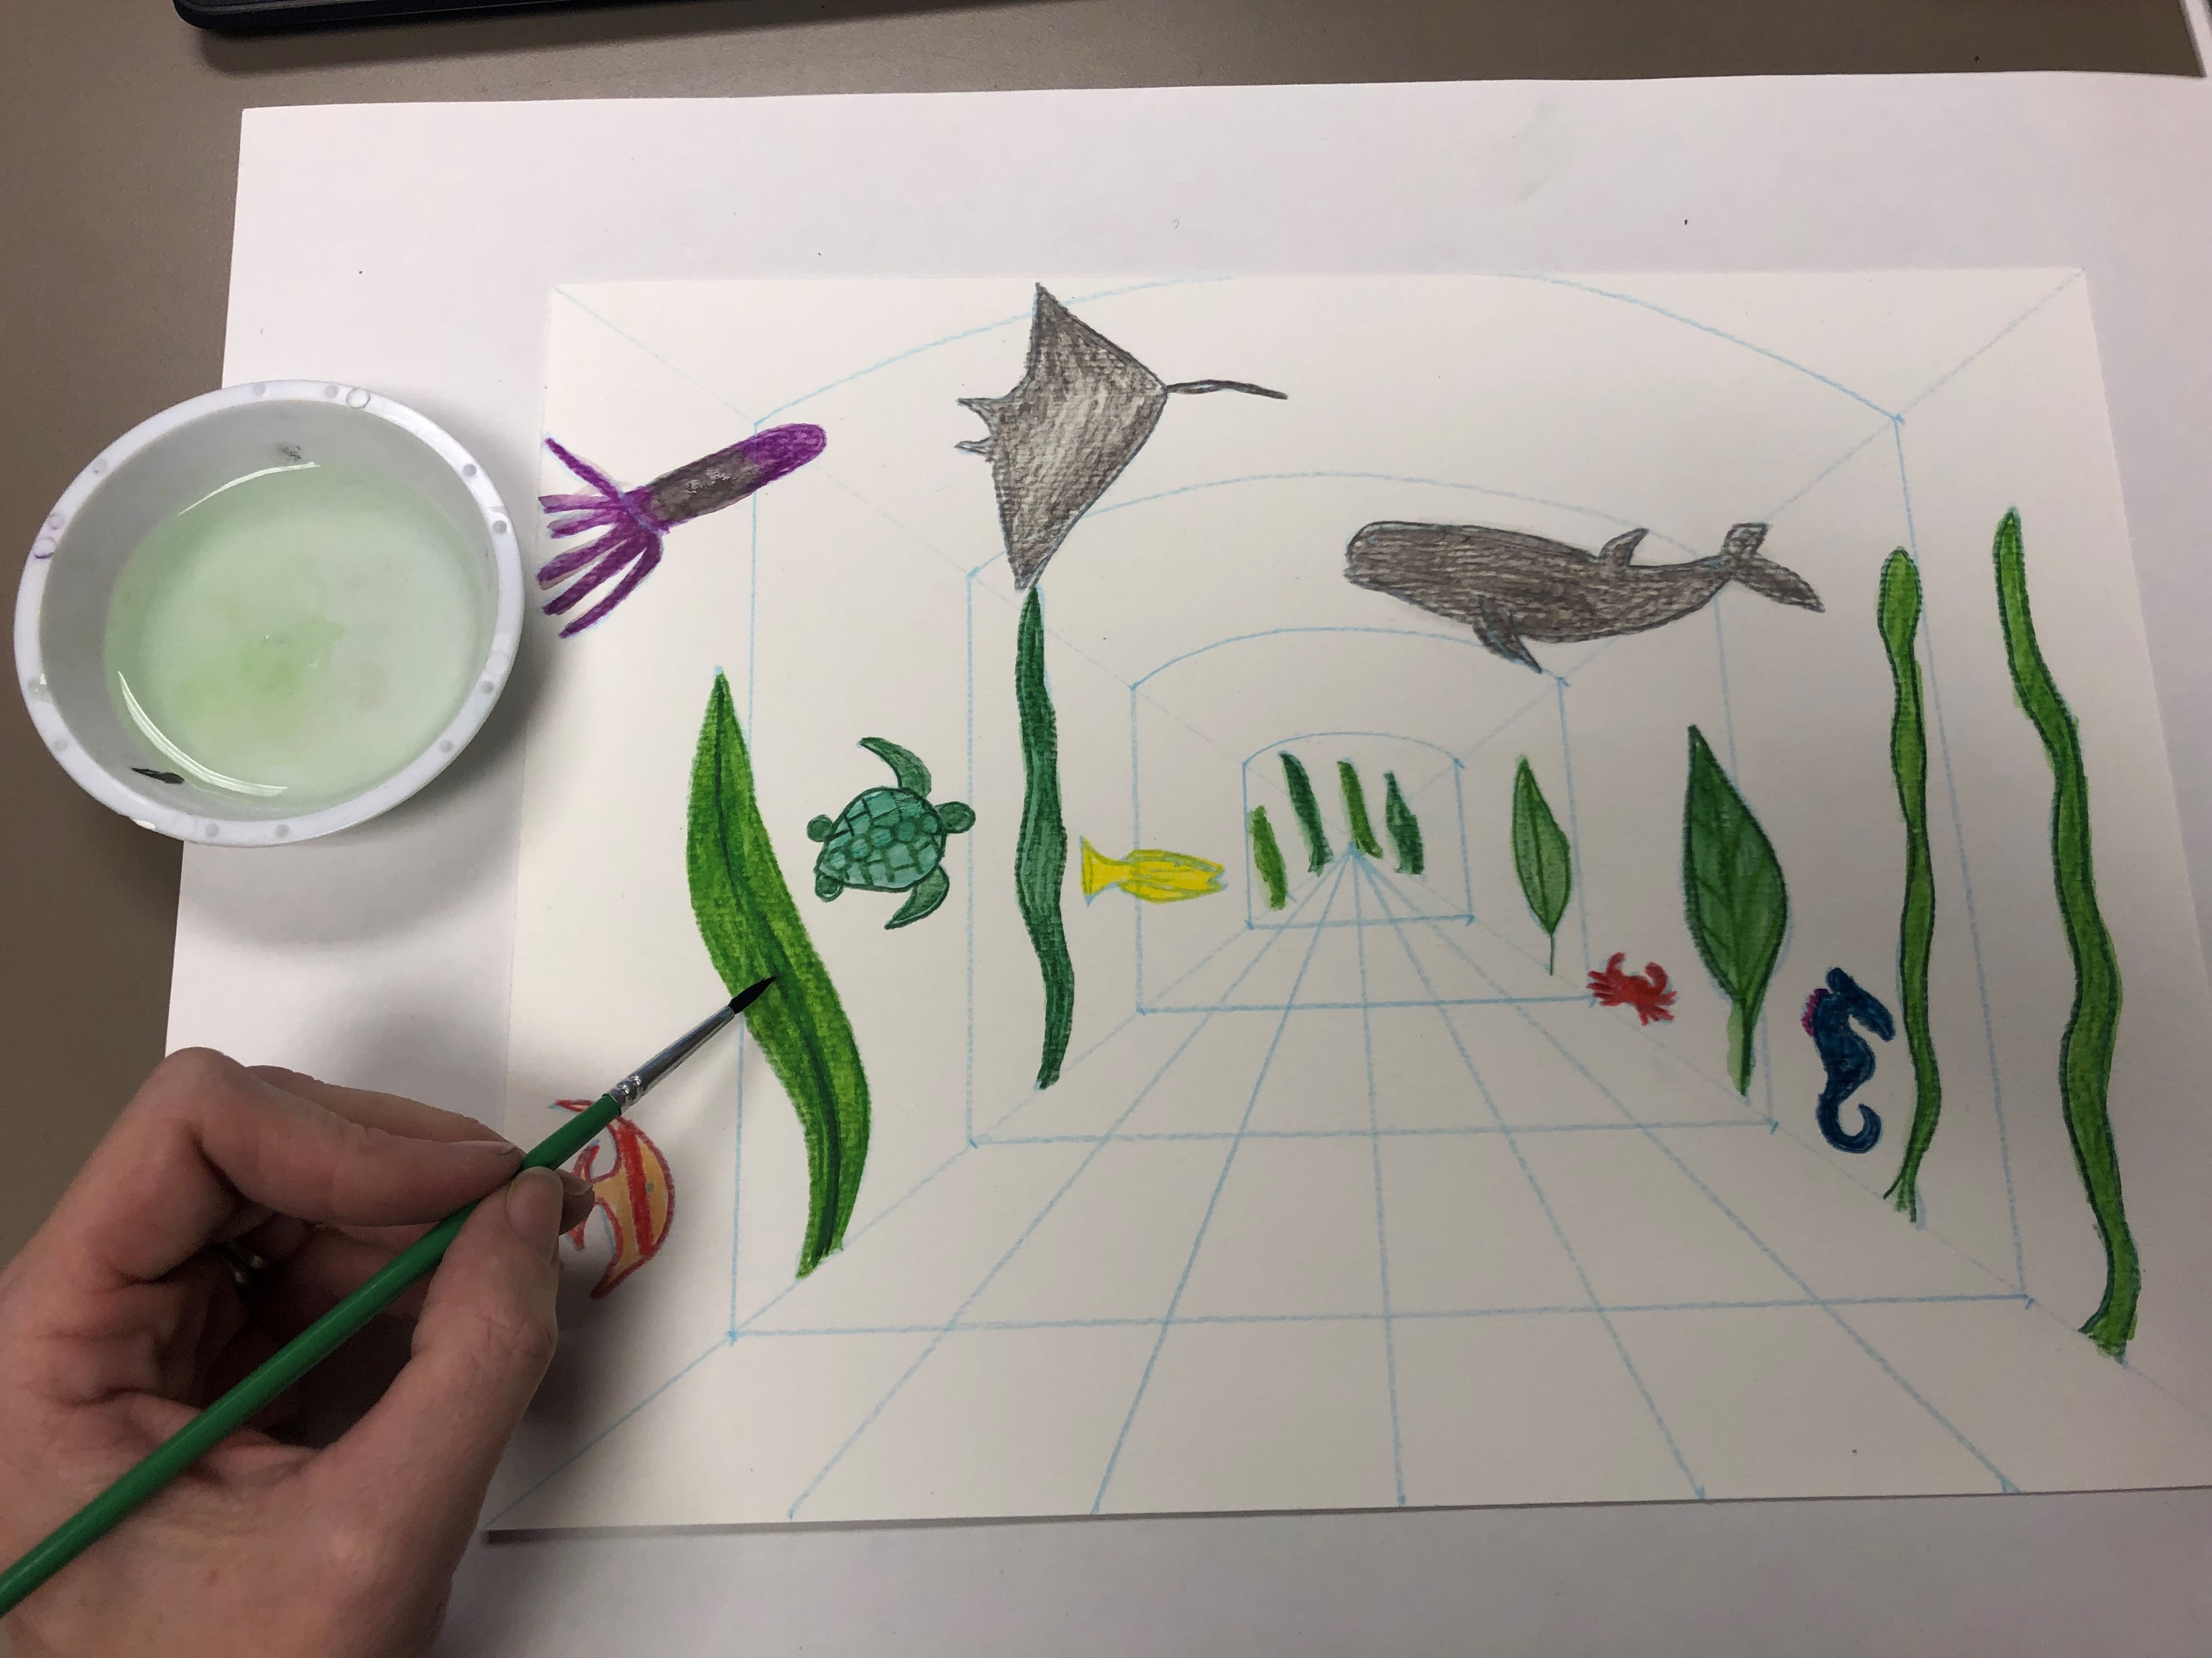
Use the watercolor pencils to color in your creatures and plants. Use a small clean paintbrush to paint in each creature with water. Notice the magic that the combination of watercolor pencil and water create! Add water to all your creatures/plants.

Slide 13
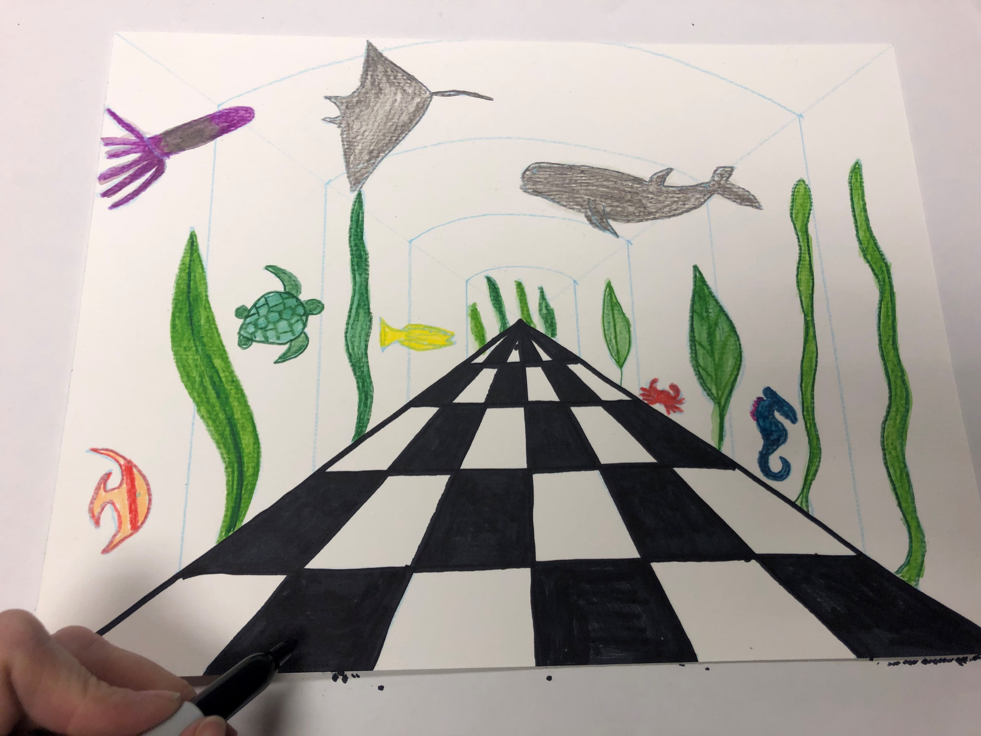
Leave all that to dry. Use a sharpie to trace and color in your checkerboard floor pattern. Start at the bottom and move across. It might help to place an x in the boxes you will be filling in so you don’t get mixed up. Color in the alternate boxes with black sharpie. After the fish are dry above, trace all the blue lines creating the aquarium. Draw through your creatures.

Slide 14
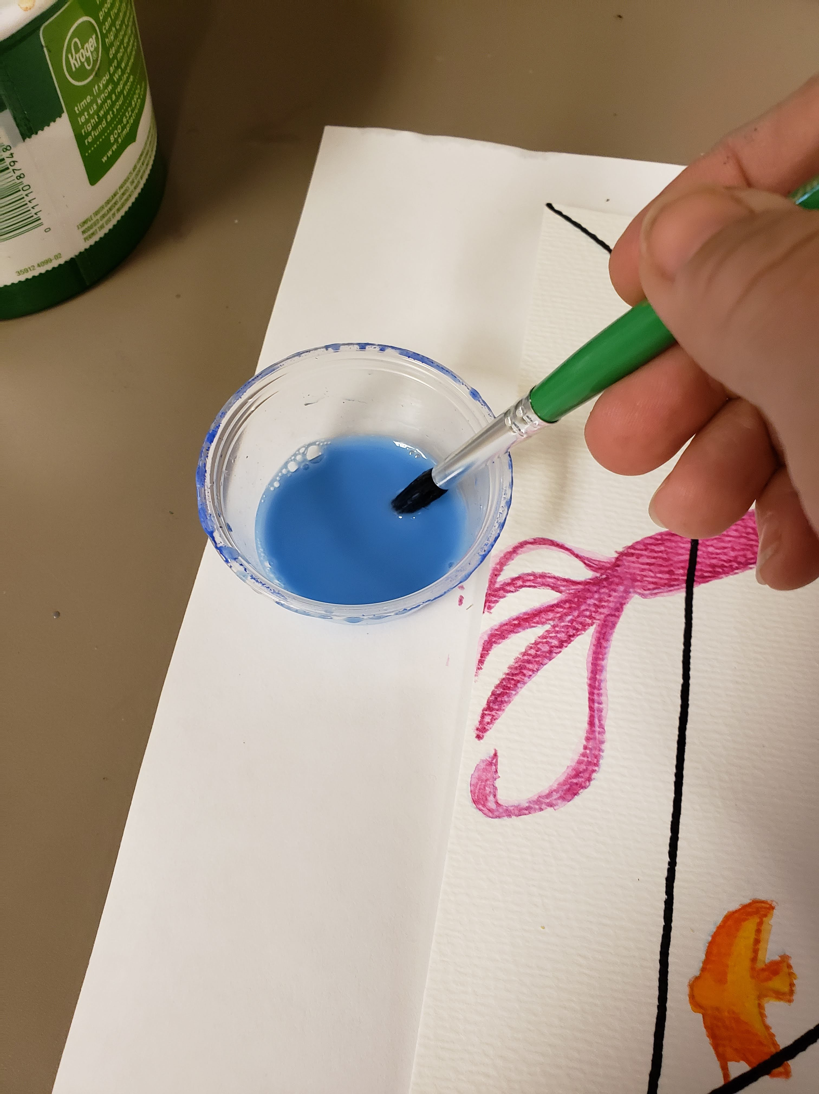
Last step! Use the liquid blue watercolor to paint around your creatures. DO NOT PAINT BLUE ON THE FLOOR! Be careful to paint around your creatures as the paint will blend if you paint over them. You CAN paint over the black sharpie lines though.

Slide 15
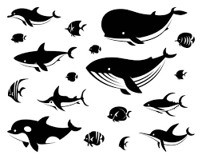

Slide 16
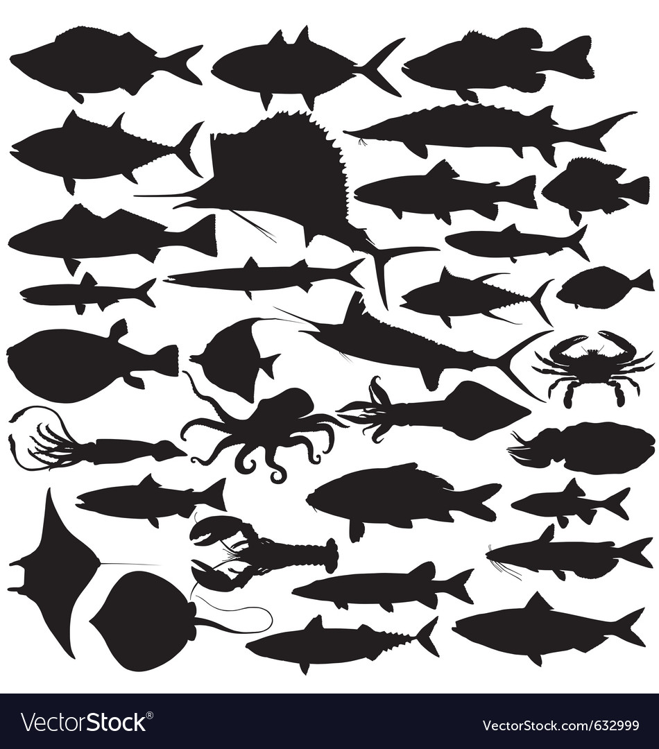

Slide 17
