Slide 1
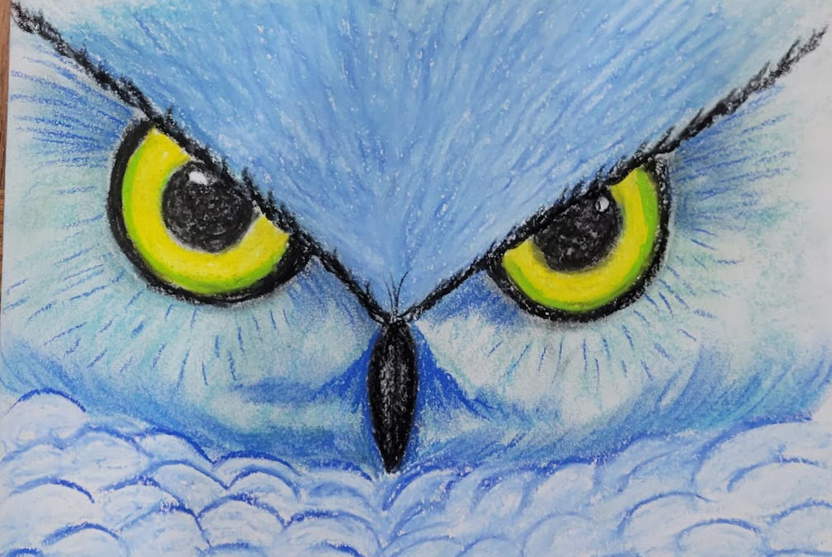
Up Close Owl
Using charcoal and chalk pastels to create visual texture and variation in value

Slide 2
Objective:
Students will create a zoomed in drawing of an owl’s eyes/face.
Students will use a wide range of line, shape, color, and texture to create their drawing.
Students must fill up the entire page for a successful composition. This is an introduction to the use of charcoal and chalk pastels.

Slide 3
Art Class Rules - How to have FUN!
All Classroom rules apply.
Relax and get ready to have fun!
Raise your hand and ask for help if you start to feel frustrated, we are here to help.
KEEP IT POSITIVE when talking about your work and your classmate’s work, everyone’s art is different.
Stand back and take a look - you might think differently about your work if you use the 5 ft rule!
Sometimes less is more, so don't overdo it.
Enjoy yourself and be proud of your finished work. There are no mistakes in art, just chances to try new things.
Wash your hands as often as needed.
Blow the chalk off your paper. Do not rub it off.
If you borrow a color, return it to the correct box.

Slide 4
Perspective
When you see something far away what do you notice?
When you see something close up, does what you notice change?
Are your eyes drawn to something specific that you didn’t notice before?
Are you drawn in by a textural detail...or maybe a stand out color?
Notes:
These questions are rhetorical – get them thinking about close up vs. distance…
Remind them to ask themselves these questions as you show them up close vs. full photo pictures

Slide 5
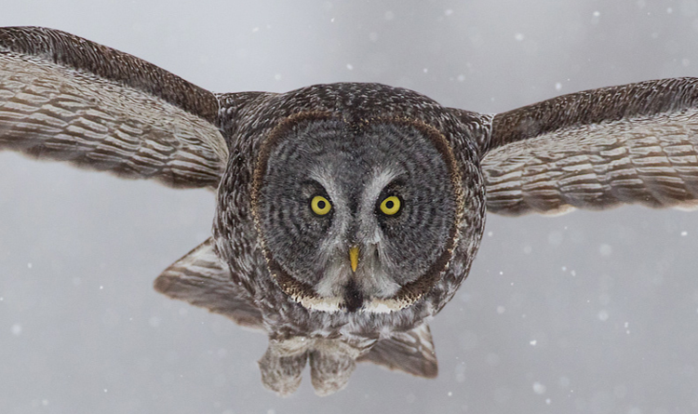
Flying Owl…
What do you notice?

Slide 6
What do you see now?
Notes:
Do you notice more details?
What stands out – his feathers, his eyes or beak?
Can you imagine a different setting?

Slide 7
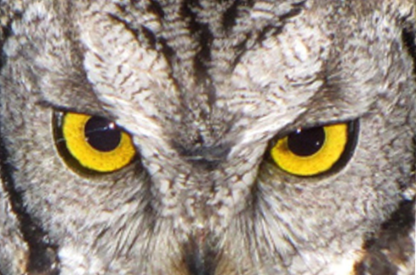
What does your imagination say about this owl?
Do you think it is day….or night?
Is the owl sitting in a hallow tree…or flying?

Slide 8
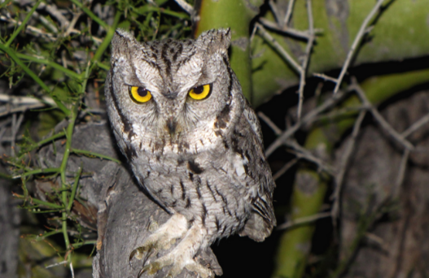
What do you see now?
Notes:
This is the same owl from a distance…

Slide 9
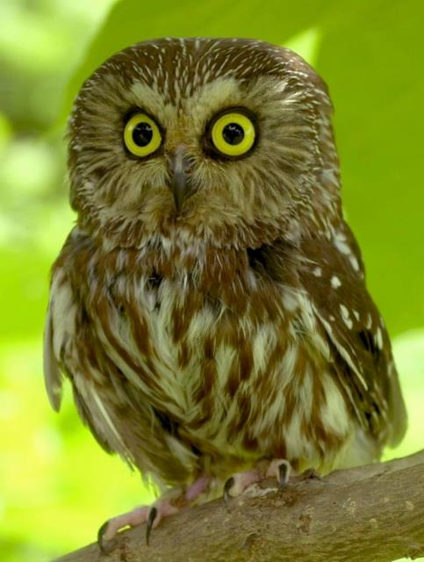

Slide 10
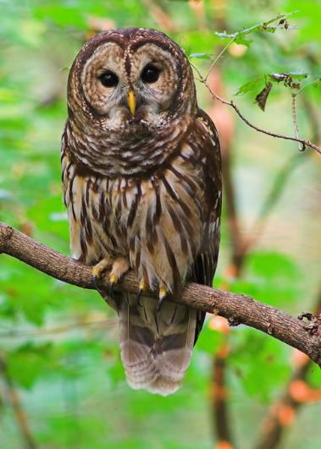
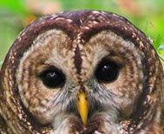

Slide 11
Vocabulary
Texture — the way something feels
Visual texture — the way something looks like it would feel, duplicated in a 2D medium
Value — the degree of lightness or darkness

Slide 12
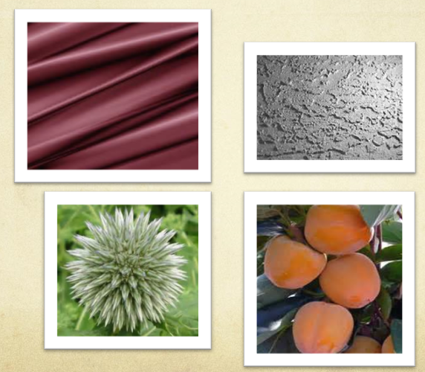
Visual texture in images
Notes:
These textures may mimic actual textures or be can imagined textures
The Mimics drapes or folds in a satiny fabric
Simulates a rough, rocky surface
Something sharp
Something soft and smooth

Slide 13
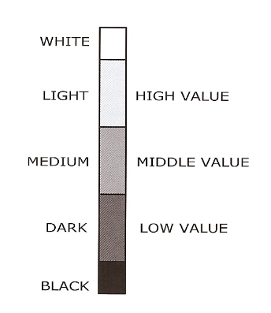
Value
The function of Value is to tell us how light or how dark a given color is. White is at the top, representing pure light. Between these are a number of divisions of gray, regularly graded between black and white.
On a Value Scale, you start the scale at 0 (Black) work up the scale to 10 (White)

Slide 14
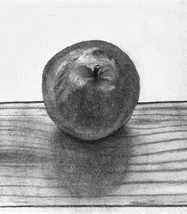
Creating visual texture with charcoal as a medium
Notes:
What types of texture do you see in these different images?
Where the charcoal is blended do you see softness?
Where the charcoal is not blended do you see sharp edges or fine lines?

Slide 15
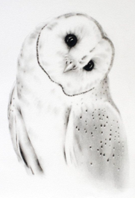
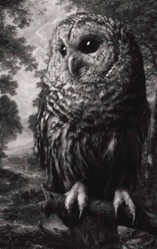
Value - dark to light – using charcoal
Notes:
Changing value can create shadows, depth or lightness
It can add texture be making this appear sharper or softer…

Slide 16
Instructions
Write your name on the back of your white paper.
Starting with Pencil, sketch a basic outline of the owl’s head, go VERY lightly, you will use black charcoal or chalk to darker later.
Sketch a rough outline for eyes – add beak and ears if you’d like. Go close up to the owls face, you can even go off the page.
Add visual texture to the owl
Create lines for feathers - soft and har
Enhance areas, add texture and depth
Use thick lines and thin lines to vary the texture and value
Leave some areas totally white to add highlights.
If you’d like, use a tissue to blend the charcoal where you want to add softness or lighten the value
To make your work really pop, select a bright colored pastel and color in the eyes and beak and even parts of the background.
Notes:
To make your work really pop, select an area or two (usually the eyes, background or beak) to add color to using chalk pastels.

Slide 17
Materials:
9x12 88# watercolor paper
11x14 black construction paper (backing)
Chalk Pastels (full range of colors)
Black Charcoal (or black chalk pastel)
Pencils & Erasers (for sketching)
Q-tips for blending colors
Paper towels for blending or wiping hands.
Hairspray to set the chalk
Alieen’s Tacky glue to attach to black construction paper
Examples of Owl Faces
Notes:
Good site for docents to go learn about chalk pastels and how to use them: https://www.deepspacesparkle.com/use-chalk-pastels-artroom/

Slide 18
Notice the basic shapes
The next few slides will walk you through how to draw one of two face shapes.
Use pencil to lightly draw the basic shapes.

Slide 19
Pay attention to the direction of the feathers
Look closely at your owl's face.
Which way do the feathers go?
This will be a clue on which way you draw your texture lines.

Slide 20
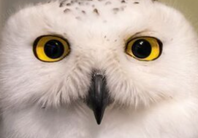
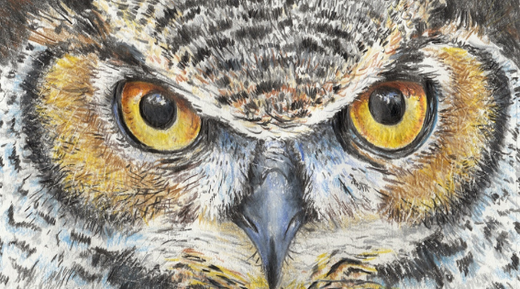
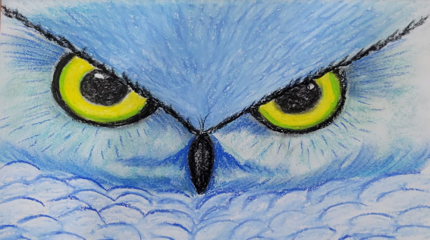
From Real to Chalk

Slide 21
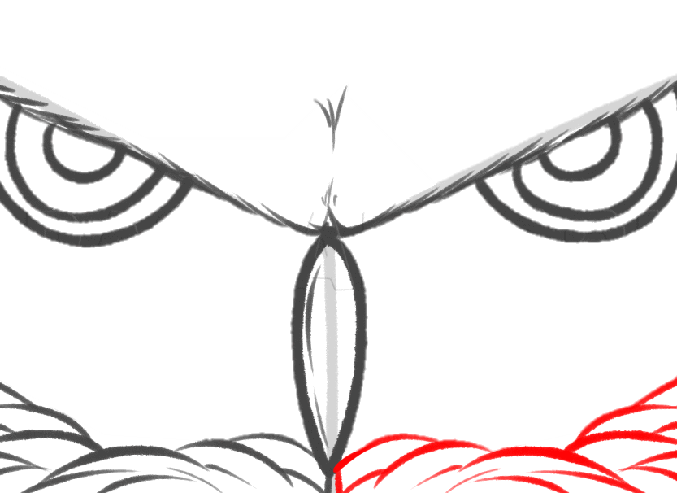
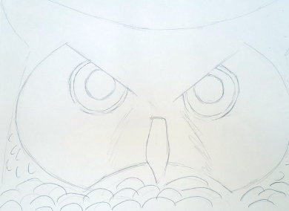
Making the close up face
Notes:
Docent’s choice to use the next set of slides to show or walk them through the steps. You can draw it on the white board, or show on a Powerpoint each step.

Slide 22
Lightly Sketch with pencil
Make a very large oval
Bottom of oval should be closer to the bottom of your paper

Slide 23
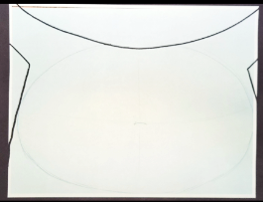
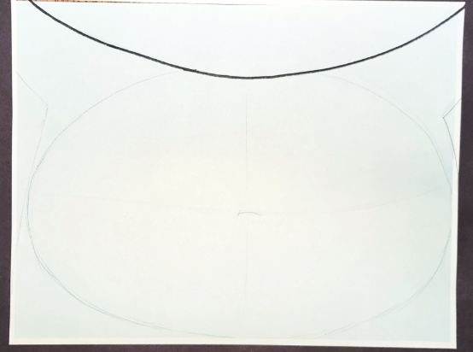
Drawing the shape of the owl
Draw an ARCH from top left corner to top right corner of page.
Going through the top of the oval
Erase the top of the oval
Add the sides of the owl

Slide 24
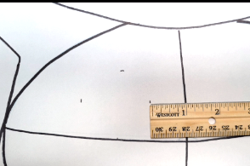
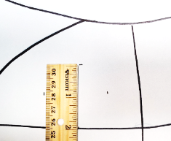
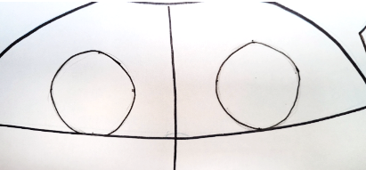
Drawing the face
Divide the oval into 4th
Centering the eyes:
Using your estimation for sizes.
Draw a 2” circle that is approximately 1” off the center vertical line.
Bottom of eye should touch the horizontal line.
Repeat for both eyes.
Notes:
You don’t need a ruler. These photos are showing how to eyeball the eyeballs.

Slide 25
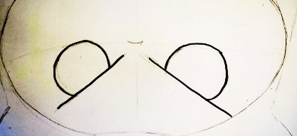
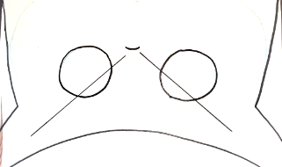
Add the Brow Line
From the bottom of the top vertical line, lightly sketch a line through the top of the eye.
Repeat for 2nd eye.
Erase the top part of the eye

Slide 26
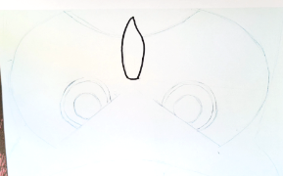
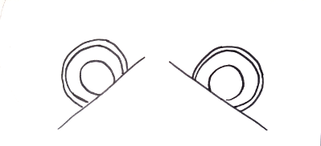
Eyes and Beak
Draw 2 concentric circles inside each eye.
Larger circle will be the black eyelid rim
The smaller circle is the pupil.
Pupil should be centered in the eye
From the center where the vertical and horizontal lines meet, draw a gem shaped beak that comes to a point at the bottom of the oval.

Slide 27
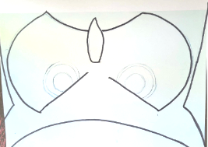
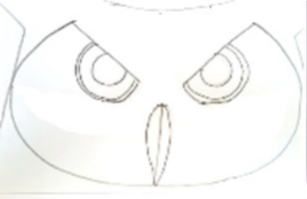
Decide face shape
Great Horned Owl
Snowy Owl
Barn Owl
Barred Owl

Slide 28
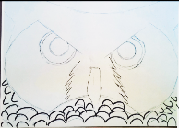
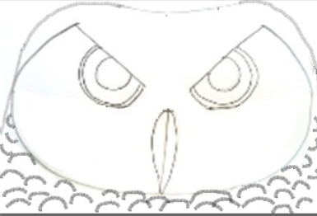
Add Chest Feathers
Owls with Ear Tufts
Owls with Round Face

Slide 29
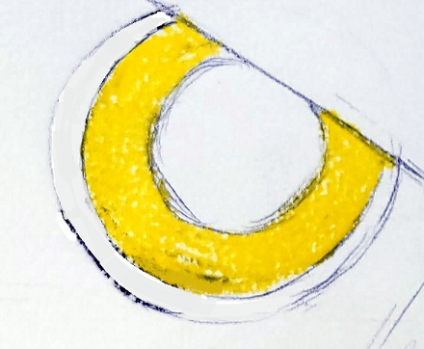
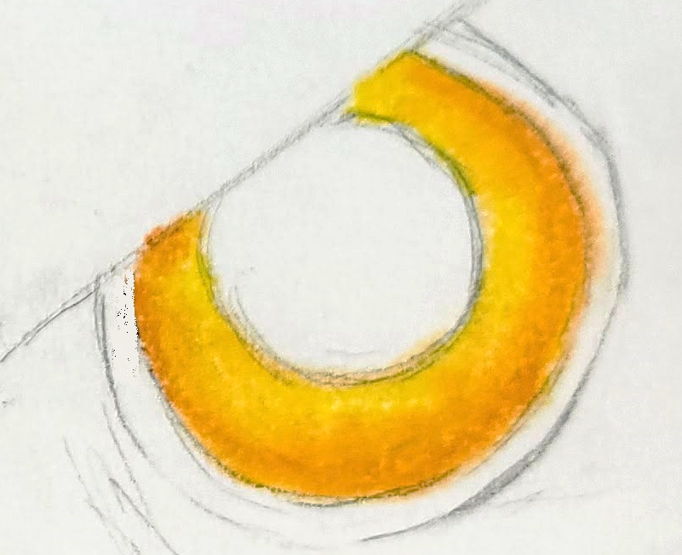
Adding Chalk
Starting with the eye opposite of your dominant hand.
Pick two colors for the eye’s iris color.
1 light
1 darker
Fill in the iris with the light color
Outline the outer rim of the iris with the darker color.
Blend with a clean Q-Tip

Slide 30
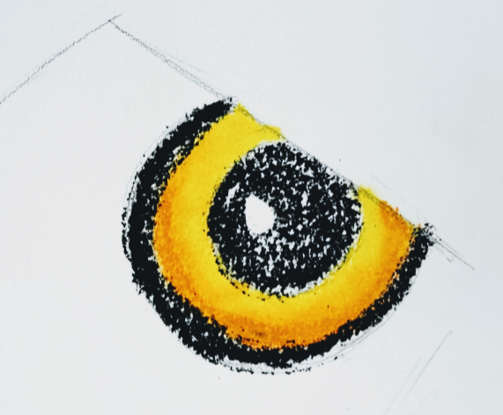
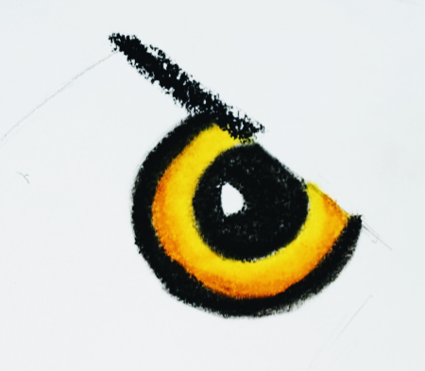
Eyes
Add a small circle to the center of the eye, to be the GLEAM.
Outline the eye in black charcoal or chalk
Fill in the pupil, except for the GLEAM
Blend the black with a Q-Tip
Trace the brow line with a dark color.
Repeat for 2nd eye.

Slide 31
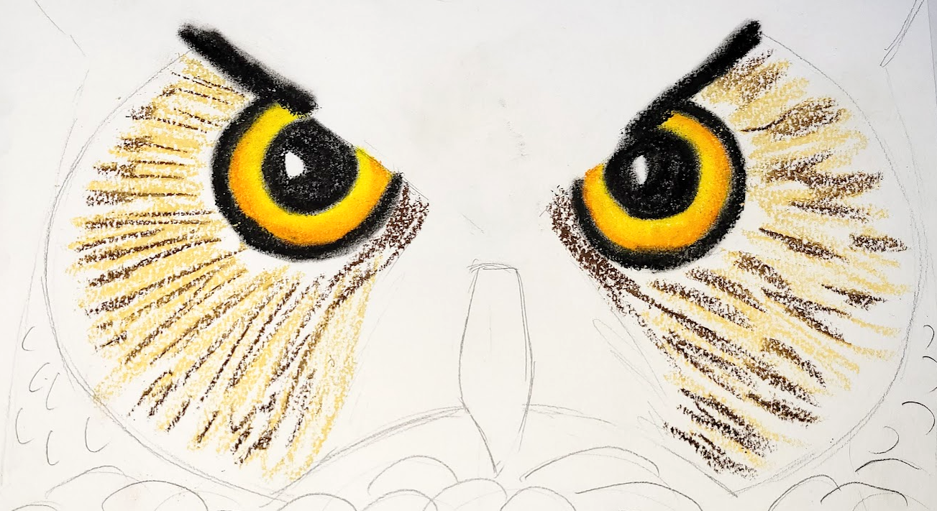
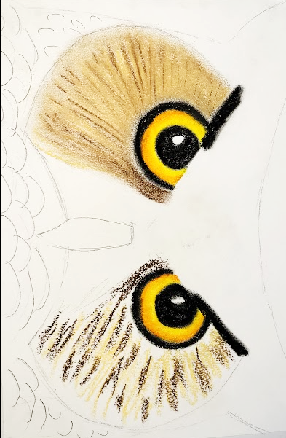
Eye Mask
Using a light colored chalk draw straight lines moving away from the eye in the direction of the feathers
Add darker colored chalk over the top where you want it to be darker.
Blend the colors together with your finger tip.
Notes:
If students want to make a round faced owl, they can extend the lines like a starburst 360 degrees around both eyes.
Any colors will work. Doesn’t need to be realistic colors.
White, and Blue or White and black are good for Snow Owl colors.

Slide 32
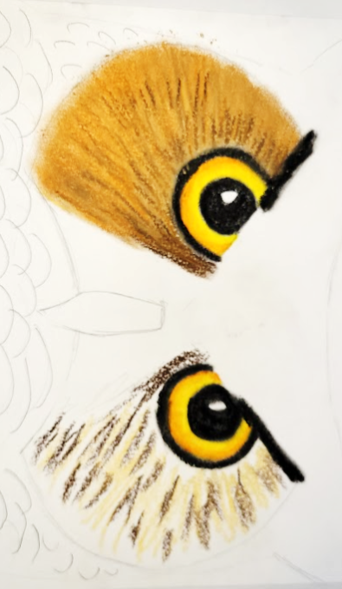
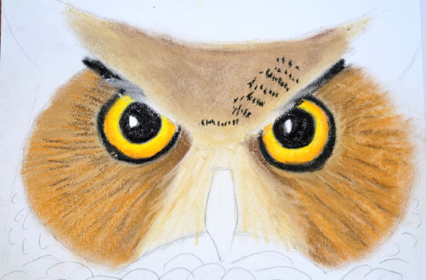
Finishing the Face
Continue to add light and dark chalk over the area to make the colors richer and brighter.
Do both eyes at the same time. (this helps from forgetting what steps you took on the first eye)
Add dark chalk to areas where there are shadows to give depth.
Use a different set of chalk colors
1 light & 1 dark for the V above the brow line.
Use two lighter shades around the beak.
Continue to smudge with your clean fingers and adding more layers of light and dark to the areas where you want them brighter and richer colors.
End with dark thin lines to give the look of texture.
Use White to give highlighting on the brows

Slide 33
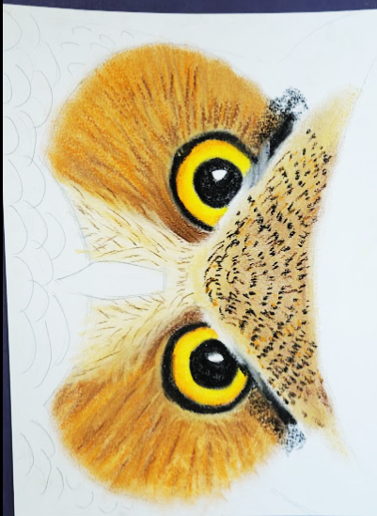
Add feathers
Using dark skinny lines will give the appearance of texture.
Layer color using LINE! Yes, lots of lines and lots of layering of the differing colored lines will give you beau=ful feather like textures in your artwork.

Slide 34
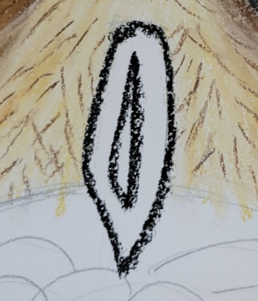
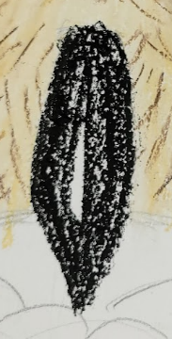
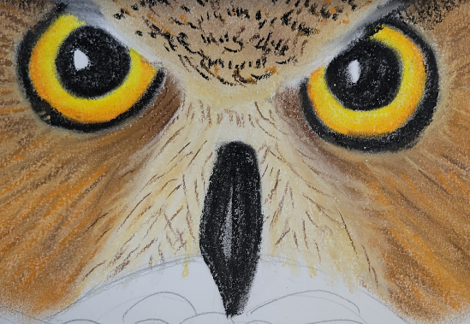
Outline the beak in black
Draw a long oval down the center of the beak
Fill in the whole beak black, except the oval.
Smudge the black with a Q-Tip to blend smooth, and go over the oval with the Qtip.
This will give the beak a rounded shape.

Slide 35
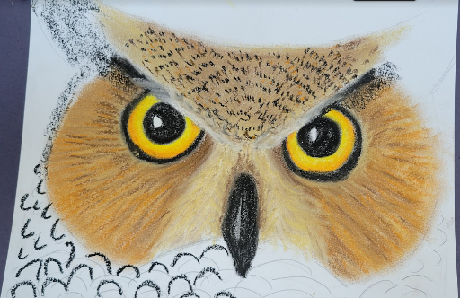
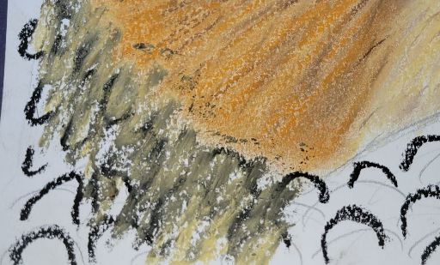
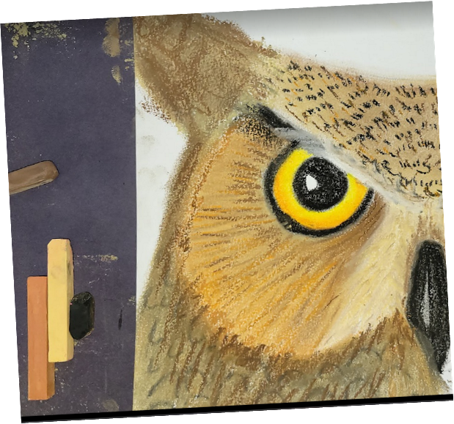
Body Feathers
Use a dark color to trace the feather arches.
Blend it with a lighter chalk and smudge with your finger.
Go over the face’s edge just a slight bit.
Take the same chalk colors up to the ear tufts if you have them.
Color the top of the head as needed if you are making an owl with a round face.

Slide 36
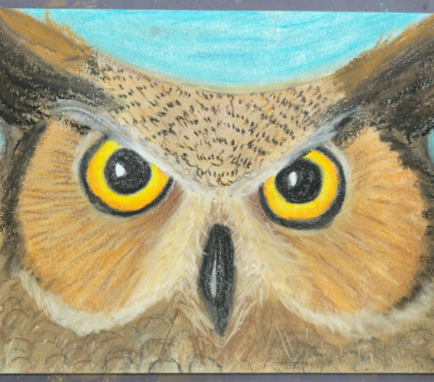
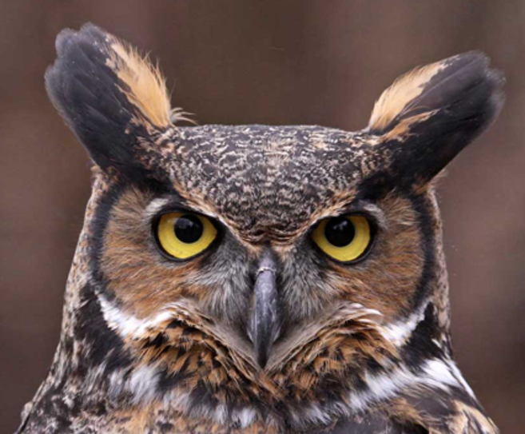
Ta DA! Use photos of your owl as inspiration and help with feather colors and directions

Slide 37
Last step is to Set the Chalk
Use Hair Spray outside and spray the whole picture.
Once dry, mount picture on black paper.

